Slide 1


Time Series Forecasting
with Keras
Eina Ooka
June 8, 2019

Slide 2
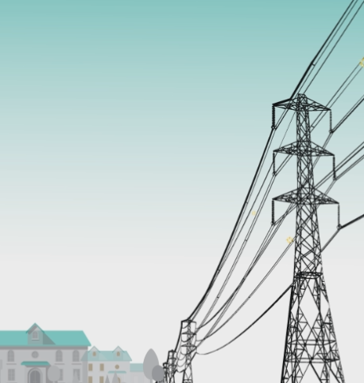
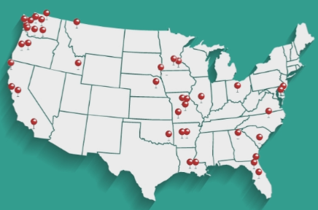
Power Utility Industry
The Energy Authority serves public utilities nationwide for trading and analytics.
Analytics team provides various forecasting and analysis services.

Slide 3

Myself…
Focused on data science and time series forecasting.
Handle all processes from research, development, deployment, execution and maintenance.
Time constrained industry practitioner.

Slide 4
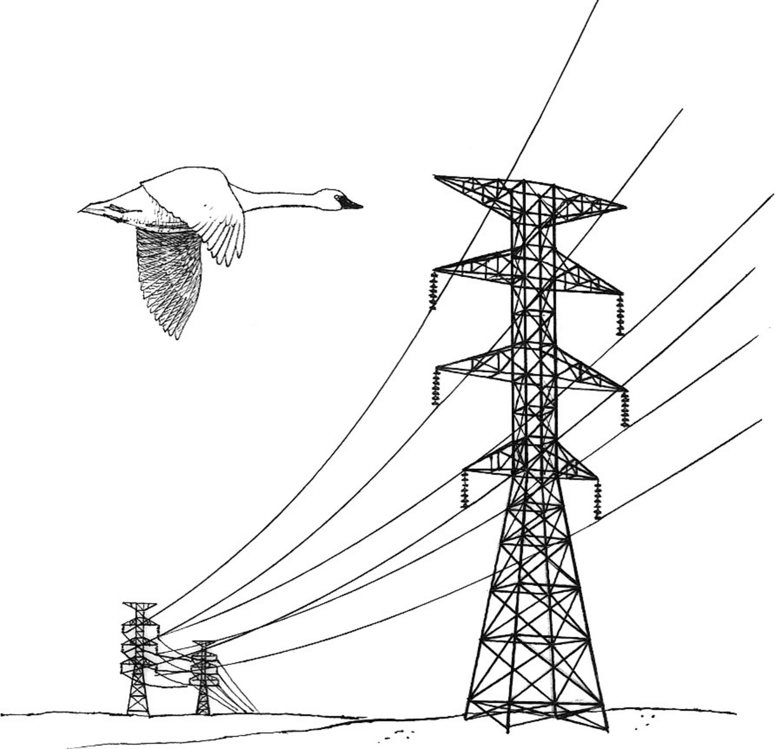

Agenda
Wholesale Power Markets
RNN Architectures with Keras
Why not ConvNN for ts??
Talk about ML for time series forecasting
Practical guide for using Keras

Slide 5
Wholesale Energy Markets

Slide 6
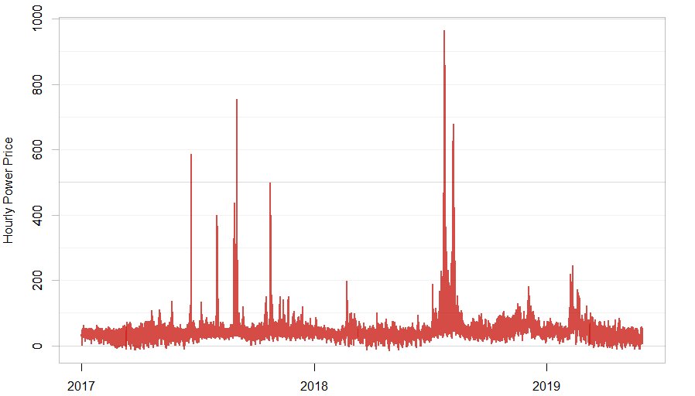
Wholesale Energy Price
←Max: 965
↓Median: 32
←Min: -15

Slide 7
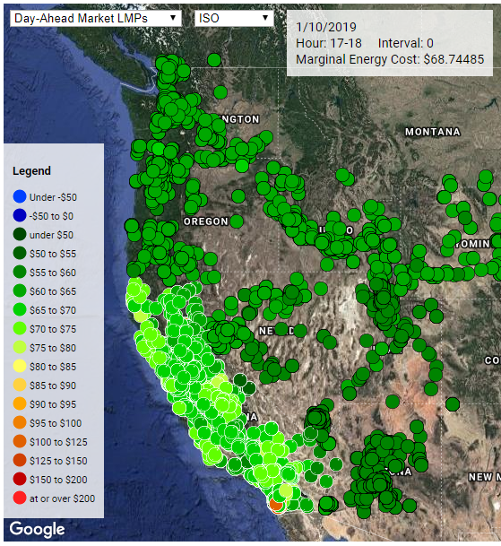
How many price nodes?
Answer: thousands.
Some markets are organized in a way that it generates a price at every resource and load node.
This design incentivizes market participants to act in accordance with the benefit of the entire grid.

Slide 8
Wholesale Energy Markets
1 Year ~
Months before ~
Day-ahead
Just before delivery
1 hour before
Energy
Financial
1. Future Market
Physical
2. Forward Market
3. Day-Ahead Market
4. Real-Time Market
Reliability
5. regulation up, 6. regulation down,
7. spinning reserve and 8. non-spinning reserve
Transmission
9. Transmission/Congestion Revenue Market
Capacity
10. Capacity Market
Environmental
11. Carbon Allowance,
12. Renewable Credit, etc…

Slide 9
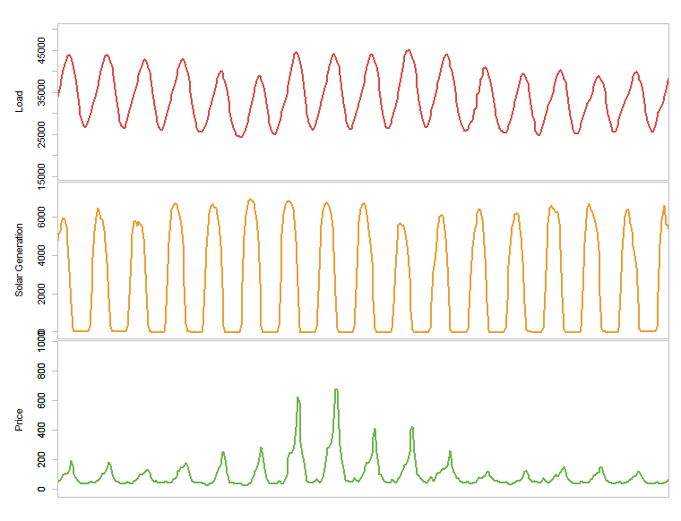
Hourly Time Series Forecasting
Energy Demand forecasts
At various consumption nodes
Generation forecasts
Solar and wind
Wholesale power prices
At dozens of nodes
Historically neural network (MLP) has been one of the most popular methods.

Slide 10
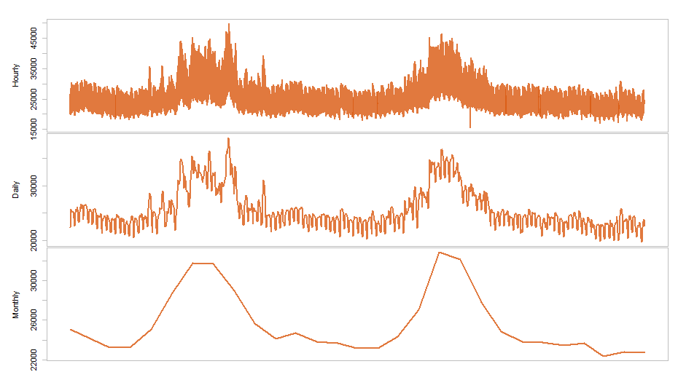
Time Series Forecasting
Old (mostly statistics) discipline, affected largely by ML in recent years.
Time series forecasting issues (compared to other ML problems)
# of available data points
How long of a history is
a good representation of
the current behavior?

Slide 11
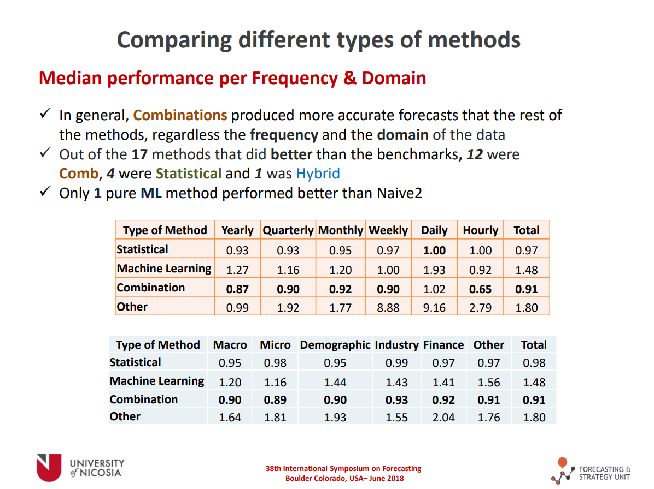
Time Series Competition Results Makridakis Competitions 2018
In search of best practices.
100,000 time series.
The winner used a combination of ML and statistical methods.
Presentation by : Evangelos Spiliotis

Slide 12




Timelines
Tenser Flow released
R Keras package CRAN release
Keras release
An RStudio blog article on sunspot prediction
ML Community
2017
2018
2019
2016
…
Keep hearing about application of LMTS & GRU
Forecast dev using ‘nnet’
Hear about Tenser Flow at a meetup
Me
An opportunity for research

Slide 13

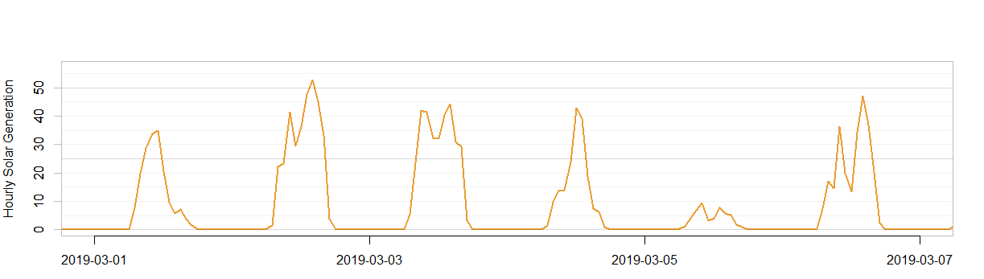
Hourly Solar Forecasting
Solar Generation Forecast
Hourly generation for the following 3 days
Exogenous Series (features)
Weather data including temperature, sunshine minutes, etc…
Same structure as other energy price or demand forecasting models.

Slide 14
RNN Architectures with Keras

Slide 15


Vanilla Neural Network
No memory of the past state in the internal structures.
For time series forecasting, we feed lagged series as inputs.
$$y_{t}$$
Outputs
Hidden
$$y_{t−1}$$
Inputs

Slide 16
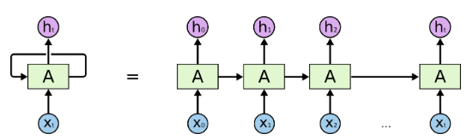
Traditional RNN
Successful in passing recent information to the next, but RNNs have difficulties learning long-range dependencies
Vanishing (or exploding) gradient problem

Slide 17
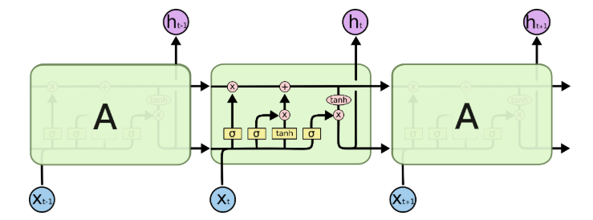

Long Short Term Memory networks
A special kind of RNN, capable of learning long-term dependencies.
Source: http://colah.github.io/posts/2015-08-Understanding-LSTMs/

Slide 18

LSMT and NLP
LSTM is built with NLP in mind.
Dependencies are usually not time-dependent.
Many time series have time-dependent dependencies.
For example, energy consumption at 6pm today is the best predictor of energy consumption at 6pm tomorrow.
Outputs
Outputs
Him or her?
Output of the hidden layer
Hidden
Memory
Inputs
Inputs
She is …

Slide 19
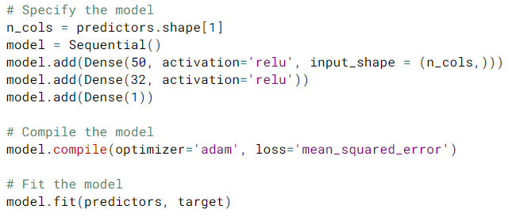
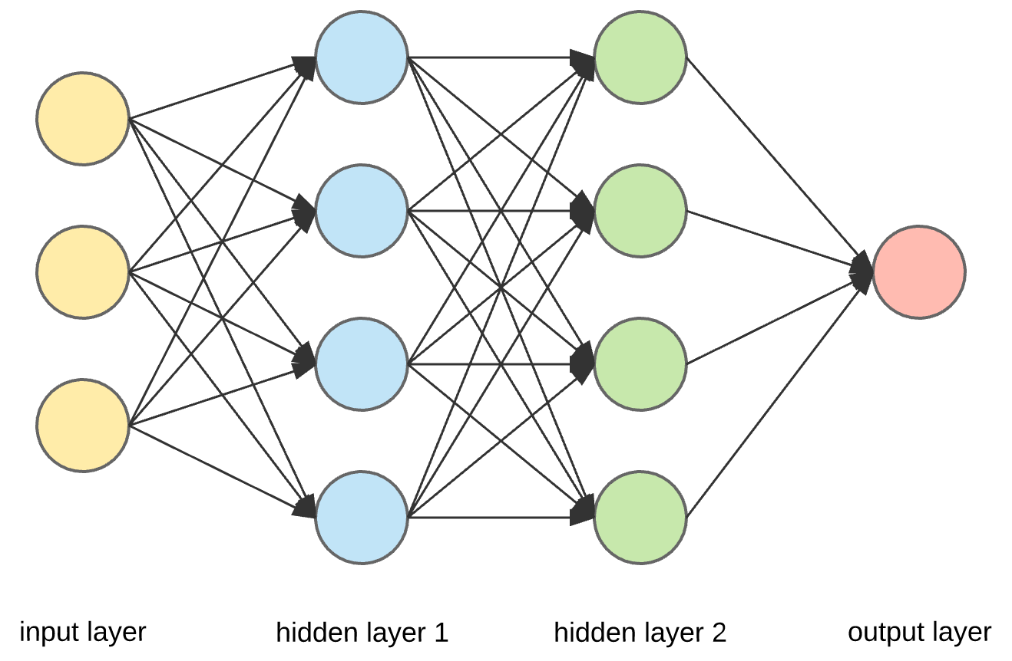
Keras - workflow
Specify architecture
Type of layer
Number of nodes
Activation
Input dimensions
Dropout
Compile
Optimizer
Loss function
Fit
Training and validation data
Callbacks
Predict
ncol
50
32
1

Slide 20
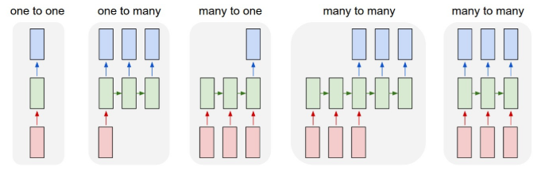

Types of RNN Architectures
One-to-one
Dense(output_size, input_shape)
One-to-many
RepeatVector(number_of_times, input_shape)
LSTM(output_size, return_sequences=True)
Many-to-one
LSTM(n, input_shape=(timesteps, data_dim))
Many-to-many
LSTM(n, input_shape=(timesteps, data_dim), return_sequences=True))
Many-to-many 2
LSTM(1, input_shape=(timesteps, data_dim), return_sequences=True)
Lambda(lambda x: x[:, -N:, :])
Note: These are in python, but equivalent r code in 2 slides.

Slide 21
Examples of RNN Architectures for TS
Many-to-One
Most commonly found examples online
Default LSTM architecture.
Predict the next step.
Many-to-Many
Sunspot frequency prediction
LSTM architecture with return_sequences.
Predict multiple steps ahead.
Inputs and outputs have the time dimension, but time may not have to match.
Source:
(←) https://machinelearningmastery.com/multivariate-time-series-forecasting-lstms-keras/
(→) https://blogs.rstudio.com/tensorflow/posts/2018-06-25-sunspots-lstm/
t4
t4
t5
t6
Not sure if it can capture autoregressive relationships of proximate steps.
t1
t2
t3
t1
t2
t3

Slide 22



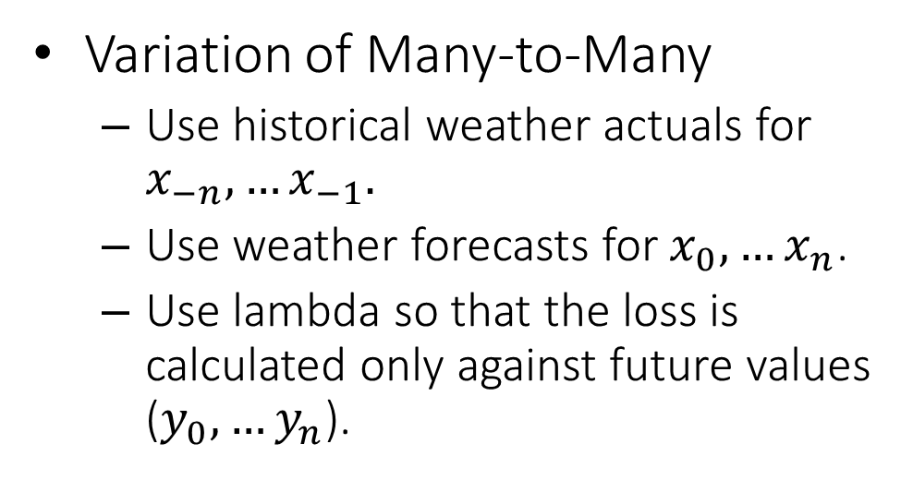





Architecture for Solar Forecasting
Variation of Many-to-Many
Use historical weather actuals for $x_{−n}, …x_{−1}.$
Use weather forecasts for $x_{0}, …x_{n}$.
Use lambda so that the loss is calculated only against future values ($y_{0}, …y_{n}$).
$$y_{0}$$
$$y_{1}$$
$$y_{2}$$
$$x_{−2}$$
$$x_{−1}$$
$$x_{o}$$
$$x_{1}$$
$$x_{2}$$
keras_model_sequential() %>%
layer_lstm(units, input_shape, activation, dropout, return_sequences = TRUE) %>%
time_distributed(layer_dense(units = 1, activation = "linear")) %>%
layer_lambda(function(x){x[,T0:Tn, 1, drop=FALSE]})

Slide 23
Basic Model Arguments
Architecture
Units
Input_shape
Activation
Dropout
Return_sequences
Compile
Loss
Optimizer
Fit
Validation_data
Batch_size
Epochs
Callbacks
EarlyStopping
TerminateOnNaN
ModelCheckpoint
Verbose
And more…

Slide 24
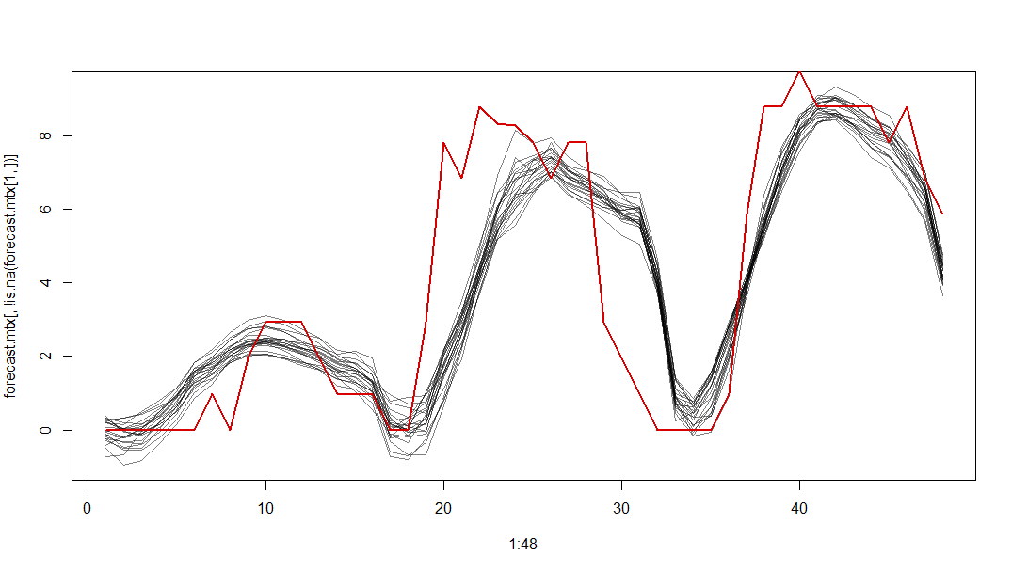
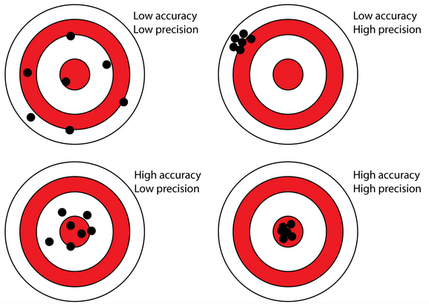
Variability by Random Initialization
Exact same model can return different results, or worse, NaNs (due to exploding gradients).
13% of results returned NaNs in this particular example (with default optimizer setting).
↓Black lines are results of the same model with different initializations.
↑The results are different by 40% here.

Slide 25
Callbacks – ModelCheckpoint
ModelCheckpoint
Save the actual model at every epoch
Allows to train from previous coefficients.
In time series forecasting, we are constantly receiving new data, and periodic retraining of the model is essential.
By utilizing the previous model fit, run time is shorter, NaN can be avoided, and there is consistency in model behavior.

Slide 26

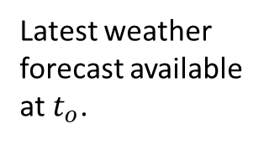
Data Setup for Backcasting
For each backcasting date, partition dates.
Include only the relevant “seasons.”
Training (and validation) input dimensions:
[#samples, #timesteps, #features]
#samples = #dates in training
If inputs are all historical actuals, you only need to temporally offset data to create the 3-D array.
For each training or validation date, set up a matrix by combining historical weather and forecasted weather data.
BACKCAST DATE
Training
Validation
Test
$$t_{o}$$
features
Weather actuals
$$t_{o}$$
t
Latest weather forecast available at $t_{o}$.

Slide 27
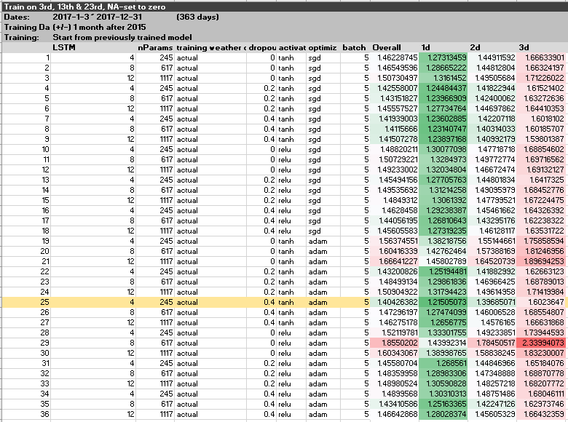
Hyperparameter Tuning

Slide 28
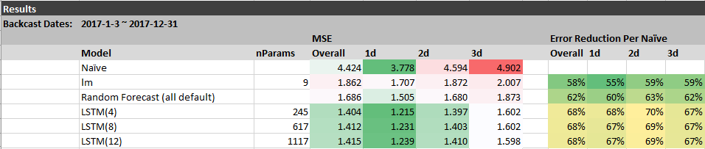
Benchmarking
Benchmark Models
Naïve model: Previous day of the same hour
MLR
Random Forest
MLR and Random Forest include previous day of the same hour as an input.
Note that each training set included a maximum of
180 samples x 7 features = 1260 data points.

Slide 29
Why not CNN for time series???

Slide 30
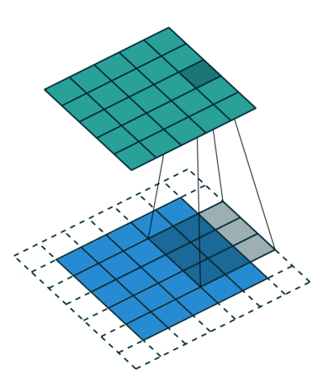
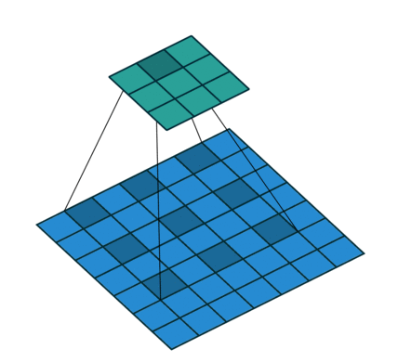
Convolutions
Slide “filters” across the input and compute dot products between the entries of the filter and the input at any position.
Kernel Size, Stride, Padding, Dilation rate.
Recall PCA as pre-processing for MLP. It can be considered a convolution with eigenvectors being the kernel.
1D convolution: Filters move only in temporal direction.
Filter (Kernel)
A 3x3 kernel with a dilation rate of 2
Input
Source: https://towardsdatascience.com/types-of-convolutions-in-deep-learning-717013397f4d

Slide 31


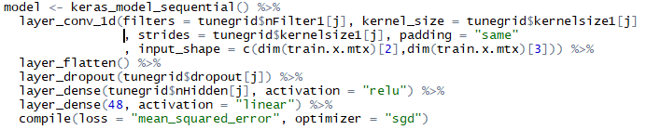
Conv1d Architecture
Input data setting is the same as for RNN.
Input: [#samples, #timesteps, #features]
Layers
Apply Conv1d
Output: [#samples, #steps/stride, #filters]
Flatten
Output:[#samples, #steps/stride x #filters]
ANN
Output: Array of desired length.

Slide 32
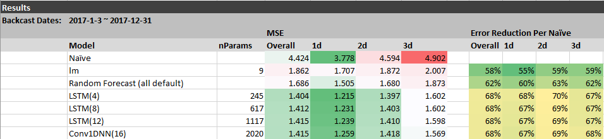
Benchmarking
Results are comparable and Conv1DNN was quicker to run.

Slide 33
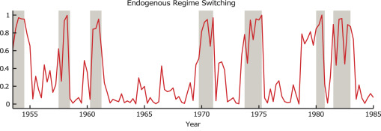
RNN vs Conv1DNN
Practical answer: In Keras, it’s the same set up. Run them both and see.
Theoretical speculations:
Which time series require flexibility of LSTM?
Extracting the time-dependent dependencies via CNN is sometimes enough.
Are there “regime switching” behaviors?
High volatility period, seasonality, etc…

Slide 34
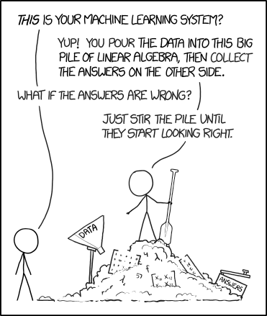
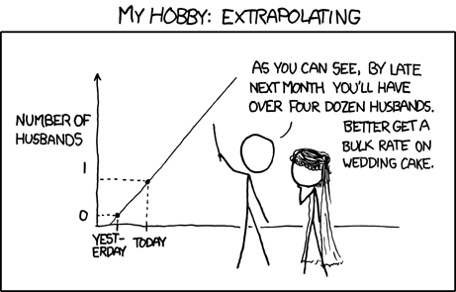
Before (Stats) and After (ML)
Source: xkcd

Slide 35
Comments on Keras
Extremely well designed platform
Easy to use
Transparent and components accessible
Flexibility is built in (custom functions).
I liked that:
Setting multivariate outputs was easy (with weights for loss calculation).
Easily train from where it left off last time.
Syntax is pretty much the same between Python and R.

Slide 36
Thank you!
Contact:
eooka@teainc.org

