Slide 1

Placement Management System
By Under the guidance of Pooja Jadhav Chittaranjan Ghosh BE(E&TC) Technical Trainer
Batch:-2020-5759 Edubridge
Center- Thane (School of Coding)

Slide 2
INDEX
Introduction
Objective
System Structure
Software & Hardware Requirement
Data Dictionary
Graphical User Interface(GUI)

Slide 3
Introduction
This project is to facilitate recruiter as well as student .
Student can get update of new jobs , track their application status.
Recruiter can post new jobs, get access of student details and their application. Also can post status of student application. Can delete jobs from the portal.

Slide 4
Objective
Helps in fast access procedures in placement related activities.
Time saving.
Facility of maintaining students details ,job details , application tracking and can get details of eligible candidates.
Proposed system intends user friendly operations which may resolve ambiguity.
Student can easily find posted jobs , check their application status.
Recruiter can easily find eligible student with all their academic details.

Slide 5
System Structure
The system is divided into different sections for better understanding of both student and recruiter as follows-
Student Module :- Which contains Student Signup, Sign in, student dashboard etc.
Recruiter module :- it contains admin sign in and many more.
Admin module :- it contains admin sign in and many more.

Slide 6
Software & Hardware Requirement
Front end: HTML, CSS, JavaScript, Bootstrap, Hibernate.
Back end: MySQL workbench 8.0CE.
Middleware/Server: Apache Tomcat v8.5. IDE: Spring Tool Suite IDE for Java EE Developers
Browser: Best result on Google Chrome .
Operating System: Window 10.
Processor: Intel Pentium dual-core.
RAM:128MB.
Hard Disk:8GB.

Slide 7
Data Dictionary
Create Database placement
Create table student
Create table recruiter
Create table admin
Create table jobs;

Slide 8
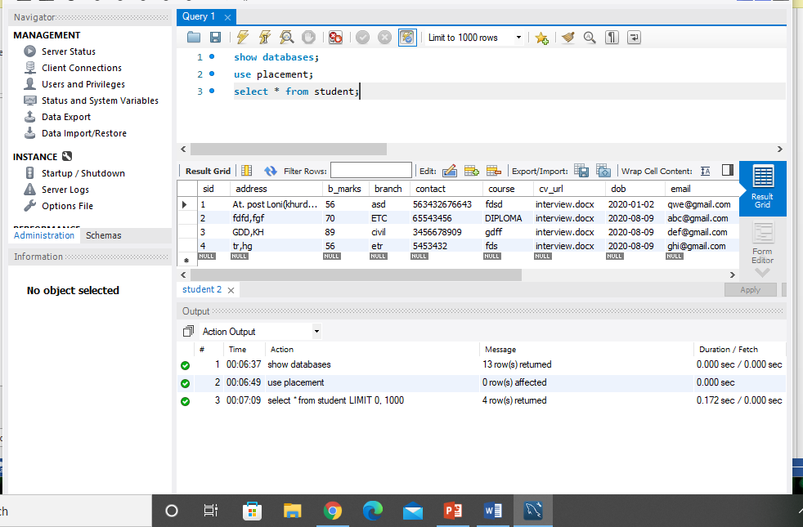
Student Table In Database Placement

Slide 9
Recruiter Table In Database Placement

Slide 10
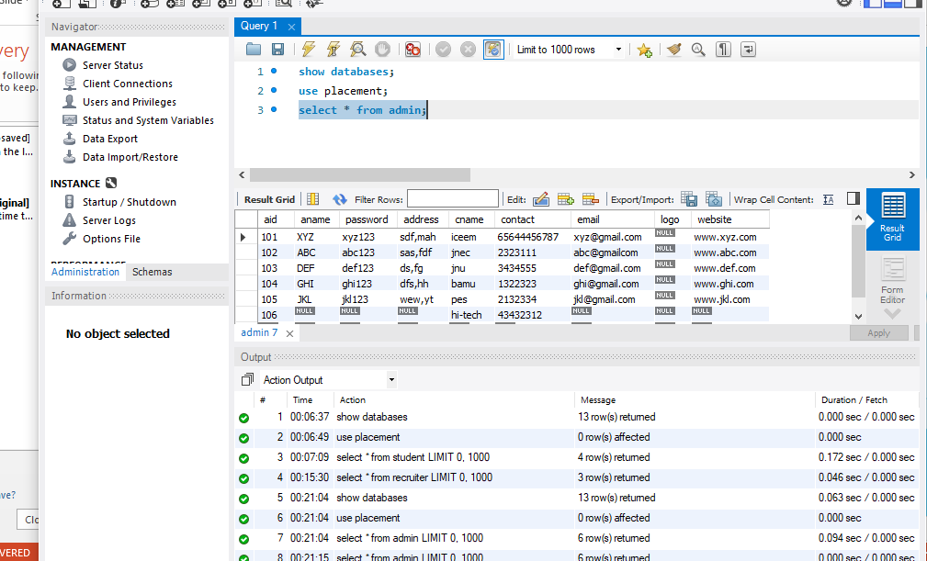
Admin Table In Database Placement

Slide 11
Graphical User Interface(GUI)

Slide 12
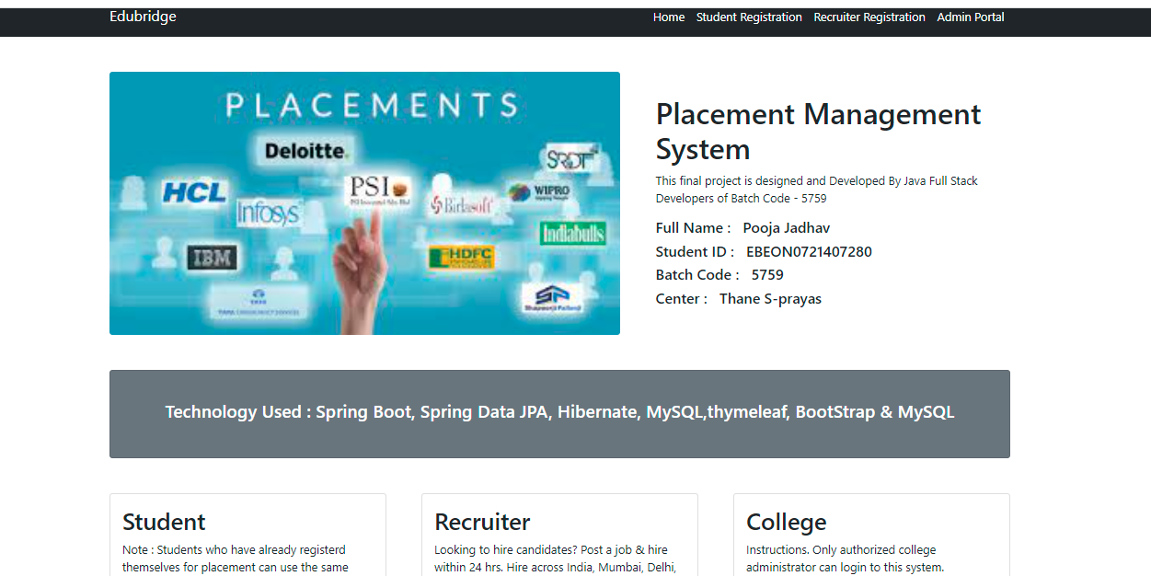
Home Page

Slide 13
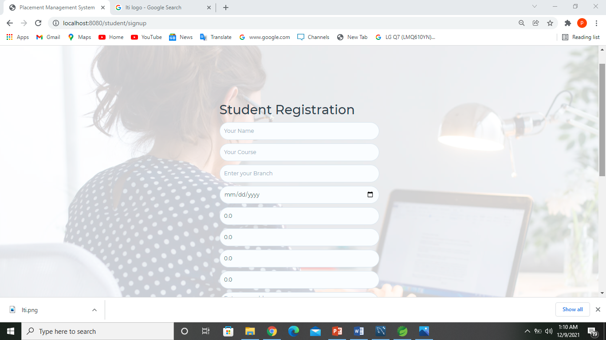
Student’s Registration page

Slide 14
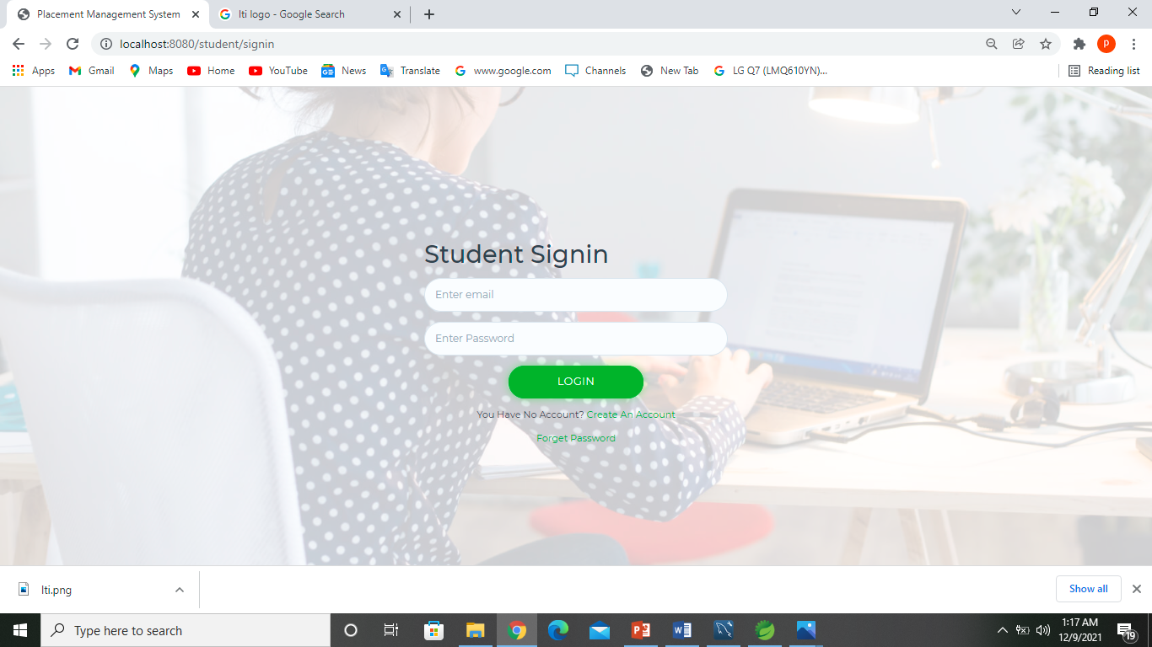
Student’s Login Page

Slide 15
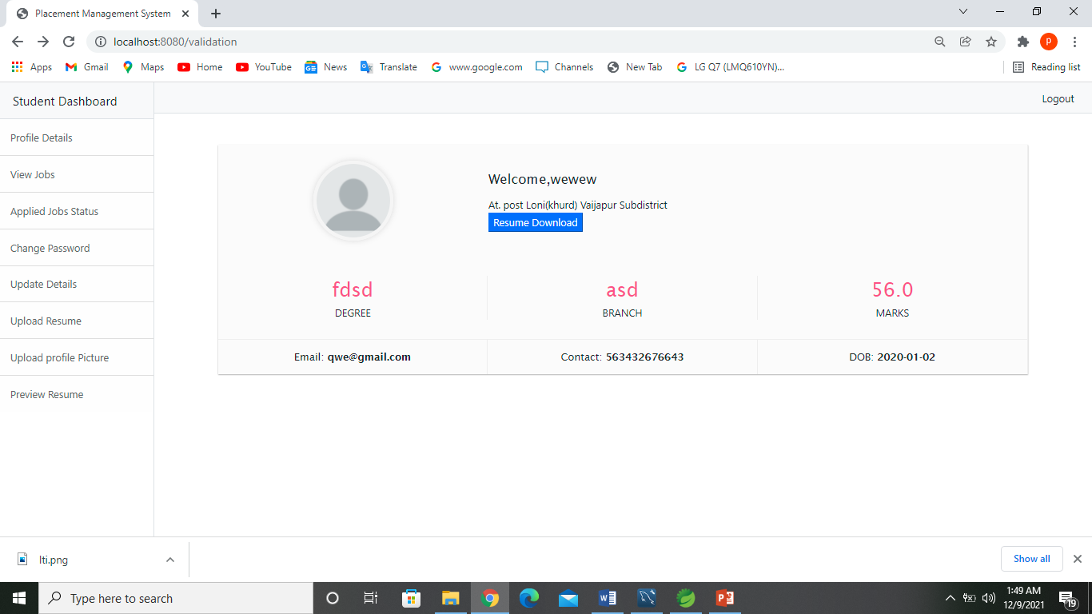
Students Dashboard

Slide 16
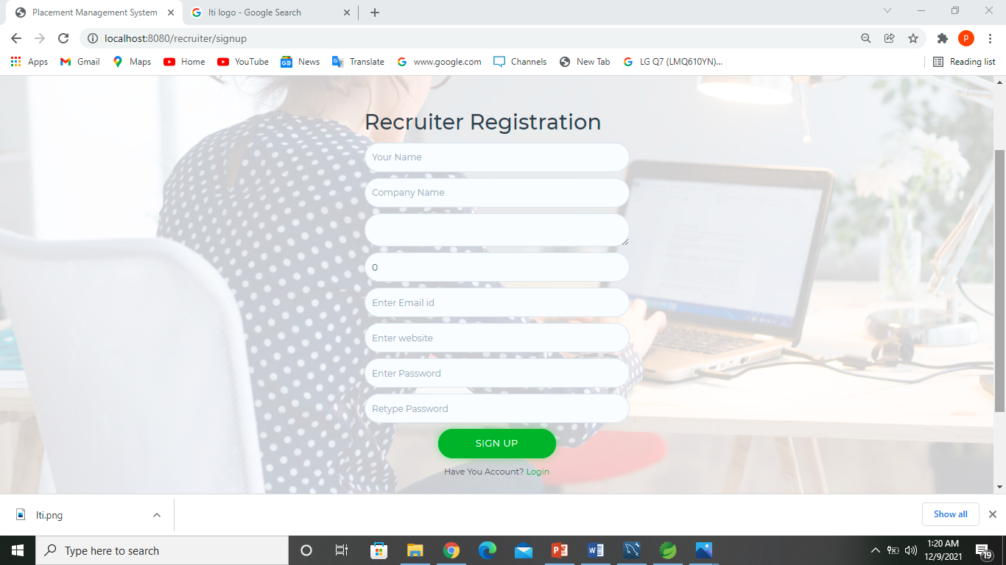
Recruiter’s Registration page

Slide 17

Recruiter’s Login Page

Slide 18
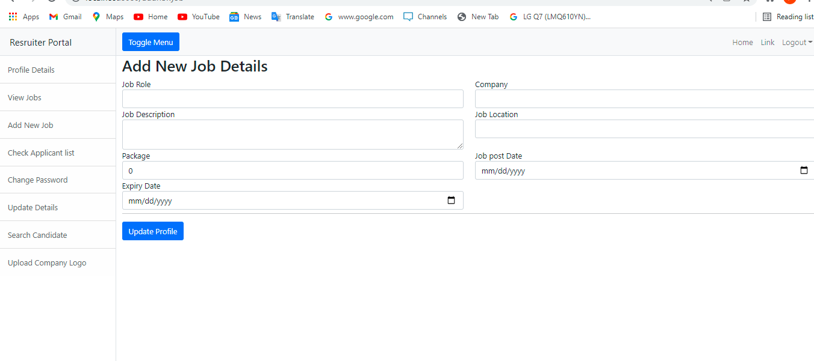
Recruiter’s Dashboard

Slide 19

Admin’s Login page

Slide 20
Thank you!

