Slide 1
Daikin case - Energy data
MovingMad solution

Slide 2

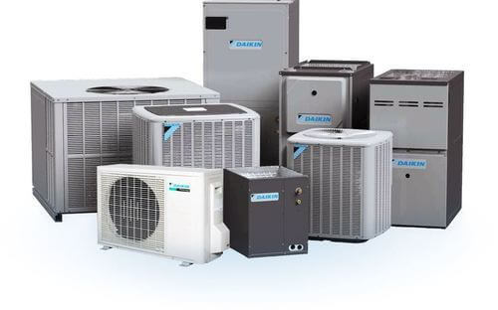

Moving mad
ABOUT US
Team MovingMad:
Rio Evrard
Kerem Okyay
Tiso Van Ootegem
Rafael Marcolin
Jad Haddad

Slide 3
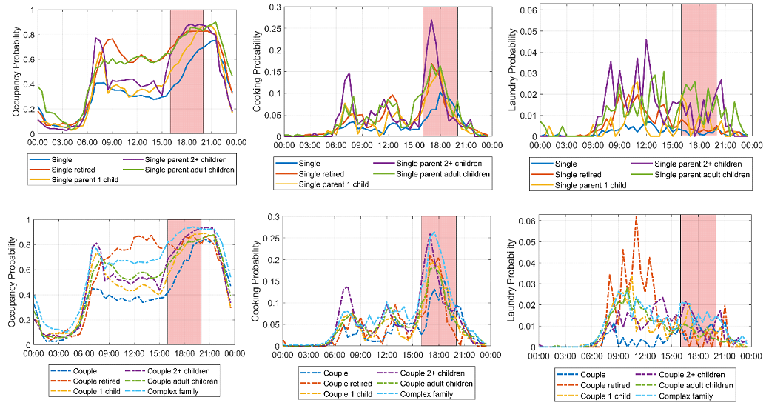
PROBLEM
Complex graphs
Low engagement
Low engagement
Not sustainable

Slide 4
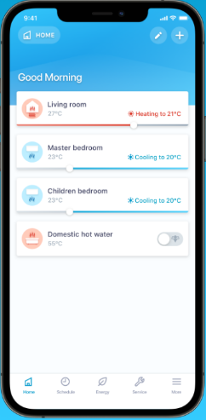
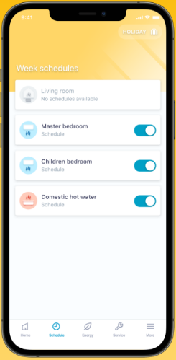
PROBLEM
Complex graphs
Low engagement
Low engagement
Not sustainable
Control and Monitoring are separate
Control and Monitoring are separate

Slide 5
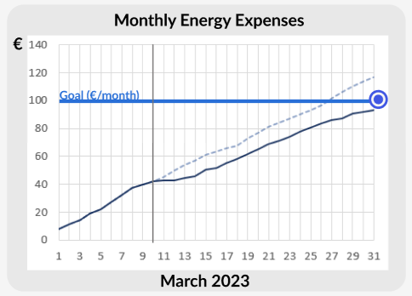
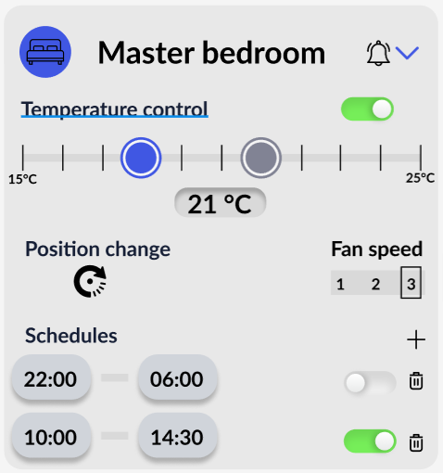
SOLUTION
Redesign App
Showing direct effects of changing device configurations
Personalizing device configurations according to your preferences and goals

Slide 6
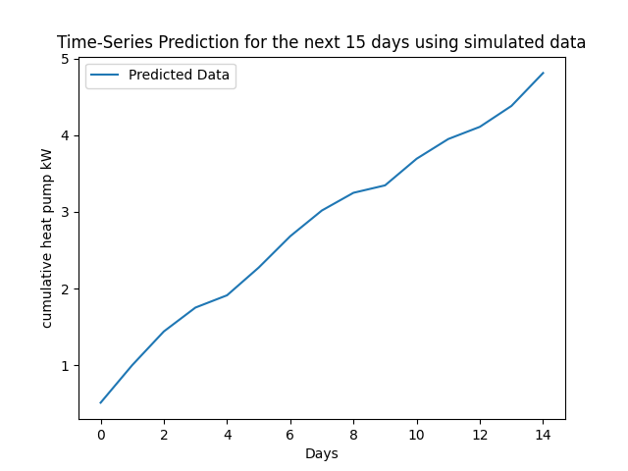
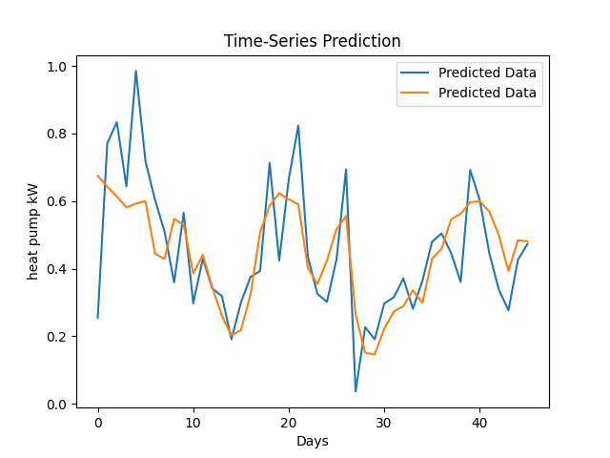
Consumption prediction LSTM model
TimeSeriesNet(
(lstm): LSTM(4, 6, batch_first=True)
(fc): Linear(in_features=6, out_features=2, bias=True)
)

Slide 7
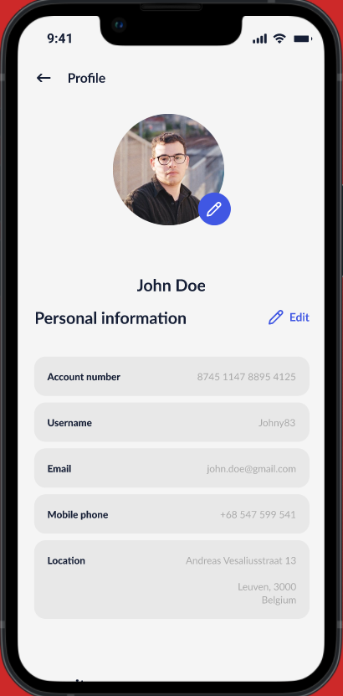

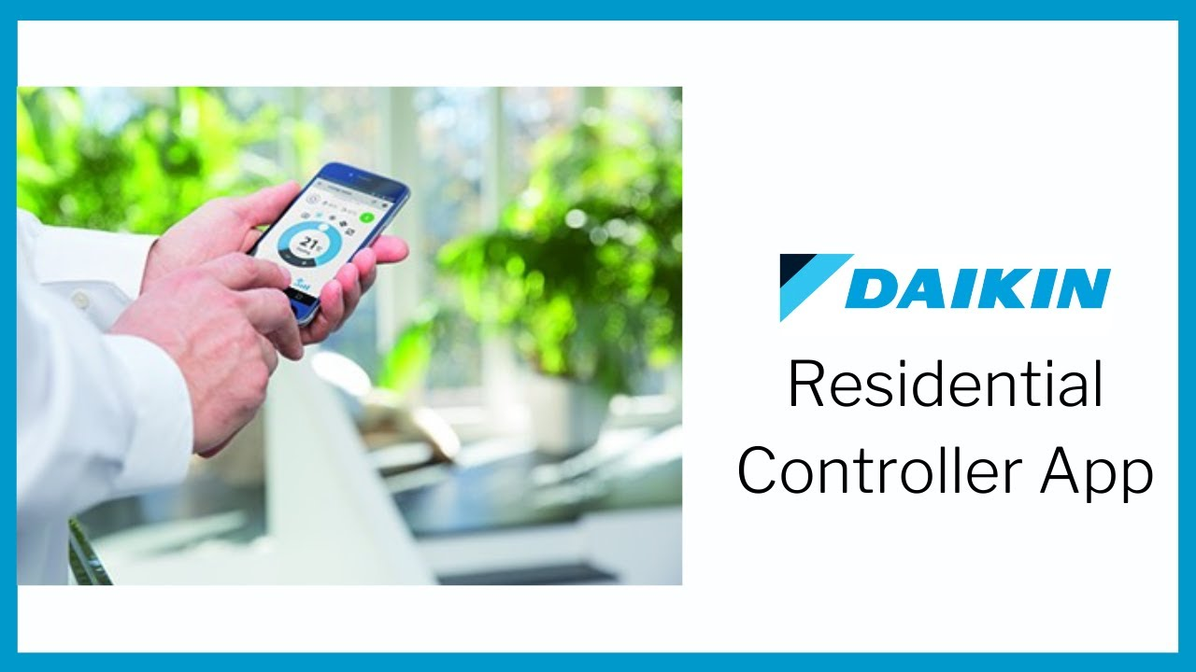
Market Potential
Target Segment
Daikin clinets i.e. families with households equipped with Daikin Products

Slide 8


Goals
Environmental Sustainability
Economical sustainability

Slide 9
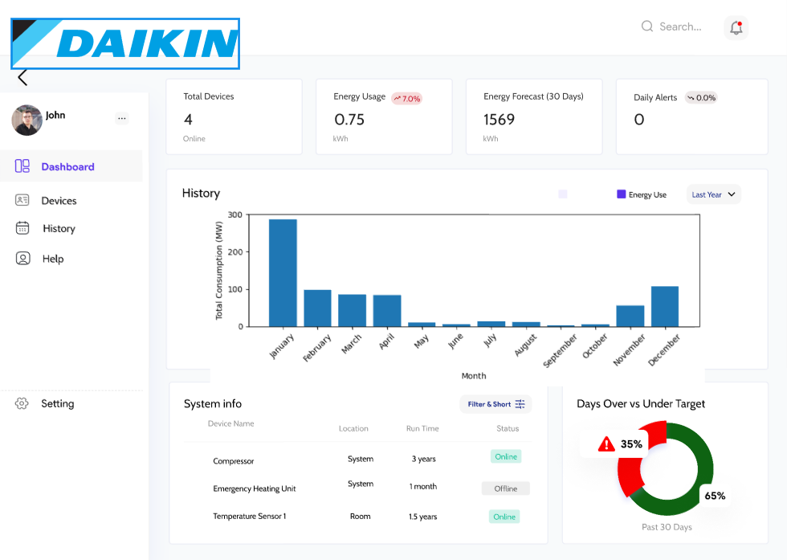
Website In Development

Slide 10


Slide 11
SUMMARY
Address the issue of low engagement and lack of sustainability incentives in Daikin's current app interface by raising awareness of energy consumption to the user.

Slide 12
THANK YOU
MovingMad team

