Slide 1


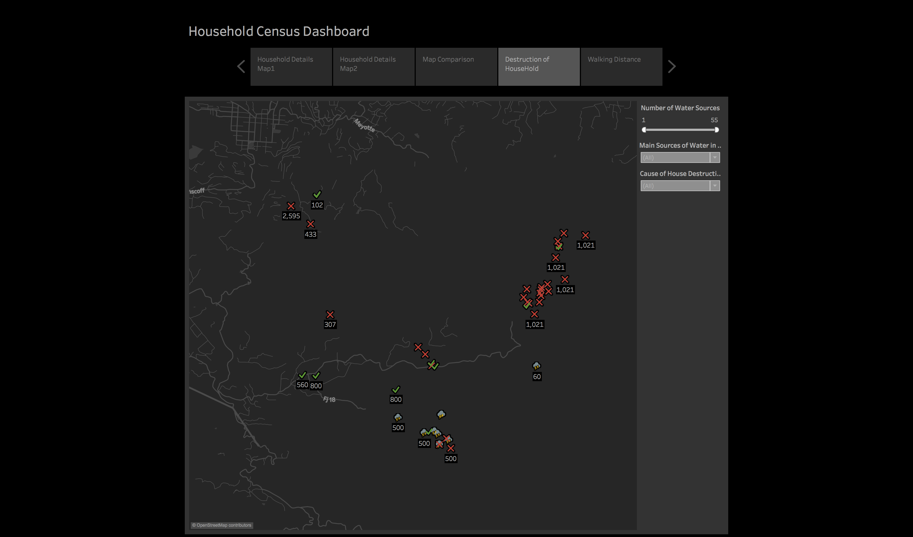
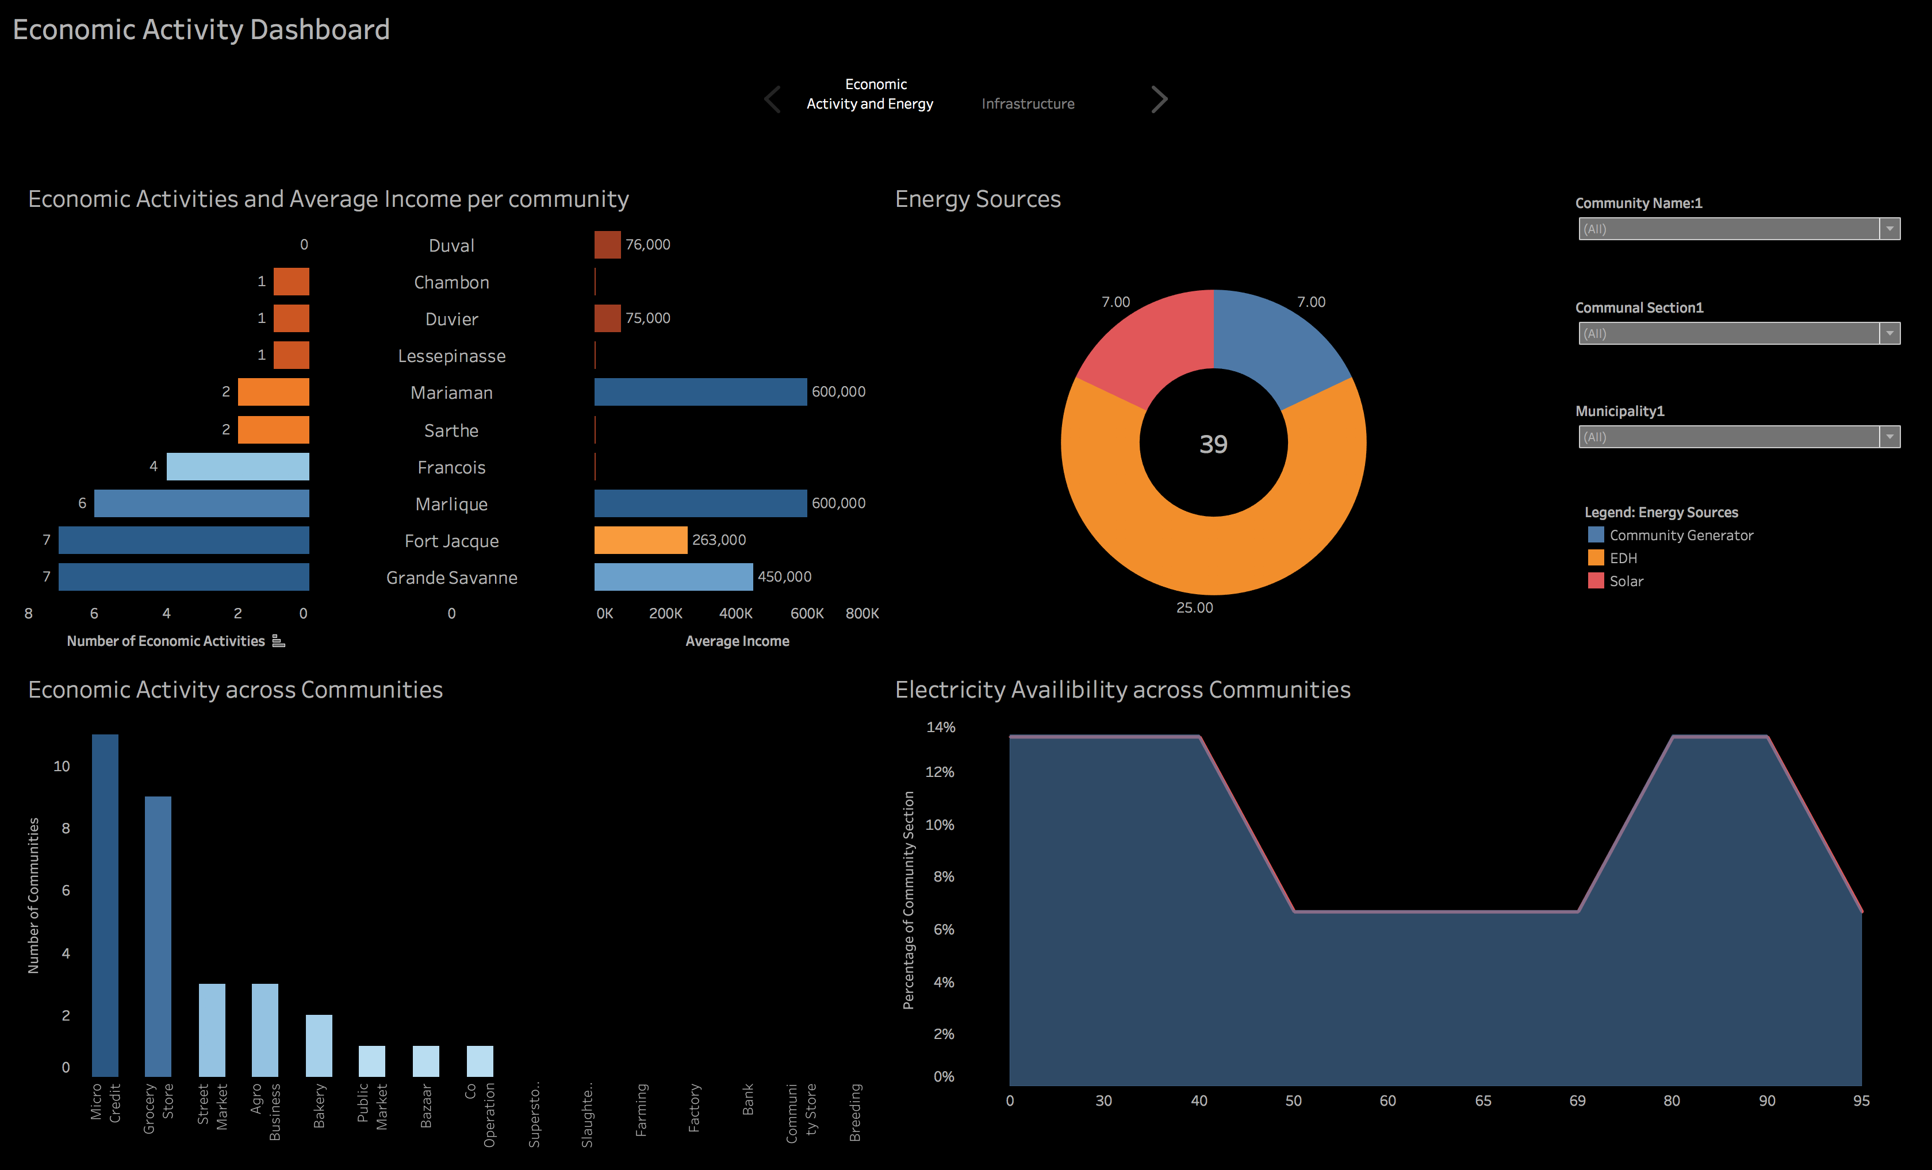

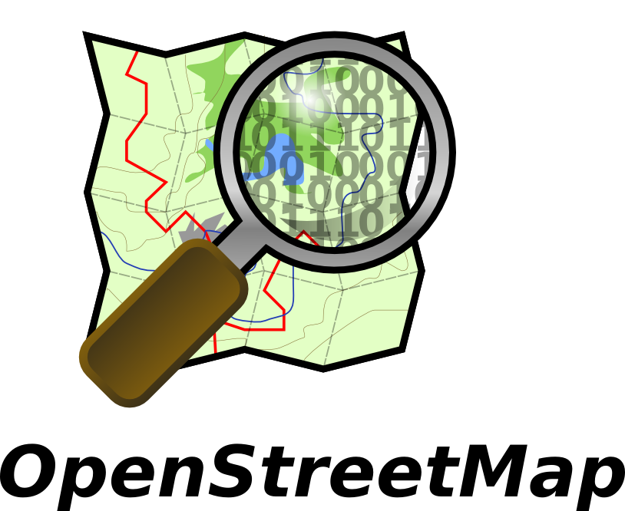


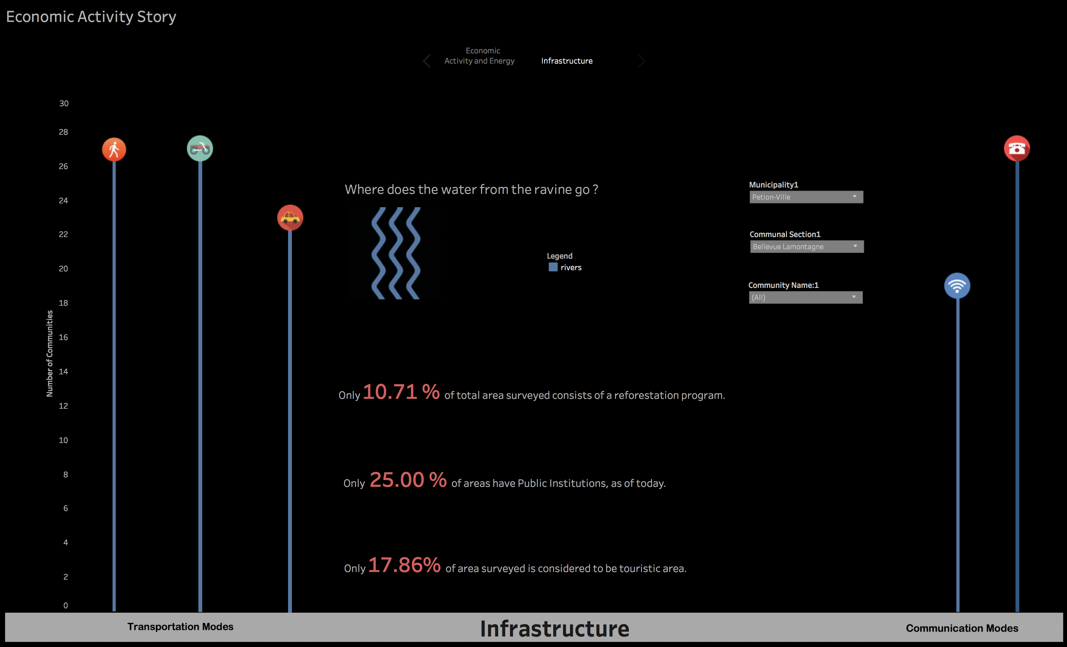


CEN Haiti Visualization: Visualization for Social Development
Developer: Aniket Jadhav | Instructor: Dr. Kathy Weaver | Client: Community Empowerment Network
Community Empowerment Network
Visualization
Deliverables
Visualization
Training & documentation
Data Dictionary
To connect people who want to develop Haiti together. The goal is to bring together organizations who want to create sustainable projects in Haiti.
VISION
OBJECTIVE
Provide support for development in Haiti by educating potential volunteers and patrons about country's developmental priorities, and facilitate direct fund-raising, through data visualizations
Technology
successes
Develop actionable insights through surveys using Tableau
Data transformation
Creation of logical affiliations and an interactive dashboard
Collect
Clean
Transform
Analyze
Visualize
process
Insights
Challenges
Micro-credit is a pre-dominant economic activity in the Petion-Ville municipality.
Électricité d'Haïti provides majority of energy sources in Haiti
Only 20.59% of communities have public institutions, as of March 2018
Data collection and survey analysis
Amendments to project scope due to unavailability of data
Efficient communication due to remote locations

