Slide 1
INTERVIEW ATTENDANCE PROBLEM
INST 767: Big Data Infrastructure
PROJECT PRESENTATION

Slide 2
Content
Motivation
Dataset
Features
Technology used
Data Cleaning
Exploratory Analysis
Models and Results
Conclusion

Slide 3
Motivation
Despite scheduling interviews at candidates’ convenience, a considerable number of them don’t turn up for the interviews.
Recruitment is a big cost to any organization
Waste of hiring organization resources
Research Question: Predicting which candidates will attend the interview using Machine Learning (Classification) models

Slide 4
Dataset
The data pertains to the recruitment industry in India for the years 2014-2016 and deals with candidate interview attendance for various clients.
Consists of answers to a set of questions asked by the recruiter when scheduling the interview
There data has 1233 rows that represent the number of candidates and 40 columns of candidate data.

Slide 5
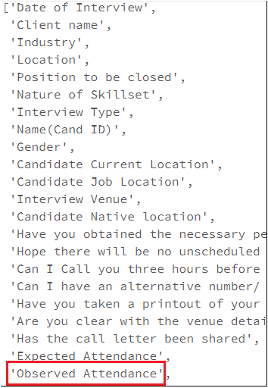
Features

Slide 6

Technology Used
Apache Spark is an open-source cluster-computing framework. Due to previous experience in Python, we choose Spark
Databricks is a high-performance analytics platform that allows us to perform big data processing using Spark.

Slide 7
Data Cleaning
5 unnamed columns, nan filled columns and empty columns: REMOVED
All columns were converted to lowercase to make cleaning more convenient
Data was entered manually by multiple recruiters and hence there was inconsistency in spellings used. Some columns had unwanted characters. Some had irregular spacing.

Slide 8
Data Cleaning
Following columns were regularized:
Client Name
Industry Name
Venue
Candidate Location
Interview Location
Native
Interview Type
Position Type
Skillset
Letter shared
Follow up call
Permission to start
Availability

Slide 9
Data Cleaning
We used domain knowledge to regularize names. Eg. IT
Removed irrelevant columns:
Candidate ID
Expected Attendance
Alternate phone number request
Lastly, all blank string were converted to None and then remove using na.drop()

Slide 10
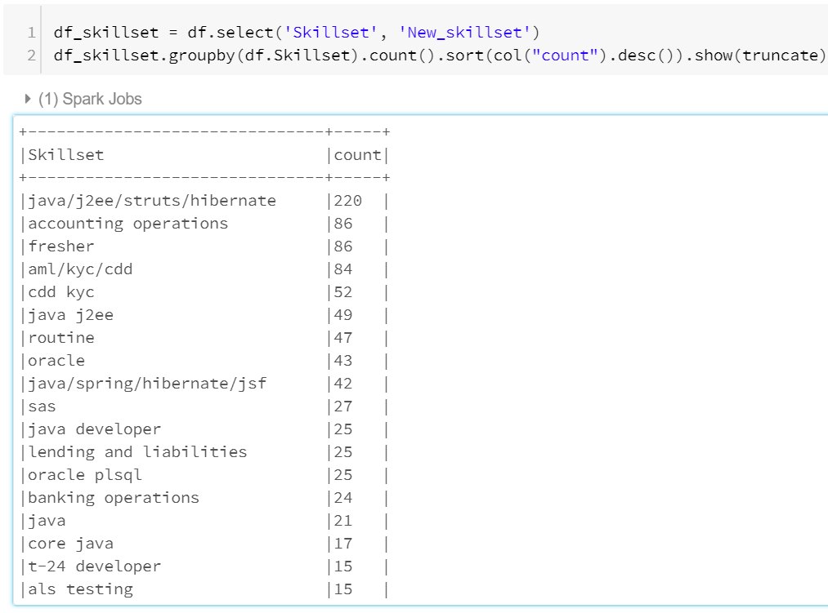
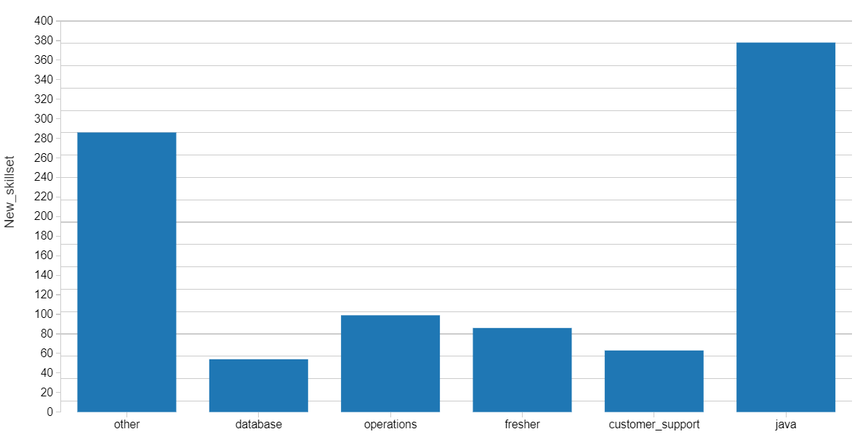

Slide 11
EXPLORATORY ANALYSIS

Slide 12
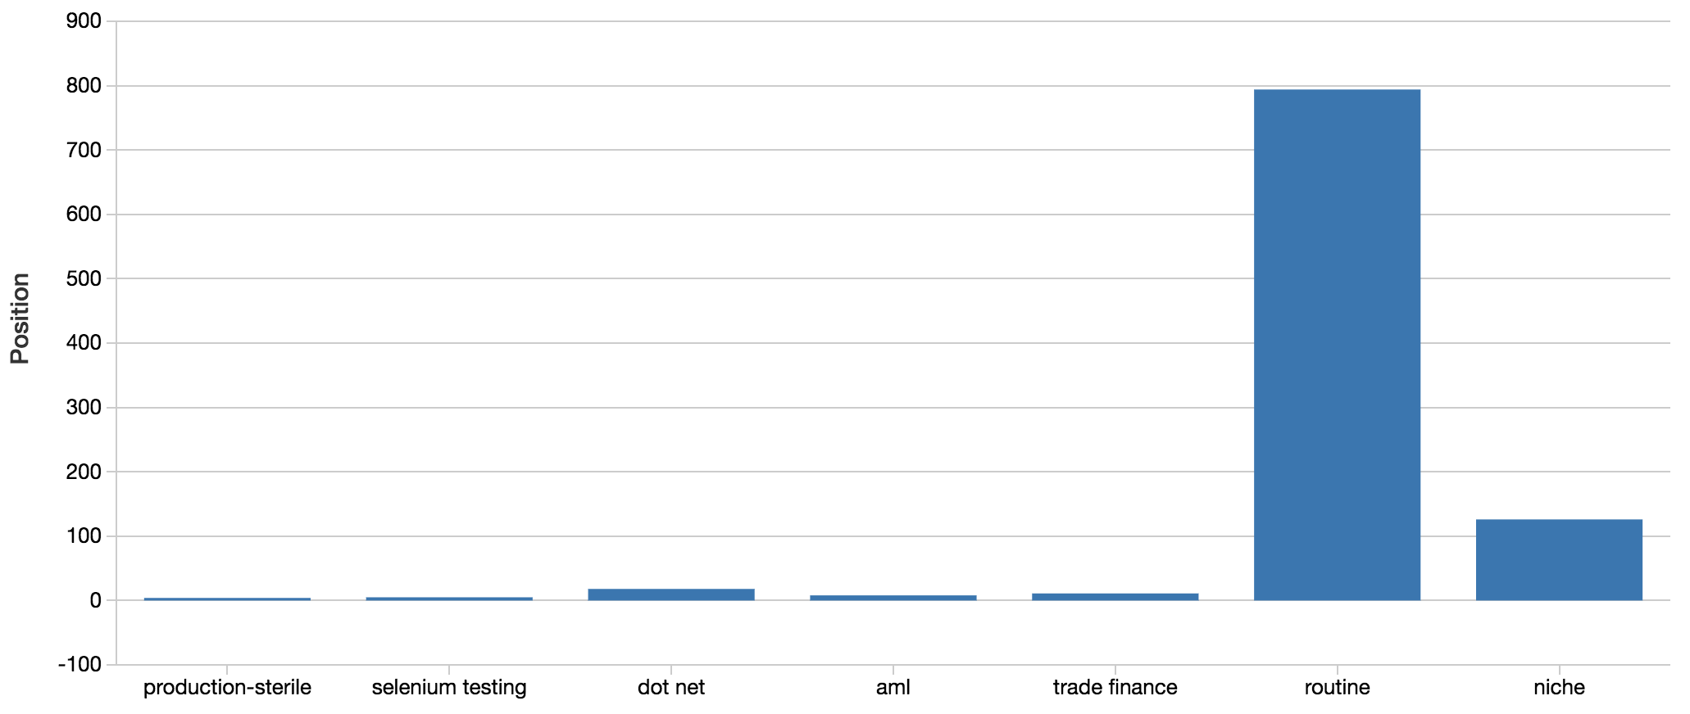
Exploratory Analysis

Slide 13
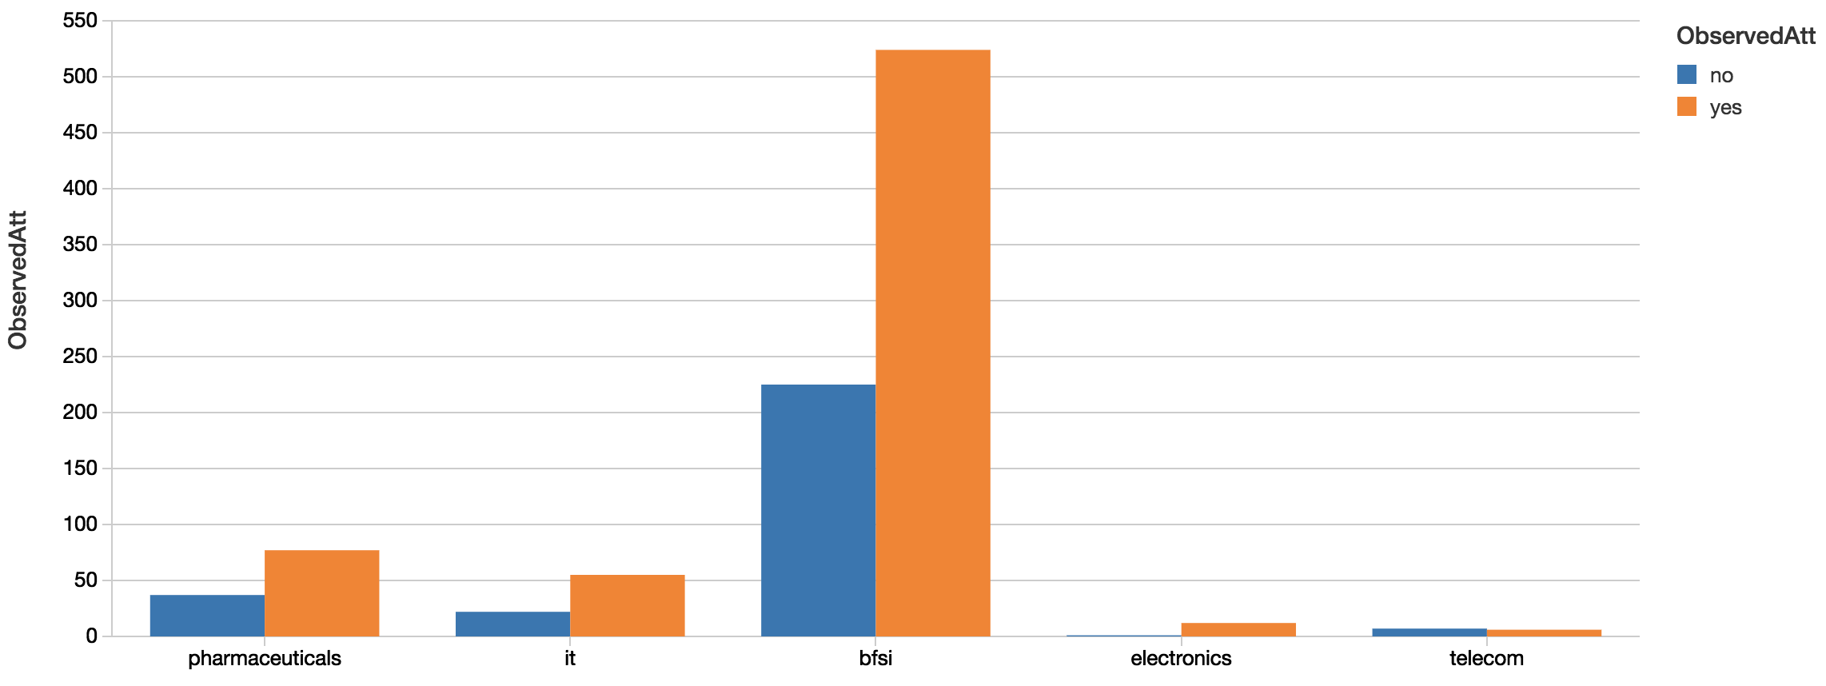
Exploratory Analysis

Slide 14
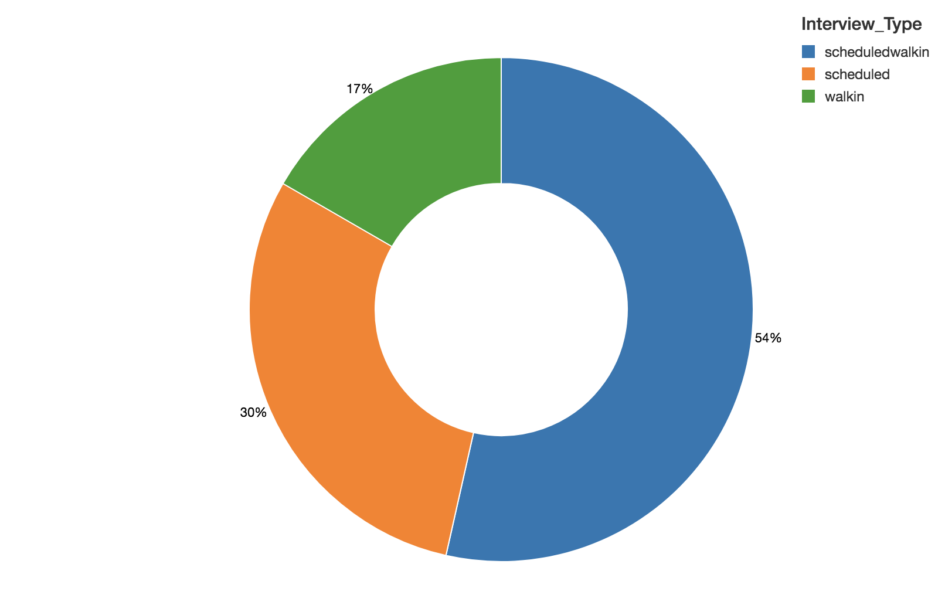
Exploratory Analysis

Slide 15
Models & Results
Logistic Regression | 73.94%
Decision Tree | 74.75%
Random Forest | 75.42%
GBC | 73.76%

Slide 16
Challenges
Size of the dataset: Classifier might perform better with more data. Accuracy keeps changing
Extensive Data cleaning was required because the data was entered manually
Geographically restricted data

Slide 17
Conclusion
Inspiration:
Kaggle Challenge (Naive Bayes ~60%)
Can any variables be modified to yield better results?
Can other algorithms improve accuracy
Modified variables and improved the accuracy using Naive Bayes to 70.3%
Used ChiSquare for feature selection to yield better results
Decision Trees (Random Forest)

Slide 18
QUESTIONS?

