Slide 1
Database Design for Healthcare Records
Patient, clinical and prescription data in a relational MySQL database
FirstBitSolutions project
PRESENTED BY
Pranita Jadhav
Notes:
Introduce the project: a database to store and retrieve patient health information with integrity, security and accessibility.

Slide 2








Problem statement: 7 requirements, 10 tables
Patient information
Medical history
Encounter records
Diagnostic tests
Name, DOB, gender, contact, insurance
Diagnoses, allergies, medications, treatments
Appointments, admissions, discharges
Test types, results, dates
Patient
Medical_History
Appointment, Encounter
Diagnostic_Test
Doctors
Prescriptions
Procedures & surgeries
Deliverables
Doctor details and specialization
Medications, dosage, dispensing
Procedures performed on patients
ER diagram, database design, tables with 10+ records
Doctor
Prescription, Medication
Procedure_Surgery, Surgeon
All done: 20 rows per table

Slide 3
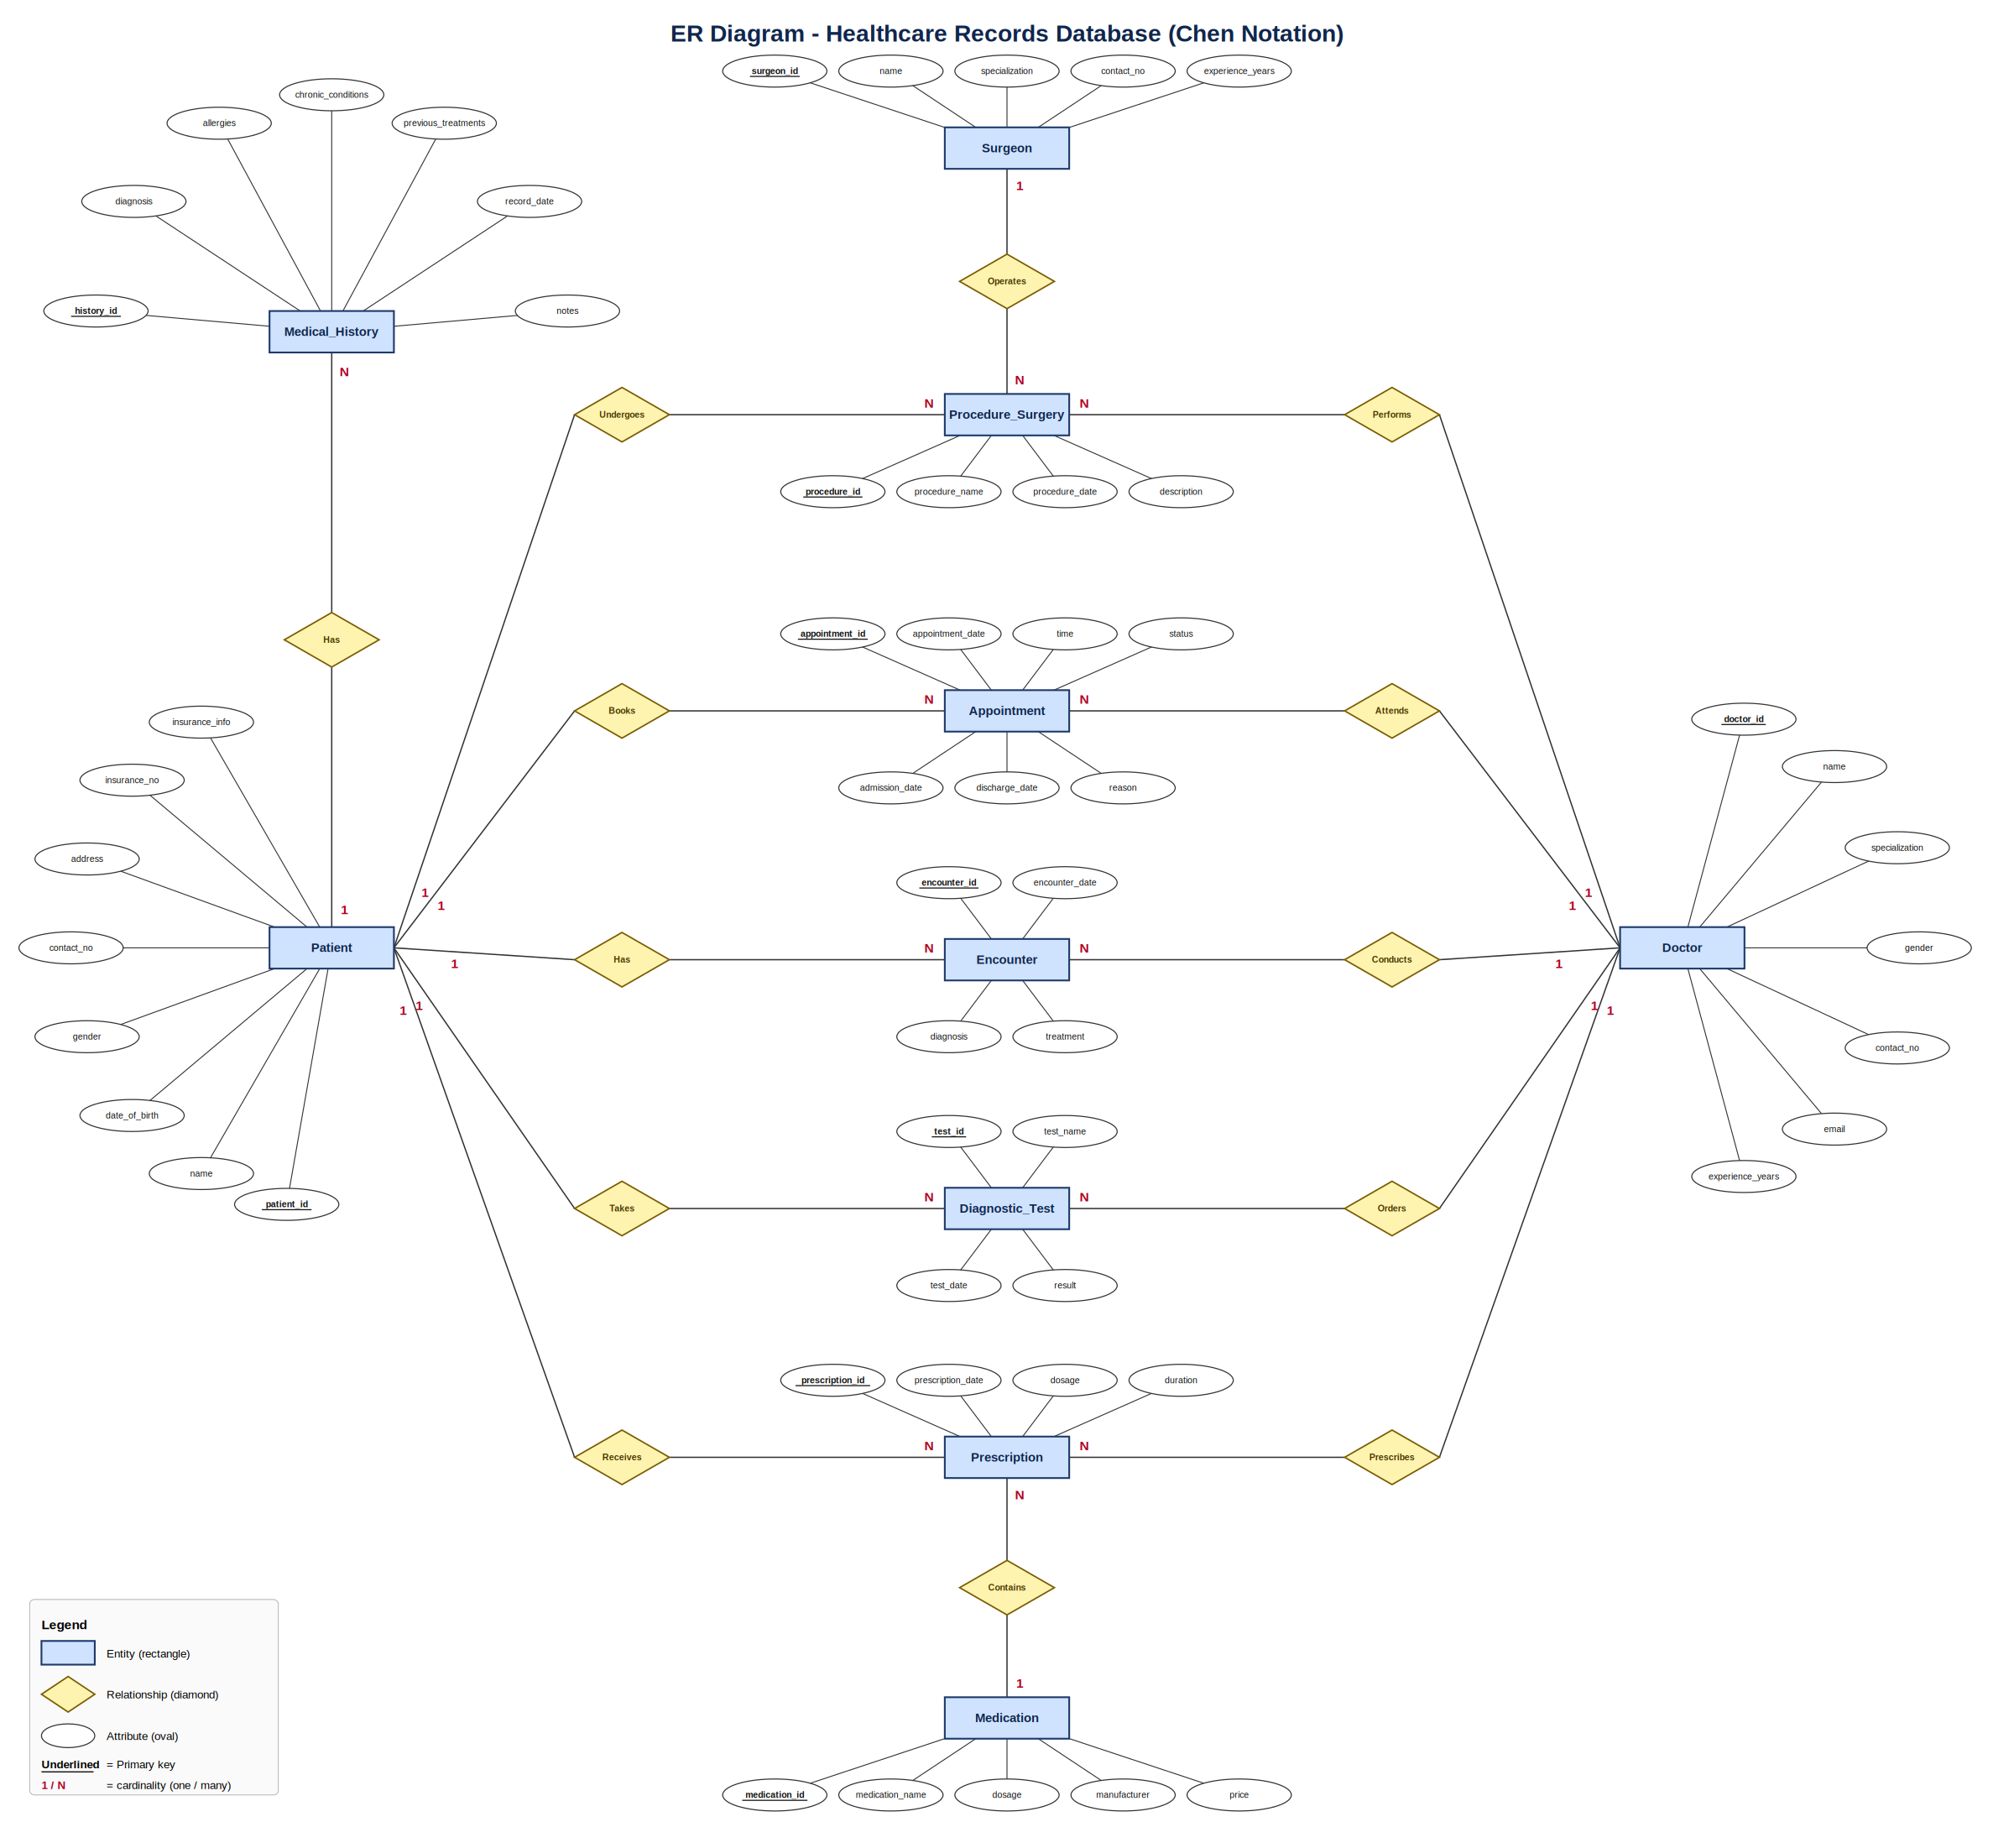
ER diagram (Chen notation)
10
entities
13
relationships
Rectangle = entity, diamond = relationship, oval = attribute
Patient and Doctor each link to Appointment, Encounter, Diagnostic_Test, Prescription and Procedure_Surgery (1:N)
Prescription N:1 Medication, Procedure_Surgery N:1 Surgeon
Medical_History belongs to one Patient (1:N)

Slide 4
Database design: tables and keys
Table | Primary key | Foreign keys | Key columns
Patient | patient_id | - | name, date_of_birth, gender, contact_no, insurance_no
Doctor | doctor_id | - | specialization, email, experience_years
Surgeon | surgeon_id | - | specialization, experience_years
Medication | medication_id | - | name, dosage, manufacturer, price
Appointment | appointment_id | patient_id, doctor_id | date, time, admission / discharge, status
Medical_History | history_id | patient_id | diagnosis, allergies, medications
Encounter | encounter_id | patient_id, doctor_id | date, diagnosis, treatment
Diagnostic_Test | test_id | patient_id, doctor_id | test_name, test_date, result
Prescription | prescription_id | patient_id, doctor_id, medication_id | dosage, duration, quantity, dispensing status
Procedure_Surgery | procedure_id | patient_id, doctor_id, surgeon_id | procedure_name, date, description

Slide 5




Data integrity and security
Data integrity
Security
Primary and foreign keys on every table
UNIQUE insurance number and doctor email
NOT NULL and CHECK rules (gender, status, price, dates)
patient_basic_view hides insurance details
Roles: doctor, reception, read-only
GRANT gives each role only what it needs
Automation
Sample data
Trigger sets a default appointment status
Stored procedure GetPatientMedicalHistory(id)
Reusable joins for reports
10 tables, 20 records each
Realistic patients, doctors, drugs, procedures
Tested: script runs with 0 errors

Slide 6


Sample queries
Who takes which medicine?
Surgeries and surgeons
Patients per diagnosis
SELECT p.name,
m.medication_name,
pr.dosage
FROM Prescription pr
JOIN Patient p
ON pr.patient_id
= p.patient_id
JOIN Medication m
ON pr.medication_id
= m.medication_id;
SELECT p.name,
ps.procedure_name,
s.name AS surgeon
FROM Procedure_Surgery ps
JOIN Patient p
ON ps.patient_id
= p.patient_id
JOIN Surgeon s
ON ps.surgeon_id
= s.surgeon_id;
SELECT diagnosis,
COUNT(*) AS total_patients
FROM Medical_History
GROUP BY diagnosis;
CALL
GetPatientMedicalHistory
(4);
Joins 3 tables
Links patient, procedure, surgeon
Aggregate and stored procedure

Slide 7


Summary
10
200
0
tables with keys and constraints
sample records (20 per table)
errors on the final test run
Possible improvements
1
Separate Admission table for admissions and discharges
2
Link Prescription to Encounter
3
Move insurance details into their own table

Slide 8
Thank you

