Slide 1
Farmer Challenges
Understanding Agricultural Problems
Research Reference for AgriVision AI
Why Farmers Need Smart Agricultural Technology

Slide 2
Major Challenge Categories
🌱 Disease & Pest Management - Early identification and prevention
🧪 Soil Health Issues - Lack of affordable testing and guidance
💧 Water Management - Unpredictable rainfall and irrigation
👨‍🌾 Expert Accessibility - Expensive agricultural consultants
🐛 Pest Identification - Distinguishing disease vs pest vs deficiency
📉 Declining Yields - Poor crop planning and decisions

Slide 3
Farmer Challenge Research Metrics
19
30%
40%
Farmers Interviewed
Avg Yield Loss
Pesticide Wastage

Slide 4
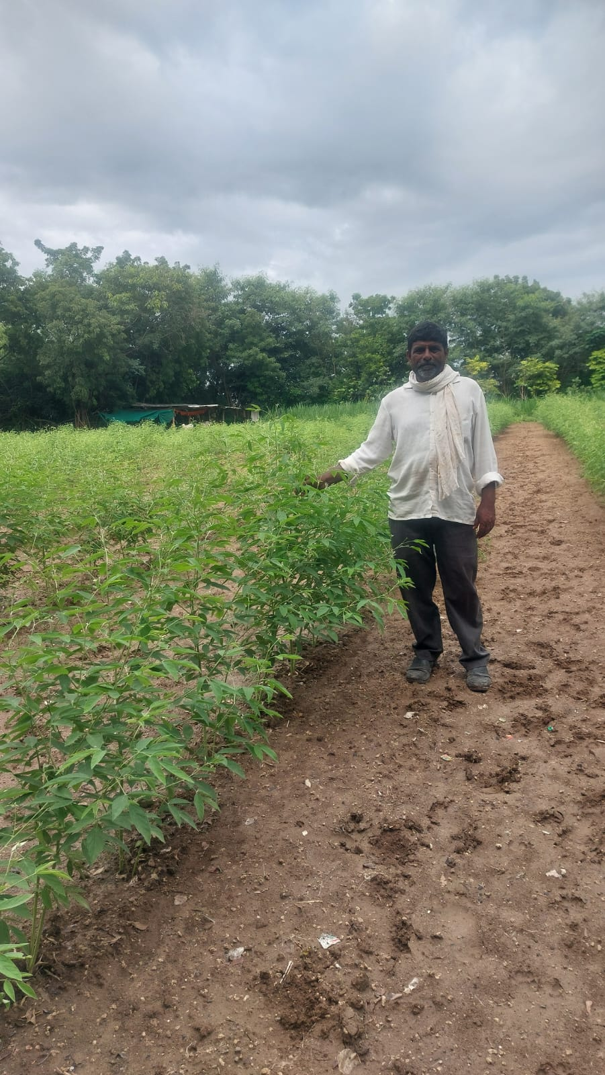
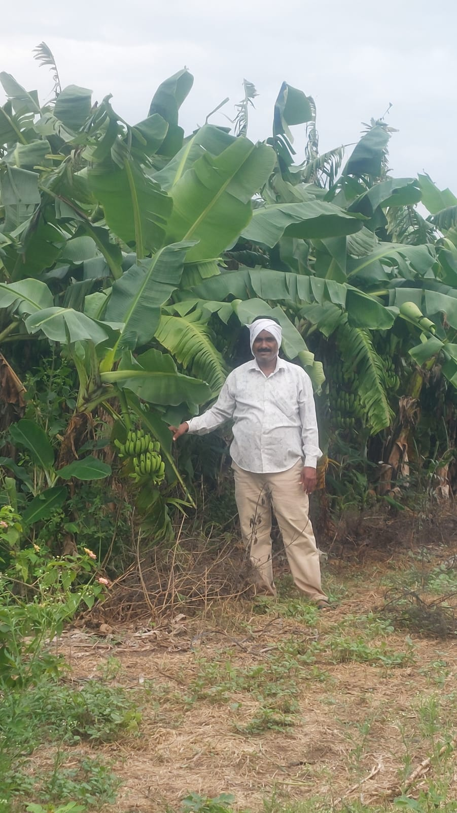
Farmer Challenges
Challenge #1
⚠️
"Struggling to identify leaf diseases in my cotton crop - lost 30% yield last season due to late detection"
Challenge #2
⚠️
"Soil quality declining year after year. Don't know what nutrients to add. Chemical fertilizers are expensive."

Slide 5
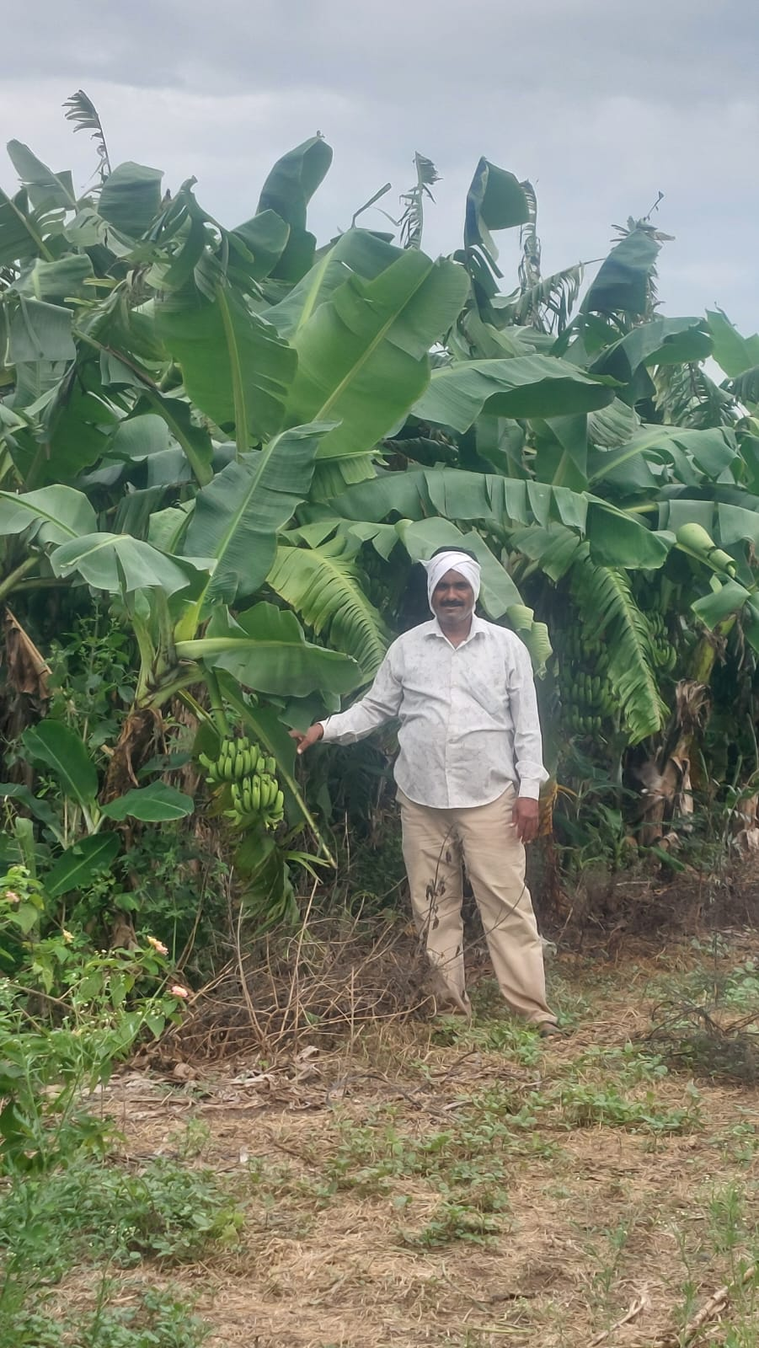
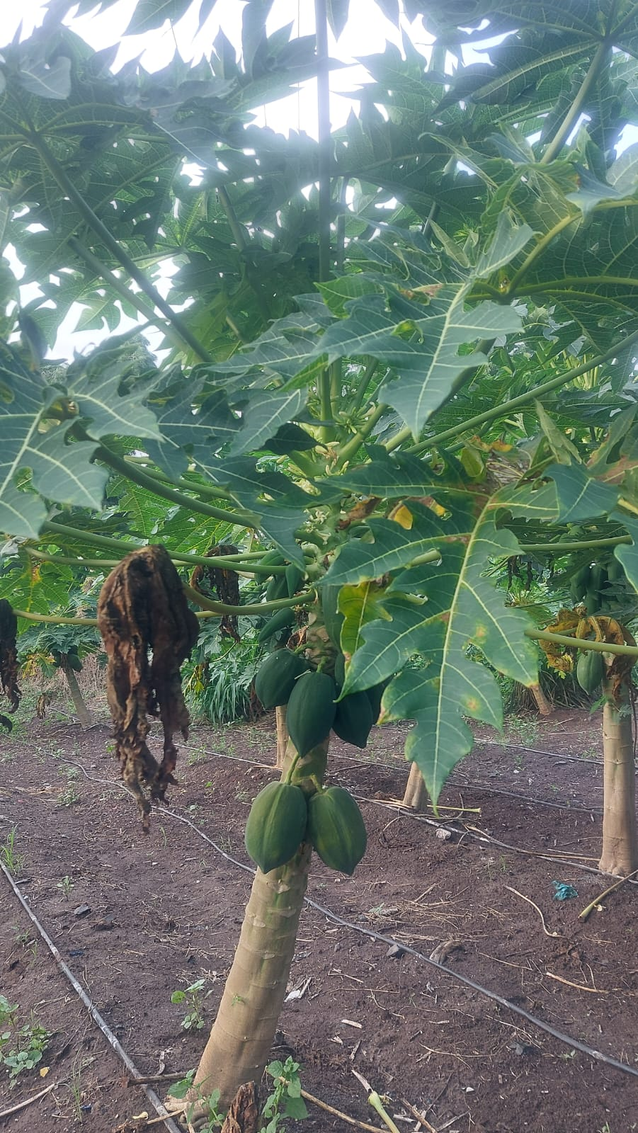
Farmer Challenges
Challenge #3
⚠️
"Unpredictable rainfall made irrigation planning extremely difficult. Lost crops due to water stress."
Challenge #4
⚠️
"Can't afford agricultural experts. Phone consultations are too expensive for small farmers like me."

Slide 6
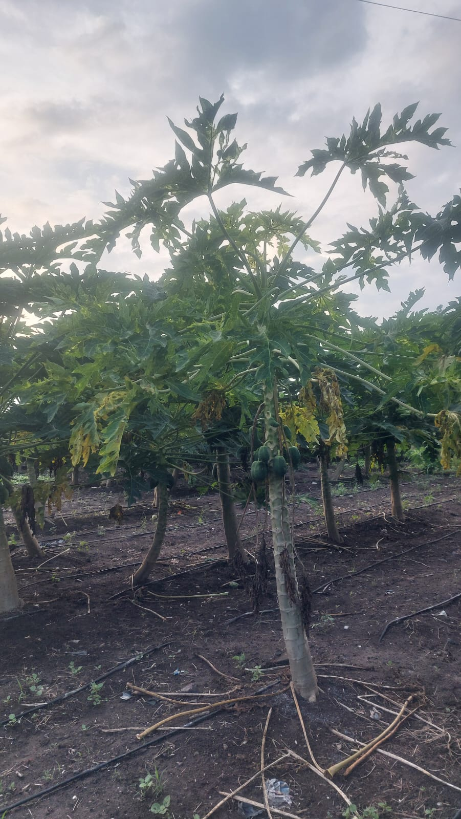
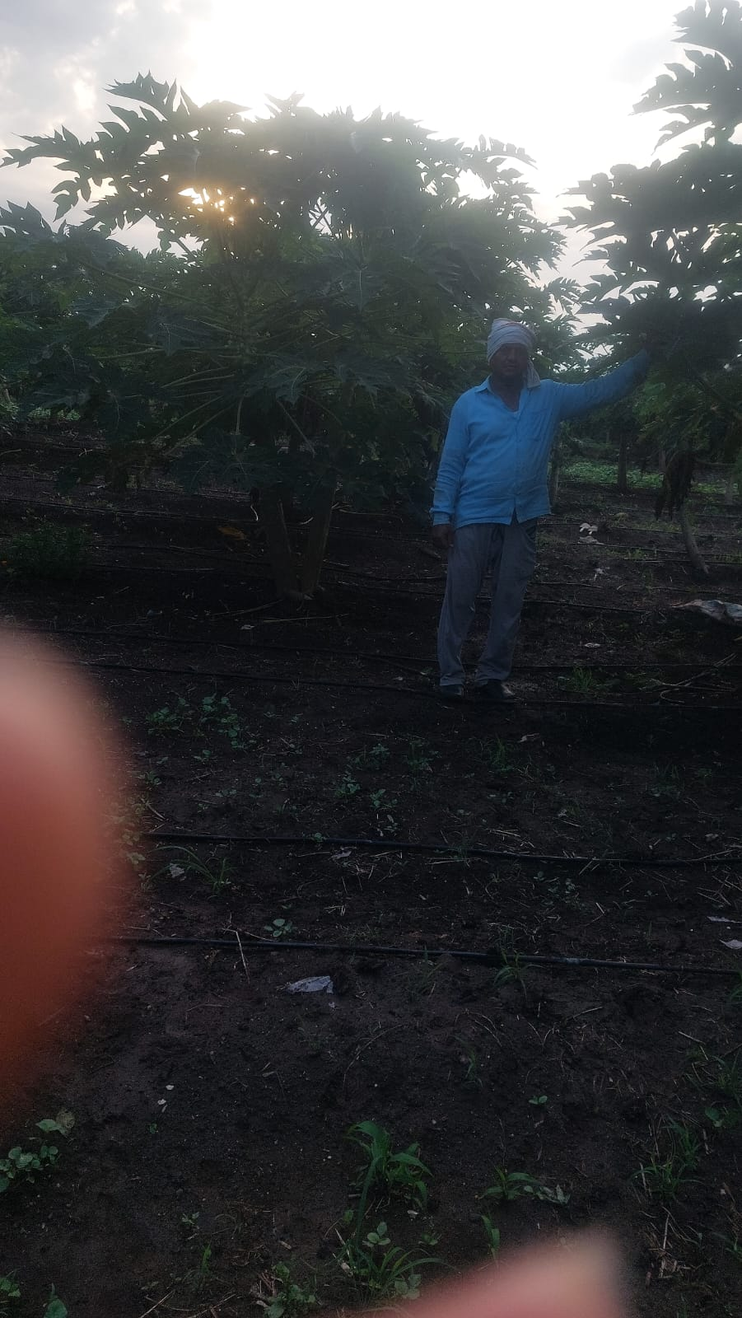
Farmer Challenges
Challenge #5
⚠️
"Pest infestation spreads rapidly before I can identify it. Lost my entire wheat crop to armyworms."
Challenge #6
⚠️
"My soil test results come back but I don't understand the reports. What should I do?"

Slide 7
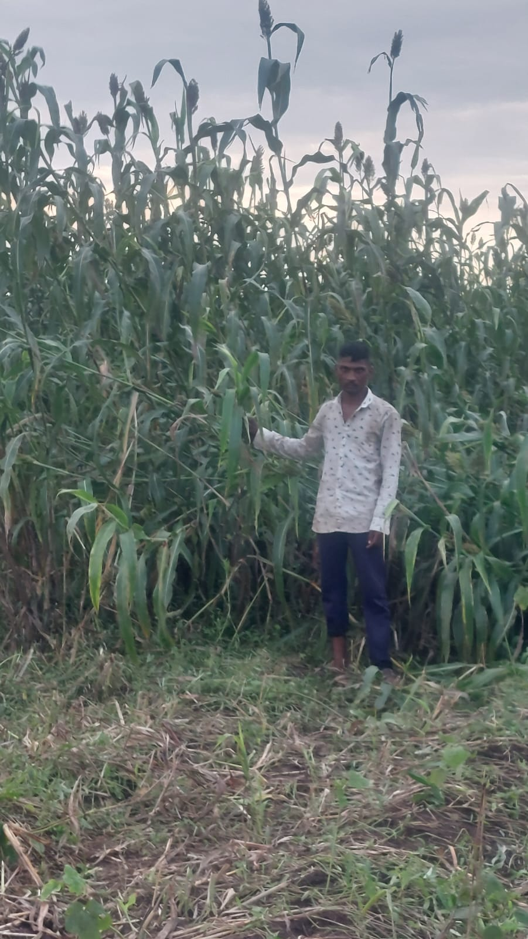
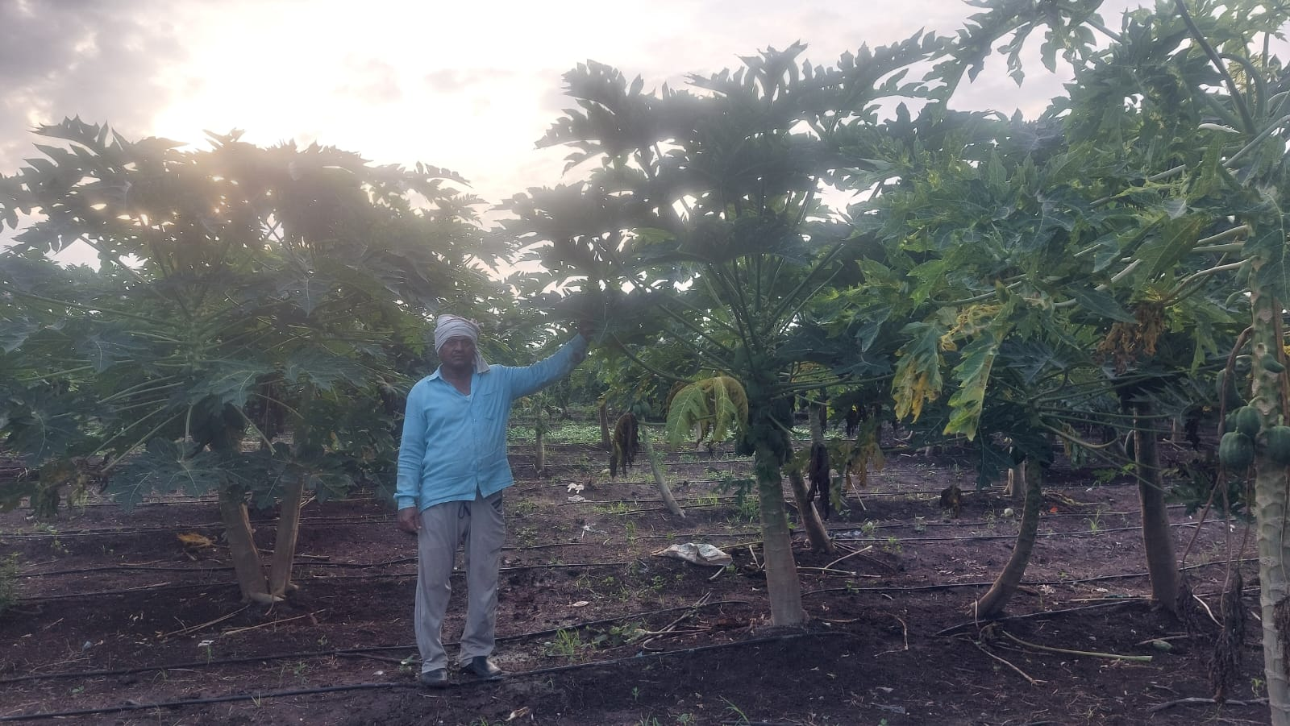
Farmer Challenges
Challenge #7
⚠️
"Weather forecasts don't help with specific crop decisions. Need real-time farming advice."
Challenge #8
⚠️
"Using too many pesticides but crops still get diseased. Want to reduce chemical use but afraid of losses."

Slide 8
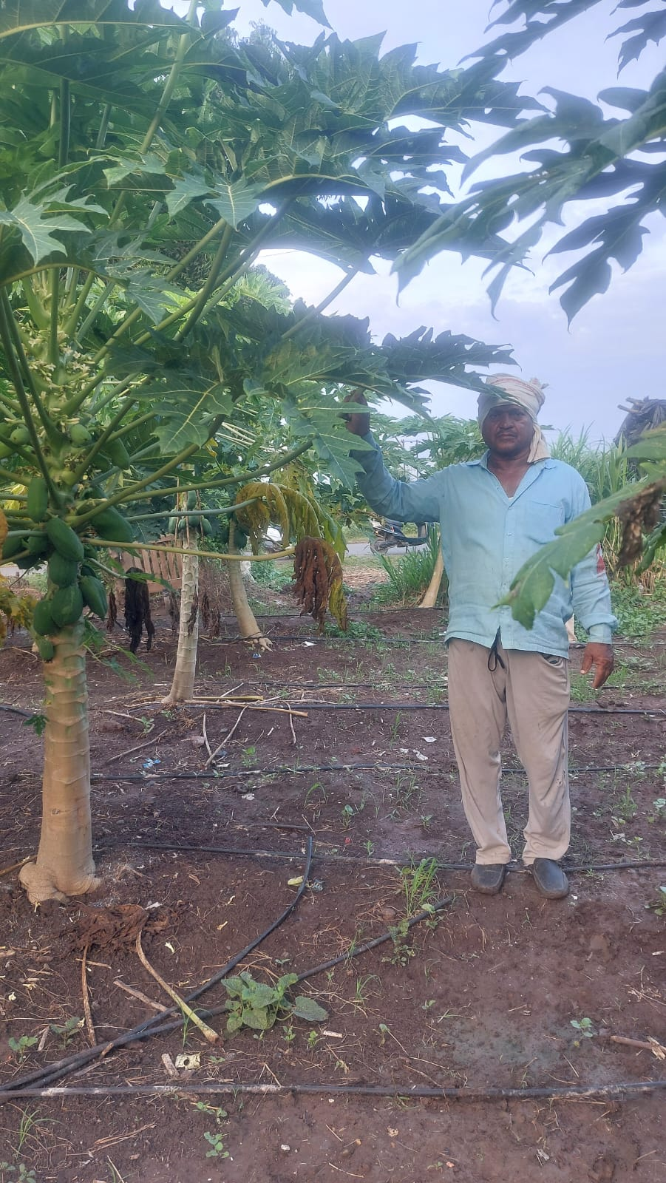
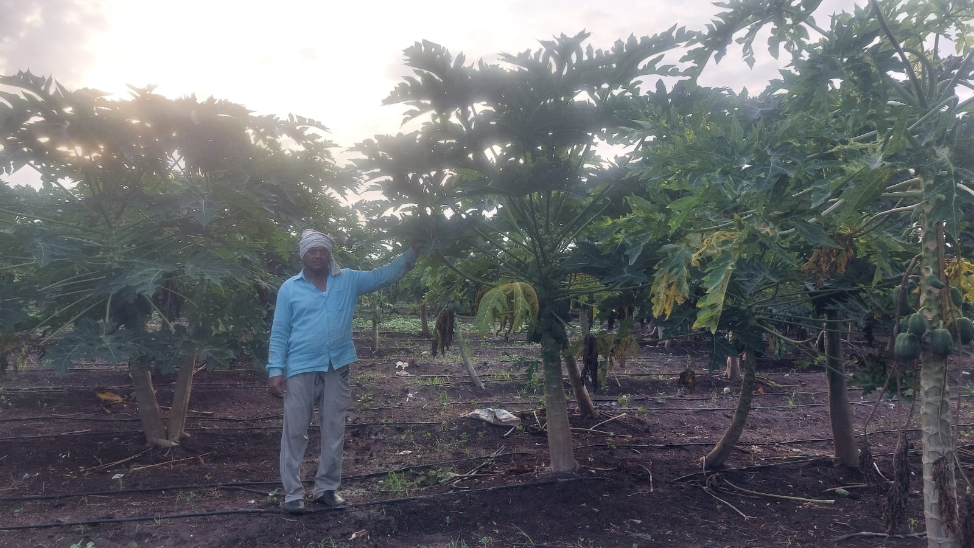
Farmer Challenges
Challenge #9
⚠️
"Disease spread from neighboring fields. How can I identify problems early before they destroy everything?"
Challenge #10
⚠️
"Rotating crops blindly without understanding soil impact. Yields decreasing season by season."

Slide 9
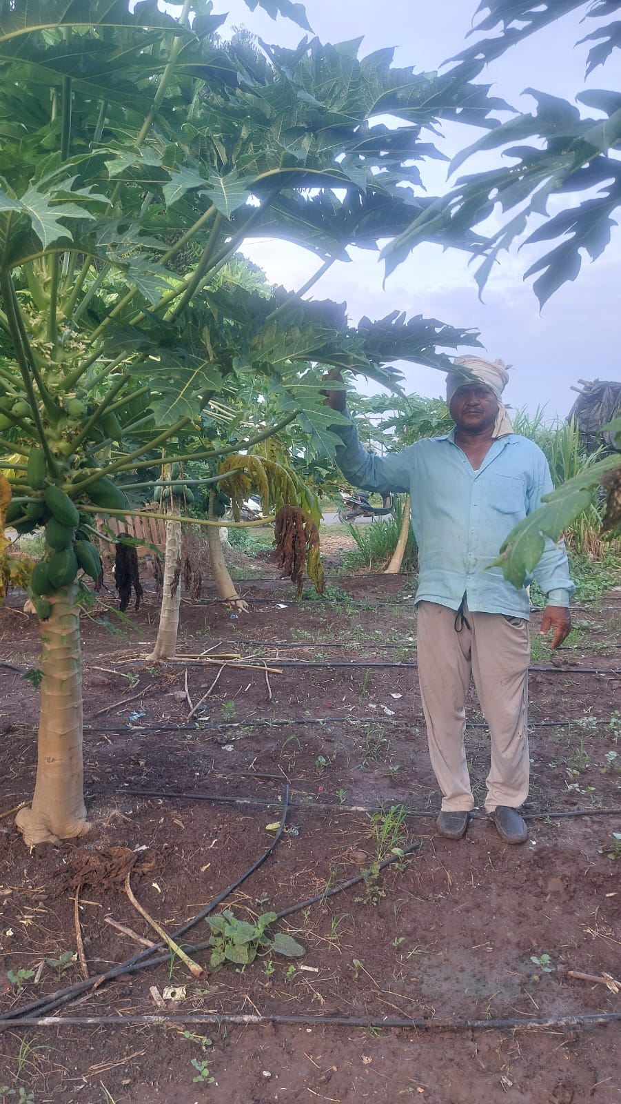
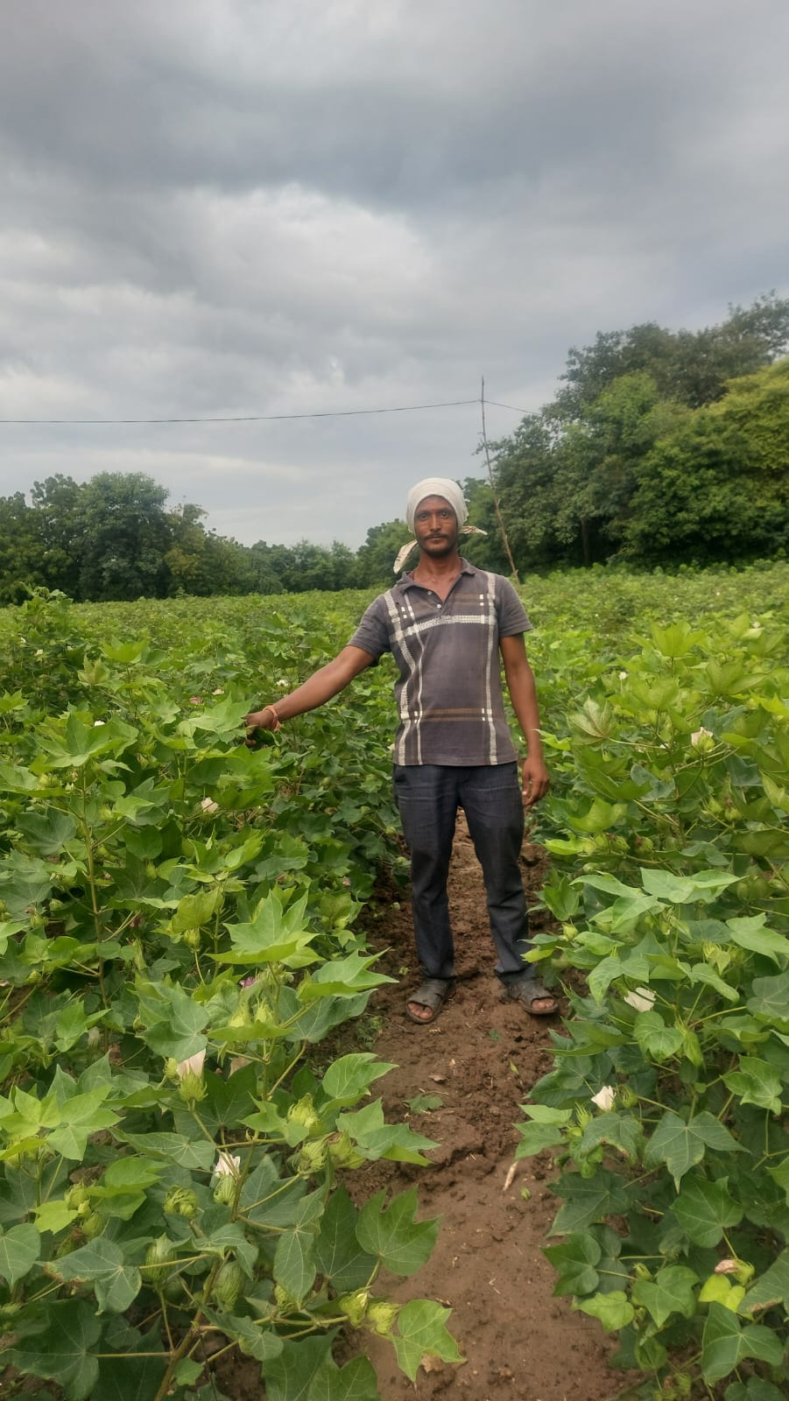
Farmer Challenges
Challenge #11
⚠️
"Fungal disease outbreak last monsoon ruined my vegetables. No idea how to prevent it next time."
Challenge #12
⚠️
"Water scarcity is increasing. Need to use every drop wisely but have no guidance system."

Slide 10
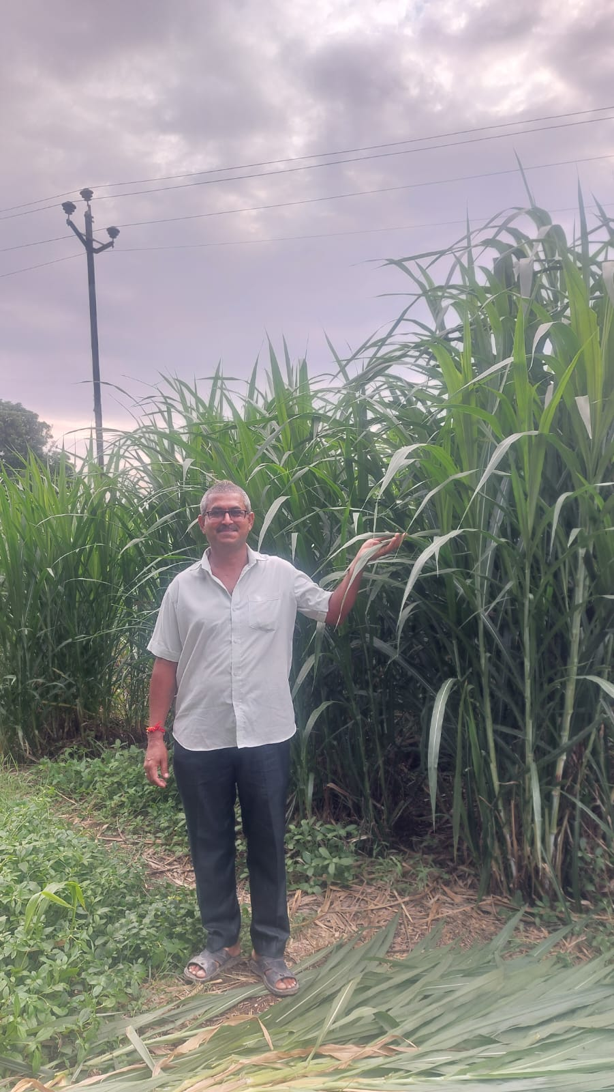
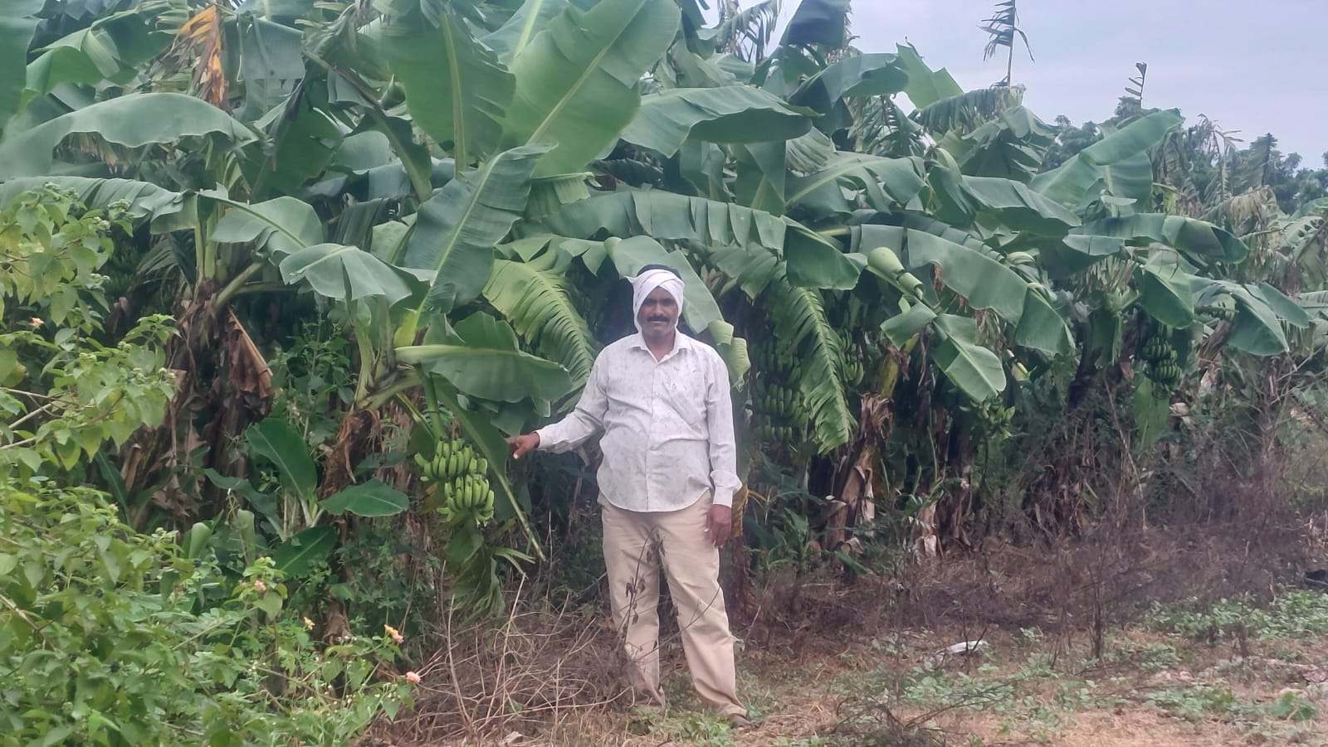
Farmer Challenges
Challenge #13
⚠️
"Early blight detected too late in my potato field. Lost half the harvest before I noticed."
Challenge #14
⚠️
"Overusing fertilizers trying to maximize yield. Soil getting degraded and production actually declining."

Slide 11
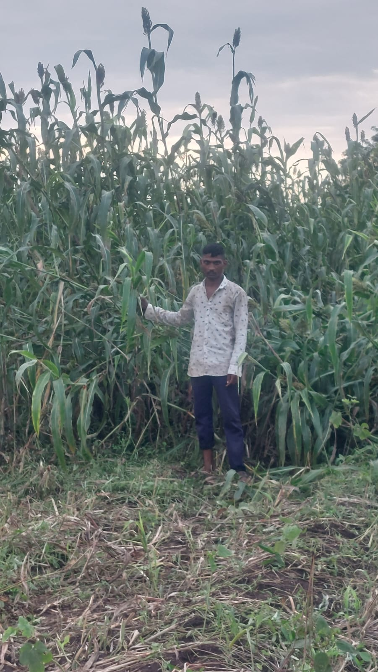
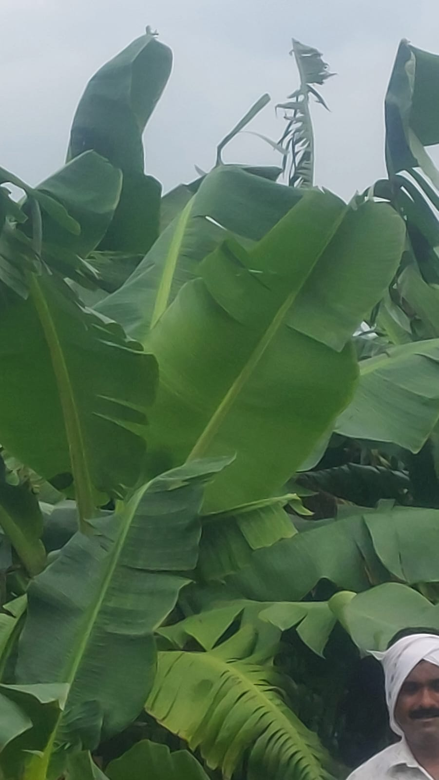
Farmer Challenges
Challenge #15
⚠️
"Can't identify if my plant problem is disease, pest, or nutrient deficiency. Expensive trial and error."
Challenge #16
⚠️
"Monsoon diseases hit suddenly. By the time advisor visits, it's too late. Need instant diagnosis."

Slide 12
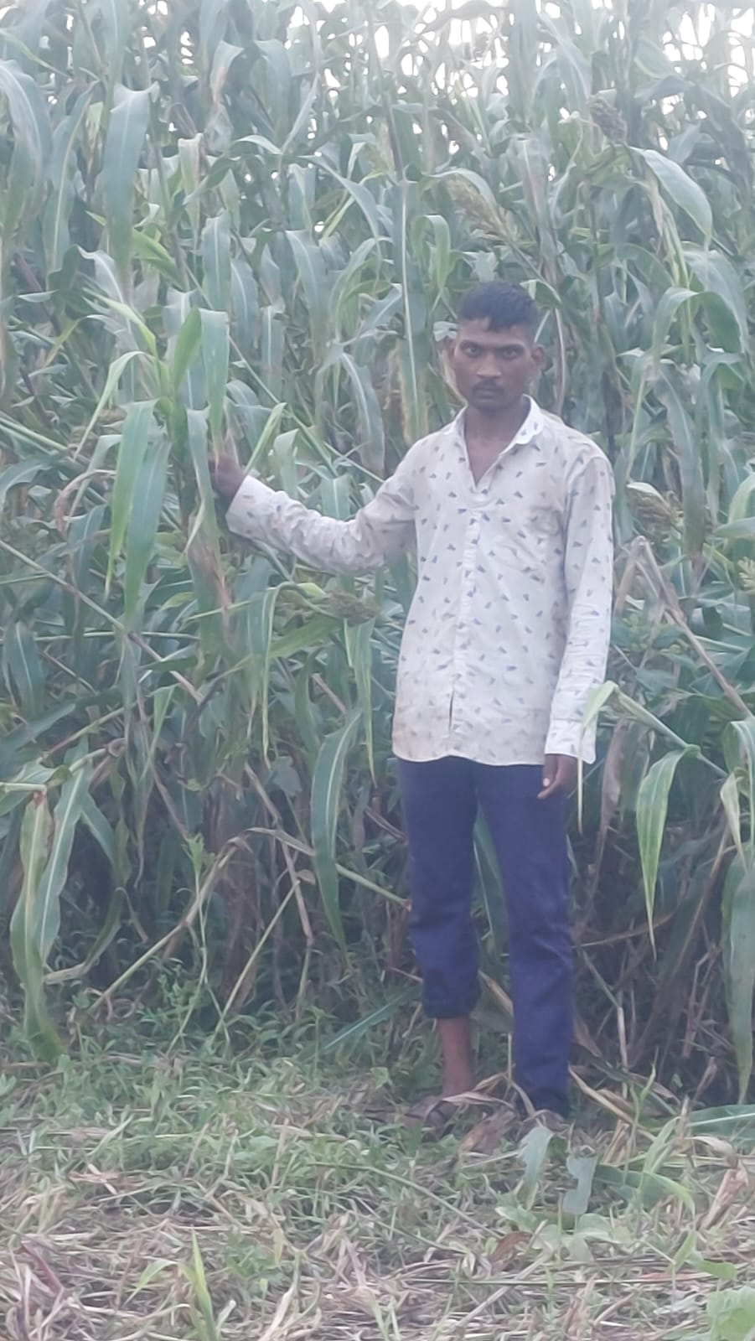
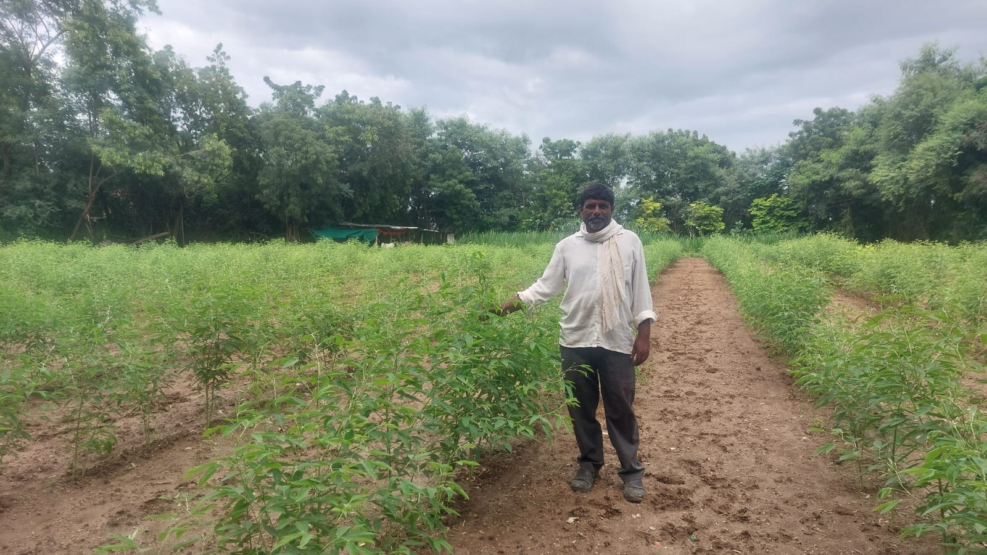
Farmer Challenges
Challenge #17
⚠️
"Spending on pesticides but still losing crops. Don't know optimal spray timing and dosage."
Challenge #18
⚠️
"Soil health declining. Can't afford detailed soil testing every season. Making blind decisions."

Slide 13
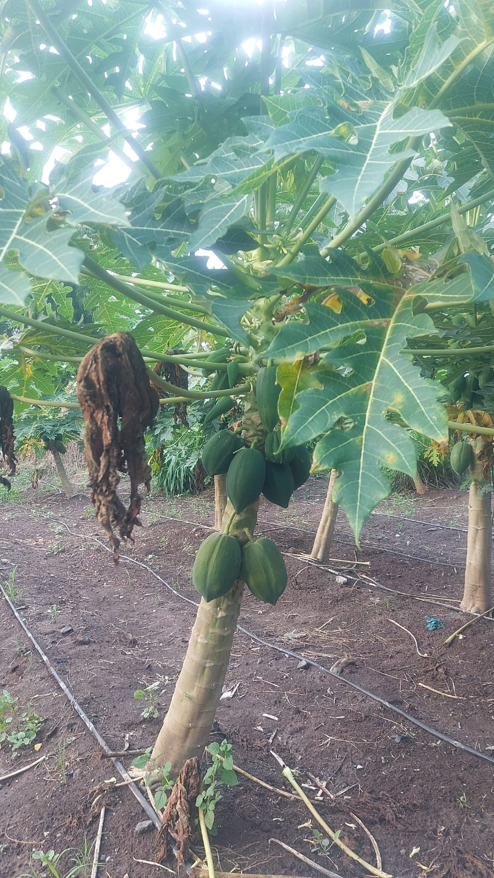
Farmer Challenges
Challenge #19
⚠️
"Need to know which crop suits my soil. Currently growing what neighbors grow, not what my land needs."

Slide 14
AgriVision AI Solution
Addressing Real Farmer Challenges with Technology
✓ Disease Detection - Prevent 30% yield losses
✓ Soil Guidance - Affordable nutrient recommendations
✓ Smart Irrigation - Reduce water waste
✓ 24/7 Expert Access - Eliminate consultant costs
Smart India Hackathon Project

