Slide 1
NexusBI
Version 6.0 · Enterprise Edition
Business Intelligence enterprises actually trust.
Replaces Tableau + dbt + Looker + Alation in one self-hosted platform.
Full workbook system. Dual-checker approval. Oracle-native.
262
41
46
27
Source Files
Oracle Tables
Permissions
Connectors

Slide 2
NexusBI
BY THE NUMBERS
NexusBI in numbers that
actually shipped.
262
27
41
46
Source Files
DB Connectors
Oracle Tables
Permissions
Real TypeScript
Postgres → ClickHouse
Full FK constraints
Server + client enforced
10
60+
6
16
Workbook Tables
API Endpoints
RBAC Roles
Invariants
Tableau equivalents
All audited
Admin → Embed
Architectural laws
01 · NexusBI v6

Slide 3
NexusBI
THE PROBLEM
Every enterprise has 5 BI tools.
None of them cooperate.
01
Fragmented stack
$420K/year on Tableau + dbt + Looker + Alation + homegrown approval scripts that nobody owns.
02
No real approval workflow
One-click publish. No dual-checker. No replay. SOX auditors are unhappy.
03
Credentials everywhere
Plaintext YAML files. Connection strings pasted in Jira. Secrets rotation is theoretical.
04
Performance is mystery
A dashboard is slow. Which widget? Which query? What pre-agg? You don't know.
05
Embedding is a second product
Different auth, different UI, different bug tracker. The vendor charges per embedded user.
02 · NexusBI v6

Slide 4
NexusBI
THE SOLUTION
One platform. One license.
Zero sprawl.
Step 1
Step 2
Step 3
Step 4
Step 5
Step 6
Connect
Define
Explore
Author
Review
Deliver
27 connectors
Cube.js semantic
Graphic Walker
Workbook editor
Dual-checker gate
Embed + export
From raw data to approved dashboard in one stack — no Tableau, no Looker, no separate workflow tool, no embed product.
03 · NexusBI v6

Slide 5
NexusBI
TECHNICAL ARCHITECTURE
Four-tier stack. Every call traced.
CLIENT TIER
React 19 · Next.js 15 App Router · Zustand · TanStack Query · React Grid Layout · ECharts 5 · AG-Grid · Graphic Walker · Monaco Editor
HTTPS / WSS
API TIER
60+ Next.js Route Handlers · NextAuth v5 (JWT sessions) · Zod validation · RBAC middleware · Audit logger · withAudit wrapper
HTTP → Oracle thin
ANALYTICS TIER
Cube.js 0.36 · 16 database drivers · Dynamic driverFactory · repositoryFactory (Oracle-backed) · Pre-aggregation engine · Query cache
HTTP (internal)
DATA TIER
Oracle 19c+ · 41 tables · CLOB for JSON · NB_STG_* staging tables (replaces DuckDB) · In-memory LRU cache · Local FS storage
TCP 1521 (Oracle Net)
16 architectural invariants enforced at compile time and runtime: ORG_ID scoping on every query · No credential in logs · bcrypt 12 rounds · AES-256-GCM at rest
04 · NexusBI v6

Slide 6
NexusBI
DATA FLOW ARCHITECTURE
From raw connection to rendered widget.
DATA
SOURCES
CREDENTIAL
VAULT
CUBE.JS
QUERY
CACHE
API
ROUTES
REACT
DASHBOARD
27 connectors
AES-256-GCM
Semantic layer
10K LRU
60+ endpoints
Builder + viewer
INGEST PIPELINE
File upload (CSV/Excel/Parquet/JSON) → CREATE TABLE NB_STG_<id> in Oracle → batch INSERT → Cube schema auto-generation
API SOURCE PIPELINE
REST poll / GraphQL / Webhook / OAuth → JMESPath transform → Oracle staging table NB_STG_API_<id> → dashboard binding
EXPORT PIPELINE
Dashboard → Puppeteer render (1920×1080 @2x) → PNG/PDF binary → download or SMTP email attachment
WEBHOOK PIPELINE
Approval event → JWT-signed payload → HTTP POST → 3 retries with exponential backoff → NB_WEBHOOK_DELIVERY_LOG
05 · NexusBI v6

Slide 7
NexusBI
BUSINESS ARCHITECTURE
Governance-first by design.
DATA GOVERNANCE MODEL
APPROVAL & ACCESS MODEL
Multi-Tenant Isolation
Dual-Checker Workflow
Every row scoped by ORG_ID. Oracle FK constraints across all 41 tables.
DRAFT → PENDING → SLOT 1 ✓ → SLOT 2 ✓ → APPROVED. Self-approval blocked.
Credential Vault
6-Role RBAC
AES-256-GCM at rest. Decrypted only server-side in driverFactory. Never logged.
PLATFORM_ADMIN (46) → DS_ADMIN (18) → AUTHOR (27) → CHECKER (6) → VIEWER (5) → EMBED_ONLY (1).
Immutable Audit Trail
Viewer Restrictions
Every API call → NB_AUDIT_LOG. SOC 2 / ISO 27001 ready.
Viewer sees ONLY explicitly shared dashboards. No "all approved" fallback.
Data Lineage
Embed Security
DataSource → CubeSchema → Dashboard → Widget. Queryable for impact analysis.
JWT-signed tokens. Per-dashboard filter restrictions. Row-level security via Cube.js.
06 · NexusBI v6

Slide 8
NexusBI
APPROVAL WORKFLOW
The dashboard that cleared compliance.
DRAFT
PENDING
SLOT 1 ✓
SLOT 2 ✓
APPROVED
Reject → REJECTED
Edit → resets to DRAFT
INVARIANTS
1.
Two distinct checker IDs required for dual-checker dashboards
2.
Self-approval blocked at API layer (returns 403)
3.
Rejection requires mandatory comments (returns 422 if empty)
4.
Immutable snapshot captured on APPROVED state transition
5.
Any subsequent edit resets approval_status to DRAFT
6.
Outbound webhook fires on every APPROVE / REJECT / SUBMIT event
07 · NexusBI v6

Slide 9
NexusBI
RBAC MODEL
6 roles. 46 permissions. Zero ambiguity.
PLATFORM
ADMIN
DS
ADMIN
AUTHOR
CHECKER
VIEWER
EMBED
ONLY
46
18
27
6
5
1
permissions
permissions
permissions
permissions
permissions
permissions
PERMISSION CATEGORIES
· datasource (4)
· schema (3)
· explorer (1)
· dashboard (10)
· workbook (5)
· story (3)
· lineage (1)
· tableau (1)
· audit (1)
· admin (3)
· webhook (1)
· preagg (1)
· template (3)
· file (1)
· api_source (1)
· perf (1)
· report (1)
· embed (1)
· replay (1)
· share (1)
08 · NexusBI v6

Slide 10
NexusBI
TABLEAU REPLACEMENT
Workbook system with full feature parity.
TABLEAU
NEXUSBI EQUIVALENT
Workbook (.twbx)
→
Workbook
Worksheet (chart sheet)
→
Worksheet
Calculated Field
→
Calculated Field
Parameter
→
Parameter
Story
→
Story + Story Points
Dashboard Action
→
Dashboard Action
Sets / Groups
→
Data Set / Data Group
Data Extract
→
Data Extract → Oracle
Marks card
→
Worksheet Shelves (color/size/label/tooltip)
Filters / Pages
→
WorksheetFilter[] (include/exclude/range/top_n)
Reference Lines
→
ReferenceLine[]
Annotations
→
Annotation[]
09 · NexusBI v6

Slide 11
NexusBI
WORKBOOK → DASHBOARD FLOW
How a Maker takes work to production.
1. Create
AUTHOR creates workbook in /workbooks. Adds 1+ worksheets with chart type, cube, shelves.
2. Define
Adds calculated fields (custom SQL) and parameters (user-input variables) per workbook.
3. Publish
POST /api/workbooks/{id}/publish creates a DRAFT dashboard with widgets from each worksheet.
4. Submit
AUTHOR submits dashboard for review. Approval status becomes PENDING_REVIEW.
5. Approve
Two CHECKERs (or one if not dual-checker) approve. Status becomes APPROVED. Visible to shared VIEWERs only.
10 · NexusBI v6

Slide 12
NexusBI
DATABASE SCHEMA
41 Oracle tables. Grouped by domain.
IDENTITY & ACCESS
NB_USERS · NB_ORGANIZATIONS · NB_ROLES · NB_PERMISSIONS · NB_USER_ROLES · NB_ROLE_PERMISSIONS
6 tables
DATA SOURCES
NB_DATA_SOURCES · NB_API_SOURCES · NB_FILE_UPLOADS · NB_CUBE_SCHEMAS · NB_COLUMN_TAGS · NB_LINEAGE_EDGES
6 tables
DASHBOARDS & APPROVAL
NB_DASHBOARDS · NB_DASHBOARD_VERSIONS · NB_DASHBOARD_REVIEWS · NB_REVIEW_ASSIGNMENTS · NB_DASHBOARD_SHARES · NB_APPROVAL_SNAPSHOTS · NB_REJECTION_REASONS · NB_NL_FILTER_HISTORY · NB_MOBILE_LAYOUTS
9 tables
WORKBOOK SYSTEM
NB_WORKBOOKS · NB_WORKSHEETS · NB_CALCULATED_FIELDS · NB_PARAMETERS · NB_STORIES · NB_STORY_POINTS · NB_DASHBOARD_ACTIONS · NB_DATA_EXTRACTS · NB_DATA_SETS · NB_DATA_GROUPS
10 tables
OPERATIONS
NB_AUDIT_LOG · NB_WEBHOOK_DELIVERY_LOG · NB_PERFORMANCE_METRICS · NB_PRE_AGGREGATIONS · NB_TIMED_ACCESS_GRANTS · NB_PLATFORM_CONFIG · NB_TEMPLATES · NB_REPORTS · NB_REPORT_DELIVERIES · NB_TABLEAU_IMPORTS
10 tables
11 · NexusBI v6

Slide 13
NexusBI
27 CONNECTORS
One unified query layer. All connectors → Cube.js.
Relational (5)
PostgreSQL · MySQL · Microsoft SQL Server · Oracle · SQLite
Cloud Data Warehouse (4)
Snowflake · BigQuery · Redshift · Databricks
Columnar & Lakehouse (8)
Athena · Hive · Spark SQL · Impala · Presto · Trino · ClickHouse · MongoDB
File Sources (4)
CSV · Excel · Parquet · JSON · all → Oracle staging tables (NB_STG_*)
API Sources (5)
REST polling · GraphQL · Webhook ingest · OAuth REST · DuckDB-compat (now Oracle)
12 · NexusBI v6

Slide 14
NexusBI
SECURITY POSTURE
Built for regulated industries.
Encryption
Authentication
AES-256-GCM at rest
bcrypt 12 rounds for passwords
TLS 1.3 in production
No credentials in logs
NextAuth v5 + JWT sessions
Password strength validation
HTTP-only secure cookies
Session rotation
Audit & Compliance
Multi-Tenancy
Every API endpoint audited
Sanitized payloads (PII redacted)
Duration + IP + status captured
SOC 2 / ISO 27001 ready
ORG_ID scoping on every query
Row-level security via Cube.js
Per-role datasource ACLs
Viewer share gates
13 · NexusBI v6

Slide 15
NexusBI
PERFORMANCE
Fast by default. Transparent when not.
287ms
1,240ms
94%
500+
P50 Widget Load
P95 Widget Load
Cache Hit Rate
Concurrent Users
PERFORMANCE OPTIMIZATION CASE STUDY
BEFORE
AFTER
2.1s
315ms
→ Applied pre-aggregation →
Funnel Analysis · P95
refresh: 0 2 * * * (daily 2am)
85% improvement · 6.7× faster
14 · NexusBI v6

Slide 16
NexusBI
9 DIFFERENTIATORS
Features no other BI tool does well.
#01
#02
#03
Approval Replay
Performance Scorecard
Mobile Layout Editor
Snapshot-based read-only replay of every approved version
P50/P95/P99 per widget with pre-agg recommendations
Dedicated 375px editor with auto-generate from desktop
#04
#05
#06
NL Filters
Smart Refresh
Outbound Webhooks
English → CubeFilter[] with confidence scoring
Query heatmap → cron generation for pre-aggregations
JWT-signed · 3 retries · exponential backoff
#07
#08
#09
Template Marketplace
Timed Access Grants
Tableau Import
Publish/install with datasource remapping
Auto-expiring grants — no manual revocation needed
.twbx parsing → workbook + worksheet mapping
15 · NexusBI v6

Slide 17
NexusBI
DEPLOYMENT
npm install. That's it.
TERMINAL
$ git clone <repo> nexusbi && cd nexusbi
$ npm install
$ npm run generate:secrets # uses Node crypto, no openssl
$ npm run dev # starts Next.js (3000) + Cube.js (4000)
REMOVED IN v6 (no longer required)
✕ Docker
✕ Redis
✕ MinIO / S3
No Compose, no images
In-memory LRU cache
Local filesystem
✕ DuckDB
✕ OpenSSL
✕ Python
Oracle staging tables
Node.js crypto module
Pure Node toolchain
16 · NexusBI v6

Slide 18
NexusBI
NEXT STEPS
Pilot today. Production in 30 days.
WEEK 1
WEEK 2
WEEK 3
WEEK 4
Setup & Connect
Migrate
Onboard
Scale
· npm install + Oracle seed
· Import existing Tableau .twbx
· Train AUTHORs on workbook editor
· Embed in customer portal
· Connect 1-3 data sources
· Migrate top 5 dashboards
· Train CHECKERs on review queue
· Set up scheduled reports
· Define first cube schema
· Set up dual-checker workflow
· Set up audit log review
· Apply pre-aggregations
· First admin login
· Configure RBAC roles
· Configure outbound webhooks
· Production cutover
17 · NexusBI v6

Slide 19
NexusBI
GET STARTED
Stop buying BI tools. Start owning one.
30-day pilot · No commitment · Full platform · Your data · Dedicated engineer
Start 30-Day Pilot →
Book 30-min Demo
18 · NexusBI v6

Slide 20
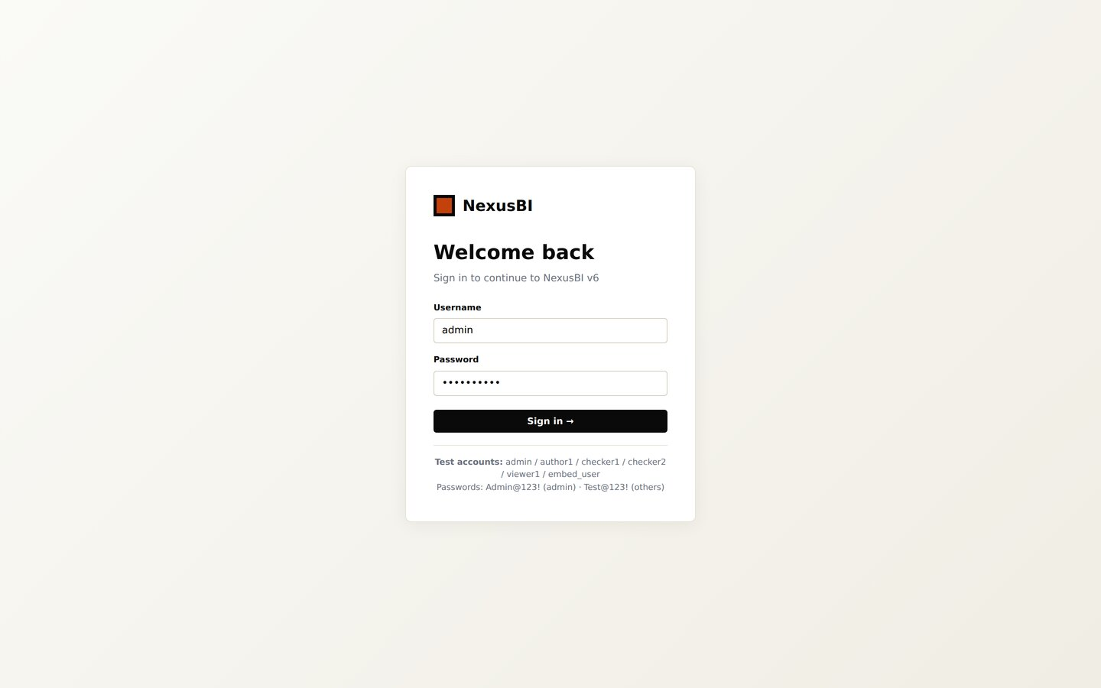
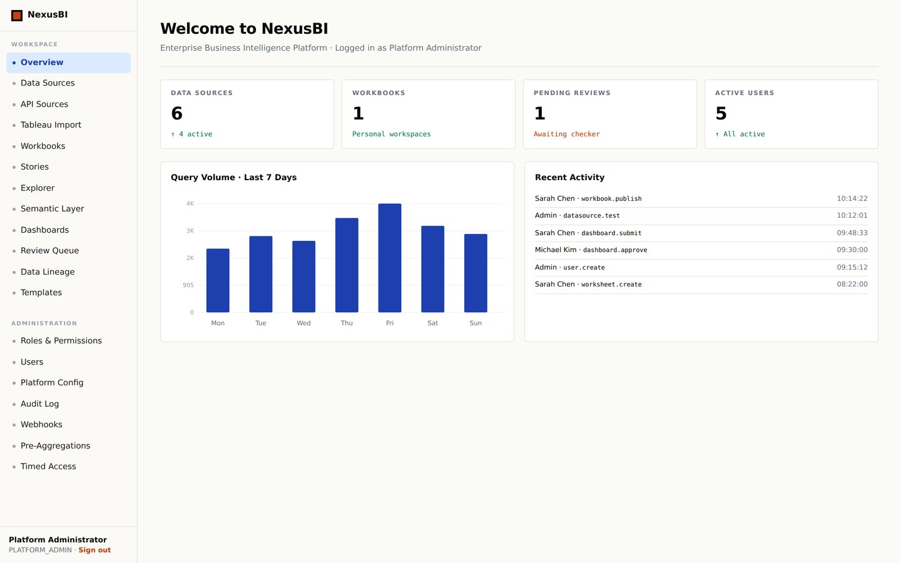
NexusBI
APPENDIX · LOGIN & WORKSPACE OVERVIEW
Login (NextAuth + bcrypt)
Platform Overview
19 · NexusBI v6

Slide 21
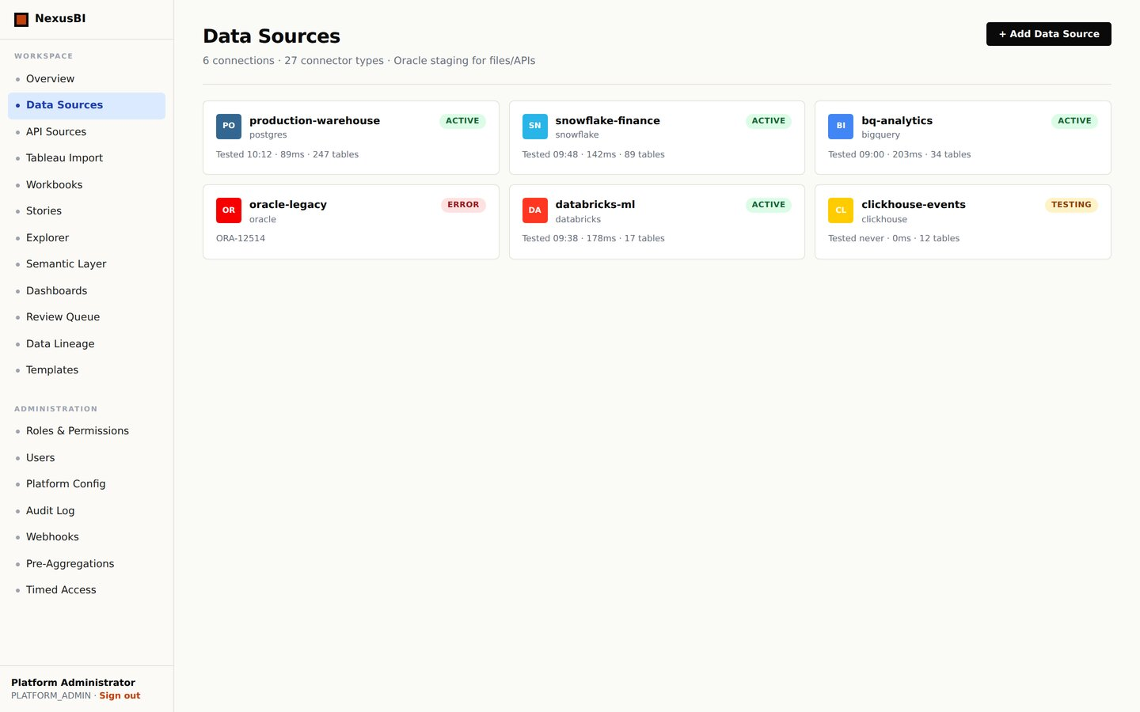
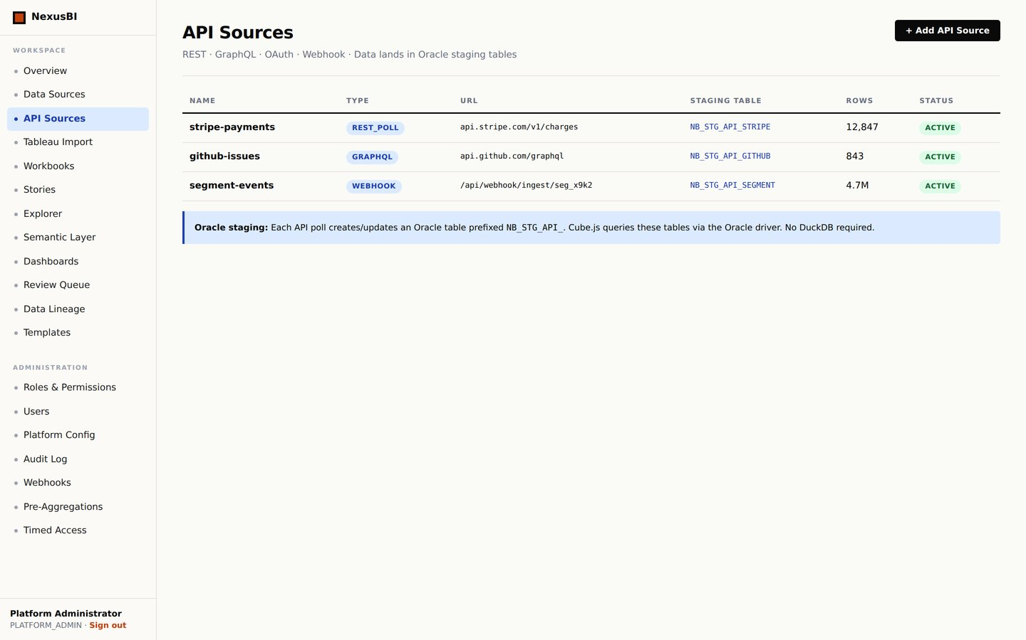
NexusBI
APPENDIX · DATA CONNECTIONS
Data Sources (27 Connectors)
API Sources → Oracle Staging
20 · NexusBI v6

Slide 22
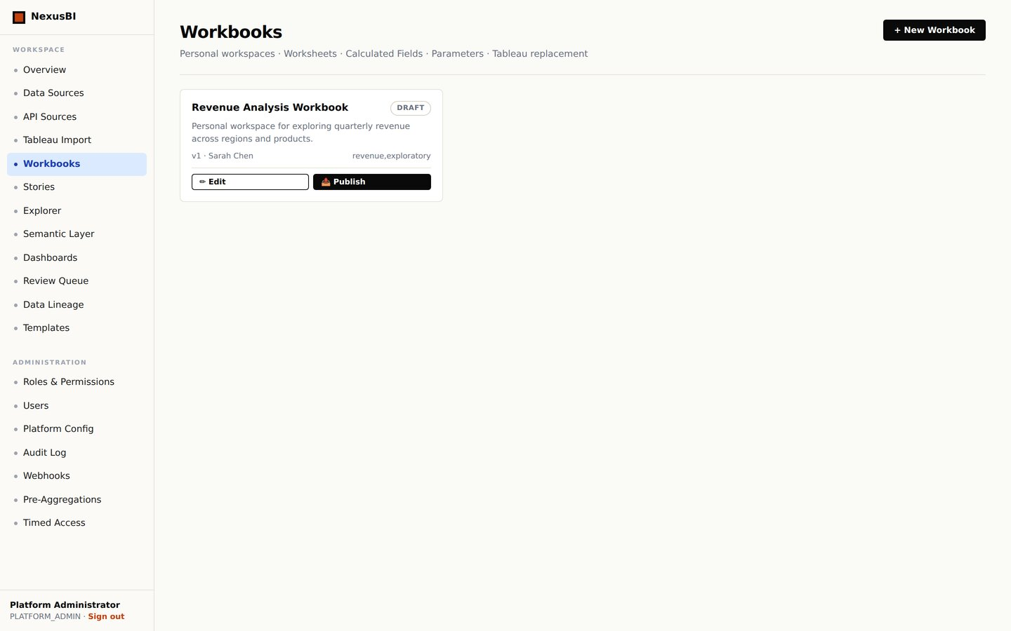
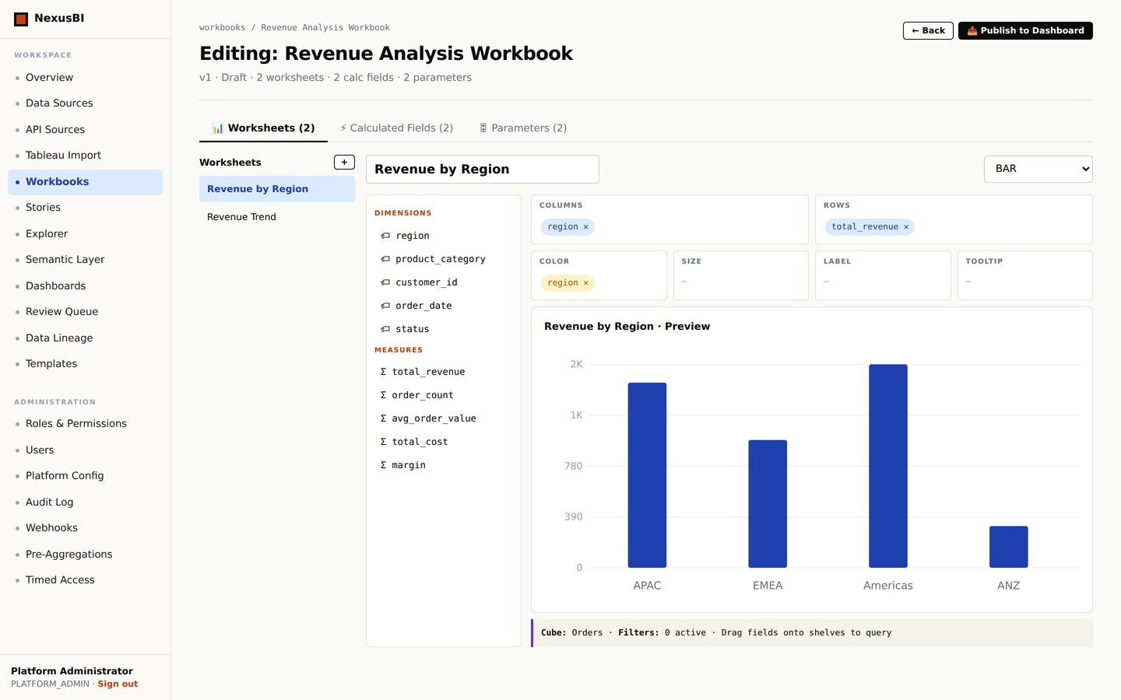
NexusBI
APPENDIX · WORKBOOK SYSTEM (TABLEAU REPLACEMENT)
Workbooks (Tableau Replacement)
Workbook Editor — Worksheets Tab
21 · NexusBI v6

Slide 23
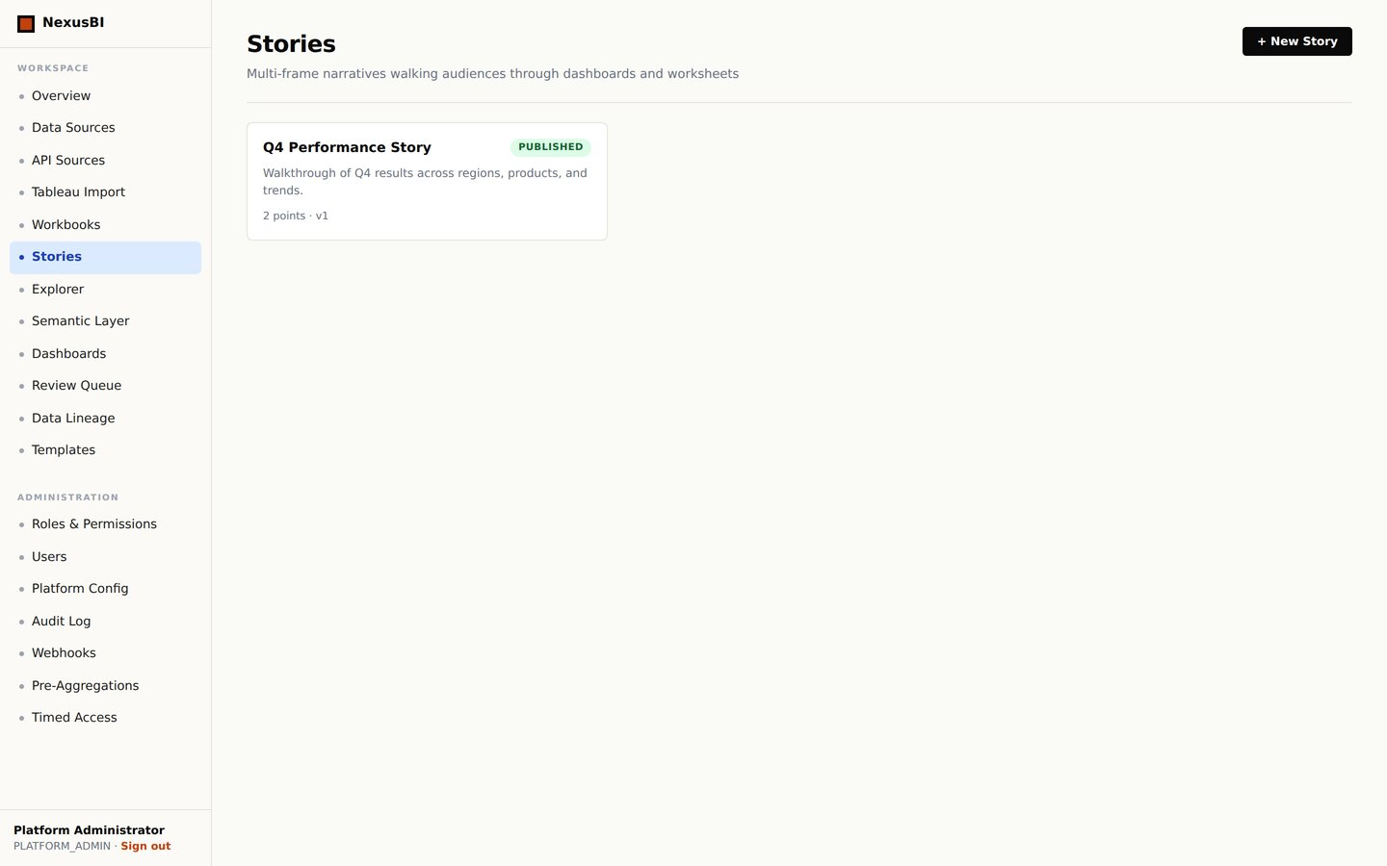
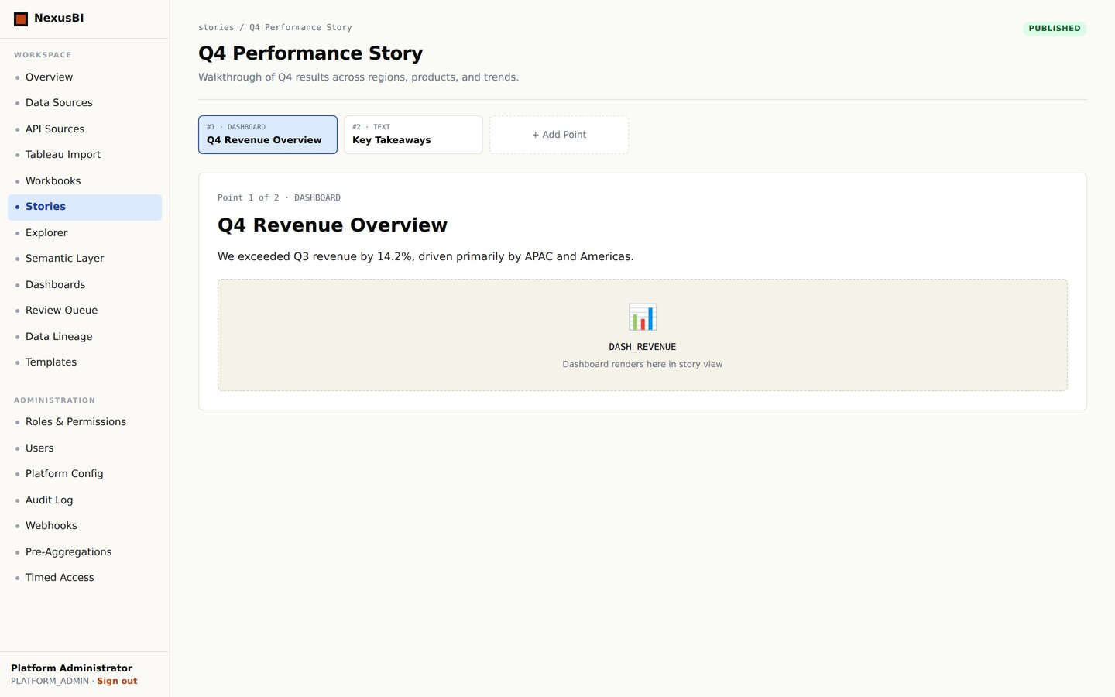
NexusBI
APPENDIX · STORIES (MULTI-FRAME NARRATIVES)
Stories — Multi-Frame Narratives
Story Detail with Filmstrip
22 · NexusBI v6

Slide 24
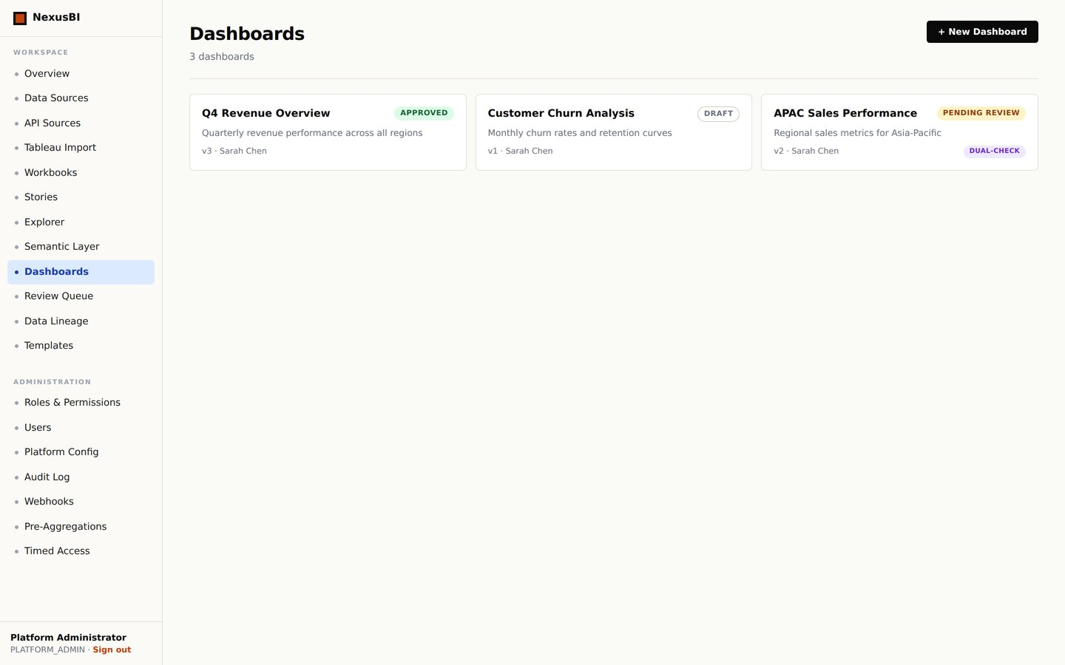
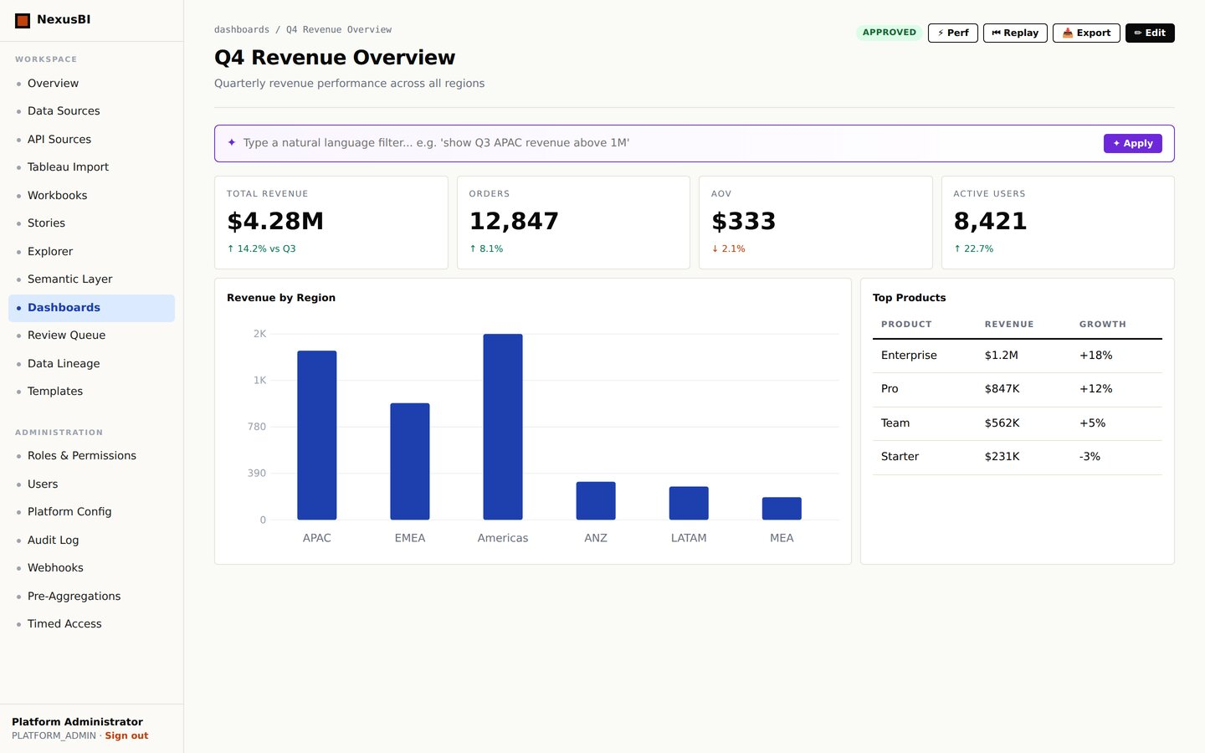
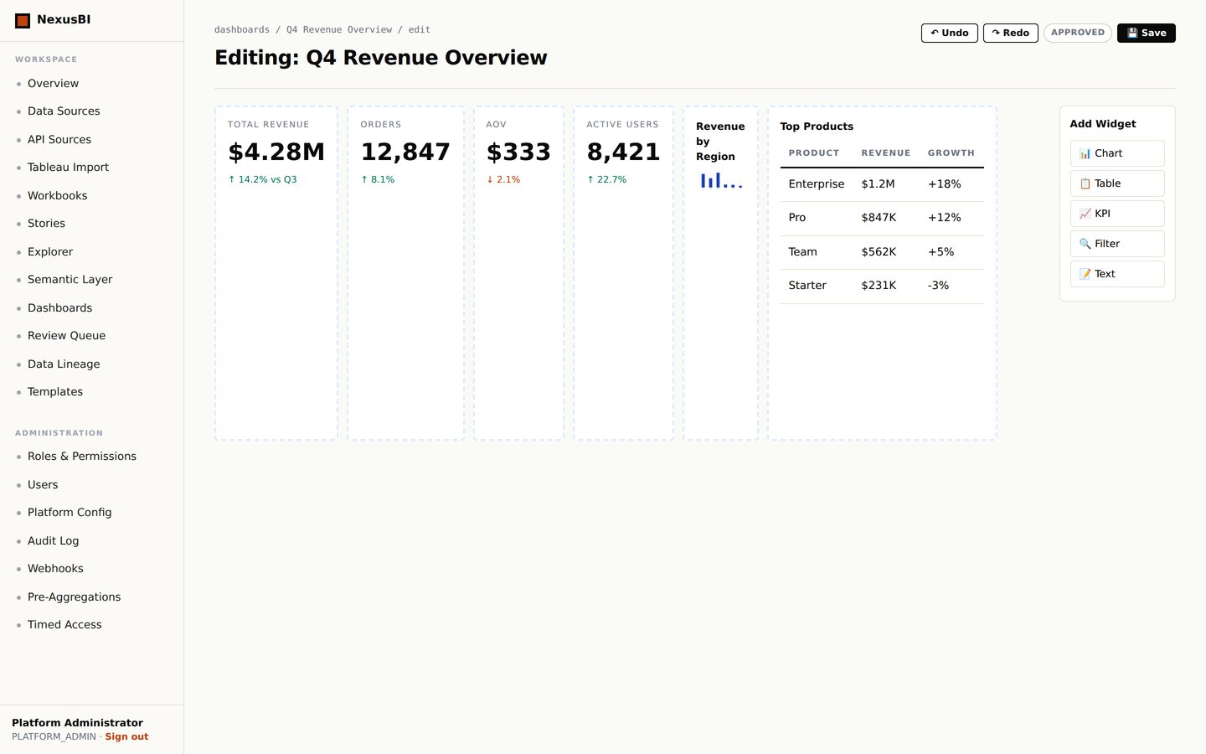
NexusBI
APPENDIX · DASHBOARD VIEWING & EDITING
Dashboard List
Dashboard View — Q4 Revenue
Dashboard Builder (Edit Mode)
23 · NexusBI v6

Slide 25
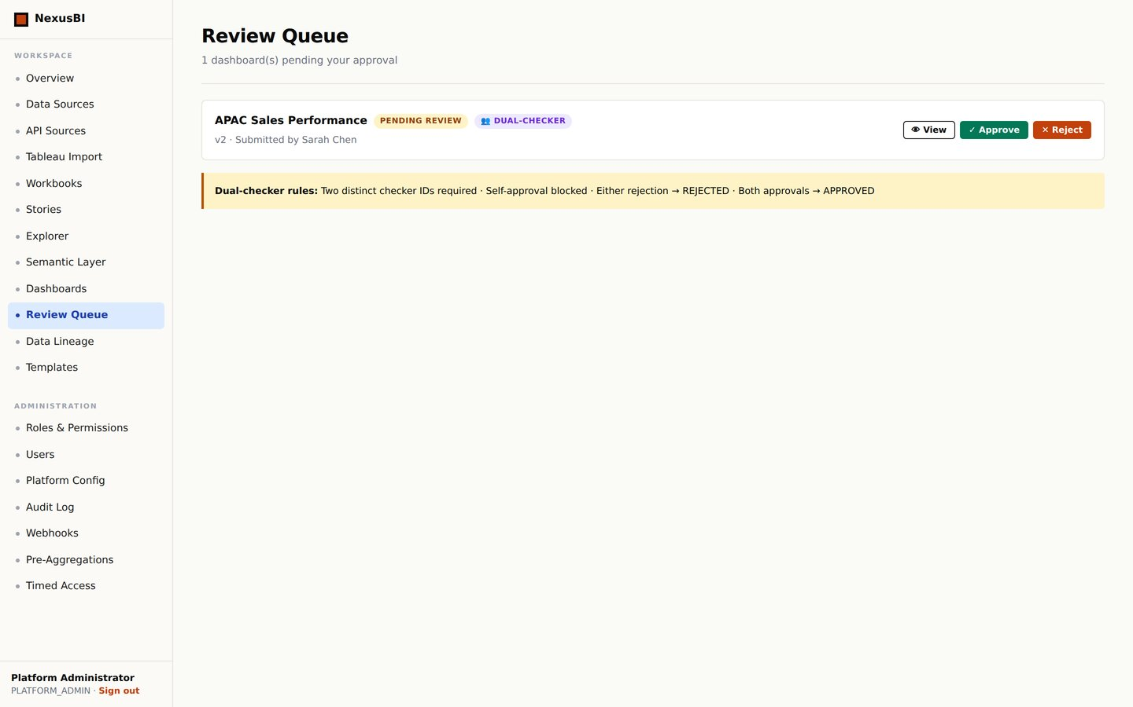
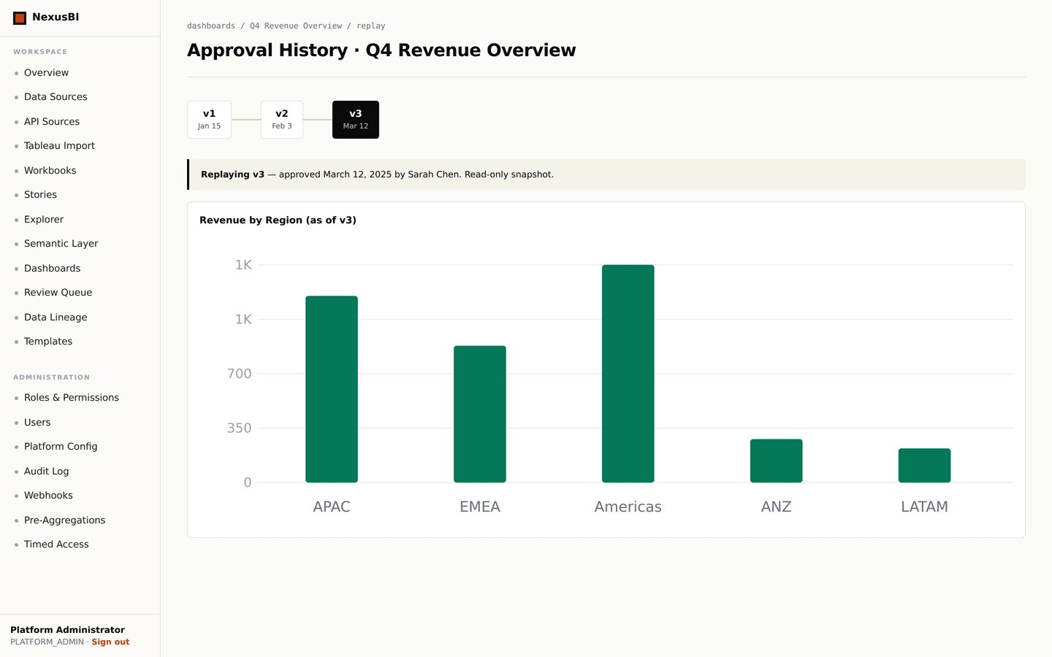
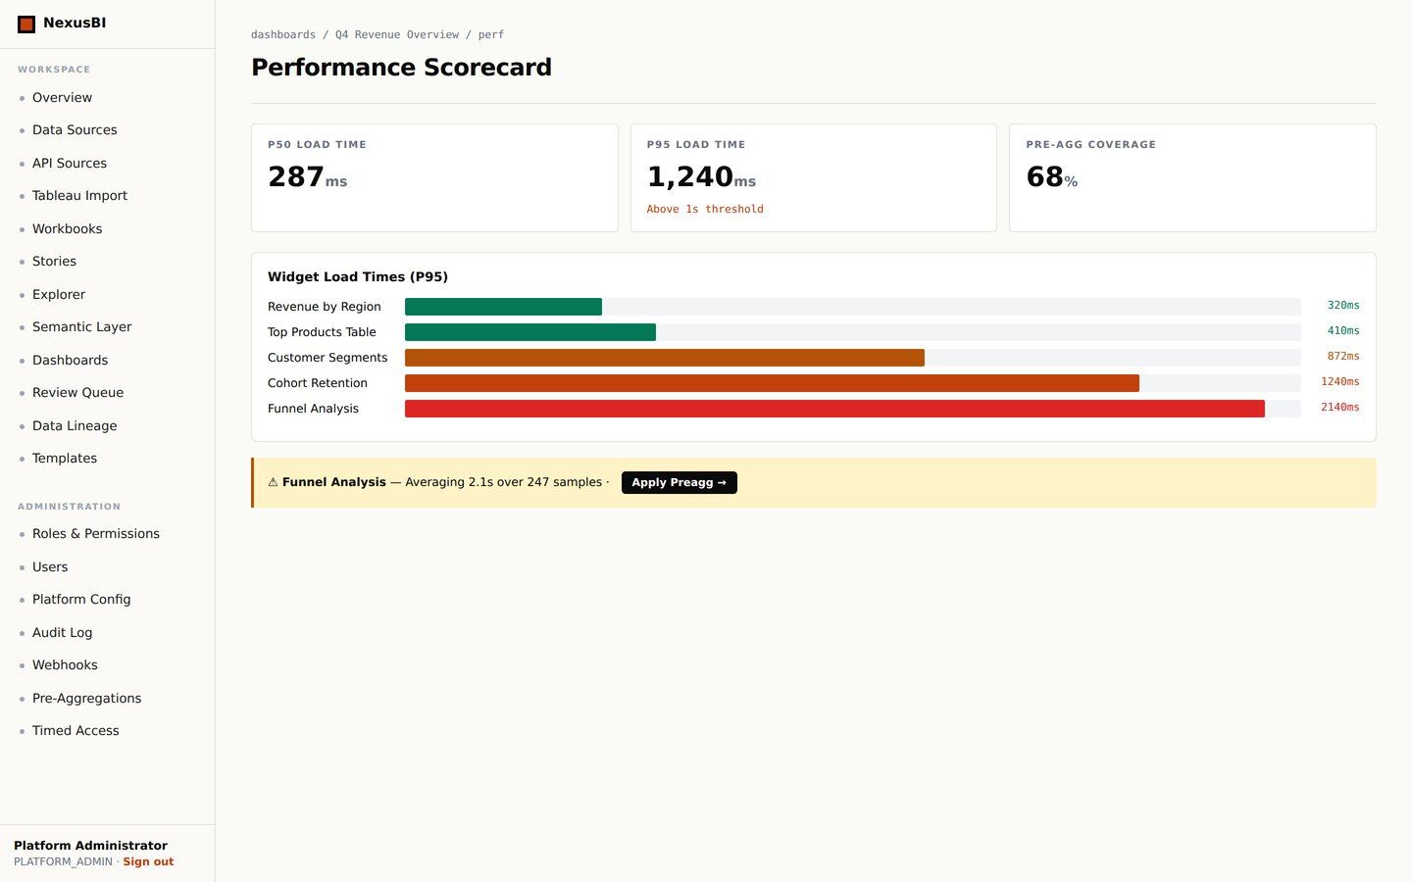
NexusBI
APPENDIX · GOVERNANCE & APPROVAL WORKFLOW
Review Queue (Dual-Checker)
Approval Replay Timeline
Performance Scorecard (P95)
24 · NexusBI v6

Slide 26
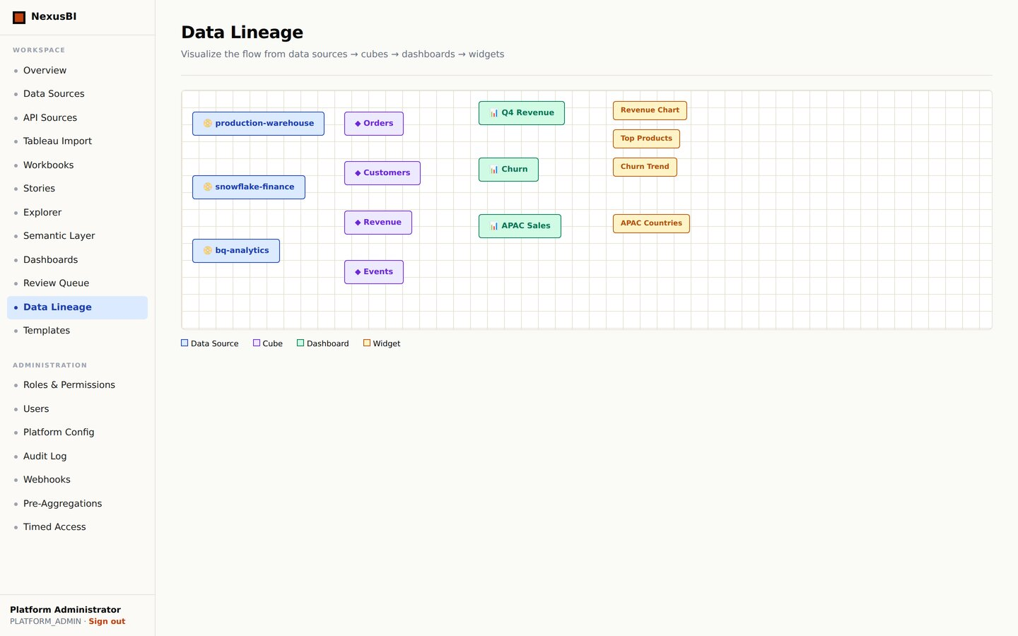
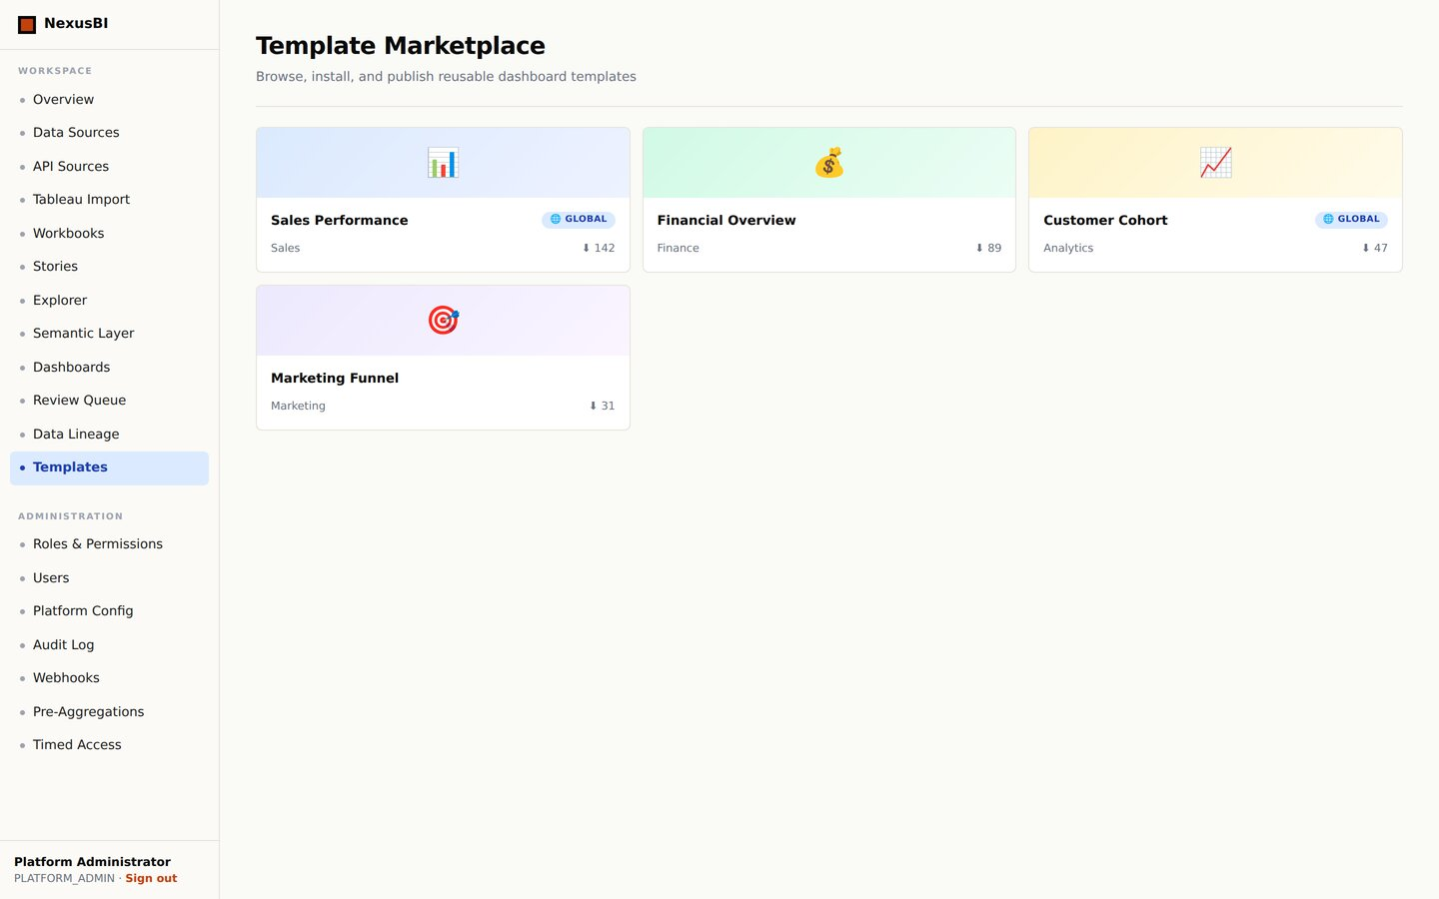
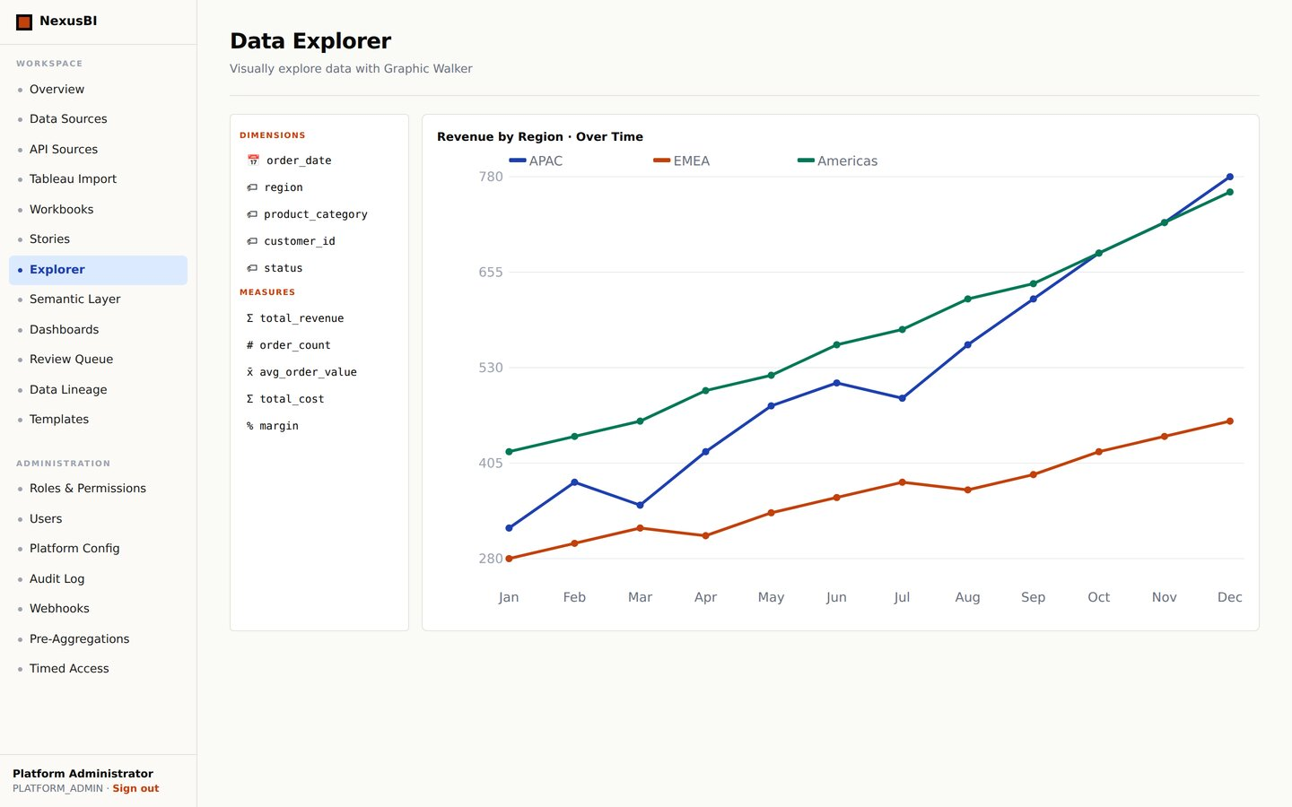
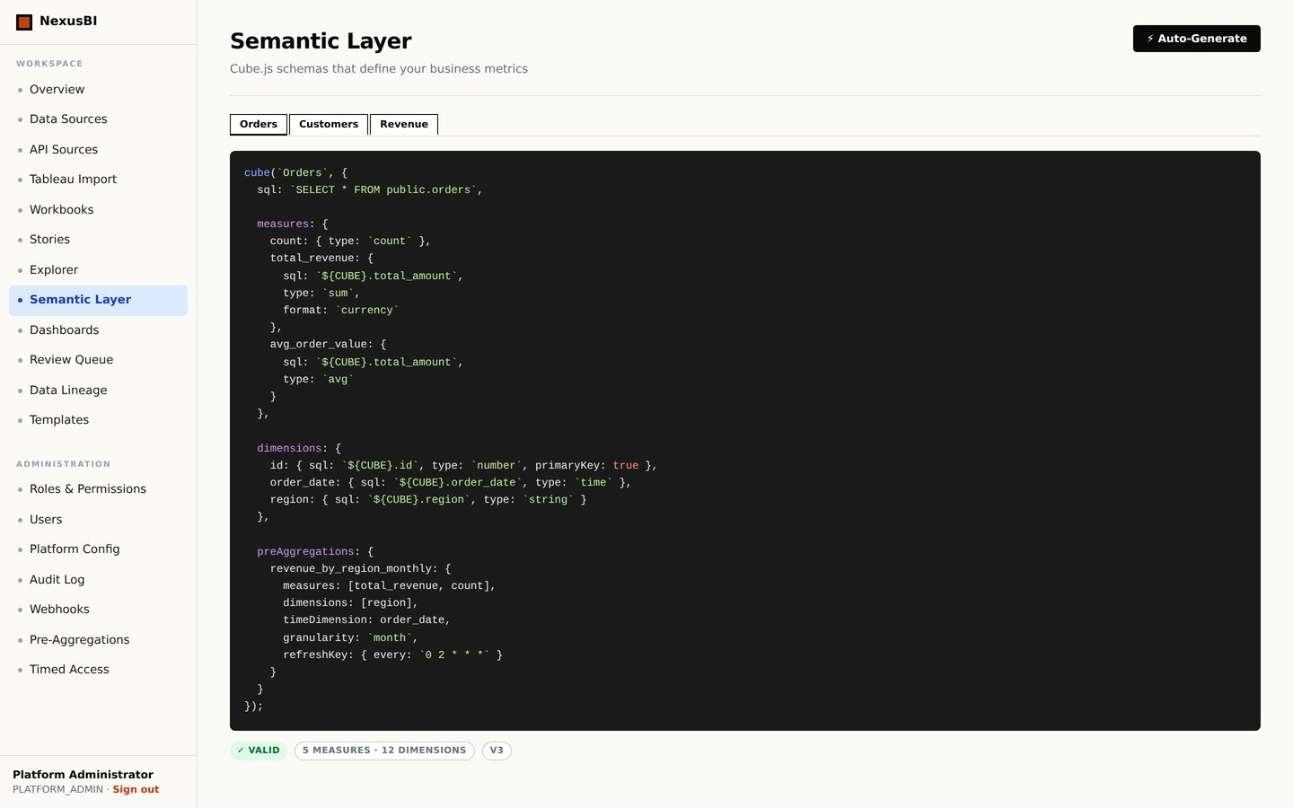
NexusBI
APPENDIX · EXPLORE · SEMANTIC LAYER · LINEAGE
Data Lineage Graph
Template Marketplace
Data Explorer
Semantic Layer (Cube.js)
25 · NexusBI v6

Slide 27
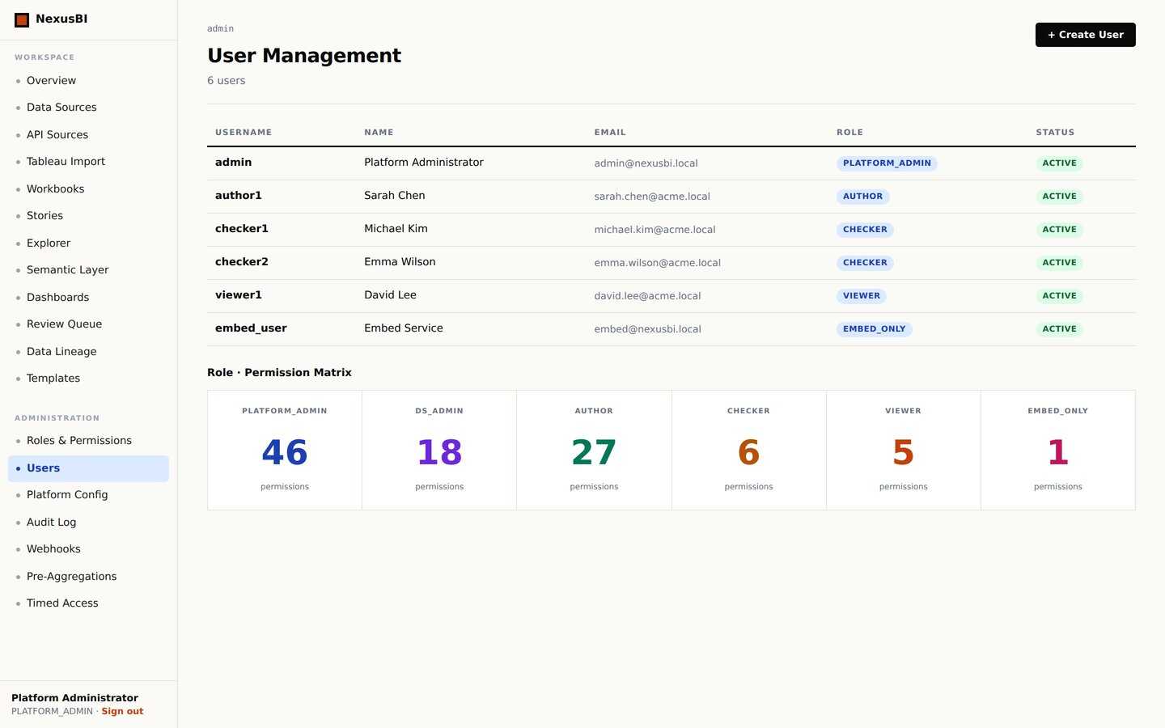
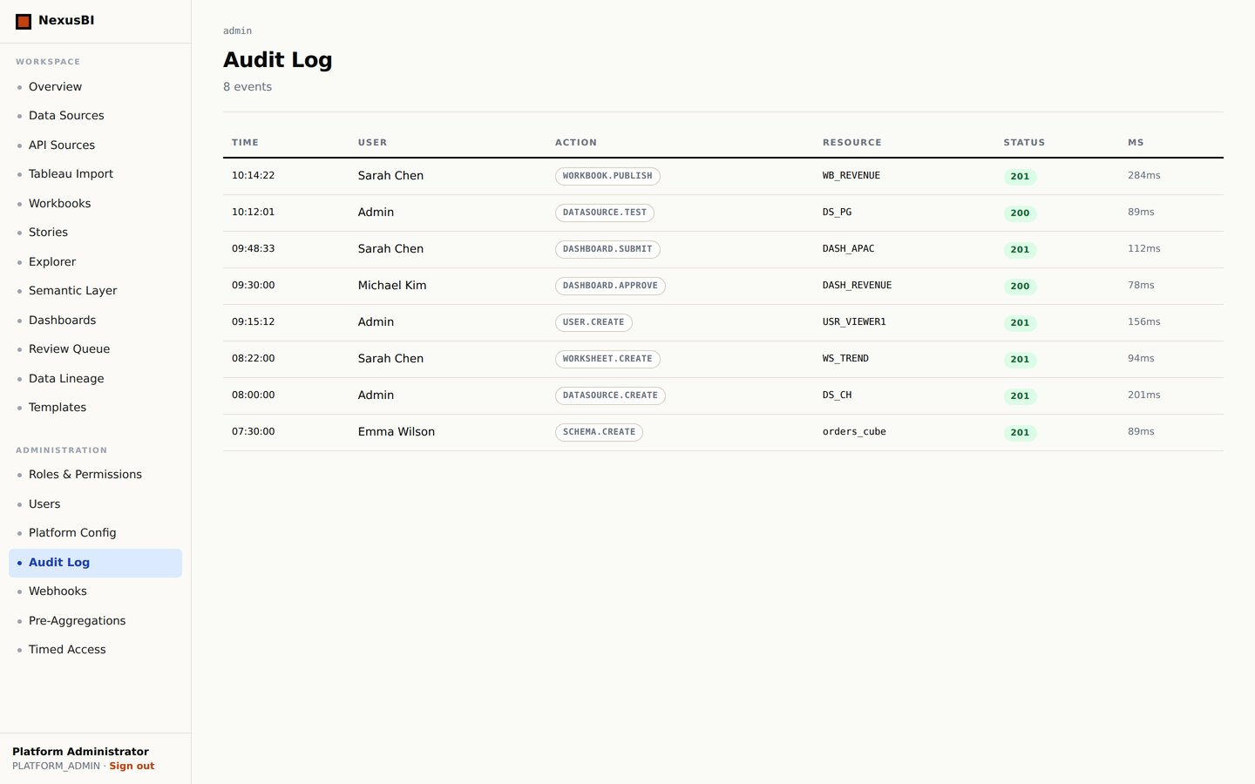
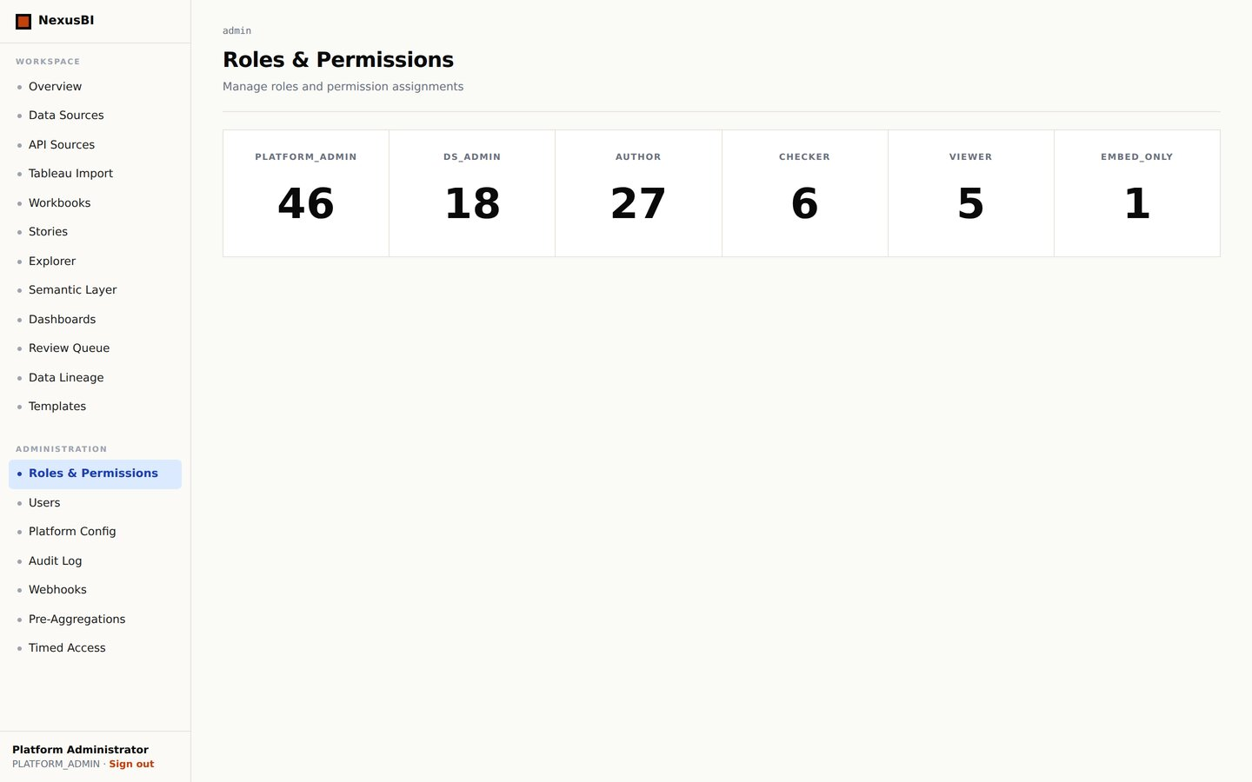
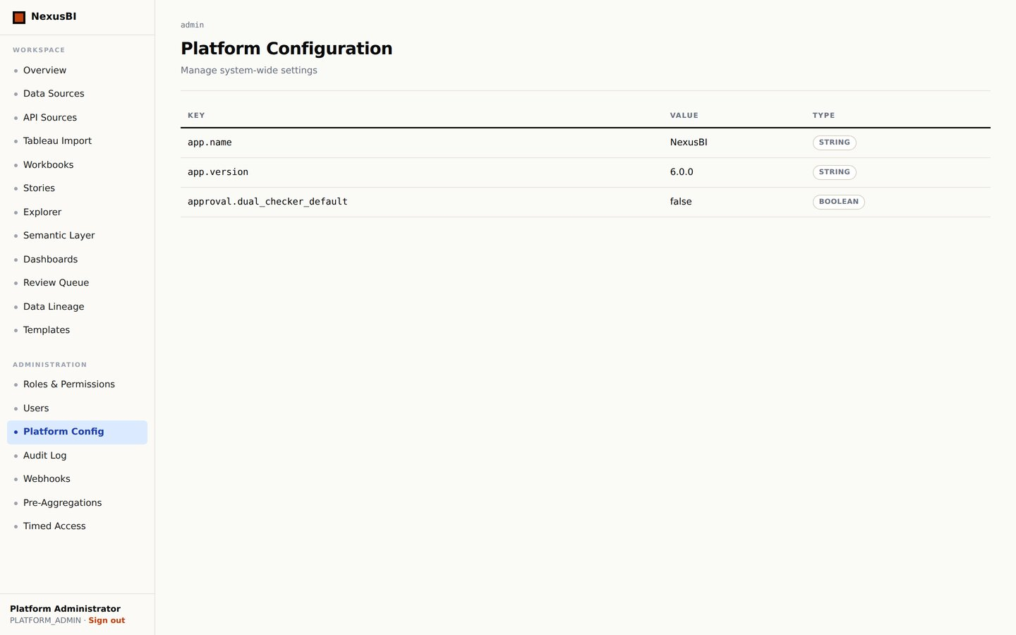
NexusBI
APPENDIX · ADMIN: USERS · AUDIT · CONFIG
Admin: Users & RBAC Matrix
Admin: Audit Log
Admin: Roles & Permissions
Admin: Platform Config
26 · NexusBI v6

Slide 28
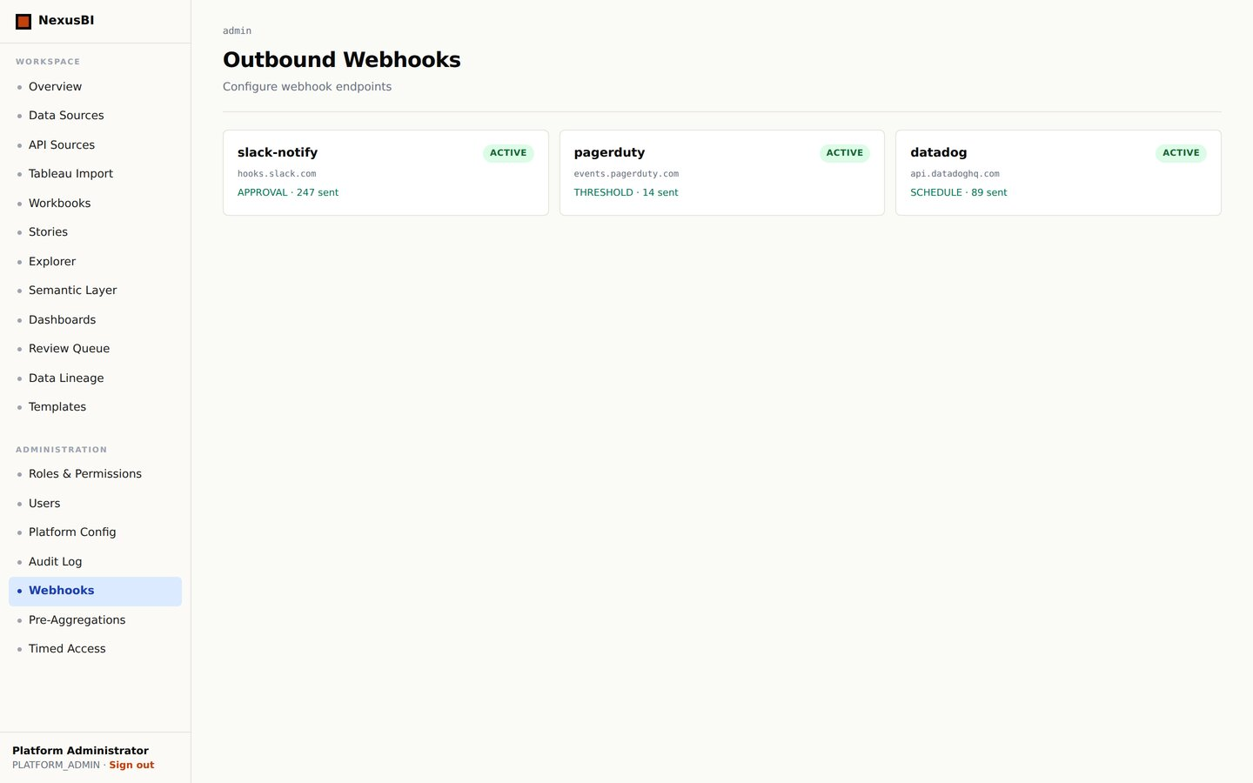
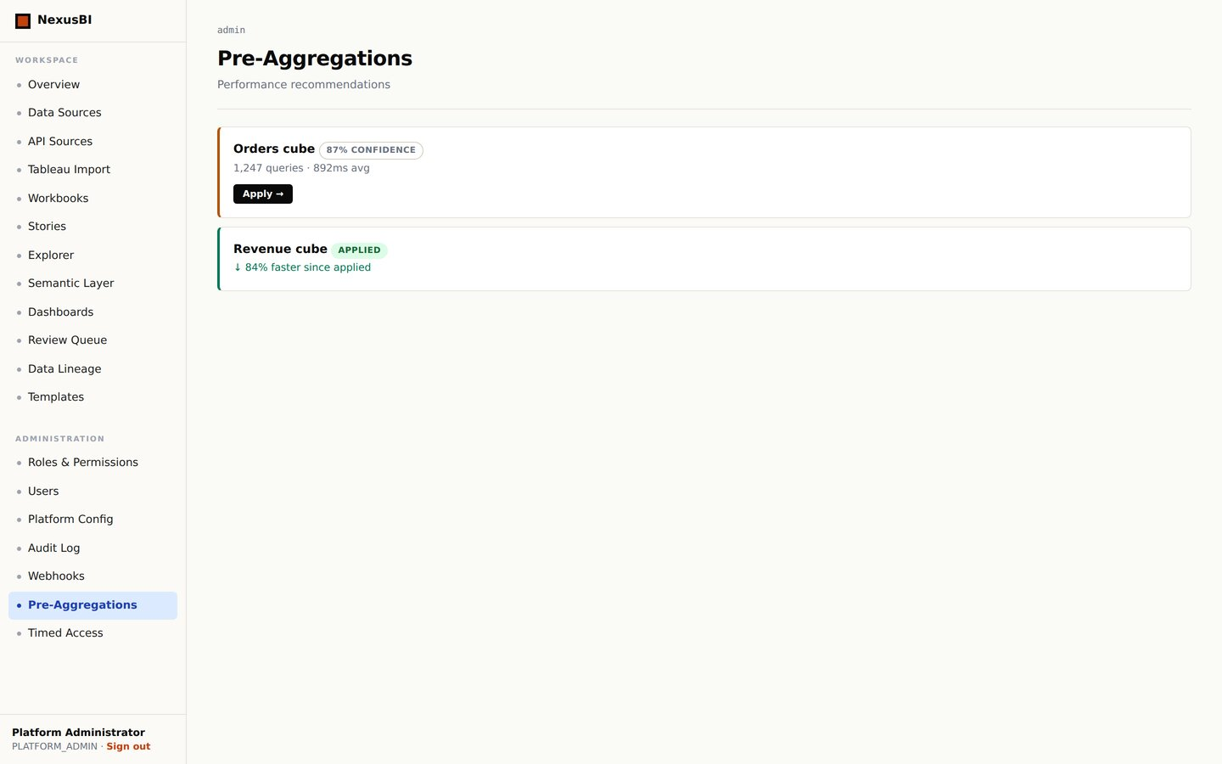
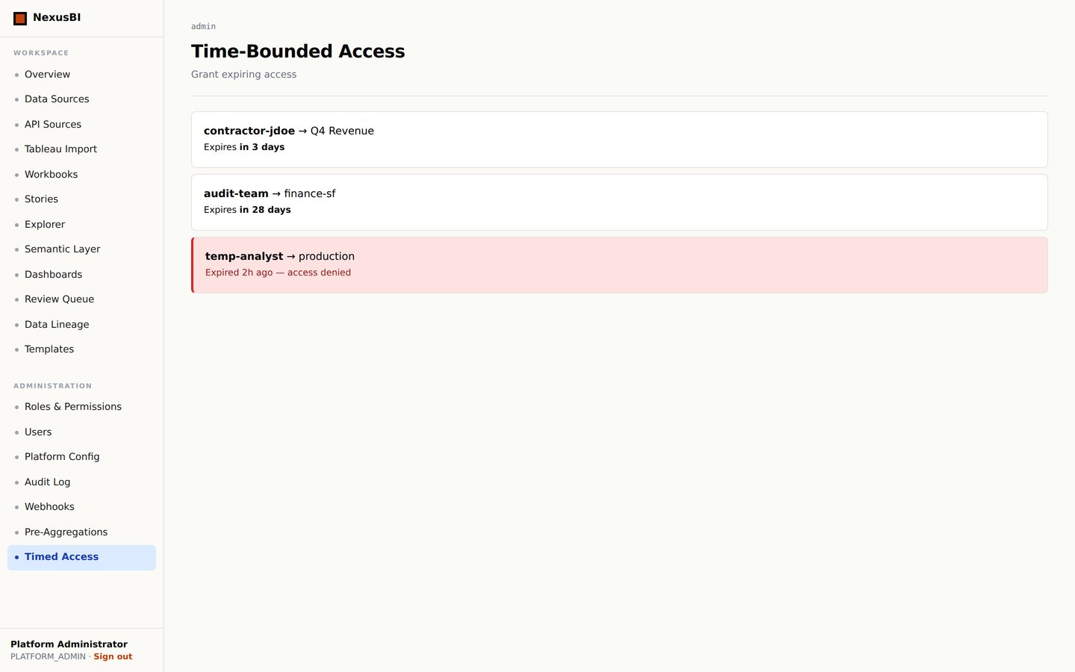
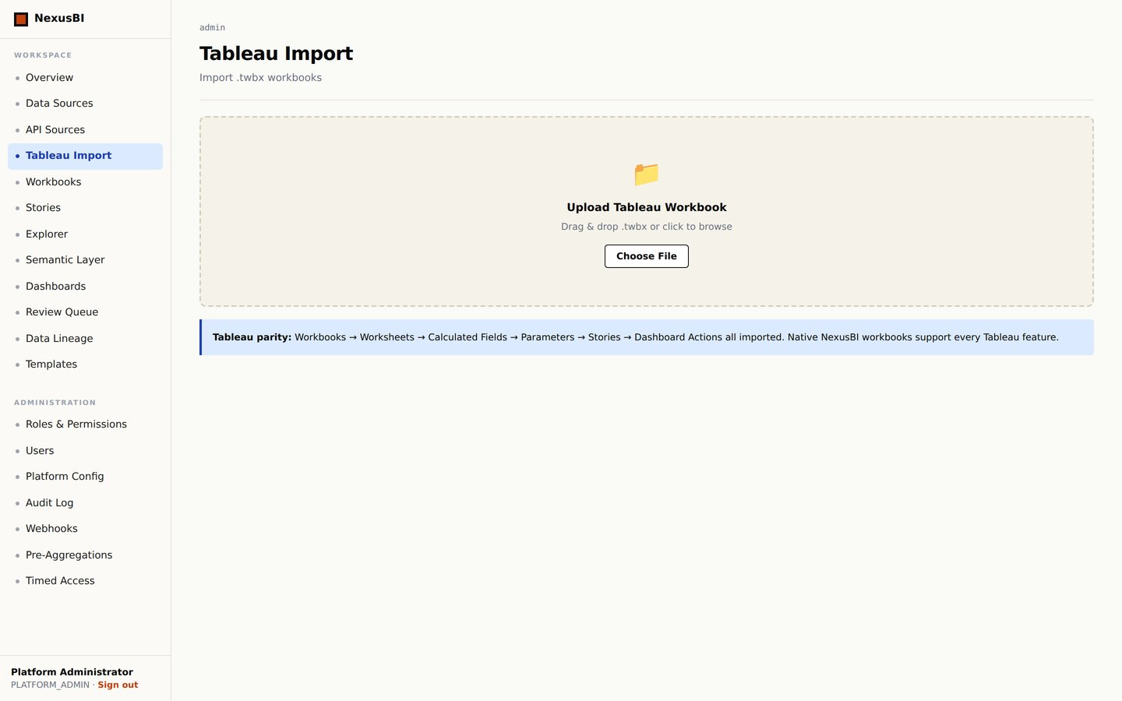
NexusBI
APPENDIX · ADMIN: WEBHOOKS · PRE-AGG · TIMED ACCESS · TABLEAU
Admin: Outbound Webhooks
Admin: Pre-Aggregations
Admin: Timed Access
Tableau Import
27 · NexusBI v6

