Slide 1

TRAIN SALES ANALYSIS
Task 4 – data storytelling & statistical validation
Presented by
Jadhav Srujana
Data Analytics Internship
ApexPlanet Software Pvt. Ltd.
July 2026

Slide 2
Business Objective
Objective
The objective of this project is to analyze the Superstore Sales dataset to identify sales trends, customer purchasing behavior, and regional performance. The project combines data cleaning, exploratory data analysis, dashboard visualization, and statistical validation to support data-driven business decisions.
Goals
Analyze sales performance
Identify key business trends
Validate insights using statistical testing
Recommend strategies to improve revenue and profitability

Slide 3
Dataset Overview
Dataset Overview
The Superstore Sales dataset contains customer order information from a retail business.
Dataset Information
Nearly 10,000 customer orders
Covers multiple years of sales data
Four geographical regions
Three product categories
Three customer segments
Multiple shipping mode

Slide 4
Important Columns
Order Date
Customer Name
Region
Category
Sub-Category
Sales
Profit
Quantity
Discount
Ship Mode

Slide 5
Data Cleaning & Preparation
Data Cleaning Process
To ensure accurate analysis, the dataset was cleaned and prepared.
Steps Performed
Checked for missing values
Removed duplicate records
Converted date columns into proper date format
Corrected data types
Created new features such as Shipping Days
Verified data consistency
Outcome
A clean, reliable, and analysis-ready dataset.

Slide 6
Exploratory Data Analysis (EDA)
Exploratory Data Analysis
EDA was performed to discover patterns and trends in sales data.
Analysis Conducted
Sales by Category
Sales by Region
Sales by Customer Segment
Monthly Sales Trend
Top Selling Products
Shipping Mode Analysis
State-wise Sales Distribution
Purpose
To identify hidden patterns and support business decision-making.

Slide 7
Key Business Insights
Key Insights
Technology products generate the highest sales revenue.
Office Supplies provide consistent sales throughout the year.
Furniture sales are comparatively lower and fluctuate across regions.
The West region contributes the highest overall sales.
Consumer customers place the largest number of orders.
Standard Class is the most frequently used shipping mode.
Seasonal trends indicate higher sales during festive periods.
Business Impact
Understanding these trends helps improve marketing, inventory planning, and customer satisfaction.

Slide 8
Dashboard Overview
Interactive Dashboard
A Power BI dashboard was created to monitor business performance.
Dashboard Features
Total Sales
Total Profit
Total Orders
Average Sales
Sales by Category
Sales by Region
Customer Segment Analysis

Slide 9
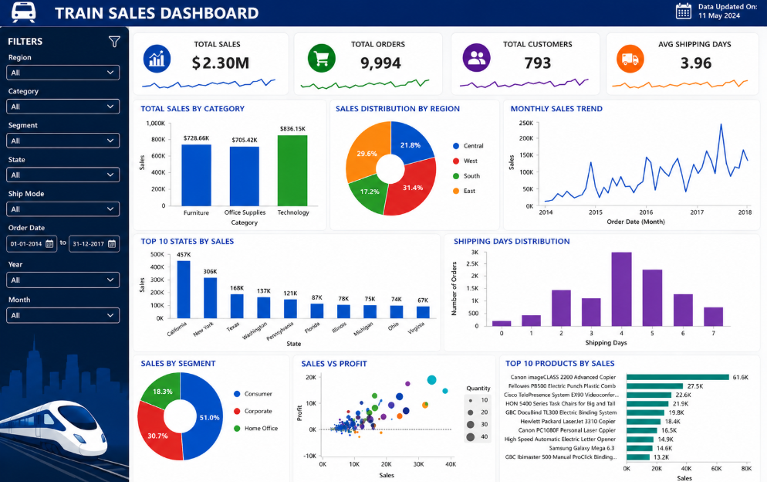
1.1 Dashboard

Slide 10
Storytelling & Statistical Validation
Business Story
The analysis revealed that not all product categories contribute equally to sales. While Technology consistently performs well, Furniture shows relatively lower sales performance. Regional analysis also indicates differences in customer demand.
Business Hypothesis
Null Hypothesis (H₀):
There is no significant difference in average sales between Technology and Furniture categories.
Alternative Hypothesis (H₁):
There is a significant difference in average sales between Technology and Furniture categories.
Statistical Test
Independent Samples T-Test
Significance Level (α) = 0.05

Slide 11
Statistical Results & Business Recommendations
Statistical Results
The T-Test was performed to compare average sales between Technology and Furniture categories.
Interpretation
If the p-value < 0.05, reject the null hypothesis.
This indicates a statistically significant difference between the sales of the two categories.
Business Recommendations
Increase investment in Technology products.
Improve promotional strategies for Furniture.
Expand marketing in high-performing regions.
Optimize inventory management based on demand.

Slide 12
Conclusion
Conclusion
This project successfully transformed raw sales data into meaningful business insights through data cleaning, exploratory analysis, dashboard visualization, and statistical validation.
Key Outcomes
Identified top-performing categories and regions.
Understood customer purchasing behavior.
Validated findings using statistical testing.
Developed actionable business recommendations.
Demonstrated the importance of data-driven decision-making in improving business performance.

Slide 13
Thank You
Thank You

