Slide 1
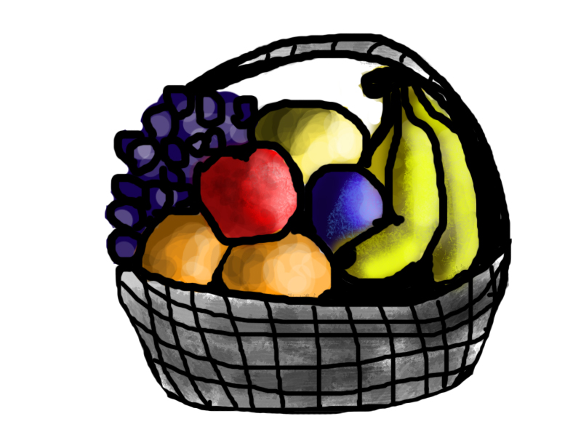
Supervised learning
Presence of supervisor as teacher
well labeled Data

Slide 2
If shape of object is rounded and depression at top having color Red then it will be labeled as –Apple.
If shape of object is long curving cylinder having color Green-Yellow then it will be labeled as –Banana.

Slide 3


Slide 4
Supervised learning classified into two categories of algorithms:
Classification: A classification problem is when the output variable is a category, such as “Red” or “blue” or “disease” and “no disease”
Regression: A regression problem is when the output variable is a real value, such as “dollars” or “weight”.

