Slide 1
XGBoost

Slide 2
What is XGBoost?
• XGBoost (Extreme Gradient Boosting) is a scalable and efficient gradient boosting framework.
• Developed for speed and performance in machine learning competitions.
• Based on ensemble learning and decision trees.

Slide 3
Ensemble Learning in XGBoost
• Combines multiple weak learners (decision trees) to form a strong learner.
• Boosting: Sequential training where each model corrects errors from the previous one.
• Reduces bias and variance, leading to high performance.

Slide 4

XGBoost Objective Function
The objective function is a combination of loss function and regularization:
Where:
• l(ŷi, yi): Loss function (e.g., MSE for regression, log-loss for classification).
• Ω(fk): Regularization term to control model complexity.

Slide 5

Loss Function
The loss function measures the difference between the actual and predicted values. Common choices are:
Mean Squared Error (MSE): For regression.

Slide 6
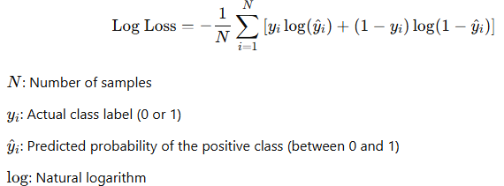
Log Loss: For classification.

Slide 7
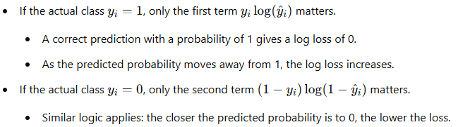

Slide 8
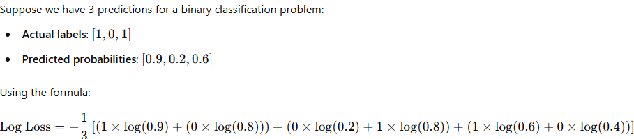

Slide 9

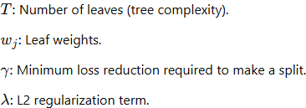
Regularization Term
Regularization helps prevent overfitting. XGBoost uses L1 and L2 regularization:

Slide 10
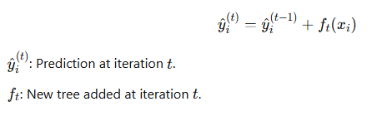
Tree Building in XGBoost
Additive Learning
XGBoost builds trees sequentially, adding one tree at a time to correct errors from previous trees. Each new tree fits the gradient of the loss function:

Slide 11

Gradient Boosting and Optimization
XGBoost uses second-order Taylor expansion to approximate the loss function:
Where:
• gi: First-order gradient (∂l/∂ŷ).
• hi: Second-order gradient (∂²l/∂ŷ²).

Slide 12
Regularization in XGBoost
XGBoost penalizes model complexity to reduce overfitting:
Ω(f) = γT + 0.5λ Σ wj²
Where:
• γ: Minimum loss reduction to make a split.
• λ: L2 regularization term.
• T: Number of leaves.

Slide 13
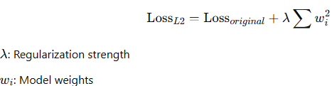
L2 Regularization (Ridge)
dds the squared value of the coefficients as a penalty term.
Shrinks coefficients but does not eliminate them entirely.
Formula for L2 Regularization:

Slide 14
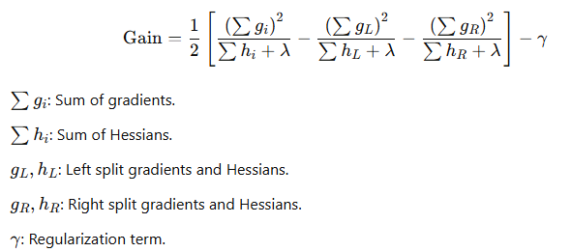
Tree Pruning in XGBoost
XGBoost performs post-pruning instead of pre-pruning:
Splits are added greedily based on gain.
Gain formula:

Slide 15
Important Hyperparameters in XGBoost
• n_estimators: Number of boosting rounds.
• learning_rate: Step size during optimization.
• max_depth: Maximum depth of each tree.
• gamma: Minimum loss reduction for further partition.
• lambda: L2 regularization term.

