Slide 1
AdaBoost

Slide 2
AdaBoost (Adaptive Boosting) is a very popular boosting technique that aims at combining multiple weak classifiers to build one strong classifier/Regressor.
A single classifier may not be able to accurately predict the class of an object, but when we group multiple weak classifiers with each one progressively learning from the others’ wrongly classified objects, we can build one such strong model.
The classifier mentioned here could be any of your basic classifiers, from Decision Trees (often the default) to Logistic Regression, etc.

Slide 3
Decision Stumps are like trees in a Random Forest, but not “fully grown.” They have one node and two leaves.
AdaBoost uses a forest of such stumps rather than trees.

Slide 4
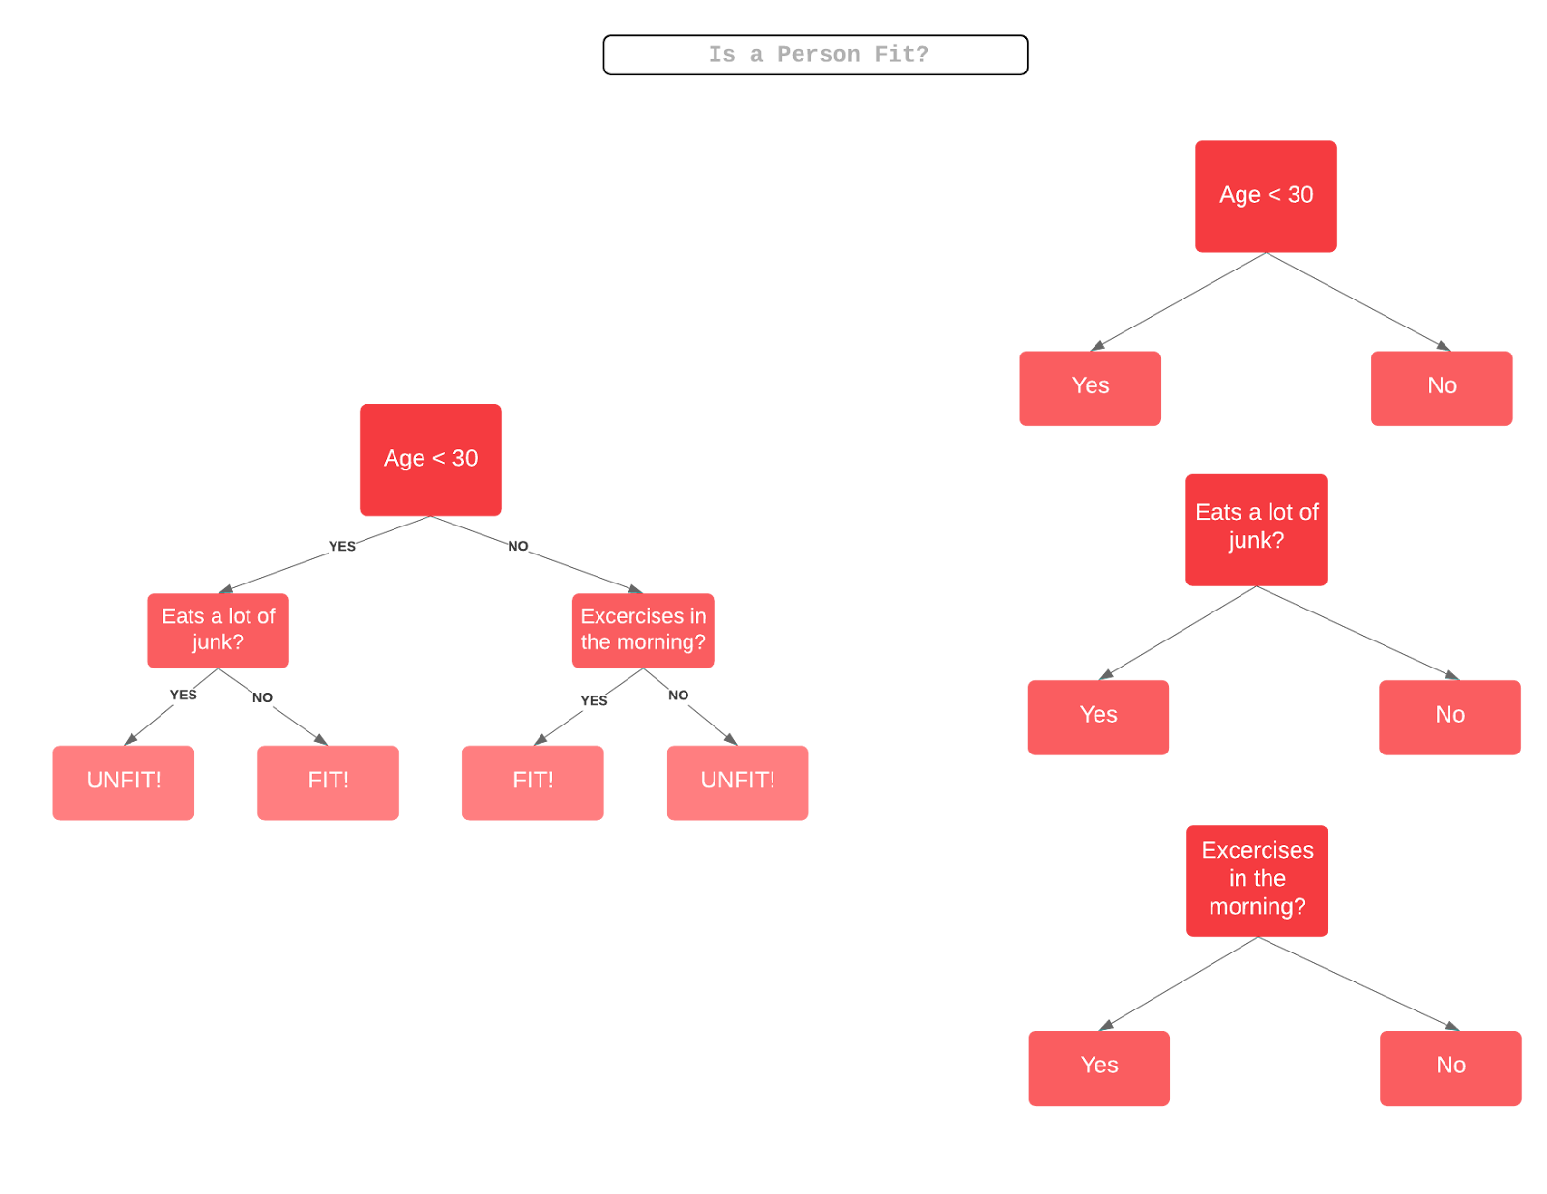

Slide 5
An Example of How AdaBoost Works
Step 1: A weak classifier (e.g. a decision stump) is made on top of the training data based on the weighted samples. Here, the weights of each sample indicate how important it is to be correctly classified. Initially, for the first stump, we give all the samples equal weights.
Step 2: We create a decision stump for each variable and see how well each stump classifies samples to their target classes. For example, in the diagram below we check for Age, Eating Junk Food, and Exercise. We’d look at how many samples are correctly or incorrectly classified as Fit or Unfit for each individual stump.

Slide 6
Step 3: More weight is assigned to the incorrectly classified samples so that they’re classified correctly in the next decision stump. Weight is also assigned to each classifier based on the accuracy of the classifier, which means high accuracy = high weight!
Step 4: Reiterate from Step 2 until all the data points have been correctly classified, or the maximum iteration level has been reached.

Slide 7
The Mathematics Behind AdaBoost
Let’s start by considering a dataset with N points, or rows, in our dataset.
In this case,
n is the dimension of real numbers, or the number of attributes in our dataset
x is the set of data points
y is the target variable which is either -1 or 1 as it is a binary classification problem, denoting the first or the second class (e.g. Fit vs Not Fit)

Slide 8
Initially, all the data points will have the same weighted sample w:
where N is the total number of data points.

Slide 9

The weighted samples always sum to 1, so the value of each individual weight will always lie between 0 and 1.
After this, we calculate the actual influence for this classifier in classifying the data points using the formula:
Alpha is how much influence this stump will have in the final classification. Total Error is nothing but the total number of misclassifications for that training set divided by the training set size.

Slide 10
Notice that when a Decision Stump does well, or has no misclassifications (a perfect stump!) this results in an error rate of 0 and a relatively large, positive alpha value.
If the stump just classifies half correctly and half incorrectly (an error rate of 0.5) then the alpha value will be 0.
Finally, when the stump ceaselessly gives misclassified results (just do the opposite of what the stump says!) then the alpha would be a large negative value.

Slide 11

It’s time for us to update the sample weights which we had initially taken as 1/N for every data point. We’ll do this using the following formula:

Slide 12
The new sample weight will be equal to the old sample weight multiplied by Euler’s number, raised to plus or minus alpha (which we just calculated in the previous step).
The two cases for alpha (positive or negative) indicate:
Alpha is positive when the predicted and the actual output agree (the sample was classified correctly).
In this case we decrease the sample weight from what it was before, since we’re already performing well.
Alpha is negative when the predicted output does not agree with the actual class (i.e. the sample is misclassified).
In this case we need to increase the sample weight so that the same misclassification does not repeat in the next stump. This is how the stumps are dependent on their predecessors.

Slide 13
Pseudocode of AdaBoost
Initially set uniform example weights.
for Each base learner do:
Train base learner with a weighted sample.
Test base learner on all data.
Set learner weight with a weighted error.
Set example weights based on ensemble predictions.
end for

