Slide 1
Boosting

Slide 2
Introduction to Boosting
Bagging (bootstrap aggregating) is an ensemble method that involves training multiple models independently on random subsets of the data, and aggregating their predictions through voting or averaging.
Boosting is an ensemble learning technique that improves weak learners.
It corrects errors from previous models to enhance accuracy.

Slide 3
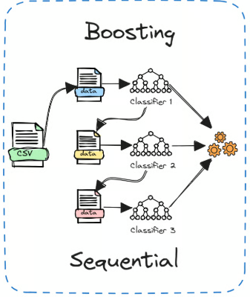
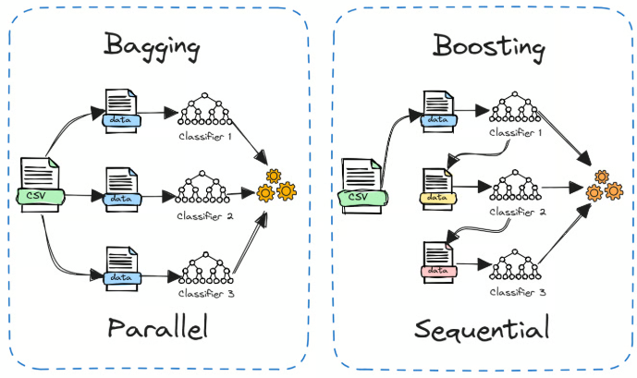

Slide 4
In detail, each model is trained on a random subset of the data sampled with replacement, meaning that the individual data points can be chosen more than once.
This random subset is known as a bootstrap sample. By training models on different bootstraps, bagging reduces the variance of the individual models.
It also avoids overfitting by exposing the constituent models to different parts of the dataset.

Slide 5
The predictions from all the sampled models are then combined through a simple averaging to make the overall prediction.
This way, the aggregated model incorporates the strengths of the individual ones and cancels out their errors.

Slide 6
Boosting is different from Bagging (e.g., Random Forest).
Boosting models learn sequentially, reducing bias and variance.

Slide 7
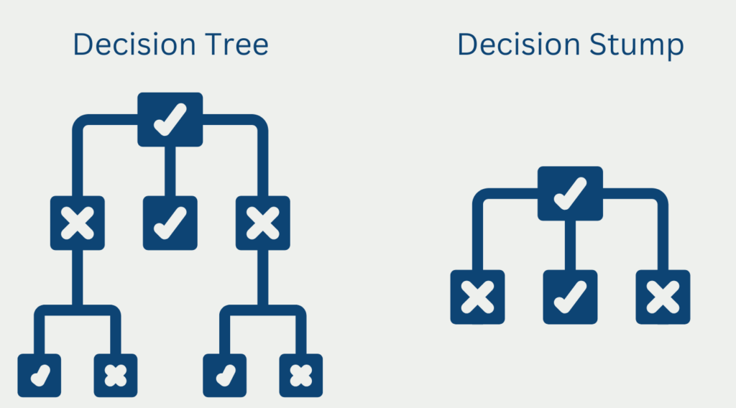
How Boosting Works
Weak learners (e.g., decision stumps) are combined to form a strong learner.

Slide 8
Models train sequentially, correcting errors from previous models.
Weights are adjusted to focus on difficult-to-classify cases.
Reduces bias and improves model accuracy.

Slide 9
Algorithm
Initialise the dataset and assign equal weight to each of the data point.
Provide this as input to the model and identify the wrongly classified data points.
Increase the weight of the wrongly classified data points and decrease the weights of correctly classified data points. And then normalize the weights of all data points.
if (got required results) Goto step 5 else Goto step 2
End

Slide 10
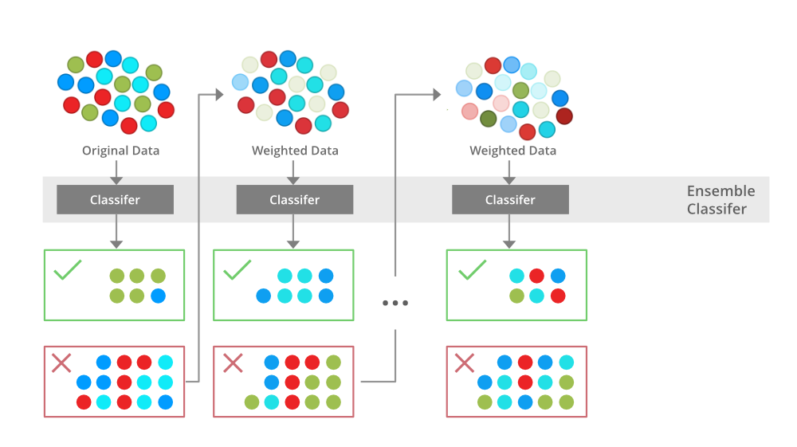

Slide 11
Example
to identify ‘spam’ and ‘not spam’ emails using following criteria. If:
Email has only one image file (promotional image), It’s a SPAM
Email has only link(s), It’s a SPAM
Email body consist of sentence like “You won a prize money of $ xxxxxx”, It’s a SPAM
Email from our official domain “atlasuniversity.edu.in” , Not a SPAM
Email from known source, Not a SPAM
Above, we’ve defined multiple rules to classify an email into ‘spam’ or ‘not spam’. But, do you think these rules individually are strong enough to classify an email successfully? No.

Slide 12
Individually, these rules are not powerful enough to classify an email into ‘spam’ or ‘not spam’. Therefore, these rules are called as weak learner.
To convert weak learner to strong learner, we’ll combine the prediction of each weak learner using methods like:
Using average/ weighted average
Considering prediction has higher vote

Slide 13
For example: Above, we have defined 5 weak learners. Out of these 5, 3 are voted as ‘SPAM’ and 2 are voted as ‘Not a SPAM’. In this case, by default, we’ll consider an email as SPAM because we have higher vote for ‘SPAM’.

Slide 14
Types of Boosting Algorithms
AdaBoost: Uses decision stumps and assigns weights to misclassified samples.
Gradient Boosting: Uses loss functions and sequential corrections.
XGBoost: Optimized for speed, handles missing values.
LightGBM: Faster than XGBoost, useful for large datasets.
CatBoost: Best for categorical data handling.

Slide 15
Boosting for Classification and Regression
Classification: Used in fraud detection, spam filtering, medical diagnosis.
Regression: Used for house price prediction, financial forecasting.
Boosting works well on structured data.

Slide 16
Hyperparameter Tuning
Use bagging when you have high-variance models like decision trees to improve stability.
Combine bagging with cross-validation for a more reliable evaluation of your models.
Use random forests (bagged decision trees) as a powerful, ready-to-use bagging technique.
Set a higher n_estimators value like 100-200 when bagging to obtain maximum benefit.

Slide 17
Bagging is easily parallelized using n_jobs. Implement it across multiple CPUs/machines for faster training.
Since bagging relies on bootstrap sampling, ensure that each model is trained on a sufficiently diverse subset of the data.
Before aggregating, optimize each model's performance using GridSearchCV. Good performance of individual models usually translates to better performance of the ensemble.

Slide 18
Advantages and Disadvantages
Advantages: Reduces bias and variance, works well with structured data.
Disadvantages: Sensitive to noisy data, computationally expensive.

Slide 19
Real-World Applications
Finance: Fraud detection, credit risk assessment.
Healthcare: Disease prediction, patient outcome analysis.
Marketing: Customer segmentation, sales forecasting.

Slide 20
Boosting Vs. Bagging
Boosting | Bagging
In Boosting we combine predictions that belong to different types | Bagging is a method of combining the same type of prediction
The main aim of boosting is to decrease bias, not variance | The main aim of bagging is to decrease variance not bias
At every successive layer Models are weighted according to their performance. | All the models have the same weightage
New Models are influenced by the accuracy of previous Models | All the models are independent of each other

