Slide 1
DBSCAN

Slide 2
Density-based clustering methods, like DBSCAN (Density-Based Spatial Clustering of Applications with Noise), are highly effective for identifying clusters in noisy datasets.
Unlike centroid-based methods, DBSCAN forms clusters based on data point density, making it suitable for datasets with arbitrary shapes.

Slide 3
DBSCAN is particularly useful in anomaly detection and spatial data analysis, where outliers must be identified.
This method offers robust performance by detecting clusters with varying densities, making it an essential tool for unsupervised learning tasks in diverse fields.

Slide 4
Key Features of DBSCAN
Noise Handling: DBSCAN efficiently identifies outliers that do not belong to any cluster.
Cluster Detection with Varying Densities: The algorithm can detect clusters with different densities, unlike K-Means, which assumes clusters are spherical.

Slide 5
Parameters of the DBSCAN Algorithm
DBSCAN relies on two primary parameters to detect clusters: Epsilon (ε) and MinPts.
Epsilon (ε)
Epsilon defines the maximum radius within which neighboring points are considered part of the same cluster.
A smaller ε results in more clusters with fewer points, while a larger ε may group more points into larger clusters.
Choosing an appropriate ε is crucial to balancing cluster granularity and performance.

Slide 6
MinPts
MinPts specifies the minimum number of points required to form a dense region, which defines the core of a cluster.
Higher MinPts values result in fewer clusters, but they are more robust to noise.
Lower values may generate more, smaller clusters.

Slide 7
Influence of Parameters on Cluster Formation
Both ε and MinPts directly affect how clusters are detected.
Setting these parameters correctly ensures DBSCAN’s effectiveness in identifying meaningful clusters and handling noise within the data.

Slide 8
Steps and Pseudocode for the DBSCAN Algorithm
Select a Random Point: Begin with an unvisited point from the dataset.
Identify Neighboring Points: Check if the number of points within the Epsilon (ε) radius meets the MinPts requirement.
If yes, mark it as a core point and form a new cluster.
If no, label the point as a noise point (though it might later belong to a cluster).
Expand the Cluster: For each core point, expand the cluster by visiting neighboring points within the ε radius.
Classify Border Points: Points within ε but without sufficient neighbors are border points and belong to the nearest cluster.
Repeat: Continue until all points are visited and assigned to a cluster or marked as noise.

Slide 9
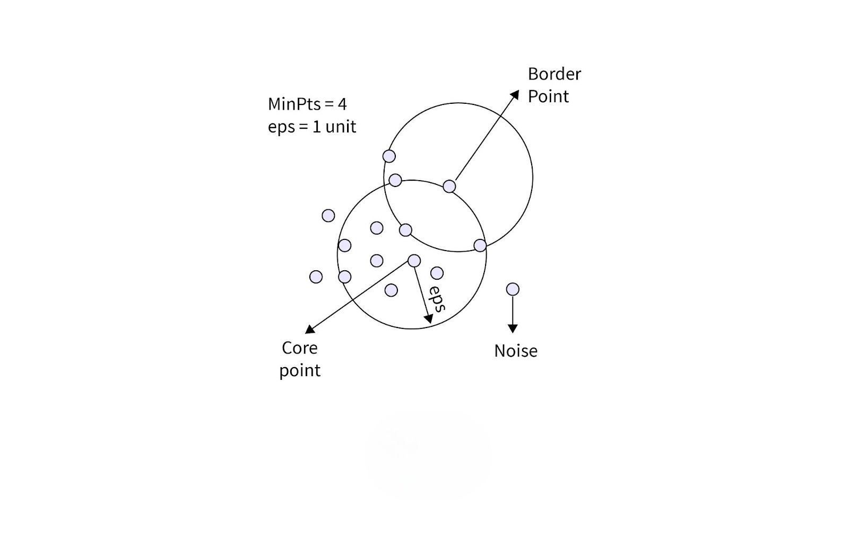

Slide 10
Core Points: Have at least MinPts neighbors within ε radius.
Border Points: Have fewer than MinPts neighbors but are close to a core point.
Noise Points: Isolated points that don’t belong to any cluster.
This structure ensures DBSCAN accurately detects clusters and outliers without requiring a predefined number of clusters.

Slide 11
Selecting ε (Epsilon)
The ε parameter determines the maximum distance between two points for them to be considered neighbors. To choose an appropriate ε:
1. Use domain knowledge: If you have insight into what distance is meaningful for your specific problem, use that as a starting point.
2. K-distance graph: This is a more systematic approach:
Calculate the distance to the k-th nearest neighbor for each point (where k = MinPts).
Plot these k-distances in ascending order.
Look for an "elbow" in the graph – a point where the curve starts to level off.
The ε value at this elbow is often a good choice.

Slide 12
Selecting MinPts
MinPts determines the minimum number of points required to form a dense region. Here are some guidelines:
1. General rule: A good starting point is to set MinPts = 2 * num_features, where num_features is the number of dimensions in your dataset.
2. Noise consideration: If your data has noise or you want to detect smaller clusters, you might want to decrease MinPts.
3. Dataset size: For larger datasets, you might need to increase MinPts to avoid creating too many small clusters.

Slide 13
MinPts >= D + 1 (where D is the number of dimensions in the dataset)If the data is 2D, then MinPts should be at least 3.
If the data is 3D, then MinPts should be at least 4, and so on.
This ensures that clusters are properly formed and not based on a single point.
2D dataset → MinPts = 4 or 5
3D dataset → MinPts = 6

Slide 14
Dataset Type | Dimensions (D) | Suggested MinPts
2D (Make Moons) | 2 | 4–6
3D (Spatial Data) | 3 | 6–8
10D+ (High-Dimensional) | 10+ | 20–50

