Slide 1
MATPLOTLIB

Slide 2
%matplotlib inline
import matplotlib.pyplot as plt
plt.plot([-1, -4.5, 16, 23])
plt.show()

Slide 3
import matplotlib.pyplot as plt
plt.plot([-1, -4.5, 16, 23], "ob")
plt.show()

Slide 4
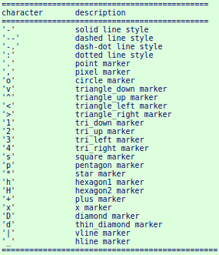

Slide 5
import matplotlib.pyplot as plt
days = list(range(1,9))
celsius_min = [19.6, 24.1, 26.7, 28.3, 27.5, 30.5, 32.8, 33.1]
celsius_max = [24.8, 28.9, 31.3, 33.0, 34.9, 35.6, 38.4, 39.2]
plt.xlabel('Day')
plt.ylabel('Degrees Celsius')
plt.plot(days, celsius_min,
days, celsius_min, "oy",
days, celsius_max,
days, celsius_max, "or")
plt.show()

Slide 6
Legend
# next line only needed if working with "ipython notebook":
%matplotlib inline
import numpy as np
import matplotlib.pyplot as plt
ax = plt.gca()
ax.plot([1, 2, 3, 4])
ax.legend(['A simple line'])

Slide 7
Bar Graph
bars = plt.bar([1,2,3,4], [1,4,9,16])
bars[0].set_color('green')
plt.show()

