Slide 1
Numpy

Slide 2
Collection Data Types
List: my_list = [3, 8, 1, 6, 0, 8, 4]
Tuple: thistuple = ("apple", "banana", "cherry")
Sets : thisset = {"apple", "banana", "cherry"}
Dictionary: thisdict = {
"brand": "Ford",
"model": "Mustang",
"year": 1964
}

Slide 3
Numpy
import numpy as np
cvalues = [20.1, 20.8, 21.9, 22.5, 22.7, 22.3, 21.8, 21.2, 20.9, 20.1]
C = np.array(cvalues)
print(C)
print(C * 9 / 5 + 32)
Type(C)

Slide 4
Arange
import numpy as np
a = np.arange(1, 10)
print(a)
x = np.arange(0.5, 10.4, 0.8)
print(x)
x = np.arange(0.5, 10.4, 0.8, int)
print(x)

Slide 5
linspace
import numpy as np
# 50 values between 1 and 10:
print(np.linspace(1, 10))
# 7 values between 1 and 10:
print(np.linspace(1, 10, 7))

Slide 6
Zero-dimensional Arrays in Numpy
import numpy as np
x = np.array(42)
print("x: ", x)
print("The type of x: ", type(x))
print("The dimension of x:", np.ndim(x))

Slide 7
One-dimensional Arrays
F = np.array([1, 1, 2, 3, 5, 8, 13, 21])
V = np.array([3.4, 6.9, 99.8, 12.8])
print("F: ", F)
print("V: ", V)
print("Type of F: ", F.dtype)
print("Type of V: ", V.dtype)
print("Dimension of F: ", np.ndim(F))
print("Dimension of V: ", np.ndim(V))

Slide 8
Two- and Multidimensional Arrays
A = np.array([ [3.4, 8.7, 9.9],
[1.1, -7.8, -0.7],
[4.1, 12.3, 4.8]])
print(A)
print(A.ndim)

Slide 9
B = np.array([ [[111, 112], [121, 122]],
[[211, 212], [221, 222]],
[[311, 312], [321, 322]] ])
print(B)
print(B.ndim)

Slide 10
Shape of an Array
x = np.array([ [67, 63, 87],
[77, 69, 59],
[85, 87, 99],
[79, 72, 71],
[63, 89, 93],
[68, 92, 78]])
print(np.shape(x))

Slide 11
x.shape = (3, 6)
print(x)
x.shape = (2, 9)
print(x)

Slide 12
B = np.array([ [[111, 112, 113], [121, 122, 123]],
[[211, 212, 213], [221, 222, 223]],
[[311, 312, 313], [321, 322, 323]],
[[411, 412, 413], [421, 422, 423]] ])
print(B.shape)

Slide 13
Indexing and Slicing
F = np.array([1, 1, 2, 3, 5, 8, 13, 21])
# print the first element of F
print(F[0])
# print the last element of F
print(F[-1])

Slide 14
A = np.array([ [3.4, 8.7, 9.9],
[1.1, -7.8, -0.7],
[4.1, 12.3, 4.8]])
print(A[1][0])

Slide 15
slicing
S = np.array([0, 1, 2, 3, 4, 5, 6, 7, 8, 9])
print(S[2:5])
print(S[:4])
print(S[6:])
print(S[:])

Slide 16
A = np.array([
[11, 12, 13, 14, 15],
[21, 22, 23, 24, 25],
[31, 32, 33, 34, 35],
[41, 42, 43, 44, 45],
[51, 52, 53, 54, 55]])
print(A[:3, 2:])

Slide 17
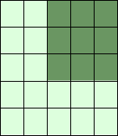

Slide 18
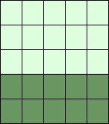
print(A[3:, :])

Slide 19
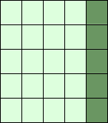
print(A[:, 4:])

Slide 20
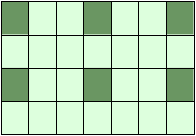
X = np.arange(28).reshape(4, 7)
print(X)
print(X[::2, ::3])

Slide 21
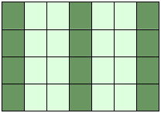
print(X[::, ::3])

Slide 22
The identity Function
import numpy as np
np.identity(4)
np.identity(4, dtype=int)

Slide 23
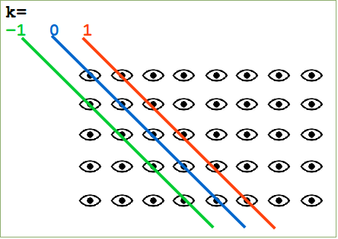
The eye Function
import numpy as np
np.eye(5, 8, k=1, dtype=int)

Slide 24
Numerical Operations
import numpy as np
lst = [2,3, 7.9, 3.3, 6.9, 0.11, 10.3, 12.9]
v = np.array(lst)
v = v + 2
print(v)

Slide 25
import numpy as np
A = np.array([ [11, 12, 13], [21, 22, 23], [31, 32, 33] ])
B = np.ones((3,3))
print("Adding to arrays: ")
print(A + B)

Slide 26
Broadcasting
import numpy as np
A = np.array([ [11, 12, 13], [21, 22, 23], [31, 32, 33] ])
B = np.array([1, 2, 3])
print("Multiplication with broadcasting: ")
print(A * B)
print("... and now addition with broadcasting: ")
print(A + B)

Slide 27
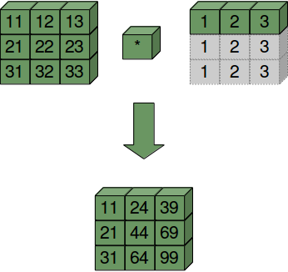

Slide 28
A = np.array([10, 20, 30])
B = np.array([1, 2, 3])
A[:, np.newaxis]
A[:, np.newaxis] * B

Slide 29
