Slide 1

Pandas

Slide 2
Pandas is one of those packages, and makes importing and analyzing data much easier.
Pandas builds on packages like NumPy and matplotlib to give you a single, convenient, place to do most of your data analysis and visualization work.

Slide 3
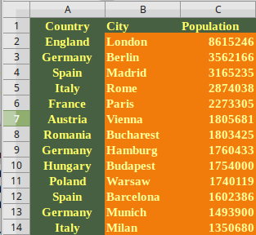
DataFrame

Slide 4
Read data
import pandas as pd
m = pd.read_csv("movies.csv")

Slide 5
Head and Tail
Once we read in a DataFrame, Pandas gives us
two methods that make it fast to print out the data. These functions are:
– pandas.DataFrame.head – prints the first N rows of a DataFrame. By default 5.
– pandas.DataFrame.tail – prints the last N rows of aDataFrame. By default 5.
We’ll use the head method to see what’s in movies:
m.head()

Slide 6
Find number of rows and columns
>>> m.shape
(10, 5)
>>> x = m.shape
>>> type(x)
<type 'tuple'>
>>> x[0]
10
>>> x[1]
5

Slide 7
Indexing
m.iloc[:5,:] – the first 5 rows, and all of the columns for those rows.
m.iloc[:,:] – the entire DataFrame.
m.iloc[5:,5:] – rows from position 5 onwards, and columns from position 5 onwards.
m.iloc[:,0] – the first column, and all of the rows for the column.
m.iloc[9,:] – the 10th row, and all of the columns for that row.

