Slide 1
Django

Slide 2
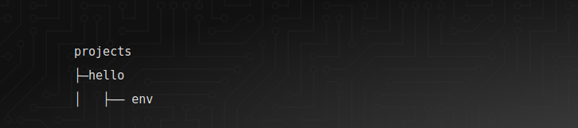
Setup virtual env virtualenv -p /usr/bin/python2.7 env
source env/bin/activate

Slide 3
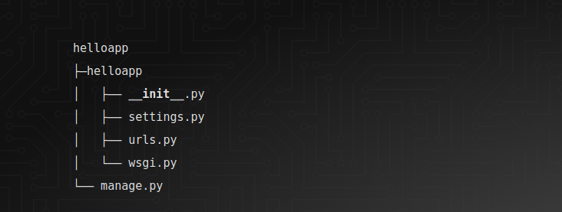
To check setup
python -m pip install "django<2"
Django-admin - -version
django-admin startproject helloapp

Slide 4
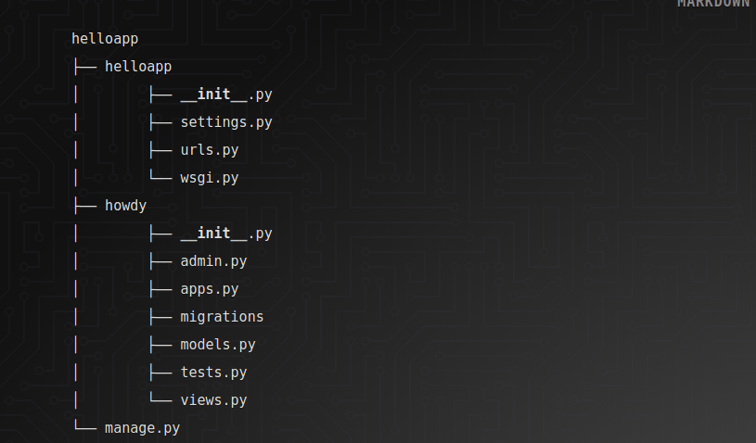
Creating your own app
python manage.py startapp howdy

Slide 5
# helloapp/settings.py
INSTALLED_APPS = [
'django.contrib.admin',
'django.contrib.auth',
'django.contrib.contenttypes',
'django.contrib.sessions',
'django.contrib.messages',
'django.contrib.staticfiles',
'howdy'
]

Slide 6
Run the App
python manage.py runserver
python manage.py migrate

Slide 7
# Urls & Templates
Open up the urls.py file inside the inner helloapp folder
# helloapp/urls.py
from django.conf.urls import url, include
from django.contrib import admin
urlpatterns = [
url(r'^admin/', admin.site.urls),
url(r'^', include('howdy.urls')),
]

Slide 8
Go to the howdy app folder and create a file called urls.py
# howdy/urls.py
from django.conf.urls import url
from howdy import views
urlpatterns = [
url(r'^$', views.HomePageView.as_view()),
]

Slide 9
Views.py
# howdy/views.py
from django.shortcuts import render
from django.views.generic import TemplateView
# Create your views here.
class HomePageView(TemplateView):
def get(self, request, **kwargs):
return render(request, 'index.html', context=None)

Slide 10
Templates
create templates folder in your howdy app folder.
Create index.html
Create about.html
Change in urls.py
url(r'^about/$',views.AboutPageView.as_view()),

Slide 11
View.py
class AboutPageView(TemplateView):
template_name = "about.html"

