Slide 1
Relational Databases
and SQLite
Notes:
Note from Chuck. If you are using these materials, you can remove the UM logo and replace it with your own, but please retain the CC-BY logo on the first page as well as retain the entire last page.

Slide 2
Relational Databases
Relational databases model data by storing rows and columns in tables. The power of the relational database lies in its ability to efficiently retrieve data from those tables and in particular where there are multiple tables and the relationships between those tables involved in the query.
http://en.wikipedia.org/wiki/Relational_database

Slide 3
Terminology
Database - contains many tables
Relation (or table) - contains tuples and attributes
Tuple (or row) - a set of fields that generally represents an “object” like a person or a music track
Attribute (also column or field) - one of possibly many elements of data corresponding to the object represented by the row

Slide 4
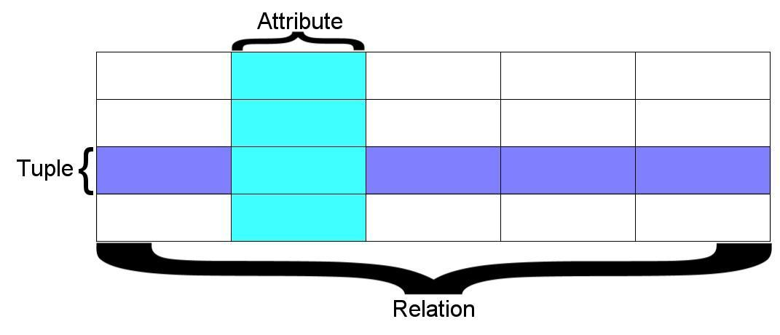
A relation is defined as a set of tuples that have the same attributes. A tuple usually represents an object and information about that object. Objects are typically physical objects or concepts. A relation is usually described as a table, which is organized into rows and columns. All the data referenced by an attribute are in the same domain and conform to the same constraints. (Wikipedia)

Slide 5
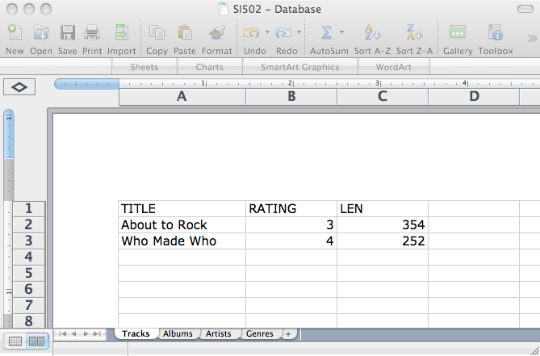
Columns / Attributes
Rows /
Tuples
Tables / Relations

Slide 6
SQL
Structured Query Language is the language we use to issue commands to the database
  Create a table
  Retrieve some data
  Insert data
  Delete data
http://en.wikipedia.org/wiki/SQL

Slide 7
Two Roles in Large Projects
Application Developer - Builds the logic for the application, the look and feel of the application - monitors the application for problems
Database Administrator - Monitors and adjusts the database as the program runs in production
Often both people participate in the building of the “Data model”

Slide 8
Common Database Systems
Three Major Database Management Systems in wide use
  Oracle - Large, commercial, enterprise-scale, very very tweakable
  MySql - Simpler but very fast and scalable - commercial open source
  SqlServer - Very nice - from Microsoft (also Access)
Many other smaller projects, free and open source
  HSQL, SQLite, Postgress, ...

Slide 9













SQLite is in lots of software...
http://www.sqlite.org/famous.html

Slide 10
Install Sqlite
sudo apt-get install sqlite3 libsqlite3-dev

Slide 11
SQL
Structured Query Language is the language we use to issue commands to the database
  Create a table
  Retieve some data
  Insert data
  Delete data
http://en.wikipedia.org/wiki/SQL

Slide 12
Start Simple - A Single Table
CREATE TABLE COMPANY(
ID INT PRIMARY KEY NOT NULL,
NAME TEXT NOT NULL,
AGE INT NOT NULL,
ADDRESS CHAR(50),
SALARY REAL
);

Slide 13
Alter Table
ALTER TABLE employees
ADD status VARCHAR;

Slide 14
Alter Table
ALTER TABLE employees
RENAME TO staff;

Slide 15
Drop Table
DROP TABLE database_name.table_name;

Slide 16
SQL Insert
The Insert statement inserts a row into a table
INSERT INTO COMPANY (ID,NAME,AGE,ADDRESS,SALARY)
VALUES (1, 'Paul', 32, 'California', 20000.00 );

Slide 17
SQL Delete
Deletes a row in a table based on a selection criteria
DELETE FROM COMPANY WHERE ID = 7;

Slide 18
SQL: Update
Allows the updating of a field with a where clause
UPDATE Users SET name='Charles' WHERE email='csev@umich.edu'

Slide 19
Retrieving Records: Select
The select statement retrieves a group of records - you can either retrieve all the records or a subset of the records with a WHERE clause
SELECT * FROM Users
SELECT * FROM Users WHERE email='csev@umich.edu'

Slide 20
Sorting with ORDER BY
You can add an ORDER BY clause to SELECT statements to get the results sorted in ascending or descending order
SELECT * FROM Users ORDER BY email
SELECT * FROM Users ORDER BY name

Slide 21
Sorting with ORDER BY
SELECT NAME, SUM(SALARY) FROM COMPANY GROUP BY NAME ORDER BY NAME;

Slide 22
SQL Summary
INSERT INTO Users (name, email) VALUES ('Kristin', 'kf@umich.edu')
DELETE FROM Users WHERE email='ted@umich.edu'
UPDATE Users SET name="Charles" WHERE email='csev@umich.edu'
SELECT * FROM Users
SELECT * FROM Users WHERE email='csev@umich.edu'
SELECT * FROM Users ORDER BY email

Slide 23
Export Data
.output c:/sqlite/chinook.sql
.dump

Slide 24
Export Data
sqlite> .headers on
sqlite> .mode csv
sqlite> .output data.csv
sqlite> SELECT customerid,
...> firstname,
...> lastname,
...> company
...> FROM customers;
sqlite> .quit

Slide 25
Import Data

Slide 26
Import Data
sqlite> .mode csv
.import c:/sqlite/city.csv cities

