Slide 1
PRDA–03 HR ANALYTICS
Workforce Dashboard, Insights & Recommendations
22,214 employee records

Slide 2
Executive KPI Summary
Core workforce measures
22,214
TOTAL EMPLOYEES
24.75%
REMOTE WORKERS
75.25%
HQ WORKERS
38.43
AVERAGE AGE
PRDA–03 HR Analytics

Slide 3
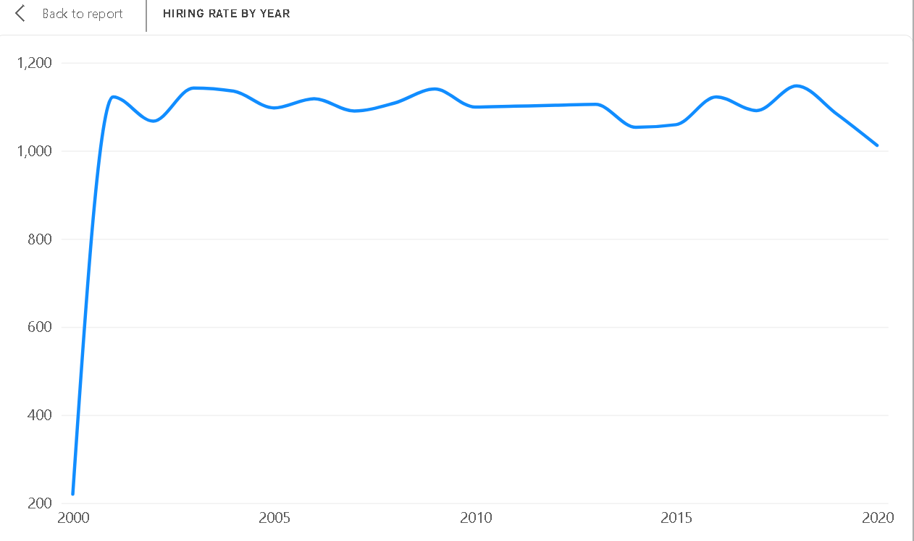
Hiring Rate by Year
PRDA–03 HR Analytics

Slide 4
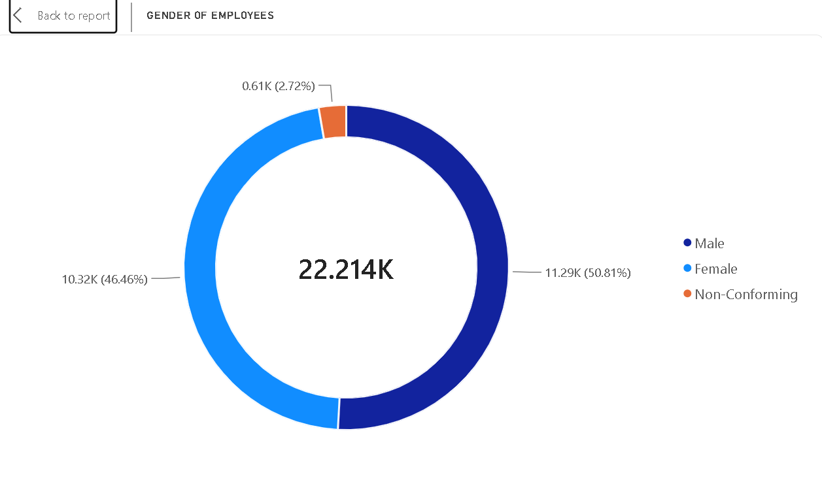
Gender of Employees
PRDA–03 HR Analytics

Slide 5
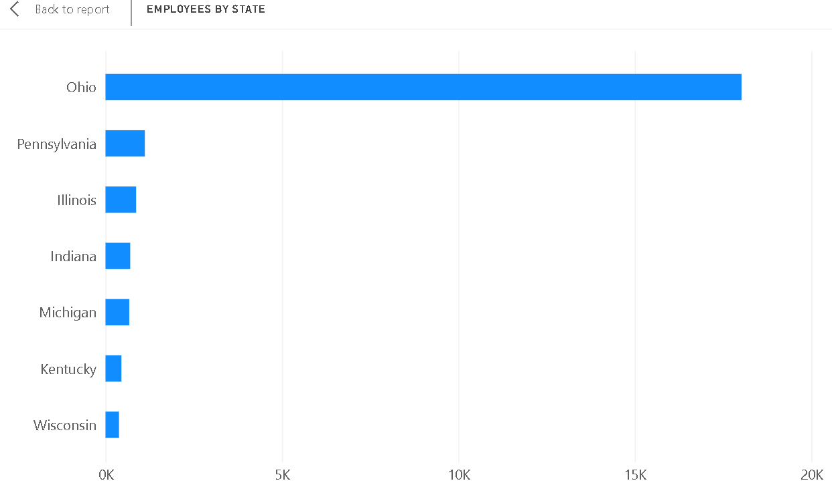
Employees by State
PRDA–03 HR Analytics

Slide 6
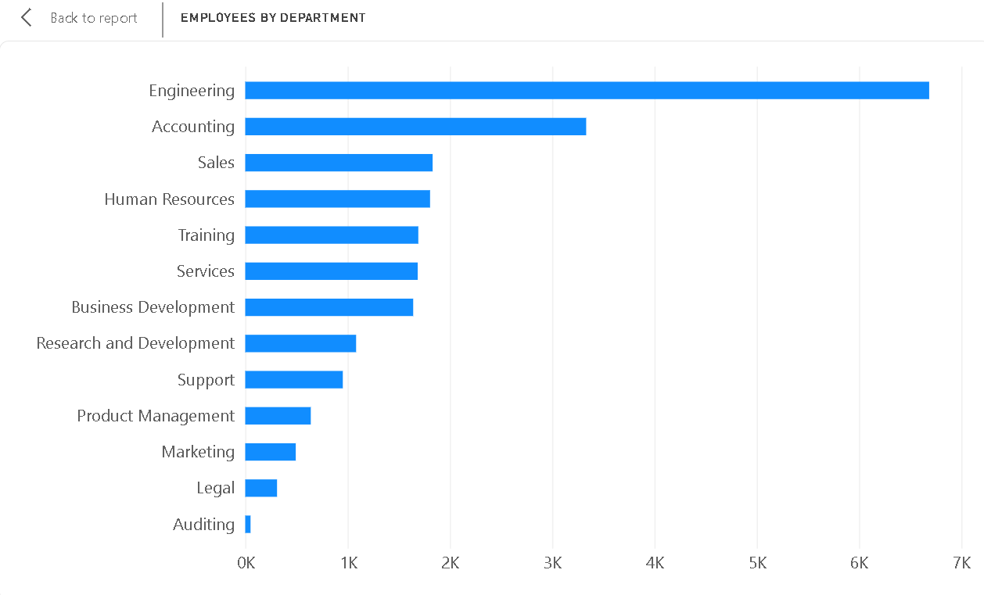
Employees by Department
PRDA–03 HR Analytics

Slide 7
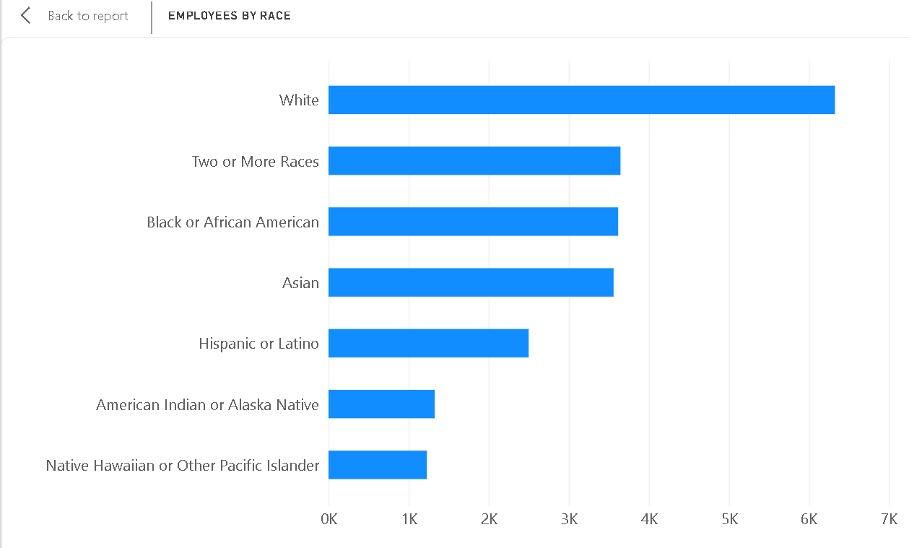
Employees by Race
PRDA–03 HR Analytics

Slide 8
Key Insights
• Engineering is the largest department, with 6,686 employees, making it the strongest workforce concentration by department.
• Ohio is the dominant state location, with 18,025 employees, indicating a highly concentrated geographic workforce.
• The workforce is predominantly Headquarters-based (75.25%), while Remote employees account for 24.75%.
• Gender representation is relatively balanced: Male employees account for 50.81%, Female employees 46.46%, and Non-Conforming employees 2.72%.
• White employees form the largest race category at 6,328 employees, followed by Two or More Races, Black or African American, and Asian employees.
• Hiring remains broadly stable at around the 1,000–1,150 employee range in most years after 2000, with 2018 showing the highest annual hiring count (1,147).
PRDA–03 HR Analytics

Slide 9
Business Recommendations
• Review engineering workforce capacity regularly because Engineering represents the largest department and is likely critical to operational delivery.
• Evaluate the geographic concentration in Ohio and consider whether workforce diversification across other states would improve talent access and operational resilience.
• Use role-level performance, collaboration, and retention measures when considering future expansion of remote work.
• Continue monitoring diversity representation at department and job-level granularity rather than relying only on overall workforce percentages.
• Use historical hiring patterns as a baseline for annual workforce planning and recruitment scenarios.
PRDA–03 HR Analytics

