Slide 1
Customer Segmentation
Using Clustering
CDACL-002 — Customer Segmentation | K-Means analysis of shopping trends
Student: Srikanth | Course: CDA | Team ID: PTID-CDA-AUG-26-11210
1

Slide 2
Project Overview
3,900
19
3
4
Customer records
Attributes per record
Analysis tasks
Final customer segments
Objective: identify products to discount, understand card-spending drivers, and segment customers into 3+ groups with targeted marketing campaigns.
Task 1: Which products should carry discounts, and why
Task 2: How card spending varies by age, season & location
Task 3: Segment customers via K-Means; map to campaigns
2

Slide 3
Data Preparation
Dataset shape | 3,900 rows × 19 columns
Missing values | 0 — no imputation required
Duplicate rows | 0
Numerical features standardized | Age, Purchase_Amount_USD, Review_Rating, Previous_Purchases
Scaler used | StandardScaler (zero mean, unit variance)
Clean, complete data means the clustering results below reflect genuine patterns rather than artifacts of missing or duplicated records.
3

Slide 4
Data Quality & Standardization Evidence
Clustering inputs were checked for data quality and standardized before K-Means.
Missing values: 0
Duplicate rows: 0
Duplicate Customer IDs: 0
Feature | Original Mean | Original Std | Standardized Mean | Standardized Std
Age | 44.068 | 15.206 | 0.000 | 1.000
Purchase Amount (USD) | 59.764 | 23.682 | 0.000 | 1.000
Review Rating | 3.750 | 0.716 | 0.000 | 1.000
Previous Purchases | 25.352 | 14.445 | 0.000 | 1.000
StandardScaler makes each clustering feature approximately mean = 0 and standard deviation = 1, so scale differences do not dominate K-Means distance calculations.
4

Slide 5
Task 1 — Which Products Should Carry Discounts?
Category-level ratings, spend and discount rate are nearly uniform (3.72–3.79 rating across all 4 categories) — the real signal is at item level.
Discount Candidates
Shirt, Jeans, Blouse, Scarf, Shorts and Pants rate below the dataset average (~3.75). A modest discount can offset weaker perceived value, encourage hesitant buyers, and move slow-moving inventory.
Protect Margin On
Gloves, Sandals, Boots and Hat are already top-rated — no price incentive needed.
5

Slide 6
Task 2 — Card Spending by Age
Overall spend is flat by age (~$59–61 across all bands) — but Credit Card shoppers consistently out-spend Debit Card shoppers, with the gap widest among 26–35 year-olds.
6

Slide 7
Task 2 — Impact of Season & Location
Season
Location
Fall & Winter: highest avg spend AND highest card-usage rate (36.4% / 34.7%) — cold-weather, higher-ticket, card-paid purchases.
~25% spread between highest state (Alaska, $67.6) and lowest (Connecticut, $54.2) — useful for regional targeting.
7

Slide 8
Task 3 — Clustering Methodology
K-Means on standardized Age, Purchase Amount, Review Rating & Previous Purchases. K evaluated 2–8 via Elbow (inertia) and Silhouette score.
Why K = 4
Silhouette scores are modest across the board (0.18–0.23) — this dataset lacks strongly separated natural clusters.
K=4 is a local silhouette peak (0.191) that produces four large, stable, easy-to-target segments.
K=8 scores marginally higher (0.230) but fragments customers into segments too small to campaign against separately.
Final model: K = 4 clusters, ~966–986 customers each
8

Slide 9
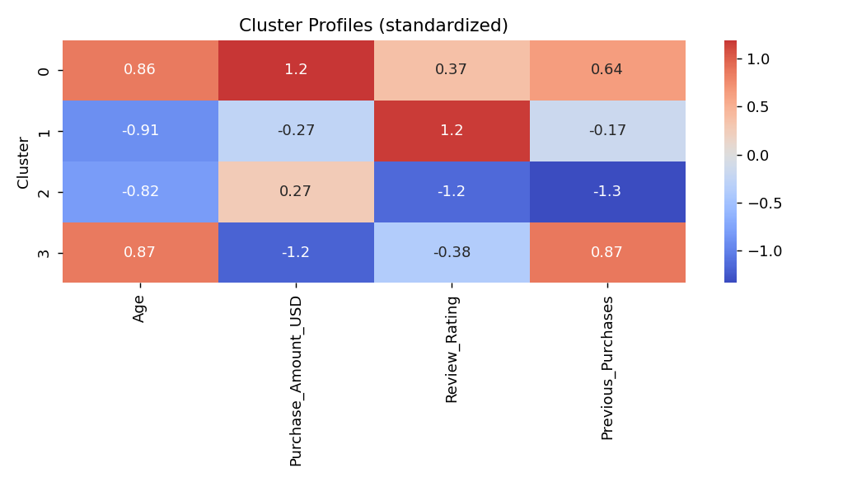
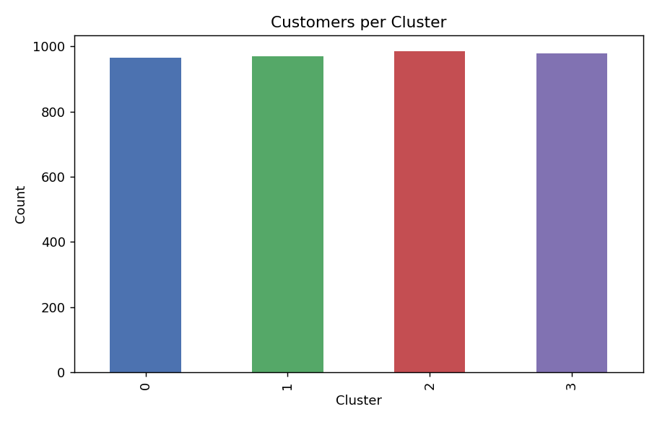
Cluster Profiles
Age and Purchase Amount separate clusters most clearly; Review Rating is the key secondary split among younger customers.
9

Slide 10
Segment Descriptions & Targeted Campaigns
Cluster | Profile | Campaign
0 | Older (~56), high spend ($82), high rating (3.96) | VIP loyalty: early access, premium bundles
1 | Younger (~31), moderate spend ($55), highest rating (4.43) | Referral & advocacy: incentivize reviews/referrals
2 | Younger (~33), decent spend ($65), lowest rating (3.09) | Retention/win-back: service recovery, targeted offers
3 | Older (~56), lowest spend ($38), moderate rating (3.54) | Value-led: free-shipping thresholds, bundle deals
10

Slide 11
Business Insights
1
Customer behavior is heterogeneous — four distinct segments, not one homogeneous base.
2
Higher-spending segments respond to premium recommendations & convenience offers, not discounts.
3
Lower-spending / at-risk segments respond better to value bundles and retention outreach.
4
Discounting should be item-targeted (low-rated items), not category-wide.
5
Fall/Winter and high-spend states are the highest-leverage windows for premium campaigns.
11

Slide 12
Conclusion
Discounts targeted at low-rated items (Shirt, Jeans, Blouse, Scarf, Shorts, Pants) — not blanket category discounts.
Card type, season and location all meaningfully shift spending — inputs for regional/seasonal promo timing.
Four K-Means segments (K=4) give actionable, differentiated marketing campaigns: VIP, Advocacy, Retention, Value.
Silhouette scores are modest — segments should be read as directional, exploratory groupings, not hard boundaries.
12

