Slide 1

BLOCKCHAINCOURSE · CURRICULUM
Practical Engineering Over Hype
This Slide
Week 01 · Blockchain Basics
No memorized buzzwords, no copy-pasted templates you can't explain. Understand the mechanics first.
Start Learning
→
01/18

Slide 2
HOW THIS COURSE IS STRUCTURED
Two Halves
Everything builds toward one goal: understand how it works, then ship something real.
1
2
Half 1 · Weeks 1-5
Half 2 · Weeks 6-9
Basics & core concepts. Everything you need to walk into a hackathon and build something real — wallets, contracts, tokens, a working dApp.
Advanced topics. Security, upgradeable contracts, Layer 2s, and the wider ecosystem — what separates a prototype from production.
◉ You are here — Week 01
02/18

Slide 3

BEFORE YOU BEGIN
Ground Rules
01
Understand before you copy
If you can't explain a line of code, don't ship it.
02
Testnet first, always
Never deploy something you haven't tested.
03
No frontend before the CLI works
Deploy and call a contract with cast first.
04
Every contract gets a test
An untested contract is unfinished.
03/18

Slide 4

BLOCKCHAINCOURSE · WEEK 01 · TOPIC 01 OF 04
Hashing
A tamper-evident fingerprint for data — change one letter, get an unrecognizable result.
Photo: Simon A. Eugster / Wikimedia Commons, CC BY-SA 3.0
04/18

Slide 5

TOPIC 01 — HASHING
Why This Matters
Before any other concept in this course makes sense, you need hashing — it's the primitive every other piece (signatures, blocks, chains) is built on top of. This topic covers the four core properties, a real worked example, real-world uses, and the misconceptions that trip people up.
05/18

Slide 6

TOPIC 01 — HASHING
The Core Concept
A hash function takes any input — a letter, a word, a gigabyte of data — and turns it into a fixed-length string of characters called a hash. For blockchain, that function is SHA-256 (Bitcoin) or Keccak-256 (Ethereum). Same input, same output, every time — but there's no way back.
06/18

Slide 7
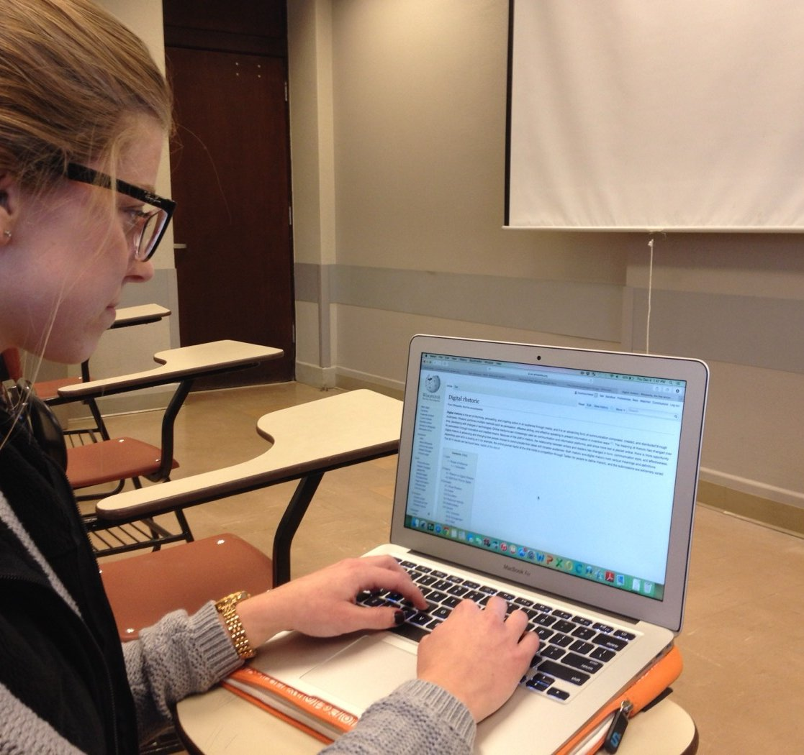
KEY IDEA 1 / 4
Deterministic
The same input always produces the exact same output. Hash “hello” today or in ten years — identical result, every time.
EXAMPLE
"hello" → 2cf24dba...9824 (always)
07/18

Slide 8
KEY IDEA 2 / 4
One-Way
Given a hash, there's no way to work backwards to the original input — easy to fall through, impossible to climb back up.
EXAMPLE
Can't reverse a fingerprint into a face.
08/18

Slide 9
KEY IDEA 3 / 4
Avalanche Effect
Changing one character of input produces a completely different, unrecognizable hash. No partial similarity, ever.
EXAMPLE
"Alice" vs "Alicf" → totally unrelated hashes
09/18

Slide 10

KEY IDEA 4 / 4
Collision-Resistant
Practically impossible to find two different inputs producing the same hash — one hash, one piece of data.
EXAMPLE
No two files should share a SHA-256 hash.
10/18

Slide 11
WORKED EXAMPLE — PART 1
Determinism, Proven On A Real Machine
$ echo -n "hello" | shasum -a 256
2cf24dba5fb0a30e26e83b2ac5b9e29e1b161e5c1fa7425e73043362938b9824
# run it again —
$ echo -n "hello" | shasum -a 256
2cf24dba5fb0a30e26e83b2ac5b9e29e1b161e5c1fa7425e73043362938b9824
# identical, every time. no randomness.
Try it yourself: shasum -a 256 (macOS) or sha256sum (Linux).
11/18

Slide 12
WORKED EXAMPLE — PART 2
The Avalanche Effect, Proven With Real Data
$ echo -n "Send 1 ETH to Alice" | shasum -a 256
9bed087e0a716e203d57c1ba36493085f7a87628da1cb1fe18bf5b4631bd7e45
$ echo -n "Send 1 ETH to Alicf" | shasum -a 256
94f17d20a09db58f6a7fe2cf97f00b2ae2dc1a67802b6e74776b0b6785e4b1eb
# one letter changed: e → f. total mismatch.
This is why altering one digit of a real transaction is instantly detectable.
12/18

Slide 13
REAL-WORLD USES
Not Just Blockchain
Software Checksums
Git Version Control
✓
⛓
Verify a download wasn't tampered with.
Every commit is identified by a hash.
Hashing predates blockchain by decades and solves a much older problem.
✖
Password Storage
☁
Cloud Dedup
Store a hash, never the password itself.
Identical files recognized by matching hashes.
⚖
Digital Forensics
⚑
Cert Transparency
Proves evidence wasn't altered after collection.
Every SSL cert logged in a public, tamper-evident record.
13/18

Slide 14
FLAGSHIP CASE STUDY
Why Plain SHA-256 Is Wrong For Passwords
SHA-256 is designed to be fast — an attacker with a leaked hash database can try billions of guesses per second. Purpose-built password-hashing algorithms like bcrypt and Argon2 are deliberately slow and add random “salt” per password, specifically to make brute-forcing impractical. Using the right hash function for the job is a real engineering judgment call.
14/18

Slide 15
REAL-LIFE ANALOGY
A Tamper-Evident Wax Seal
A hash is like a wax seal on a letter. The seal doesn't tell you what's written inside — you can't reverse it back into words. But if someone changes one word and reseals it, the new seal looks completely different. Anyone who remembers the original can instantly tell it was tampered with, without reading a single word.
15/18

Slide 16
COMMON MISCONCEPTIONS
Where People Get Tripped Up
Two claims that sound reasonable, but aren't quite right.
1
2
“Hashing is encryption.”
“A public hash is always safe.”
It isn't — hashing is deliberately one-way; there's no key that reverses it. “Decrypting a hash” is a contradiction in terms.
Only for high-entropy inputs — a 4-digit PIN's hash can be cracked instantly by hashing all 10,000 possibilities.
16/18

Slide 17

HANDS-ON PRACTICE
Do This Now
01
Hash your own name twice
Confirm identical output — determinism, proven yourself.
02
Change one character, re-hash
Confirm total mismatch — the avalanche effect.
03
Try the live hash demo
andersbrownworth.com/blockchain/hash
04
Compare in CyberChef
"Hello World" vs "hello World".
17/18

Slide 18

TAKE-HOME ASSIGNMENT
Before You Move On
✓
Explain immutability
Why does blockchain immutability depend entirely on hashing?
✓
Pick one real-world use
Which property of hashing makes it work for that case?
✓
Write a 2-block script
Hash a string, then chain a second block onto it.
Videos: How does SHA-256 work? (full explanation)
Practice: andersbrownworth.com/blockchain/hash · CyberChef
18/18

