Slide 1

BLOCKCHAINCOURSE · CURRICULUM
Practical Engineering Over Hype
This Slide
Week 02 · Concepts
No memorized buzzwords, no copy-pasted templates you can't explain. Understand the mechanics first.
Start Learning
→
01/22

Slide 2
HOW THIS COURSE IS STRUCTURED
Two Halves
Everything builds toward one goal: understand how it works, then ship something real.
1
2
Half 1 · Weeks 1-5
Half 2 · Weeks 6-9
Basics & core concepts. Everything you need to walk into a hackathon and build something real — wallets, contracts, tokens, a working dApp.
Advanced topics. Security, upgradeable contracts, Layer 2s, and the wider ecosystem — what separates a prototype from production.
◉ You are here — Week 02
02/22

Slide 3

BEFORE YOU BEGIN
Ground Rules
01
Understand before you copy
If you can't explain a line of code, don't ship it.
02
Testnet first, always
Never deploy something you haven't tested.
03
No frontend before the CLI works
Deploy and call a contract with cast first.
04
Every contract gets a test
An untested contract is unfinished.
03/22

Slide 4
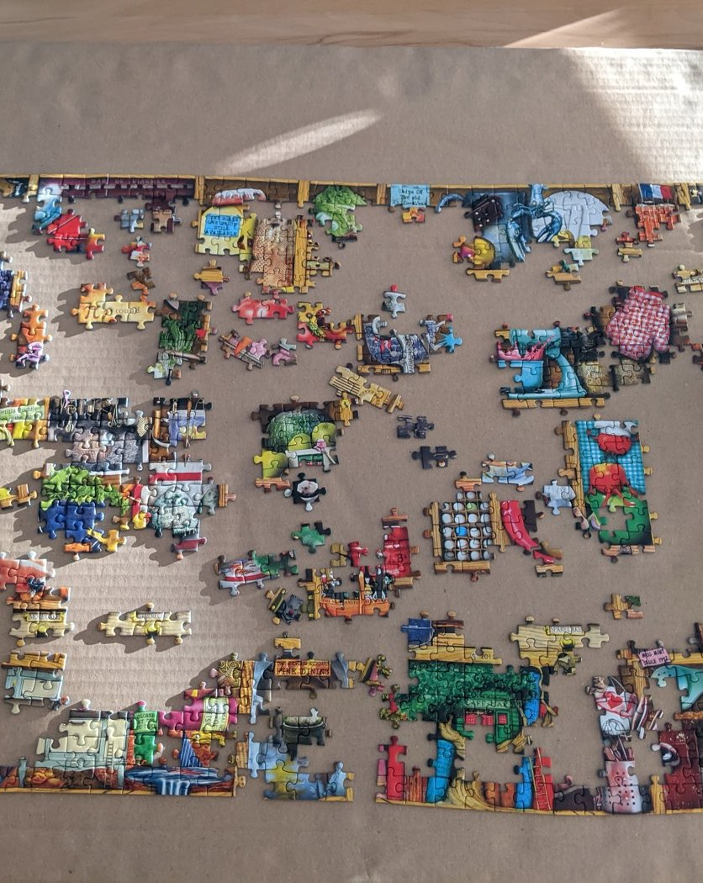
BLOCKCHAINCOURSE · WEEK 02 · TOPIC 02 OF 04
Types & Forms of Decentralization
Decentralization isn't one property — it's three separate, independent measurements.
Photo: Balise42 / Wikimedia Commons, CC BY-SA 4.0
04/22

Slide 5
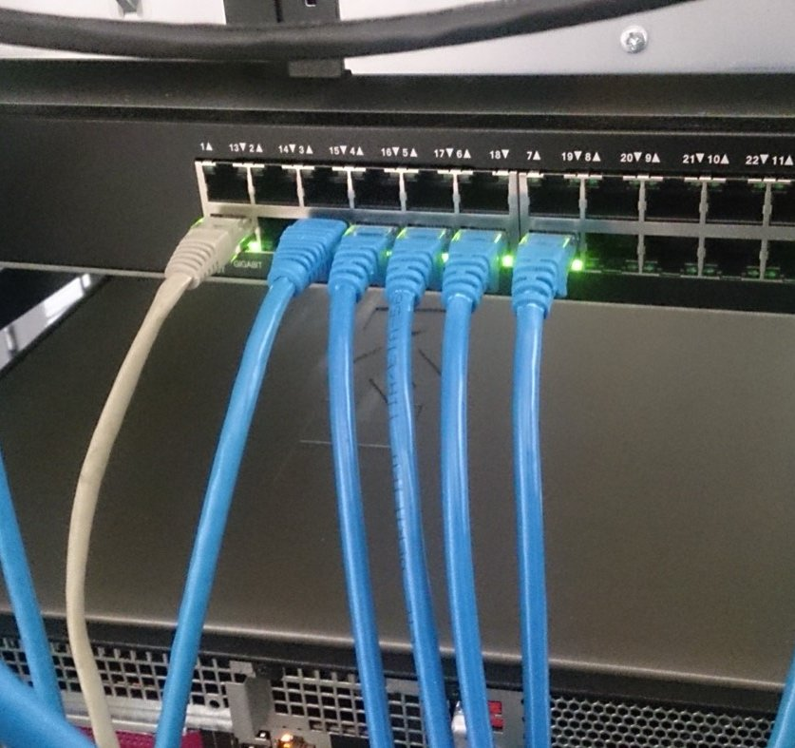
START HERE
A Question, Not A Definition
Is Ethereum decentralized? Most people answer with a confident yes or no. Here's why that's the wrong shape of answer: decentralization isn't one property a system either has or doesn't — it's several separate, independent measurements, and a system can score high on one and low on another at the same time.
05/22

Slide 6

NOTICE IT, BEFORE WE NAME IT — SETUP
Thousands Of Independent Operators
Ethereum runs on thousands of independently operated nodes, spread across the world, run by individuals, universities, companies, and hobbyists who mostly don't know each other. That sounds about as decentralized as it gets.
06/22

Slide 7

NOTICE IT, BEFORE WE NAME IT — RESULT
Yet They All Agree On One Single Truth
At any given moment, all of those thousands of independent nodes agree on one single, shared version of the truth — one balance for your wallet, one state for every contract. Functionally, the network behaves like one giant, unified computer, not a loose federation of separate ones.
EXAMPLE
Thousands of independent operators + one unified, agreed-upon state.
07/22

Slide 8
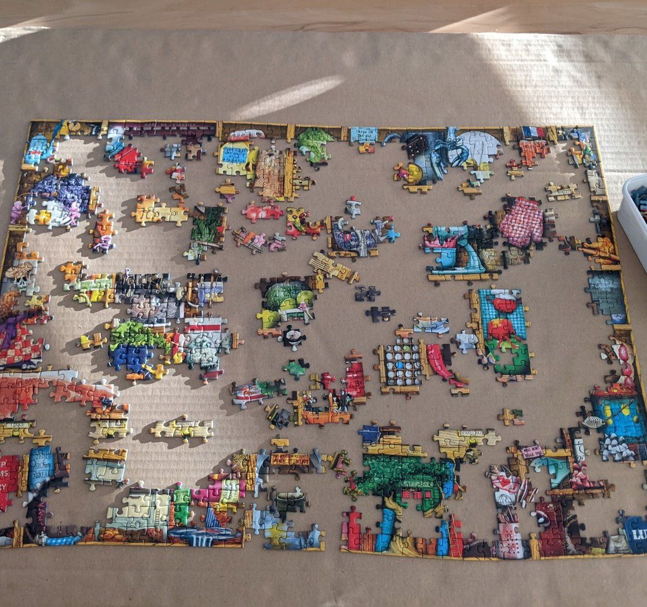
NOW IT HAS A NAME
Three Separate Axes, Not One Property
Vitalik Buterin's 2017 essay laid out three axes: Architectural (how many computers, how many could fail?), Political (how many people/orgs control those computers?), and Logical (does the system behave like one unified object, or an amorphous swarm?). A system's score on one tells you almost nothing about its score on another.
08/22

Slide 9

KEY IDEA 1 / 3
Architectural Decentralization
How many physical computers make up the system, and how many could fail before it breaks? Ethereum: thousands of independent nodes; losing a large fraction changes nothing.
09/22

Slide 10
KEY IDEA 2 / 3
Political Decentralization
How many individuals or organizations ultimately control those computers? A handful of mining pools or staking operators controlling the majority is a much smaller number than the raw node count suggests.
10/22

Slide 11
KEY IDEA 3 / 3
Logical Decentralization
Does the system behave like one unified object, or an amorphous swarm that could keep functioning split in half? Blockchains are logically centralized — one agreed state — even while architecturally and politically decentralized.
11/22

Slide 12
?
CHECK YOUR UNDERSTANDING
Bitcoin mining has historically been concentrated in a handful of large pools. Does that make Bitcoin “centralized”?
ANSWER
Not architecturally — thousands of independent nodes still verify the chain, and anyone can run one. But it can mean Bitcoin is, at times, less politically decentralized than the raw node count suggests, since a small number of pool operators control an outsized share of block-production decisions. Both statements can be true at once.
12/22

Slide 13
CONNECT IT
Forms Of Decentralization In Practice
Once you have this vocabulary, you can spot the same idea applied differently: DeFi (lending/trading without a bank as the central party), decentralized storage like IPFS (files addressed by content hash — a callback to Week 1), decentralized identity, and DAOs — significant enough to be next topic's entire focus.
13/22

Slide 14
FLAGSHIP CASE STUDY
The Genuinely Surprising Result
A blockchain is decentralized in who runs it and who controls it, but centralized in how it behaves — one unified ledger, not many independent ones. That third axis is actually the point: a unified, agreed-upon ledger is what lets a decentralized network avoid the “which copy is real” problem that plagues systems without consensus (Week 1, Topic 04). Buterin's own conclusion: these three axes are largely independent — treating “decentralized” as one yes/no property collapses a real, useful distinction.
14/22

Slide 15
REAL-WORLD USES
Where This Shows Up
☁
✉
CDNs
Email (SMTP)
Architecturally distributed globally, but politically centralized — a handful of companies run most CDN infrastructure.
Architecturally decentralized by design, politically concentrated in practice.
The same three-axis lens applies far outside blockchain.
🏛
🗂
DAOs
Decentralized Storage
Decision-making itself decentralized, not just infrastructure — next topic's full focus.
IPFS/Filecoin — files distributed and addressed by content hash across independent providers.
15/22

Slide 16
REAL-WORLD DEEP-DIVE
Applying All Three Axes To One System
Take any blockchain you know and rate it on all three axes with a specific fact, not a vibe: how many nodes, and how many could fail (architectural)? How concentrated is mining/staking power (political)? Does the network behave as one unified state, or could it split and keep functioning independently (logical)? Most people can only answer the first.
16/22

Slide 17
COMMON MISCONCEPTIONS
Where People Get Tripped Up
Two claims that sound reasonable, but aren't quite right.
1
2
“Logically centralized contradicts decentralization.”
“More nodes always means more decentralized.”
It doesn't — it's a different axis. A unified, agreed-upon ledger is the point: it avoids the “which copy is real” problem.
Only architecturally. If a handful of organizations run most of those nodes, political decentralization can be low even with a high node count.
17/22

Slide 18
?
ONE MORE CHECK
If a network has 10,000 nodes but 3 companies run 9,000 of them, is it decentralized?
ANSWER
Architecturally, technically yes — 10,000 separate machines. Politically, no — 3 organizations effectively control the outcome. This is exactly the kind of mismatch the three-axis framework exists to describe precisely, instead of collapsing into a single misleading yes/no.
18/22

Slide 19

HANDS-ON PRACTICE
Do This Now
01
Rate a blockchain on all 3 axes
Bitcoin, Ethereum, or any network you know — justify each with a specific fact.
02
Apply the framework outside blockchain
DNS, open-source development, or email — where does it score high, and surprisingly low?
03
Read Buterin's original essay
Short, and worth reading in full — link in Resources.
19/22

Slide 20
RESOURCES
Watch, Read, Explore
RECOMMENDED VIDEOS
What is a DAO in Crypto? (Decentralized Autonomous Organization) — previews next topic
WHERE TO READ MORE
Vitalik Buterin, “The Meaning of Decentralization” — the original essay this topic is built on.
PRACTICE SITE
Apply the 3-axis framework to any network you already use daily.
20/22

Slide 21

TAKE-HOME ASSIGNMENT
Before You Move On
✓
Rewrite “is X decentralized?”
As three more precise questions someone could actually answer with evidence.
✓
Justify each axis rating
For a network of your choice, with a specific fact — not a vibe.
✓
Find one real mismatch
A system that scores differently on two of the three axes, and explain why.
21/22

Slide 22
RECAP
On To DAOs.
You have the vocabulary for decentralized infrastructure. Next: what happens when the decision-making itself is decentralized too.
REPOSITORY
github.com/jadonamite/BlockchainCourse
THIS TOPIC
curriculum/week-02/02-types-and-forms-of-decentralization.md
NEXT UP
Topic 03 — DAOs
22/22

