Slide 1
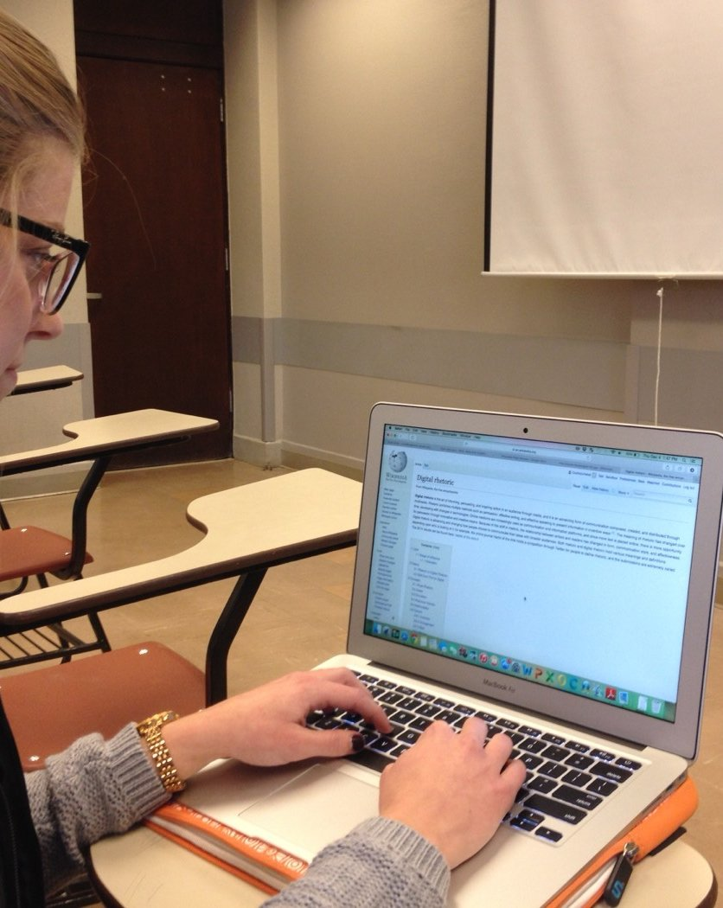
BLOCKCHAINCOURSE · CURRICULUM
Practical Engineering Over Hype
This Slide
Week 02 · Concepts
No memorized buzzwords, no copy-pasted templates you can't explain. Understand the mechanics first.
Start Learning
→
01/22

Slide 2
HOW THIS COURSE IS STRUCTURED
Two Halves
Everything builds toward one goal: understand how it works, then ship something real.
1
2
Half 1 · Weeks 1-5
Half 2 · Weeks 6-9
Basics & core concepts. Everything you need to walk into a hackathon and build something real — wallets, contracts, tokens, a working dApp.
Advanced topics. Security, upgradeable contracts, Layer 2s, and the wider ecosystem — what separates a prototype from production.
◉ You are here — Week 02
02/22

Slide 3

BEFORE YOU BEGIN
Ground Rules
01
Understand before you copy
If you can't explain a line of code, don't ship it.
02
Testnet first, always
Never deploy something you haven't tested.
03
No frontend before the CLI works
Deploy and call a contract with cast first.
04
Every contract gets a test
An untested contract is unfinished.
03/22

Slide 4

BLOCKCHAINCOURSE · WEEK 02 · TOPIC 03 OF 04
DAOs
Decentralization you can actually join — no CEO, no board, rules enforced by code.
Photo: Christina Morillo / Pexels via Wikimedia Commons, CC0
04/22

Slide 5
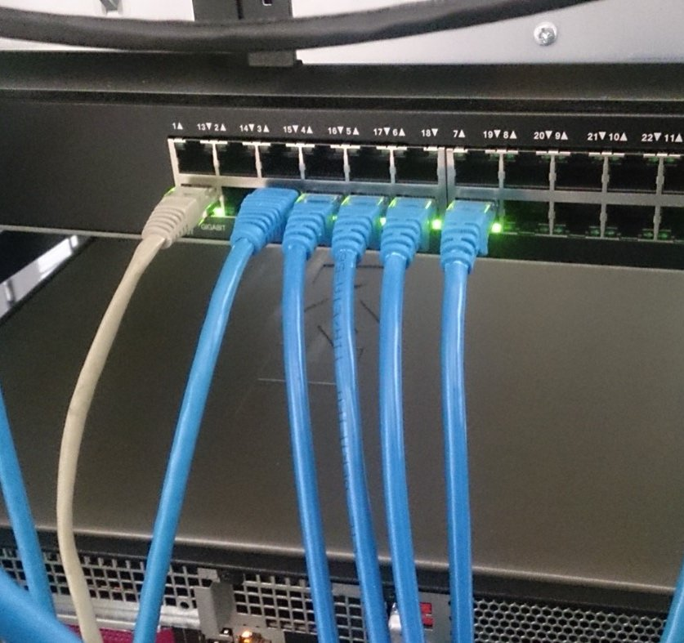
START HERE
A Question, Not A Definition
You now have real vocabulary for decentralization as a property of infrastructure and control. Here's the next question: what does an actual organization look like if it's decentralized from the ground up — no CEO, no board, no small group who alone can move the treasury? Is that even possible, or just a slogan?
05/22

Slide 6
NOTICE IT, BEFORE WE NAME IT — SETUP
A Decentralized Venture Fund, Built From Nothing
In 2016 — Ethereum barely a year old — a group built exactly this and called it, simply, “The DAO.” Anyone could send ETH to its smart contract in exchange for voting tokens, and token holders would vote on which projects the pooled funds should fund. No company, no fund manager with sole signing authority.
06/22

Slide 7
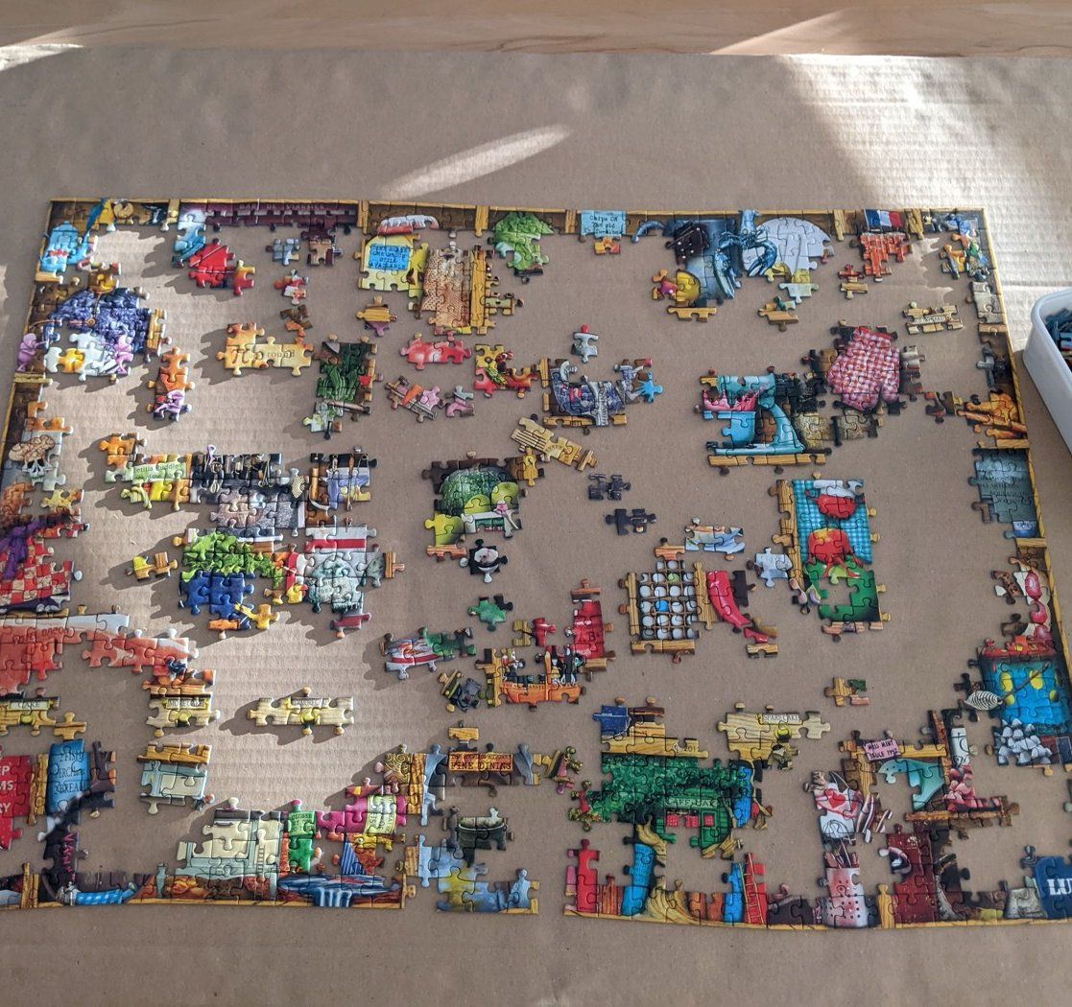
NOTICE IT, BEFORE WE NAME IT — RESULT
It Worked Remarkably Well — Until It Didn't
The DAO raised roughly $150 million worth of ETH (about 3.6 million ETH) from thousands of independent contributors — one of the largest crowdfunding events in history, coordinated without a company. Then in June 2016, an attacker found a reentrancy bug and drained roughly 3.6 million ETH — the majority of the fund.
EXAMPLE
$150M raised. ~3.6M ETH later drained by one bug. No customer support line to call.
07/22

Slide 8

NOW IT HAS A NAME
What A DAO Actually Is
A Decentralized Autonomous Organization: an organization whose core rules — who can spend shared funds, how decisions get made — are written into smart contracts and enforced by the network, not a person with unilateral authority. Membership and voting power are usually token-based; approved proposals can execute automatically.
08/22

Slide 9

KEY IDEA 1 / 3
No Customer Support Line
The code did exactly what it was written to do — nobody lied or broke consensus. The rules, as written, allowed the exploit.
09/22

Slide 10
KEY IDEA 2 / 3
The Contentious Choice
Let the theft stand because “the code is the law,” or intervene at the protocol level to reverse it?
10/22

Slide 11
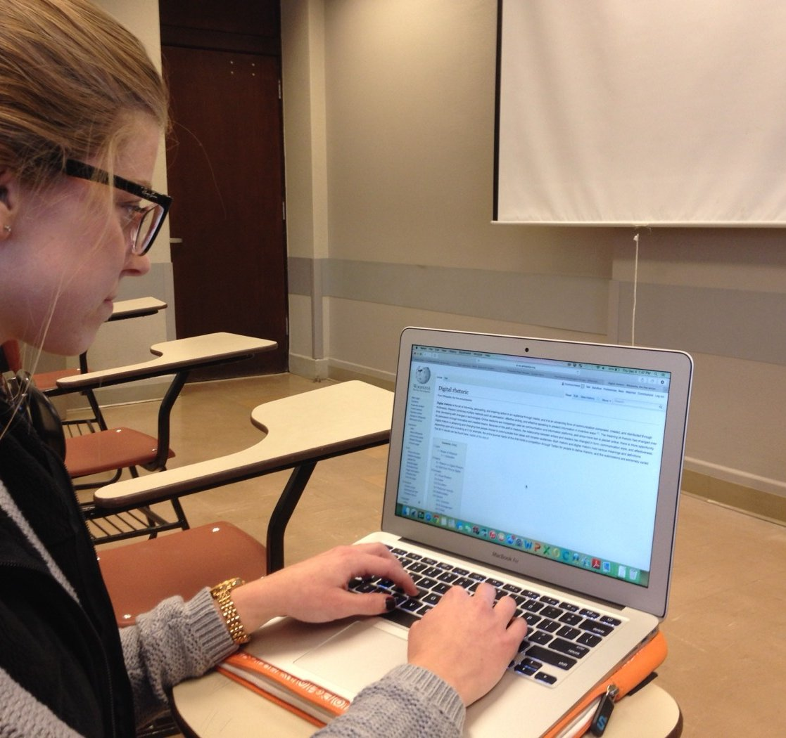
KEY IDEA 3 / 3
The Hard Fork
The chain that intervened continued as Ethereum (ETH). The minority who rejected intervention kept the original chain — Ethereum Classic (ETC), the exact same ETC from Week 1's 51%-attack case study.
11/22

Slide 12
?
CHECK YOUR UNDERSTANDING
If a DAO's smart contract has a bug, can “the DAO” just decide to pause it and patch it, like a company pulling a broken feature overnight?
ANSWER
Not unless that exact capability was deliberately built into the contract in advance — a pause function, an upgrade mechanism, an emergency multi-sig override. This is precisely why The DAO's exploit couldn't simply be undone through ordinary means: nobody had anticipated needing one. Fixing it required changing the blockchain itself.
12/22

Slide 13
CONNECT IT
DAOs Didn't Stop In 2016
Uniswap DAO — token holders vote on protocol fee changes using UNI. MakerDAO — governs the risk parameters backing the DAI stablecoin entirely through on-chain votes. Grants and treasury DAOs — pool funds and vote on which projects to fund, a direct descendant of The DAO's original idea, with the hard lessons about security (Week 6) baked in.
13/22

Slide 14
FLAGSHIP CASE STUDY
The Exact Same Ethereum Classic From Week 1
If “Ethereum Classic” sounds familiar, it's because it is — the exact same network from Week 1's consensus topic, where you read about its real, documented 51%-attacks in 2019 and 2020. Its origin story is this event. The Ethereum community faced a genuine choice between two principles: “code is law” vs. “intervene to fix an obvious wrong.” There was no clean answer — and the split that resulted still exists today, as two separate, living blockchains.
14/22

Slide 15
REAL-WORLD USES
Where This Shows Up
🦄
🏦
Uniswap DAO
MakerDAO
Token holders vote on protocol fee structures using UNI tokens as voting power.
Governs DAI's risk parameters entirely through on-chain governance votes.
The cooperative, member-governed idea behind DAOs predates blockchain by decades.
📜
🤝
Open-Source Foundations
Worker Co-ops
Decisions made collectively by members, not an ownership class — DAOs' older organizational ancestor.
Apache-style distributed maintainer voting — DAOs make this cryptographically enforceable.
15/22

Slide 16
REAL-WORLD DEEP-DIVE
A Real, Current Governance Vote
Look up one active DAO — Uniswap or MakerDAO — and find a real governance proposal it voted on. What was proposed? What was the outcome? Unlike The DAO in 2016, these systems have years of hard-won security practice behind them.
16/22

Slide 17
COMMON MISCONCEPTIONS
Where People Get Tripped Up
Two claims that sound reasonable, but aren't quite right.
1
2
“A DAO means no leadership or structure at all.”
“The DAO hack proves DAOs don't work.”
Most real DAOs still have core contributor teams or multisig signers handling day-to-day execution — “decentralized” describes major decisions and fund custody, not the absence of coordination.
It proved this specific, early, unaudited contract had a bug — the same way one bankruptcy doesn't prove companies don't work. It's why security (Week 6) is now a first-class discipline.
17/22

Slide 18
?
ONE MORE CHECK
Why couldn't Ethereum's developers just quietly rewrite the one transaction that stole the funds, without anyone noticing?
ANSWER
Because every node independently verifies the chain's history using the hashing and consensus mechanisms from Week 1 — a quiet, undetected rewrite is exactly what that system is built to make impossible. Any change had to be an open, network-wide hard fork that every node could see and choose whether to adopt — exactly why it split into two chains instead of one silent fix.
18/22

Slide 19
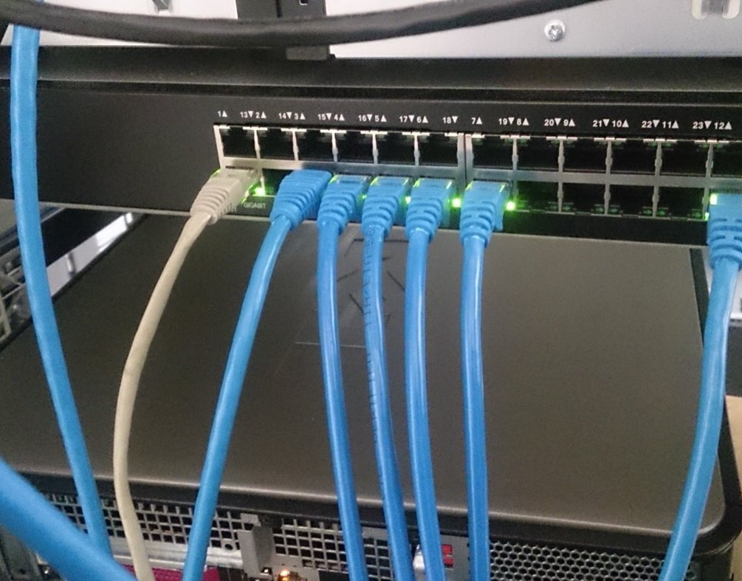
HANDS-ON PRACTICE
Do This Now
01
Find a real governance proposal
From Uniswap, MakerDAO, or any active DAO — what was proposed, what happened?
02
Write The DAO's timeline
One paragraph, launch to the ETH/ETC split, in your own words.
03
Compare to Week 1's ETC case study
Same network — connect the 2016 origin to the 2019/2020 attacks.
19/22

Slide 20
RESOURCES
Watch, Read, Explore
RECOMMENDED VIDEOS
Explained: What Is A DAO? | Crypto 101
WHERE TO READ MORE
“The DAO” on Wikipedia has a detailed, well-sourced account of the 2016 event.
PRACTICE SITE
Uniswap governance forum or MakerDAO governance portal — read real, current proposals.
20/22

Slide 21
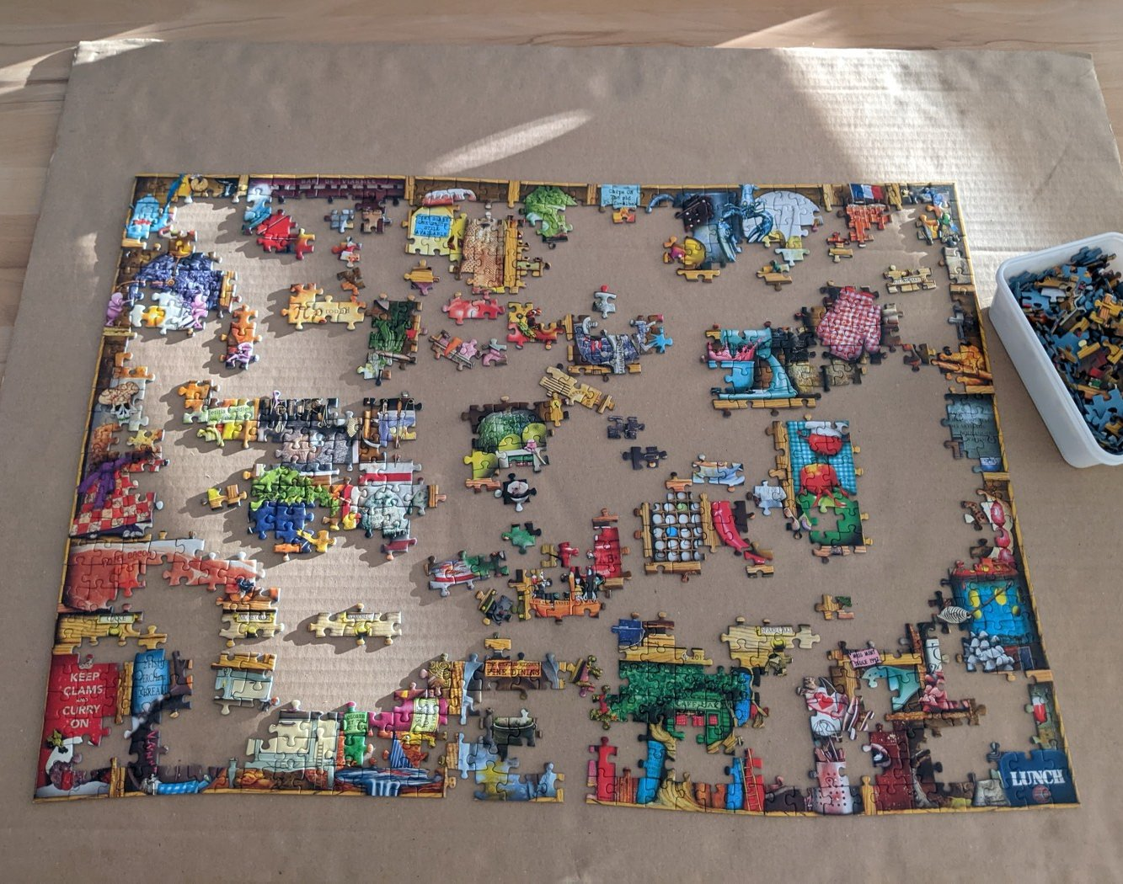
TAKE-HOME ASSIGNMENT
Before You Move On
✓
Explain the philosophical split
Why was this a genuine disagreement, not just a technical problem?
✓
Take a side
“Code is law” vs. “intervene to fix a wrong” — which do you find more convincing, and why?
✓
Connect it to Week 1
How does this origin story change how you read Ethereum Classic's 51%-attacks?
21/22

Slide 22
RECAP
On To Smart Contracts.
You've seen what a DAO is built from. Next: a first, code-free look at the actual thing every DAO — and every dApp — is made of.
REPOSITORY
github.com/jadonamite/BlockchainCourse
THIS TOPIC
curriculum/week-02/03-daos.md
NEXT UP
Topic 04 — What A Smart Contract Is
22/22

