Slide 1
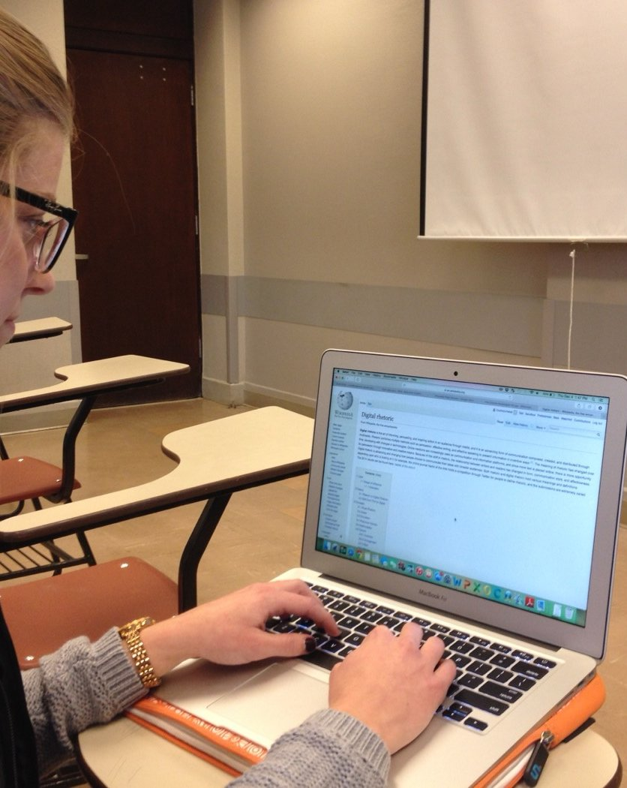
BLOCKCHAINCOURSE · CURRICULUM
Practical Engineering Over Hype
This Slide
Week 02 · Concepts
No memorized buzzwords, no copy-pasted templates you can't explain. Understand the mechanics first.
Start Learning
→
01/22

Slide 2
HOW THIS COURSE IS STRUCTURED
Two Halves
Everything builds toward one goal: understand how it works, then ship something real.
1
2
Half 1 · Weeks 1-5
Half 2 · Weeks 6-9
Basics & core concepts. Everything you need to walk into a hackathon and build something real — wallets, contracts, tokens, a working dApp.
Advanced topics. Security, upgradeable contracts, Layer 2s, and the wider ecosystem — what separates a prototype from production.
◉ You are here — Week 02
02/22

Slide 3

BEFORE YOU BEGIN
Ground Rules
01
Understand before you copy
If you can't explain a line of code, don't ship it.
02
Testnet first, always
Never deploy something you haven't tested.
03
No frontend before the CLI works
Deploy and call a contract with cast first.
04
Every contract gets a test
An untested contract is unfinished.
03/22

Slide 4
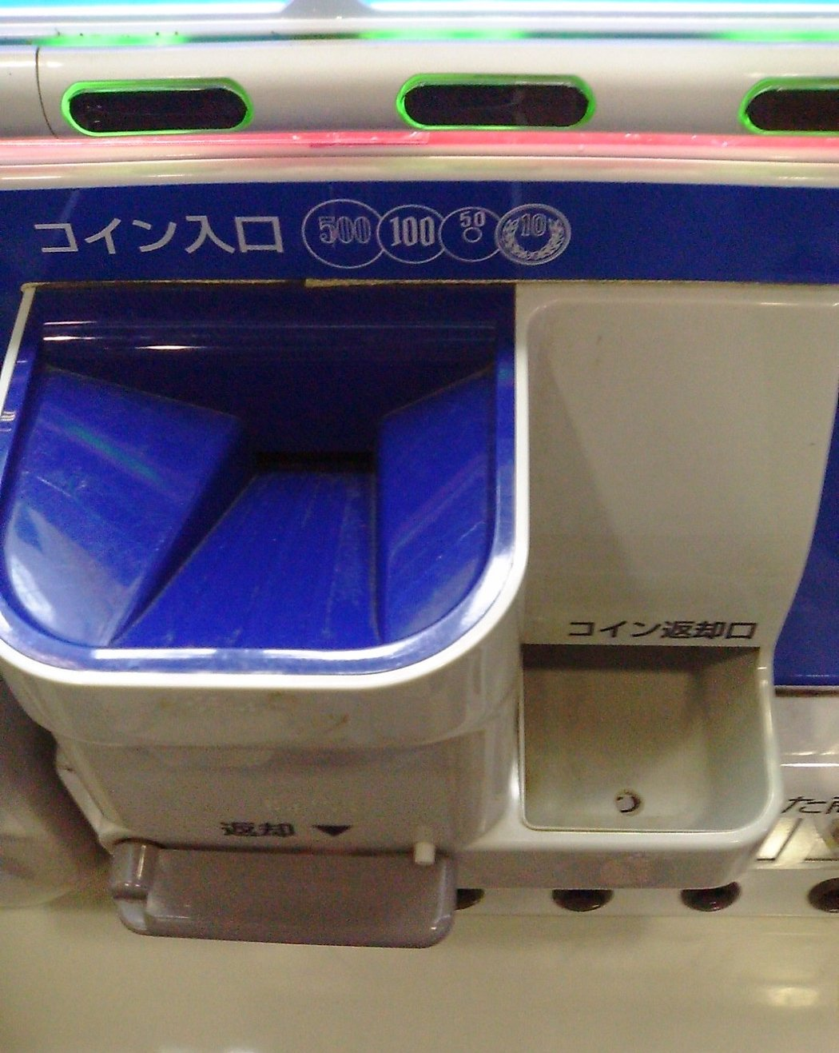
BLOCKCHAINCOURSE · WEEK 02 · TOPIC 04 OF 04
What A Smart Contract Is
A first, code-free look at the actual thing every dApp is made of.
Photo: ぶる♂ / Wikimedia Commons, CC BY-SA 3.0
04/22

Slide 5

START HERE
A Question, Not A Definition
Three topics in, you've used the phrase “smart contract” a dozen times without actually looking at one. The DAO was “a smart contract.” DeFi protocols are “smart contracts.” But what does one actually look like, physically, and how does a network with no central computer manage to run code at all?
05/22

Slide 6
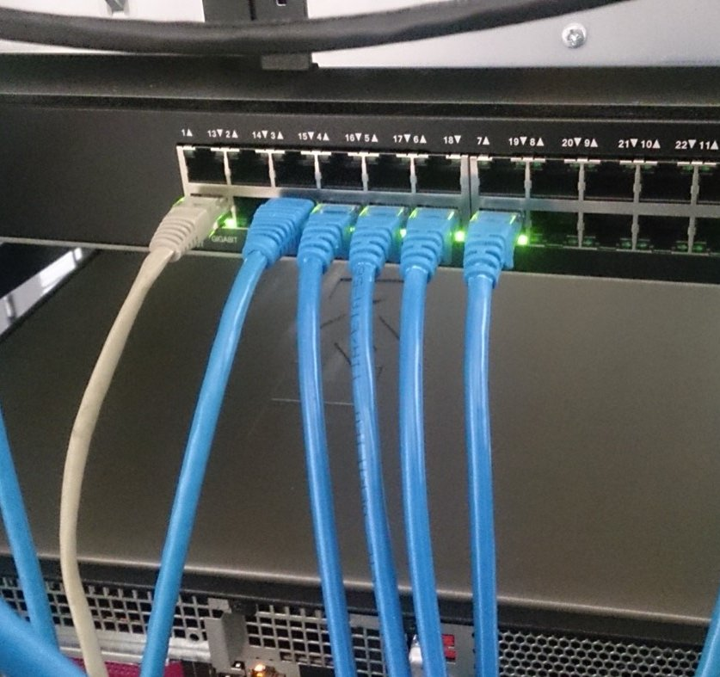
NOTICE IT, BEFORE WE NAME IT — SETUP
A Plain Text File, Nothing Exotic
pragma solidity ^0.8.24; contract Counter { uint256 public count; function increment() public { count += 1; } } — that's a real, complete smart contract. contract Counter { ... } looks like a class definition in any object-oriented language: a named container with data (count) and behavior (increment).
06/22

Slide 7
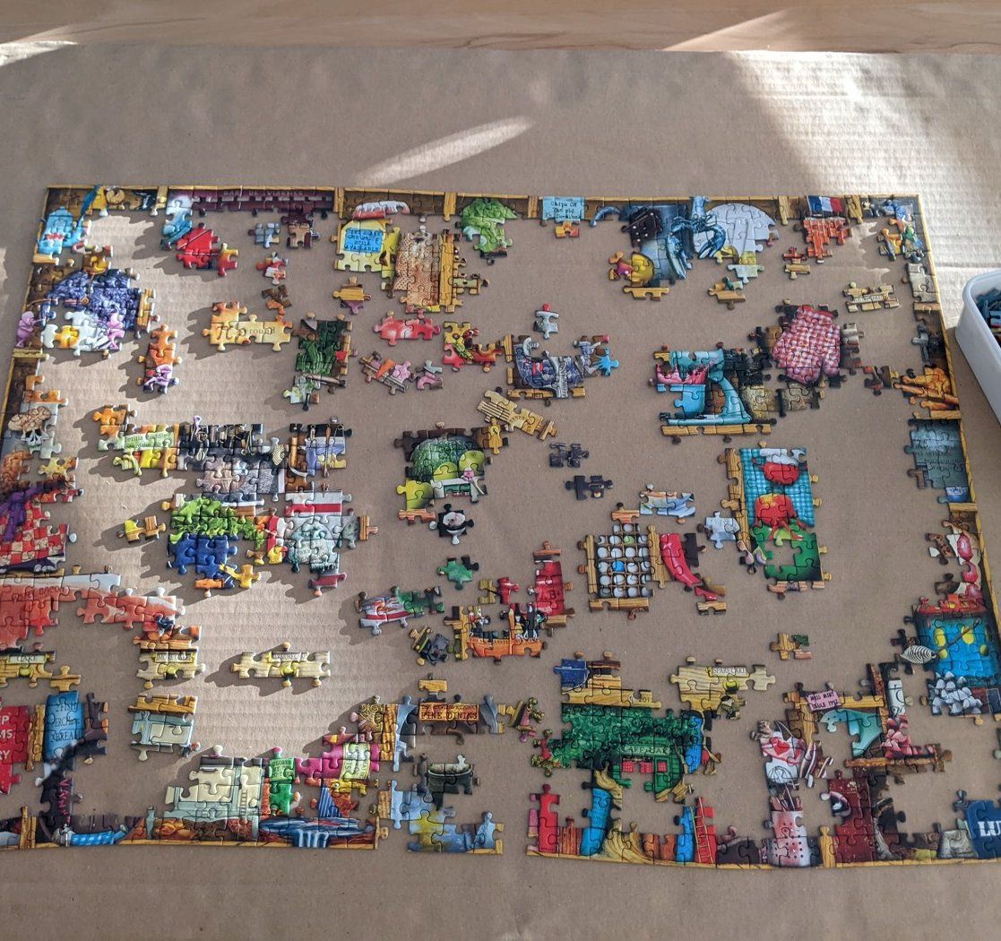
NOTICE IT, BEFORE WE NAME IT — RESULT
What Happens After It's Written Is The Interesting Part
An ordinary program runs on one computer when someone launches it. This file, once deployed, gets compiled into bytecode and stored at a permanent address. From then on, every node on the network can execute that exact bytecode, and whenever someone calls increment(), every node that processes the transaction runs the same computation and must arrive at the identical result.
EXAMPLE
No “the server is down” — as long as the network exists, the contract exists, identically everywhere.
07/22

Slide 8
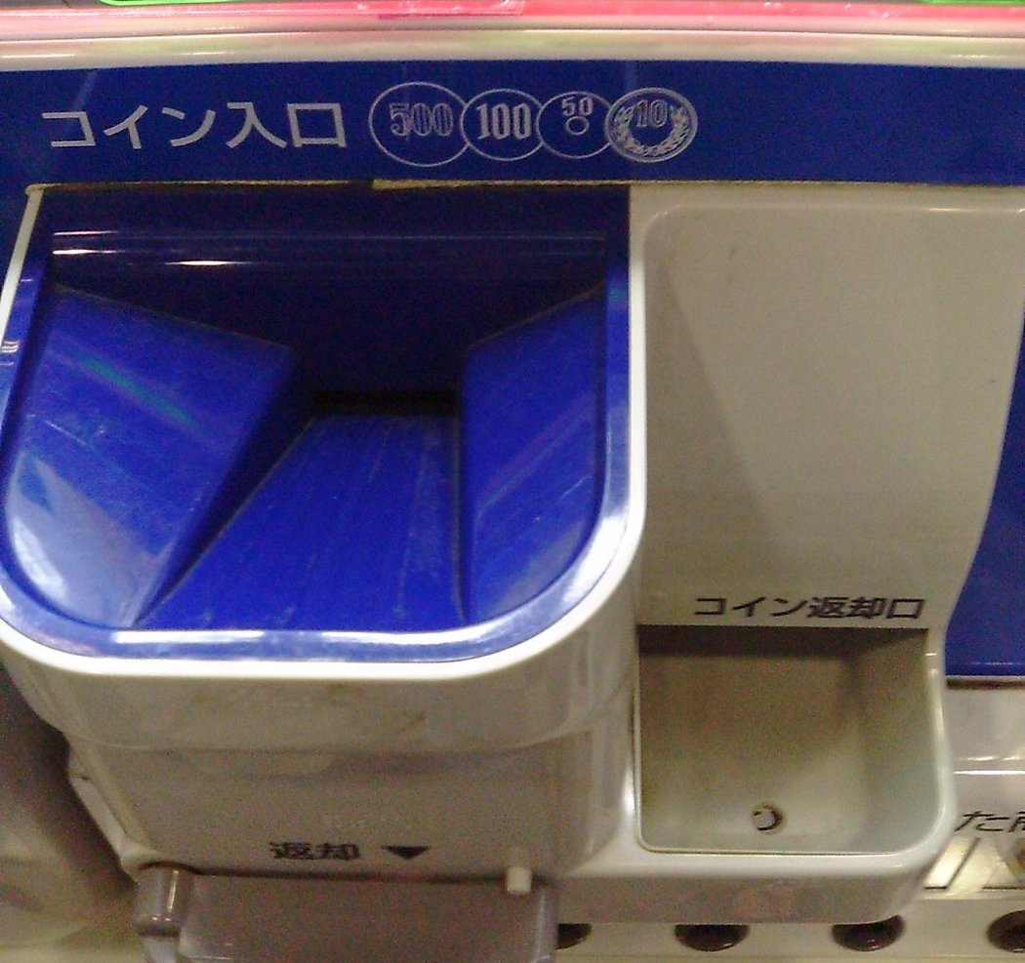
NOW IT HAS A NAME
Code + Storage + Address, Enforced By The Network
A smart contract is code describing state and functions, compiled to bytecode and deployed via a transaction, executed identically by every node — which is why execution must be fully deterministic and gas-metered — and enforced by the network's rules, not a company's internal policy.
08/22

Slide 9

KEY IDEA 1 / 3
Deployment Is Just A Transaction
The contract's compiled bytecode, with no specific recipient — the network computes a new address and stores the bytecode there.
09/22

Slide 10
KEY IDEA 2 / 3
Execution Must Be Deterministic
Every node computing the same result from the same input is the only way thousands of independent computers stay in agreement (Week 1, Topic 04).
10/22

Slide 11
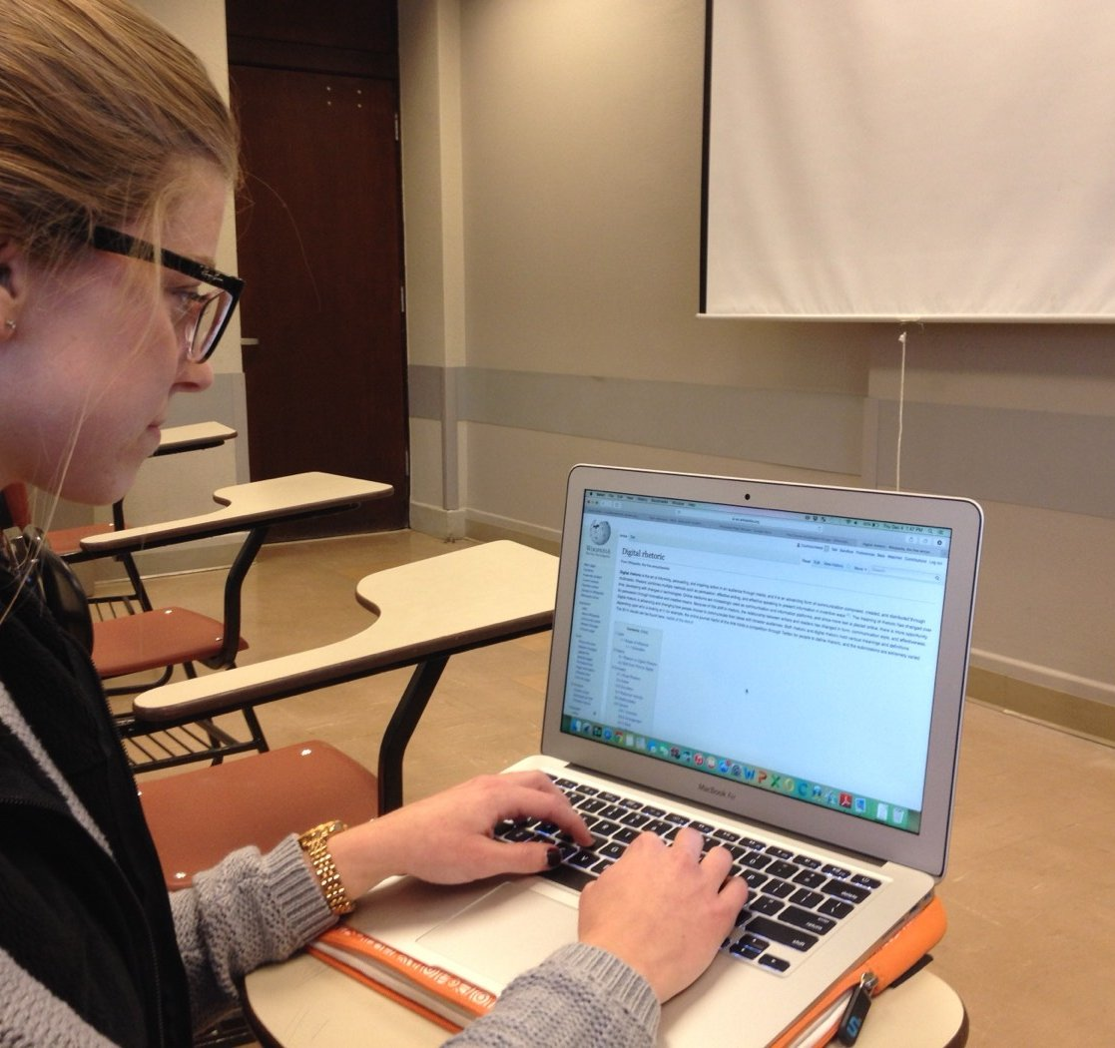
KEY IDEA 3 / 3
No Default Patch Button
Once deployed, logic is fixed unless an upgrade mechanism was deliberately designed in advance — Topic 03's DAO lesson, again.
11/22

Slide 12
?
CHECK YOUR UNDERSTANDING
If a smart contract has a bug that lets anyone drain its funds, can the team that wrote it just push a fix overnight?
ANSWER
Not by default — this is the exact lesson from The DAO. Once deployed, a contract's logic is fixed unless it was specifically designed with an upgrade mechanism, a deliberate, non-default design decision with real trade-offs (Week 7). “We'll patch it later” doesn't work here the way it does for ordinary software.
12/22

Slide 13
CONNECT IT
Next Week, This Stops Being Abstract
Next week, you write a contract like this yourself, compile it, and use real tools to look at exactly what's described here: the actual compiled bytecode, the actual storage slot holding count, and the actual deployment transaction — a real transaction hash you can look up.
13/22

Slide 14
FLAGSHIP CASE STUDY
Nick Szabo's Vending Machine, Three Decades Early
The term “smart contract” was coined in the 1990s by Nick Szabo — well before blockchains existed — using a vending machine as the defining analogy. Put in the right amount, select an option, and the machine mechanically guarantees the outcome. No cashier, no trust required — the rules are enforced by the mechanism itself. A blockchain smart contract is the same idea, with a global network of independent computers standing in for the vending machine's internal mechanics.
14/22

Slide 15
REAL-WORLD USES
Where This Shows Up
🥤
🔒
Vending Machines
Escrow Services
Szabo's original analogy — mechanical rule enforcement with no cashier required.
Traditionally a trusted third party; a contract can hold and release funds automatically instead.
Every one of these is, underneath, the exact same code + storage + address model as the six-line Counter contract.
🖼
🏛
NFT Marketplaces
DAO Treasuries
Larger, more carefully engineered versions of the same code+storage+address model.
From Topic 03 — fund custody and voting logic, enforced the same way.
15/22

Slide 16
REAL-WORLD DEEP-DIVE
Read A Real Verified Contract
Find any well-known token or protocol on Etherscan and just read its source code — don't worry about understanding every line yet, just notice the shape: contract, state variables, functions. The exact same pattern from this topic's six-line Counter, just at real-world scale and stakes.
16/22

Slide 17
COMMON MISCONCEPTIONS
Where People Get Tripped Up
Two claims that sound reasonable, but aren't quite right.
1
2
“A smart contract is a legal contract.”
“Smart contracts can access anything on the internet.”
Not inherently — it's a program that automatically enforces rules. Whether it's also legally binding depends on jurisdiction, a separate, still-evolving question.
They can't, by default — only data already on-chain or submitted in a transaction. Real-world data needs a deliberate oracle mechanism (Week 7).
17/22

Slide 18
?
ONE MORE CHECK
Why does a vending machine need no cashier, and a smart contract need no company to enforce it — is that really the same property?
ANSWER
Yes — viewed from two angles. “No cashier required” means the rules are enforced by the mechanism itself, not a trusted human in the loop. “No company can quietly change the rules” means nobody can override that mechanism after the fact either. Both are the same underlying idea: the rules are enforced by the system, not anyone's ongoing goodwill.
18/22

Slide 19

HANDS-ON PRACTICE
Do This Now
01
Read a verified contract on Etherscan
Search any well-known token — just notice the shape, not every line.
02
Sketch a raffle contract
On paper: what state would it need, what functions?
03
Re-read Counter.sol
Confirm you can now name what each line is for, even without writing Solidity yet.
19/22

Slide 20
RESOURCES
Watch, Read, Explore
RECOMMENDED VIDEOS
Smart contracts - Simply Explained
PRACTICE SITE
Any verified contract on etherscan.io — read real, production Solidity.
20/22

Slide 21
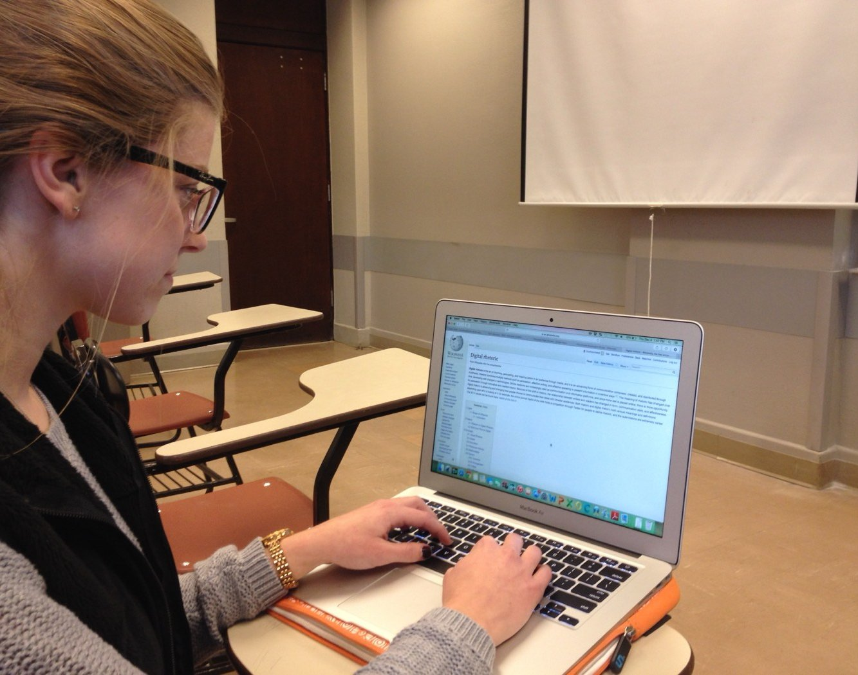
TAKE-HOME ASSIGNMENT
Before You Move On
✓
Explain the vending-machine analogy
Why are “no cashier” and “rules can't be quietly changed” the same property, viewed two ways?
✓
Identify the 3 pieces
In a contract you find on Etherscan: where's the code, the state, and the address?
✓
Preview Week 3
Write down one question you still have about how deployment actually works — bring it to Week 3.
21/22

Slide 22
RECAP
On To Week 3.
You've read a smart contract's shape. Next week you write, test, deploy, and verify a real one — with real tools, not just description.
REPOSITORY
github.com/jadonamite/BlockchainCourse
THIS TOPIC
curriculum/week-02/04-what-is-a-smart-contract.md
NEXT UP
Week 03 — Writing & Deploying Your First Smart Contract
22/22

