Slide 1
01 / 18
BLOCKCHAINCOURSE
Practical Engineering
Over Hype
Most newcomers memorize buzzwords or copy-paste Solidity templates they can't explain. This course is built differently: understand EVM execution, state transitions, and security trade-offs — before you ever touch a framework.
2 Halves
8 Weeks
Hackathon-Ready by Week 4
Understand How It Works

Slide 2
02 / 18
HOW THIS COURSE IS STRUCTURED
Two Halves, Four Weeks Each
Half 1 · Weeks 1–4
Half 2 · Weeks 5–8
Basics & Core Concepts. Everything you need to walk into a hackathon and build something real — wallets, contracts, tokens, a working dApp.
Advanced Topics. Security, upgradeable contracts, Layer 2s, and the wider ecosystem — what separates a prototype from production.
◉ YOU ARE HERE — WEEK 01

Slide 3
03 / 18
GROUND RULES
Before You Begin
01
Understand before you copy — if you can't explain a line of code, don't ship it.
02
Testnet first, always — never deploy something you haven't tested locally and on a testnet.
03
No frontend before your contract works from the command line.
04
Every contract gets at least a basic test — an untested contract is unfinished.
05
Treat every external call as a potential attack.

Slide 4
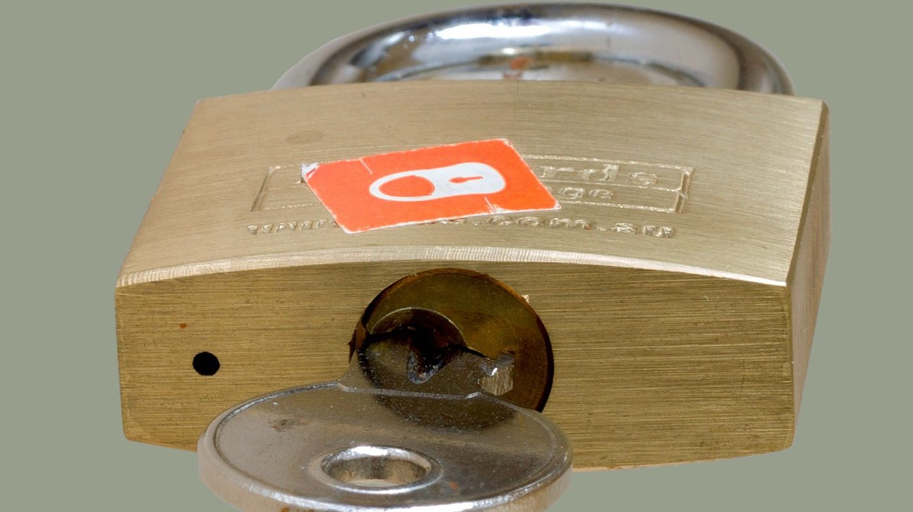
BlockchainCourse · Curriculum · Week 01 · Topic 02 of 04
04 / 18
02
Public / Private Keys
Prove ownership without ever revealing the secret that proves it.
01 · Hashing
02 · Public / Private Keys
03 · Blocks & Chains
04 · Consensus
Photo: Shillings1005 / Wikimedia Commons, CC BY-SA 4.0

Slide 5
05 / 18
TOPIC 02 — PUBLIC / PRIVATE KEYS
Why This Matters
Hashing gave you tamper-evidence. Keys give you authorization — proving who's allowed to move funds, with no login system, no password reset, and no bank sitting in the middle. This is the entire foundation of blockchain authorization.
WHAT THIS SECTION COVERS
Core concept
Four key ideas, one at a time
A real, reproducible worked example
Real-world uses beyond blockchain
A flagship case study
A real-life analogy
Common misconceptions
Hands-on practice
Take-home assignment

Slide 6
06 / 18
TOPIC 02 — PUBLIC / PRIVATE KEYS
The Core Concept
Asymmetric cryptography gives you two mathematically related keys: a private key (secret, signs things) and a public key (shareable, verifies things). Ethereum and Bitcoin use ECDSA on a specific curve named secp256k1. One direction is easy; the other is computationally infeasible.

Slide 7
07 / 18
TOPIC 02 — PUBLIC / PRIVATE KEYS
KEY IDEA 1 / 4
Private Key
A very large random number, generated when you create a wallet. Whoever holds it has complete control of the wallet. It must never be shared with anyone, ever, for any reason.
EXAMPLE
A 256-bit random number — never leaves your device.

Slide 8
08 / 18
TOPIC 02 — PUBLIC / PRIVATE KEYS
KEY IDEA 2 / 4
Public Key
Derived one-way from the private key, using a process similar in spirit to hashing. Safe to share — you cannot work backwards from a public key to the private key that produced it.
EXAMPLE
Private key → (one-way math) → Public key

Slide 9
09 / 18
TOPIC 02 — PUBLIC / PRIVATE KEYS
KEY IDEA 3 / 4
Signature
Produced using the private key, a signature proves you authorized a specific message — without ever revealing the key itself. Anyone can verify it using only your public key.
EXAMPLE
sign(message, private key) → signature; verify(message, signature, public key) → true/false

Slide 10
10 / 18
TOPIC 02 — PUBLIC / PRIVATE KEYS
KEY IDEA 4 / 4
Address
Your wallet address is a hash of your public key — one more one-way step, layered on top, for extra safety margin. This directly connects back to Topic 01: your address is literally a hash.
EXAMPLE
Private key → Public key → hash() → Address (0x...)

Slide 11
11 / 18
WORKED EXAMPLE — PART 1
A Real secp256k1 Keypair, Generated With openssl
$ openssl ecparam -name secp256k1 -genkey -noout -out priv.pem
$ openssl ec -in priv.pem -pubout -out pub.pem
# private key (excerpt):
MHQCAQEEIHoNT3gUJYe9tBv7ZZoRYRGGIGkvCFmX60mY...
# public key, derived one-way (excerpt):
MFYwEAYHKoZIzj0CAQYFK4EEAAoDQgAEjO0NYj4xwIE6...
secp256k1 is the exact curve Ethereum and Bitcoin wallets actually use — not a simplified stand-in.

Slide 12
12 / 18
WORKED EXAMPLE — PART 2
Sign A Message, Verify It, Then Tamper With It
$ openssl dgst -sha256 -verify pub.pem \
-signature sig.bin message.txt
Verified OK
# same signature, but the message text was changed:
$ openssl dgst -sha256 -verify pub.pem \
-signature sig.bin tampered.txt
Verification failure
An attacker can't change "1 ETH" to "100 ETH" without invalidating the signature — and can't forge a new one.

Slide 13
13 / 18
REAL-WORLD USES
Not Just Blockchain
HTTPS / TLS
SSH Keys
Code Signing
The padlock in your browser — a server proving it owns its certificate's private key.
Logging into GitHub or a server without a password, using this exact mechanism.
Your OS verifies an update genuinely came from Apple or Google, not an attacker.
Signed Git Commits
PGP Email
git commit -S — proving a commit really came from you.
Encrypting a message so only the intended recipient's private key can read it.

Slide 14
14 / 18
FLAGSHIP CASE STUDY
Encryption vs. Signing — A Distinction Worth Getting Right
Two different jobs: encryption (public key locks, private key unlocks — for confidentiality) vs. signing (private key signs, public key verifies — for authenticity). Blockchain wallets use almost entirely signing. Your transaction is never secret — “send 0.1 ETH to X” is fully readable on a block explorer. What's proven is WHO authorized it, not WHAT it says.

Slide 15
15 / 18
REAL-LIFE ANALOGY
A Signet Ring And A Reference Card
Your private key is a unique, impossible-to-forge signature stamp — a wax-seal signet ring only you own. Your public key is a reference card everyone holds, showing exactly what your genuine seal impression looks like. Anyone can compare a seal against the card; nobody can forge the ring's impression from the card alone.

Slide 16
16 / 18
COMMON MISCONCEPTIONS
Where People Get Tripped Up
“My wallet address IS my public key.”
Not quite — your address is a hash of your public key. The full chain is public key → hash → address, one more one-way step layered on top.
“If I lose my private key, I can reset it like a password.”
There is no reset. No recovery mechanism is built into the protocol — only a backup phrase, if you saved one in advance.

Slide 17
17 / 18
HANDS-ON PRACTICE
Do This Now
1
Generate a real keypair with openssl and sign a message of your own choosing.
2
Verify the signature succeeds — then tamper with the message and confirm verification fails.
3
Repeat the same experiment on the Anders Brownworth public/private key demo.
4
Open MetaMask and notice: every "Confirm" click is your private key signing, invisibly, behind the scenes.

Slide 18
18 / 18
TAKE-HOME ASSIGNMENT
Before You Move On
Reproduce the openssl worked example yourself and record your own output.
Write your own real-world analogy for signing — not the ones given in this section.
Explain what an attacker could and couldn't do with your private key vs. your public key.
RECOMMENDED VIDEOS
• Public Key Cryptography - Computerphile
• Public Key & Private Key Explained | Asymmetric Encryption for Beginners
PRACTICE SITE
andersbrownworth.com/blockchain/public-private-keys · your terminal, with openssl

