Slide 1
P&L Review
{{Title}}
Business Performance Team
{{Date}}

Slide 2
Agenda
1
Monthly Revenue Act
Today
2
Quarterly Revenue Act
3
Quarter Revenue Commit
4
Sign-off (Slide #14)
Today
5
Expense (Slides #15-16)
6
CML Personal & Bookings (Slides #17-23)
7
Backup & Additional Analysis
(Slides #25-40)

Slide 3
Revenue
Sheeba Saravanan & San Lai
{{Date}}

Slide 4
Callouts
Q3 Act: ~$1.3M Over vs. Prior Fcst
Key Callouts:
Verifone M2 & M3 revenue captured via accrual (due to Invoice delay)
Written Exams CLC Estimated ~$311K of CLN/Exams allocations into Exams for March & April. Verifone report mapping for allocations not yet complete, actuals will be available after Q3 close.
~$860K vs. Prior Fcst (includes CLN allocation estimates)
Digital Library: Public Sector cautious of slowdown tied to Fed Funding. No slow down yet.
~$496K vs. Prior Fcst
ILT: POD Timing (Courses with late delivery in the quarter)
~($290)K vs. Prior Fcst
Concerns:
Potential Impact in Federal business due to early retirements and staffing cuts
Notes:
Notes:
Digital CLC’s: Public Sector cautious of slowdown tied to Fed Funding.
Top 3 Fed Deals:
US Navy - $103K Renewal with expansion of $30K.
US Gov't Palomino - $82K Renewal.
US Africa Command - $71K Renewal with expansion of $50K.
Top 3 Private sector deals:
FedEx - $102K Renewal
Baker Tom Group - $94K New sale
New York University Langone Medical Center - $92K New sale

Slide 5
{{MonthLabel}} Details

Slide 6
{{MonthLabel}} {{QuarterLabel}}FY{{YearLabel}} Revenue Act (vs. Prior Fcst)
Drivers/Callouts:
Digital Library: ($272)K Under vs. Commit
Digital CLC: ($216)K under vs. Commit
Coursera: Tracking $91K ( increase by 138%) for Q4 to post in M2 Expected to maintain this level at 140% for following quarters
Instructor Led: $367K over Commit (Monthly Linearity)
Certifications/Exams: $427K Over Commit
Exams Volume (April Deliveries): 12,341
Monthly Vol: Feb– Apr: 11,725 – 10,434 – 12,341
Weekly Vol Avg: Feb– Apr: 2,931 – 2,609 – 2,468
Written Exams:
Cash: $219K over vs. Commit Good exam volume: CCNA, CCNP Ent Core, DC. Strong globally, call-out Brazil, Mexico, US & Japan.
CLCs: $241K over vs. Commit (2 large orders from repeat customers Bharti Airtel & NTT India Prvt)
Success Track: $188K over Commit (Bookings came in higher in M1 that drove Revenue up)
Expirations: ($155)K under Commit (Monthly Linearity)
M1 Act: $504K over vs. Commit
Product Lines ($M) | {{a1}} | {{a2}} | {{a3}} | {{aa1}}
 | {{a4}} | {{a5}} | {{a6}} | {{aa2}}
Digital Learning (Cisco U., ELT, CDL, Coursera) | {{a7}} | {{a8}} | {{a9}} | {{aa3}}
CX Offers (Success Tracks, BCS, TSA) | {{a10}} | {{a11}} | {{a12}} | {{aa4}}
ILT Course (ILT CLG, Gilmore, ILT CLD) | {{a13}} | {{a14}} | {{a15}} | {{aa5}}
Certifications/Exams | {{a16}} | {{a17}} | {{a18}} | {{aa6}}
Event (Cisco Live) | {{a19}} | {{a20}} | {{a21}} | {{aa7}}
Other (CLC Exp, CML, Cisco Press, Misc.) | {{a22}} | {{a23}} | {{a24}} | {{aa8}}
Accounting Adjustments | {{a25}} | {{a26}} | {{a27}} | {{aa9}}
Total Service Revenue | {{a28}} | {{a29}} | {{a30}} | {{aa10}}
Notes:
Q4
Commit set on 4.30.25
Q4 M1 Notes (5.22.25)
CCIE:
Lab CLCs: $(32)K under vs. Commit
(Mostly small orders from repeat customers & 1-large order from Banque Africaine de Development)) – not tied to 525 program ( Dollars are in ILT)
CLCs: Are right on track on where it should be
Digital Coursera: Tracking $91K ( increase by 138%) for Q4 and will be posted in M2 Expected to maintain this level at 140% for following quarters
· Cisco revenue increased by over 138% compared to Q4 · Revenue from subscriptions grew by over 148% driven by the positive impact of the new engagement-based revenue accounting model. · Enterprise revenue grew by 246% compared to Q4 showing good tailwinds there · Consumer revenue grew by over 78%, a result of scaled paid media efforts that Coursera has run since the beginning of this year. We expect its impact on the Consumer segment over the next few quarters as well.

Slide 7
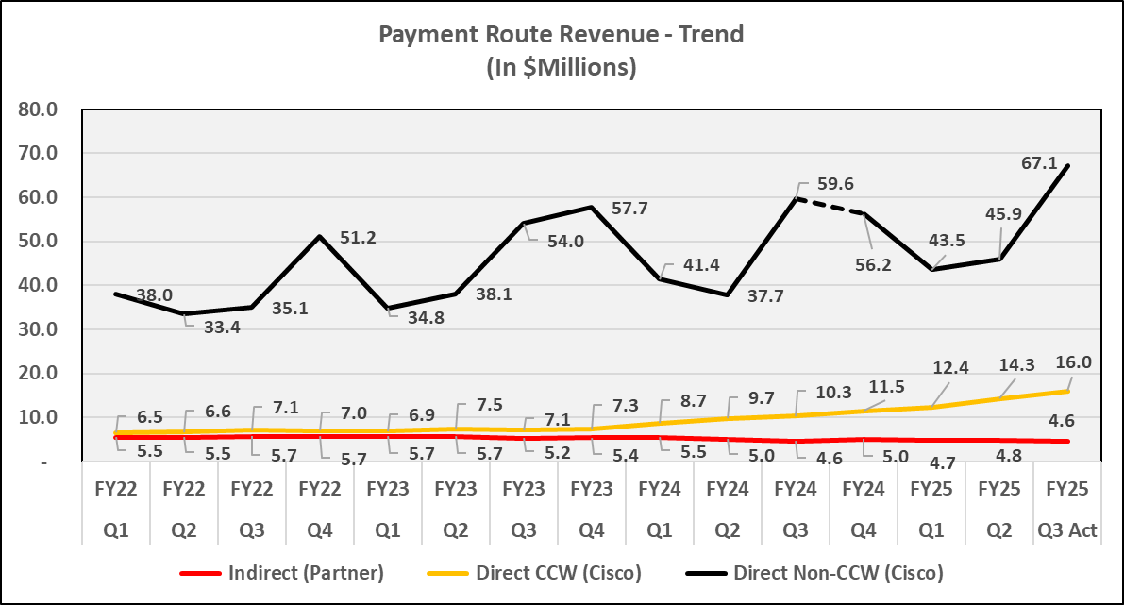
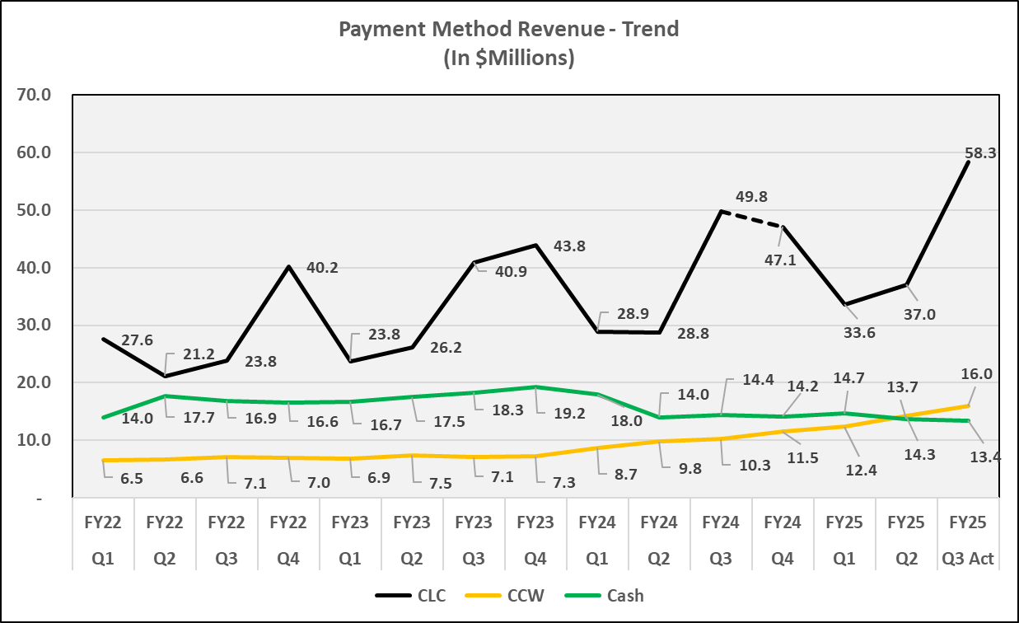
QTD Views: Payment Route & Payment Type
Payment Route ($M) | {{b1}} | {{b2}} | {{b3}} | {{bb1}}
 | {{b4}} | {{b5}} | {{b6}} | {{bb2}}
Indirect (Partner) | {{b7}} | {{b8}} | {{b9}} | {{bb3}}
Direct CCW (Cisco) | {{b10}} | {{b11}} | {{b12}} | {{bb4}}
Direct Non-CCW (Cisco) | {{b13}} | {{b14}} | {{b15}} | {{bb5}}
Total Services Revenue | {{b16}} | {{b17}} | {{b18}} | {{bb6}}
{{c1}}
{{cc1}}
{{cc2}}
{{cc3}}
Payment Method ($M) | {{d1}} | {{d2}} | {{d3}} | {{dd1}}
 | {{d4}} | {{d5}} | {{d6}} | {{dd2}}
CLC | {{d7}} | {{d8}} | {{d9}} | {{dd3}}
CCW | {{d10}} | {{d11}} | {{d12}} | {{dd4}}
Cash | {{d13}} | {{d14}} | {{d15}} | {{dd5}}
Total Services Revenue | {{d16}} | {{d17}} | {{d18}} | {{dd6}}
{{e1}}
{{ee1}}
{{ee2}}
{{ee3}}
Notes:
Q3
Commit set on 1.30.25
Prior fcst set on 3.27.25
Components of category:
Payment Route:
Indirect- All revenue from Gilmore (LSRT)
Direct CCW- Dig Lib CCW/Coursera, BCS/TSA, Success Track, ILT CCW, CML Service
Direct Non CCW- ILT CLC, Dig CLC, Exams CLC, Cisco Live, CLC expiration, Gilmore Contra COGS
Payment Method:
CLC- All CLC lines (ILT, Digital, Exams, Expirations etc.)
CCW- All CCW lines (ILT, Digital, Coursera, CML Service, Success Track)
Cash- Gilmore store (LSRT), ILT CLDS, Dig CLDS, CLN Store Direct, Gilmore Contra COGS
For reference ( past discussion) Action Item (12.21.23):
Par’s guidance: Don’t change this slide view yet. Need to have further discussions. Pull out CX Attribution ( Success track) to show trend
Or do we double click on CCW line to see the success Track split?
1) Indirect (Partner) – how much of the scaling and mainly via VE.
vs Direct
How are we shifting over to Digital.
2) How much is coming through CCW?
Break out CCW ( CML, BCS & TSA; Digital Learning : split to TRN & TRN6 (eLearning =TRN6), Success Tracks)

Slide 8
{{QuarterLabel}} Details

Slide 9
{{QuarterLabel}} Current vs. Prior Fcst
Key Callouts:
Q3 Act: ~$87.7M
Verifone: M1 (partial) – M3) captured revenue with an accrual
Digital Library: ~$496K over vs. Prior Fcst
Public Sector cautious of slowdown tied to Fed Funding. No slow down yet.
Details on Deals in note section
ILT: ~($290)K under (Month end courses delivery timing)
Exams & CCIE: ~860K over vs. Prior Fcst. Estimating ~$300K of CLN/Exams allocations into Exams for March & April. Verifone report mapping for allocations not yet complete, actuals will be available after Q3 close.
Exams Volume (Q3 Deliveries): 34,038
Quarterly Vol: Q1– Q3: 35,655- 32,016 – 34,038
Quarterly Avg: Q1– Q3: 2,743 – 2,463 – 2,618
Written Exams:
Cash: ~$231K over vs. Prior Fcst (Exam Volume higher than Q2)
CLC: ~$491K over vs. Prior Fcst (Repeat Customers)
CCIE:
Labs Cash: ~$83K over vs. Prior Fcst (CCDE Volume down as anticipated due to BP changes in Feb)
Lab CLCs: ~$55K over vs. Prior Fcst
Success Track: ~$193K over vs. Prior Fcst
CML Service: ~(16)K under vs. Prior Fcst. ( See notes section for CML details)
Q3 Act: ~$87.7M
Product Lines ($M) | {{f1}} |  |  |  | {{h1}} | {{j1}} | {{l1}}
 | {{g1}} | {{g2}} | {{g3}} | {{g4}} | {{i1}} | {{k1}} | {{ff1}}
Digital Learning (Cisco U., ELT, CDL, Coursera) | {{g5}} | {{g6}} | {{g7}} | {{g8}} | {{i2}} | {{k2}} | {{ff2}}
CX Offers (Success Tracks, BCS, TSA) | {{g9}} | {{g10}} | {{g11}} | {{g12}} | {{i3}} | {{k3}} | {{ff3}}
ILT Course (ILT CLG, Gilmore, ILT CLD) | {{g13}} | {{g14}} | {{g15}} | {{g16}} | {{i4}} | {{k4}} | {{ff4}}
Certifications/Exams | {{g17}} | {{g18}} | {{g19}} | {{g20}} | {{i5}} | {{k5}} | {{ff5}}
Event (Cisco Live) | {{g21}} | {{g22}} | {{g23}} | {{g24}} | {{i6}} | {{k6}} | {{ff6}}
Other (CLC Exp, CML, Cisco Press, Misc.) | {{g25}} | {{g26}} | {{g27}} | {{g28}} | {{i7}} | {{k7}} | {{ff7}}
Accounting Adjustments | {{g29}} | {{g30}} | {{g31}} | {{g32}} | {{i8}} | {{k8}} | {{ff8}}
Total Service Revenue | {{g33}} | {{g34}} | {{g35}} | {{g36}} | {{i9}} | {{k9}} | {{ff9}}
Notes:
Q3
Commit set on 1.30.25
Prior Fcst set on 3.27.25
Exams &CCIE: Q3 Exam Deliveries volume is tracking based on dates revenue is received. For Example, Q3 is showing Jan-March delivery volume
Written Exams CLCs: Top Deals from repeat customers: Bharti Airtel $120K, MTN Nigeria Comm. - $75K, NTT India Private - $74K)
* Note: Cisco Press in “Other” product line is actually “Exam Practice tests” provided by Pvue. Quarterly revenue ranges between $10 - $15K
Action: Bus Ops team will re-label it to “Pvue Practice tests” and move it under Exams Product line. Expect to complete the move for FY26 Plan
Digital:
Public Sector cautious of slowdown tied to Fed Funding. No slow down yet.
Top 3 Fed Deals: US Navy - $103K Renewal with expansion of $30K, US Gov't Palomino - $82K Renewal. , US Africa Command - $71K Renewal with expansion of $50K.
Top 3 Private sector deals: FedEx - $102K Renewal, Baker Tom Group - $94K New sale, New York University Langone Medical Center - $92K New sale
CML Service: ~(77)K under vs. Prior Fcst. $2.08M bookings so far in Q3
Financial services has been the leading sector: MS Financing, Incomm, Commonwealth Bank of Australia
General Dynamics Electric Boat (submarine building and modernization)
APJC leads EMEA right now, $613k to $268k. Japan Semiconductor and NTT (Japan)
In terms of the Navy deal, it quickly became the #1 services revenue line item. Have done $47k this quarter alone

Slide 10
{{QuarterLabel}} Current Comparisons
Product Lines ($M) | {{m1}}
 | {{n1}} | {{n2}} | {{n3}} | {{n4}}
Digital Learning (Cisco U., ELT, CDL, Coursera) | {{n5}} | {{n6}} | {{n7}} | {{n8}}
CX Offers (Success Tracks, BCS, TSA) | {{n9}} | {{n10}} | {{n11}} | {{n12}}
ILT Course (ILT CLG, Gilmore, ILT CLD) | {{n13}} | {{n14}} | {{n15}} | {{n16}}
Certifications/Exams | {{n17}} | {{n18}} | {{n19}} | {{n20}}
Event (Cisco Live) | {{n21}} | {{n22}} | {{n23}} | {{n24}}
Other (CLC Exp, CML, Cisco Press, Misc.) | {{n25}} | {{n26}} | {{n27}} | {{n28}}
Accounting Adjustments | {{n29}} | {{n30}} | {{n31}} | {{n32}}
Total Service Revenue | {{n33}} | {{n34}} | {{n35}} | {{n36}}
{{o1}} | {{p1}} | {{gg1}}
{{o2}} | {{q1}} | {{gg2}}
{{o3}} | {{q2}} | {{gg3}}
{{o4}} | {{q3}} | {{gg4}}
{{o5}} | {{q4}} | {{gg5}}
{{o6}} | {{q5}} | {{gg6}}
{{o7}} | {{q6}} | {{gg7}}
{{o8}} | {{q7}} | {{gg8}}
{{o9}} | {{q8}} | {{gg9}}
{{o10}} | {{q9}} | {{gg10}}
{{r1}} | {{s1}} | {{hh1}}
{{r2}} | {{t1}} | {{hh2}}
{{r3}} | {{t2}} | {{hh3}}
{{r4}} | {{t3}} | {{hh4}}
{{r5}} | {{t4}} | {{hh5}}
{{r6}} | {{t5}} | {{hh6}}
{{r7}} | {{t6}} | {{hh7}}
{{r8}} | {{t7}} | {{hh8}}
{{r9}} | {{t8}} | {{hh9}}
{{r10}} | {{t9}} | {{hh10}}
{{u1}} | {{v1}} | {{ii1}}
{{u2}} | {{w1}} | {{ii2}}
{{u3}} | {{w2}} | {{ii3}}
{{u4}} | {{w3}} | {{ii4}}
{{u5}} | {{w4}} | {{ii5}}
{{u6}} | {{w5}} | {{ii6}}
{{u7}} | {{w6}} | {{ii7}}
{{u8}} | {{w7}} | {{ii8}}
{{u9}} | {{w8}} | {{ii9}}
{{u10}} | {{w9}} | {{ii10}}

Slide 11
{{QuarterLabel}} {{x1}}
Product Lines ($M) | {{x1}} |  |  |  | {{z1}} | {{ac1}} | {{ae1}} | {{ag1}}
 | {{y1}} | {{y2}} | {{y3}} | {{y4}} | {{ab1}} | {{ad1}} | {{af1}} | {{ah1}}
Digital Learning (Cisco U., ELT, CDL, Coursera) | {{y5}} | {{y6}} | {{y7}} | {{y8}} | {{ab2}} | {{ad2}} | {{af2}} | {{ah2}}
CX Offers (Success Tracks, BCS, TSA) | {{y9}} | {{y10}} | {{y11}} | {{y12}} | {{ab3}} | {{ad3}} | {{af3}} | {{ah3}}
ILT Course (ILT CLG, Gilmore, ILT CLD) | {{y13}} | {{y14}} | {{y15}} | {{y16}} | {{ab4}} | {{ad4}} | {{af4}} | {{ah4}}
Certifications/Exams | {{y17}} | {{y18}} | {{y19}} | {{y20}} | {{ab5}} | {{ad5}} | {{af5}} | {{ah5}}
Event (Cisco Live) | {{y21}} | {{y22}} | {{y23}} | {{y24}} | {{ab6}} | {{ad6}} | {{af6}} | {{ah6}}
Other (CLC Exp, CML, Cisco Press, Misc.) | {{y25}} | {{y26}} | {{y27}} | {{y28}} | {{ab7}} | {{ad7}} | {{af7}} | {{ah7}}
Accounting Adjustments | {{y29}} | {{y30}} | {{y31}} | {{y32}} | {{ab8}} | {{ad8}} | {{af8}} | {{ah8}}
Total Service Revenue | {{y33}} | {{y34}} | {{y35}} | {{y36}} | {{ab9}} | {{ad9}} | {{af9}} | {{ah9}}
Key Callouts:
Q4 Update: ~$85.8M
Digital: Army GEMSS 2.0 deal Activation expected in April, Redemption expected in Q4 (working out details with Finance on amortization)
DR Impact not assumed in forecast
Q4 roll-up: ~$85.8M
Finance will hold to the prior Fcst of $85.8M for now

Slide 12
{{Month}}: {{MonthLabel}} Current & {{QuarterLabel}} Commit (Final- {{dateLabel}})
{{AA1}}
{{A1}} | {{A2}} | {{A3}} | {{A4}} | {{A5}} | {{A6}}
{{A7}} | {{A8}} | {{A9}} | {{A10}} | {{A11}} | {{A12}}
{{A13}} | {{A14}} | {{A15}} | {{A16}} | {{A17}} | {{A18}}
{{A19}} | {{A20}} | {{A21}} | {{A22}} | {{A23}} | {{A24}}
{{AB1}} | {{AB2}} | {{AB3}} | {{AB4}} | {{AB5}} | {{AB6}}
{{FF1}}
{{F1}} | {{F2}} | {{F3}} | {{F4}} | {{F5}} | {{F6}}
{{F7}} | {{F8}} | {{F9}} | {{F10}} | {{F11}} | {{F12}}
{{F13}} | {{F14}} | {{F15}} | {{F16}} | {{F17}} | {{F18}}
{{F19}} | {{F20}} | {{F21}} | {{F22}} | {{F23}} | {{F24}}
{{FG1}} | {{FG2}} | {{FG3}} | {{FG4}} | {{FG5}} | {{FG6}}
{{BB1}}
{{BB1}} | {{B2}} | {{B3}} | {{B4}} | {{B5}} | {{B6}}
{{B7}} | {{B8}} | {{B9}} | {{B10}} | {{B11}} | {{B12}}
{{B13}} | {{B14}} | {{B15}} | {{B16}} | {{B17}} | {{B18}}
{{B19}} | {{B20}} | {{B21}} | {{B22}} | {{B23}} | {{B24}}
{{BC1}} | {{BC2}} | {{BC3}} | {{BC4}} | {{BC5}} | {{BC6}}
Q4 Commit: $85.8M
Revenue: $85.8M
P&L COGS: $40.5M
GM%: 52.8%
Q4 Revenue Fcst: ~$85.8M (Holding to Prior Fcst)
Revenue vs. Plan: 105%
Revenue vs. Commit: 100%
Revenue vs. Prior Fcst: 100%
Revenue vs. Q4’24 Act: 118%
Q4 P&L COGS Fcst: $39.3M (Holding to Prior Fcst)
Q4 Margin Fcst: 54.2% (Holding to Prior Fcst)
Margin vs. Plan: 1.4 pts vs. (52.8%)
Margin vs. Commit: 1.4 pts vs. (52.8%)
Margin vs. Prior Fcst: 0.0 pts vs. (54.2%)
Margin vs. Q4’24 Act: 12.6 pts vs. (41.7%)
{{CC1}}
{{C1}} | {{C2}} | {{C3}} | {{C4}} | {{C5}} | {{C6}}
{{C7}} | {{C8}} | {{C9}} | {{C10}} | {{C11}} | {{C12}}
{{C13}} | {{C14}} | {{C15}} | {{C16}} | {{C17}} | {{C18}}
{{C19}} | {{C20}} | {{C21}} | {{C22}} | {{C23}} | {{C24}}
{{CD1}} | {{CD2}} | {{CD3}} | {{CD4}} | {{CD5}} | {{CD6}}
{{DD1}}
{{D1}} | {{D2}} | {{D3}} | {{D4}} | {{D5}} | {{D6}}
{{D7}} | {{D8}} | {{D9}} | {{D10}} | {{D11}} | {{D12}}
{{D13}} | {{D14}} | {{D15}} | {{D16}} | {{D17}} | {{D18}}
{{D19}} | {{D20}} | {{D21}} | {{D22}} | {{D23}} | {{D24}}
{{DE1}} | {{DE2}} | {{DE3}} | {{DE4}} | {{DE5}} | {{DE6}}
{{EE1}}
{{E1}} | {{E2}} | {{E3}} | {{E4}} | {{E5}} | {{E6}}
{{E7}} | {{E8}} | {{E9}} | {{E10}} | {{E11}} | {{E12}}
{{E13}} | {{E14}} | {{E15}} | {{E16}} | {{E17}} | {{E18}}
{{E19}} | {{E20}} | {{E21}} | {{E22}} | {{E23}} | {{E24}}
{{EF1}} | {{EF2}} | {{EF3}} | {{EF4}} | {{EF5}} | {{EF6}}
Notes:
Q3
Commit set on 1.30.25
Prior Fcst set on 3.27.25
Callouts:
PTO credits (no longer an accrual) will go away, impacted the FY25 plan / targets

Slide 13
Next Steps/Pending Items
1
M3 Revenue Act (Slides #3-8)
Last Week
2
Q3 Revenue Act (Slides #9-12)
3
Q4 Revenue Commit (Slides #13)
4
Next Steps (Slide# 14)
Today
5
Expenses
6
CML & Bookings
7
Backup & Additional Analysis
Month 3 Sign-off Deadline: Wednesday 04/30/25 EOD (Finance will complete the submission upon sign-off)

Slide 14
Month End Meetings
P&L Readout Meetings reduced from 3 to 1
WD-2: Par, L1s, Finance, Revenue Ops team & Key SMEs
Focus: Revenue flash for the close month
WD+1: L1s, Finance, Revenue Ops team & Forecast Leads
Focus: Month actuals read-out
Review & finalize Revenue Quarter forecast roll-up
WD+2: Par, L1s, Finance, Revenue Ops team & Forecast Leads
Focus: Request Sign-off/approval
Present Month’s final results (Revenue & Expenses)
Revenue Forecast, Prelim P&L COGS Fcst, Margin Fcst
Prep Sessions: 30 minutes
WD-2: Monthly and Quarterly flash/commentary
WD+1: Monthly and Quarterly forecast/commentary
Please Note: Cisco Holidays will impact/shift the P&L meeting dates.
Notes:
9.25.24
Q1 Fcst: $59.3M (TBD Not Final)
Current Fcst vs. Plan: ~$2.0M Favorable
Q1 Margin Fcst: 36.8% (TBD Not Final)
Current Fcst vs. Plan/Commit: 1.0 Points
Current Fcst vs. Q1’24: 11.4 Points
YoY growth: 7.5% (Please note in FY25 $3.96M/Q moved to OPEX; So this growth comparison may not show the true YoY comparison)

Slide 15
Expenses
Shamanth Sheshadri
{{Date}}

Slide 16
Spend Summary – L@C
L@C | Q3 |  |  |  | vs. FCST/Commit
 | Act | Fcst/ Commit | $ Var. | % Ach.
P&L COGS | 41,118 | 39,451 | 1,667 | 104% | Approved overspend Lower LCBU & Gilmore Contra ILT VE timing Spend from aged POs & Equipment expense not in commit
Non-P&L COGS | 776 | 803 | (28) | 97% | Small variances across multiple expense lines
OPEX | 6,041 | 6,015 | 26 | 100%
TOTAL L&C | 47,935 | 46,269 | 1,666 | 104%
Networking Academy (OPEX) | 6,928 | 7,304 | (376) | 95%
TOTAL L@C | 54,863 | 53,573 | 1,290 | 102%
Source: Shamanth Sheshadri
Notes:
L&C Actuals:
P&L COGS M1: 12,897,672
M2: 13,209,281
M3: 15,011,198
Q: 41,118,151
Non-P&L COGS
M1: 374,517
M2: (243,985)
M3: 645,259
Q: 775,791
OPEX:
M1: 1,531,253
M2: 1,996,852
M3: 2,512,996
Q: 6,041,101

Slide 17
CML & Bookings
April 29th, 2025

Slide 18
CML Breakdown
Source: Finance & Ops Team

Slide 19
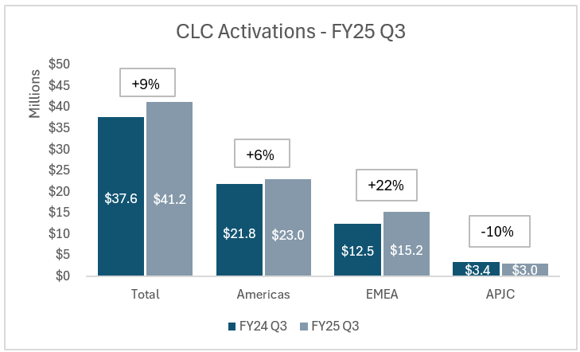
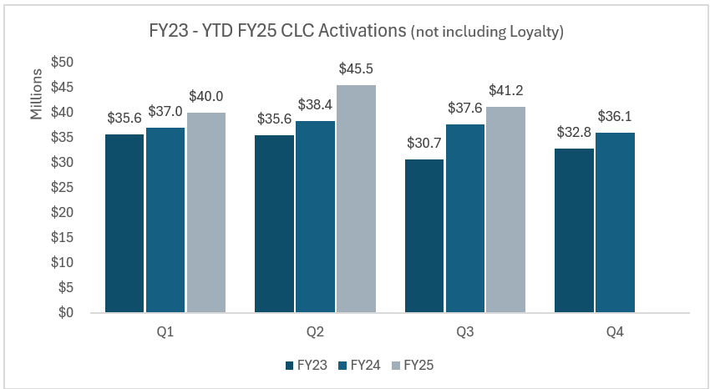
FY25 Q3 & Historic CLC Activations
Number of deals have increased 25% YoY while the avg deal size has decreased -12% YoY
Top 5 Activations
$630K – Orange (EMEA_SP)
$550K – SOCOM Security Adoption (US PS)
$500K – PM Warfighter Tactical (US PS)
$440K – NYC Health & Hospitals (GES)
$436K – US Navy (US PS)
Loyalty Credit Activations are not included in totals
YoY Growth | Q1 | Q2 | Q3 | Q4
FY23 to FY24 | 4% | 8% | 23% | 10%
FY24 to FY25 | 8% | 18% | 9%
Source: Allen Drake (Tableau SO Detail Report)
Notes:
YTD FY25 Totals (Through Q3) : +12% YoY growth (Americas +8, EMEA +19, APJC +5)
YoY Deals/Deal Size
Americas: +15% Deals, -9% Deal Size
EMEA: +41% Deals, -13% Deal Size
APJ: +33% Deals, -32% Deal Size

Slide 20
FY25 CML Service and Success Track Bookings – April
Digital CCW Bookings
Success Track
CML Service
Source: Larisa Mitroshkina
Notes:
Notes:
* Cisco U is TRN
* 6 month digital classes are booked under TRN6
LRNR – New subscriptions launched (Oct 23rd)

Slide 21
TRN (Cisco U) Discount (March)
Source: Larisa Mitroshkina
Notes:
Notes:
* Cisco U is TRN
* 6 month digital classes are booked under TRN6

Slide 22
CML – CX Discount Only (March)
Source: Larisa Mitroshkina

Slide 23
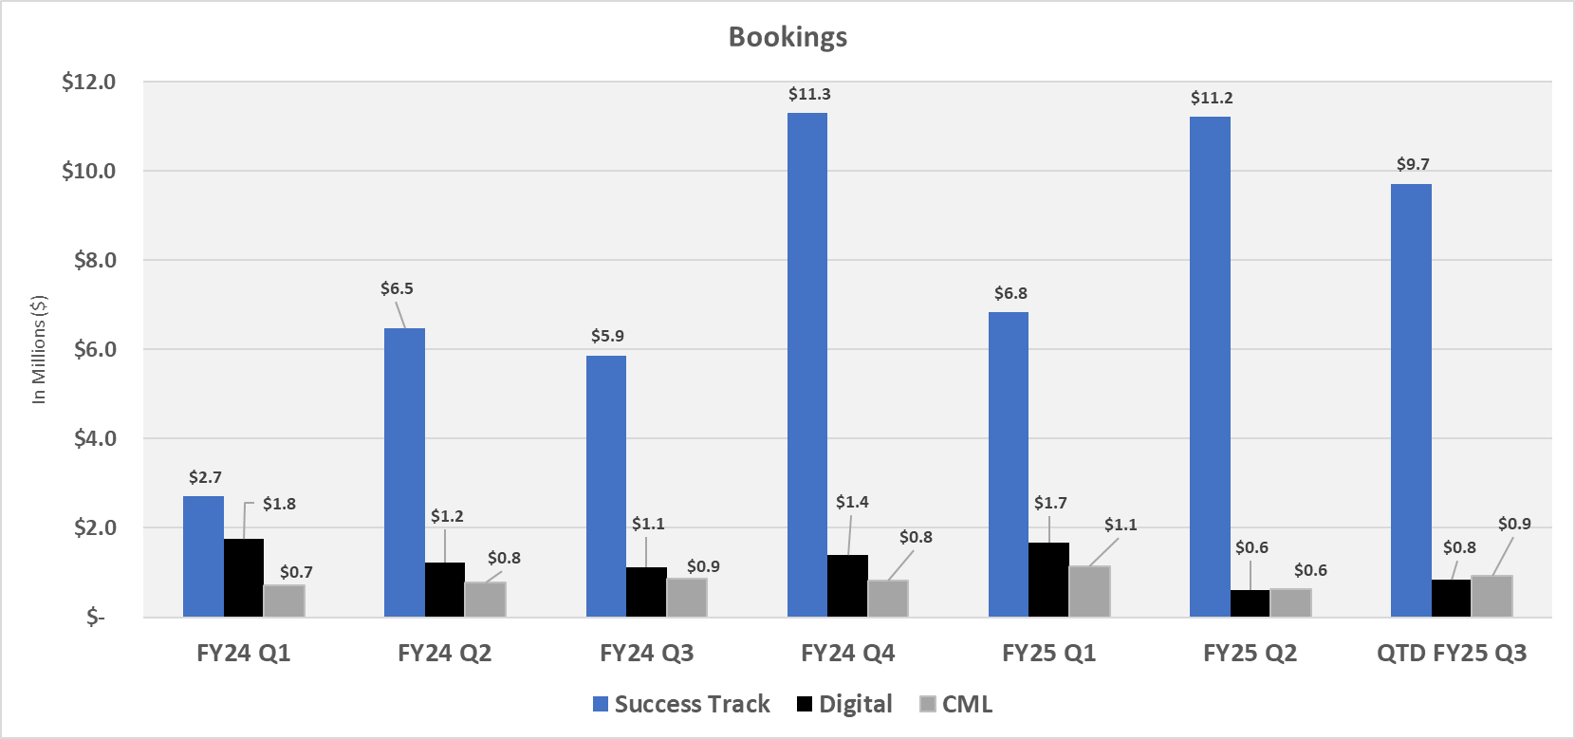
Bookings – April update
Source: Bus Ops Team

Slide 25
BACKUP

Slide 26
Product View: YoY & QoQ Comparison

Slide 27
Payment Route & Payment Type: YoY & QoQ Comparison

Slide 28
Learning Partner View

Slide 29
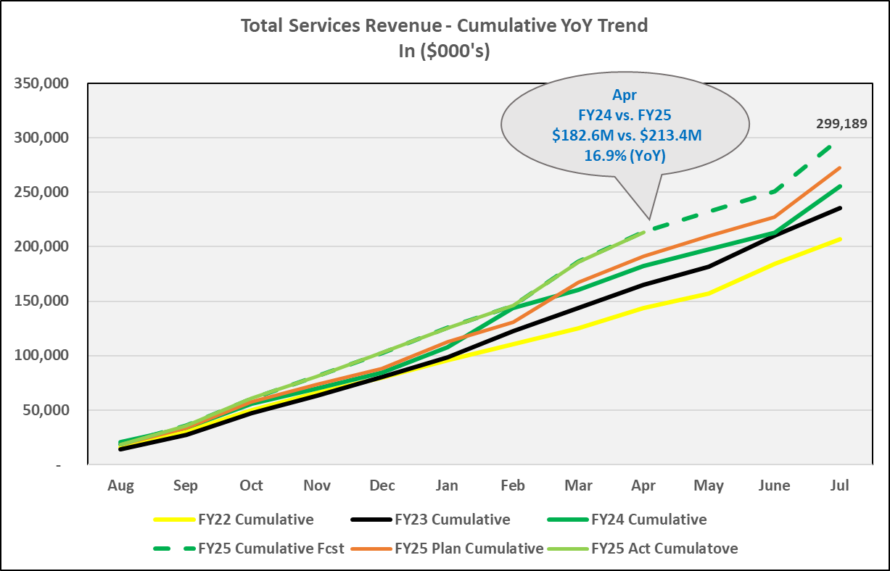
Total L&C YoY

Slide 30
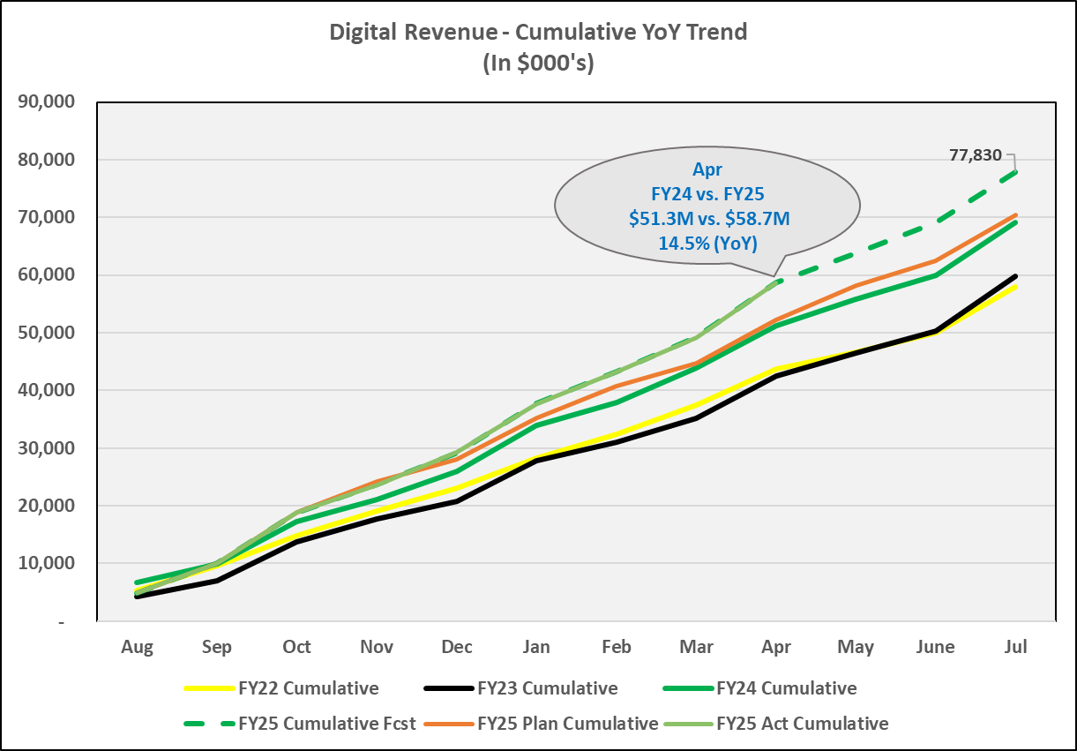
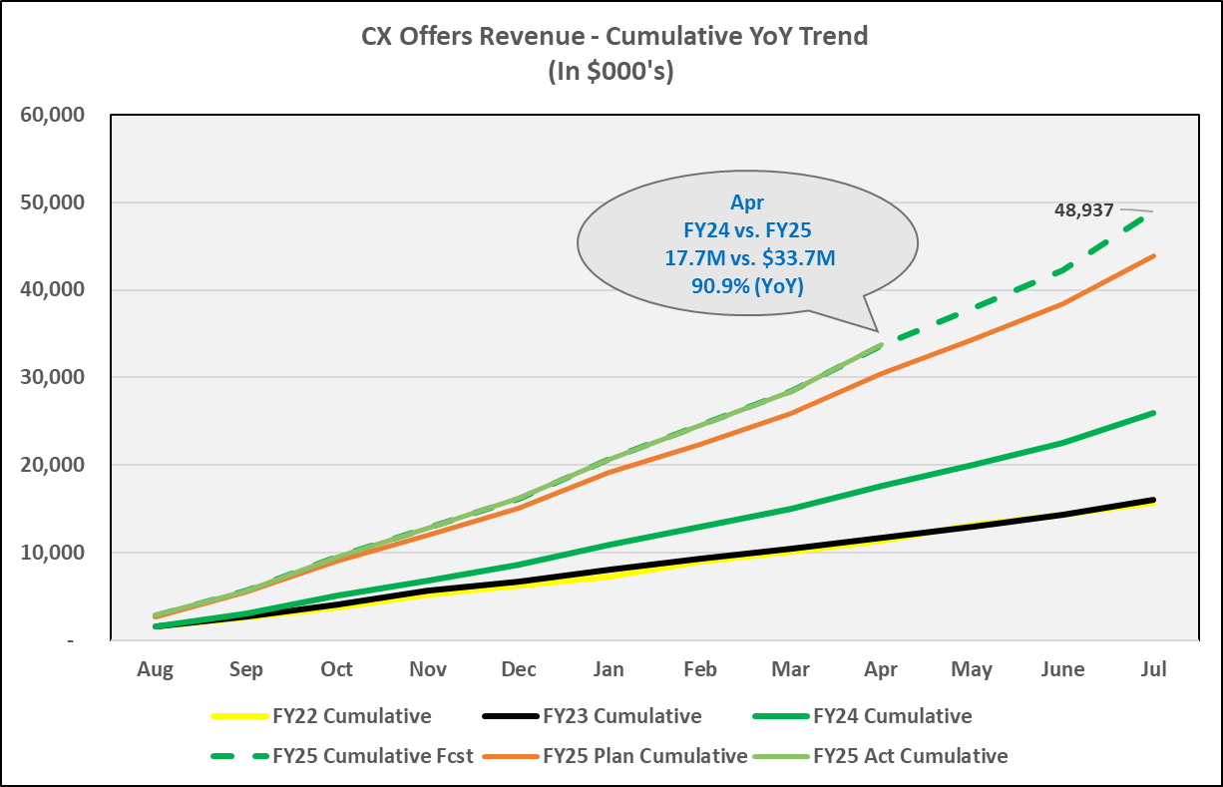
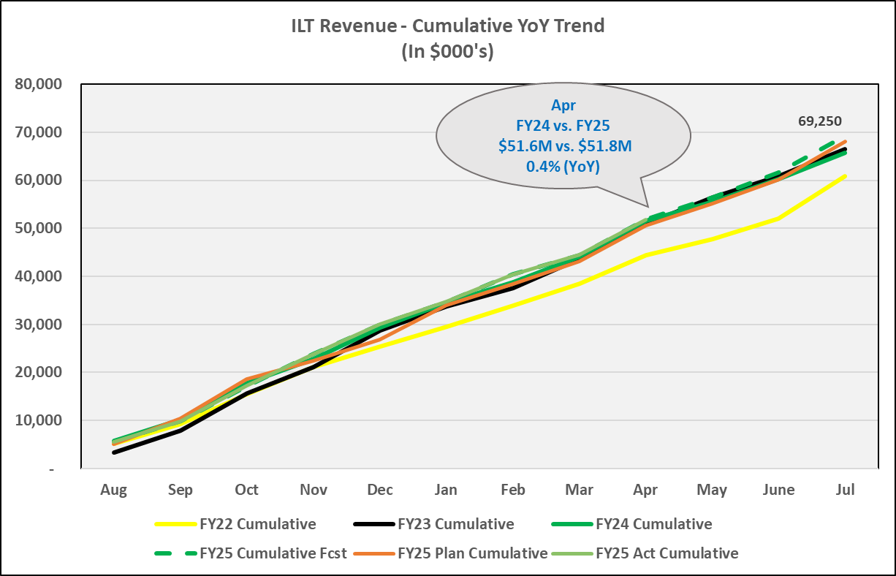
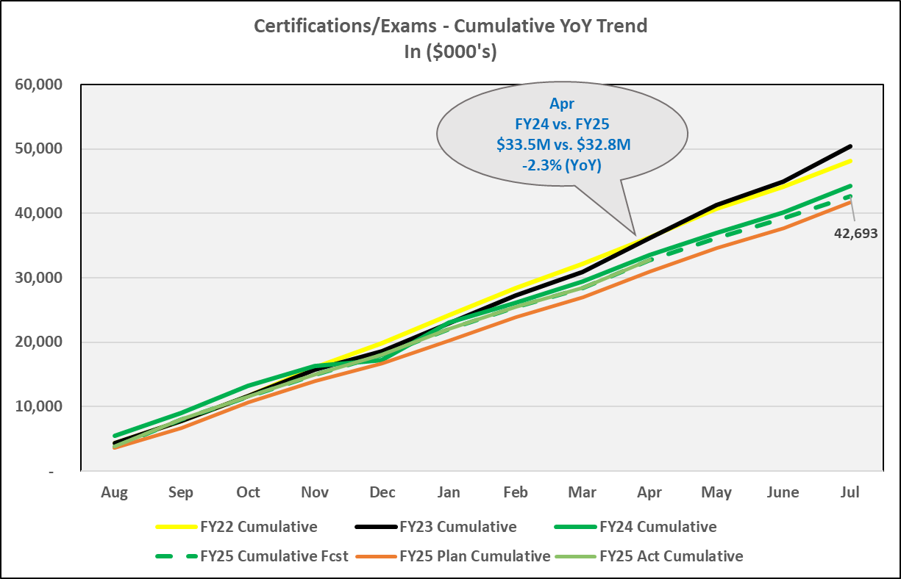
Revenue Products YoY

Slide 31
L&C Revenue: FY25 Current Fcst

Slide 32
FY25 Current Fcst (Pymt Route & Pymt Type Views)

Slide 33
L&C Revenue FY22–24 Act & FY25 Fcst
Notes:
Update to current product view, including FY22 Act, FY23 Act, & FY23 Fcst

Slide 34
Q3 Commit
January 30th, 2025

Slide 35
Q3 Commit Roll-up (FINAL – 1.30.25)
Key Callouts:
Q3 Update: ~$84.0M
Digital:
Expecting $1.0M deal GEMSS 1.0 Deal
Army GEMSS 2.0 deal Activation expected in April, Redemption expected in Q4 (working out details with Finance on amortization)
Success Track: Adjusted up due to higher Bookings than expected in Q3 (80% YoY increase on bookings; ST is replacing Smartnet in total care)
Exams: Reduced forecast by ~100K; brought it back to Plan
Other (CLC Expirations): Correcting expirations fcst tied to new policy
Please Note:
Digital River (DR) Impact not assumed in Commit;
Got an update that Cash piece of CLN and CLD swapped over to Verifone from DR; CCIE moved to Verifone as well
Q3 Commit: ~$84.0M
Notes:
1.27.25 Exam Notes: We believe the increase in CLC revenue is due to the expiration date being shortened to 1-yr vs. 1.5 yrs and BDM increase in sales/forecast. This moves revenue to CLC redemptions for exams at the front end vs. CCIE cash at point sale (CCIE) or written exam appointment (in arrears).

Slide 36
FY25 Plan
FY25 Plan Submission: * Revenue: $272.5M (Based on 7% Annual Growth)
* COGS: $148.5M
Q3’25 Revenue Commit:
Plan: $84.0M
Q3’25 COGS Commit:
Plan: $39.2M
Notes:
Final Plan set on: 8.30.24

Slide 37
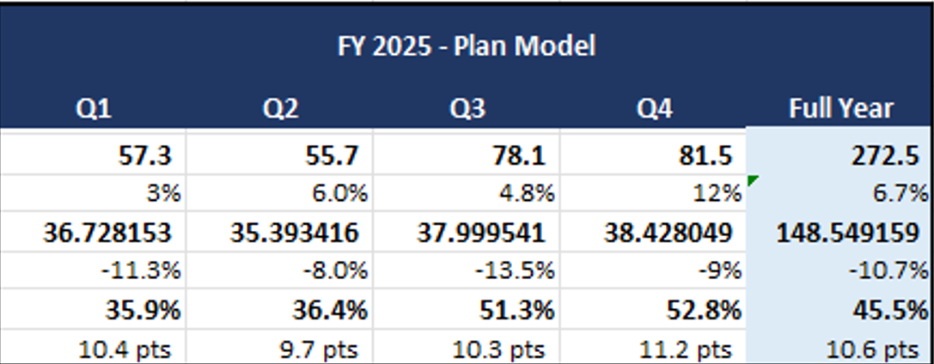
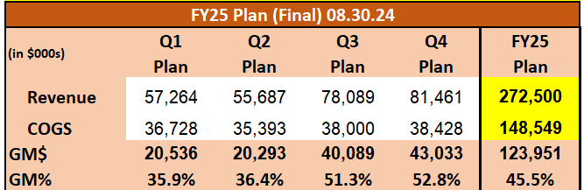
FY25 FINAL Plan
Source: Mike Sanburn
Notes:
Q1
Plan set on 08.30.24

Slide 38
Fiscal Calendar

Slide 39
