Slide 1
beagleconnect

Slide 2
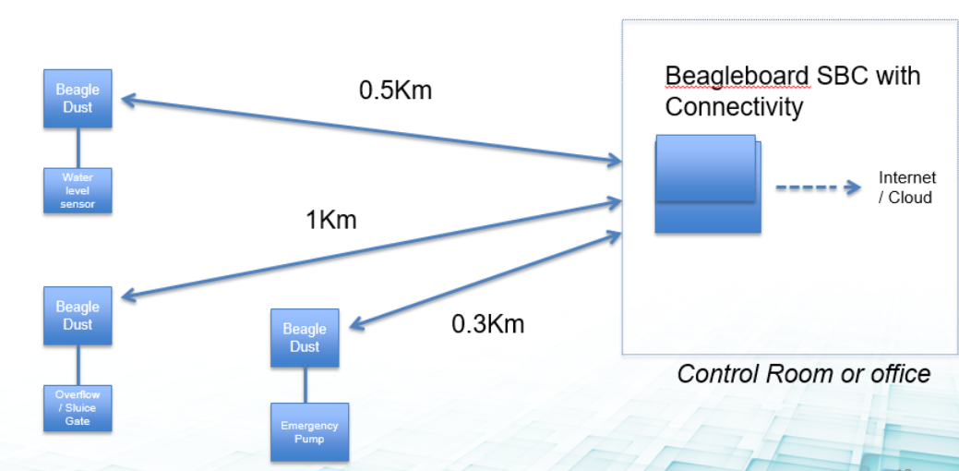
The Concept
Digital Dust -> A low cost sub $10, low-profile edge node that is easily deployed almost anywhere
  Sub 1GHz network based on TI-15.4 stack
User experience is simple and seamless with out of box setup taking minutes
Adaptable by Makers and Professionals alike for it’s plug and play usability
  Professionals would use for proof of concept, assume higher volumes would result in design / manufacturing customization opportunities and the wider portfolio of IoT services

Slide 3
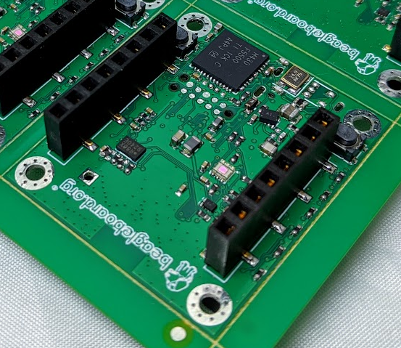
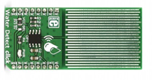
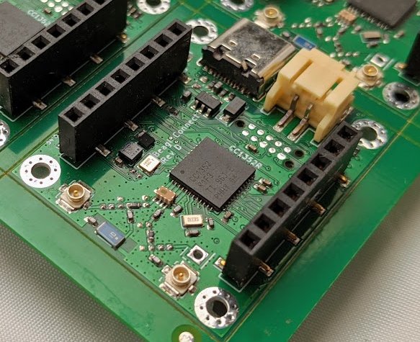

BeagleConnect Leash Feature Set
FRONT
BACK
MSP430
(USB MCU)
CC1352
(wireless MCU)
USB
(debug/flash/power)
Power
2x mikroBUS headers
2x buttons
mikroBUS add-on boards

Slide 4

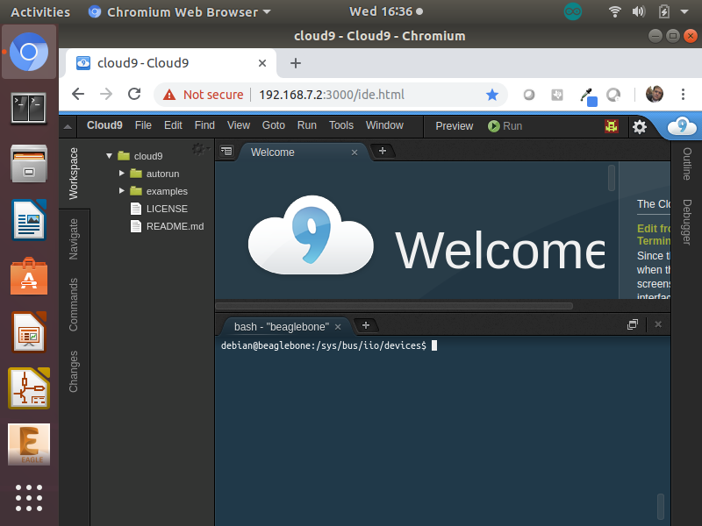
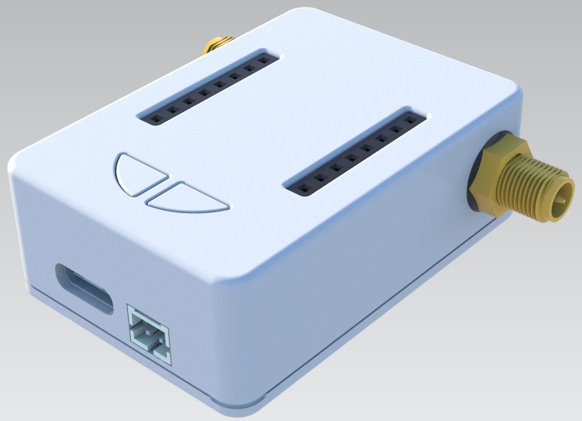
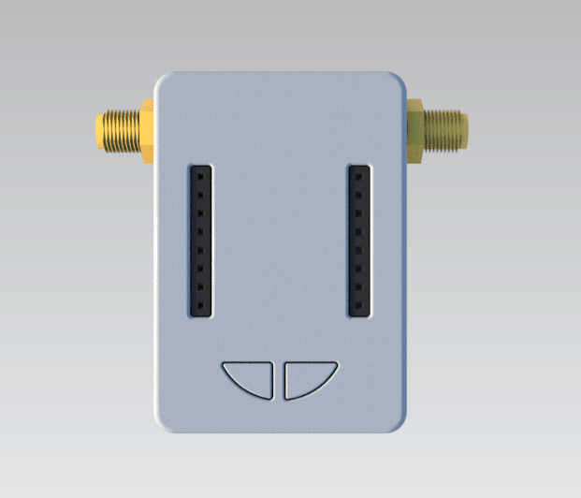
The User Experience
Step 1 – Gateway login
Gateway
(BeagleConnect Leash)
Node
(BeagleConnect Leash + mikroBUS add-on board)
Host (Linux)

Slide 5

The User Experience
Step 2 – Connect with button push
Gateway
(BeagleConnect Leash)
Node
(BeagleConnect Leash + mikroBUS add-on board)
Host (Linux)

Slide 6
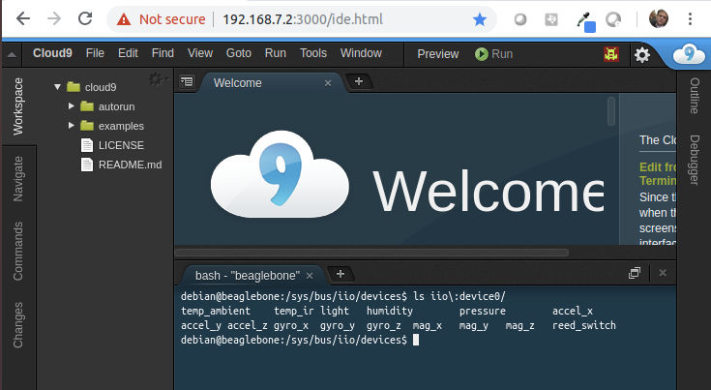
The User Experience
Step 3 – Live edge data automatically appears
Gateway
(BeagleConnect Leash)
Node
(BeagleConnect Leash + mikroBUS add-on board)
Host (Linux)

Slide 7
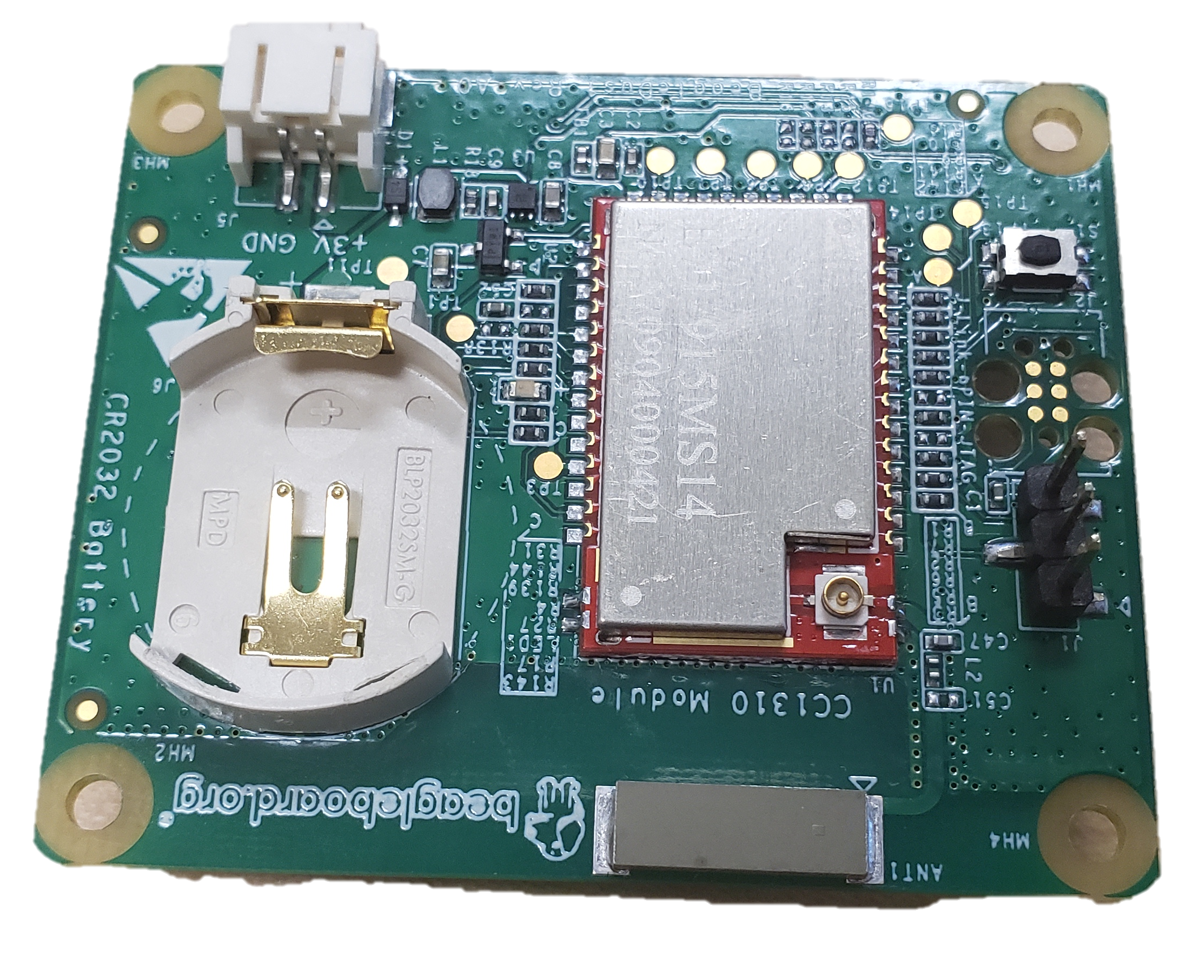
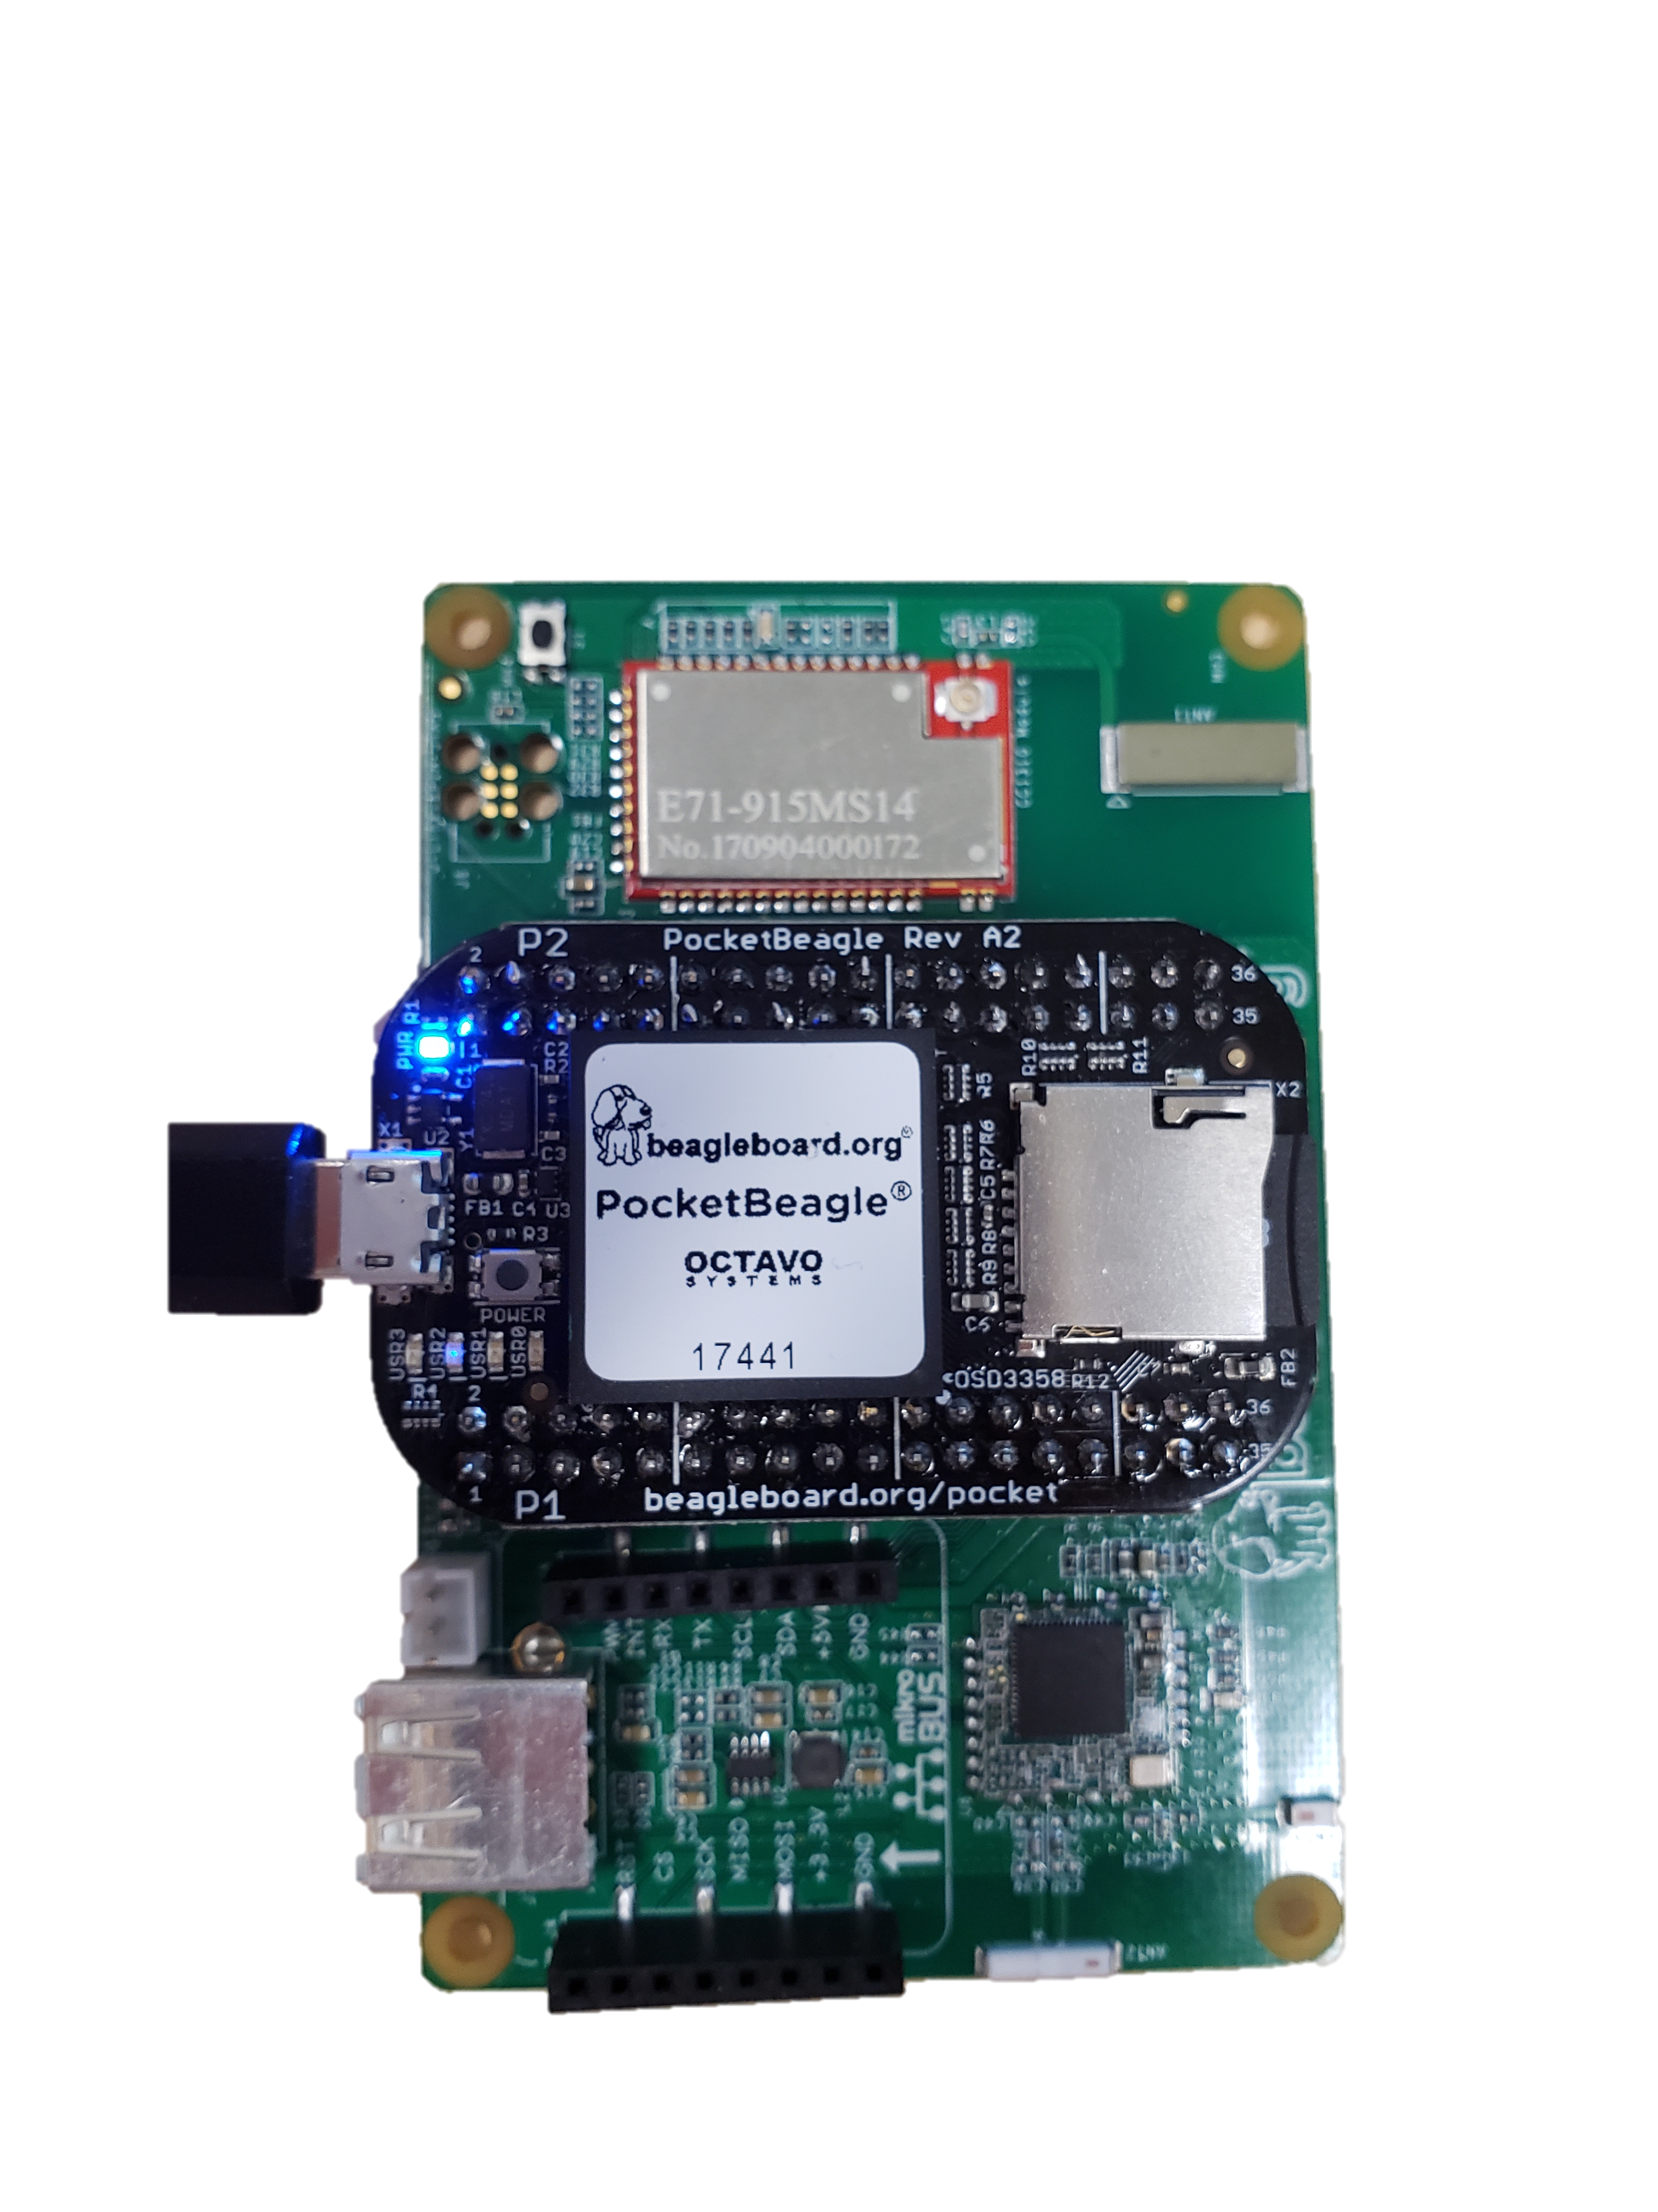
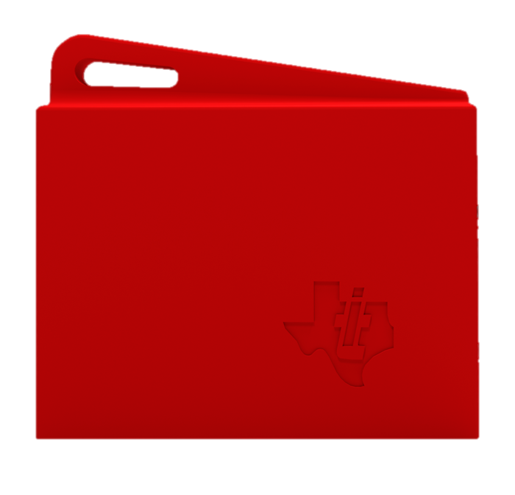
The User Experience
Same firmware, infinite sensors
BeagleDust
IDE
Gateway
SensorTag

Slide 8
User Experience Value Proposition
Automatic provisioning for I2C, SPI, GPIO, UART, ADC, and PWM
No cut-and-paste
  No device specific code lives my program
  Driver maintenance is owned by Linux kernel
No “firmware” development
  Everything a developer needs to do sits above the OS in any language
All sensor data is readily accessible in read and write files
Every programming language supported
  No language specific libraries
Out of the box support for ecosystem of 500+ mikroElektronika click boards

Slide 9
The Ask
Marketing Support
  How can TI drive market awareness – what does TI need from BB.org to do this?
Software and Hardware Development
  Design support and consultancy for discrete implementation of CC13xx
    Required to achieve pricing targets
  Split cost of 6 months firmware development, ~$150k
Pricing
  Target BOM cost is $3 to achieve a MSRP of <$10

Slide 10
Appendix

Slide 11
Example: flood mitigation system
BeagleBoard SBC with Connectivity
Beagle Dust
0.5Km
Water level sensor
Internet/ Cloud
1Km
Beagle Dust
Beagle Dust
0.3Km
Control room, office or
enclosure
Overflow/ Sluice Gate
Emergency Pump

Slide 12
Software Proposition
Greybus: automatic provisioning for I2C, SPI, and GPIO
USB in Linux Today
Before Greybus
With Greybus
HOST
Peripheral
Connect Device
Probe
what is it
SOC
I2C
Peripheral
SOC
I2C
Peripheral
Tell it
UART
MCU
MCU
SPI
SPI
Load
Driver
GPIO
GPIO
It Works!
Specific device tree required
Connect Device
Probe
what is it
Manifest

Slide 13
The Concept
Low cost (< $10), low-profile edge node that is easily deployed almost anywhere
Adaptable by Makers and Professionals alike for it’s plug and play usability
  Professionals would use for proof of concept, assume higher volumes would result in design / manufacturing customization opportunities and the wider portfolio of IoT services
Features Long Range Radio comms (Sub-GHz TI 15.4 compare with LoRA) module with on-board MCU for control and uFL connector
Low power with ample GPIO for easily sensor attachments
Compatible with MikroBus interface, allowing for deployment of MikroE click sensor & actuator boards
Works (& communicates) out-of-the-box with PocketBeagle or BBB, enabled with their respective Long Range Comms cape
Debug / Programming via header / JTAG connector / USB option(s)
Battery-holder for Li-Ion coin-cell
Power-management with appropriate voltage translations

Slide 14
What is probing and a probable bus?

Slide 15
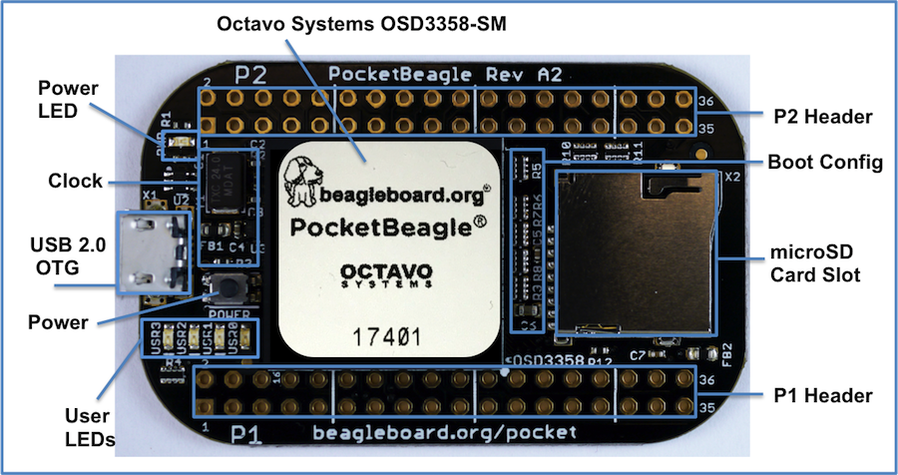
PocketBeagle top

Slide 16
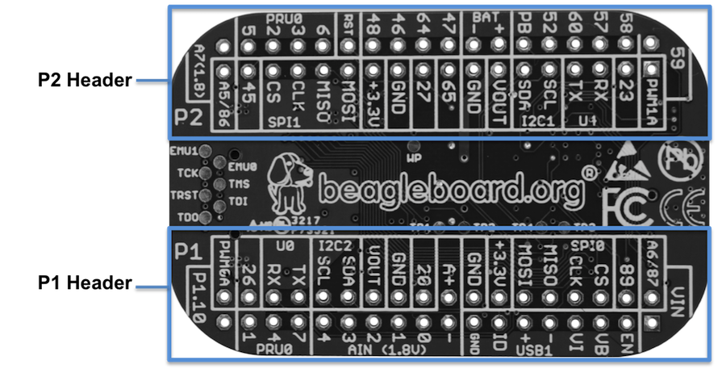
PocketBeagle bottom

Slide 17
PocketBeagle bottom
44

Slide 18

PocketBeagle expansion

Slide 19
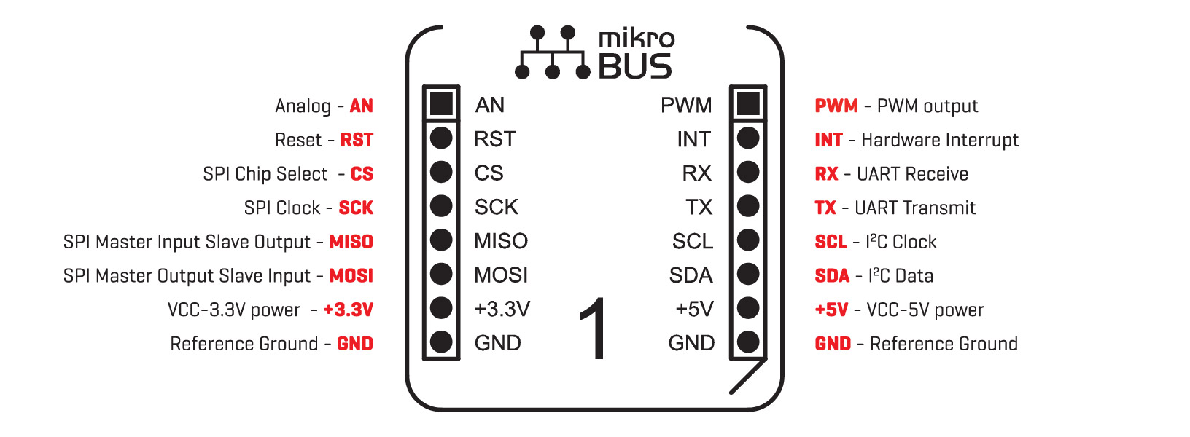
mikroBus Click

Slide 20
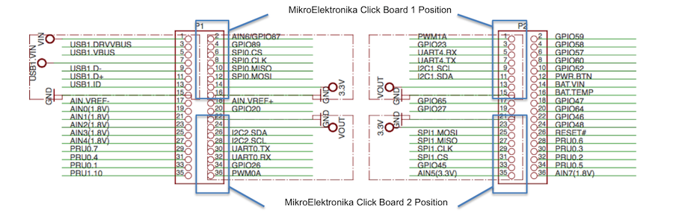
Connecting mikroBus Clicks

Slide 21
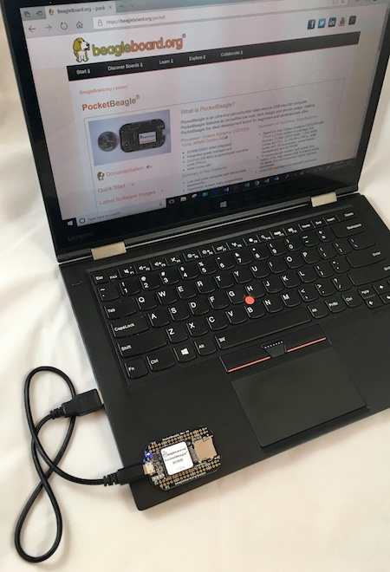
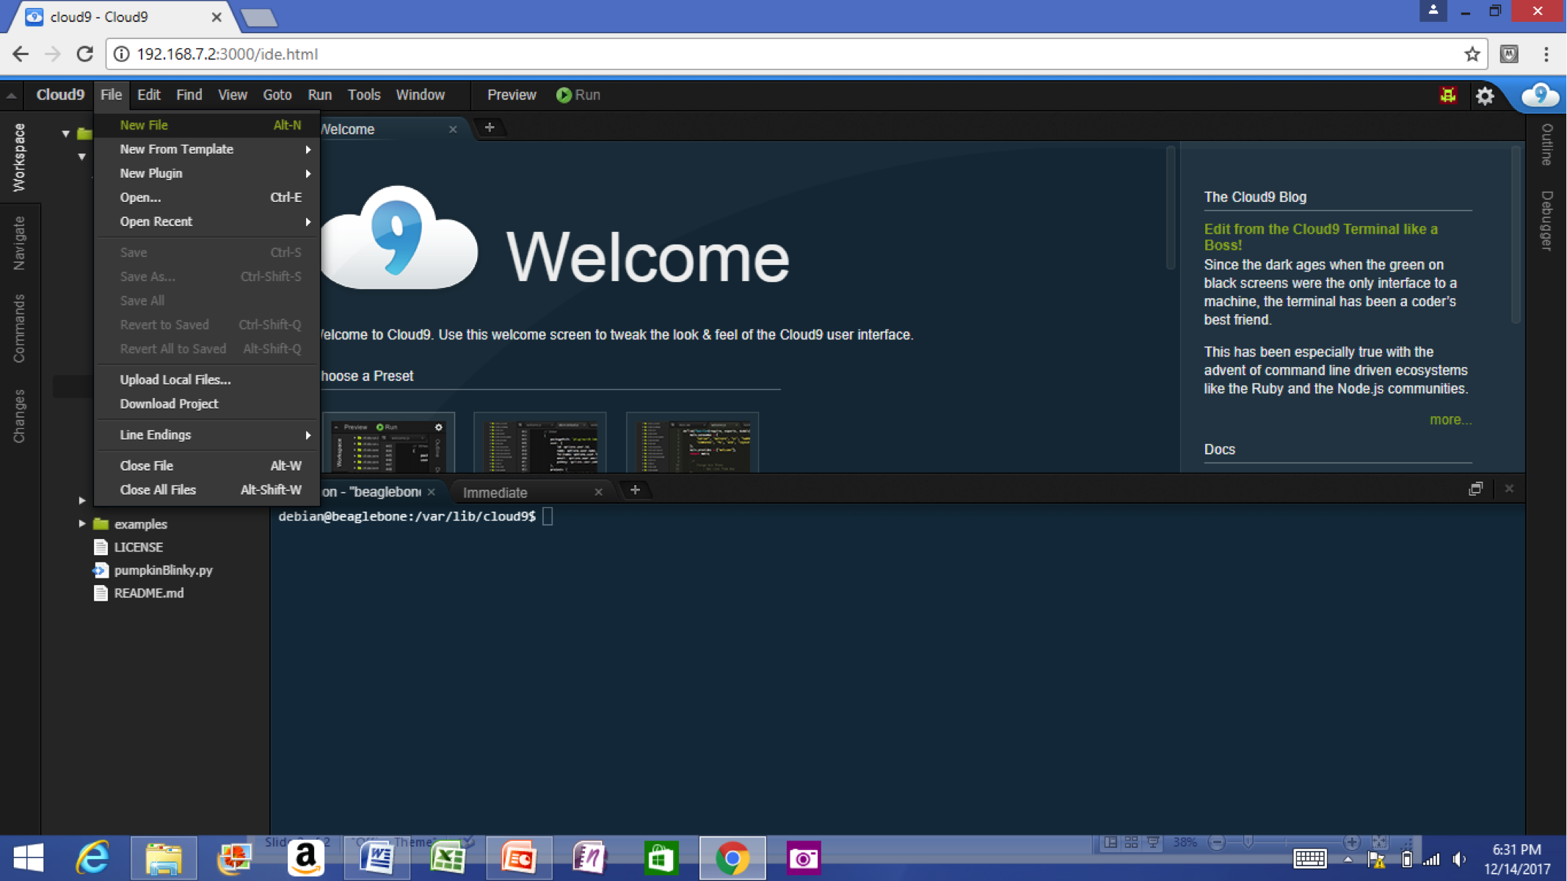
Single cable development
Power, network, develop
You can add a network and power many other ways

Slide 22
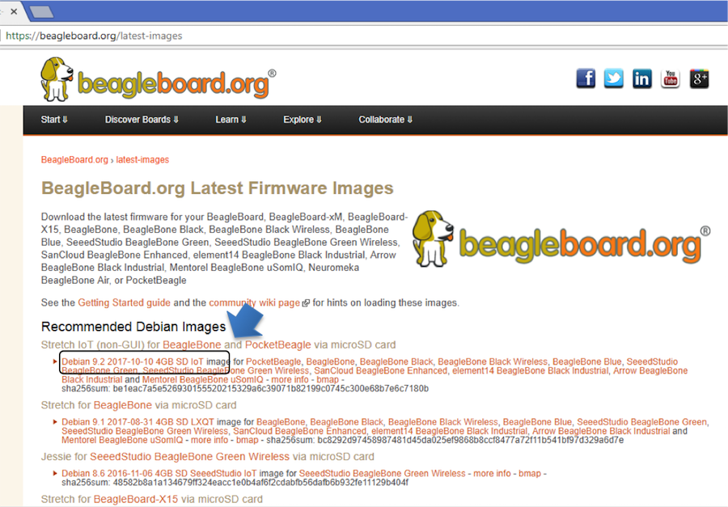
Download image

Slide 23
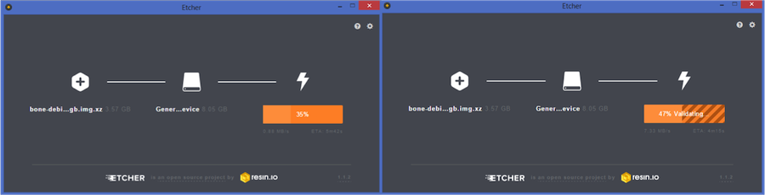
Write image to microSD with Etcher

Slide 24
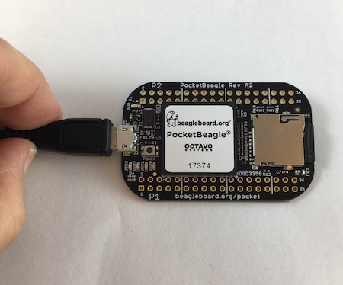
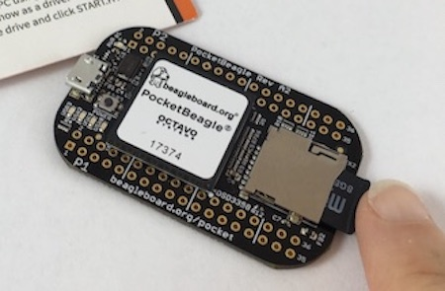
Insert microSD and boot

Slide 25
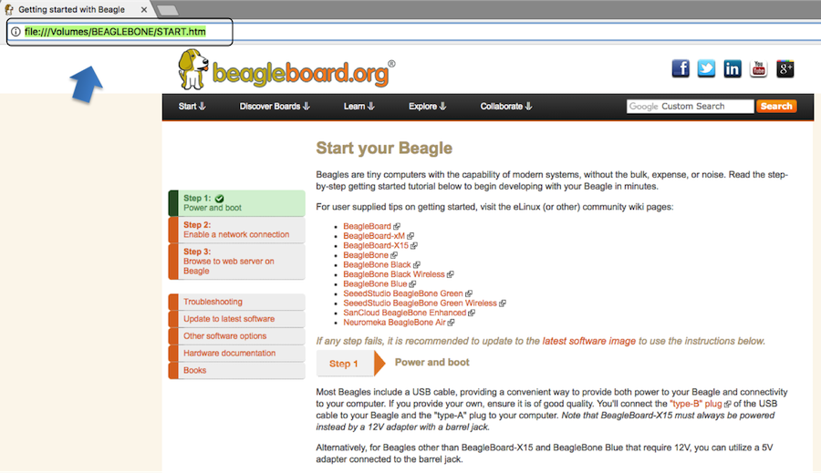

Connect to the USB network

Slide 26
Open the IDE

