Slide 1
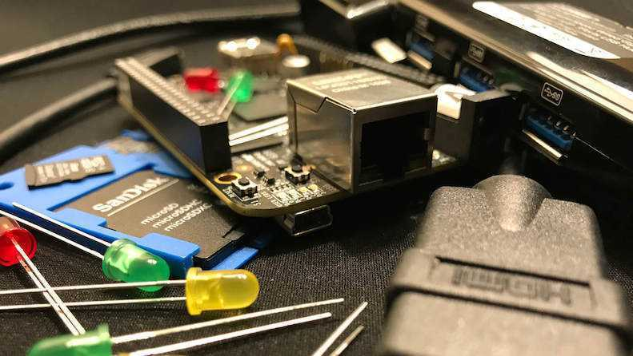


PocketBeagle TechLab Workshop

Slide 2

PocketBeagle walk-through
Friendly to novices and experts alike, the Beagle experience tracks mainline u-boot, Linux and Debian development, while augmenting it to enable development to start as quickly as possible. Attendees will get started interacting with the hardware via the command-line, shell scripts, Python and JavaScript. Attendees will be walked through the configuration details for the boot configuration, pin multiplexing, USB networking and other helper scripts they should get to know. Support and development processes within the BeagleBoard.org community will be covered. Exercises will pave the way for the other workshops to dive into their topic without needing to backtrack excessively on PocketBeagle-specific details.

Slide 3
Author and license
Author
  Jason Kridner
  Co-founder BeagleBoard.org, Texas Instruments Sitara apps
  https://beagleboard.org/about
License
  Creative Commons Attribution – Share Alike 4.0
  https://creativecommons.org/licenses/by-sa/4.0/

Slide 4
Other authors and license
Authors
  Michael Opdenacker (michael@bootlin.com)
  Founder of Bootlin,
  kernel and embedded Linux engineering company
  https://bootlin.com/company/staff/michael-opdenacker
License
  Creative Commons Attribution – Share Alike 4.0
  https://creativecommons.org/licenses/by-sa/4.0/
  Document sources: https://github.com/e-ale/Slides

Slide 5
Outline
BeagleBoard.org, PocketBeagle and BaconBits
Developer experience
  Command-line and shell script
  JavaScript and Python
  C/C++
  C on PRUs
Project examples
Labs

Slide 6
BeagleBoard.org’s objectives
Education
  Design and use of open source SW/HW
  Embedded computing
Collaboration
  Physical computing
  Robotics
  Industrial/machine controls

Slide 7
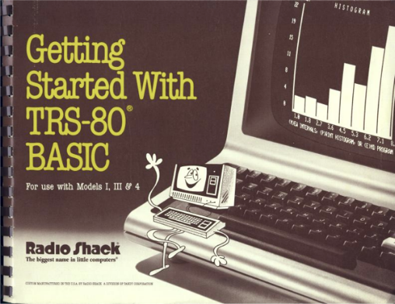
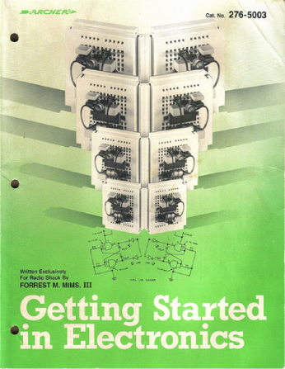
Inspiration from early PCs
http://newcome.wordpress.com/2009/12/15/make-electronics-the-new-engineers-notebook/
http://www.sandywalsh.com/2012_07_01_archive.html

Slide 8
Inspiration from early PCs
How do people learn about embedded computers with so much ground to cover?
http://newcome.wordpress.com/2009/12/15/make-electronics-the-new-engineers-notebook/
http://www.sandywalsh.com/2012_07_01_archive.html

Slide 9
Inspiration from early PCs
How do people learn about embedded computers with so much ground to cover?
Linux keeps history
Affordable -> hackable
Open from boot
High-level languages
Motivate with hardware
http://newcome.wordpress.com/2009/12/15/make-electronics-the-new-engineers-notebook/
http://www.sandywalsh.com/2012_07_01_archive.html

Slide 10
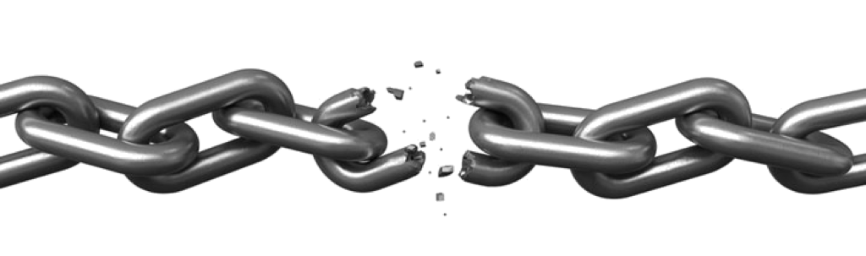


Vision

Slide 11
Vision
Creating with electronics should be as easy as creating a web page

Slide 12
Vision
Creating with electronics should be as easy as creating a web page
Appliances are better than applications

Slide 13
Vision
Creating with electronics should be as easy as creating a web page
Appliances are better than applications
Open source software and hardware enable
  Collaboration on the problem
  Ability to understand and improve the fundamentals

Slide 14
Reality
Boot-to-browser feels too limiting → booting to Debian distro
Collaborative programming still complex → collaborate at the kernel
Many possible development environments
  command-line/ssh, Cloud9 IDE, node-red, pureData, SuperCollider, LabView, Matlab, Eclipse, Visual Studio, Scratch, Blockly
Domain specific approaches
  Machinekit/LinuxCNC, PLC, many IoT toolkits
  Many rapid sensor approaches: capes, mikroBus, Grove/Grove Zero, PMOD
  Many rapid build approaches: LEGO, printing/milling, Makeblock, Vex, various other aluminum kits

Slide 15
Approach
Don’t try to boil the ocean
  We seek to engage the open source community
Help where we can
  Blue supports Grove cables
  PocketBeagle supports mikroBus click pinout
  Many “BeagleBoard Compatible” devices targeting specific application areas

Slide 16

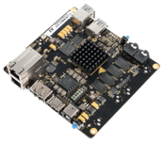
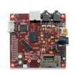
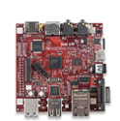

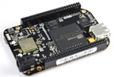

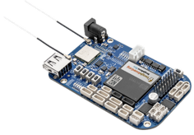
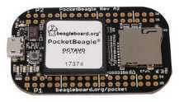
Board history
Fanless open computer (BeagleBoard)
$249
Mint tin sized with industrial peripherals (BeagleBone)
$50-70
Application focused BeagleBones
$79
Smalls mint tin sized with super-flexible design - PocketBeagle
$25

Slide 17
PocketBeagle objectives
Get simple
  4-layer PCB done in both Kicad and EAGLE
  Every expansion header pin has a useful predefined mode
Get flexible
  USB to holes, no on-board pin consumption, no header soldered
  Support for 2 mikroBus Click boards (over 300 already exist)
Get small
  Stick with mint-tin survival-kit theme, but go to “smalls” (35mm x 55mm)
Get low cost
  System-in-package approach has can lower build costs
  Launched/sustainable at $25

Slide 18
PocketBeagle key features
Processing
  1-GHz ARM Cortex-A8 processor
  2x200-MHz programmable real-time units (PRUs)
  ARM Cortex-M3 microcontroller for power and security
  SGX530 graphics processor (OpenGLES)
Memory
  512-MB DDR3
  4-KB I2C EEPROM
Interfaces
  USB 2.0 OTG
  microSD
72 expansion header pins
  8 analog inputs (6@1.8V, 2@3.3V)
  44 digital I/Os (18 enabled)
  3 UARTs (2 enabled)
  2 I2C ports
  2 SPI ports
  2 quadrature encoders accessible
  2 CAN bus controllers accessible
  USB, power/reset buttons, battery/DC

Slide 19
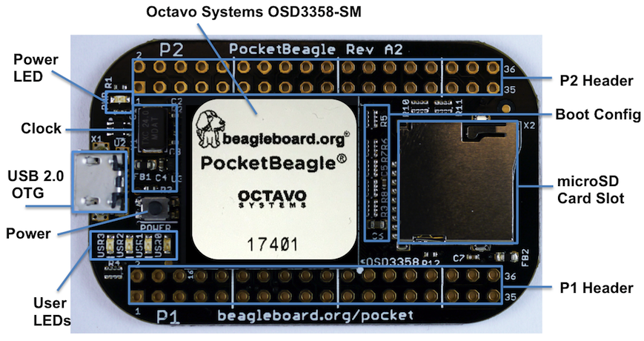
PocketBeagle top

Slide 20
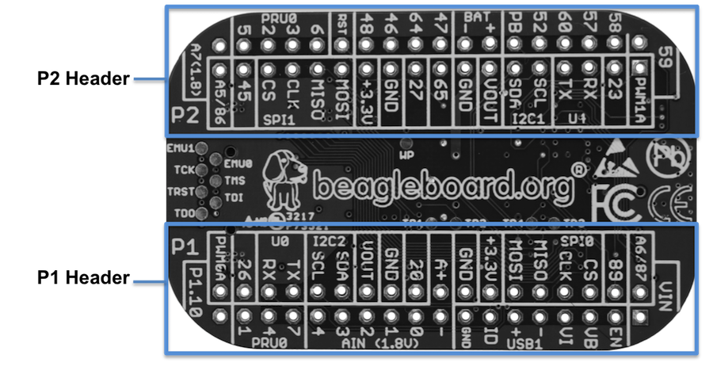
PocketBeagle bottom

Slide 21
PocketBeagle bottom
44

Slide 22
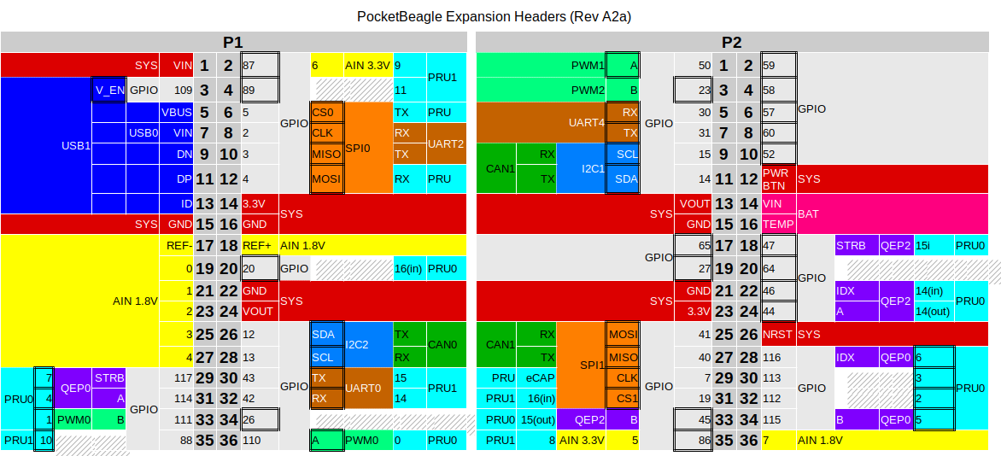
PocketBeagle expansion

Slide 23
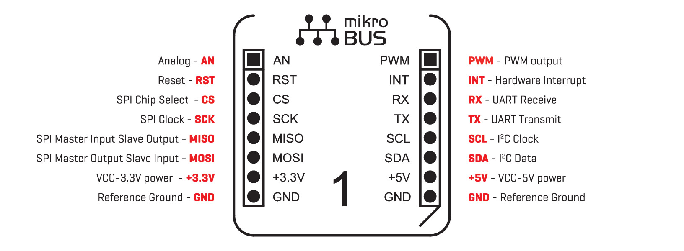
mikroBus Click

Slide 24
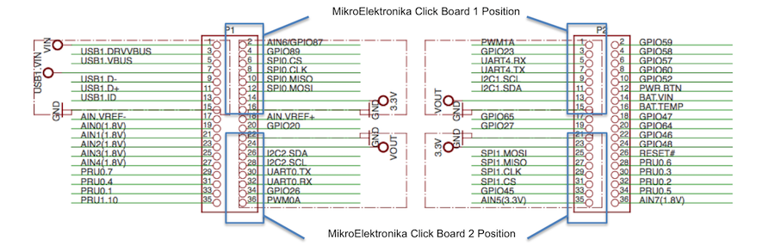
Connecting mikroBus Clicks

Slide 25
TechLab objectives
Designed specifically for e-ale training
Inspired by “Bacon Cape” by Dave Anders
  Designed for similar purpose on BeagleBone
Migrated to PocketBeagle as “BaconBits” by Michael Welling
Updated to have mikroBus header and made “pretty”
  Extra button (with PRU option), light sensor rather than potentiometer
Provides target for common embedded interfaces
  SPI, I2C, GPIO, PWM, ADC, USB, serial
Avoid users needing to buy several modules

Slide 26
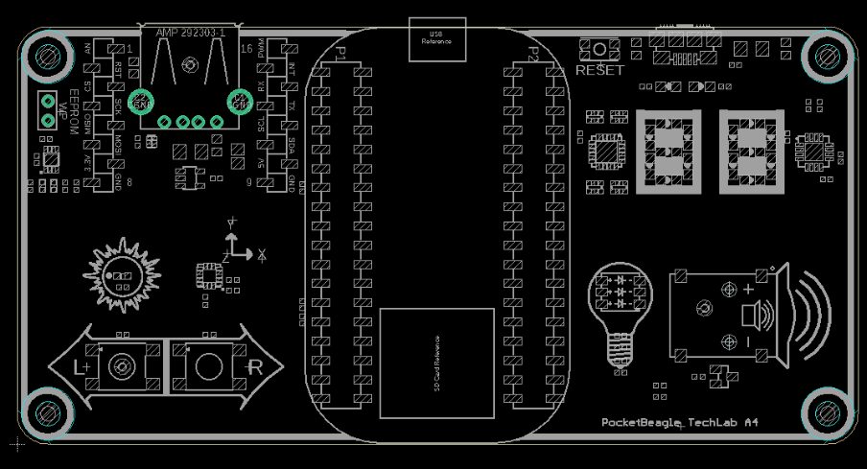
TechLab features
USB-to-Serial micro B
USB Host A with power
Reset button
2 GPIO push buttons (L and R)
ADC light sensor
PWM tri-color LED
SPI 2-digit 7-segment display
I2C accelerometer
mikroBus header

Slide 27
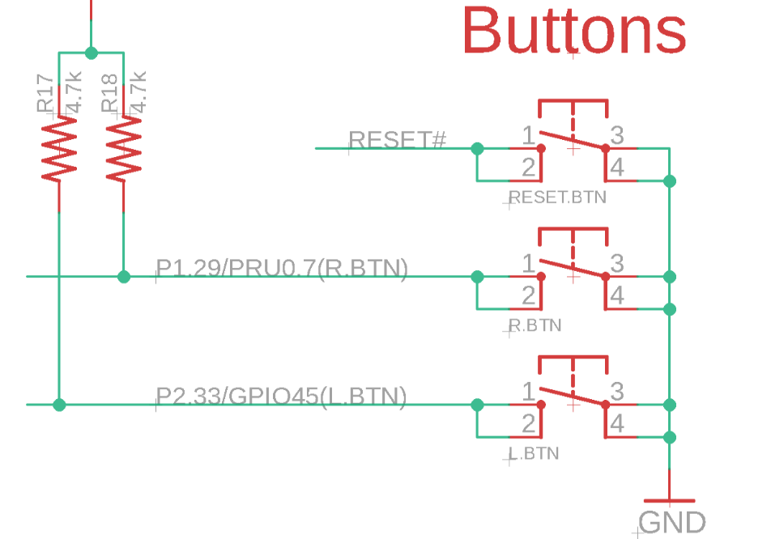
TechLab GPIO inputs

Slide 28
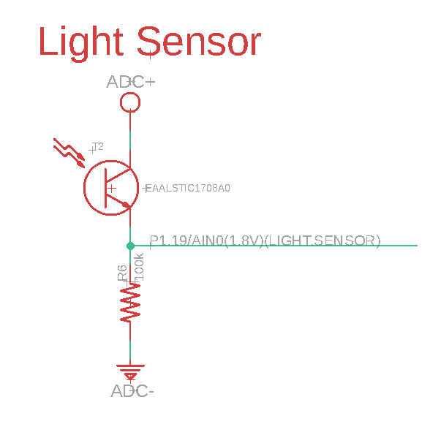
TechLab ADC input

Slide 29
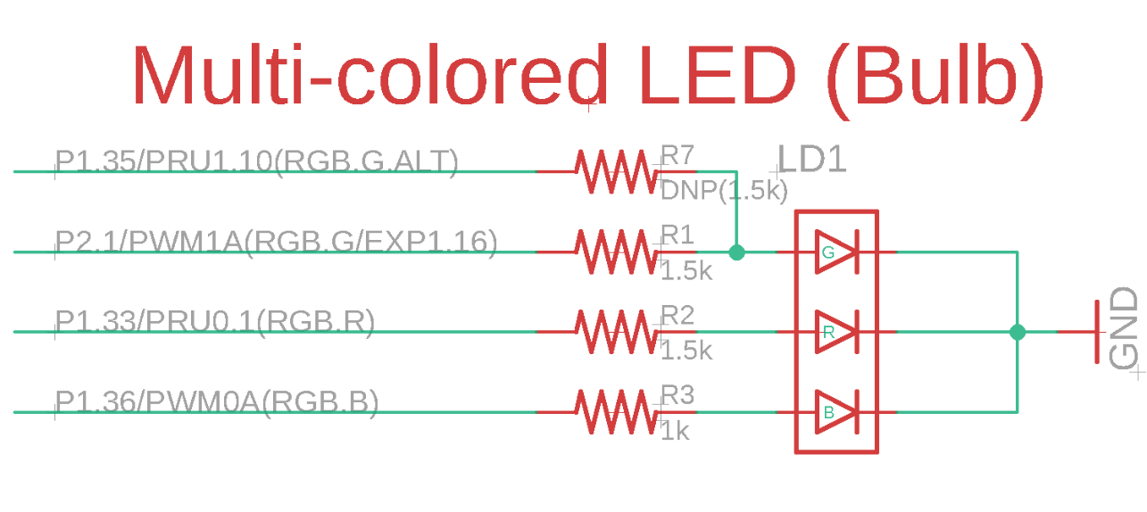
TechLab PWM output

Slide 30
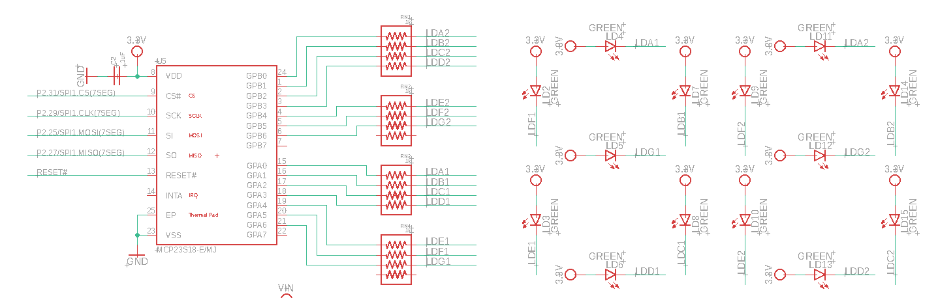
TechLab SPI 7-segment display

Slide 31
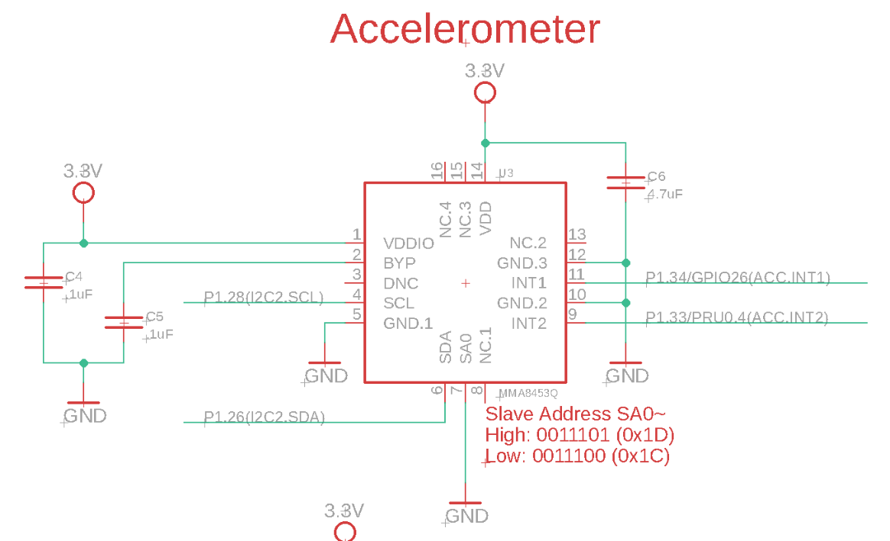
TechLab I2C sensor

Slide 32
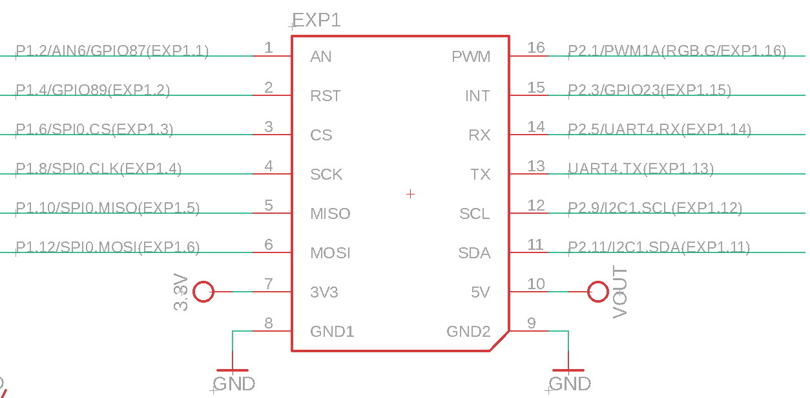
TechLab mikroBus header

Slide 33
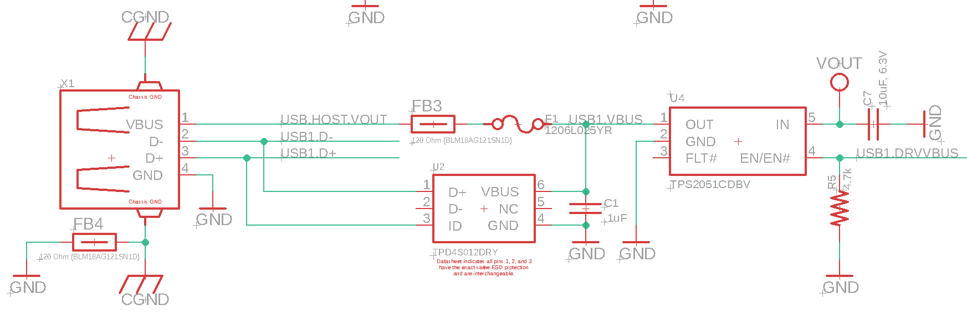
TechLab USB host

Slide 34
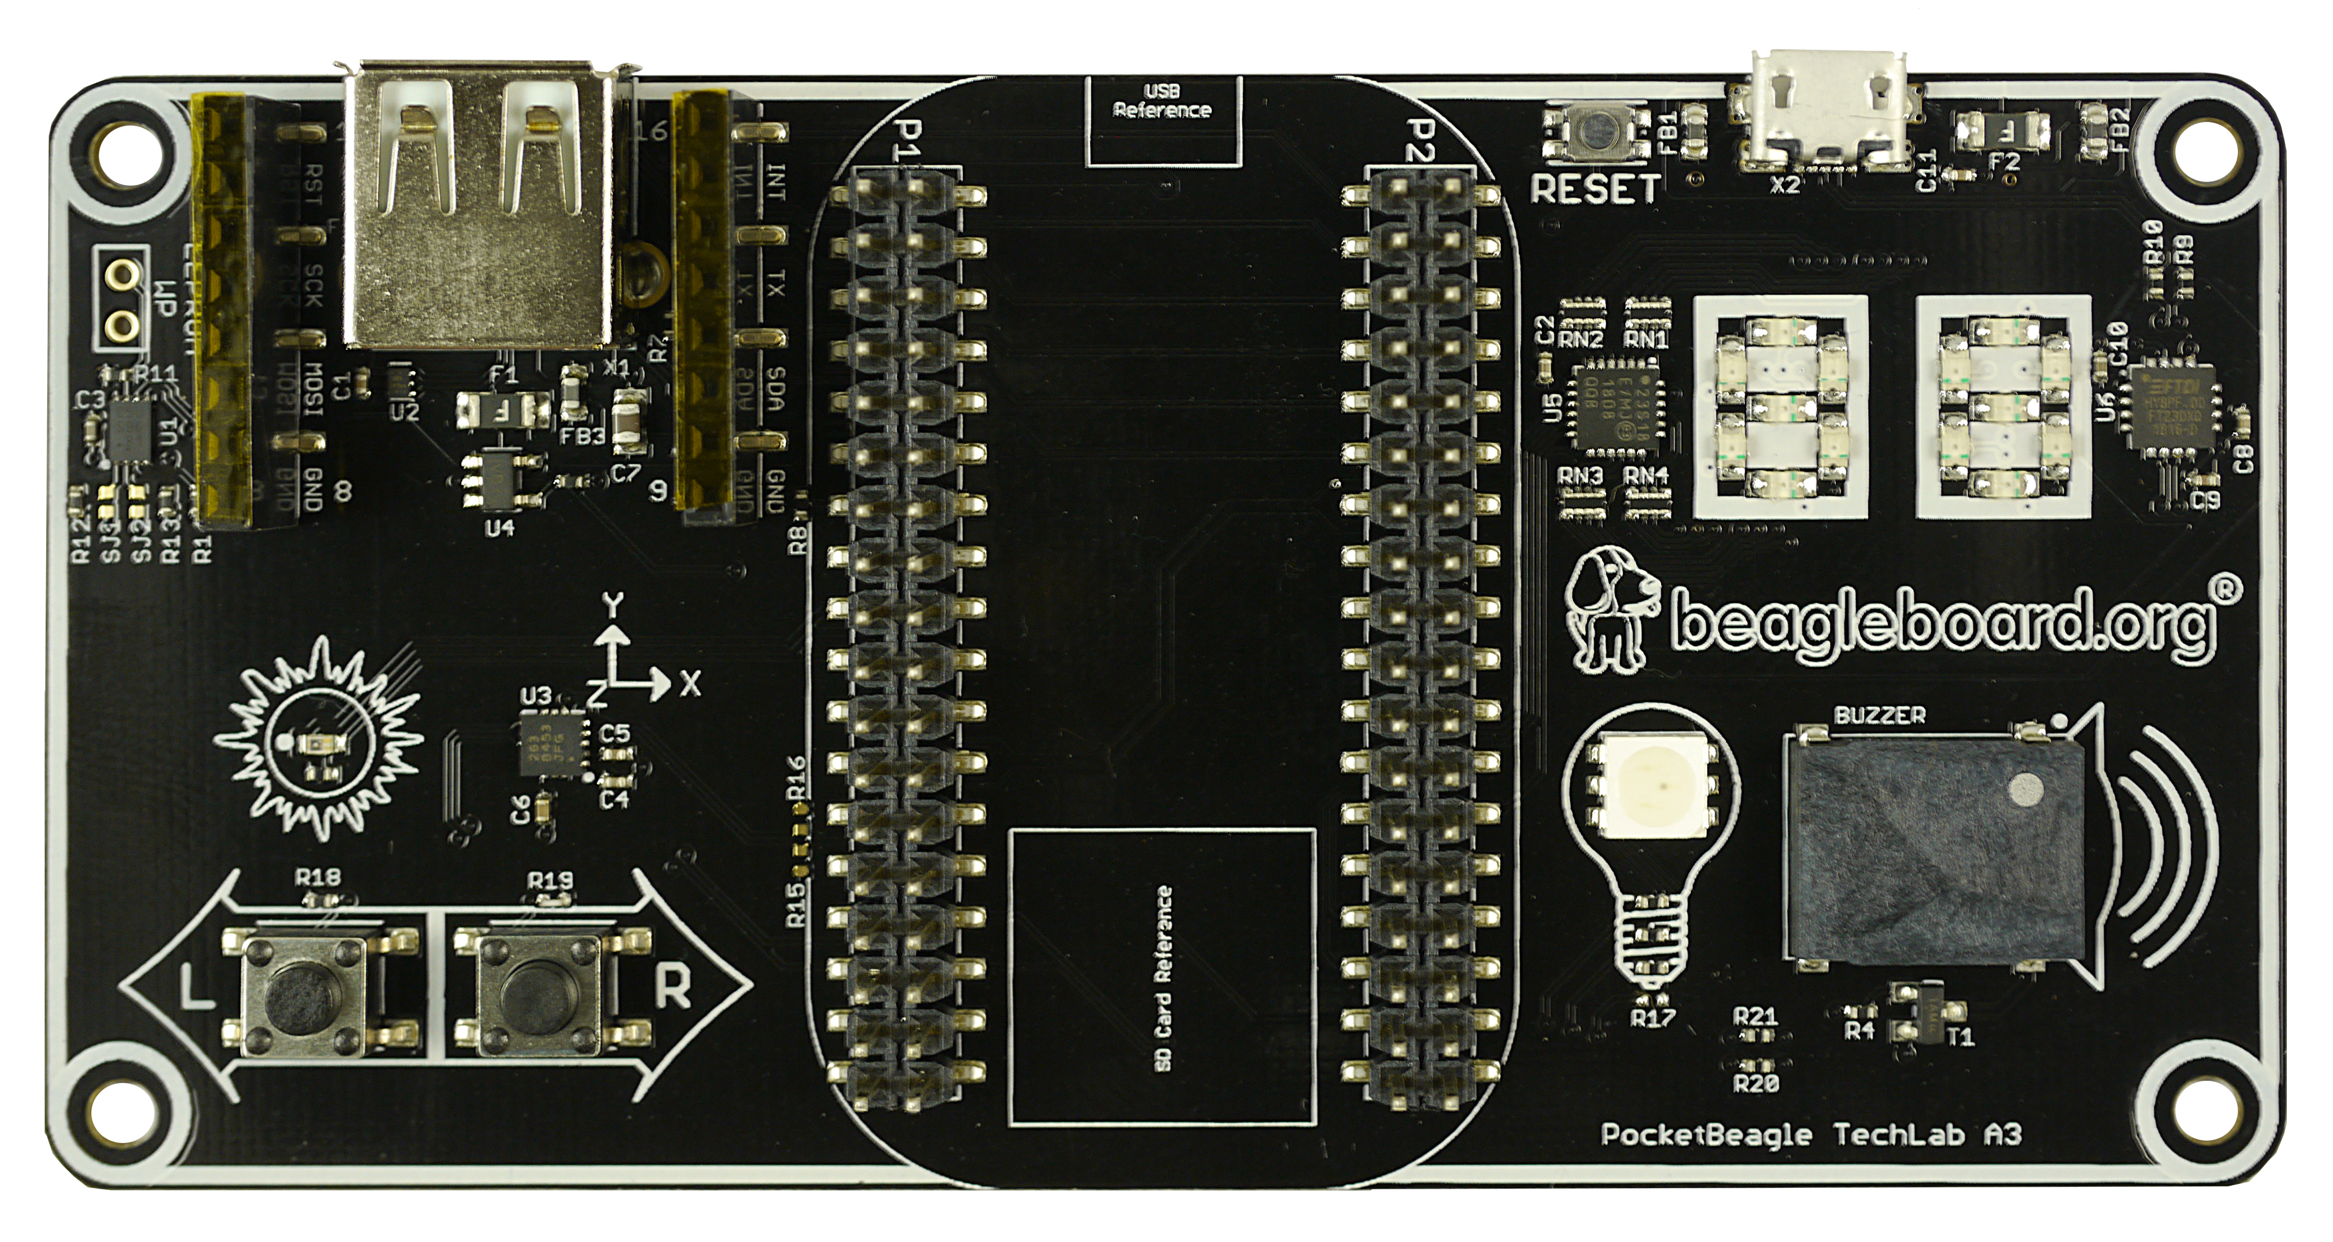
TechLab board image

Slide 35
Developer experience
Customized Debian images – bbb.io/latest
Self-hosted tools for ARMs (A8/M3) and PRUs
Libraries for various high-level languages
Scripts for common tasks
Sources for bootloader, device tree, etc.
Servers for network-based development

Slide 36
See labs in the Handouts
No need to program the microSD card
  The link is for your reference. This is already done for you.
Do the first 4 labs
  “Blink PocketBeagle on-board USRx LED”
  “Read a button”
  “Read an analog sensor”
  “Fade an LED”
I will interrupt with hints and discussion at intervals

Slide 37
Walk me through the getting started process

Slide 38
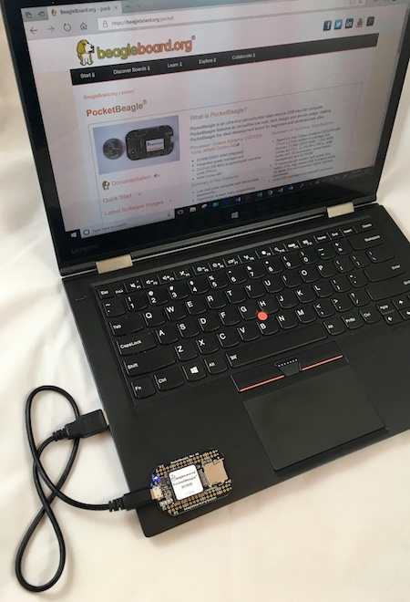
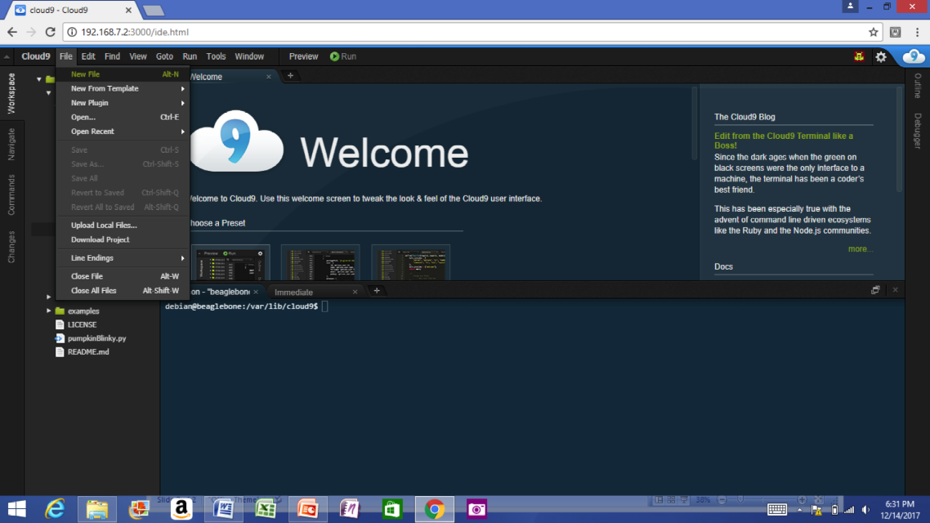
Single cable development
Power, network, develop
You can add a network and power many other ways

Slide 39
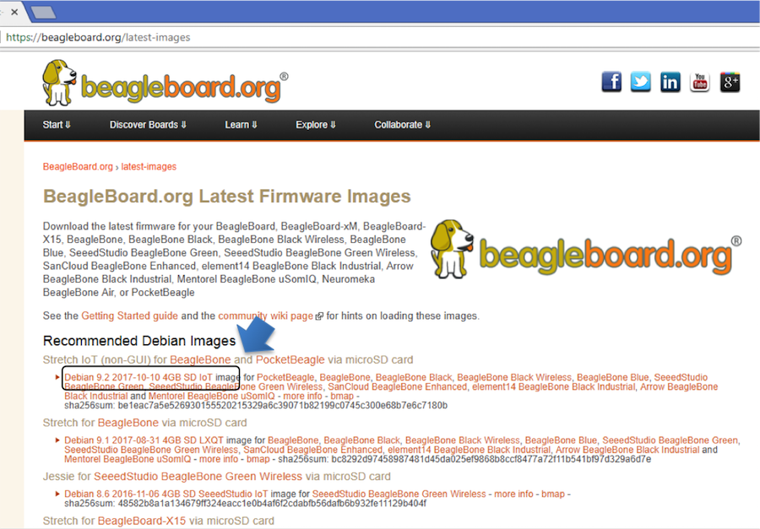
Download image

Slide 40
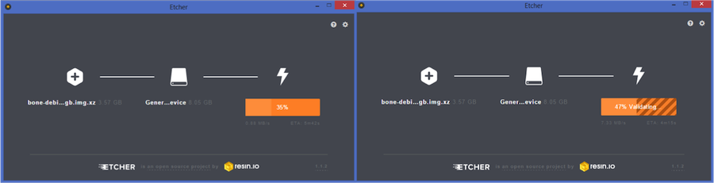
Write image to microSD with Etcher

Slide 41
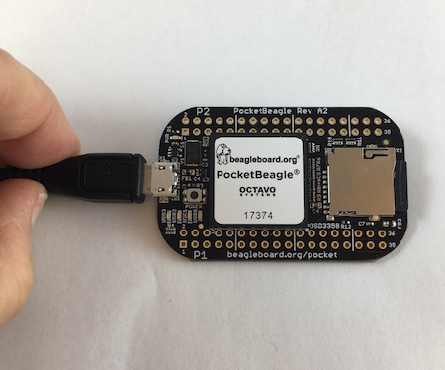
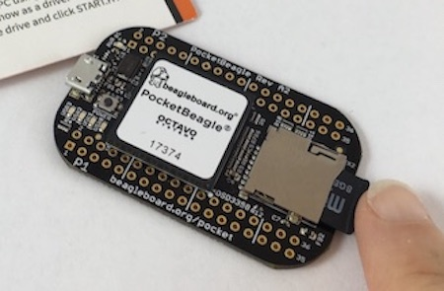
Insert microSD and boot

Slide 42
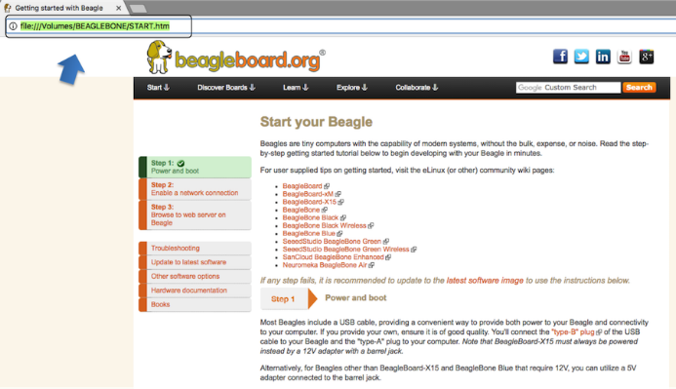
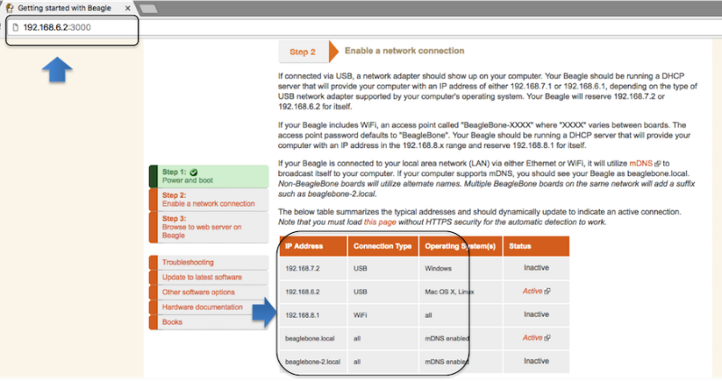
Connect to the USB network

Slide 43
Open the IDE

Slide 44
OK, how is this working?

Slide 45
USB gadgets
Linux name for device/slave drivers
  ie., when not host
USB devices have “classes”
  Mass storage
  Camera
  Audio
  Printer
  “HID” or human-interface device like mouse and keyboard
  Communications

Slide 46
USB gadgets
Default image USB gadgets
  Virtual mass storage
    Serves you up README.htm
  Virtual serial
    Provides access to console after kernel boot
  Virtual network
    Enables access to ssh and web servers

Slide 47

Cloud9 IDE
Open source project
Written in JavaScript
  Node.js
Hosted on PocketBeagle
  No cloud server involved
  No special tools on your computer,
  just your web browser

Slide 48
Yes, but what happens at startup?

Slide 49
Boot summary
Linux kernel
initramfs
rootfs
/dev
/mmcblk0p1
sysboot pins
uSD
@128k
uSD
@384k
/boot
/uEnv.txt
ROM
SPL
UBoot
Device tree
systemd
overlay
service
overlay
service

Slide 50
Device Tree
See kernel documentation for bindings
  devicetree/bindings/eeprom/eeprom.txt
Local copies enable you to extend on the fly
  /opt/source/dtb-4.14-ti
  /opt/source/bb.org-overlays
Overlays loaded in u-boot, but also possible via kernel configfs

Slide 51
Here are some more gory details
for your reference

Slide 52
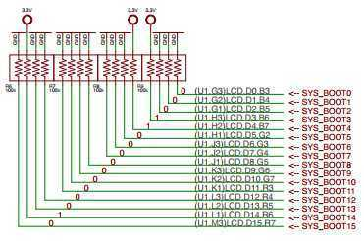

TI AM335x: bootrom
From: (AM335x and AMIC110 Sitara™ Processors Technical Reference Manual (Rev. P))
http://www.ti.com/lit/ug/spruh73p/spruh73p.pdf (page 5032)
SYSBOOT[15:14] = 01 = 24Mhz
SYSBOOT[4:0] = 11000
SPI0
MMC0 - going to use today
USB0 - (node-beagle-boot)
UART0

Slide 53
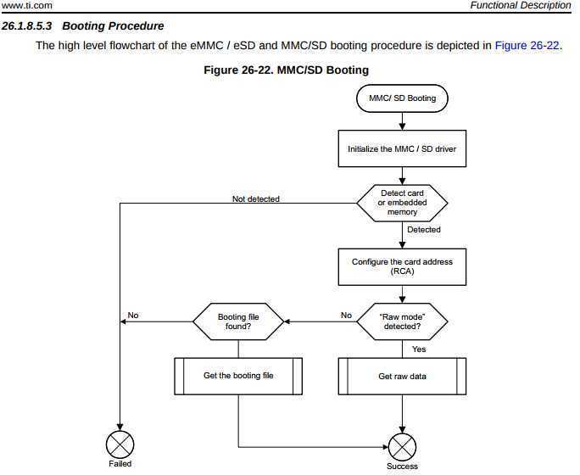
TI AM335x: bootrom
http://www.ti.com/lit/ug/spruh73p/spruh73p.pdf
Page: 5053
MLO

Slide 54
TI AM335x: bootrom: raw mode:
http://www.ti.com/lit/ug/spruh73p/spruh73p.pdf (Page: 5054)
0x0 <- (FAT Boot Sector, let's leave it blank...)
0x20000 (128KB) <- We are going to use this location
0x40000 (256KB) <- (2nd “backup” location)
0x60000 (384KB) <- (3rd “backup” location)
Only 128KB in size… (hint, only 128KB of SRAM)

Slide 55
Das U-Boot (the Universal Boot Loader) U-Boot
Original Author: Wolfgang Denk, now maintained by Tom Rini
https://www.denx.de/wiki/U-Boot
http://git.denx.de/?p=u-boot.git;a=summary
https://en.wikipedia.org/wiki/Das_U-Boot

Slide 56
U-Boot: AM335x
Outputs two files for TI am335x targets:
MLO = SPL (or Secondary Program Loader)
u-boot.img (or u-boot-dtb.img) (U-Boot)
ROM
SPL
UBoot

Slide 57
U-Boot: SPL
Initializes main memory (DDRx for am335x)
Loads full (U-Boot) into DDR memory
Or:
Initializes main memory (DDRx for am335x)
Loads Linux Kernel into DDR memory (aka: Falcon mode, faster boot mode/etc)

Slide 58
U-Boot:
Network
USB
MMC
File System (fat/extX)
Shell
Sometimes you don’t need a full OS, have U-Boot init and then have U-Boot load/run your application.

Slide 59
U-Boot:
CPU : AM335X-GP rev 2.1
I2C: ready
DRAM: 512 MiB
Some drivers were not found
Reset Source: Power-on reset has occurred.
MMC: OMAP SD/MMC: 0, OMAP SD/MMC: 1
Using default environment
Board: BeagleBone Black
<ethaddr> not set. Validating first E-fuse MAC
BeagleBone Black:
Model: SeeedStudio BeagleBone Green:

Slide 60
U-Boot: microSD
Insert USB-microSD adapter, and type “lsblk”
voodoo@hestia:~/Supercon-2017-PocketBeagle$ lsblk
NAME MAJ:MIN RM SIZE RO TYPE MOUNTPOINT
sda 8:0 0 465.8G 0 disk
└─sda1 8:1 0 465.8G 0 part /
sde 8:64 1 7.4G 0 disk
└─sde1 8:65 1 7.4G 0 part
Open: system.sh change: MMC=/dev/sde
That’s our 8GB USB Flash Drive

Slide 61
U-Boot: Format microSD
sudo dd if=/dev/zero of=${MMC} bs=1M count=10
sudo sfdisk ${MMC} <<-__EOF__
4M,,L,*
__EOF__
sudo mkfs.ext4 -L rootfs ${MMC}1
voodoo@hestia:~/Supercon-2017-PocketBeagle$ ./scripts/format_drive.sh

Slide 62
U-Boot: (refresh for your memory)
http://www.ti.com/lit/ug/spruh73p/spruh73p.pdf (Page: 5054)
0x0
0x20000 (128KB) <- We are going to use this location
0x40000 (256KB)
0x60000 (384KB)
sudo dd if=./deploy/MLO of=${MMC} count=1 seek=1 bs=128k
sudo dd if=./deploy/u-boot.img of=${MMC} count=2 seek=1 bs=384k

Slide 63
Base Rootfs: Debian 9.x (Stretch)
Maintainer: Robert Nelson (with lots of help from all the Debian Developers and 1000’s of other users)
https://elinux.org/Beagleboard:BeagleBoneBlack_Debian#2017-11-05_-_Debian_9_.28Stretch.29_-_Weekly
https://www.debian.org/
https://github.com/beagleboard/image-builder

Slide 64
See more labs in the Handouts
Do the last 3 labs
  “Using Node-RED to read and write files”
  “Explore the Linux command line”
  “Toggle LED based on a button press using a PRU”
I will interrupt with hints and discussion at intervals

Slide 65
In Linux, everything becomes a file
Much to learn
  I'm used to microcontrollers: just give me the datasheet with register definitions and set me free!
Training on boot & device drivers useful
  Often geared more at system bring-up
  What about the everyday user?
  Where is that abstraction benefit?
Let's just walk a working system!

Slide 66
What is the baseline?
http://refspecs.linuxfoundation.org/lsb.shtml
Every Linux system may be customized
  This is the nature of open source
  Stuff still needs to work together
The Linux Standard Base
  Umbrella for various Linux Foundation groups
  A specification and a testkit
  Documents typical libraries, functions and files expected to be found by the developer

Slide 67
lsb_release
debian@beaglebone:~$ sudo apt install -y lsb debian@beaglebone:~$ lsb_release -a No LSB modules are available. Distributor ID: Debian Description: Debian GNU/Linux 9.5 (stretch) Release: 9.5 Codename: stretch

Slide 68
Filesystem Hierarchy Standard
http://www.pathname.com/fhs/
/tmp: temporary files
/var: data that is changes at run-time
/proc: "information from processes" (virtual)
/sys: "system filesystem" (virtual)
/dev: device files
/media: mount point for removable media
/lost+found: data without directory entry
/mnt: mount point for temporary mounted file systems
/opt: add-on application software packages

Slide 69
/proc
debian@beaglebone:~$ ls /proc 1 1692 22 3354 878 990 fb misc sysvipc 10 17 23 3362 89 apm filesystems modules thread-self 11 18 2370 34 9 asound fs mounts timer_list 1110 1857 2375 4 90 buddyinfo interrupts mtd tty 1112 19 2377 6 91 bus iomem net uptime 1119 1951 2379 69 913 cgroups ioports pagetypeinfo version 1150 1964 24 7 918 cmdline irq partitions vmallocinfo 1151 2 25 70 92 config.gz kallsyms pvr vmstat 1152 20 26 71 93 consoles keys sched_debug zoneinfo 12 21 27 72 945 cpu key-users schedstat 1215 2107 28 73 951 cpuinfo kmsg self 1247 2120 29 74 959 crypto kpagecgroup slabinfo 13 2149 30 8 973 devices kpagecount softirqs 1440 2152 31 800 977 device-tree kpageflags stat 15 2153 32 820 980 diskstats loadavg swaps 159 2155 33 821 983 driver locks sys 16 2173 3353 858 984 execdomains meminfo sysrq-trigger

Slide 70
/proc/cpuinfo
debian@beaglebone:~$ cat /proc/cpuinfo processor : 0 model name : ARMv7 Processor rev 2 (v7l) BogoMIPS : 995.32 Features : half thumb fastmult vfp edsp thumbee neon vfpv3 tls vfpd32 CPU implementer : 0x41 CPU architecture: 7 CPU variant : 0x3 CPU part : 0xc08 CPU revision : 2 Hardware : Generic AM33XX (Flattened Device Tree) Revision : 0000 Serial : 1741GPB42934

Slide 71
The file interface abstraction
What can I do with files?
  open, read, write, close, delete
  What is an "ioctl"?
  What is "mmap"?
What is a virtual file system?
  Looks like a file, but executes code in the kernel
  Not really storing anything to media
  A bit like a "ram disk"

Slide 72
Kernel.org documentation
http://www.kernel.org/doc/
Documentation extracted from the Linux kernel and mirrored on the web where Google can find it:
  Documentation - Text files in the kernel source tarball's Documentation subdirectory
  htmldocs - Kernel Documentation maintained in docbook format (output of "make htmldocs")
  Menuconfig - help text for each kernel configuration option (from kconfig source)
  README various README files scattered around Linux kernel source
  RFC - List of IETF RFCs referred to by kernel source files. Links to both the text of the RFC and the source files that refer to it
  Output of kernel's "make help"
Standards documents applicable to the Linux kernel
Other web pages containing kernel documentation
Translations to other languages
Documentation on memory management
Miscellaneous

Slide 73
Kernel Application Binary Interface
http://www.kernel.org/doc/Documentation/ABI/
Low-level kernel interface from "userland"
Status of interface
  Stable
    Encouraged to use freely
    Guaranteed for at least two years
  Testing
    Mostly complete, but might change
    Let developers know how you are using
    Where you’ll find most of the good stuff
  Obsolete
    Scheduled for removal
  Removed

Slide 74
Kernel Application Binary Interface
http://www.kernel.org/doc/Documentation/ABI/
Types of interfaces
  Syscalls
    Trap interface with IDs
    May be possible to have a direct entry
  SYSFS
    Virtual file system
    See also DEBUGFS and CONFIGFS

Slide 75
Syscalls
http://www.kernel.org/doc/man-pages/online/pages/man2/syscalls.2.html
open/read/write/lseek/close/unlink
ioctl
mknod
fork/select/poll/...
mkdir/...
mount/umount
mmap

Slide 76
What is SYSFS?
Virtual file system that exposes drivers to userspace
mount | grep sysfs
  sysfs on /sys type sysfs (rw,nosuid,nodev,noexec,relatime)
/sys/devices - driver hierarchy
/sys/bus - symbolic links to bus owners
/sys/class - common interfaces
/sys/block - block interface
How about some examples?

Slide 77
/sys/module
http://www.kernel.org/doc/Documentation/ABI/stable/sysfs-module
/sys/module/MODULENAME
  .../parameters: options you can provide
  .../refcnt: number of times in use
debian@beaglebone:~$ ls /sys/module 8250 fb lockd pruss sysrq usb_f_ecm apparmor firmware_class mma8452 pruss_intc tcp_cubic usb_f_mass_storage auth_rpcgss fscrypto mmcblk pruss_soc_bus tda18271 usb_f_rndis block fuse module pvrsrvkm tda827x usbhid bone_capemgr hid mt20xx r8188eu tda8290 usb_storage can hid_logitech netpoll random tda9887 u_serial cec hid_logitech_hidpp nf_conntrack rc_core tea5761 vt cfg80211 i2c_algo_bit nf_conntrack_ipv4 rcupdate tea5767 watchdog configfs ima nf_defrag_ipv4 rcutree ti_cpsw wireguard cpufreq iptable_filter nf_nat rfkill tpm workqueue cpuidle iptable_mangle nf_nat_ipv4 rng_core tuner_simple xc4000 cryptomgr iptable_nat nfs scsi_mod tuner_xc2028 xc5000 dns_resolver ip_tables nfs_layout_nfsv41_files sdhci ubi xhci_hcd drm ipv6 nfsv4 snd ubifs x_tables drm_kms_helper ir_kbd_i2c omapdrm snd_pcm udl xz_dec dvb_core kernel omap_mailbox snd_timer u_ether zswap dynamic_debug keyboard onenand spidev uinput eeprom_93cx6 leds_pwm overlay spurious uio ehci_hcd libahci pinctrl_mcp23s08 srcutree uio_pdrv_genirq etnaviv libata printk sunrpc usbcore evdev libcomposite pru_rproc suspend usb_f_acm

Slide 78
/sys/class/leds
https://www.kernel.org/doc/Documentation/ABI/testing/sysfs-class-led
/sys/class/leds/LED
  .../brightness: 0-max_brightness, >0 = on
  .../max_brightness: default is 255
  .../trigger: triggers available from kernel
  .../inverted: invert on/off state
debian@beaglebone:~$ ls /sys/class/leds beaglebone:green:usr0 techlab::blue techlab::seg1 techlab::seg13 techlab::seg3 techlab::seg7 beaglebone:green:usr1 techlab::green techlab::seg10 techlab::seg14 techlab::seg4 techlab::seg8 beaglebone:green:usr2 techlab::red techlab::seg11 techlab::seg15 techlab::seg5 techlab::seg9 beaglebone:green:usr3 techlab::seg0 techlab::seg12 techlab::seg2 techlab::seg6

Slide 79
/sys/class/gpio
http://www.kernel.org/doc/Documentation/ABI/testing/sysfs-gpio
Must be explicitly exported to userspace and not claimed by kernel code
/sys/class/gpio
  .../export: asks the kernel to export a GPIO to userspace
  .../unexport: to return a GPIO to the kernel
  .../gpioN: for each exported GPIO #N
    .../value: always readable, writes fail for input GPIOs
    .../direction: r/w as: in, out (low); write: high, low
    .../edge: r/w as: none, falling, rising, both
  .../gpiochipN:for each gpiochip; #N is its first GPIO
    .../base: (r/o) same as N
    .../label: (r/o) descriptive, not necessarily unique
    .../ngpio: (r/o) number of GPIOs; numbered N to N + (ngpio - 1)
debian@beaglebone:~$ ls /sys/class/gpio export gpio114 gpio13 gpio20 gpio30 gpio42 gpio47 gpio58 gpio7 gpiochip0 unexport gpio110 gpio115 gpio14 gpio23 gpio31 gpio43 gpio5 gpio59 gpio86 gpiochip32 gpio111 gpio116 gpio15 gpio26 gpio4 gpio44 gpio50 gpio60 gpio87 gpiochip496 gpio112 gpio117 gpio19 gpio27 gpio40 gpio45 gpio52 gpio64 gpio88 gpiochip64 gpio113 gpio12 gpio2 gpio3 gpio41 gpio46 gpio57 gpio65 gpio89 gpiochip96

Slide 80
On-chip peripherals (OCP)
debian@beaglebone:~$ ls /sys/devices/platform/ocp 40300000.ocmcram 480c8000.mailbox 53100000.sham ocp:P1_32_pinmux ocp:P2_20_pinmux 44e07000.gpio 480ca000.spinlock 53500000.aes ocp:P1_33_pinmux ocp:P2_22_pinmux 44e09000.serial 4819c000.i2c 56000000.sgx ocp:P1_34_pinmux ocp:P2_24_pinmux 44e0b000.i2c 481a0000.spi driver_override ocp:P1_35_pinmux ocp:P2_25_pinmux 44e0d000.tscadc 481a8000.serial modalias ocp:P1_36_pinmux ocp:P2_27_pinmux 44e35000.wdt 481ac000.gpio ocp:cape-universal ocp:P2_01_pinmux ocp:P2_28_pinmux 44e3e000.rtc 481ae000.gpio ocp:l4_wkup@44c00000 ocp:P2_02_pinmux ocp:P2_29_pinmux 47400000.usb 481cc000.can ocp:P1_02_pinmux ocp:P2_03_pinmux ocp:P2_30_pinmux 48022000.serial 481d0000.can ocp:P1_04_pinmux ocp:P2_04_pinmux ocp:P2_31_pinmux 48024000.serial 48300000.epwmss ocp:P1_06_pinmux ocp:P2_05_pinmux ocp:P2_32_pinmux 4802a000.i2c 48302000.epwmss ocp:P1_08_pinmux ocp:P2_06_pinmux ocp:P2_33_pinmux 48030000.spi 48304000.epwmss ocp:P1_10_pinmux ocp:P2_07_pinmux ocp:P2_34_pinmux 48042000.timer 48310000.rng ocp:P1_12_pinmux ocp:P2_08_pinmux ocp:P2_35_pinmux 48044000.timer 49000000.edma ocp:P1_20_pinmux ocp:P2_09_pinmux of_node 48046000.timer 49800000.tptc ocp:P1_26_pinmux ocp:P2_10_pinmux power 48048000.timer 49900000.tptc ocp:P1_28_pinmux ocp:P2_11_pinmux subsystem 4804a000.timer 49a00000.tptc ocp:P1_29_pinmux ocp:P2_17_pinmux uevent 4804c000.gpio 4a326004.pruss-soc-bus ocp:P1_30_pinmux ocp:P2_18_pinmux 48060000.mmc 4c000000.emif ocp:P1_31_pinmux ocp:P2_19_pinmux

Slide 81
Reading events
TBD

Slide 82
Instantiating a device: .dts example
&i2c0 {
pinctrl-names = "default";
pinctrl-0 = <&i2c0_pins>;
status = "okay";
clock-frequency = <400000>;
tps: tps@24 {
reg = <0x24>;
};
baseboard_eeprom: baseboard_eeprom@50 {
compatible = "at,24c256";
reg = <0x50>;
#address-cells = <1>;
#size-cells = <1>;
baseboard_data: baseboard_data@0 {
reg = <0 0x100>;
};
};
};
Pin muxing configuration
(routing to external package pins)
Phandle
(reference
to label)
Enabling this device, otherwise ignored
Node property: frequency
List of devices on
i2c0
I2C bus identifier
From arch/arm/boot/dts/am335x-boneblue.dts

Slide 83
Pin multiplexing
Modern SoCs have too many hardware blocks compared to physical pins exposed on the chip package.
Therefore, pins have to be multiplexed
Pin configurations are defined in the Device Tree
Correct pin multiplexing is mandatory
to make a device work from an electronic point of view.

Slide 84
DT pin definitions
&am33xx_pinmux {
...
i2c0_pins: pinmux_i2c0_pins {
pinctrl-single,pins = <
AM33XX_IOPAD(0x988, PIN_INPUT_PULLUP | MUX_MODE0) /* (C17) I2C0_SDA.I2C0_SDA */
AM33XX_IOPAD(0x98c, PIN_INPUT_PULLUP | MUX_MODE0) /* (C16) I2C0_SCL.I2C0_SCL */
>;
};
…
};
...
&i2c0 {
pinctrl-names = "default";
pinctrl-0 = <&i2c0_pins>;
status = "okay";
clock-frequency = <400000>;
...
};
Register offset corresponding
to a given package pin
Allows to select
a given SoC signal
Package pin
name
SoC signal
name
Configures the pin:
input, output, drive
strengh, pull up/down...
From arch/arm/boot/dts/am335x-boneblue.dts

Slide 85
DT: matching devices and drivers
Platform drivers are matched with platform devices that have the same compatible property.
static const struct of_device_id omap_i2c_of_match[] = {
{
.compatible = "ti,omap4-i2c",
.data = &omap4_pdata,
},
{
…
};
…
static struct platform_driver omap_i2c_driver = {
.probe = omap_i2c_probe,
.remove = omap_i2c_remove,
.driver = {
.name = "omap_i2c",
.pm = OMAP_I2C_PM_OPS,
.of_match_table = of_match_ptr(omap_i2c_of_match),
},
};
From drivers/i2c/busses/i2c-omap.c

Slide 86
config-pin
https://github.com/beagleboard/bb.org-overlays - tools/beaglebone-universal-io
debian@beaglebone:~$ config-pin -i p1.36 Pin name: P1_36 Function if no cape loaded: pwm Function if cape loaded: default gpio gpio_pu gpio_pd gpio_input spi_sclk pwm pruout pruin Function information: ehrpwm0a default gpio3_14 gpio3_14 gpio3_14 gpio3_14 spi1_sclk ehrpwm0a pru0_out0 pru0_in0 Kernel GPIO id: 110 PRU GPIO id: 142 debian@beaglebone:~$ config-pin -q p1.36 P1_36 Mode: default Direction: in Value: 0 debian@beaglebone:~$ config-pin p1.36 pruout debian@beaglebone:~$ config-pin -q p1.36 P1_36 Mode: pruout

Slide 87
show-pins.pl
perl /opt/scripts/device/bone/show-pins.pl -v

Slide 88
Enabling PRU
2 possible drivers: remoteproc or uio
Enabled via device tree at boot
  Different systems might have different defaults

Slide 89
mikroBus Click usage
See bbb.io/pbmb
Supported with device-tree overlays loaded in u-boot

Slide 90
Some work in progress
Add proxy for various services (in Buster IoT images today)
Integrate common web-based WiFi provisioning
  SeeedStudio BealgeBone Green Wireless ships with ‘wifidog’ → we will unify approach
Cross-platform distro installer app
  See USB NETCONSOLE presentation
Support for Grove modules and mikroBus clicks
  Focus on device-tree overlays and kernel patches
Integration alignment with complete domain solutions
  Intelligent Agent Replicape/Revolve, Bela Mini, BeagleLogic, PocketPilot, etc.
Improved and integrated PRU examples
Move to distro friendly approaches for customizations

Slide 91
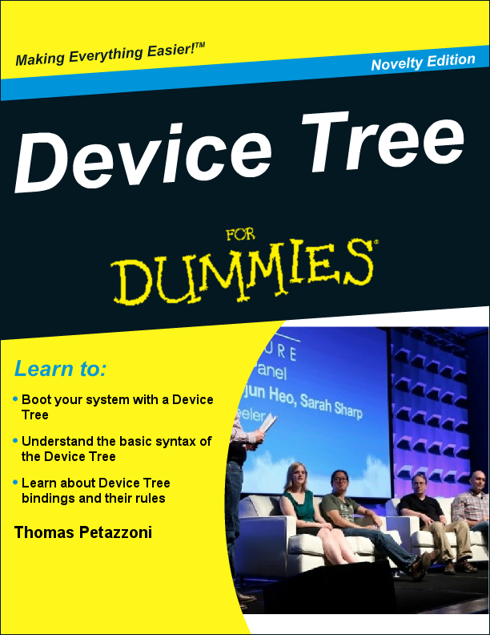
Further reading
Bootlin’s kernel and driver development training materials for full details
https://bootlin.com/training/kernel/
Device Tree for Dummies presentation
Thomas Petazzoni (Apr. 2014)
http://j.mp/1jQU6NR

Slide 92
Contributions and issues
Cape/add-on support
  https://github.com/beagleboard/bb.org-overlays
Image deltas
  https://github.com/beagleboard/image-builder
In-system examples
  https://github.com/beagleboard/bone101

Slide 93
Questions?

Slide 94
Thank you!

