Slide 1
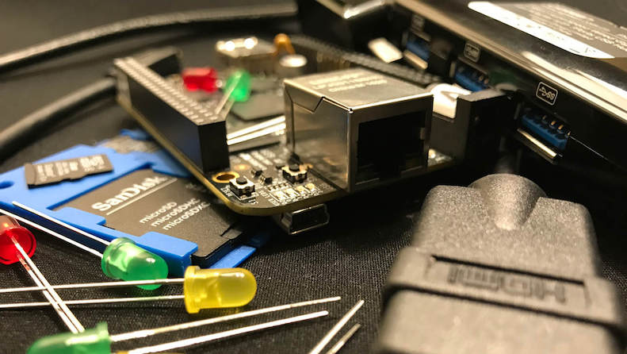


PocketBeagle TechLab Workshop

Slide 2

PocketBeagle walk-through
Friendly to novices and experts alike, the Beagle experience tracks mainline u-boot, Linux and Debian development, while augmenting it to enable development to start as quickly as possible. Attendees will get started interacting with the hardware via the command-line, shell scripts, Python and JavaScript. Attendees will be walked through the configuration details for the boot configuration, pin multiplexing, USB networking and other helper scripts they should get to know. Support and development processes within the BeagleBoard.org community will be covered. Exercises will pave the way for the other workshops to dive into their topic without needing to backtrack excessively on PocketBeagle-specific details.

Slide 3
Author and license
Author
  Jason Kridner
  Co-founder BeagleBoard.org, Texas Instruments Sitara apps
  https://beagleboard.org/about
License
  Creative Commons Attribution – Share Alike 4.0
  https://creativecommons.org/licenses/by-sa/4.0/

Slide 4
Outline (detailed)
BeagleBoard.org overview
  History and objectives: non-profit focus on education, open to business, sustainable open source ie. not a loss-leader
  Experience vision
    Outline: boot, kernel, distro, IDEs (cloud9, node-red, bela, bone101)
    Gaps
    Today
  Hardware overview
What’s in the kit
  Setting up access
Programming demonstrations
  Command-line
  Shell script
  Python
  JavaScript
  PRU example
Questions from Hack Chat
Project examples
Labs

Slide 5
Outline
BeagleBoard.org, PocketBeagle and BaconBits
Developer experience
  Command-line and shell script
  JavaScript and Python
  C/C++
  C on PRUs
Project examples
Labs

Slide 6
BeagleBoard.org’s objectives
Education
  Design and use of open source SW/HW
  Embedded computing
Collaboration
  Physical computing
  Robotics
  Industrial/machine controls

Slide 7
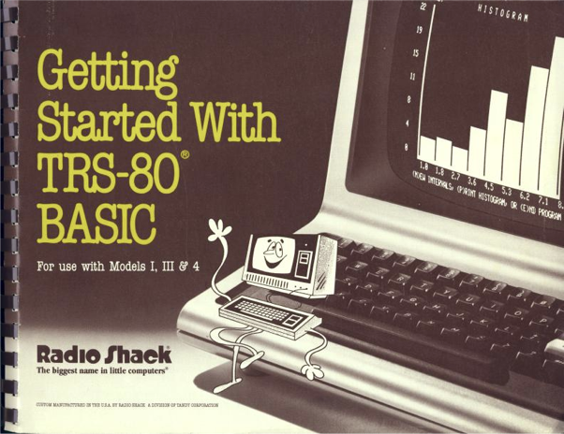
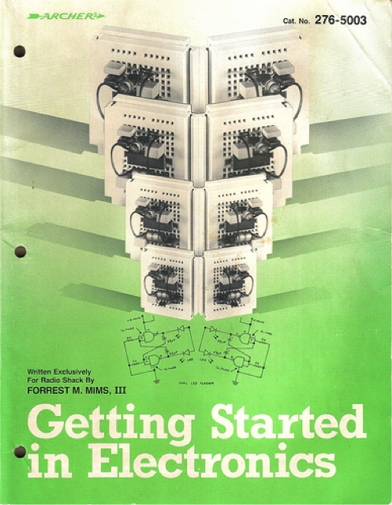
Inspiration from early PCs
http://newcome.wordpress.com/2009/12/15/make-electronics-the-new-engineers-notebook/
http://www.sandywalsh.com/2012_07_01_archive.html

Slide 8
Inspiration from early PCs
How do people learn about embedded computers with so much ground to cover?
http://newcome.wordpress.com/2009/12/15/make-electronics-the-new-engineers-notebook/
http://www.sandywalsh.com/2012_07_01_archive.html

Slide 9
Inspiration from early PCs
How do people learn about embedded computers with so much ground to cover?
Linux keeps history
Affordable -> hackable
Open from boot
High-level languages
Motivate with hardware
http://newcome.wordpress.com/2009/12/15/make-electronics-the-new-engineers-notebook/
http://www.sandywalsh.com/2012_07_01_archive.html

Slide 10
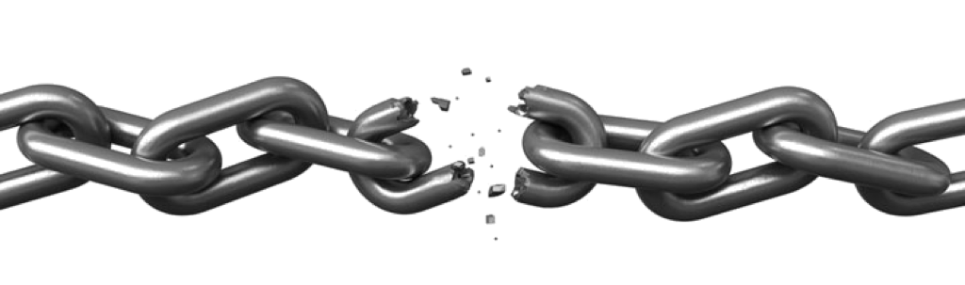


Vision
Creating with electronics should be as easy as creating a web page

Slide 11
Vision
Creating with electronics should be as easy as creating a web page
Appliances are better than applications

Slide 12
Vision
Creating with electronics should be as easy as creating a web page
Appliances are better than applications
Open source software and hardware enable
  Collaboration on the problem
  Ability to understand and improve the fundamentals

Slide 13
Reality
Boot-to-browser feels too limiting → booting to Debian distro
Collaborative programming still complex → collaborate at the kernel
Many possible development environments
  command-line/ssh, Cloud9 IDE, node-red, pureData, SuperCollider, LabView, Matlab, Eclipse, Visual Studio, Scratch, Blockly
Domain specific approaches
  Machinekit/LinuxCNC, PLC, many IoT toolkits
  Many rapid sensor approaches: capes, mikroBus, Grove/Grove Zero, PMOD
  Many rapid build approaches: LEGO, printing/milling, Makeblock, Vex, various other aluminum kits

Slide 14
Approach
Don’t try to boil the ocean
  We seek to engage the open source community
Help where we can
  Blue supports Grove cables
  PocketBeagle supports mikroBus click pinout
  Many “BeagleBoard Compatible” devices targeting specific application areas

Slide 15

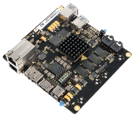
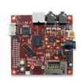
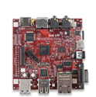

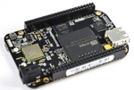

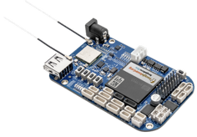
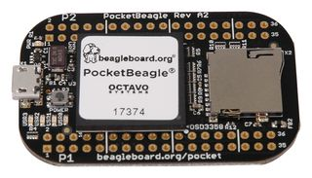
Board history
Fanless open computer (BeagleBoard)
$249
Mint tin sized with industrial peripherals (BeagleBone)
$69
Application focused BeagleBones
$79
Smalls mint tin sized with super-flexible design - PocketBeagle
$25

Slide 16
PocketBeagle objectives
Get simple
  4-layer PCB done in both Kicad and EAGLE
  Every expansion header pin has a useful predefined mode
Get flexible
  USB to holes, no on-board pin consumption, no header soldered
  Support for 2 mikroBus Click boards (over 300 already exist)
Get small
  Stick with mint-tin survival-kit theme, but go to “smalls” (35mm x 55mm)
Get low cost
  System-in-package approach has can lower build costs
  Launched/sustainable at $25

Slide 17
PocketBeagle key features
Processing
  1-GHz ARM Cortex-A8 processor
  2x200-MHz programmable real-time units (PRUs)
  ARM Cortex-M3 microcontroller for power and security
  SGX530 graphics processor (OpenGLES)
Memory
  512-MB DDR3
  4-KB I2C EEPROM
Interfaces
  USB 2.0 OTG
  microSD
72 expansion header pins
  8 analog inputs (6@1.8V, 2@3.3V)
  44 digital I/Os (18 enabled)
  3 UARTs (2 enabled)
  2 I2C ports
  2 SPI ports
  2 quadrature encoders accessible
  2 CAN bus controllers accessible
  USB, power/reset buttons, battery/DC

Slide 18
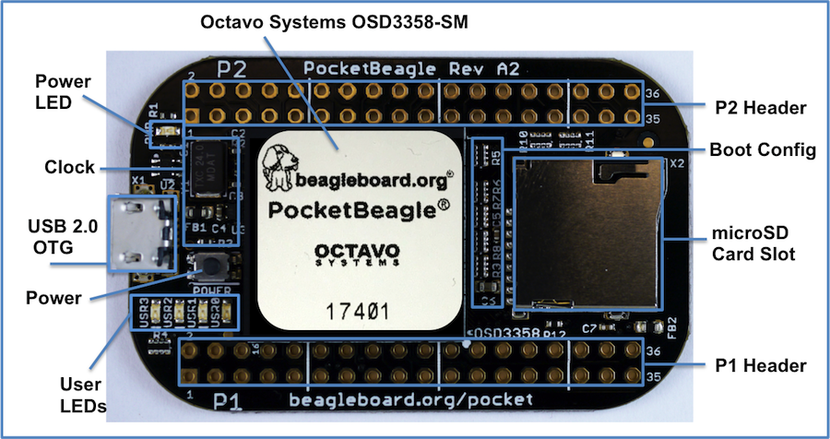
PocketBeagle top

Slide 19
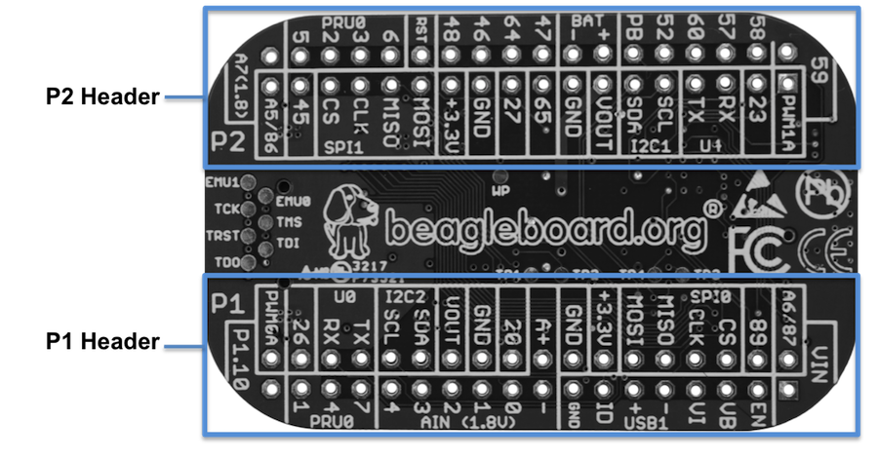
PocketBeagle bottom

Slide 20
PocketBeagle bottom
44

Slide 21

PocketBeagle expansion

Slide 22
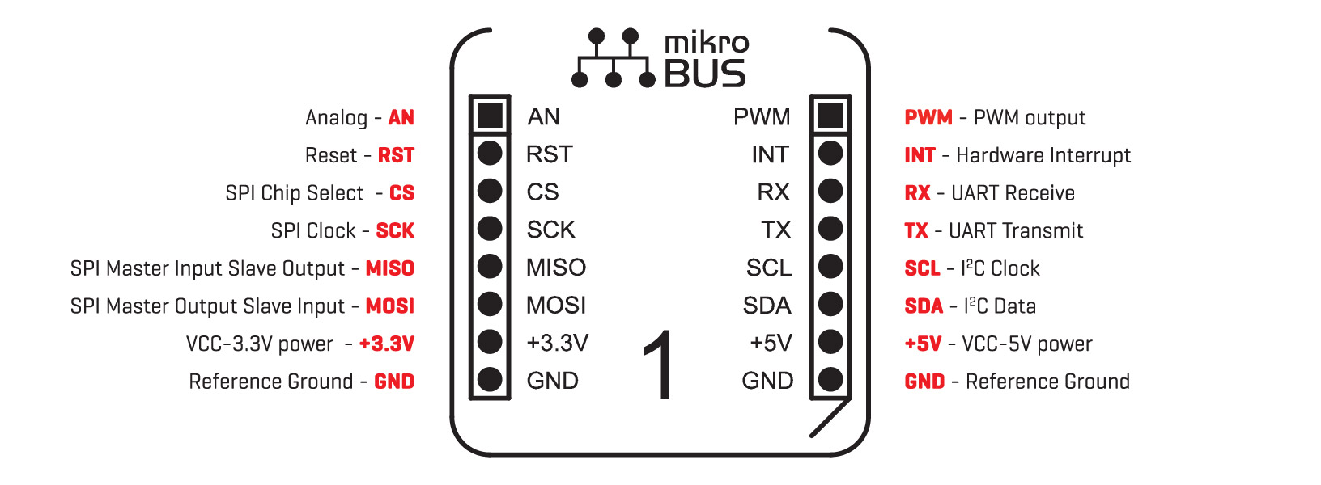
mikroBus Click

Slide 23
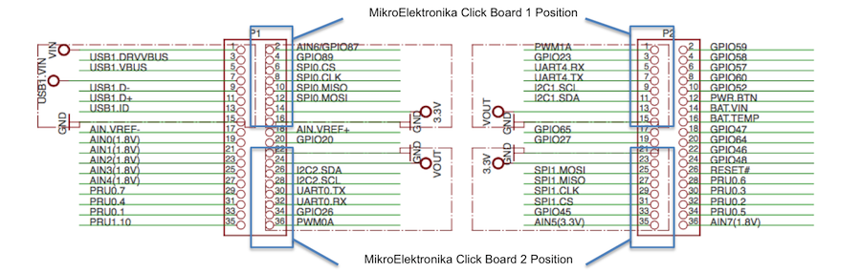
Connecting mikroBus Clicks

Slide 24
TechLab objectives
Designed specifically for e-ale training
Inspired by “Bacon Cape” by Dave Anders
  Designed for similar purpose on BeagleBone
Migrated to PocketBeagle as “BaconBits” by Michael Welling
Updated to have mikroBus header and made “pretty”
  Extra button (with PRU option), light sensor rather than potentiometer
Provides target for common embedded interfaces
  SPI, I2C, GPIO, PWM, ADC, USB, serial
Avoided buying several modules

Slide 25
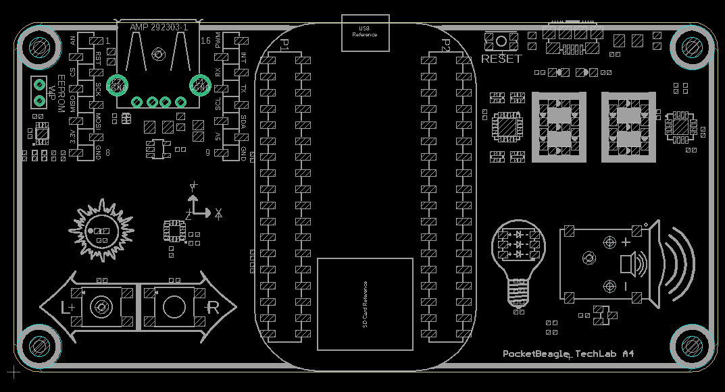
TechLab features
USB-to-Serial micro B
USB Host A with power
Power and Reset buttons
2 GPIO push buttons (L and R)
ADC light sensor
PWM tri-color LED
SPI 2-digit 7-segment display
I2C accelerometer
mikroBus header

Slide 26
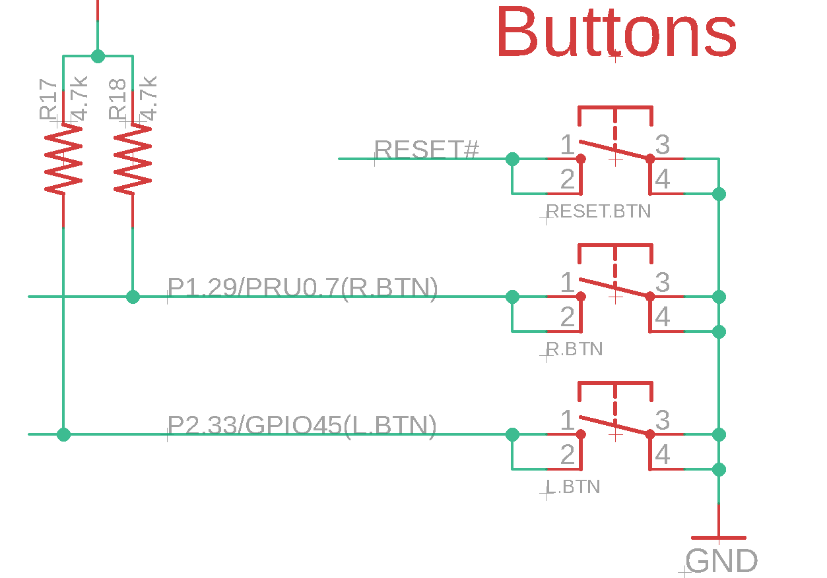
TechLab GPIO inputs

Slide 27
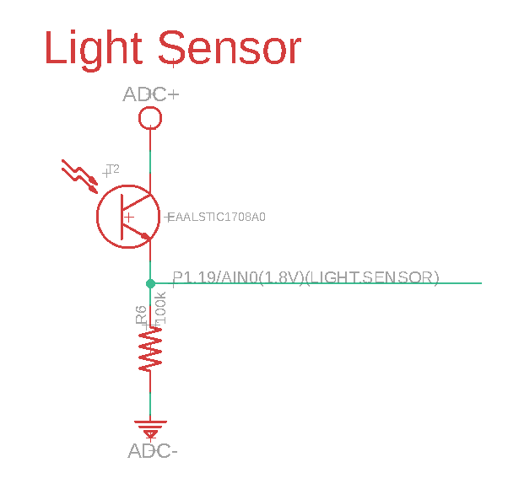
TechLab ADC input

Slide 28
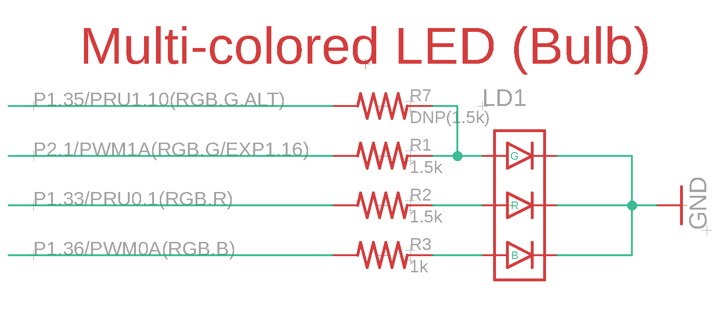
TechLab PWM output

Slide 29
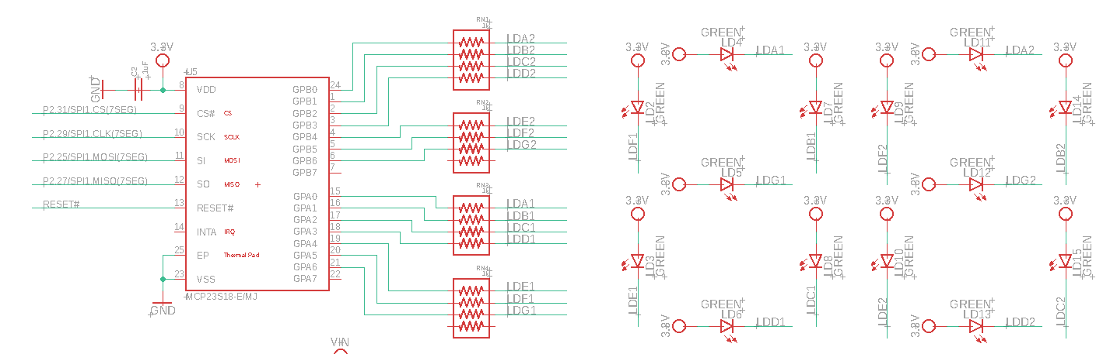
TechLab SPI 7-segment display

Slide 30
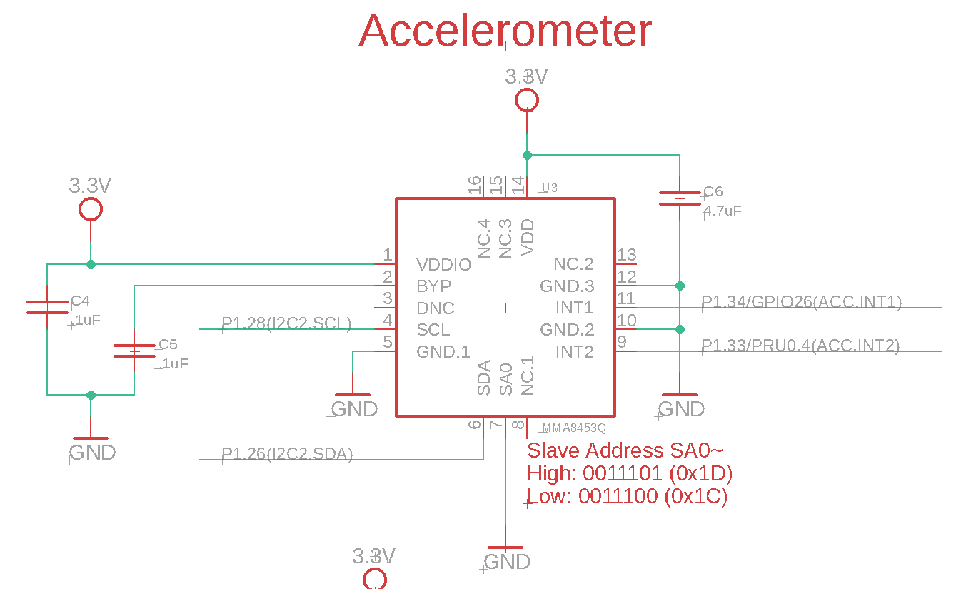
TechLab I2C sensor

Slide 31
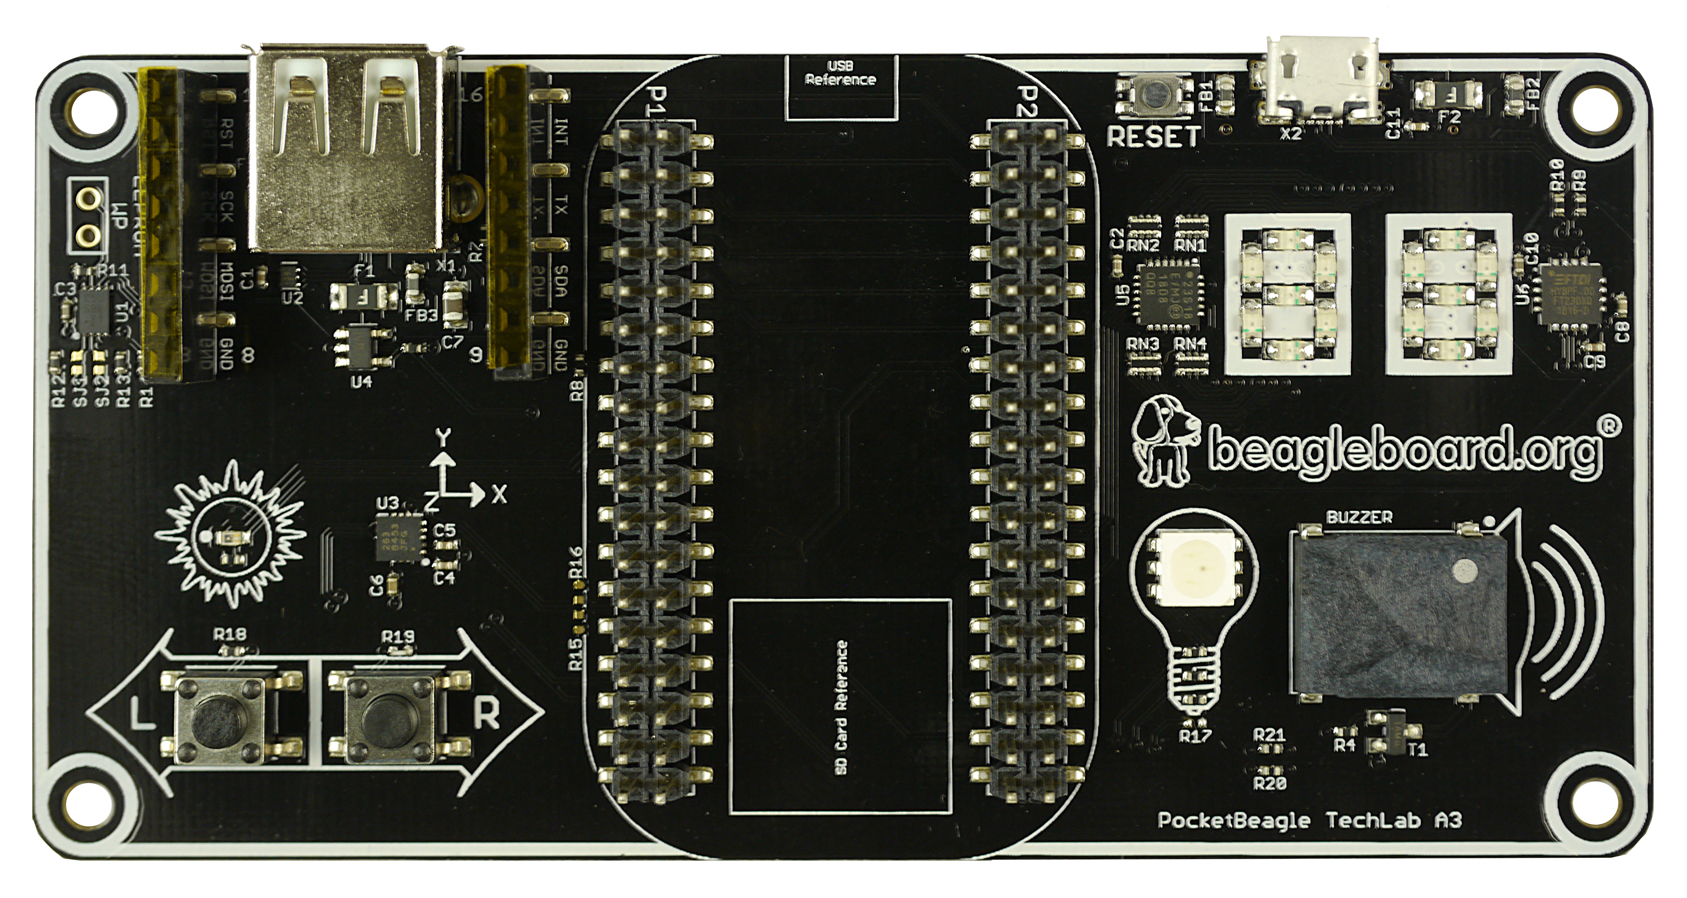
TechLab board image

Slide 32
Developer experience
Customized Debian images – bbb.io/latest
Self-hosted tools for ARMs and PRU
Libraries for various high-level languages
Scripts for common tasks
Sources for bootloader, device tree, etc.
Servers for network-based development

Slide 33
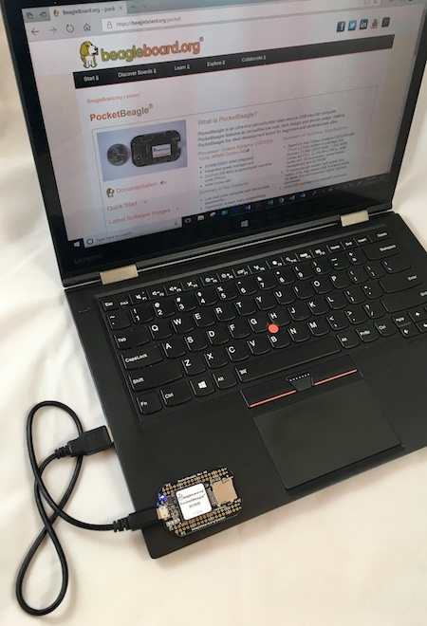
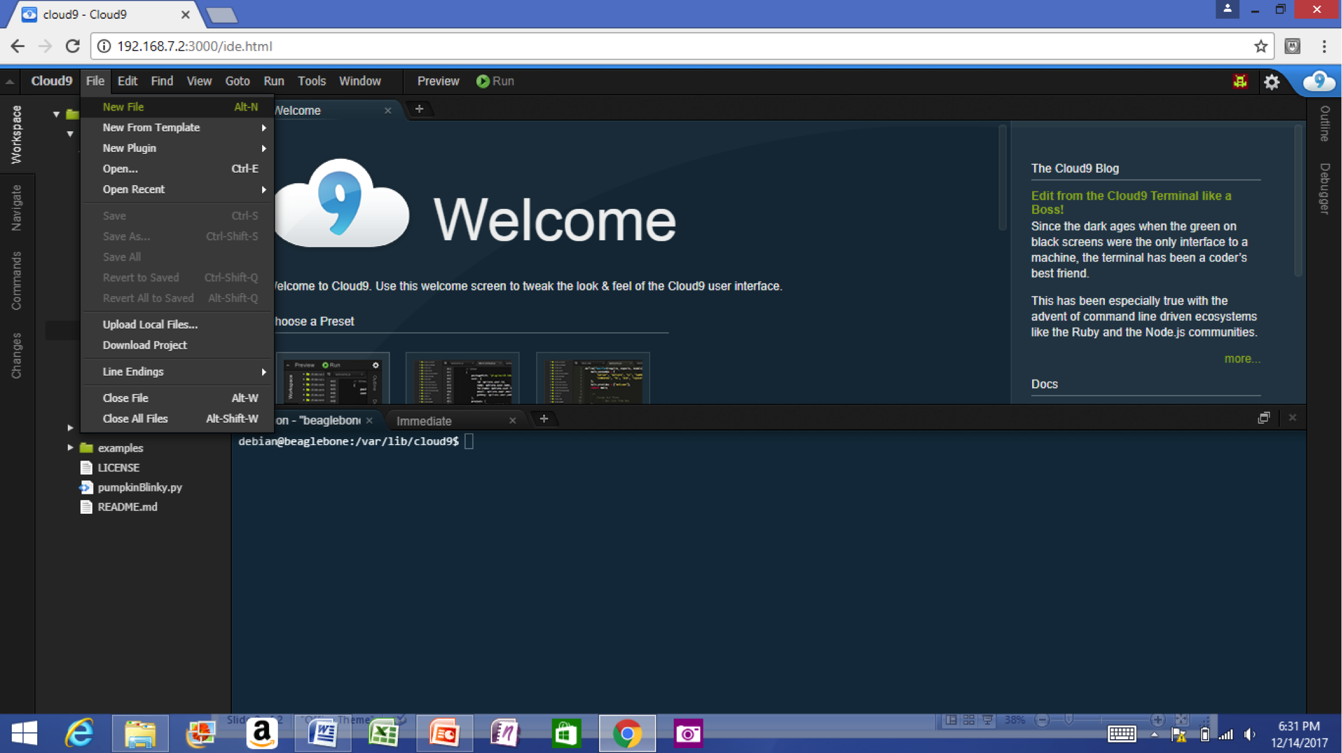
Single cable development
Power, network, develop
You can add a network and power many other ways

Slide 34
Some work in progress
Add proxy for various services (in Buster IoT images today)
Integrate common web-based WiFi provisioning
  SeeedStudio BealgeBone Green Wireless ships with ‘wifidog’ → we will unify approach
Cross-platform distro installer app
  See USB NETCONSOLE presentation
Support for Grove modules and mikroBus clicks
  Focus on device-tree overlays and kernel patches
Integration alignment with complete domain solutions
  Intelligent Agent Replicape/Revolve, Bela Mini, BeagleLogic, etc.
Improved and integrated PRU examples
Move to distro friendly approaches for customizations

Slide 35
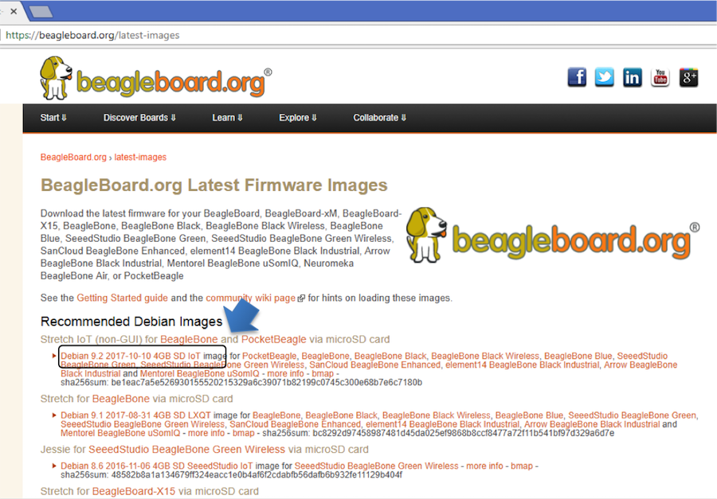
Download image

Slide 36
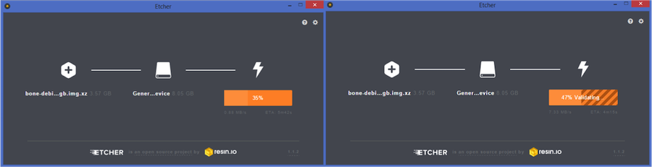
Write image to microSD with Etcher

Slide 37
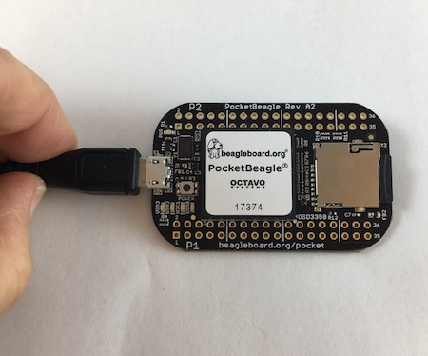
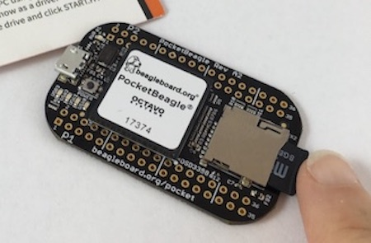
Insert microSD and boot

Slide 38
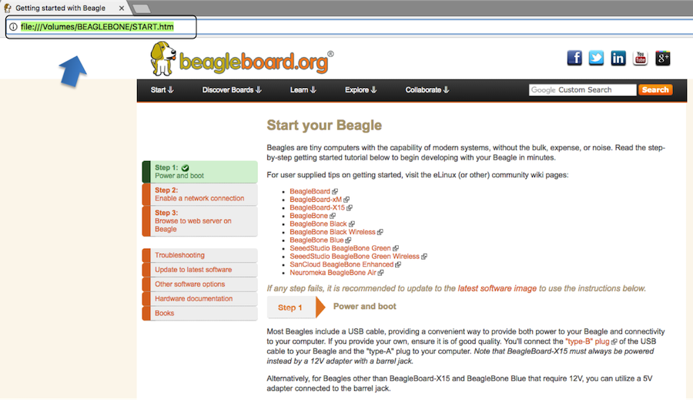

Connect to the USB network

Slide 39
Open the IDE

Slide 40
USB gadgets
Linux name for device/slave drivers
  ie., when not host
USB devices have “classes”
  Mass storage
  Camera
  Audio
  Printer
  “HID” or human-interface device like mouse and keyboard
  Communications

Slide 41
USB gadgets
Default image USB gadgets
  Virtual mass storage
    Serves you up README.htm
  Virtual serial
    Provides access to console after kernel boot
  Virtual network
    Enables access to ssh and web servers

Slide 42
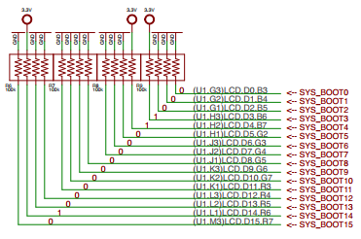

TI AM335x: bootrom
From: (AM335x and AMIC110 Sitara™ Processors Technical Reference Manual (Rev. P))
http://www.ti.com/lit/ug/spruh73p/spruh73p.pdf (page 5032)
SYSBOOT[15:14] = 01 = 24Mhz
SYSBOOT[4:0] = 11000
SPI0
MMC0 - going to use today
USB0 - (node-beagle-boot)
UART0

Slide 43
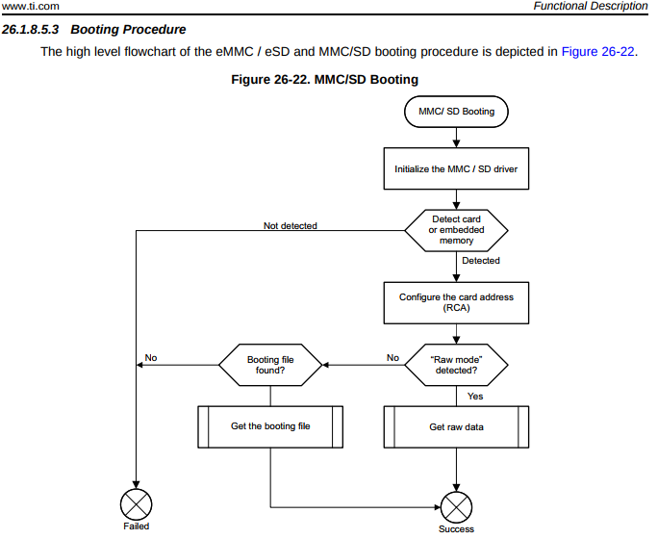
TI AM335x: bootrom
http://www.ti.com/lit/ug/spruh73p/spruh73p.pdf
Page: 5053
MLO

Slide 44
TI AM335x: bootrom: raw mode:
http://www.ti.com/lit/ug/spruh73p/spruh73p.pdf (Page: 5054)
0x0 <- (FAT Boot Sector, let's leave it blank...)
0x20000 (128KB) <- We are going to use this location
0x40000 (256KB) <- (2nd “backup” location)
0x60000 (384KB) <- (3rd “backup” location)
Only 128KB in size… (hint, only 128KB of SRAM)

Slide 45
Das U-Boot (the Universal Boot Loader) U-Boot
Original Author: Wolfgang Denk, now maintained by Tom Rini
https://www.denx.de/wiki/U-Boot
http://git.denx.de/?p=u-boot.git;a=summary
https://en.wikipedia.org/wiki/Das_U-Boot

Slide 46
U-Boot: AM335x
Outputs two files for TI am335x targets:
MLO = SPL (or Secondary Program Loader)
u-boot.img (or u-boot-dtb.img) (U-Boot)
ROM
SPL
UBoot

Slide 47
U-Boot: SPL
Initializes main memory (DDRx for am335x)
Loads full (U-Boot) into DDR memory
Or:
Initializes main memory (DDRx for am335x)
Loads Linux Kernel into DDR memory (aka: Falcon mode, faster boot mode/etc)

Slide 48
U-Boot:
Network
USB
MMC
File System (fat/extX)
Shell
Sometimes you don’t need a full OS, have U-Boot init and then have U-Boot load/run your application.

Slide 49
U-Boot:
CPU : AM335X-GP rev 2.1
I2C: ready
DRAM: 512 MiB
Some drivers were not found
Reset Source: Power-on reset has occurred.
MMC: OMAP SD/MMC: 0, OMAP SD/MMC: 1
Using default environment
Board: BeagleBone Black
<ethaddr> not set. Validating first E-fuse MAC
BeagleBone Black:
Model: SeeedStudio BeagleBone Green:

Slide 50
U-Boot: microSD
Insert USB-microSD adapter, and type “lsblk”
voodoo@hestia:~/Supercon-2017-PocketBeagle$ lsblk
NAME MAJ:MIN RM SIZE RO TYPE MOUNTPOINT
sda 8:0 0 465.8G 0 disk
└─sda1 8:1 0 465.8G 0 part /
sde 8:64 1 7.4G 0 disk
└─sde1 8:65 1 7.4G 0 part
Open: system.sh change: MMC=/dev/sde
That’s our 8GB USB Flash Drive

Slide 51
U-Boot: Format microSD
sudo dd if=/dev/zero of=${MMC} bs=1M count=10
sudo sfdisk ${MMC} <<-__EOF__
4M,,L,*
__EOF__
sudo mkfs.ext4 -L rootfs ${MMC}1
voodoo@hestia:~/Supercon-2017-PocketBeagle$ ./scripts/format_drive.sh

Slide 52
U-Boot: (refresh for your memory)
http://www.ti.com/lit/ug/spruh73p/spruh73p.pdf (Page: 5054)
0x0
0x20000 (128KB) <- We are going to use this location
0x40000 (256KB)
0x60000 (384KB)
sudo dd if=./deploy/MLO of=${MMC} count=1 seek=1 bs=128k
sudo dd if=./deploy/u-boot.img of=${MMC} count=2 seek=1 bs=384k

Slide 53
Base Rootfs: Debian 9.x (Stretch)
Maintainer: Robert Nelson (with lots of help from all the Debian Developers and 1000’s of other users)
https://elinux.org/Beagleboard:BeagleBoneBlack_Debian#2017-11-05_-_Debian_9_.28Stretch.29_-_Weekly
https://www.debian.org/
https://github.com/beagleboard/image-builder

Slide 54
Device Tree
See kernel documentation for bindings
  devicetree/bindings/eeprom/eeprom.txt
Local copies enable you to extend on the fly
  /opt/source/dtb-4.14-ti
  /opt/source/bb.org-overlays
Overlays loaded in u-boot, but also possible via kernel configfs

Slide 55
config-pin
config-pin -i p1.36
config-pin -q p1.36
config-pin p1.36 pruout

Slide 56
show-pins.pl
perl /opt/scripts/device/bone/show-pins.pl -v

Slide 57
mikroBus Click usage
See bbb.io/pbmb
Supported with device-tree overlays loaded in u-boot

Slide 58
Enabling PRU
2 possible drivers: remoteproc or uio
Enabled via device tree at boot
  Different systems might have different defaults

Slide 59
Some current projects
Bela Mini
PocketPilot

Slide 60
Contributions and issues
Cape/add-on support
  https://github.com/beagleboard/bb.org-overlays
Image deltas
  https://github.com/beagleboard/image-builder
In-system examples
  https://github.com/beagleboard/bone101

Slide 61
Questions?

Slide 62

Thank you!

