Slide 1


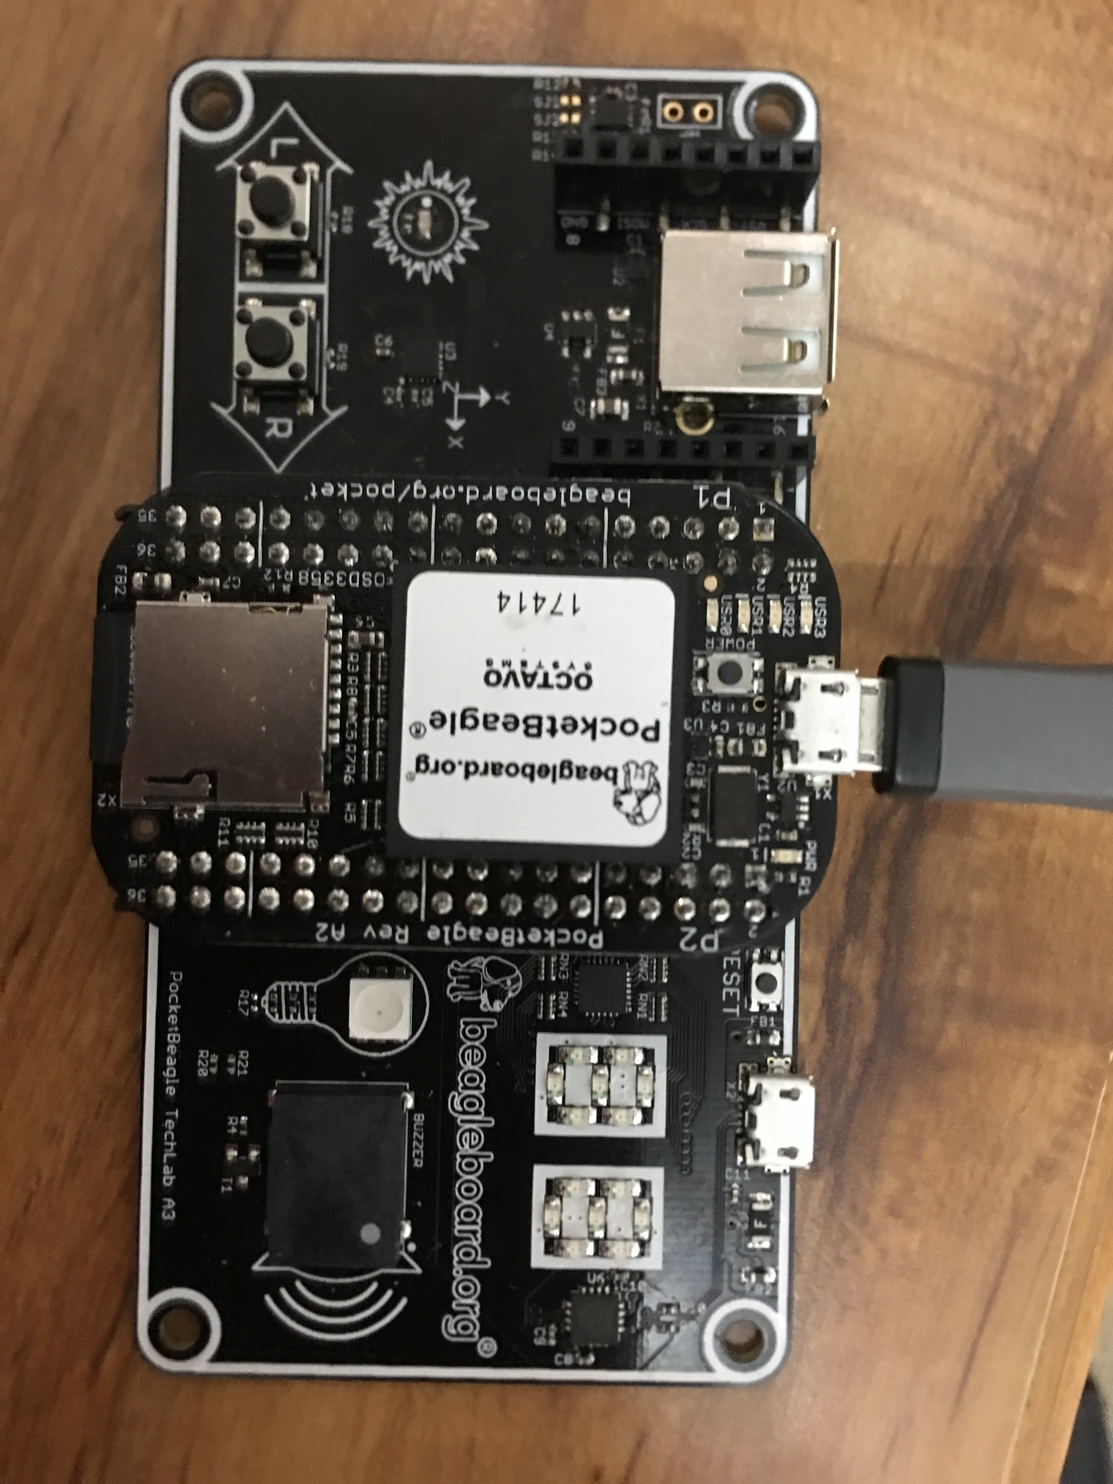
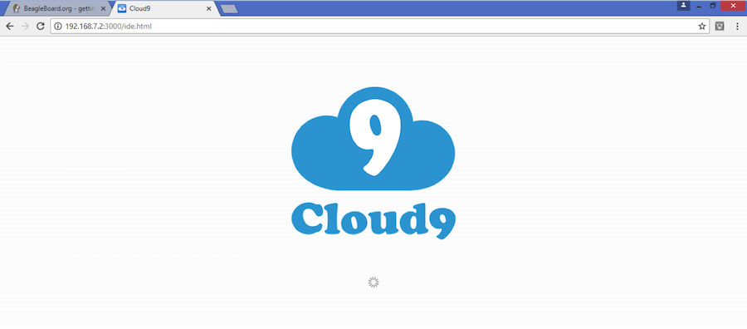
PocketBeagle® TechLab Cape Hands-On Coding Workshop
MicroSD software image and other materials available from bbb.io/techlab
See bbb.io/start for instructions on using Etcher.io to write a microSD card
Plug into the microUSB on PocketBeagle to provide power and a network connection. Look for the “heartbeat” pulse on the USR0 LED to know the board has Linux up-and-running.
Get to the Cloud9 IDE
Served on port 3000
Windows:
http://192.168.7.2:3000
Linux/Mac:
http://192.168.6.2:3000
The BeagleBoard.org Foundation is a 501(c)(3) non-profit corporation existing to provide education in and collaboration around the design and use of open-source software and hardware in embedded computing.

Slide 2
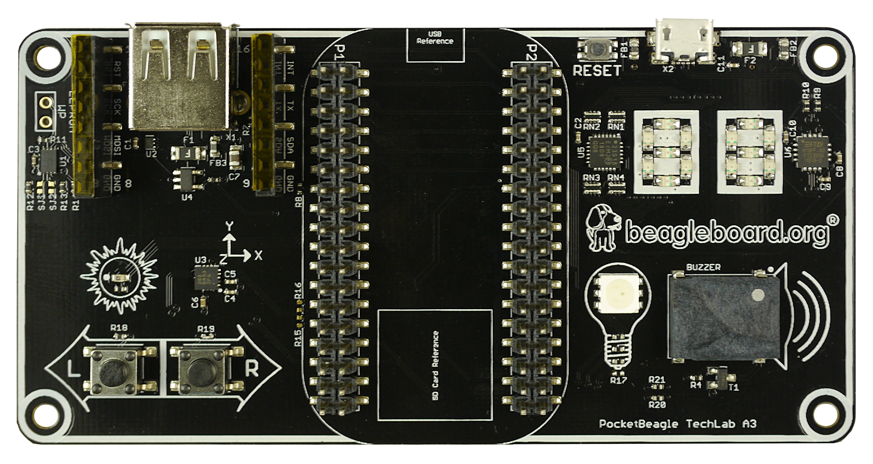

PocketBeagle® TechLab Cape Hands-On Coding Workshop
TechLab Wiring Summary
SPI1 CS1
leds/techlab::seg*
0
1
13
8
9
5
6
12
14
10
4
3
2
11
P1_19
iio:device0
I2C2
iio:device1
P2_30
R: P1_33
G: P2_1
B: P1_36
P2_33
P1_29
PocketBeagle Expansion Header Pin-out
Great getting started information is at beagleboard.org/pocket

Slide 3
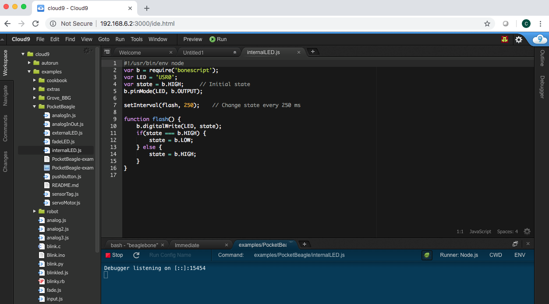
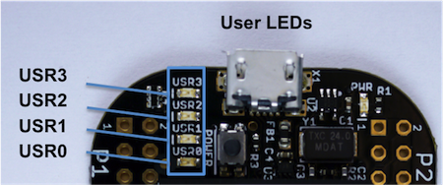
Blink PocketBeagle on-board USRx LED
Goal: Blink USR3 LED on PocketBeagle.
Overview: BoneScript is a Node.js library customized for the Beagle family and featuring familiar Arduino function calls. Here we will use it to blink an LED built into your PocketBeagle.
Do this:
1. Navigate to TechLab/internalLED.js and double-click on it.
2. Click the Run button in the toolbar to execute the script in the active file window
3. You will see the run configuration window open with a Stop button. Click the Stop button to halt the program.
4. Try changing the LED or blink time, save the program and run again.
TIP: Click the green bug to disable the debugger and begin execution quicker.
internalLED.js
#!/usr/bin/env node
var b = require('bonescript');
var LED = 'USR3';
var state = b.HIGH; // Initial state
b.pinMode(LED, b.OUTPUT);
setInterval(flash, 250); // Change state every 250 ms
function flash() {
b.digitalWrite(LED, state);
if(state === b.HIGH) {
state = b.LOW;
} else {
state = b.HIGH;
}
}

Slide 4
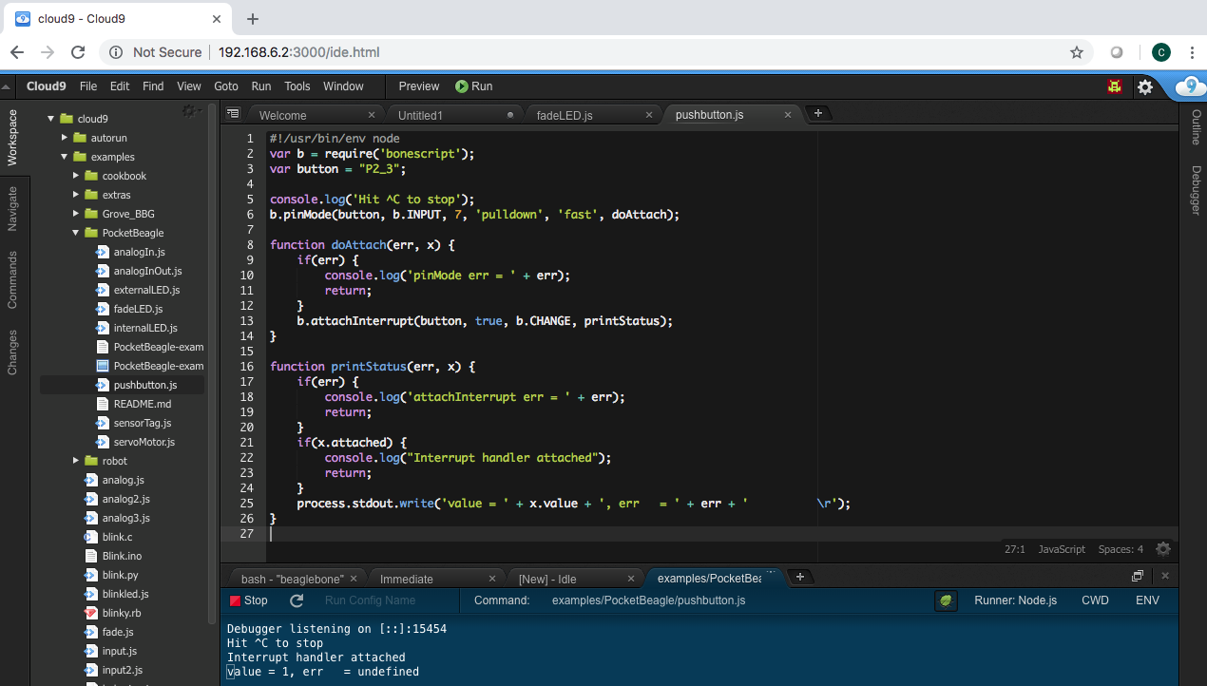
Read a button
Goal: Sense the external world by reading a digital input.
Overview: Reading a switch attached to a GPIO (general purpose input/output) port is as
easy as configuring the port as an input and attaching an interrupt handler to it. Note the buttons are “active low”.
Do this:
1. Navigate to TechLab/pushbutton.js and double-click on it.
2. Click the Run button in the toolbar to execute the script in the active file window
3. Press the “L” button on TechLab and check the output in the configuration window. Click the Stop button on the IDE to halt the program.
Challenge #1: Can you modify the program to read from the “R” button?
Challenge #2: Can you modify the program to toggle the USR3 LED?
Challenge #3: Can you modify the program to turn the USR3 LED on with the “L” button and off with the “R” button?
pushbutton.js
#!/usr/bin/env node
var b = require('bonescript');
var button = "P2_33";
console.log('Hit ^C to stop');
b.pinMode(button, b.INPUT, 7, null, null, doAttach);
function doAttach(err, x) {
if(err) {
console.log('pinMode err = ' + err);
return;
}
b.attachInterrupt(button, true, b.CHANGE, printStatus);
}
function printStatus(err, x) {
if(err) {
console.log('attachInterrupt err = ' + err);
return;
}
if(x.attached) {
console.log("Interrupt handler attached");
return;
}
process.stdout.write('value = ' + x.value + ' \r');
}

Slide 5
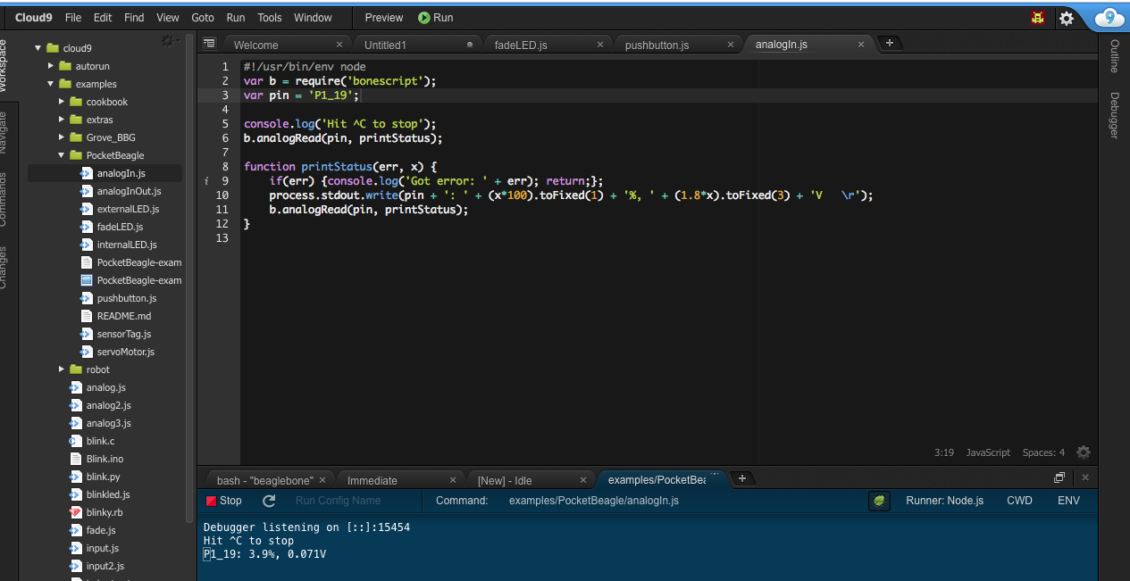
Read an analog sensor
Goal: Sense the external world by reading a variable analog input
Overview: Reading a light sensor attached to an analog input pin.
Do this:
1. Navigate to TechLab/analogIn.js and double-click on it.
2. Click the Run button in the toolbar to execute the script in the active file window
3. Cover the light sensor and check the output in the configuration window. Click the Stop button to halt the program.
Challenge #1: Can you change how often the sensor is read? What happens?
Challenge #2: Can you activate the USR3 LED based upon a voltage threshold from the light sensor?
Challenge #3: Try using the I2C accelerometer input from /sys/bus/iio/devices/iio:device1/in_accel_x_raw. Hint: use b.readTextFile()
analogIn.js
#!/usr/bin/env node
var b = require('bonescript');
var pin = 'P1_19';
console.log('Hit ^C to stop');
doAnalogRead();
function printStatus(err, x) {
if(err) {console.log('Got error: ' + err); return;};
process.stdout.write(pin + ': ' + (x*100).toFixed(1) +
'%, ' + (1.8*x).toFixed(3) + 'V \r');
setTimeout(doAnalogRead, 100);
}
function doAnalogRead() {
b.analogRead(pin, printStatus);
}

Slide 6
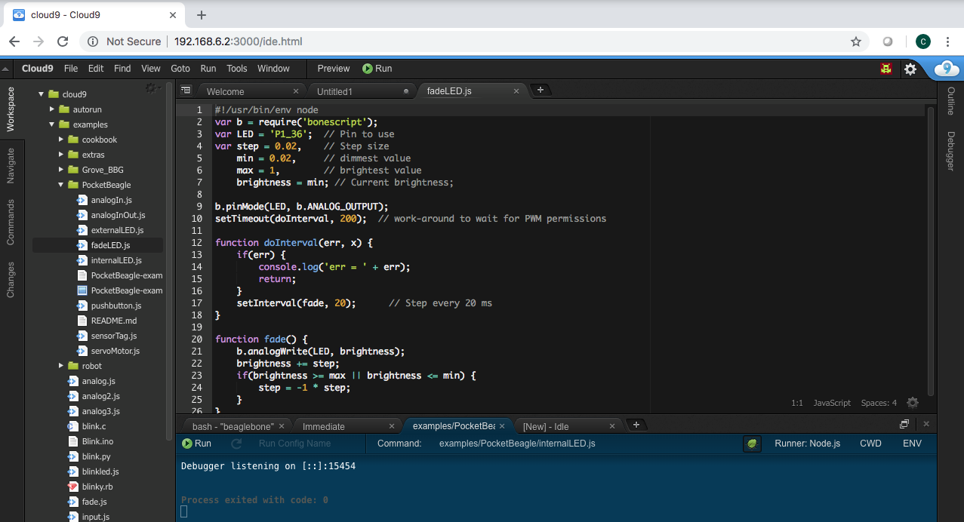
Fade an LED
Goal: Utilize a hardware pulse-width-modulator (PWM) to light an LED with variable brightness
Overview: Linux provides LED drivers that understand how to utilize PWM drivers, making use of PocketBeagle’s built-in PWM hardware. They are controlled with simple text files where you can set the brightness.
Do this:
1. Navigate to TechLab/fadeLED.js and double-click on it.
2. Click the Run button in the toolbar to execute the script in the active file window
3. You will see the run configuration window open with a Stop button. Click the Stop button to halt the program.
Challenge #1: Try changing the fade interval, save the program and run again.
Challenge #2: Try using the light sensor input to set the LED brightness.
Challenge #3: Try using the I2C accelerometer input for all 3 color LEDs..
fadeLED.js
#!/usr/bin/env node
var b = require('bonescript');
var LED = '/sys/class/leds/techlab::blue/brightness';
var step = 10, // Step size
min = 0, // dimmest value
max = 255, // brightest value
brightness = min; // Current brightness;
doInterval();
function doInterval(err, x) {
if(err) {
console.log('err = ' + err);
return;
}
setInterval(fade, 20); // Step every 20 ms
}
function fade() {
b.writeTextFile(LED, brightness);
brightness += step;
if(brightness >= max || brightness <= min) {
step = -1 * step;
}
}

Slide 7
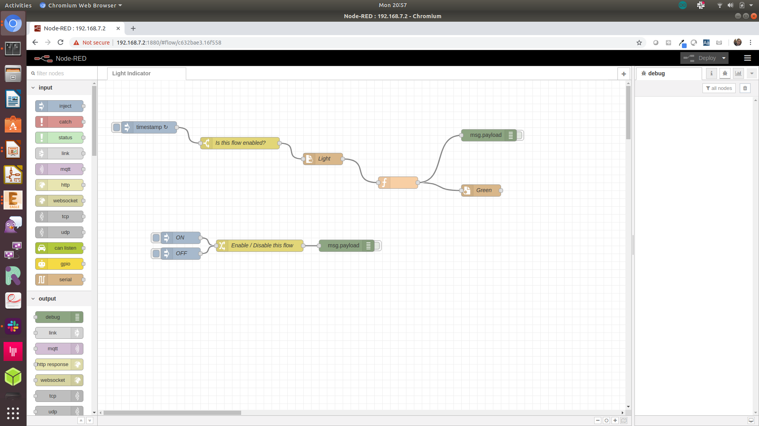
Using Node-RED to read and write files
Goal: Read light sensor data and output to green LED brightness
Overview: Node-RED is a flow-based development tool developed originally by IBM for wiring together hardware devices, APIs and online services as part of the Internet of Things. Node-RED provides a browser-based flow editor, which can be used to create JavaScript functions. Linux turns devices into virtual files, making Node-RED well suited to interacting with the physical world.
Do this:
1. Open Node-RED by pointing your browser to http://192.168.7.2:1880

Slide 8
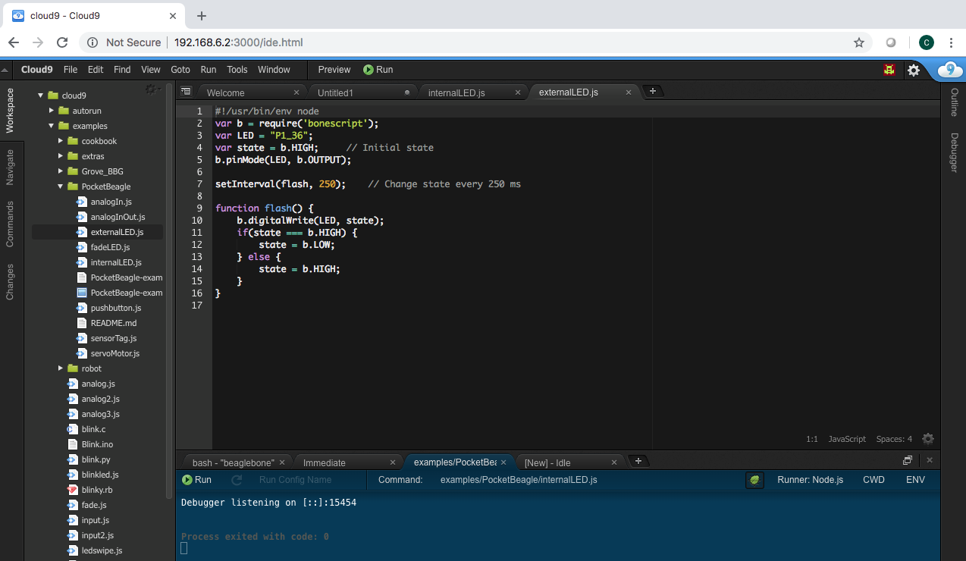
Explore the Linux command line
Goal: Blink an LED connected via breadboard to PocketBeagle
Overview: Similar to the internalLED.js here we will use Bonescript to blink an LED connected to a GPIO pin on PocketBeagle. The LED used in this exercise has the resistor built in simliar to the Adafruit “sequins”
Do this:
1. Open Cloud9 by pointing your browser to http://192.168.8.1:3000
2. Navigate to examples/pocketbeagle/externalLED.js and double-click on it.
3. Click the Run button in the toolbar to execute the script in the active file window
4. You will see the run configuration window open with a Stop button. Click the Stop button to halt the program.
5. Try changing the LED or blink time, save the program and run again
externalLED.js
#!/usr/bin/env node
var b = require('bonescript');
var LED = "P1_36";
var state = b.HIGH; // Initial state
b.pinMode(LED, b.OUTPUT);
setInterval(flash, 250); // Change state every 250 ms
function flash() {
b.digitalWrite(LED, state);
if(state === b.HIGH) {
state = b.LOW;
} else {
state = b.HIGH;
}
}

