Slide 1
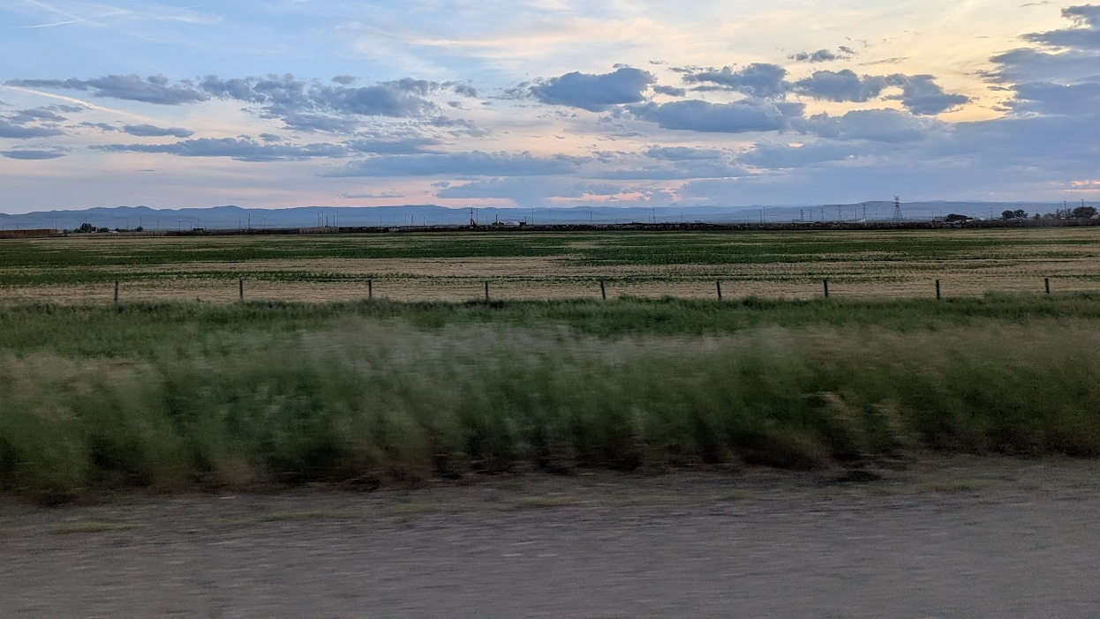
Welcome to ground school!
CI Jadon Tsai
8 November 2025

Slide 2
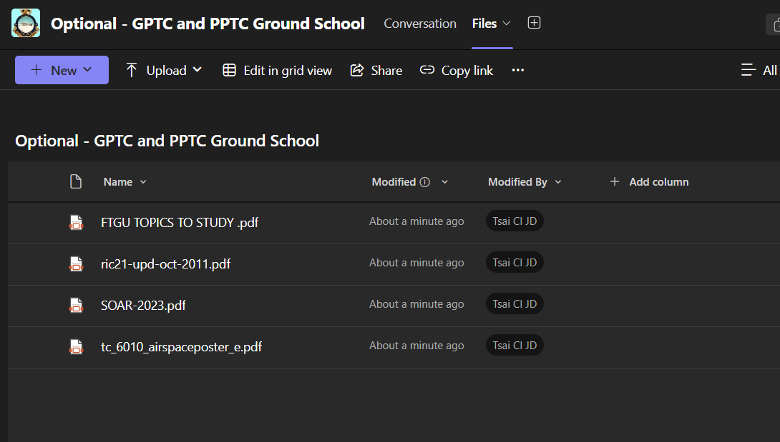
HOusekeeping
Attendance
Meeting times?
Practice exams/other resources (post in channel)
National OGS format/timeline

Slide 3
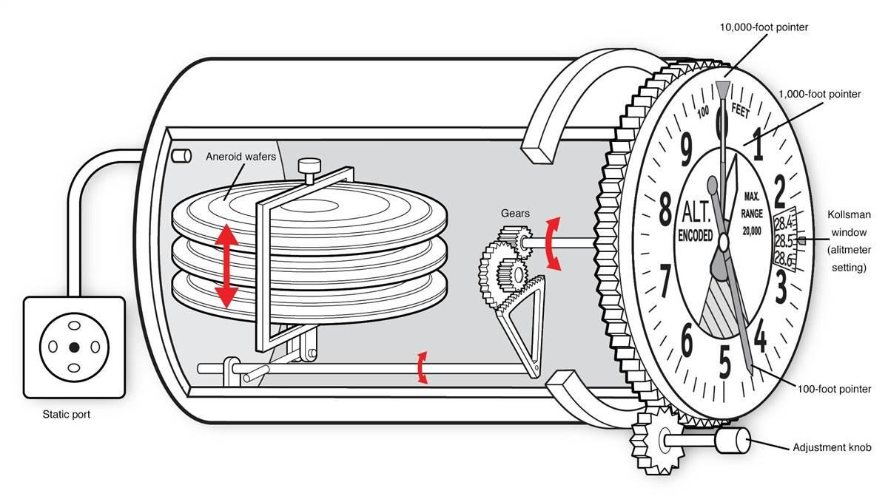
High to low, look out below

Slide 4
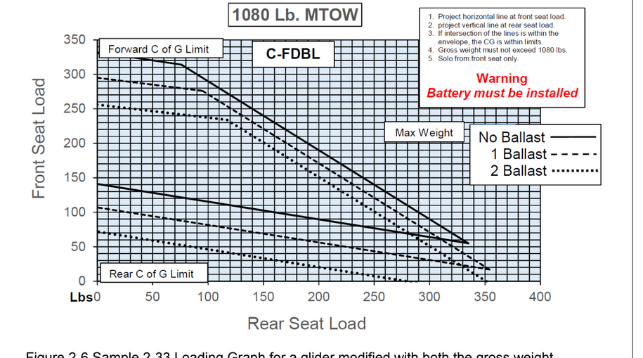
Weight and balance

Slide 5
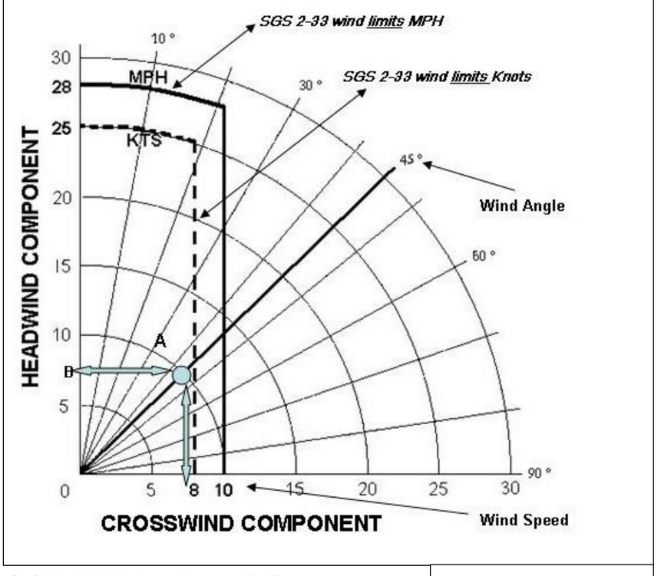
X wind chart

Slide 6
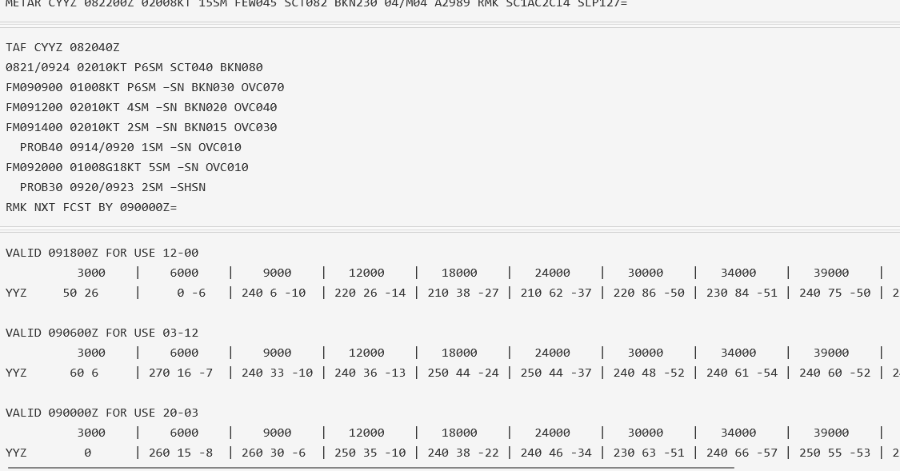
PLAN.navcanada.ca/wxrecall/

