Slide 1
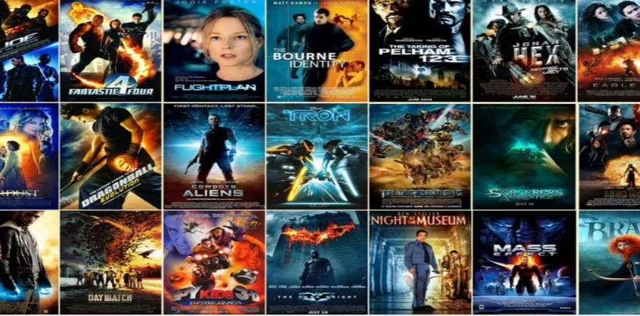
bookyourmovie.com
Python Project
DS080321

Slide 2
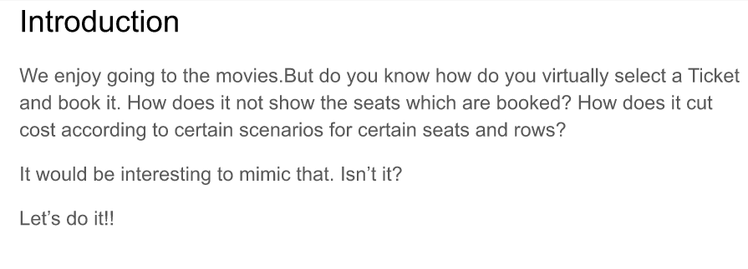

Slide 3
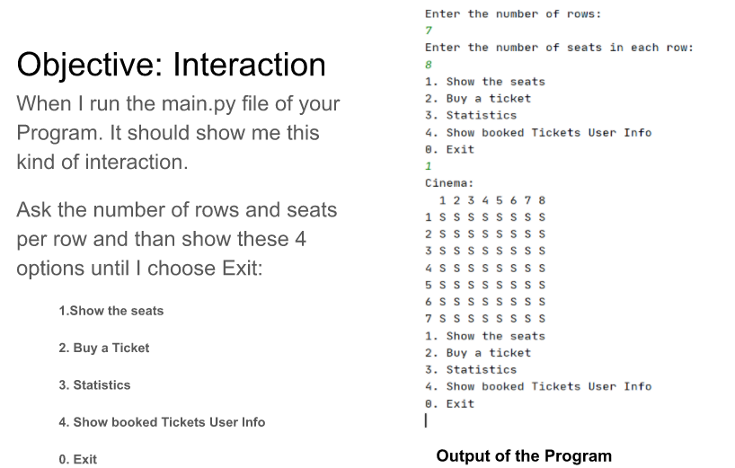

Slide 4
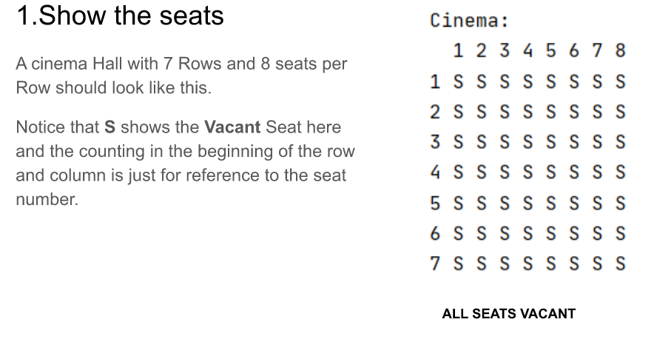

Slide 5
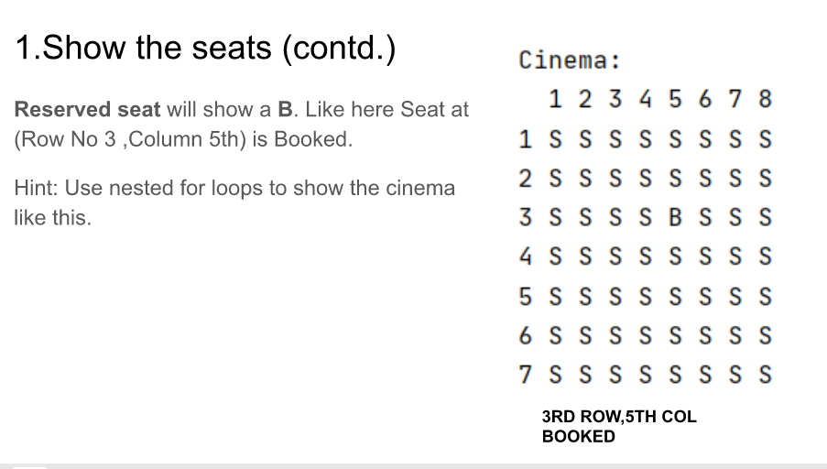

Slide 6
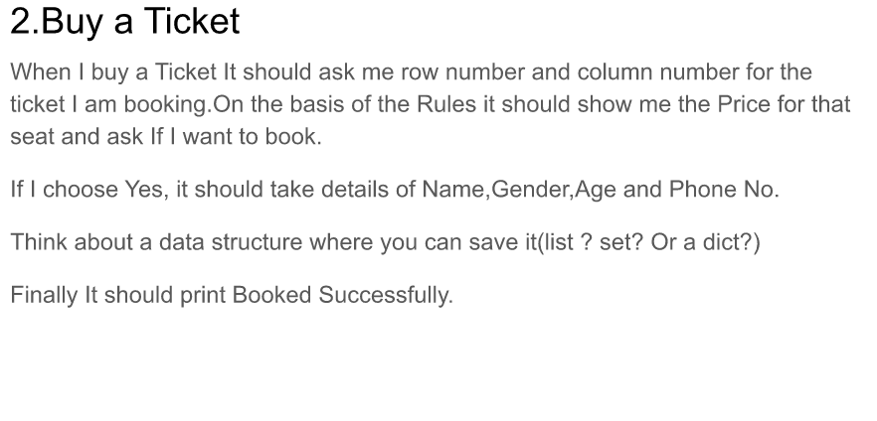

Slide 7
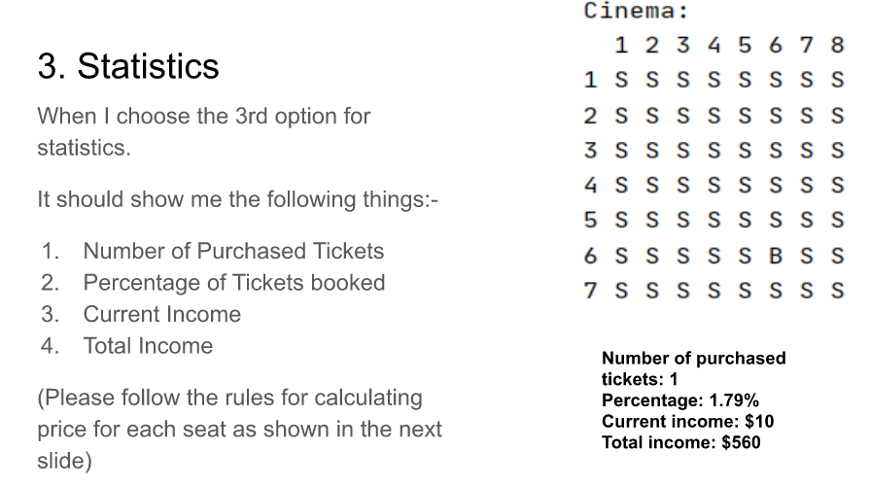

Slide 8
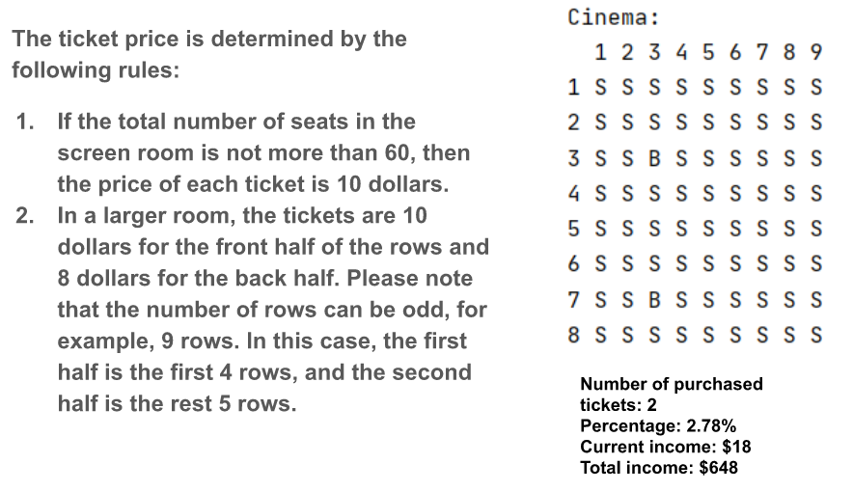

Slide 9
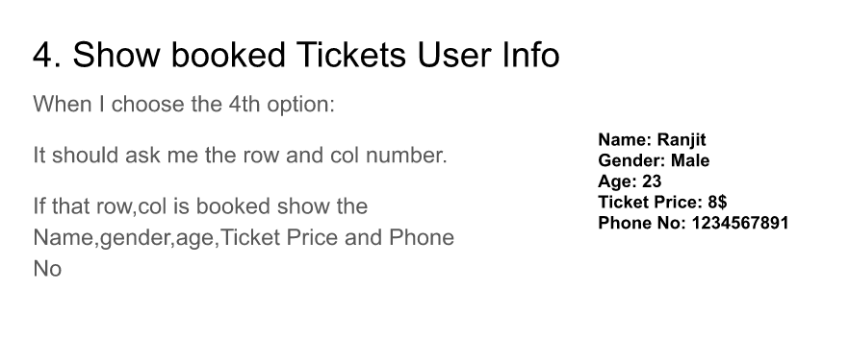

Slide 10
Case Diagram

Slide 11
Show the Seats
Define Cinema Size
Get Seat Matrix
Buy a Ticket
Get user details
Statistics
User
Get ticket price
Show Booked Ticket user info
Get total income
Exit
List with ticket info

Slide 12

THANK YOU!

