Slide 1
NFHS-5 India Healthcare Analysis
National Family Health Survey 2019–2021 | State-wise Study
Prepared by: Lavish Pratap Singh
Source: data.gov.in | Department of Health & Family Welfare

Slide 2
Agenda
01 Project Overview & Objectives
02 Data Source — NFHS-5 (2019-21)
03 Female Literacy Analysis
04 Health Insurance Coverage
05 Sanitation Access
06 Key Findings & Recommendations

Slide 3
Project Overview
36
5
2019-21
136
States Analyzed
Key Indicators
Survey Period
Data Columns
This study analyzes NFHS-5 data to understand healthcare disparities across Indian states covering literacy, sanitation, sex ratio and insurance.

Slide 4
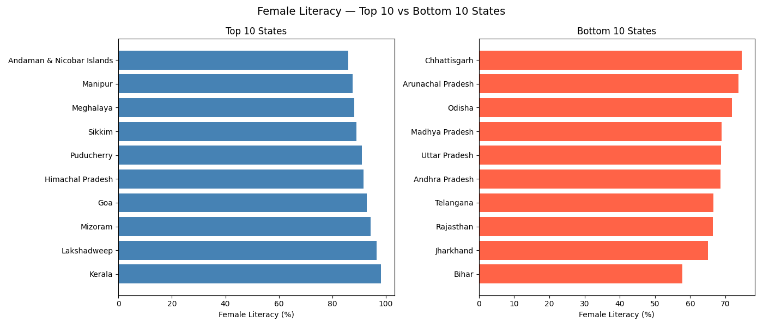
Female Literacy — State Analysis

Slide 5
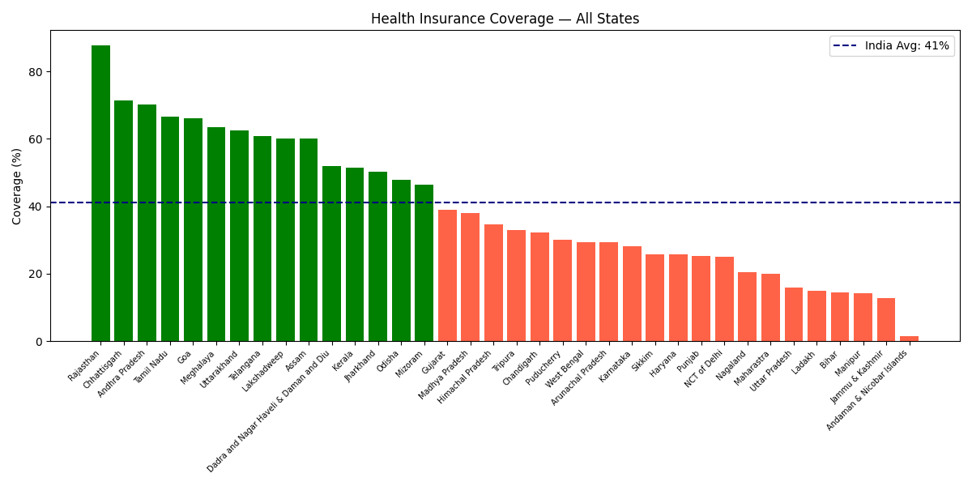
Health Insurance Coverage

Slide 6
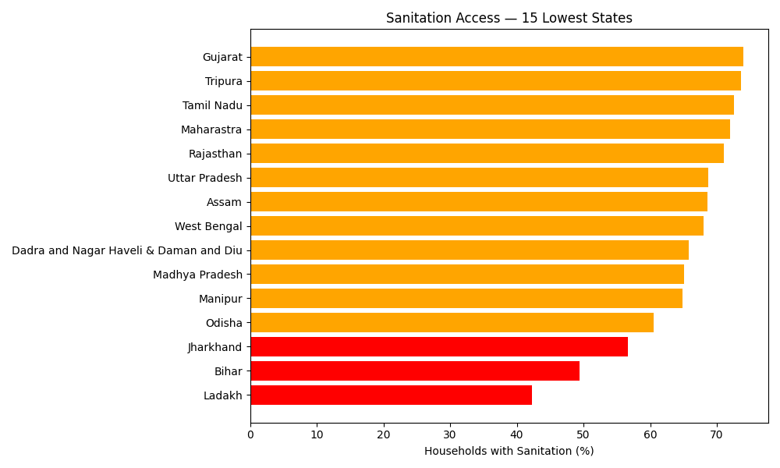
Sanitation Access — Lowest States

Slide 7
Key Findings
🔴 Bihar female literacy only 57% — needs urgent attention
🔴 Sanitation access in Bihar just 49% — half households uncovered
🟡 Health insurance national avg only 41% — huge gap
🟢 Kerala & Lakshadweep lead in female literacy (95%+)
🟢 Goa & Andaman top in sanitation access (87%+)

Slide 8
Recommendations
HIGH
Launch girl education campaigns in Bihar, Rajasthan, UP
HIGH
Accelerate Swachh Bharat Mission in low-sanitation states
MED
Expand Ayushman Bharat PM-JAY coverage nationally
MED
Strengthen Beti Bachao Beti Padhao in low sex-ratio states
LOW
Adopt Kerala healthcare model in lagging states

Slide 9
Thank You
NFHS-5 Healthcare Analysis | data.gov.in
Lavish Pratap Singh

