Slide 1
Black Magic Probe univerzalni programator
Jadran Marinović

Slide 2
Osnovne značajke
Black Magic Probe je univerzalni programator i debbuger za STM 32, Atmel, Nordic i NXP mikrokontrolere
Koristi SWD i JTAG sučelja
STM32F103RBTx (ARM Cortex-M3 jezgra)
Koristi vanjski 8 MHz kristal
Pločica je veličine 55 x 31 mm
Koristi micro USB B konektor
Koristi 5 V i 3.3 V

Slide 3
Popis komponenata
Id | Designator | Footprint | Quantity | Designation
1 | R7 | R_0805_2012Metric | 1 | 330E
2 | C1 | C_0805_2012Metric | 1 | 100u
3 | D2 | LED_1206_3216Metric | 1 | RED
4 | C3,C4 | C_0805_2012Metric | 2 | 18p
5 | R3,R2 | R_0805_2012Metric | 2 | 22E
6 | R4 | R_0805_2012Metric | 1 | 1K5
7 | U2 | SOT-666 | 1 | USBLC6-2P6
8 | X1 | Crystal_SMD_3225-4Pin_3.2x2.5mm | 1 | 8MHz
9 | R6 | R_0805_2012Metric | 1 | 10M
10 | R1 | R_0805_2012Metric | 1 | 1K
11 | Q1 | SOT-23 | 1 | BC846
12 | U1 | LQFP-64_10x10mm_P0.5mm | 1 | STM32F103RBTx
13 | C9,C7,C2,C10,C8 | C_0805_2012Metric | 5 | 100n
14 | LED | LED_1206_3216Metric | 1 | GREEN
15 | D4,D3 | LED_1206_3216Metric | 2 | YELLOW
16 | R12,R5 | R_0805_2012Metric | 2 | 1k
17 | R9,R10,R11,R8 | R_0805_2012Metric | 4 | 390E
18 | C6,C5 | C_0805_2012Metric | 2 | 10u
19 | R15 | R_0805_2012Metric | 1 | 100E
20 | J1 | IDC-Header_2x08_P2.54mm_Vertical | 1 | Conn_02x10_Odd_Even
21 | J2 | USB_Mini-B_Lumberg_2486_01_Horizontal | 1 | USB_B_Mini
22 | J3 | PinHeader_1x02_P1.00mm_Vertical | 1 | Jumper_2_Open
23 | U4 | SOT-223 | 1 | AMS1117-3.3
24 | U3 | TSSOP-20_4.4x6.5mm_P0.65mm | 1 | TXS0108EPW
25 | R13 | R_0805_2012Metric | 1 | 10k
26 | TP1,TP2,TP3,TP4 | TestPoint_Pad_D1.0mm | 4 | TestPoint_Alt

Slide 4
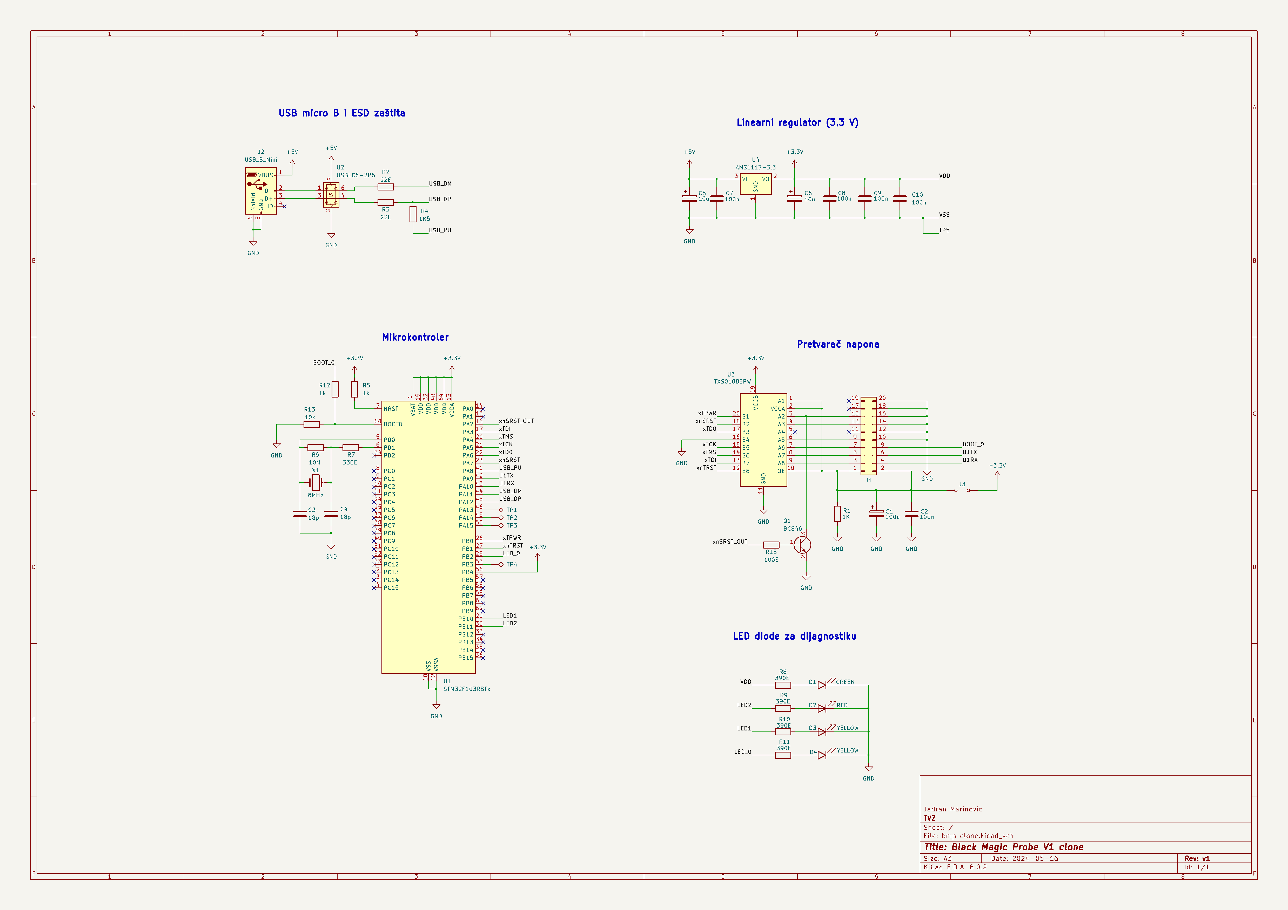
Električna shema

Slide 5
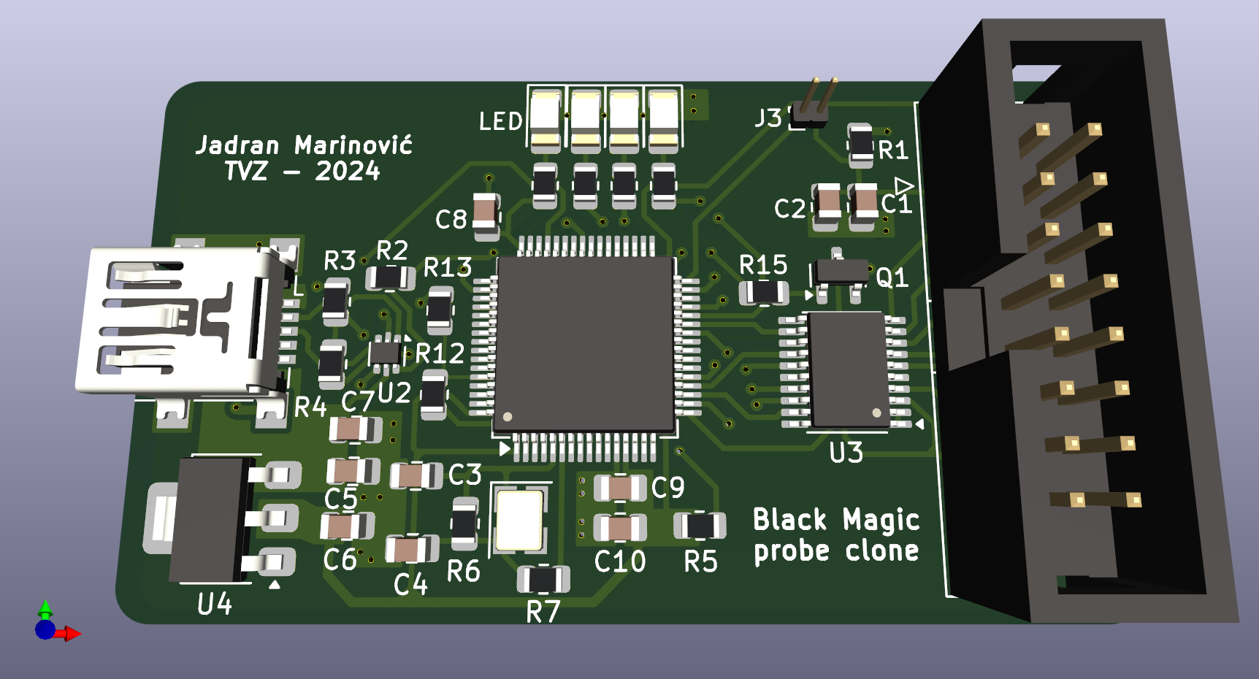
Izgled pločice u 3D-u

Slide 6
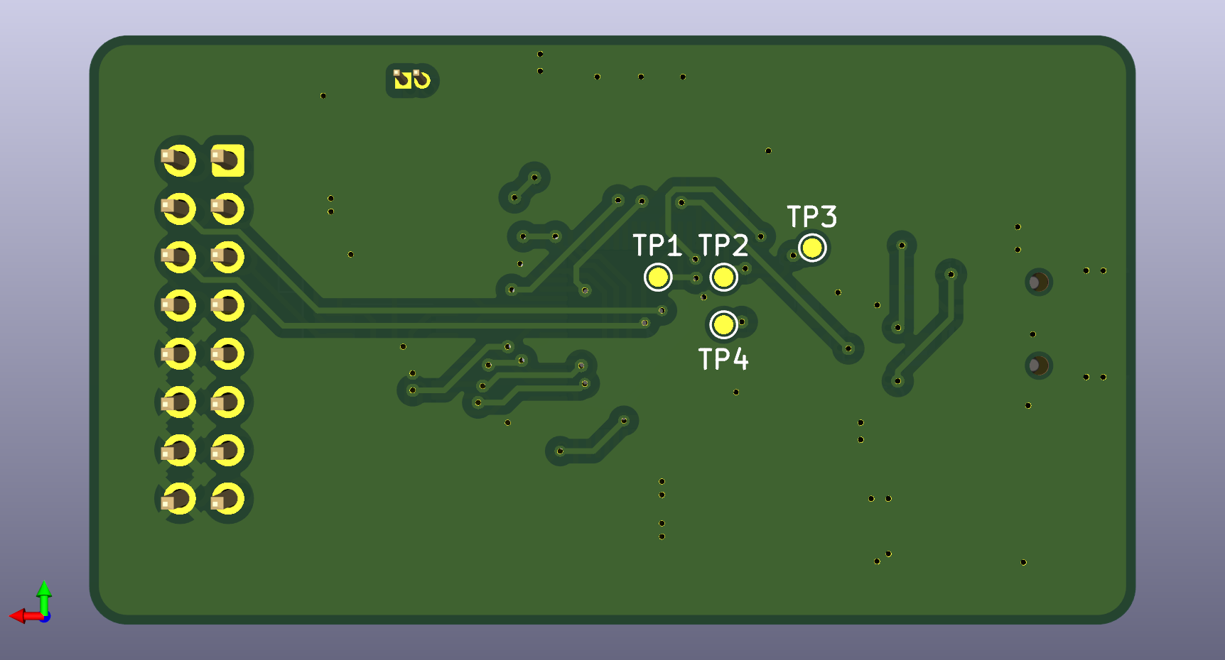
Izgled pločice u 3D-u

Slide 7
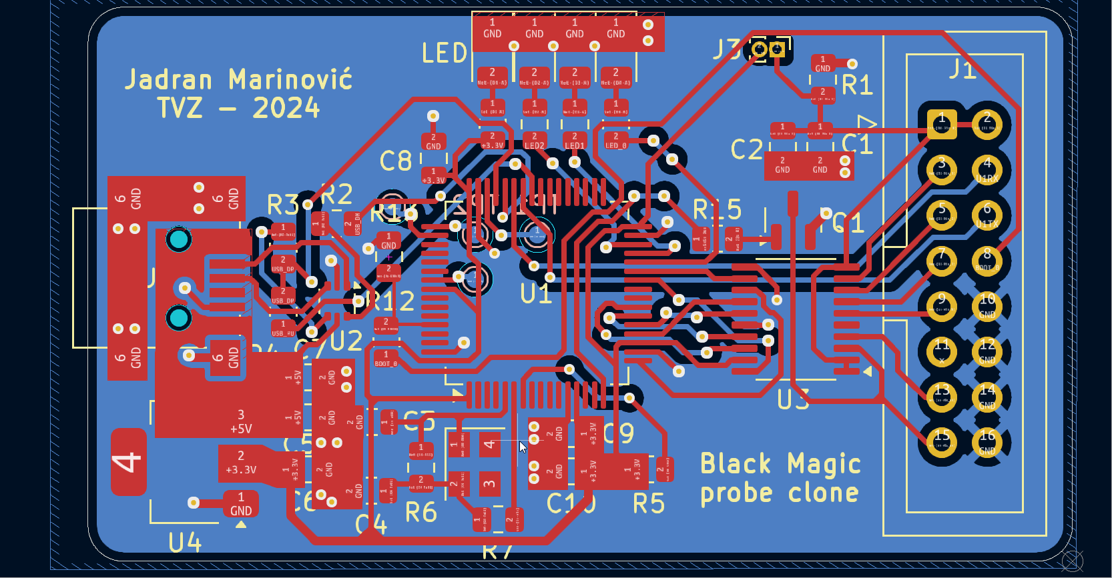
Izgled pločice

Slide 8
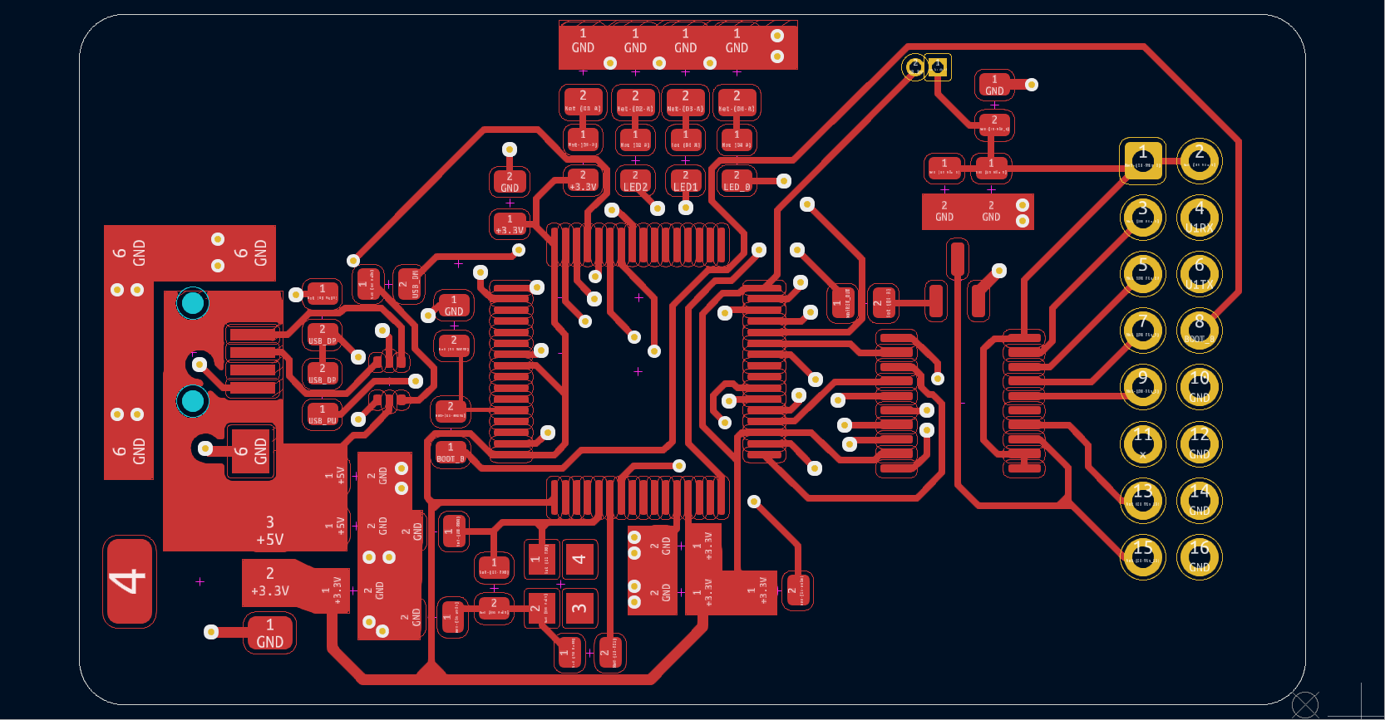
Gornji sloj

Slide 9
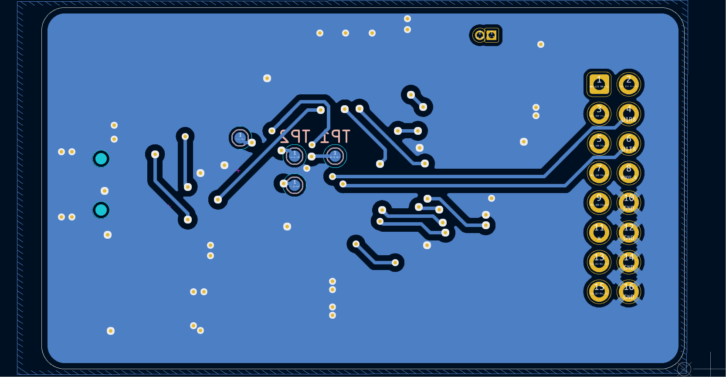
Donji sloj

Slide 10
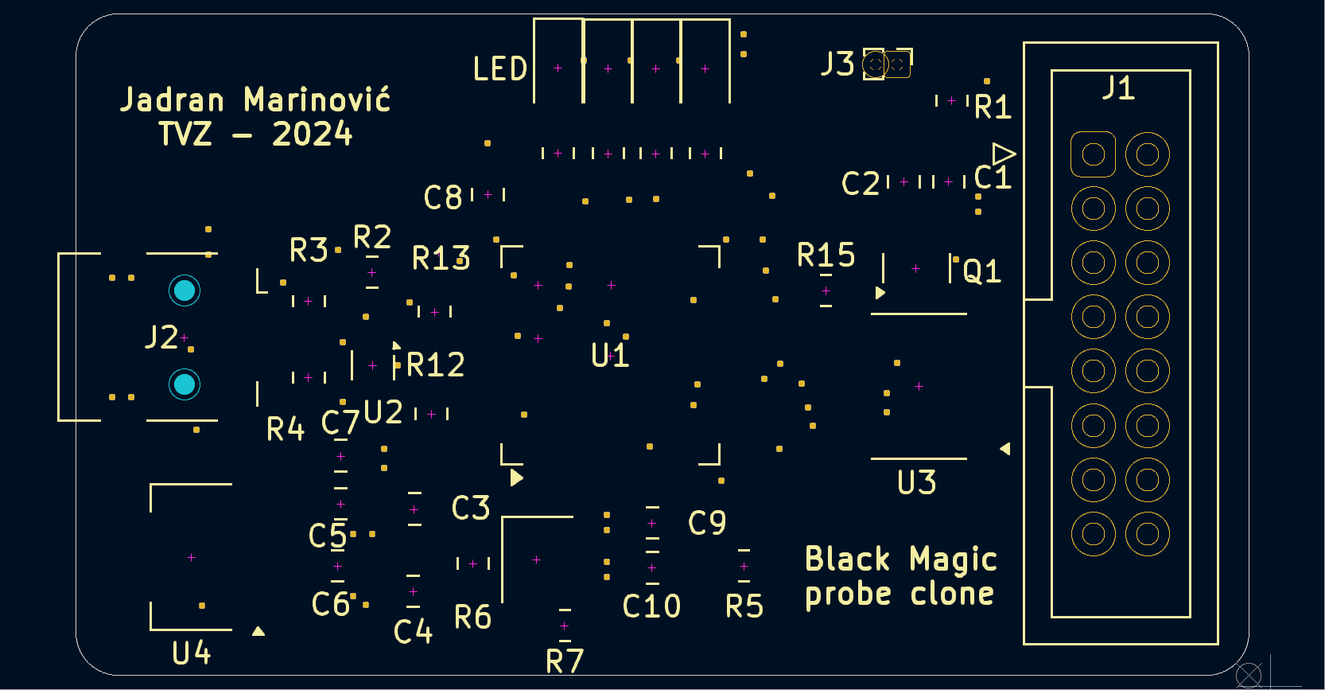
Sitotisak

Slide 11
Hvala na pažnji

