Slide 1
BCI practical course :
P300 Visual/Matrix Speller
Jason Farquhar <J.Farquhar@donders.ru.nl>

Slide 2
Learning Goals – Last Time:
Imagined Movement
Know how to:
  Build a multi-phase experiement
  Collect labelled data during the callibration phase of an experiment for later classifier training
  Train an Event Related Spectral Pattern (ERSP) classifier using the saved data, and the example ERSP classifier training code
  Build a continuous feedback testing block, with
    Feedback display
    Data signal processing and classifier application
  Speed-up Matlab drawing by making a plot and drawing objects once, and thereafter setting properties on a handle to the drawn object

Slide 3
Learning Goals : Visual Speller
Know how to:
  Present complex parallel stimuli
  Perform sequence decoding for multiple different sequences

Slide 4
Today's Plan
Hands-on : Scanning Visual Speller – Calibration Block
Hands-on : Scanning Visual Speller – Classifer training
break
Hands-on : Scanning Visual Speller – Testing Block
Break
Hands-on : Row/Col Visual Speller – Calibration
Hands-on : Row/Col Visual Speller – Training
Hands-on : Row/Col Visual Speller – Testing

Slide 5
Hands on : Visual Matrix Speller
Experiment Task:
Build a complete visual matrix speller based BCI experiment consisting of 3 blocks:
  1) Training/Calibration Block : where the user is presented with matrix speller stimuli and an instruction on which target to attend to
  2) Classifier Training Blocks : where the saved labelled data from the calibration block is used to train an ERP classifier
  3) Testing Block : where the trained classifier is used predict which symbol the user is attending to and at the end of the sequence this prediction is used to generate feedback

Slide 6
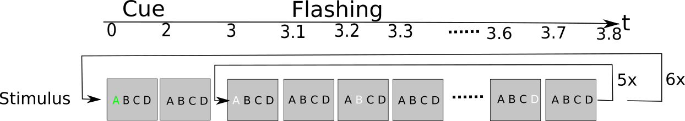
Hands-on : Scanning Visual Speller Calibration Block Stimuli

Slide 7
Hands-on : Scanning Visual Speller Calibration Block Stimuli
In 5 sequences of with 5 repeititions epochs
  (N.B. A repetition is one complete set of stimulating all symbols)
Start a sequence by displaying the symbol matrix with the target symbol highlighted in green for 2 seconds.
Clear the cue and display the matrix
Loop over epochs in the sequence and
  Highlight the indicated symbol for 100ms
  display the unhighlighted matrix for 100ms
  move to the next epoch
Wait for user key press to move to the next sequence
After the last sequence, display a thankyou message

Slide 8
Useful Functions : initGrid
hdls=initGrid(symbols)
  Create a figure with the strings contained in the cell-array of strings symbols are displayed in the same shape as that of symbols,
    i.e. If symbols={4 x 3} them the figure has a matrix of 4 rows by 3 columns etc.
  Return the handles to the text objects in hdls.
    Note: hdls has the same size as symbols, so hdls(i,j) refers to the text object containing symbols(i,j)
  Note – to change the text color use:
    set(hdls(i),'color',[r g b])

Slide 9
Hands-on : Scanning Visual Speller Calibration Block Signal Processing
Question: What information does the signal processor need to gather calibration data to train the classifier?

Slide 10
Hands-on : Scanning Visual Speller Calibration Block Signal Processing
Question: What information does the signal processor need to gather calibration data to train the classifier?
Answer:
  1) When a ‘flash’ started
  2) How long the flash brain response should last
  3) For each flash what ‘class’ of brain response it should be.
    Specificially, for the visual speller if this was a ‘target’ flash or not

Slide 11
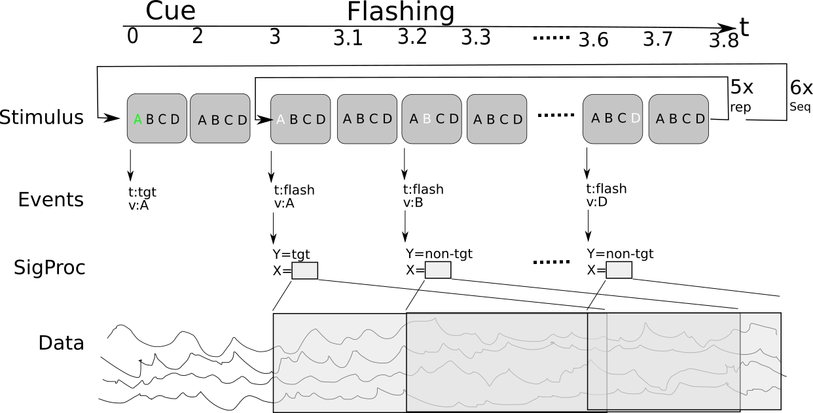
Hands-on : Scanning Visual Speller Calibration Block Signal Processing

Slide 12
Hands-on : Scanning Visual Speller Calibration Block Signal Processing
For every epoch, i.e. point where a symbol is highlighed:
In the Stimulus Presentation:
  Send a target event which says if the current flash is a target-symbol flash or not
In the Signal Processor
  Catch the target event which says when the flash started
  Record 600ms of data (expected P300 duration)
  When the block is finished save the saved annotated training data

Slide 13
Hands on : Classifier Training Block
Experiment Task
Load the calibration data saved previously
Pre-process and train an ERP classifier
Save the trained classifier for later

Slide 14
Key functions
clsfr=buffer_train_erp_clsfr(data,devents,hdr,...)
  train a linear classifier on the frequency power spectrum of the data
  data, devents – are data and associated events as output by buffer_waitdata.
  devents.type is used as the unique label for the class of data
Useful Options to change the signal-processing pipeline:
  capFile – cap file to use, e.g. 1010
  spatialfilter – type of reference to use, e.g. 'CAR','slap'
  freqband – frequency range used for classifier training
  badchrm – do we do bad channel removal?
  badtrrm – do we do bad trial removal?

Slide 15


Slide 16
Hands on : Scanning Visual Speller Feedback Stimulus
As for calibration block, except
  No initial target symbol display
  Prediction display at the end of the sequence
    Highlight the predicted target letter in green for 2 seconds

Slide 17
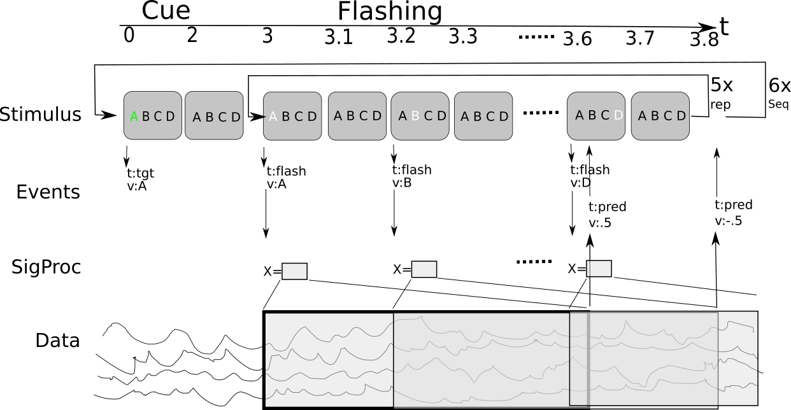
Hands on : Scanning Visual Speller
Feedback Signal Processing

Slide 18
Hands on : Scanning Visual Speller
Feedback Signal Processing
Get 0-.6s data every time a stimulus event happens
Apply the trained classifier to this to get a classifier prediction
Send an event with the classifier prediction
  (Be sure to use the same sample number so can be connected to the orginal flash)

Slide 19
Key functions
[f,fraw,p]=buffer_apply_erp_clsfr(X,clsfr)
Apply the ERP pre-processing and trained classifier stored in clsfr to the input [channels x time] data in X
f is the classifiers output decision value
  decision value is a real number where f<0 predicts class -1, f>0 predicts class +1
  combine decision values from different data by simply adding them, e.g. f(Xa&Xb) = f(Xa) + f(Xb)
p=Pr(+|X) is the estimated probability of the positive class
  Pr(+|X) = 1/(1+exp(-f(X))) for logistic regression

Slide 20
Hands on : Scanning Visual Speller
Feedback Decoding
Now we have stimuli running and the classifier generating flash predictions.
How do we combine these to identify the most-likely letter?

Slide 21
Notes: Decoding sequences
For each epoch;
  the stimulus sequence says if that symbol was stimulated or not
  the classifier gives a predicts if that epoch was an attended stimulus event or not
If the classifier was perfect then for the target symbol these 2 sequences would be the same
For an error prone classifer, then the symbol with the stimulus sequence most similar to the classifier predicted sequence is most likely the target symbol

Slide 22
Notes: Decoding sequences (2)
Compute the similarity between the classifiers sequence of predictions (f) and each symbols highlight sequence;
The symbol with the highest similarity is the most likely target symbol
Many possible similarity measures:
  correlation, inv-distance...
  Suggest use a simple inner-product;
    ip(symb) = Σt highlight(symb,t)*f(t) = highlight(symb,:)*f
  as this can be shown (for exponential family classifiers) equivalent finding the maximum likelihood solution

Slide 23
Notes : Process architecture
Decoding the correct letter requires
  Knowledge of the sequence of symbol highlights
    Readily availabe in the stimulus process
  Knowledge of the sequence of classifier predictions
    Readily available in the signal processing process
We have 2 choices where this combination takes place
  Collect the per-stimulus classifier predictions in the stimulus code
  Collect the symbol stimulus sequence information in the signal-processing code, combine and send the symbol prediction back to the stimulus code
The first is simplier, so you should probably use it.
The second is useful if someone else is writing the stimulus code (they don't need to understand anything about how the signal processing works)

Slide 24
Notes : Process architecture
Decoding the correct letter requires
  Knowledge of the sequence of symbol highlights
    Readily availabe in the stimulus process
  Knowledge of the sequence of classifier predictions
    Readily available in the signal processing process
We have 2 choices where this combination takes place
  Collect the per-stimulus classifier predictions in the stimulus code
  Collect the symbol stimulus sequence information in the signal-processing code, combine and send the symbol prediction back to the stimulus code
The first is simplier, so you should probably use it.
The second is useful if someone else is writing the stimulus code (they don't need to understand anything about how the signal processing works)

Slide 26
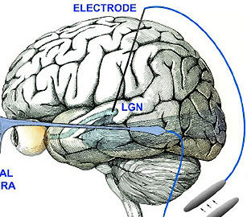
Brain Test
Test you system using a real participant
Hint: For a quick test that everything is working, you can:
  use a slow stimulus (400ms ISI)
  'blink' for each target event
  Use a single repetition

Slide 27
Summary
BCI is fun!
Evoked experiments are;
  Fiddly – because you need to get the stimulus right!
  Fiddly – because you need to get the timing right!
  Fiddly – because you have to do sequence decoding..

Slide 28
Hands-on : Scanning Visual Speller Calibration Block
Experiment Task - stimuli
In 5 sequences of with 5 repeititions epochs
  (N.B. A repetition is one complete set of stimulating all symbols)
Start a sequence by displaying the symbol matrix with the target symbol highlighted in green for 2 seconds.
Clear the cue and display the matrix
Loop over epochs in the sequence and
  Highlight the indicated row or column for 100ms as determined by the epoch count and this sequences stimulus code
  display the unhighlighted matrix for 100ms before moving to the next epoch
Initially: highlight all rows for 5 reps, then columns for 5 reps
Wait for user key press to move to the next sequence
After the last sequence, display a thankyou message

Slide 29
Hands-on : Matrix Speller Calibration Block
Experiment Task – signal processing
For every epoch, i.e. point where a row/col is highlighed, record 600ms of data annotated with whether the current sequences target symbol was highlighted at this time or not
When the block is finished save the saved annotated training data

Slide 30
Useful Functions : initGrid
hdls=initGrid(symbols)
  Create a figure with the strings contained in the cell-array of strings symbols are displayed in the same shape as that of symbols,
    i.e. If symbols={4 x 3} them the figure has a matrix of 4 rows by 3 columns etc.
  Return the handles to the text objects in hdls.
    Note: hdls has the same size as symbols, so hdls(i,j) refers to the text object containing symbols(i,j)
  Note – to change the text color use:
    set(hdls(i),'color',[r g b])

Slide 31
Extra Credit
interleave row and col stimulus
  but ensure you always do all rows then all cols, i.e. Don't do row1, col3, row5 etc.
  this ensures the target-to-target interval is large which maximises the strength of the generated ERP
Test the timing quality of your stimulus, i.e.
  Are the flashes exactly 200ms apart?
Modify your code to reduce this timing jitter
  Hint : allow for Matlab run time when sleeping...
  Useful function : getwTime() -- get current time in seconds with ns accurate clock

Slide 33
Hands on : Classifier Training Block
Experiment Task
Load the calibration data saved previously
Pre-process and train an ERP classifier
Save the trained classifier for later

Slide 34
Key functions
clsfr=buffer_train_erp_clsfr(data,devents,hdr,...)
  train a linear classifier on the frequency power spectrum of the data
  data, devents – are data and associated events as output by buffer_waitdata.
  devents.type is used as the unique label for the class of data
Useful Options to change the signal-processing pipeline:
  capFile – cap file to use, e.g. 1010
  spatialfilter – type of reference to use, e.g. 'CAR','slap'
  freqband – frequency range used for classifier training
  badchrm – do we do bad channel removal?
  badtrrm – do we do bad trial removal?

Slide 35
Hands on : Matrix Speller Feedback
Experiment Task -- stimuli
Display some instructions for the user
Run the same type of stimulus generation as for the calibration block, except
  No initial target symbol display
  Prediction display at the end of the sequence
    Highlight the predicted target letter in green for 2 seconds

Slide 36
Hands on : Matrix Speller Feedback
Experiment Task – signal processing
Get 0-.6s data every time a stimulus event happens
Apply the trained classifier to this to get a classifier prediction
At the end of the sequence identify the most likely target symbol from the set of classifier predictions and the knowledge of the stimulus sequence

Slide 37
Notes: Decoding sequences
For each epoch;
  the stimulus sequence says if that symbol was stimulated or not
  the classifier gives a predicts if that epoch was an attended stimulus event or not
If the classifier was perfect then for the target symbol these 2 sequences would be the same
For an error prone classifer, then the symbol with the stimulus sequence most similar to the classifier predicted sequence is most likely the target symbol

Slide 38
Notes: Decoding sequences (2)
Thus to identify the likely target letter:
  Compute the similarity between the classifiers sequence of predictions (f) and each symbols highlight sequence;
    Similarity could be: correlation, inv-distance etc.
    Suggest use a simple inner-product;
      im(symb) = Σt highlight(symb,t)*f(t) = highlight(symb,:)*f
    as this can be shown (for expionential family classifiers) to give the same prediction as gives the same result as correlation, i.e.
  The symbol with the highest similarity is the most likely target symbol

Slide 39
Notes : Process architecture
Decoding the correct letter requires
  Knowledge of the sequence of symbol highlights
    Readily availabe in the stimulus process
  Knowledge of the sequence of classifier predictions
    Readily available in the signal processing process
We have 2 choices where this combination takes place
  Collect the per-stimulus classifier predictions in the stimulus code
  Collect the symbol stimulus sequence information in the signal-processing code, combine and send the symbol prediction back to the stimulus code
The first is simplier, so you should probably use it.
The second is useful if someone else is writing the stimulus code (they don't need to understand anything about how the signal processing works)

Slide 40
Key functions
[f,fraw,p]=buffer_apply_erp_clsfr(X,clsfr)
Apply the ERP pre-processing and trained classifier stored in clsfr to the input [channels x time] data in X
f is the classifiers output decision value
  decision value is a real number where f<0 predicts class -1, f>0 predicts class +1
  combine decision values from different data by simply adding them, e.g. f(Xa&Xb) = f(Xa) + f(Xb)
p=Pr(+|X) is the estimated probability of the positive class
  Pr(+|X) = 1/(1+exp(-f(X))) for logistic regression

Slide 42
Brain Test
Test you system using a real participant
Hint: For a quick test that everything is working, you can:
  use a slow stimulus (400ms ISI)
  'blink' for each target event
  Use a single repetition

Slide 43
Summary
BCI is fun!
Evoked experiments are;
  Fiddly – because you need to get the stimulus right!
  Fiddly – because you need to get the timing right!
  Fiddly – because you have to do sequence decoding..

