Slide 1
BCI practical course :
“Hello World” & ERP Viewer
Jason Farquhar <J.Farquhar@donders.ru.nl>

Slide 2
Learning Goals
Understand:
What is needed to make a BCI, i.e. progress tracking, data acquisition, annotation and processing, stimulus presentation, and an overall process scheduler/sequencer
How to used event-driven programming ideas coupled to a global shared event pool (blackboard) to provide these facilities
How the fieldtrip buffer provides the event blackboard which is used for inter-process communication.
Know how to:
What the struct of an 'event' is and how to use it to annotate data with experiment relevant event information
present simple visual stimulus/feedback to the user/experimenter
How to wait for specific events, get the necessary data, process it and post the updated results back to the event blackboard
Startup the buffer and an experiment control Matlab, and how to connect these processes to provide a basic BCI
Test your experiment with simulated data generated by the signal-proxy
Debug your experiment when it fails!

Slide 3
Today's Plan
Discussion : What do we need to make a BCI?
Introduction to the Buffer-BCI framework
break
Hands-on 1: Echo-server (event IPC)
Hands-on 2: Hello World
Hands-on 3: Sequenced Sentences
break
Hands-on 4: Visual ERP Viewer

Slide 4
Discussion: What do we need to make a BCI?
Based on your prior knowledge and experience with the hands on demo we've did last time.
Discuss: What do we require to make a BCI system?
Think about:
    Hardware requirements?
    Software requirements?
    Information flows?

Slide 5
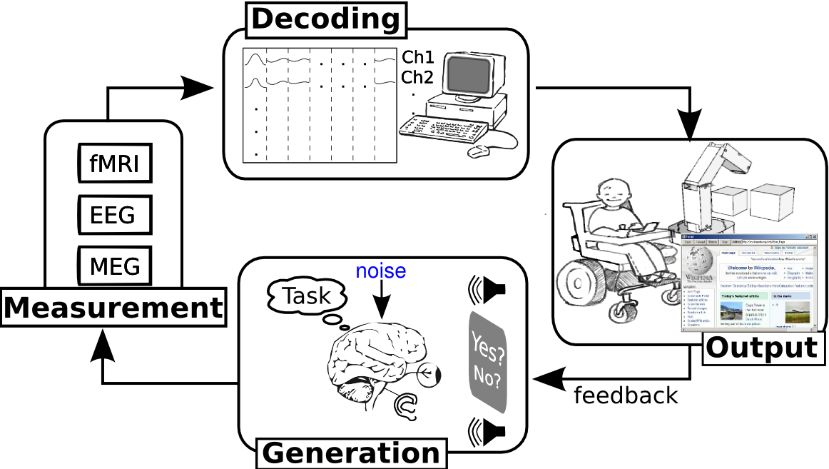
BCI information flow

Slide 6
Gross structure of a typical BCI experiment
Cap Fitting
Offline Training
(calibration)
Classifier
Training
Online Use
(feedback)

Slide 7
BCI terminology (our group!)
Epoch/Trial
  Single BCI prediction
  e.g. 1-imagined movement, 1 visual-speller flash
Sequence
  Short group of epochs (~1min)
  v. short breaks 1-2sec between epochs (usually automatic)
  short (usually self-paced) subject break between sequences (~10sec)
Block/Run/Phase
  Short group of sequences (>10min)
  long (~1-2min) subject break between blocks
  e.g. cap-fitting, calibration, classifier training, on-line use
Session – during one cap-fitting
Experiment – imagined movement, visual-speller etc.

Slide 8
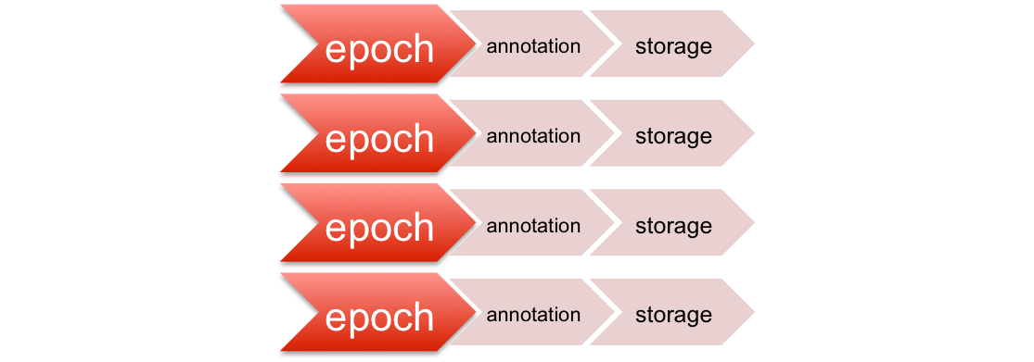
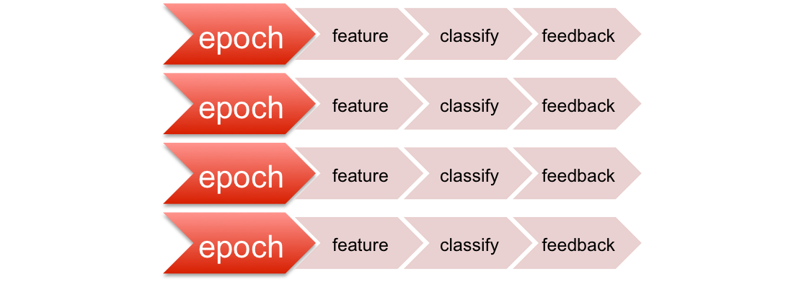
Flow chart of an individual epoch in a simple BCI experiment
Processing epochs offline
init / instruct
{
self paced
repeat
sequence
task / stim. pres.
Processing epochs online
{
no
yes
end

Slide 9
Requirements: what do you need to build a BCI?
Way of tracking where we are in execution of the experiment flowchart, i.e. block, sequence, epoch number.
Way of annotating data to what the subject was experiencing/doing at that time with what was measured from their brain/body, e.g. LH movement, reading instruction, watching queue, etc.
Data acquisition: Drivers to extract data from hardware (and combine data fro different hardware sources)
Stimulus Generation: makes stimuli that the subject will experience, for subject instruction, feedback, event-related stimuli
Something to process the signals, firstly to train the classifier, and secondly to decode the users mental state, i.e. do the BCI bit ;-)
Scheduler (sequencer?) to tie it all these bits together,
    so the correct functions, i.e. stimulus display, signal processing, are executed
    at the correct position in the experiment flowchart
    based on the right bits of measured datacc

Slide 10
Summary
To build a BCI we need a system to; track our progress through the experiment, acquire, annotate and process data, present the stimuli and schedule all these processes in an appropriate way.
Next we introduce a Matlab based system which provides these facilities.

Slide 11

Overview – “buffer_bci” framework
Open-source BCI development environment
Available from Github: www.github.com/jadref/buffer_bci
Core is “fieldtrip-buffer”
  Hardware access, data-storage, IPC
  Platform independent: Win, Mac, Linux, (Andriod/iOS)
  Language Neutral: C, C++, Matlab, Python, C#, java
Matlab/Octave/Python/Java based BCI examples
Notes:
The brain operates as an orchestra without a conductor.
To be able to produce the right cognitive melody, different neural ‘players' must coordinate their activities, each providing the right contribution at exactly the right time.

Slide 12

Overview – “buffer_bci” framework
Open-source BCI development environment
Available from Github: www.github.com/jadref/buffer_bci
Demos:
  Brain Viewer
  Games : Snake, Pacman, Sokoban
  Visual Speller
  Thought-buttons
Tutorial:
  How a BCI works and how to build one
Notes:
The brain operates as an orchestra without a conductor.
To be able to produce the right cognitive melody, different neural ‘players' must coordinate their activities, each providing the right contribution at exactly the right time.

Slide 13
Buffer-BCI Framework
We can break the requirements into 4 largely independent communicating processes:
  Data-acquisitation & annotation
    Get data from hardware
    Attach annotations (markers, events) to particular data sample
  Experiment control (scheduling)
    Control the flow of the experiment
  Stimulus generation
    Make stimuli when requested by the expt controller
    Make feedback based on predictions generated by the sig-processor
  Signal Processing
    Process the data based on the annotationss, and generate predictions

Slide 14
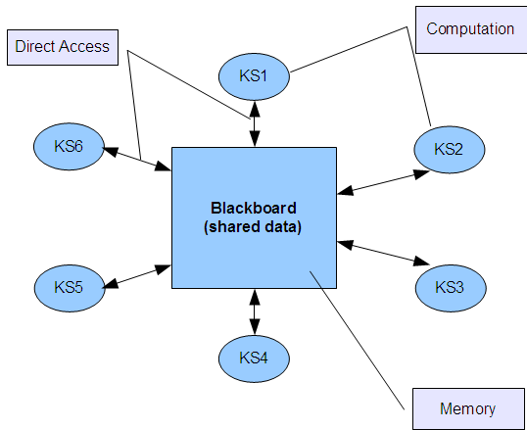
Buffer-BCI Framework
Basic Idea:
set of independent processes
any process can send/recieve data-annotation events
events are visible to all other processes
Processes communication implemented by sending recieving events
(N.B. As all events are saved with the data, annotations are automatically archived for later off-line use).
Similar in concept to that used in 'Blackboard architectures' for AI, see <en.wikipedia.org/wiki/Blackboard_system>

Slide 15
Ft-buffer based Implementation
Buffer-BCI framework implemented using the fieldtrip-buffer system (fieldtrip.fcdonders.nl/development/realtime)
Ft-buffer provides:
  Drivers for data-acquisation
  buffer storage for data (~last 1 minute data)
  buffer storage for events (~last 50 events)
Idea:
  Buffer events store represents the blackboard used for inter-process communication (IPC)
  Every event has timestamp (sample number) used for data-annotation

Slide 16
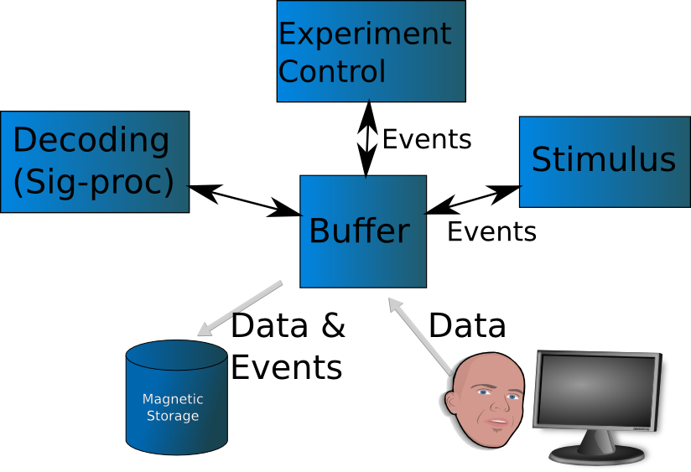
Typical Structure of BCI system
Data &
Events
Images,
Sounds,
Keypresses

Slide 17
Buffer_bci Usage
client/server architecture
Buffer server: for data storage, annotation (IPC) and archive
Acquisition driver: to access (or simulate) the measurement hardware
BCI Application.
Normally, split into 2/3 pieces:
  Signal-processing
  Stimulus presentation
  Experiment control
  (commonly part of stimulus-presentation)

Slide 18


Slide 19
Buffer_bci Quickstart
client/server architecture
Buffer server: for data storage, annotation (IPC) and archive
Acquisition driver: to access (or simulate) the measurement hardware
BCI Application.
Normally, split into 2/3 pieces:
  Signal-processing
  Stimulus presentation
  Experiment control
  (commonly part of stimulus-presentation)

Slide 20
Running buffer-bci code:
You need to have (at least) the following processes running:
Buffer server
Data-acquisation system (real or simulated)
BCI Application

Slide 21
1) Buffer Server
Saving server (saves all data and events)
dataAcq/startJavaBuffer.{sh/bat}
Server (saves nothing): dataAcq/startJavaNoSaveBuffer.{sh/bat}
C-based implementations:
Saving: dataAcq/startBuffer.{sh/bat}
NoSaving: dataAcq/startNoSaveBuffer.{sh/bat}

Slide 22
2) Data-acquisation
Simulated data: (for debugging/testing)
Java-based: dataAcq/startJavaSignalProxy.{sh/bat}
(Alternative implementions Matlab: startMatlabSignalProxy, c:startSignalProxy)
Real data: (for debugging/testing)
FilePlayback: dataAcq/startJavaFileProxy.{sh/bat}
Microphone: dataAcq/startAudio.{sh/bat}
EEG amplifier data: (for real usage)
Biosemi: dataAcq/startBiosemi.{sh/bat}
Mobita: dataAcq/startMobita.{sh/bat}
OpenBCI: dataAcq/startOpenBCI.{sh/bat}
Many others... (look in dataAcq/startXXXXX.{bat/sh})

Slide 23
3) BCI-Application
Generally what you will write yourself in this course ;-)
Typically in 2 (or more) separate processes:
Stimulus presentation:
  Controls what the user sees/hears, i.e. UI
    Show App, show feedback, control output-devices, etc.
Signal processing:
  Processes the EEG data and events to generate predictions for UI feedback.
    Collect calibration data, train classifier, generate predictions

Slide 24
Example : Games-demo
Buffer Server:
  dataAcq/startJavaNoSaveBuffer.{sh,bat}
Data Acquisation (simulated) :
  dataAcq/startJavaSignalProxy.{sh,bat}
BCI Application(1) -- Stimulus Presentation:
  games/runGame.{bat,sh}
BCI Application(2) – Signal Processing:
  games/startSigProcBuffer.{bat,sh}

Slide 25
Quickstart Example : Games-demo
Core Quickstart: Server + Acquisation + EventViewer:
  Debug mode (simulated data):
  debug_quickstart.{sh,bat}
  EEG Mode (mobita source):
  eeg_quickstart.{sh,bat}
BCI Application(1) -- Stimulus Presentation:
  games/runGame.{bat,sh}
BCI Application(2) – Signal Processing:
  games/startSigProcBuffer.{bat,sh}

Slide 26
Useful (debugging) Functions: EventViewer
Seeing the what events are sent and when is important for debugging experiment flow.
Basic event viewer has been implemented in multiple languages
  MATLAB:
    Quickstart: dataAcq/startMatlabEventViewer.{sh,bat}
    Source code: matlab/utilities/eventViewer.m
  JAVA :
    Quickstart: dataAcq/startJavaEventViewer.{sh,bat}
    Source code: java/echoClient/eventViewer.java
  Python:
    Source code: python/echoClient/eventViewer.py
  C :
    Source code: c/echoClient/eventViewer.c

Slide 28

Hands-on 1: Event Echo-Server
Events for IPC
As well as being used for data annotation, Events are used for inter-process-communication,
    e.g. to communicate results from signal-processing to stimulus presentation
To use events in this way, each process must
  monitor for new events
  filter out the events it should react to
  send response events

Slide 29
(Key concept) event structure
sample
  time at which event occurred in samples from start of experiment
type
  arbitrary event type (usually a string)
value
  arbitrary event value (usually string or number)
duration (optional)
  duration of the event in samples
offset (optional)
  zero-time for the event.
  Usually, offset from sample at which the event actually started.
Examples:
Visual speller “flash”;
ev=struct('sample',123,...
'type','stimulus.flash',...
'value',[0 0 1 0 0],...
'offset',0,'duration',0)
Classifier prediction:
ev=struct('sample',123,...
'type','prediction',...
'value',[-1 -1 -1 1 -1],...
'offset',0,'duration',0)
Imagined Movement event:
ev=struct('sample',123,...
'type','stimulus.move',...
'value','left-hand',...
'offset',0,'duration',300)
Compact notation:
s:123,t:'stimulus.flash',v:[0 0 1 0 0],o:0,d:0

Slide 30
MATLAB
(key functions) Event manipulation
evt=mkEvent(type,value,[sample,offset,duration])
make a buffer event, with sensible defaults
sendEvent
evt=sendEvent(type,value,[sample,offset,duration,host,port])
evt=sendEvent(evt,[host,port])
Send event to the buffer on machine host at port.
mi=matchEvents(evts,mtype,mval)
Find events with type mtype and value mval in evts a vector of event structures.
mtype – can be cell-array of types to match, e.g. {'type1' 'type2'}
mval – can be cell-array of values to match, e.g. {'val1' 10 'val3'}
match if any mtype matches and any mval matches,
  i.e. above matches (t:'type1',v:10), (t:'type2',v:10),(t:'type1',v:'val1')
mi is logical vector of which evts matched
N.B. Empty ([]) or '*' mtype/mvalue matches everything

Slide 31
Python
(key functions) Event manipulation
import Fieldtrip
evt=Fieldtrip.Event(type,value,[sample,offset,duration])
make a buffer event, with sensible defaults
sendEvent
evt=bufhelp.sendEvent(type,value,[sample,offset,duration,host,port])
evtfilter=bufhelp.createeventfilter((mtype,mvalue))
Create a function to filter a list of events and return only events with with type mtype and value mval in evts a vector of event structures.
Can also use a list of (mtype,mvalue) pairs to match multiple types, e.g. [('type1','val1'),('type2','val2')]
Or a list of strings to only match on the type: e.g. ['type1','type2']
Apply the resulting filter function:
mevts=evtfilter(evts)

Slide 32
Hands-on 1: Event Echo-Server
Experiment Task
Write a simple echo-server which:
  Connects to the Buffer server
  Waits for any incoming event, and
  Responds by sending a 'echo' event with the same value but type='echo'
  Quits if it receives an event with type='exit'
N.B. Don't 'echo' your own echo events!
Assignment:
start from : echoServer_skel.{m/py}
N.B. send 'keyboard' events by pressing keys in the eventViewer window.

Slide 33
MATLAB
Useful Functions:
Setup MATLAB paths and connect to buffer:
  See the header code block in echoServer_skel.m
  This will initialize the paths:
    run ../../utilities/initPaths.m
  Then try to connect to the buffer server until valid header is returned.
    while ( isempty(hdr) || .....
  Then initialize some utility functions for high-precision timing
    initsleepSec();initgetwTime();

Slide 34
MATLAB
Useful Functions:
[devents,state]=...
buffer_newevents(host,port,state,mtype,mval,timeout_ms)
wait for any new events matching (mtype,mval)
  Matching done by matchEvents
    mtype – can be cell-array of types to match, e.g. {'type1' 'type2'}
    mval – can be cell-array of values to match, e.g. {'val1' 10 'val3'}
    match if any mtype matches and any mval matches
return the matched events in the vector of structure(s) devents
state is the match state, used to track which events have been processed between function calls
Return after timeout_ms milliseconds even if no matching events found

Slide 35
PYTHON
Useful Functions:
Setup PYTHON paths and connect to buffer:
  See the header code block in echoServer_skel.py
  This will initialize the paths:
    bufhelpPath = "../../python/signalProc"
    sys.path.append(os.path.join(os.path.dirname(os.path.abspath(__file__)),bufhelpPath))
  Then try to connect to the buffer server until valid header is returned.
    ftc,hdr=bufhelp.connect();

Slide 36
PYTHON
Useful Functions:
devents=bufhelp.buffer_newevents(mtype,timeout_ms)
wait for any new events matching (mtype)
  Matching done by matchEvents
    mtype – can be list of type strings to match, e.g. ['type1', 'type2']
    match if any mtype matches and any mval matches
return the matched events in the vector of structure(s) devents
state is the match state, used to track which events have been processed between function calls
Return after timeout_ms milliseconds even if no matching events found

Slide 37
Debug/Test your echoSever
Start an event viewer: dataAcq/startJavaEventViewer.{sh,bat}
Or directly buffer+simulated EEG+eventViewer: debug_quickstart.{sh,bat}
Generate events to be echo'ed:
  Directly in the javaEventViewer.
    Press return
    Enter the event type, e.g. 'hello'
    Press return
    Enter the event value, e.g. 'world'
    Press return
  You should now see a copy of your created event in the event log.
  If the your echoServer is working you should also see your 'echoed' version.

Slide 38
Echo-Server in different languages
Basic echo-server example has been implemented in multiple languages
MATLAB: echoClient/matlabclient.m
JAVA : java/echoClient/javaclient.java
C# : csharp/echoClient/csharpclient.cs
Python: python/echoClient/pythonclient.py
C : c/echoClient/cclient.c

Slide 39
Hands-on 2: “Hello World”
Experiment Task
Display the string “Hello World” (or any other pre-specified string) on the screen, and wait for a key to be pressed to exit
Send events to annotate what has happened, e.g. startup, string display, key-pressed, shutdown etc.
Method:
Start from the 'helloworld_skel.{m/py}' function skeleton
  contains initialisation code to connect to the ft_buffer
  Some examples of functions you may find useful

Slide 40
Note : event timestamps
Accurate event time-stamps are critical for evoked potential analysis
  >10ms event jitter causes significant reduction in signal quality
However,
  data-acquisation may only send data every >20ms
  And this data may be subject to additional network delays of >20ms
Stop this jitter reducing time-stamp accuracy by;
  aligning (and tracking) computers real-time-clock and data-sample clock to prevent this jitter reducing time-stamp accuracy

Slide 41
Hands-on 3: Sequenced Sentences
Experiment Task
display set of sentences on the screen where every second 1 more character gets added to the sentence
pause for 5 seconds between sentences (and/or wait for key press)
send events for everything that happens
Assignment:
Make flowchart
Write code -> test -> debug -> until it works :-)
Start from runSentences_skel.{m/py}
Useful Functions:
MATLAB: sleepSec(time) sleep for the indicated duration in second
PYTHON: sleep(time) sleep for the indicated duratin in seconds

Slide 42
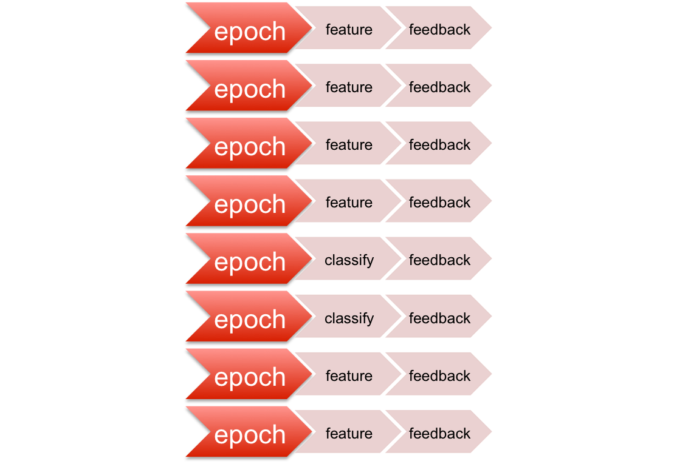
Flowchart : sequenced sentences
sequenced sentence
Sentence
Stimulus presentation
init sentences
M
a
k
i
n
g
B
self paced
{
next
sentence
display sentence
no
yes
end
end of sequence

Slide 43
Events and processing functions
sequenced sentences
Events
initSequence
t:'stimulus.seq',v:'start'
no
yes
(init sentence)
t:'stimulus.sentence',v:'start'
wait button press
t:'stimulus.keypress',v:key
clear string
t:'stimulus.cleardisplay'
ready
no
t:stimulus.sentence,v:'end'
yes
displayString
t:'stimulus.addletter',v:letter
end
t:'stimlus.seq',v:'end'

Slide 45
Hands-on 4: ERP Viewer
Experiment Task
In 5 sequences of 10 seconds:
  Every 1 seconds: either randomly display or don't display a cross (+) on the screen for 200ms
Display a 'Press key to continue string' between sequences, and wait for key press to move to the next sequence
For every 'stimulus event', i.e. point when the '+' could have been displayed, record 600ms of data annotated with whether it was a '+' or not
Every time you get some data, compute an average of the EEG data for that type of stimulus, i.e. + or no-+, and display the resulting averages as a multi-plot on the screen
N.B. You will need a separate signal processing process to: get the data, compute the ERP and display the results!
Assignment:
Make flowchart for each of the processes, i.e. stimulus, and signalProcessing
For the expt-control & simulus presentation start from : runStimulus_skel.{m/py}
For the signalProcessing & results generation use : runSigProc_skel.{m/py}

Slide 46
MATLAB
Useful Functions:
[data,devents,state]=buffer_waitData(host,port,state,...
'startSet',startEvts,'trlen_samp',samp,'exitSet',exitEvts)
for all events matching startEvts record samp samples of data
until an event matching exitEvts is generated
startEvts and exitEvts specify the events to match in the format:
  type – event type has this value
  {'type' val} – event has type==type and value==val
  {{'type1' ''type2'}} – event has type == 'type1' or 'type2'
  {{'type1' 'type2'} {val1 val2}} – event has type == 'type1' or 'type2' and value== val1 or val12
return the matched event structure(s) in devents and corrospending data in data
  Data is a vector of structures. data.buf = [nChannels x nSamples] raw EEG data
state is the match state, used to identify which events have been processed between function calls
N.B. ExitEvts has the special event type 'data' which returns as soon as the data is available for the first matched startEvt

Slide 47
PYTHON
Useful Functions:
[data,devents,stopevents]=bufhelp.gatherdata(trigger,trlen,exitTrigger)
for all events matching trigger record trlen samples of data
until an event matching exitTrigger is recieved
trigger and exitTrigger specify the events to match in the format used for bufhelp.createeventfilter. e.g.
  [type1, type2,... ] - list of types to match
  [(type1,val1),(type2,val2)...] - list of type+val pairs to match
return the matched event structure(s) in devents and corrospending data in data
Data is a vector of structures. data.buf = [nChannels x nSamples] raw EEG data

Slide 48
MATLAB/PYTHON
DEBUGGING: ERP Injection
Debugging the correct signal-analysis script is difficult without a true-signal to validate that the trigger event timing/value is correct.
To make this easier the simulated-eeg data supports ERP-injection.
  This allows the presentation system to ‘tell’ the EEG simulator to add an erp to the TRG channel at this point.
  This can then be used to check the correctness of the signal processing, e.g. do all the ‘flash’ events have a trigger ERP at time=0? do all the ‘non-flash’ events have no ERP?

Slide 49
MATLAB
DEBUGGING: ERP Injection
ERP injection works by sending a number for the ERP strength on UDP port 8300.
Setup the socket connection:
trigsocket=javaObject('java.net.DatagramSocket');
trigsocket.connect(javaObject('java.net.InetSocketAddress','localhost',8300));
Use the socket to inject an ERP
trigsocket.send(javaObject('java.net.DatagramPacket',int8([1 0]),1));

Slide 50
PYTHON
DEBUGGING: ERP Injection
ERP injection works by sending a number for the ERP strength on UDP port 8300.
Send a number to inject an ERP:
import socket
socket.socket(socket.AF_INET,socket.SOCK_DGRAM,0).sendto(bytes(1),(‘localhost’,8300))

Slide 51
Summary
BCI can be broken into 4 processes: data-acquisation, experimental control, signal processing, and stimulus presentation
buffer_bci framework : uses buffer events as a blackboard for inter-process communication

