Slide 1
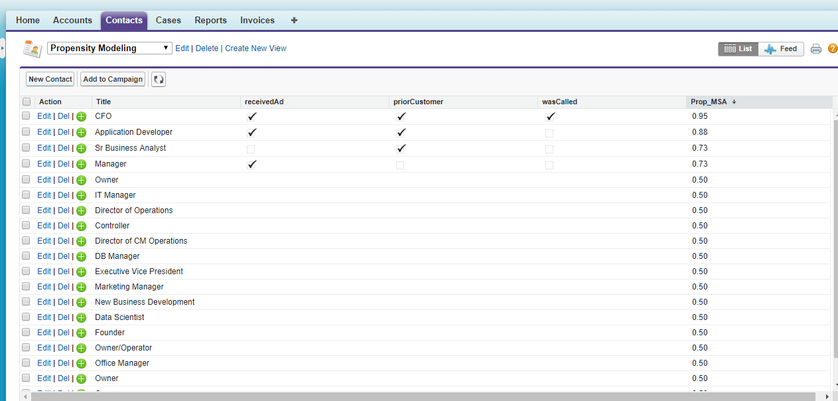
What is the Probability Client….

Slide 2
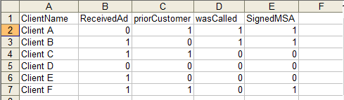
Propensity Modeling
(Historical Data Mining)

Slide 3
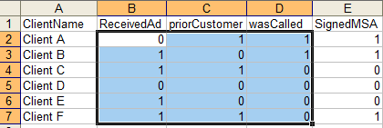
X
(------input----)
Y
(predict)

Slide 4
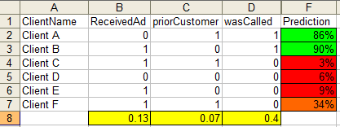
Logistic Regression OUTPUT

Slide 5
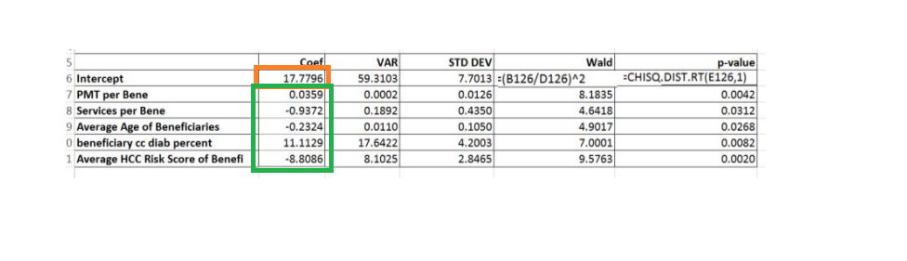

Slide 6
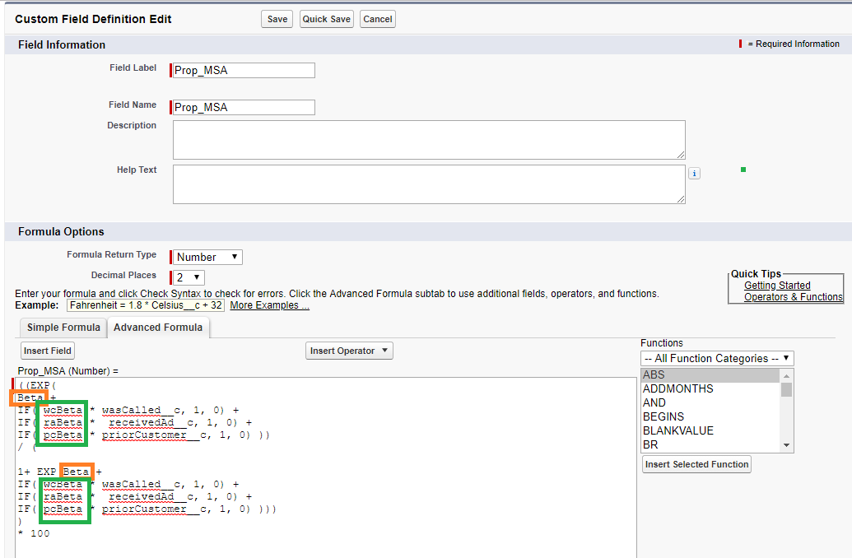

Slide 7
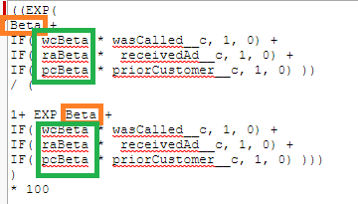

Slide 8
((EXP(
Beta +
IF( wcBeta * wasCalled__c, 1, 0) +
IF( raBeta * receivedAd__c, 1, 0) +
IF( pcBeta * priorCustomer__c, 1, 0) ))
/ (
1+ EXP(Beta +
IF( wcBeta * wasCalled__c, 1, 0) +
IF( raBeta * receivedAd__c, 1, 0) +
IF( pcBeta * priorCustomer__c, 1, 0) )))
)
* 100

Slide 9
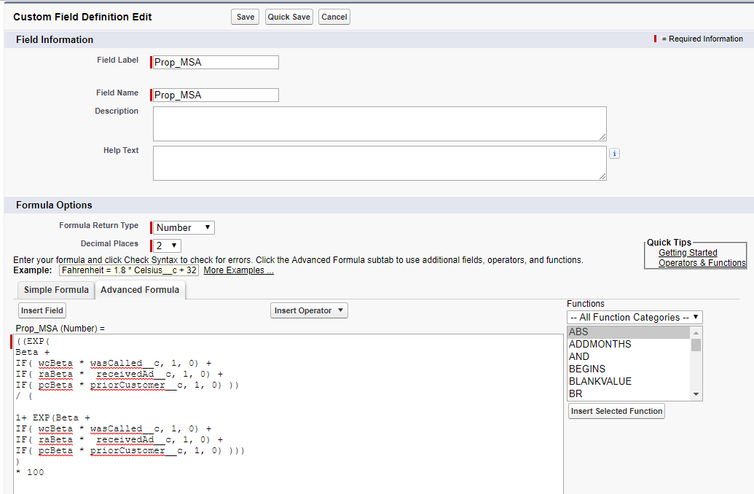

Slide 10
What is the Probability Client….

Slide 11
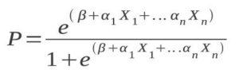
Logistic Regression OUTPUT

