Slide 1

CS1951 L
Blockchains & Cryptocurrencies
Spring 2025
Lecture 6
Solidity
Maurice Herlihy
Brown University

Slide 2
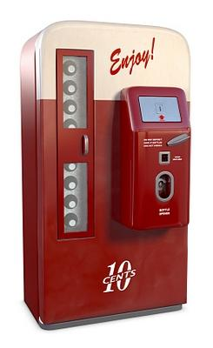
Smart Contracts
Not smart
Not a contract

Slide 3
Smart Contracts
one thin dime
Alice
refreshing soda

Slide 4
Smart Contracts
cryptocurrency
one thin dime
Alice
refreshing soda
security tokens,
stable coins,
options …

Slide 5
Smart Contracts
Control Assets (coins & bottles)
Alice
Program controls state

Slide 6
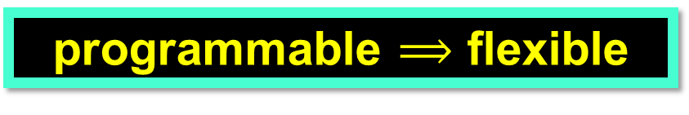

Smart Contracts
programmable $⟹$ flexible
coins
10 cents
Alice
transparent $⟹$trusted
refreshing soda
tokens
DeFi = “Decentralized Finance”

Slide 7

Solidity Tutorial
Solidity is usual high-level language for the EVM
Based on Javascript
Here, example-based tutorial
Use on-line docs and compiler to learn

Slide 8
Coin Example
pragma solidity ^0.5.2;
contract Coin {
address minter;
mapping (address => uint) balances;
…
}

Slide 9
Coin Example
pragma solidity ^0.5.2;
contract Coin {
address minter;
mapping (address => uint) balances;
…
}
This program needs compiler version 0.5.2 or later
(important because of bug fixes, compatibility)

Slide 10
Coin Example
pragma solidity ^0.5.2;
contract Coin {
address minter;
mapping (address => uint) balances;
…
}
A contract is like a class.
This contract manages a simple coin

Slide 11
Coin Example
pragma solidity ^0.5.2;
contract Coin {
address minter;
mapping (address => uint) balances;
…
}
long-lived state in EVM storage

Slide 12
Coin Example
pragma solidity ^0.5.2;
contract Coin {
address minter;
mapping (address => uint) balances;
…
}
Names an account (person or contract).

Slide 13
Coin Example
pragma solidity ^0.5.2;
contract Coin {
address minter;
mapping (address => uint) balances;
…
}
Names an account (person or contract).
Only that account allowed to mint new coins.

Slide 14
Coin Example
pragma solidity ^0.5.2;
contract Coin {
address minter;
mapping (address => uint) balances;
…
}
Like a hash table

Slide 15
Coin Example
pragma solidity ^0.5.2;
contract Coin {
address minter;
mapping (address => uint) balances;
…
}
Like a hash table
Initially, every address maps to zero

Slide 16
Coin Example
pragma solidity ^0.5.2;
contract Coin {
address minter;
mapping (address => uint) balances;
…
}
Like a hash table
Initially, every address maps to zero
Tracks client balances

Slide 17
Coin Example
pragma solidity ^0.5.2;
contract Coin {
address minter;
mapping (address => uint) balances;
constructor() {
minter = msg.sender;
}
}
Initializes a contract

Slide 18
Coin Example
pragma solidity ^0.5.2;
contract Coin {
address minter;
mapping (address => uint) balances;
constructor() {
minter = msg.sender;
}
}
address of contract making the call

Slide 19
Coin Example
pragma solidity ^0.5.2;
contract Coin {
address minter;
mapping (address => uint) balances;
constructor() {
minter = msg.sender;
}
}
Remember the creator’s address.

Slide 20
Coin Example
pragma solidity ^0.5.2;
contract Coin {
address minter;
mapping (address => uint) balances;
…
function mint(address owner, uint amount)
public {
require(msg.sender == minter,"not owner");
balances[owner] += amount;
}
…
}
A function is like a method.

Slide 21
Coin Example
pragma solidity ^0.5.2;
contract Coin {
address minter;
mapping (address => uint) balances;
…
function mint(address owner, uint amount)
public {
require(msg.sender == minter , "not owner");
balances[owner] += amount;
}
…
}
If the caller is not authorized, cancel.

Slide 22
Coin Example
pragma solidity ^0.5.2;
contract Coin {
address minter;
mapping (address => uint) balances;
…
function mint(address owner, uint amount)
public {
require(msg.sender == minter, "not owner");
balances[owner] += amount;
}
…
}
Otherwise credit the amount to the owner’s balance

Slide 23
Coin Example
pragma solidity ^0.5.2;
contract Coin {
address minter;
mapping (address => uint) balances;
…
function send(address receiver, uint amount)
public {
if (balances[msg.sender] < amount) return;
balances[msg.sender] -= amount;
balances[receiver] += amount;
}
…
}
One party transfers coins to counterparty

Slide 24
Coin Example
pragma solidity ^0.5.2;
contract Coin {
address minter;
mapping (address => uint) balances;
…
function send(address receiver, uint amount)
public {
if (balances[msg.sender] < amount) return;
balances[msg.sender] -= amount;
balances[receiver] += amount;
}
…
}
Quit if insufficient funds

Slide 25
Coin Example
pragma solidity ^0.5.2;
contract Coin {
address minter;
mapping (address => uint) balances;
…
function send(address receiver, uint amount)
public {
if (balances[msg.sender] < amount) return;
balances[msg.sender] -= amount;
balances[receiver] += amount;
}
…
}
transfer amount from one account to the other

Slide 26
The Flippening
Alice and Bob want to flip a fair coin
Each one is willing to cheat
Obvious sources of randomness:
time, block hashes, etc. don’t work
Let’s try something else

Slide 27
Coin Flip Contract
pragma solidity ^0.8.7;
contract CoinFlipMaybe {
address[2] player;
mapping (address => uint) vote;
mapping (address => bool) played;
bool result;
bool done;
…

Slide 28
Coin Flip Example
pragma solidity ^0.5.1;
contract CoinFlipMaybe {
address[2] player;
mapping (address => uint) vote;
mapping (address => bool) played;
bool result;
bool done;
…
declare contract and compiler version

Slide 29
Coin Flip Example
pragma solidity ^0.5.1;
contract CoinFlipMaybe {
address[2] player;
mapping (address => uint) vote;
mapping (address => bool) played;
bool result;
bool done;
…
will want to restrict interactions to the two players

Slide 30
Coin Flip Example
pragma solidity ^0.5.1;
contract CoinFlipMaybe {
address[2] player;
mapping (address => uint) vote;
mapping (address => bool) played;
bool result;
bool done;
…
each player contributes to the result

Slide 31
Coin Flip Example
pragma solidity ^0.5.1;
contract CoinFlipMaybe {
address[2] player;
mapping (address => uint) vote;
mapping (address => bool) played;
bool result;
bool done;
…
each player gets one move only

Slide 32
Coin Flip Example
pragma solidity ^0.5.1;
contract CoinFlipMaybe {
address[2] player;
mapping (address => uint) vote;
mapping (address => bool) played;
bool result;
bool done;
…
remember outcome

Slide 33
Coin Flip Example
pragma solidity ^0.5.1;
contract CoinFlipMaybe {
…
constructor (address alice, address bob)
public {
player[0] = alice;
player[1] = bob;
}
…

Slide 34
Coin Flip Example
pragma solidity ^0.5.1;
contract CoinFlipMaybe {
…
constructor (address alice, address bob)
public {
player[0] = alice;
player[1] = bob;
}
…
constructor just remembers players

Slide 35
Coin Flip Example
function play(uint _vote) public {
require(msg.sender == player[0] ||
msg.sender == player[1]);
require(!played[msg.sender]);
vote[msg.sender] = _vote;
played[msg.sender] = true;
if (played[player[0]] && played[player[1]]) {
done = true;
result = ((vote[player[0]] ^
vote[player[1]]) % 2) == 1;
}
}

Slide 36
Coin Flip Example
function play(uint _vote) public {
require(msg.sender == player[0] ||
msg.sender == player[1]);
require(!played[msg.sender]);
vote[msg.sender] = _vote;
played[msg.sender] = true;
if (played[player[0]] && played[player[1]]) {
done = true;
result = ((vote[player[0]] ^
vote[player[1]]) % 2) == 1;
}
}
require(condition)
revert computation if condition not satisfied.
Like throwing an exception

Slide 37
Coin Flip Example
function play(uint _vote) public {
require(msg.sender == player[0] ||
msg.sender == player[1]);
require(!played[msg.sender]);
vote[msg.sender] = _vote;
played[msg.sender] = true;
if (played[player[0]] && played[player[1]]) {
done = true;
result = ((vote[player[0]] ^
vote[player[1]]) % 2) == 1;
}
}
Only Alice and Bob allowed to play

Slide 38
Coin Flip Example
function play(uint _vote) public {
require(msg.sender == player[0] ||
msg.sender == player[1]);
require(!played[msg.sender]);
vote[msg.sender] = _vote;
played[msg.sender] = true;
if (played[player[0]] && played[player[1]]) {
done = true;
result = ((vote[player[0]] ^
vote[player[1]]) % 2) == 1;
}
}
Each player can play only once

Slide 39
Coin Flip Example
function play(uint _vote) public {
require(msg.sender == player[0] ||
msg.sender == player[1]);
require(!played[msg.sender]);
vote[msg.sender] = _vote;
played[msg.sender] = true;
if (played[player[0]] && played[player[1]]) {
done = true;
result = ((vote[player[0]] ^
vote[player[1]]) % 2) == 1;
}
}
record player’s vote

Slide 40
Coin Flip Example
function play(uint _vote) public {
require(msg.sender == player[0] ||
msg.sender == player[1]);
require(!played[msg.sender]);
vote[msg.sender] = _vote;
played[msg.sender] = true;
if (played[player[0]] && played[player[1]]) {
done = true;
result = ((vote[player[0]] ^
vote[player[1]]) % 2) == 1;
}
}
remember that player voted

Slide 41
Coin Flip Example
function play(uint _vote) public {
require(msg.sender == player[0] ||
msg.sender == player[1]);
require(!played[msg.sender]);
vote[msg.sender] = _vote;
played[msg.sender] = true;
if (played[player[0]] && played[player[1]]) {
done = true;
result = ((vote[player[0]] ^
vote[player[1]]) % 2) == 1;
}
}
Finished when both players have voted

Slide 42
Coin Flip Example
function play(uint _vote) public {
require(msg.sender == player[0] ||
msg.sender == player[1]);
require(!played[msg.sender]);
vote[msg.sender] = _vote;
played[msg.sender] = true;
if (played[player[0]] && played[player[1]]) {
done = true;
result = ((vote[player[0]] ^
vote[player[1]]) % 2) == 1;
}
}
remember we are done

Slide 43
Coin Flip Example
function play(uint _vote) public {
require(msg.sender == player[0] ||
msg.sender == player[1]);
require(!played[msg.sender]);
vote[msg.sender] = _vote;
played[msg.sender] = true;
if (played[player[0]] && played[player[1]]) {
done = true;
result = ((vote[player[0]] ^
vote[player[1]]) % 2) == 1;
}
}
XOR the votes

Slide 44
Coin Flip Example
function play(uint _vote) public {
require(msg.sender == player[0] ||
msg.sender == player[1]);
require(!played[msg.sender]);
vote[msg.sender] = _vote;
played[msg.sender] = true;
if (played[player[0]] && played[player[1]]) {
done = true;
result = ((vote[player[0]] ^
vote[player[1]]) % 2) == 1;
}
}
flip value is parity of XOR of votes

Slide 45
Coin Flip Example
function getResult() public view returns (bool) {
require (done);
return result;
}

Slide 46
Coin Flip Example
function getResult() public view returns (bool) {
require (done);
return result;
}
anyone can request outcome

Slide 47
Coin Flip Example
function getResult() public view returns (bool) {
require (done);
return result;
}
make sure outcome is ready

Slide 48
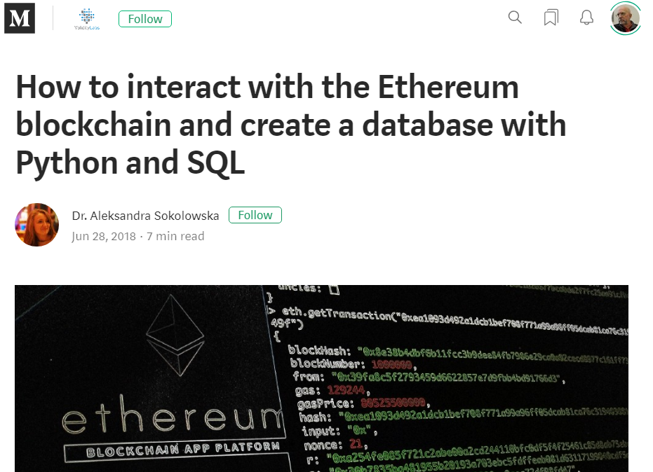
This Contract is Insecure
Suppose Alice plays first
Bob then observes contract state on Etherscan.io
Picks his vote after seeing hers
Bob controls coin flip outcome

Slide 49
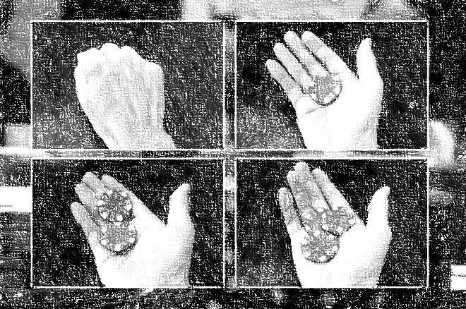
Commit-Reveal Pattern
Step One: commit to a value without revealing it
you cannot change your value
Step Two: Wait for others to commit
Step Three: reveal your value
you can check validity

Slide 50
Commit-Reveal Pattern
Alice generates a random value r
Alice commits to r by sending hash(r) to contract
Alice waits for Bob to commit
All done
off-chain!
Alice reveals r to contract
Compute outcome when Bob reveals

Slide 51
Commit-Reveal Flip
contract CoinFlipCR {
address[2] player;
mapping (address => uint) commit;
mapping (address => uint) reveal;
mapping (address => bool) committed;
mapping (address => bool) revealed;
bool result;
bool done;

Slide 52
Commit-Reveal Flip
contract CoinFlipCR {
address[2] player;
mapping (address => uint) commit;
mapping (address => uint) reveal;
mapping (address => bool) committed;
mapping (address => bool) revealed;
bool result;
bool done;
track both commit and reveal

Slide 53
Commit-Reveal Flip
function commit(uint _commit) public {
require(msg.sender == player[0] ||
msg.sender == player[1]);
require(!committed[msg.sender]);
commit[msg.sender] = _commit;
committed[msg.sender] = true;
}

Slide 54
Commit-Reveal Flip
function commit(uint _commit) public {
require(msg.sender == player[0] ||
msg.sender == player[1]);
require(!committed[msg.sender]);
commit[msg.sender] = _commit;
committed[msg.sender] = true;
}
members only

Slide 55
Commit-Reveal Flip
function commit(uint _commit) public {
require(msg.sender == player[0] ||
msg.sender == player[1]);
require(!committed[msg.sender]);
commit[msg.sender] = _commit;
committed[msg.sender] = true;
}
You only commit once

Slide 56
Commit-Reveal Flip
function commit(uint _commit) public {
require(msg.sender == player[0] ||
msg.sender == player[1]);
require(!committed[msg.sender]);
commit[msg.sender] = _commit;
committed[msg.sender] = true;
}
close the deal

Slide 57
Coin Flip Example
function reveal(uint _reveal) public {
require(msg.sender == player[0] ||
msg.sender == player[1]);
require(!revealed[msg.sender]);
require(
commit[msg.sender]==hash(_reveal));
reveal[msg.sender] = _reveal;
revealed[msg.sender] = true;
if (revealed[player[0]] &&
revealed[player[1]]) {
done = true;
result = ((reveal[player[0]] ^
reveal[player[1]])
% 2) == 1;
}
}

Slide 58
function reveal(uint _reveal) public {
require(msg.sender == player[0] ||
msg.sender == player[1]);
require(!revealed[msg.sender]);
require(
commit[msg.sender]==hash(_reveal));
reveal[msg.sender] = _reveal;
revealed[msg.sender] = true;
if (revealed[player[0]] &&
revealed[player[1]]) {
done = true;
result = ((reveal[player[0]] ^
reveal[player[1]])
% 2) == 1;
}
}
Usual preconditions
(necessary?)

Slide 59
function reveal(uint _reveal) public {
require(msg.sender == player[0] ||
msg.sender == player[1]);
require(!revealed[msg.sender]);
require(
commit[msg.sender]==hash(_reveal));
reveal[msg.sender] = _reveal;
revealed[msg.sender] = true;
if (revealed[player[0]] &&
revealed[player[1]]) {
done = true;
result = ((reveal[player[0]] ^
reveal[player[1]])
% 2) == 1;
}
}
make sure reveal is sincere

Slide 60
function reveal(uint _reveal) public {
require(msg.sender == player[0] ||
msg.sender == player[1]);
require(!revealed[msg.sender]);
require(
commit[msg.sender]==hash(_reveal));
reveal[msg.sender] = _reveal;
revealed[msg.sender] = true;
if (revealed[player[0]] &&
revealed[player[1]]) {
done = true;
result = ((reveal[player[0]] ^
reveal[player[1]])
% 2) == 1;
}
}
record what was revealed

Slide 61
function reveal(uint _reveal) public {
require(msg.sender == player[0] ||
msg.sender == player[1]);
require(!revealed[msg.sender]);
require(
commitment[msg.sender]==hash(_reveal));
revelation[msg.sender] = _reveal;
revealed[msg.sender] = true;
if (revealed[player[0]] &&
revealed[player[1]]) {
done = true;
result = ((revelation[player[0]] ^
revelation[player[1]])
% 2) == 1;
}
}
If done, compute outcome as before

Slide 62
Solidity Details

Slide 63
Scalar Types
int8, …, int256 = int
uint8, …, uint256 = uint
bool
address
bytes1, …, bytes32

Slide 64
Enums
enum Actions{ GoLeft, GoRight, GoStraight};
Actions choice;
Actions constant default = Actions.GoStraight;

Slide 65
Static Arrays
uint[8] a; // 8 256-bit uints

Slide 66
Dynamic Arrays
uint[] a = new uint[](8); // 8 256-bit uints

Slide 67
Structs
struct Funder {
address addr;
uint amount;
}

Slide 68
Mappings
mapping (address => uint)
Every key implicitly bound to all-zero value
binding always defined

Slide 69
Call Opcode
Contract A
Contract B
A calls B’s function …
which runs in B’s address space

Slide 70
DelegateCall Opcode
Contract A
Contract B
Contract B’s
code
A delegatecalls B’s function …
which runs in A’s address space

Slide 71
Library
library SafeMath {
…
}
Syntactic sugar
Contract where every function call
is a delegate call

Slide 72
Inheritance
contract Feline {
function utterance()
public returns (bytes32);
}
contract Cat is Feline {
function utterance()
public returns (bytes32) {
return "meow";
}
}
Like other languages

Slide 73
Abstract Contracts
contract Config {
{// defined
function name() public
returns (string) return “Config”;
}
// undefined
function lookup(uint id) public
returns (address);
}
At least one function implementation missing
Compiler type-checking, inheritance

Slide 74
Interfaces
interface Config {
function lookup(uint id) public
returns (address);
}
All function implementations missing
Compiler type-checking, inheritance

Slide 75
Events
An event is a public record that something happened
event Deposit(address from, uint value);
…
emit Deposit(msg.sender, msg.value);
Events can be monitored from outside the blockchain

Slide 76
Function Visibility
External: only from outside
Public: only internal or external
Internal: only current or derived contracts
Private: only current not derived contracts

Slide 77
Receive & Fallback Functions
contract Example {
uint x = 0;
function foo() public {
x = 1;
}
receive () external payable {
emit Paid(msg.sender, msg.value);
}
fallback () external payable {
emit Unknown(msg.sender, msg.data);
}
}

Slide 78
Receive & Fallback Functions
contract Example {
uint x = 0;
function foo() public {
x = 1;
}
receive () external payable {
emit Paid(msg.sender, msg.value);
}
fallback () external payable {
emit Unknown(msg.sender, msg.data);
}
}
regular
function

Slide 79
Receive Function
Handles plain ether transfers
calls to send() or transfer()

Slide 80
Receive & Fallback Functions
contract Example {
uint x = 0;
function foo() public {
x = 1;
}
receive () external payable {
emit Paid(msg.sender, msg.value);
}
fallback () external payable {
emit Unknown(msg.sender, msg.data);
}
}
receive
function

Slide 81
Receive Function Idiosyncrasies
receive () external payable {
revert();
}
function deposit() external {
balances[msg.sender] += msg.value;
}
This works

Slide 82
Sending Ether to a receive() Function
address.send(amount);
Limited to 2300 gas
Protects against re-entrancy attack
requires near-trivial function
If transfer fails, returns Boolean
Programming pitfall

Slide 83
Sending Ether to a receive() Function
address.transfer(amount);
Limited to 2300 gas
Protects against re-entrancy attack
requires near-trivial function
If transfer fails, reverts transaction
Safer programming practice

Slide 84
Sending Ether to a receive() Function
address.call.value(amount).gas(extra);
Can specify how much gas
No re-entrancy protection
non-trivial functions OK
If transfer fails, reverts transaction
Safer programming practice

Slide 85
Sending Ether to a Payable Named Function
address.fun.value(amount)(args);
Uses as much gas as needed
No re-entrancy protection
If transfer fails, reverts transaction
Safer programming practice

Slide 86
Sending Ether to a Payable Named Function
address.fun.value(amount).gas(limit)(args);
Limits gas as shown
No re-entrancy protection
If transfer fails, reverts transaction
Safer programming practice

Slide 87
Receive & Fallback Functions
contract Example {
uint x = 0;
function foo() public {
x = 1;
}
receive () external payable {
emit Paid(msg.sender, msg.value);
}
fallback () external payable {
emit Unknown(msg.sender, msg.data);
}
}
fallback
function

Slide 88
Function Call
Contract A
Contract B
not me!
call “bar”
fn foo()
me!
fn bar()
fallback ()
A calls B’s “bar” function …

Slide 89
Fallback Function
Contract A
Contract B
not me!
call “xyzzy”
fn foo()
not me!
fn bar()
fallback ()
me, by default
A calls B’s “xyzzy” function …

Slide 90
Sending Ether to a Payable fallback() Function
If no receive() function defined …
Plain ether transfer calls fallback() …
Same 2300 gas limit

Slide 91
Old-School Nameless Fallback
Nameless
fallback
function
contract Example {
uint x = 0;
function foo() public {
x = 1;
}
function () external payable {
emit Paid(msg.sender, msg.value);
}
}
In older versions of solidity …
Used for both transfers & last resort
Now deprecated

Slide 92
Moral
Payment breaks abstraction
You don’t know how to call a fallback function …
unless you know what it does
See later lectures on pitfalls!

Slide 93
require()
require(msg.sender == owner, "not owner")
If condition fails …
Revert transaction
Display error message
Refund unused gas
Usually for checking inputs

Slide 94
assert()
assert(denominator != 0, "uh-oh")
If condition fails …
Revert transaction
Display error message
Confiscate all gas
For conditions that should never happen

Slide 95
require() and assert() conventions
Roll back if condition fails
require(msg.sender == owner)
require() might fail if input is bad
assert(denominator != 0)
assert() should never fail

Slide 96
Function Modifiers
modifier ownerOnly() {
require (msg.sender == owner);
_;
}

Slide 97
Function Modifiers
modifier ownerOnly() {
require (msg.sender == owner);
_;
}
If test passes …

Slide 98
Function Modifiers
modifier ownerOnly() {
require (msg.sender == owner);
_;
}
If test passes …
Execute function body

Slide 99
Function Modifiers
function pay(address _payto, uint amount)
public
ownerOnly() {
balance[_payTo] += amount;
}

Slide 100
Function Modifiers
If test passes …
function pay(address _payto, uint amount)
public
ownerOnly() {
balance[_payTo] += amount;
}

Slide 101
Function Modifiers
If test passes …
function pay(address _payto, uint amount)
public
ownerOnly() {
balance[_payTo] += amount;
}
Execute function body

Slide 102
Self Destruction
selfdestruct(sendMoneyTo)
terminates contract
sends remaining balance to argument
beneficiary cannot refuse

Slide 103
Data Location
storage or memory
memory is default for arg & result passing
storage is default for local vars
assignment across regions is copying

Slide 104
Ethereum Storage
2²⁵⁶-1
A very, very big array
Initially all 0s
0
32 bytes

Slide 105
Variables
contract aContract {
uint256 a;
…
}
a
0

Slide 106
Static Arrays
uint256[2] b;
a
b
b
0
1
2

Slide 107
Structs
struct aStruct{
uint256 id;
uint256 value;
}
aStruct c;
a
b
b
c
c
0
1
2
3
4

Slide 108
Dynamic Arrays
struct aStruct{
uint256 id;
uint256 value;
}
aStruct d[];
d.length
d[0]
d[0]
d[1]
d[1]
5
Hash(5)

Slide 109
Mappings
mapping(uint256 => uint 256) e;
empty
e[123]
e[345]
6
Hash(123,6)
Hash(345,6)

Slide 110
Simple Variable
declaration
T v;
value
location
v
v’s slot

Slide 111
Fixed-Size Arrays
declaration
T[10] v;
value
location
V[1]
(v’s slot)+i*(sizeof T)

Slide 112
Dynamic Arrays
declaration
T[] v;
value
location
V[1]
hash(v’s slot)+i*(sizeof T)
v.length
v’s slot

Slide 113
Mappings
declaration
mapping(T1 => T2) v;
value
location
V[1]
hash(i.(v’s slot))
https://programtheblockchain.com/posts/2018/03/09/understanding-ethereum-smart-contract-storage/

Slide 114
TL;DR: Smart Contracts are Weird
Information-hiding, modularity can be bad
Attackers don’t respect abstraction boundaries
Often, Implementation is the spec
Notes:
Programming languages for smart contracts are inherently different from normal programming languages. They have to be transparent from the top to the bottom, so information-hiding and abstraction actually get in the way. They also have to withstand determined attack from intelligent and well-funded adversaries, the fuzzers from hell.

Slide 115
TL;DR: Smart Contracts are Weird
Computational power can be bad
Immutability? need static analysis
Turing-Completeness?
Non-determinism?
Indirection, dynamic dispatch?
Notes:
Programming languages for smart contracts are inherently different from normal programming languages. They have to be transparent from the top to the bottom, so information-hiding and abstraction actually get in the way. They also have to withstand determined attack from intelligent and well-funded adversaries, the fuzzers from hell.

Slide 116
Ether Trivia
10¹⁸ Wei (after Wei Dai)
10⁹ Gwei (gas fee quotes)
10⁶ Szabo (after Nick Szabo)
Rarely
used
10³ Finney (after Hal Finney)

Slide 117

Ideas we covered in this lecture
Coin example
Data types
Modifiers
require() and assert()
Various Features
Datatype layouts in EVM memory

Slide 118
