Slide 1

CS1951 L
Blockchains & Cryptocurrencies
Spring 2025
Lecture 7
Ethereum Data Structures
Maurice Herlihy
Brown University

Slide 2
Ethereum Storage Model
2²⁵⁶-1
A very, very big array
Initially all 0s
0
32 bytes

Slide 3
Simple Variable
declaration
T v;
value
location
v
v’s slot

Slide 4
Fixed-Size Arrays
declaration
T[10] v;
value
location
V[i]
(v’s slot)+i*(sizeof T)

Slide 5
Dynamic Arrays
declaration
T[] v;
value
location
V[i]
hash(v’s slot)+i*(sizeof T)
v.length
v’s slot

Slide 6
Mappings
declaration
mapping(T1 => T2) v;
value
location
V[i]
hash(i.(v’s slot))

Slide 7
OK, We Lied to You
We don’t really have an array with 2²⁵⁶ elements
Instead, we keep data structures in a …
Key-value store: key → value
So we don’t have to store all those zeros

Slide 8
Key-Value Pairs
Key | Value
do | 0
dog | 1
dax | 2
dodo | 3
cat | 4
cats | 5

Slide 9
Radix Trie
Key | Value
do | 0
dog | 1
dax | 2
dodo | 3
cat | 4
cats | 5
a
z
…
b
y
One possible child for each letter
Each path spells a key word
Value at end of path
Search time = key length

Slide 10
Radix Trie
d
c
Key | Value
do | 0
dog | 1
dax | 2
dodo | 3
cat | 4
cats | 5
a
o
a
0
x
g
d
t
2
1
4
o
s
3
5

Slide 11
Radix Trie
Search for “dog”
d
c
Key | Value
do | 0
dog | 1
dax | 2
dodo | 3
cat | 4
cats | 5
a
o
a
0
x
g
d
t
2
1
4
o
s
3
5

Slide 12
Radix Trie
Search for “dog”
d
c
Key | Value
do | 0
dog | 1
dax | 2
dodo | 3
cat | 4
cats | 5
a
o
a
0
x
g
d
t
2
1
4
o
s
3
5

Slide 13
Radix Trie
Search for “dog”
d
c
Key | Value
do | 0
dog | 1
dax | 2
dodo | 3
cat | 4
cats | 5
a
o
a
0
x
g
d
t
2
1
4
o
s
3
5

Slide 14
Radix Trie
Search for “dog”
d
c
Key | Value
do | 0
dog | 1
dax | 2
dodo | 3
cat | 4
cats | 5
a
o
a
0
x
g
d
t
2
1
4
o
s
3
5

Slide 15
Radix Trie
Search for “dog”
d
c
Key | Value
do | 0
dog | 1
dax | 2
dodo | 3
cat | 4
cats | 5
a
o
a
0
x
g
d
t
2
1
4
o
s
Search successful, bound to 1
3
5

Slide 16
Radix Trie
Search for “ca”
d
c
Key | Value
do | 0
dog | 1
dax | 2
dodo | 3
cat | 4
cats | 5
a
o
a
0
x
g
d
t
2
1
4
o
s
3
5

Slide 17
Radix Trie
Search for “ca”
d
c
Key | Value
do | 0
dog | 1
dax | 2
dodo | 3
cat | 4
cats | 5
a
o
a
0
x
g
d
t
2
1
4
o
s
3
5

Slide 18
Radix Trie
Search for “ca”
d
c
Key | Value
do | 0
dog | 1
dax | 2
dodo | 3
cat | 4
cats | 5
a
o
a
0
x
g
d
t
2
1
4
o
s
3
5

Slide 19
Radix Trie
Search for “ca”
d
c
Key | Value
do | 0
dog | 1
dax | 2
dodo | 3
cat | 4
cats | 5
a
o
a
0
x
g
d
t
2
1
4
o
s
Search failed,
Node contains no value
3
5

Slide 20
Radix Trie
Search for “zoo”
d
c
Key | Value
do | 0
dog | 1
dax | 2
dodo | 3
cat | 4
cats | 5
a
o
a
0
x
g
d
t
2
1
4
o
s
3
5

Slide 21
Radix Trie
Search failed,
No path
Search for “zoo”
d
c
Key | Value
do | 0
dog | 1
dax | 2
dodo | 3
cat | 4
cats | 5
a
o
a
0
0
x
g
d
t
g
2
1
4
2
1
4
o
s
3
5
3
5

Slide 22
Radix Trie
d
c
One more optimization
a
o
a
0
x
g
d
t
2
1
4
o
s
3
5

Slide 23
Radix Trie
Combine “degenerate”
Edges"
d
cat
One more optimization
4
a
o
s
0
5
x
g
do
x
g
2
1
3

Slide 24
Questions?

Slide 25
Actual Ethereum Patricia Trie
key
hash
value
0
1
2
3
4
10
11
12
13
14
15
data

Slide 26
BTW: Patricia Tries
PATRICIA =
"Practical Algorithm To Retrieve Information Coded In Alphanumeric"
“Trie” is pronounced either try or tree

Slide 27
BTW: Recursive Length Prefix
Binary data structure
RLP
Byte string

Slide 28
BTW: Recursive Length Prefix
[ "cat", "dog" ]
List payload 8
RLP
Raw, seething chars
0xc8, 0x83,'c','a','t',0x83,'d','o','g'
string payload 3

Slide 29
Alternative Data Structures
Patricia Merkle trees not only choice
What do we need from search structure?
What is out there?

Slide 30
Efficient Operations?
1
2
8
7
10
5
O(log n) searches, updates
Even when adversary chooses keys!

Slide 31
Small Proofs of Inclusion?
h₀₃
h₀₁
h₂₃
h₀
h₁
Constant factors matter too
d₁

Slide 32
Small Proofs of Non-Inclusion?
d
c
Proof that radix trie does not contain key “ca”
h₁
a
h₂

Slide 33
History Independence?
1
same content
different shape
1
2
2
8
7
7
10
8
5
5
10
Data structure shape depends on contents only

Slide 34
History Independence?
1
1
Same hashes for
2
Replication
2
8
7
7
10
8
5
5
10
Data structure shape depends on contents only

Slide 35
History Independence?
1
1
Same hashes for
2
Replication
2
8
Concurrency
7
7
10
8
5
5
10
Data structure shape depends on contents only

Slide 36
History Independence?
1
1
Same hashes for
2
Replication
2
8
Concurrency
7
Debugging
7
10
8
5
5
10
Data structure shape depends on contents only

Slide 37
Sharding?
1
2
8
7
10
5

Slide 38
Sharding?
1
2
8
7
10
5

Slide 39
Sharding?
1
2
8
7
10
Parallelism: per-shard threads
5

Slide 40
Sharding?
1
2
8
7
10
Parallelism: per-shard threads
5
Load-balancing

Slide 41
Sharding?
1
2
8
7
10
Parallelism: per-shard threads
5
Load-balancing
Must minimize communication

Slide 42
Fork-Join Parallelism
integer fib(Integer n) {
if (n > 2) {
left = new Future( fib(n-1) );
right = fib(n-2);
return left.get() + right;
} else {
return 1;
}}}

Slide 43
Fork-Join Parallelism
integer fib(Integer n) {
if (n > 2) {
left = new Future( fib(n-1) );
right = fib(n-2);
return left.get() + right;
} else {
return 1;
}}}
If convenient, create a thread to evaluate expression

Slide 44
Fork-Join Parallelism
integer fib(Integer n) {
if (n > 2) {
left = new Future( fib(n-1) );
right = fib(n-2);
return left.get() + right;
} else {
return 1;
}}}
Wait for thread to join, or evaluate sequentially

Slide 45
Fork-Join Parallelism
Efficient “Work-Stealing” schedulers
Parallelism adapts to resources
No locks, only fork + join

Slide 46
Questions?

Slide 47
What Makes a Good Smart Contract Data Structure?
Efficient lookup against adversary
History independence
Short proof of inclusion
Short proof of non-inclusion
Sharding & Parallelism

Slide 48
The Storage Structure Arboretum
Radix or Patricia Trie
Sparse Merkle Tree
Treaps

Slide 49

Radix or Patricia Trie
Efficient lookup against adversary
History independence
Short proof of inclusion
Log in num keys
Short proof of non-inclusion
Sharding & Parallelism

Slide 50
Radix or Patricia Trie
Efficient lookup against adversary
History independence
Short proof of inclusion
Short proof of non-inclusion
Sharding & Parallelism

Slide 51
Radix or Patricia Trie
Efficient lookup against adversary
History independence
Short proof of inclusion
¯\_(ツ)_/¯
Short proof of non-inclusion
Asymptotically good
Constants suboptimal
Sharding & Parallelism

Slide 52
Radix or Patricia Trie
Efficient lookup against adversary
History independence
Short proof of inclusion
¯\_(ツ)_/¯
Short proof of non-inclusion
¯\_(ツ)_/¯
Sharding
Same as proof
of inclusion
Parallelism

Slide 53
Radix or Patricia Trie
Efficient lookup against adversary
History independence
Short proof of inclusion
¯\_(ツ)_/¯
Short proof of non-inclusion
¯\_(ツ)_/¯
Sharding & Parallelism
Each subtree on own node

Slide 54
Review: Merkle Tree
h₀₃ =H(h_{01,}h₂₃)
h₀₁ =H(h_{0,}h₁)
h₂₃ =H(h_{2,}h₃)
h₀ =H(d₀)
h₁ =H(d₁)
h₂ =H(d₂)
h₃ =H(d₃)
d₀
d₁
d₂
d₃

Slide 55
Review: Proof of d₁ Inclusion
h₀₃ =H(h_{01,}h₂₃)
h₀₁ =H(h_{0,}h₁)
h₂₃ =H(h_{2,}h₃)
h₀ =H(d₀)
h₁ =H(d₁)
h₂ =H(d₂)
h₃ =H(d₃)
d₀
d₁
d₂
d₃

Slide 56
Proof of d₅ Non-Inclusion?
h₀₃ =H(h_{01,}h₂₃)
Can’t prove a value not included
h₀₁ =H(h_{0,}h₁)
h₂₃ =H(h_{2,}h₃)
Except by displaying entire tree
h₀ =H(d₀)
h₁ =H(d₁)
h₂ =H(d₂)
h₃ =H(d₃)
d₀
d₁
d₂
d₃
56

Slide 57
Sorted Merkle Tree
h₀₃ =H(h_{01,}h₂₃)
h₀₁ =H(h_{0,}h₁)
h₂₃ =H(h_{2,}h₃)
h₀ =H(00)
h₁ =H(⊥)
h₂ =H(⊥)
h₃ =H(11)
00
⊥
⊥
11

Slide 58
Sorted Merkle Tree
h₀₃ =H(h_{01,}h₂₃)
h₀₁ =H(h_{0,}h₁)
h₂₃ =H(h_{2,}h₃)
h₀ =H(00)
h₁ =H(⊥)
h₂ =H(⊥)
h₃ =H(11)
00
00, 11 included
⊥
⊥
11

Slide 59
Sorted Merkle Tree
h₀₃ =H(h_{01,}h₂₃)
h₀₁ =H(h_{0,}h₁)
h₂₃ =H(h_{2,}h₃)
01, 10 not included
h₀ =H(00)
h₁ =H(⊥)
h₂ =H(⊥)
h₃ =H(11)
00
⊥
⊥
11

Slide 60
Proof of Inclusion for 00
h₀₃ =H(h_{01,}h₂₃)
h₀₁ =H(h_{0,}h₁)
h₂₃ =H(h_{2,}h₃)
h₀ =H(00)
h₁ =H(⊥)
h₂ =H(⊥)
h₃ =H(11)
00
⊥
⊥
11

Slide 61
Proof of Non-Inclusion for 01
h₀₃ =H(h_{01,}h₂₃)
h₀₁ =H(h_{0,}h₁)
h₂₃ =H(h_{2,}h₃)
h₀ =H(00)
h₁ =H(⊥)
h₂ =H(⊥)
h₃ =H(11)
00
⊥
⊥
11

Slide 62
Sparse Merkle Tree
h₀₃ =H(h_{01,}h₂₃)
h₀₁ =H(h_{0,}h₁)
h₂₃ =H(h_{2,}h₃)
h₀ =H(00)
h₃ =H(11)
H(⊥)
00
11

Slide 63
Sparse Merkle Trees
Most leaves are ⊥
H(⊥), H(H(⊥)), ... can be precomputed
Can truncate all Traps-⊥ subtrees
Navigation vs re-hashing trade-offs

Slide 64
Sparse Merkle Tree
Efficient lookup against adversary
History independence
Short proof of inclusion
Short proof of non-inclusion
Sharding & Parallelism

Slide 65
Sparse Merkle Tree
Efficient lookup against adversary
History independence
Short proof of inclusion
Short proof of non-inclusion
Sharding & Parallelism

Slide 66
Sparse Merkle Tree
Efficient lookup against adversary
History independence
Short proof of inclusion
Short proof of non-inclusion
Sharding & Parallelism
Usual Merkle proof

Slide 67
Sparse Merkle Tree
Efficient lookup against adversary
History independence
Short proof of inclusion
Short proof of non-inclusion
Sharding & Parallelism

Slide 68
Sparse Merkle Tree
Efficient lookup against adversary
History independence
Short proof of inclusion
Short proof of non-inclusion
Sharding & Parallelism

Slide 69
Binary Search Tree
x
keys < x
Challenge: balance
keys > x

Slide 70
Rotations
x
y
a
A
b
c
B
C

Slide 71
Rotation (1)
y
x
c
C
a
A
b
B

Slide 72
Rotation (2)
y
x
c
C
a
A
b
B

Slide 73
Rotations
y
x
right
x
c
a
y
C
A
left
a
b
b
c
A
B
B
C

Slide 74
Heap
1
2
2
4
3
8
28
Each key < children keys

Slide 75
Treap
1,K
2,J
2,L
4,B
3,H
8,M
28,A
Both search tree & heap!

Slide 76
Treap
H(K),K
H(J),J
H(L),L
H(B),B
H(H),H
H(M),M
H(A),A
Use key hash as priority?

Slide 77
Adding an Item
H(K),K
H(J),J
H(L),L
H(B),B
H(H),H
H(M),M
H(N),N
H(A),A
Step1: add as if for search tree

Slide 78
Rotations
y
x
right
x
c
a
y
C
A
left
a
b
b
c
A
B
B
C
Step 2: rotate tree to restore heap

Slide 79
Treap
Linear depth if adversary controls priorities
Efficient lookup against adversary
¯\_(ツ)_/¯
History independence
Short proof of inclusion
Short proof of non-inclusion
Sharding & Parallelism
Log-depth but only with high probability

Slide 80
Treap
Efficient lookup against adversary
¯\_(ツ)_/¯
History independence
Short proof of inclusion
Short proof of non-inclusion
Sharding & Parallelism

Slide 81
Treap
Efficient lookup against adversary
¯\_(ツ)_/¯
History independence
Short proof of inclusion
Short proof of non-inclusion
Sharding & Parallelism

Slide 82
Treap
Efficient lookup against adversary
¯\_(ツ)_/¯
History independence
Short proof of inclusion
Short proof of non-inclusion
Sharding & Parallelism

Slide 83
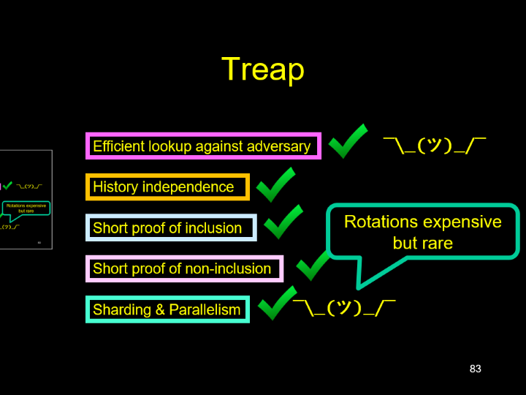

Treap
Efficient lookup against adversary
¯\_(ツ)_/¯
History independence
Rotations expensive but rare
Short proof of inclusion
Short proof of non-inclusion
Sharding & Parallelism
¯\_(ツ)_/¯

Slide 84
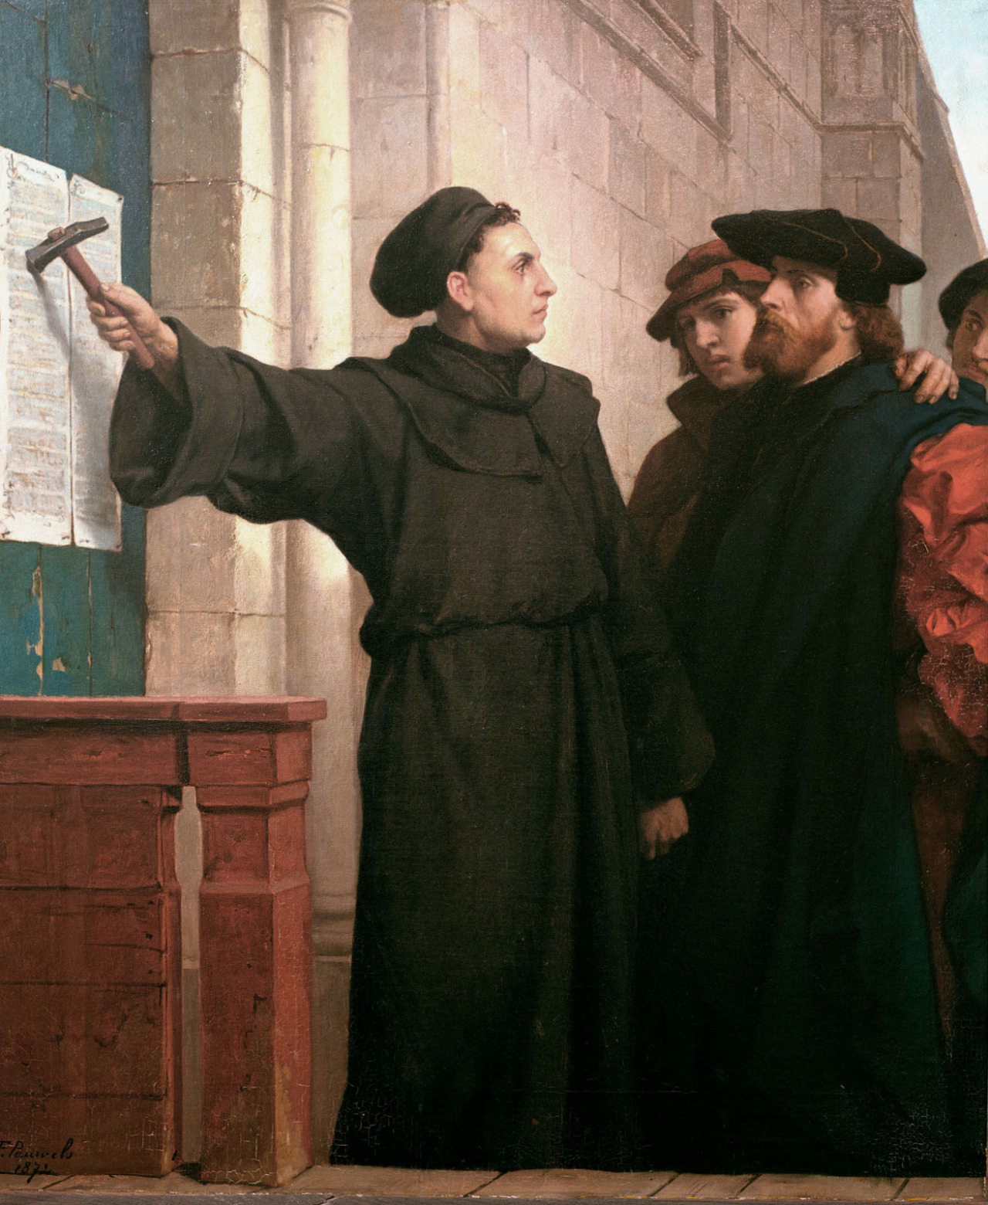
Ideas we covered in this lecture
EVM storage model
What do we want from search trees?
Patricia or radix tries
Sparse Merkle tree
Treaps

Slide 85
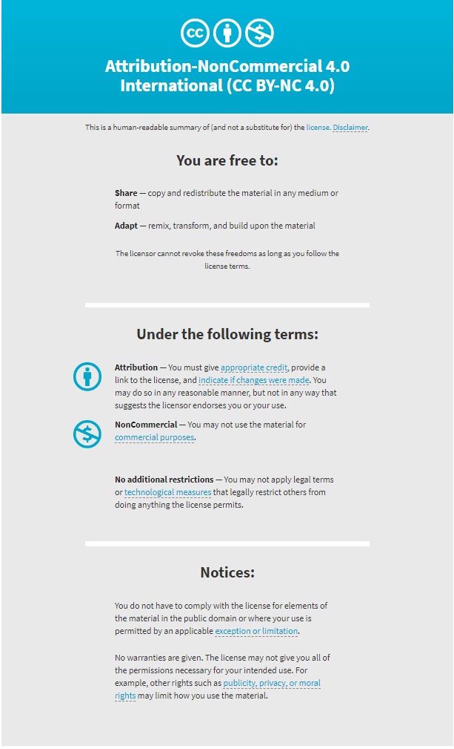

Slide 86
h₀=H(h_{10,}h_{11,}h₁₂)
h₁₀=H(h_{20,}h_{21,}h₂₂)
h₁₁=H(h_{23,}h_{24,}h₂₂)
h₁₂=H(h_{20,}h_{21,}h₂₂)
H₂₀=H(d₀)
H_{21`}=H(d₁)
H₂₂=H(d₂)
H₂₆=H(d₆)
H_{27`}=H(d₇)
H₂₈=H(d₈)
H₂₃=H(d₃)
H_{24`}=H(d₄)
H₂₅=H(d₅)
d₀
d₁
d₂
d₃
d₄
d₅
d₆
d₇
d₃

