Slide 1
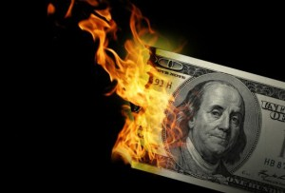
CS1951 L
Blockchains & Cryptocurrencies
Spring 2023
Lecture 15
Off-Chain Payment Channels
Maurice Herlihy
Brown University

Slide 2
Alice and Bob do a lot of Bitcoin micro-transactions
not happy
low throughput: 3.5 TPS
high latency: ~1 hour finality
blockchain
High fees !!!

Slide 3
Reparameterize?
Larger Blocks?
Takes longer to propagate
blockchain
More centralization

Slide 4
Reparameterizing is Politically Infeasible
Increase Block Rate?
More Forks
longer confirmation times
blockchain
More centralization

Slide 5
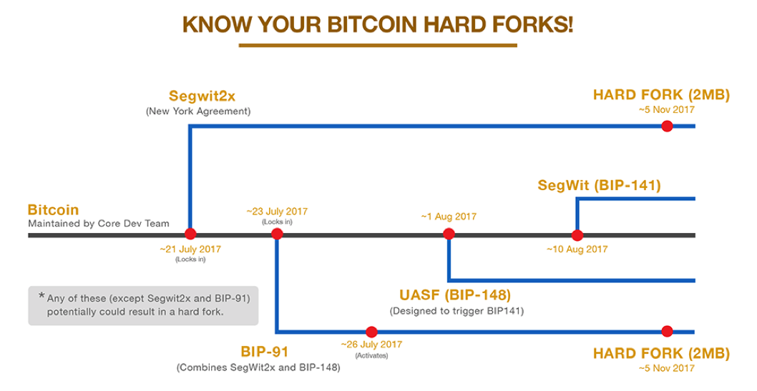
Reparameterizing is Politically Infeasible
blockchain

Slide 6
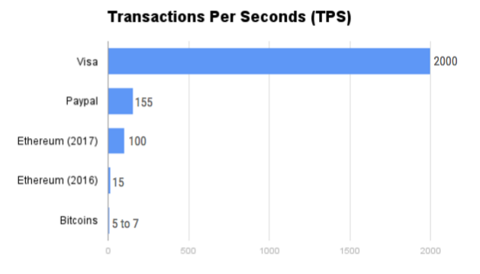
this graph tho …

Slide 7
Off-chain Payment Channels
Promises orders of magnitude improvement
Builds on existing infrastructure
Claims to “save” Bitcoin

Slide 8
Basic Idea
Alice and Bob transact directly
at network speeds
blockchain
Blockchain used only for settlement

Slide 9
Basic Idea
put 100 BTC in escrow,
released by signed ledgers
from both Alice and Bob
blockchain
Alice: 100

Slide 10
Basic Idea
Alice | Bob
100 | 0
Alice | Bob
100 | 0
Each Party has “mental picture” of balances
blockchain
Alice: 100

Slide 11
Basic Idea
Alice | Bob
100 | 0
Alice | Bob
100 | 0
Alice | Bob
20 | 80
Alice | Bob
20 | 80
80 BTC
Alice sends 80 BTC to Bob
Alice and Bob both sign new ledgers
blockchain
Alice: 100

Slide 12
Basic Idea
Alice | Bob
100 | 0
Alice | Bob
100 | 0
Alice | Bob
20 | 80
Alice | Bob
20 | 80
Alice | Bob
30 | 70
Alice | Bob
30 | 70
10 BTC
Bob sends 10 BTC back to Alice
blockchain
Alice: 100

Slide 13
Basic Idea
Alice | Bob
100 | 0
Alice | Bob
100 | 0
Alice | Bob
20 | 80
Alice | Bob
20 | 80
Alice | Bob
30 | 70
Alice | Bob
30 | 70
Alice | Bob
40 | 60
Alice | Bob
40 | 60
10 BTC
Again
blockchain
Alice: 100

Slide 14
Basic Idea
Alice | Bob
100 | 0
Alice | Bob
100 | 0
Alice | Bob
20 | 80
Alice | Bob
20 | 80
Alice | Bob
30 | 70
Alice | Bob
30 | 70
Alice | Bob
40 | 60
Alice | Bob
40 | 60
It’s Friday night and
I want to go out and party.
Let’s cash in!
blockchain
Alice: 100

Slide 15
Basic Idea
Alice | Bob
100 | 0
Alice | Bob
100 | 0
Alice | Bob
20 | 80
Alice | Bob
20 | 80
Alice | Bob
30 | 70
Alice | Bob
30 | 70
Alice | Bob
40 | 60
Alice | Bob
40 | 60
Alice | Bob
40 | 60
OK
blockchain
Alice: 100
Notes:
Only one on-chain txn at end.
Could have been zillions of off-chain txns.
Some Privacy
No fees, no latency.

Slide 16
Phases
Setup
Put money in escrow
Exchange
Send signed IoUs back and forth off-chain
Settlement
Single on-chain transaction establishes final balances

Slide 17
Uh, Oh
Alice | Bob
100 | 0
Alice | Bob
100 | 0
Alice | Bob
20 | 80
Alice | Bob
20 | 80
Alice | Bob
30 | 70
Alice | Bob
30 | 70
Alice | Bob
40 | 60
Alice | Bob
40 | 60
what?
Heh-heh …
blockchain
BOOM!
Alice: 100

Slide 18
Let’s Do That Again, This Time with Security

Slide 19
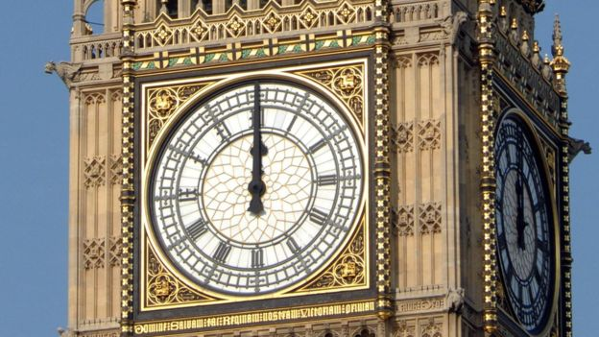
nLockTime
A timelock makes a txn valid only after some time in the future
“pay Alice 10 BTC after 7 days”
Specified in terms of chain height or Unix timestamps

Slide 20
Unidirectional Channel
I’m Alice
I’m Bob
blockchain

Slide 21
Setup
put 100 BTC in dual-sig account
both Alice & Bob must sign to release
blockchain

Slide 22
Setup
put 100 BTC in dual-sig account
both Alice & Bob must sign to release
Refund money to Alice in 30 days
signed by Bob
blockchain

Slide 23
Setup
put 100 BTC in dual-sig account
both Alice & Bob must sign to release
Refund money to Alice in 30 days
signed by Bob
Refund Alice
in 30 days
signed Bob
blockchain
100 BTC
dual-sig

Slide 24
Exchange
I’m going to send Bob a
signed txn for 10 BTC
Refund Alice
in 30 days
signed Bob
blockchain
100 BTC
dual-sig

Slide 25
Exchange
pay 10 to Bob,
90 to Alice
signed Alice
Refund Alice
in 30 days
signed Bob
blockchain
100 BTC
dual-sig

Slide 26
Exchange
I could deposit this on the blockchain right now, but I won’t
pay 10 to Bob,
90 to Alice
signed Alice
Refund Alice
in 30 days
signed Bob
blockchain
100 BTC
dual-sig

Slide 27
Exchange
I’m going to send Bob 10 BTC more
pay 10 to Bob,
90 to Alice
signed Alice
Refund Alice
in 30 days
signed Bob
blockchain
100 BTC
dual-sig

Slide 28
Exchange
pay 10 to Bob,
90 to Alice
signed Alice
pay 20 to Bob,
80 to Alice
signed Alice
Refund Alice
in 30 days
signed Bob
blockchain
100 BTC
dual-sig

Slide 29
Exchange
The 2nd txn is more valuable so I will keep that one and discard the other
pay 10 to Bob,
90 to Alice
signed Alice
pay 20 to Bob,
80 to Alice
signed Alice
Refund Alice
in 30 days
signed Bob
blockchain
100 BTC
dual-sig

Slide 30
Exchange
pay 20 to Bob,
80 to Alice
signed Alice
refund
in 30 days
signed Bob
blockchain
100 BTC
dual-sig

Slide 31
Settlement
Closing time!
I will sign and publish most recent txn on the blockchain now
pay 20 to Bob,
80 to Alice
signed Alice
Refund Alice
in 30 days
signed Bob
blockchain
100 BTC
dual-sig

Slide 32
Settlement
pay 20 to Bob,
80 to Alice
signed Alice
Refund Alice
in 30 days
signed Bob
blockchain
100 BTC
dual-sig

Slide 33
Settlement
I have 80
I have 20
blockchain
100 BTC
dual-sig
pay 20 to Bob,
80 to Alice
signed Alice & Bob

Slide 34
Settlement
pay 20 to Bob,
80 to Alice
signed Alice
Uh,oh …
Refund Alice
in 30 days
signed Bob
blockchain
100 BTC
dual-sig

Slide 35
Settlement
If Bob is unresponsive,
will get my money back in 30 days
pay 20 to Bob,
80 to Alice
signed Alice
Refund Alice
in 30 days
signed Alice & Bob
blockchain
100 BTC
dual-sig

Slide 36
Questions?

Slide 37
Bidirectional Channel
I’m Alice
I’m Bob
blockchain

Slide 38
Setup
put 100 BTC in dual-sig account
both Alice & Bob must sign to release
blockchain
100 BTC
dual-sig

Slide 39
Setup
put 100 BTC in dual-sig account
both Alice & Bob must sign to release
Refund money to Alice in 30 days
signed by Bob
blockchain
100 BTC
dual-sig
refund
in 30 days

Slide 40
Exchange
I’m going to send Bob a
signed txn for 10 BTC
with a 29-day timelock
blockchain
100 BTC
dual-sig
refund
in 30 days

Slide 41
Exchange
pay 10 to Bob,
90 to Alice
in 29 days
signed Alice
blockchain
100 BTC
dual-sig
refund
in 30 days

Slide 42
Exchange
pay 10 to Bob,
90 to Alice
in 29 days
signed Alice
Timelock must be less than refund timelock!
blockchain
100 BTC
dual-sig
refund
in 30 days

Slide 43
Exchange
I’m going to send Bob 10 BTC more
pay 10 to Bob,
90 to Alice
in 29 days
signed Alice
blockchain
100 BTC
dual-sig
refund
in 30 days

Slide 44
Exchange
pay 10 to Bob,
90 to Alice
in 29 days
signed Alice
pay 20 to Bob,
80 to Alice
in 29 days
signed Alice
blockchain
100 BTC
dual-sig
refund
in 30 days

Slide 45
Exchange
This timelock is the same as the last one …
pay 10 to Bob,
90 to Alice
in 29 days
signed Alice
pay 20 to Bob,
80 to Alice
in 29 days
signed Alice
blockchain
100 BTC
dual-sig
refund
in 30 days

Slide 46
Exchange
The 2nd txn is more valuable so I will keep that one and discard the other
pay 10 to Bob,
90 to Alice
in 29 days
signed Alice
pay 20 to Bob,
80 to Alice
in 29 days
signed Alice
blockchain
100 BTC
dual-sig
refund
in 30 days

Slide 47
Exchange
pay 20 to Bob,
80 to Alice
in 29 days
signed Alice
blockchain
100 BTC
dual-sig
refund
in 30 days

Slide 48
Exchange
I’m going to send 5 back to Alice
pay 20 to Bob,
80 to Alice
in 29 days
signed Alice
blockchain
100 BTC
dual-sig
refund
in 30 days

Slide 49
Exchange
pay 15 to Bob,
85 to Alice
in 28 days
signed Bob
pay 20 to Bob,
80 to Alice
in 29 days
signed Alice
blockchain
100 BTC
dual-sig
refund
in 30 days

Slide 50
Exchange
Timelock of 28 days is earlier than my last timelock
pay 15 to Bob,
85 to Alice
in 28 days
signed Bob
pay 20 to Bob,
80 to Alice
in 29 days
signed Alice
blockchain
100 BTC
dual-sig
refund
in 30 days

Slide 51
Exchange
Each time we reverse direction, we shorten the timelocks
pay 15 to Bob,
85 to Alice
in 28 days
signed Bob
pay 20 to Bob,
80 to Alice
in 29 days
signed Alice
blockchain
100 BTC
dual-sig
refund
in 30 days

Slide 52
Settlement
Closing time! Let’s draw up a settlement transaction
pay 15 to Bob,
85 to Alice
in 28 days
signed Bob
pay 20 to Bob,
80 to Alice
in 29 days
signed Alice
blockchain
100 BTC
dual-sig
refund
in 30 days

Slide 53
Settlement
pay 15 to Bob,
85 to Alice
in 28 days
signed Alice
pay 20 to Bob,
80 to Alice
in 29 days
signed Alice
pay 15 to Bob,
85 to Alice
immediately
signed Alice, Bob
blockchain
100 BTC
dual-sig
refund
in 30 days

Slide 54
Settlement
Now I have to wait for 28 days
pay 15 to Bob,
85 to Alice
in 28 days
signed Bob
pay 20 to Bob,
80 to Alice
in 29 days
signed Alice
blockchain
100 BTC
dual-sig
refund
in 30 days

Slide 55
Bob Tries to Cheat
pay 15 to Bob,
85 to Alice
in 28 days
signed Bob
pay 20 to Bob,
80 to Alice
in 29 days
signed Alice
blockchain
100 BTC
dual-sig
refund
in 30 days

Slide 56
Bob Tries to Cheat
pay 15 to Bob,
85 to Alice
in 28 days
signed Bob
bwa-ha-ha!
pay 20 to Bob,
80 to Alice
in 29 days
signed Alice
blockchain
100 BTC
dual-sig
refund
in 30 days

Slide 57
Bob Tries to Cheat
pay 15 to Bob,
85 to Alice
in 28 days
signed Bob
bwa-ha-ha!
pay 20 to Bob,
80 to Alice
in 29 days
signed Alice
blockchain
100 BTC
dual-sig
refund
in 30 days

Slide 58
Bob Tries to Cheat
not so fast …
bwa-ha-ha!
pay 20 to Bob,
80 to Alice
in 29 days
signed Alice
pay 15 to Bob,
85 to Alice
in 28 days
signed Alice
blockchain
100 BTC
dual-sig
refund
in 30 days
blockchain can tell Alice’s txn is more recent

Slide 59
Questions?

Slide 60
Lightning Network

Slide 61
Alice Wants to Pay Carol
I’m Alice
I’m Carol
Alice can send Carol all the micro-transactions she wants …
But there is no settlement channel between them

Slide 62
They Both Have Settlement Channels with Bob
Alice could pay Bob
Bob could pay Carol
What could go wrong?
I’m Bob

Slide 63

Bob Could Steal the Coins
What payment?
I never got no payment!

Slide 64
Carol Could Deny Everything
Bob never gave me the coins!

Slide 65
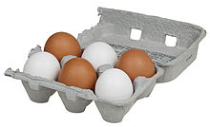
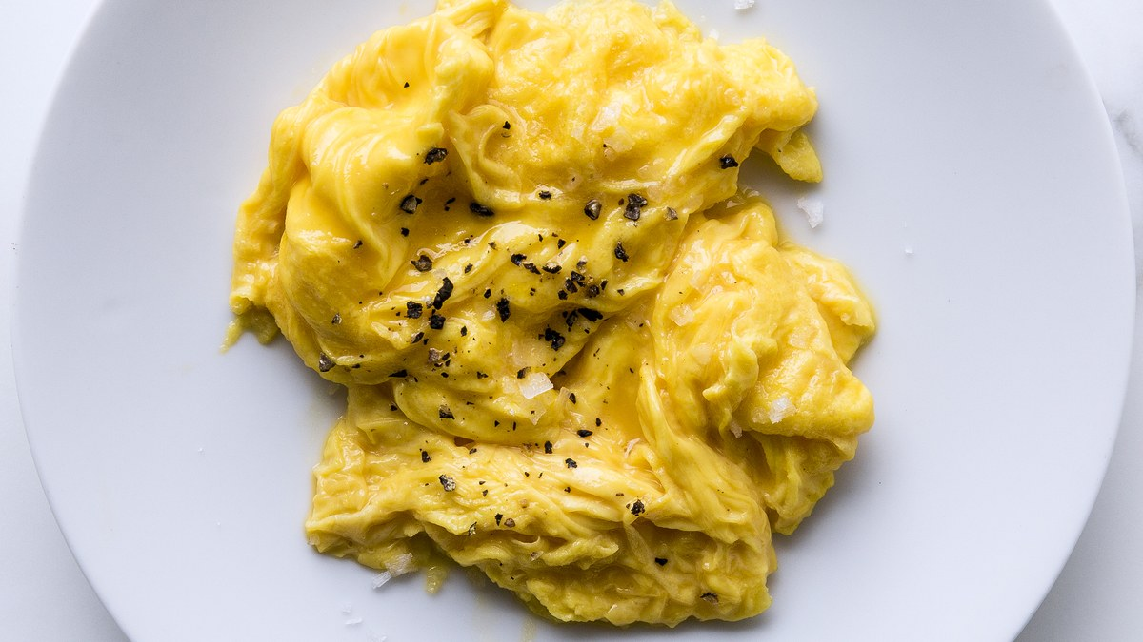
Cryptographic Hash Functions
Easy
x
Hard
H(x)

Slide 66
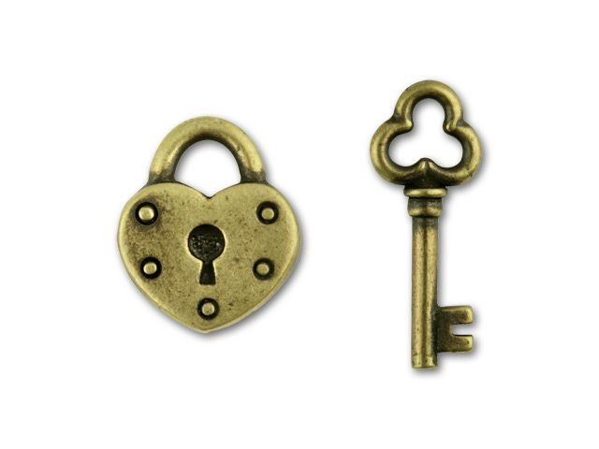
Hashlock
Secret s
Hashlock H(s)
Contract
I know H(s), will pay $$$ if you provide s

Slide 67
Carol Has a Secret
s
h = H(s)

Slide 68
Settlement
Alice, my hashlock is h. if you learn the matching secret, exchange is settled.
Carol’s hashlock is h

Slide 69
Settlement
Here is 100 BTC that I will pay Bob if he produces a secret matching h

Slide 70
Settlement
pay 100 to Bob hashlock h

Slide 71
Settlement
Here is 100 BTC that I will pay Carol if she produces a secret matching h
pay 100 to Bob hashlock h

Slide 72
Settlement
pay 100 to Bob hashlock h
pay 100 to Carol
hashlock h

Slide 73
Settlement
the secret is s
pay 100 to Bob hashlock h
pay 100 to Carol
hashlock h

Slide 74
Settlement
the secret is s
pay 100 to Bob hashlock h
pay 100 to Carol
hashlock h

Slide 75
Settlement
I just learned s
pay 100 to Bob hashlock h

Slide 76
Settlement
I just learned s
pay 100 to Bob hashlock h

Slide 77
Settlement Complete

Slide 78
Oh, Wait …
pay 100 to Bob hashlock h
pay 100 to Carol
hashlock h

Slide 79
Oh, Wait …
My money is
locked up forever!
My money is
locked up forever!
pay 100 to Bob hashlock h
pay 100 to Carol
hashlock h

Slide 80
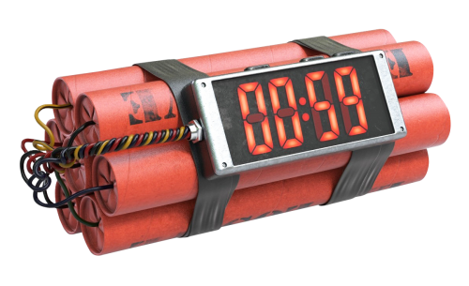
Timelock
Contract
If secret not provided before time t, will refund to source!

Slide 81
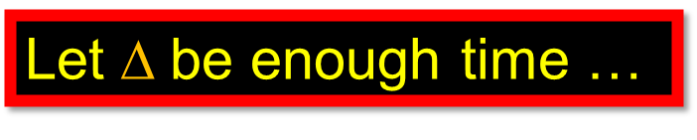
Synchrony
$\text{Let} $be enough time …
to publish a txn on the blockchain
and for everyone to notice it
can be large because …
only matters when things go wrong

Slide 82
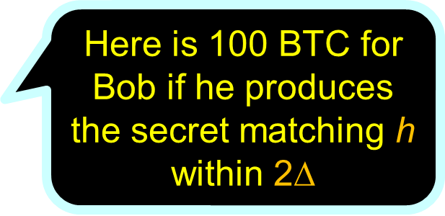
Settlement
Here is 100 BTC for Bob if he produces the secret matching h within 2$$

Slide 83

Settlement
pay 100 to Bob hashlock h
timelock 2$$

Slide 84
Settlement
pay 100 to Bob hashlock h
timelock 2$$

Slide 85
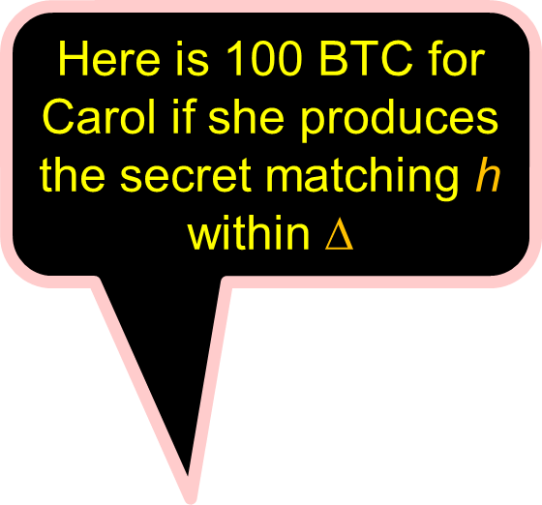
Settlement
Here is 100 BTC for Carol if she produces the secret matching h within $$
pay 100 to Bob hashlock h
timelock 2$$

Slide 86

Settlement
pay 100 to Bob hashlock h
timelock 2$$
pay 100 to Carol hashlock h
timelock $$

Slide 87
Settlement
pay 100 to Bob hashlock h
timelock 2$$
pay 100 to Carol hashlock h
timelock $$

Slide 88
Settlement
TIMEOUT!
pay 100 to Bob hashlock h
timelock 2$$
pay 100 to Carol hashlock h
timelock $$

Slide 89
Settlement
pay 100 to Bob hashlock h
timelock 2$$
pay 100 to Carol hashlock h
timelock $$
TIMEOUT!

Slide 90
Settlement
pay 100 to Bob hashlock h
timelock 2$$
pay 100 to Carol hashlock h
timelock $$
TIMEOUT!

Slide 91
All Good
pay 100 to Bob hashlock h
timelock 2$$
pay 100 to Carol hashlock h
timelock $$
TIMEOUT!

Slide 92
Settlement
pay 100 to Bob hashlock h
timelock 2$$
pay 100 to Carol hashlock h
timelock $$

Slide 93
Settlement
the secret is s
pay 100 to Bob hashlock h
pay 100 to Carol
hashlock h

Slide 94
Settlement
pay 100 to Bob hashlock h
TIMEOUT!

Slide 95
All Good
You snooze, you lose
What if Bob was victim of DoS?
Is it fair to punish him?

Slide 96
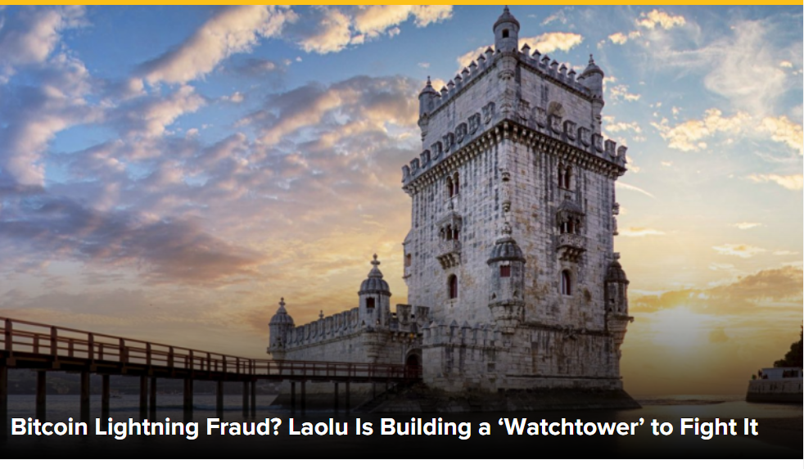
Watchtowers
Participants have to watch the blockchain all the time
When a hashlock is unlocked …
You have to react in time …
Or you lose your stake.
Burdensome

Slide 97
Watchtowers
A watchtower is a service …
That will watch the blockchain for you …
And forward revealed secrets as needed
It does not know any of your secrets
and cannot betray you

Slide 98
Lightning Network
I’m Alice and I want to do business with David
I’m David and I want to do business with Alice

Slide 99
Lightning Network will Find a Way
I’m Carol
I’m Bob

Slide 100
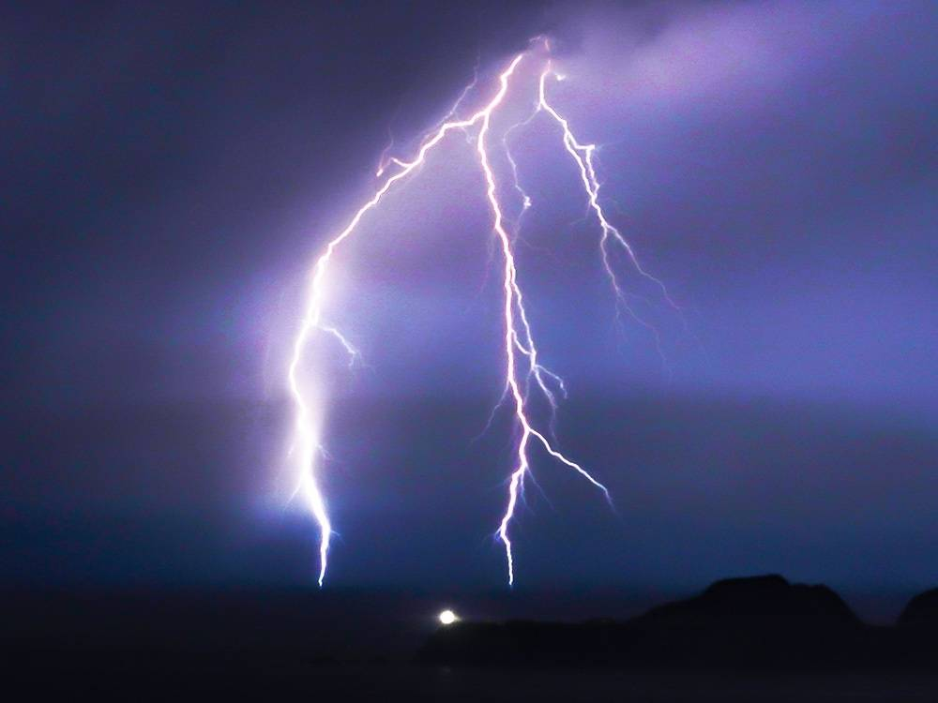
Lightning Network
Alice sends multiple micro-transactions to David
Settlement:
Find channel route from Alice to David
Use generalization of 3-party protocol to settle
Timed Hashlocked contracts

Slide 101
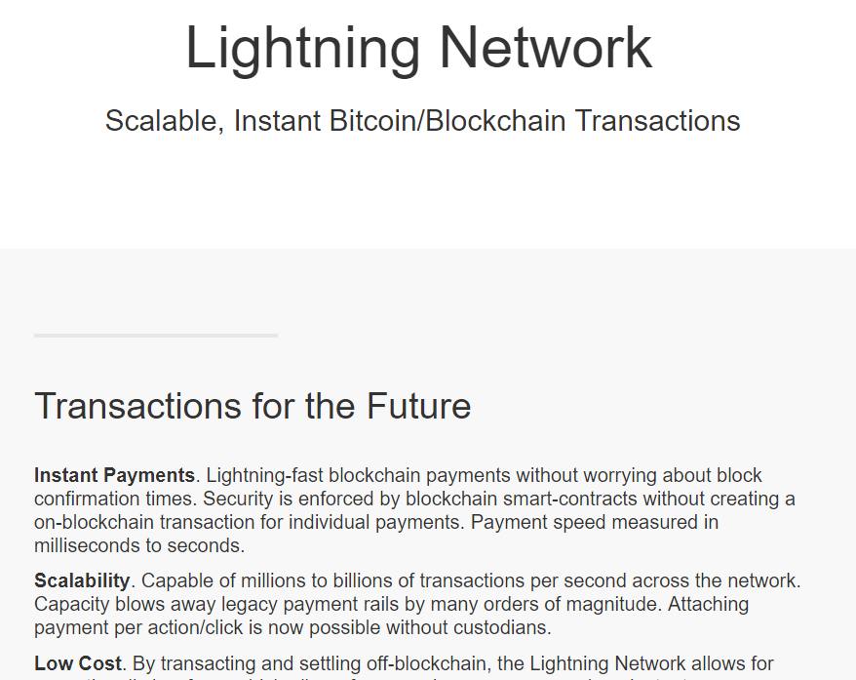
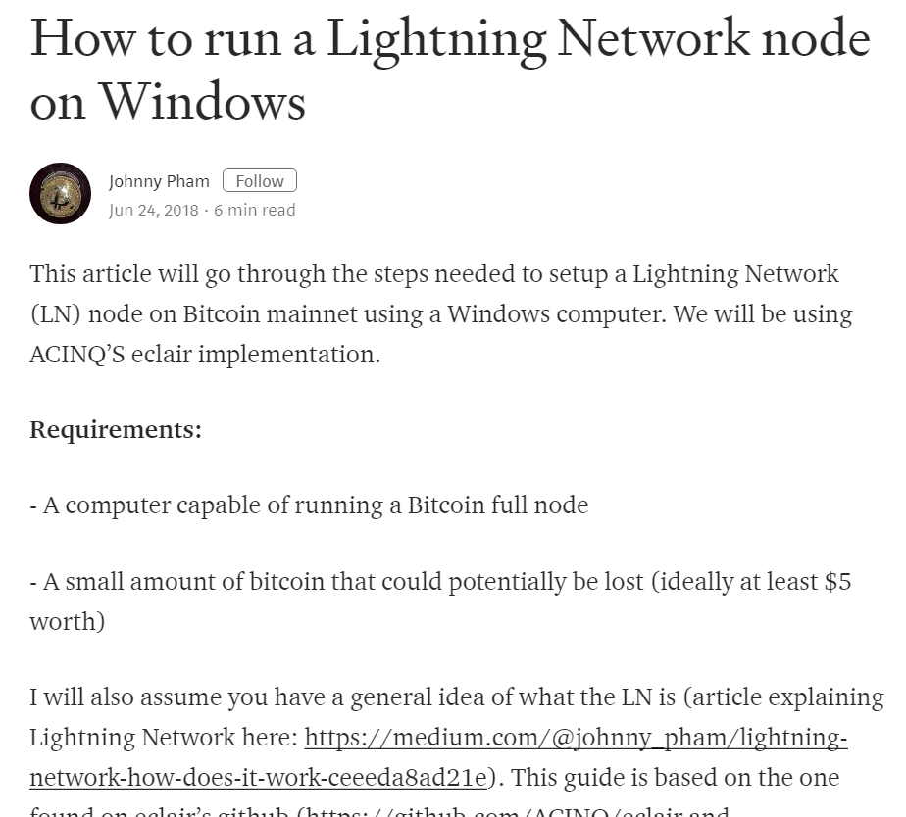
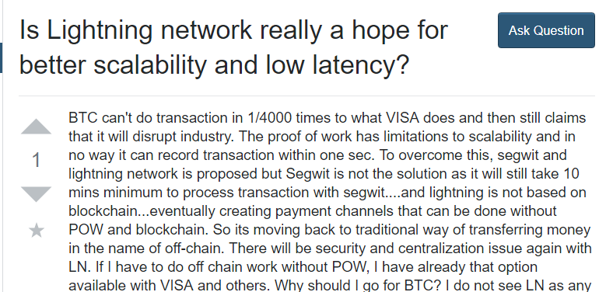
Lightning Network is a Thing
Lightning network touted as Bitcoin’s best hope …
to become an actual coin (medium of exchange) …
instead of merely a speculative instrument!
Poor latency and throughput don’t mater if blockchain is settlement-only

Slide 102
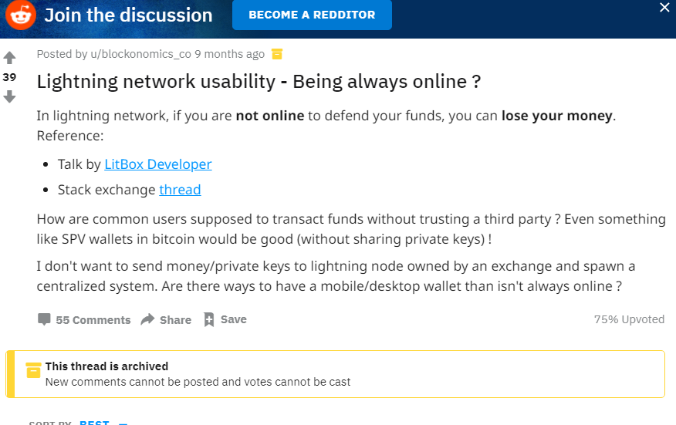
Concerns: Eternal Vigilance
Nodes must be on-line all the time to protect against fraudulent channel closing
ok watchtowers but who really wants that?
Security concerns: keys in hot storage

Slide 103
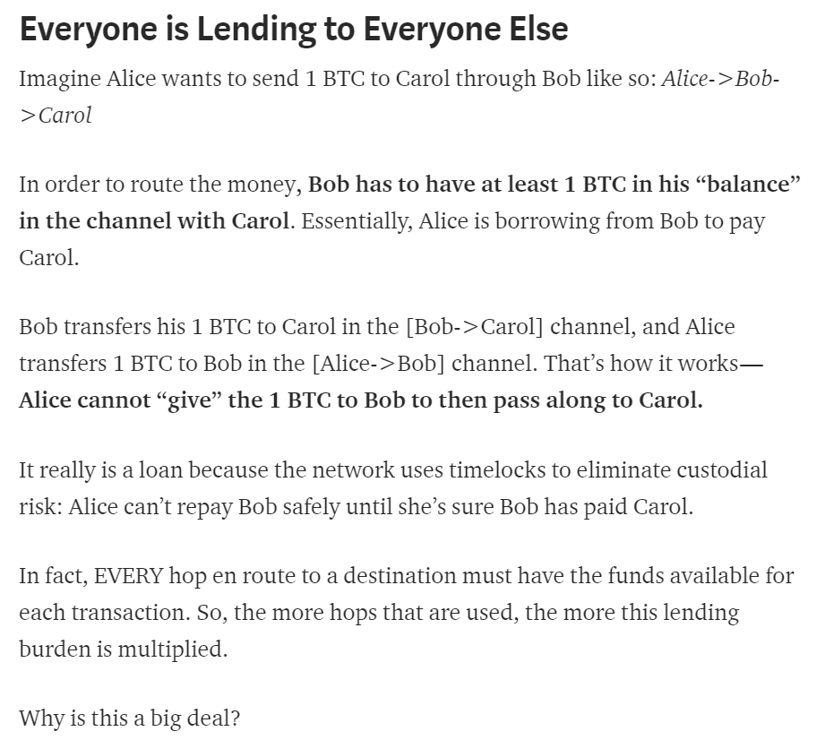
Concerns: Economic Model
Makes sense only when endpoints have frequent exchanges
Must have O(N k) coins tied up in channels
Counterparty misbehavior can leave coins locked up for a long time
Could network fees rival blockchain fees?

Slide 104
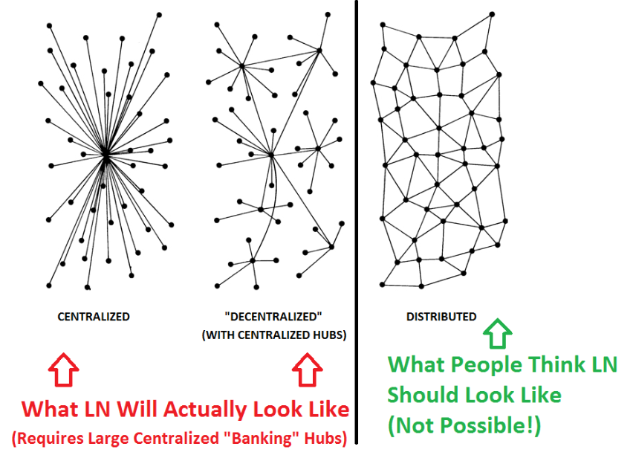
Concern: Centralization
Routing is hard
You can’t just “link in”, you need a payment channel
You have to have capital to run a channel
Channel capacities degrade, must be refreshed
Longer the route, larger chance of delay
Most natural structure is centralized star

Slide 105
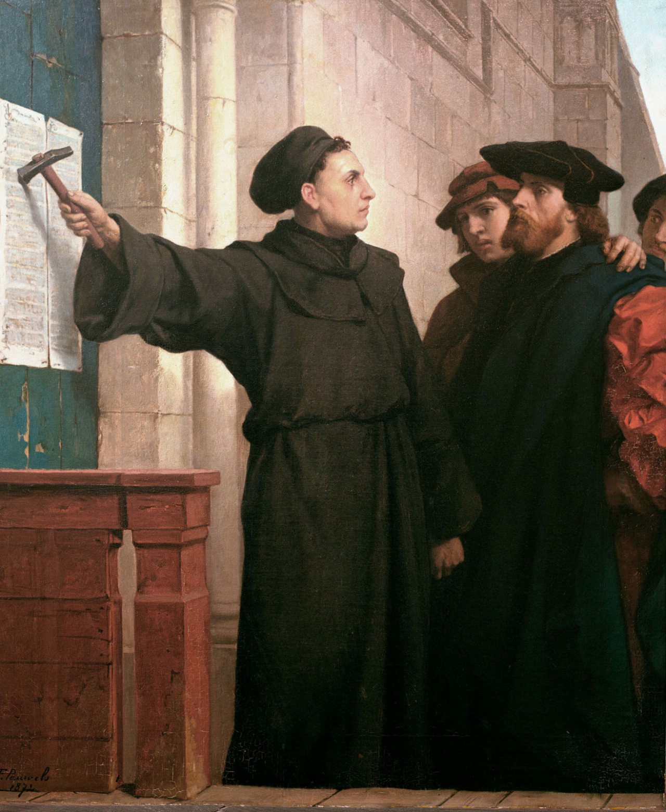
Ideas we covered in this lecture
Can off-chain txns save BTC?
Phases: setup, exchange, settlement
Channels: unidirectional. bidirectional, multi-party
Hashlocks and timelocks
Watchtowers
Lightning network

Slide 106
