Slide 1
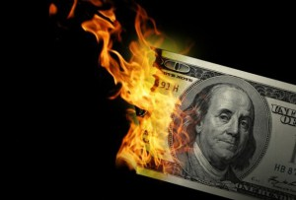
CS1951 L
Blockchains & Cryptocurrencies
Spring 2024
Lecture 18
Privacy Coins
Maurice Herlihy
Brown University

Slide 2
Zero Knowledge Proofs
I know how to solve a puzzle …
I want to prove to you I know a solution
Without revealing that solution!

Slide 3
1
5
7
Sudoku
1
6
8
2
3
8
6
4
9 X 9 array of cards
9
4
5
6
7
Some face-up
4
7
8
3
7
3
2
6
4
Some face-down
4
8
1
9
Challenge:
Identify face-down!
1
7
2
8
5
3
7

Slide 4
1
5
7
Sudoku Rules
1
6
8
2
Each row has …
3
8
6
4
9
4
5
6
7
4
7
8
3
7
3
2
6
4
4
8
1
9
1
7
2
8
5
3
7

Slide 5
1
5
7
Sudoku Rules
1
6
8
2
Each row has …
3
7
5
8
6
2
9
4
1
9
4
5
6
7
Each digit once
4
7
8
3
7
3
2
6
4
4
8
1
9
1
7
2
8
5
3
7

Slide 6
1
5
7
Sudoku Rules
1
6
8
2
Each column
has …
3
8
6
4
9
4
5
6
7
4
7
8
3
7
3
2
6
4
4
8
1
9
1
7
2
8
5
3
7

Slide 7
2
1
5
7
Sudoku Rules
1
9
6
8
2
Each column
has …
3
7
8
6
4
9
8
4
5
6
7
6
4
7
8
3
Each digit once
7
3
2
6
4
4
8
1
9
1
7
2
8
5
3
7

Slide 8
1
5
7
Sudoku Rules
1
6
8
2
Each square
has …
3
8
6
4
9
4
5
6
7
4
7
8
3
7
3
2
6
4
4
8
1
9
1
7
2
8
5
3
7

Slide 9
1
5
9
7
Sudoku Rules
1
6
3
7
4
8
2
Each square
has …
3
8
6
2
4
9
4
5
6
7
4
7
8
3
Each digit once
7
3
2
6
4
4
8
1
9
1
7
2
8
5
3
7

Slide 10
1
5
7
Hi, I’m Victoria
(the verifier)
1
6
8
2
3
8
6
4
9
4
5
6
7
4
7
8
3
7
3
2
6
4
Hi, I’m Peter
(the prover)
4
8
1
9
1
7
2
8
5
3
7

Slide 11
I will pay you for a solution to this puzzle
1
5
7
1
6
8
2
3
8
6
4
9
4
5
6
7
4
7
8
3
7
3
2
6
4
I know a solution!
4
8
1
9
1
7
2
8
5
3
7

Slide 12
1
5
7
Show me, and I’ll pay
1
6
8
2
3
8
6
4
9
4
5
6
7
4
7
8
3
7
3
2
6
4
Pay me, and I’ll show
4
8
1
9
1
7
2
8
5
3
7

Slide 13
1
5
7
1
6
8
2
3
8
6
4
9
4
5
6
7
4
7
I will prove I know a solution without revealing anything about it !
8
3
7
3
2
6
4
4
8
1
9
1
7
2
8
5
3
7

Slide 14
Why should I believe you?
1
5
7
1
5
7
1
6
8
2
1
6
8
2
3
8
6
4
3
8
6
4
9
4
5
6
7
9
4
5
6
7
Here is my solution on a new set of cards
4
7
8
3
4
7
8
3
7
3
2
6
4
7
3
2
6
4
4
8
1
9
4
8
1
9
1
7
2
8
1
7
2
8
Challenge me!
5
3
7
5
3
7

Slide 15
I randomly challenge …
1
5
7
1
5
7
1
6
8
2
1
6
8
2
3
8
6
4
3
8
6
4
9
4
5
6
7
9
4
5
6
7
4
7
8
3
4
7
8
3
7
3
2
6
4
7
3
2
6
Pick rows, columns, or squares!
4
4
8
1
9
4
8
1
9
1
7
2
8
1
7
2
8
5
3
7
5
3
7

Slide 16
1
5
7
Rows!
1
5
7
1
6
8
2
1
6
8
2
3
8
6
4
3
8
6
4
9
4
5
6
7
9
4
5
6
7
4
7
8
3
4
7
8
3
7
3
2
6
4
Collect cards per-row
7
3
2
6
4
4
8
1
9
4
8
1
9
1
7
2
8
1
7
2
8
5
3
7
5
3
7

Slide 17
1
5
7
1
6
8
2
3
8
6
4
9
4
5
6
7
4
7
8
3
7
3
2
6
4
4
8
1
9
1
7
2
8
5
3
7

Slide 18
1
5
7
1
5
7
1
6
8
2
1
6
8
2
3
8
6
4
3
8
6
4
9
4
5
6
7
9
4
5
6
7
4
7
8
3
4
7
8
3
7
3
2
6
4
7
3
2
6
4
Shuffle each row
4
8
1
9
4
8
1
9
1
7
2
8
1
7
2
8
5
3
7
5
3
7

Slide 19
OMG! They’re all 1..9
1
5
7
6
7
8
9
1
6
8
2
6
7
8
9
3
8
6
4
6
7
8
9
9
4
5
6
7
6
7
9
But I learned nothing about the solution
8
4
7
8
3
6
7
8
9
7
3
2
6
4
6
7
8
9
Told you!
4
8
1
9
6
7
8
9
1
7
2
8
6
7
8
9
5
3
7
6
7
8
9

Slide 20
1
5
7
Rewind, Reload
1
5
7
1
6
8
2
1
6
8
2
3
8
6
4
3
8
6
4
9
4
5
6
7
9
4
5
6
7
4
7
8
3
4
I don’t actually know a solution, but I guess Victoria will challenge me on rows
7
8
3
7
3
2
6
4
7
3
2
6
4
4
8
1
9
4
8
1
9
1
7
2
8
1
7
2
8
5
3
7
5
3
7

Slide 21
1
5
7
2
3
4
1
5
6
8
7
9
1
6
8
2
1
2
6
3
4
5
8
2
7
3
8
6
4
3
1
2
8
6
5
7
4
8
9
4
5
6
7
9
1
2
4
3
8
5
6
7
4
7
Fill in rows (easy) and don’t bother with columns and squares …
8
3
1
2
4
7
5
8
3
6
9
7
3
2
6
4
7
3
2
1
5
6
8
9
4
4
8
1
9
2
4
3
4
8
1
5
6
9
1
7
2
8
3
1
7
4
5
6
2
9
8
5
3
7
1
5
2
4
3
7
6
8
9

Slide 22
1
5
7
Row!
1
5
7
1
6
8
2
1
6
8
2
3
8
6
4
3
8
6
4
9
4
5
6
7
9
4
5
6
7
4
7
8
3
4
7
8
3
7
3
2
6
4
Bingo!
7
3
2
6
4
4
8
1
9
4
8
1
9
1
7
2
8
1
7
2
8
5
3
7
5
3
7

Slide 23
OMG! They’re all 1..9
1
5
7
6
7
8
9
1
6
8
2
6
7
8
9
3
8
6
4
6
7
8
9
9
4
5
6
7
6
7
8
9
4
7
8
3
6
7
8
9
7
3
2
6
4
6
7
8
9
Heh-heh
4
8
1
9
6
7
8
9
1
7
2
8
6
7
8
9
5
3
7
6
7
8
9

Slide 24
1
5
7
1
5
7
Repeat challenge multiple times
1
6
8
2
1
6
8
2
3
8
6
4
3
8
6
4
9
4
5
6
7
9
4
5
6
7
4
7
8
3
Each time I cheat, I get away with it with probability 1/3
4
7
8
3
7
3
2
6
4
7
3
2
6
4
4
8
1
9
4
8
1
9
1
7
2
8
1
7
2
8
5
3
7
5
3
7

Slide 25
1
5
7
2
3
4
1
5
6
8
7
9
1
6
8
2
1
2
6
3
4
5
8
2
7
3
8
6
4
3
1
2
8
6
5
7
4
8
9
4
5
6
7
9
1
2
4
3
8
5
6
7
I don’t know solution,
But I guess Victoria will pick “row”
4
7
8
3
1
2
4
7
5
8
3
6
9
7
3
2
6
4
7
3
2
1
5
6
8
9
4
4
8
1
9
2
4
3
4
8
1
5
6
9
1
7
2
8
3
1
7
4
5
6
2
9
8
5
3
7
1
5
2
4
3
7
6
8
9

Slide 26
1
5
7
Column!
1
5
7
1
6
8
2
1
6
8
2
3
8
6
4
3
8
6
4
9
4
5
6
7
9
4
5
6
7
4
7
8
3
4
7
8
3
7
3
2
6
4
Busted!
7
3
2
6
4
4
8
1
9
4
8
1
9
1
7
2
8
1
7
2
8
5
3
7
5
3
7

Slide 27
1
5
7
Wait, what? These cards don’t add up!
1
6
8
2
3
8
6
4
9
4
5
6
7
4
7
8
3
7
3
2
6
4
foiled again!
4
8
1
9
1
7
2
8
5
3
7
9
8
7
8
8
9
7
9
9

Slide 28
After k successful challenges…
1
5
7
1
5
7
1
6
8
2
1
6
8
2
3
8
6
4
3
8
6
4
9
4
5
6
7
9
4
5
6
7
4
7
8
3
4
7
8
3
Probability of fooling Victoria is 1/3^{k}
7
3
2
6
4
7
3
2
6
4
4
8
1
9
4
8
1
9
1
7
2
8
1
7
2
8
5
3
7
5
3
7

Slide 29
Accumulators
A data structure that lets you …
Query whether an item is in a set
Without revealing anything else about the set!

Slide 30



Accumulators
Given a set X:
A(
) = true
Membership test A(x)
A(
) = false
A(x) easy to compute
Hard to recover X from A

Slide 31
Accumulator Example
Product of large primes: p₁^{x} p₂^{y} p₃^{z} …
Easy to check whether prime p is a factor
Hard to tell which other primes are factors

Slide 32
Commitment
I pick a value now
Later I want to prove I picked that value then

Slide 33


Commitment
Hi, I’m Alice
Bob here

Slide 34
Commitment
We have a dispute!
Let’s settle by flipping a coin

Slide 35
Commitment
I’ll call, you flip
How does that work?

Slide 36
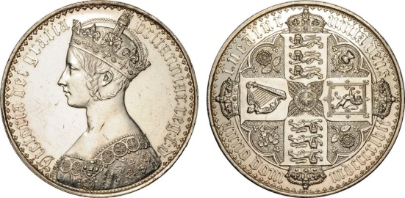
Commitment

Slide 37
Commitment
I call heads
I can’t see that call

Slide 38
Commitment
Put call in box …

Slide 39
Commitment
Lock that box …

Slide 40
Commitment
Now to perform actual flip

Slide 41
Commitment
I flipped tails

Slide 42
Commitment
He flipped tails
She called heads

Slide 43
Commitment
I won
I lost

Slide 44

Making Zerocoin
Zerocoin: mixing is “baked in”
Coins have value once on blockchain
Publishing on blockchain costs 1 BTC

Slide 45
Zerocoin
Mixing is “baked in” to protocol
Advantage: only trust crypto
Don’t need to trust other players
Less efficient than Bitcoin
But more efficient than you might think

Slide 46
Zerocoin
Zerocoin lives with BTC-like basecoin
Basecoin ≠ BTC, but OK to pretend it is
Convertible: like USD and poker chips
Conversion breaks link

Slide 47
Zerocoin
I owned a Basecoin
Then I burned it
I have a proof I burned it
That proof is redeemable for a new Basecoin

Slide 48
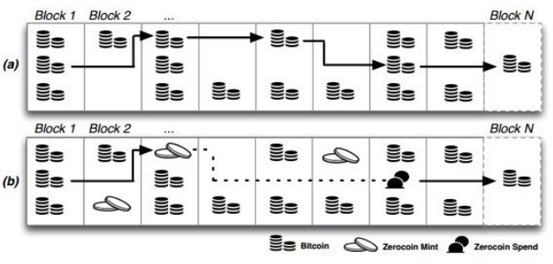
Bitcoin & Zerocoin Transaction Graphs

Slide 49
Tricky Part
How to prove I burned a Basecoin?
How to prevent double-spending proof?

Slide 50
Minting a Zerocoin
Pick random secret r (never released)
Pick long random serial # S for new zerocoin
Create commitment
C = hash(S,r)
(assume single denomination)

Slide 51
Minting a Zerocoin
Anyone can mint a zerocoin
By itself, zerocoin is worthless
Has value only if put on blockchain
That will cost you one Basecoin

Slide 52

Mint Txn
Signed by Alice
Input: 1 Basecoin Output: Hash(S,r)
BTC-like Blockchain
I just burned 1 Basecoin to create a Zerocoin

Slide 53
I want to spend my Zerocoin
Mint Txn
Signed by Alice
Input: 1 Basecoin Output: Hash(S,r)
Reveal S so no double-spending
ZK proof that
“I know some r such that H(S,r) is on the chain”
Pick any Zerocoin as input

Slide 54
Spend Txn
Serial: S
ZK-Proof
Input: 1 Basecoin Output: Alice
Mint Txn
Signed by Alice
Input: 1 Basecoin Output: Hash(S,r)
Make sure S not spent earlier

Slide 55
How is this Anonymous?
Mint Txn
Mint Txn
Mint Txn
h₁
h₂
h_{K}
…
Without r, cannot tell which h_{i}=hash(S,r)

Slide 56
Efficiency
I know r such that
Large statement
O(# coins)
H(S,r) = h₁
or
H(S,r) = h₂
or
But proof is
O(log # coins) size!
…
or
H(S,r) = h_{K}

Slide 57

Zcash
Successor to Zerocoin (2016)
Merges basecoin & zerocoin
Splits txns into public & shielded

Slide 58
Zcash
Replaces
Zero-knowledge proofs with
zk-SNARKs (more efficient)
Miners check validity, learn nothing else

Slide 59
Zcash
Bitcoin-like chain
UTXOs
Equihash PoW
ASIC-resistant
Coinbase rewards, fixed supply like BTC

Slide 60
Zcash Transactions
Transparent
Public, like Bitcoin
Shielded
Private: sender, receive, amount hidden

Slide 61
Shielded Transactions
Create shielded address
Public-private key pair
zk-SNARK: proof sender has enough money, but no other info
Private: sender, receive, amount hidden

Slide 62
Zcash Transaction Types

Slide 63
Zcash Transaction Types
Shielded-to-shielded
Txn appears on-chain
But sender, recipient, amount hidden

Slide 64
Zcash Transaction Types
Transparent-to-transparent
Same as Bitcoin
Sender, recipient, amount visible

Slide 65
Zcash Transaction Types
unlinkable

Slide 66

Monero
All transactions private
Uses “ring signatures” for anonymity
Signatures mixed together
Can’t distinguish actual signer from decoys
“stealth addresses” disguise txn targets

Slide 67
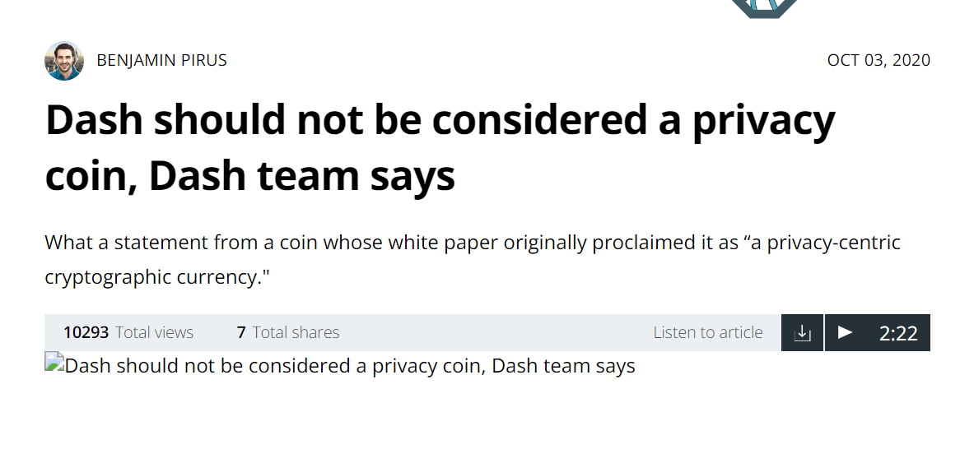
DASH
Once touted as privacy coin
Provides optional built-in CoinJoin
Much weaker than Zcash, Monero

Slide 70
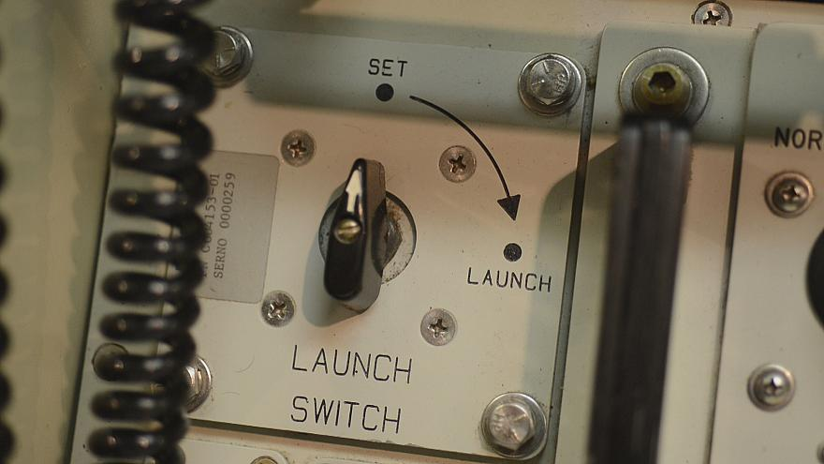
What’s the Catch?
Public parameters generated by …
Random secret inputs (gigabyte size)
Those inputs must be destroyed!
Anyone who knows inputs can counterfeit coins
Undetectably

Slide 71
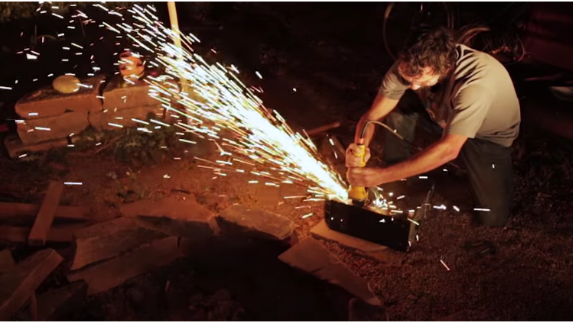
Initialization “Ceremony”
Different people create parts of parameters
Must destroy inputs without revealing
OK if even one person destroys
If all collude, undetectable counterfeiting
And maybe also privacy compromised

Slide 72
Initialization “Ceremony”
6 participants, undisclosed locations
“air gapped” computers generate pieces
Bought new, removed WIFI, Bluetooth
Input: write-once DVDs
Permanent record of inputs
Message hashes published on
Twitter, BTC blockchain
Secure Linux kernel …

Slide 73
Privacy Options
 | Type | Attacks | status
Bitcoin | Pseudonymous | Txn graph analysis | default
Single mix | Mix | Txn graph analysis, bad mixers | Available BTC
Mix chain (centralized or not) | Mix | Side channels, bad mixers | Available BTC
Zerocoin | Crypto mix | Side channels maybe | Altcoin
Zcash | Untraceable | None known | Tricky setup

Slide 74





Modern Privacy Coins

Slide 75
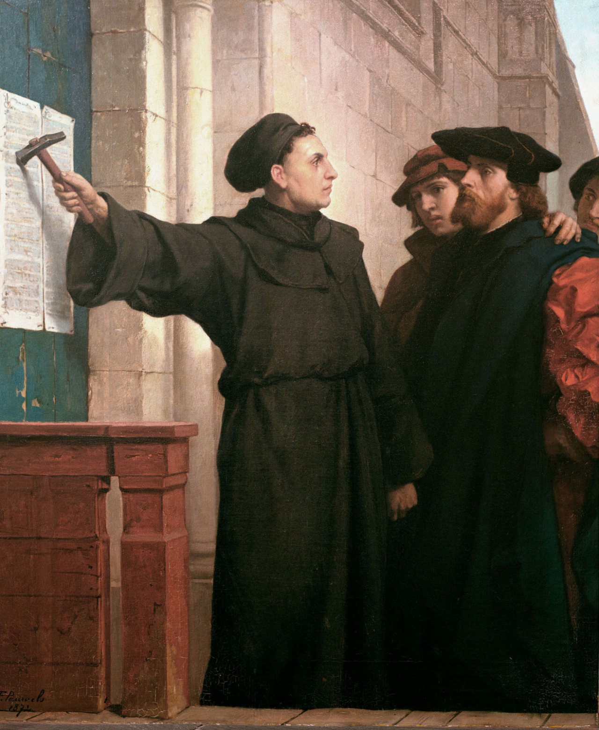
Ideas we covered in this lecture
Zero Knowledge
ZK Accumulators
ZeroCoin (+ BTC)
Zcash (no BTC)
Initialization Ceremony

Slide 76
ZCash
Zero Knowledge
ZK Accumulators
ZeroCoin (+ BTC)
Zcash (no BTC)
Initialization Ceremony

