Slide 1
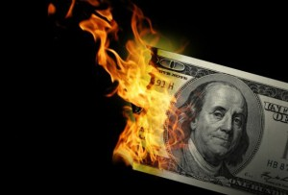
CS1951 L
Blockchains & Cryptocurrencies
Spring 2024
Lecture 18
Cross-chain Swaps
Maurice Herlihy
Brown University

Slide 2
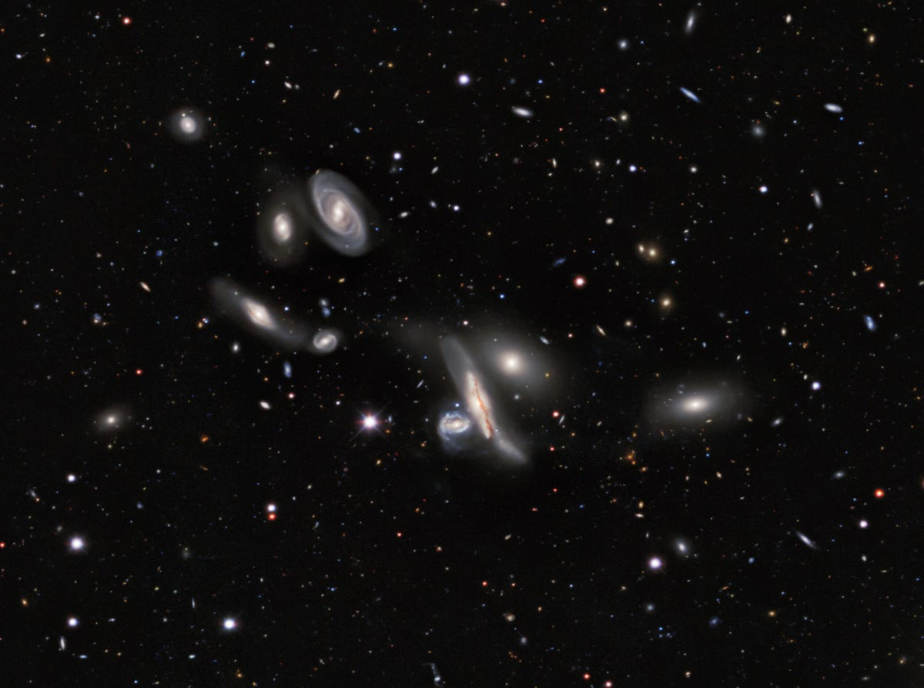
In the Future …
bitcoin
cardano
algorand
celo
ethereum
There will be many chains
Notes:
I the future, the world’s assets will be managed by multiple tamper-proof distributed ledgers, often called blockchains. There will never be one ledger to rule them all because different organizations will want to control their own blockchains.

Slide 3
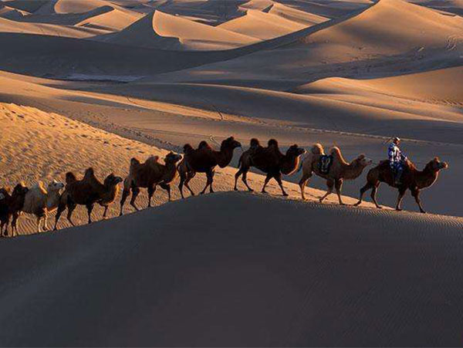
Cross-chain commerce
“Decentralized Finance”
This is a distributed computing problem
Notes:
That said, the ability for blockchains to interoperate will become crucial. The art of conducting commerce and transferring value across multiple blockchains has come to be known as decentralized finance, or DeFi for short.

Slide 4

Mutual benefit if we co-operate
But we don’t trust each other
No recourse to civil institutions
The oldest economic problem?
Distributed Computing’s most important problem?

Slide 5


Carol
has
wants

Slide 6

Alice
has
wants

Slide 7
Bob
has
wants

Slide 8



Slide 10
Three-Way Swap?
If all parties conform to protocol…
All swaps happen
If some parties deviate…
No conforming party ends up worse off.

Slide 11
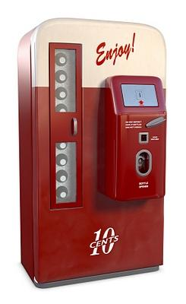
Smart Contracts
Not smart
Not contracts
Scripts on chain

Slide 12
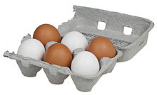
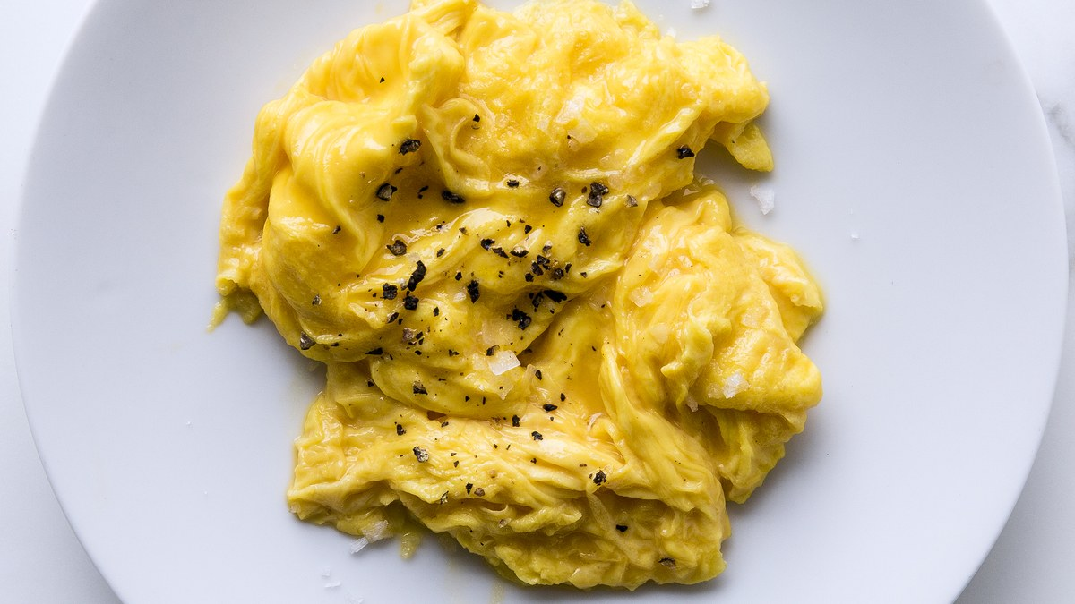
Cryptographic Hash Functions
Easy
x
Hard
H(x)

Slide 13
Two Approaches
Hashed Timelock Contracts
Token Bridges

Slide 14
Hash Locks and Time Locks

Slide 15

Hashlock
Secret s
Hashlock H(s)
Contract
I know H(s), will pay $$$ if you provide s

Slide 16
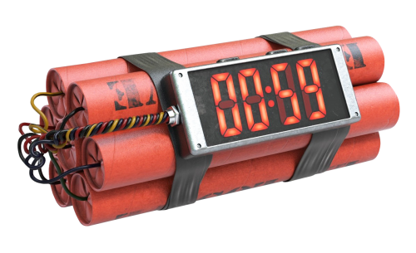
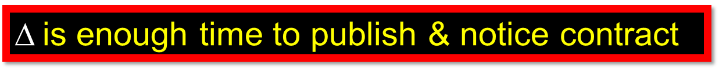
Time lock
Contract
But if secret not provided before t, refunds for everyone!
$$is enough time to publish & notice contract

Slide 17
Alice Has a Secret
s
H(s)
Time: t

Slide 18
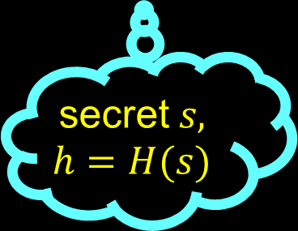
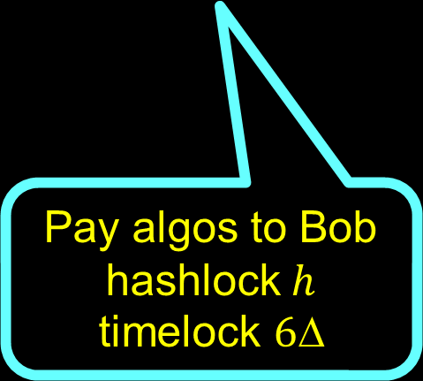
Alice Publishes Contract with Bob
Pay algos to Bob
hashlock$h$
$$\text{time}\text{lock} 6Δ$$
$$\text{secret} s,$$
$$h=H(s)$$

Slide 19
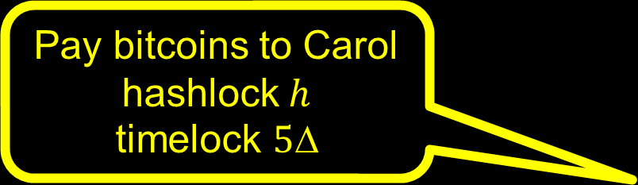

Bob Publishes Contract with Carol
Pay bitcoins to Carol
hashlock$h$
$$\text{time}\text{lock} 5Δ$$
Time: t$+2$

Slide 20
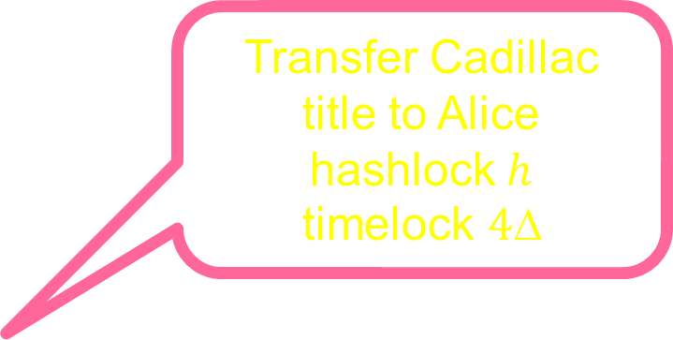

Carol Publishes Contract with Alice
Transfer Cadillac title to Alice
hashlock$h$
$$\text{time}\text{lock} 4Δ$$
Time: t$+3$

Slide 21



Alice Triggers Contract with Carol
reveal $s$
$$\text{learn} s$$
Time: t$+4$

Slide 22




Carol Triggers Contract with Bob
$$\text{learn} s$$
reveal $s$
Time: t$+5$

Slide 23


Bob Triggers Contract with Alice
reveal $s$
Time: t$+6$

Slide 24
Timeouts?

Slide 25
Timeouts?
Refund!
Refund!
Refunds for all
C

Slide 26
Crashes?
B
Timeout, refund!!
Only faulty party loses

Slide 27
Contract Deployment Order?

Slide 28
Contract Deployment Order?
???!!!!

Slide 29
Timelock Miscalculation
???!!!!
Timeout!
5Δ
Reveal s
5Δ

Slide 30
Irrational Behavior
Reveal s
prematurely
No Cadillac for you!

Slide 31
Atomic Swap Protocol
If all parties conform, all swaps take place
If some parties deviate, no conforming party “worse off”
No coalition has an incentive to deviate

Slide 32
Questions
When is this even possible?
How can we do this?
How much does it cost?

Slide 33
Digraphs

Slide 34
Vertex

Slide 35
Arc

Slide 36
Path

Slide 37
Cycle

Slide 38
Reachable

Slide 39
Strongly Connected
Every vertex reachable from every other

Slide 40
Feedback Vertex Set
Removal breaks all cycles

Slide 41
Blockchain
Distributed Ledger
Clients publish transactions
Smart Contracts
Which chain unimportant

Slide 42
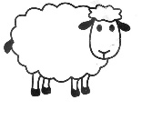






Swap Digraph
Alice
Bob
Felix
David
Carol
Ellen

Slide 43
Swap
party
Proposed asset transfer
party

Slide 44

A swap is a cooperative game
A protocol is a strategy for that game
Parties can form coalitions, committing to common strategy
Result is payoff

Slide 45
What does “worse off” mean?

Slide 46
FreeRide
Payoffs
At least one entering arc triggered
No leaving arc triggered
Something for nothing

Slide 47
Discount
Payoffs
All entering arcs triggered
Some leaving arc not triggered
Cheaper than expected

Slide 48
Deal
Payoffs
All entering arcs triggered
All leaving arcs triggered
Successful Deal

Slide 49
NoDeal
Payoffs
No entering arcs triggered
No leaving arcs triggered
Unsuccessful Deal

Slide 50
Underwater
Payoffs
Some entering arc not triggered
Some leaving arc triggered
Chaos

Slide 51

Payoffs
Payoffs
better
worse

Slide 52
Payoffs
Payoffs
better
Deal
NoDeal
worse
Otherwise, why join?

Slide 53
Payoffs
Payoffs
better
Discount
Deal
NoDeal
worse
Cheaper than expected!

Slide 54
Payoffs
Payoffs
better
Discount
FreeRide
Deal
NoDeal
worse
Something for nothing!

Slide 55
Payoffs
Payoffs
better
Discount
FreeRide
Deal
NoDeal
worse
Underwater

Slide 56
Payoffs
Payoffs
better
Discount
FreeRide
Deal
Acceptable
NoDeal
Unacceptable
worse
Underwater

Slide 57
Uniform Swap Protocol
If all parties conform, they finish with payoff Deal
If any coalition deviates, no conforming party finishes with payoff Underwater

Slide 58

Strong Nash Equilibrium
Everyone follows one strategy …
But if a coalition deviates…
It won’t improve its payoff

Slide 59
Theorem
If swap digraph is strongly connected, then parties have incentive to conform.
More precisely: conforming to any uniform swap protocol is a strong Nash Equilibrium

Slide 60
Theorem
If swap digraph is not strongly connected, then parties have no incentive to conform.
More precisely: conforming to any uniform swap protocol is never a strong Nash Equilbrium

Slide 61
Weakly Connected Swap Graph

Slide 62
Weakly Connected Swap Graph
Subgraph U

Slide 63
Weakly Connected Swap Graph
Subgraph V
Subgraph U

Slide 64
Weakly Connected Swap Graph
Arcs go from U to V, but not vice-versa
Subgraph V
Subgraph U

Slide 65
Weakly Connected Swap Graph
Arcs go from U to V, but not vice-versa
Subgraph V
Free Riders!
Subgraph U

Slide 66
Weakly Connected Swap Graph
Arcs go from U to V, but not vice-versa
Better payoff to pretend to pay parties in V
Subgraph V
Free Riders!
Subgraph U

Slide 67
Next
Let’s construct a protocol.

Slide 68
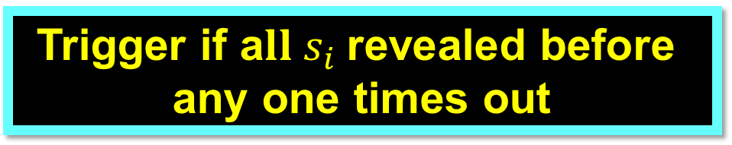
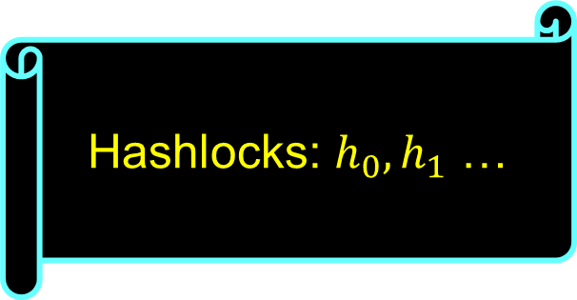
Hashlock vectors
Hashlocks: $h_{0},h_{1}$ …
Trigger if a$ll s_{i} \text{revealed} \text{before} \text{any} \text{one} \text{times} \text{out}$

Slide 69
Swap Graph

Slide 70
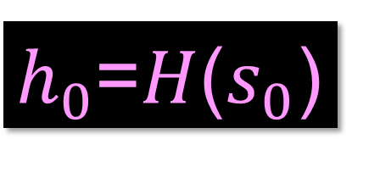
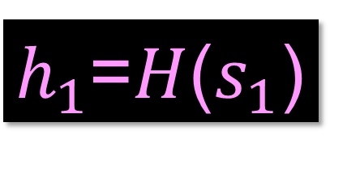
Swap Graph
$h_{0}$=$H$($s_{0}$)
$h_{1}$=$H$($s_{1}$)
Leaders know secrets

Slide 71
Swap Graph
Leaders form feedback vertex set

Slide 72
Theorem
Leaders must form a feedback vertex set

Slide 73



Swap Graph
Leader: publish contract on each outgoing arc
$h_{0}$=$H$($s_{0}$)
$h_{0}$,$h_{1}$
$h_{0}$,$h_{1}$
$h_{1}$=$H$($s_{1}$)
$h_{0}$,$h_{1}$

Slide 74
Swap Graph
Leader: publish contract on each outgoing arc
Wait for contracts on incoming arcs …
$h_{0}$=$H$($s_{0}$)
$h_{0}$,$h_{1}$
$h_{0}$,$h_{1}$
$h_{1}$=$H$($s_{1}$)
$h_{0}$,$h_{1}$

Slide 75
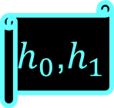



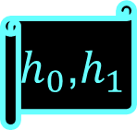
Non-Leaders
$h_{0}$,$h_{1}$
$h_{0}$,$h_{1}$
Wait for Contracts on all incoming arcs
$h_{0}$,$h_{1}$
$h_{0}$,$h_{1}$
Before publishing on outgoing arcs
$h_{0}$,$h_{1}$

Slide 76
Theorem
No other order works

Slide 77
Theorem
Every arc receives a contract in time O(diam(D))

Slide 78
We need to talk about Timeouts

Slide 79
reveal s_{i}
timeouts
A
C
B

Slide 80
reveal s_{i}
A
unlock h_{i} within Δ
C
B

Slide 81
A
C
B
reveal sig(s_{i} ,C)

Slide 82
A
unlock h_{i} within 2Δ
C
B
reveal sig(s_{i} ,C)

Slide 83
A
unlock h_{i} within 3Δ
C
B
reveal sig(s_{i} ,C,B)

Slide 84
How Timeouts Work
Secret s_{i} arrives along a path p from source
Each link is signed
Unlocks h_{i} if p is path from source, and received within time |p|Δ

Slide 85
Theorem
No compliant party ends up Underwater

Slide 86
Theorem
If all comply, swap finishes in time < O(diam D)

Slide 87
Theorem
Bits on blockchain: O(|L| × |A|), where L = set of leaders,
and A = set of arcs

Slide 88

Hedged Deals
Party who walks away pays a premium to others
How to identify who is guilty?
How to bootstrap escrow premiums?
Can hedging be automated?

Slide 89
Other Applications?
Cross-chain atomic transactions?
Off-chain transactions?
Off-chain atomic transactions?

Slide 90
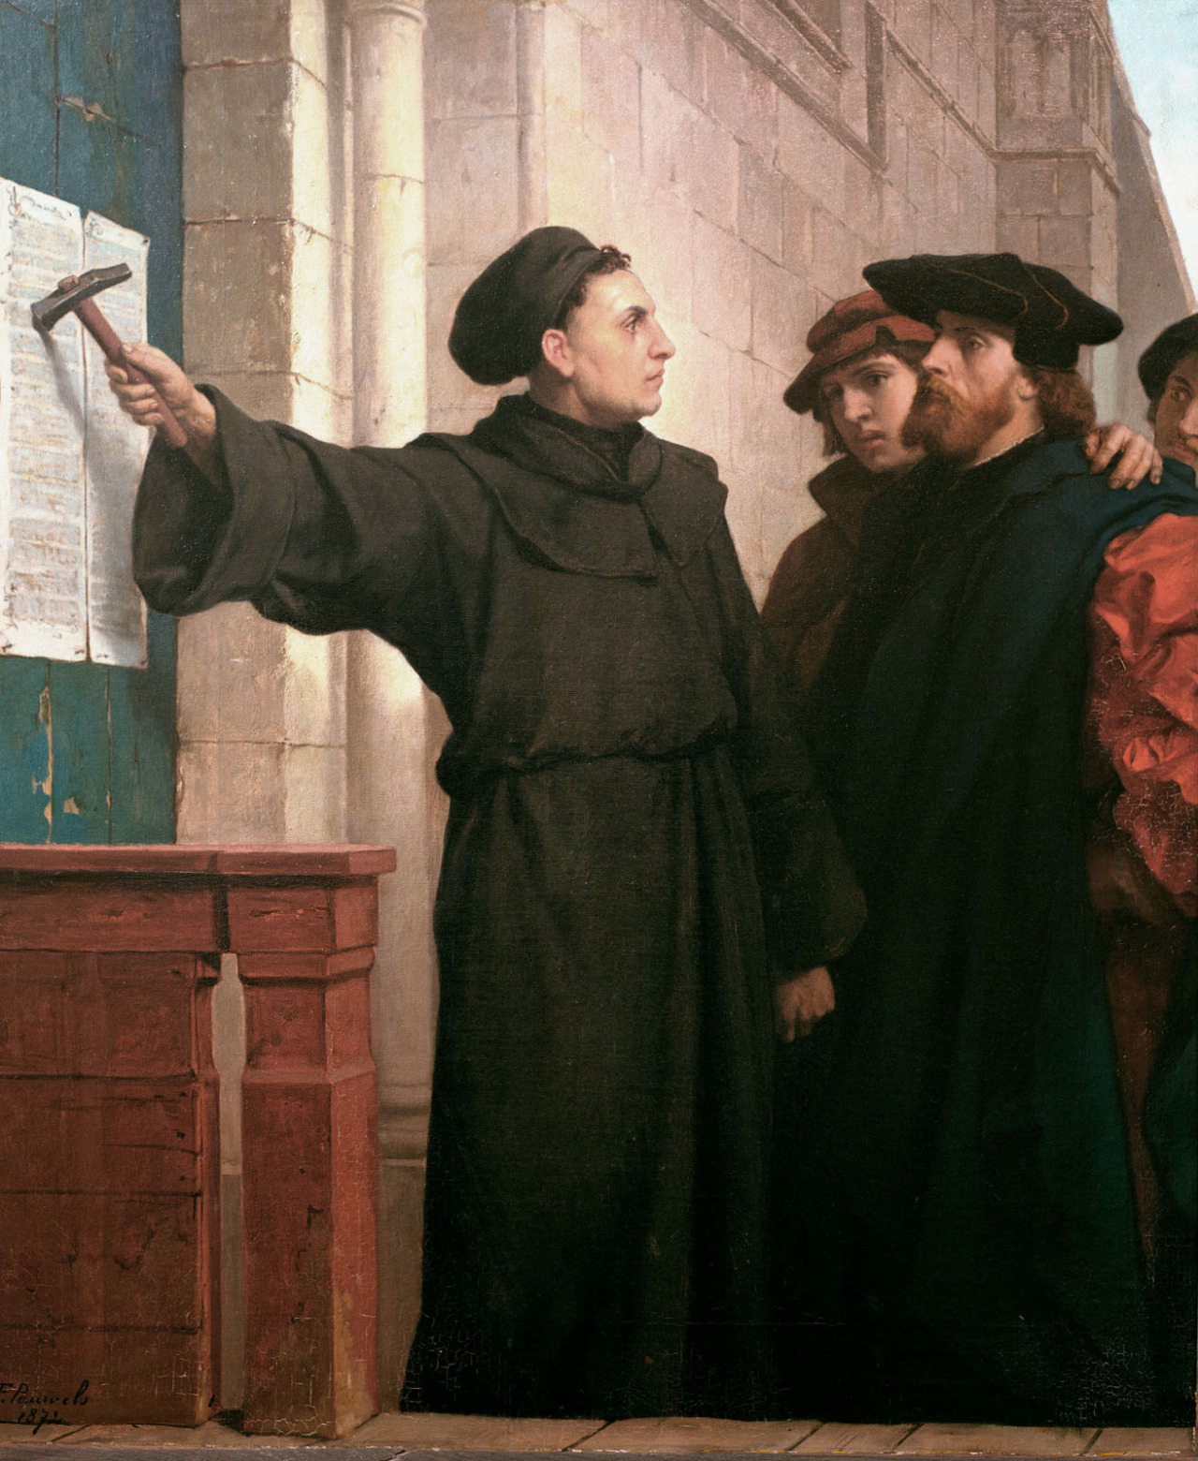
Ideas we covered in this lecture
Swaps
Hashed timelock contracts
Digraphs
Cross-chain swap protocol

