Slide 1

CS1951 L
Blockchains & Cryptocurrencies
Spring 2024
Lecture 4
Bitcoin Continued
Maurice Herlihy
Brown University

Slide 2
Bitcoin Script
Simple scripting language
Stack machine
Encumbers transactions
Must be satisfied for transfer to happen

Slide 3
Hashlocks
“Here is constant k.
Pay this UTXO to anyone who can produce s such that k = sha256(s)”

Slide 4
Bitcoin Script
stack
code
<s>
OP_HASH256
<k>
OP_EQUAL
pc

Slide 5
Bitcoin Script
stack
<s>
code
<s>
OP_HASH256
<k>
OP_EQUAL
pc
Push secret onto stack

Slide 6
Bitcoin Script
stack
OP_HASH256
<s>
code
<s>
OP_HASH256
<k>
OP_EQUAL
pc
Push hash operation onto stack

Slide 7
Bitcoin Script
stack
<h>
code
<s>
OP_HASH256
<k>
OP_EQUAL
pc
Evaluate hash

Slide 8
Bitcoin Script
stack
<k>
<h>
code
<s>
OP_HASH256
<k>
OP_EQUAL
pc
Push key

Slide 9
Bitcoin Script
stack
OP_EQUAL
<k>
<h>
code
<s>
OP_HASH256
<k>
OP_EQUAL
pc
Push equality test

Slide 10
Bitcoin Script
stack
true
code
<s>
OP_HASH256
<k>
OP_EQUAL
pc
Evaluate equality test

Slide 11
Pay to Public Key Hash
code
OP_DUP
OP_HASH160
<pubKeyHash>
OP_EQUALVERIFY
OP_CHECKSIG
“Was the transaction signature created using the public key that corresponds to the given pubkey hash?”

Slide 12
Multi-Sigs
code
<pubKeyA>
OP_CHECKSIGVERIFY
<pubKeyB>
OP_CHECKSIG
“Did at least 2 out of the 3 public keys provided sign the transaction?”

Slide 13
Simple Escrow Contract
code
<pubKeyA>
OP_CHECKSIGVERIFY
<pubKeyB>
OP_CHECKSIG
“Did both A and B sign the transaction?”

Slide 14
Bitcoin Script
Not “Turing-complete”
No recursion, unbounded loops …
Limited expressive power?
Maybe, but no infinite loops
Limited amount of long-lived state

Slide 15
Transaction Malleability

Slide 16
Transaction Hashes
Hash(T) is unique identifier
Txn T

Slide 17

Hashes are Unique IDs
Submit T

Slide 18
Hashes are Useful
Looking for H(T)

Slide 19
Hashes are Useful
I’m good!!!
H(T)

Slide 20
A Closer Look
Txn T | signature data
Ensures txn is authorized

Slide 21
Transaction Malleability
Hash(T) is unique identifier
(includes sigs)
Txn T | signature data

Slide 22
Malleability
Txn T | signature data
Txn T | signature data
Can alter signature data
Still considered valid
Same txn but different hash!!!

Slide 23
Malleability is Dangerous
Submit T | sigs

Slide 24
Malleability is Dangerous
Looking for H(T | sigs)
T | sigs
T | sigs

Slide 25
Malleability is Dangerous
Where did it go?
H(T | sigs)
Should I resubmit?

Slide 26
Segmented Witness (SegWit)
signature data
Txn T
Sigs kept in separate structure

Slide 27
Transaction Malleability
signature data
Txn T
Hash(T) is unique identifier
(ignores sigs)

Slide 28
Hashes are Useful Again
I’m good!!!
H(T)

Slide 29
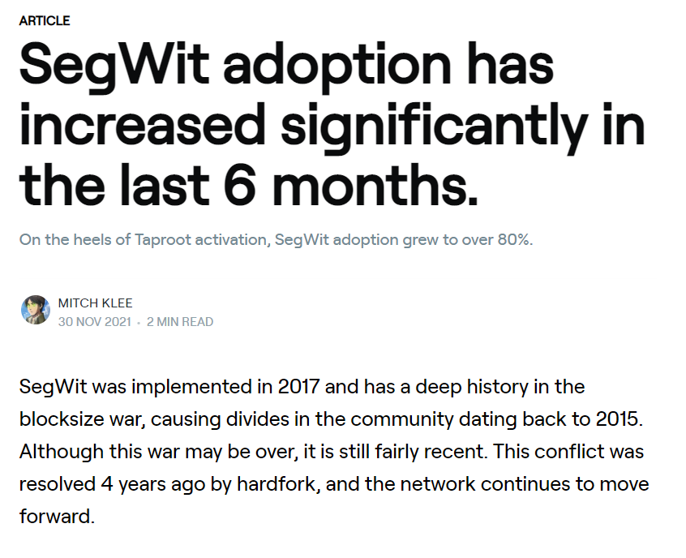
SegWit Adopted 2017

Slide 30
Controversy
Incompatible change to Bitcoin consensus
Radical overhaul
Might be rejected by miners
Leading to a split
30

Slide 31
Controversy
Changes to economics of mining
Older mining hardware less valuable
Some miners worried about their profits
31

Slide 32
Controversy
How bit should blocks be?
Some clients: bigger
Some miners: not bigger
SegWit: effectively bigger (more room)
Scalability, but not everyone happy
32

Slide 33
Happy Ending?
Activated in 2017
Took some time to catch on
Made other advances possible
Like Lightning Network, discussed later
33

Slide 34
Questions?

Slide 35
Bitcoin Nodes
A node is a mini operating system
Except highly specialized

Slide 36
Bitcoin Node
File System
LevelDB
block
block
Block Index DB
block
block
block
Chainstate DB
block
block

Slide 37
Bitcoin Node
File System
LevelDB
block
block
Block Index DB
block
Each block lives in a file
block
block
Chainstate DB
block
block

Slide 38
Bitcoin Node
File System
LevelDB
block
block
Block Index DB
Block hash → block info
block
block
block
Chainstate DB
block
block

Slide 39
Bitcoin Node
File System
LevelDB
block
block
Block Index DB
block
block
block
Chainstate DB
Txn hash → txn info
block
block

Slide 40
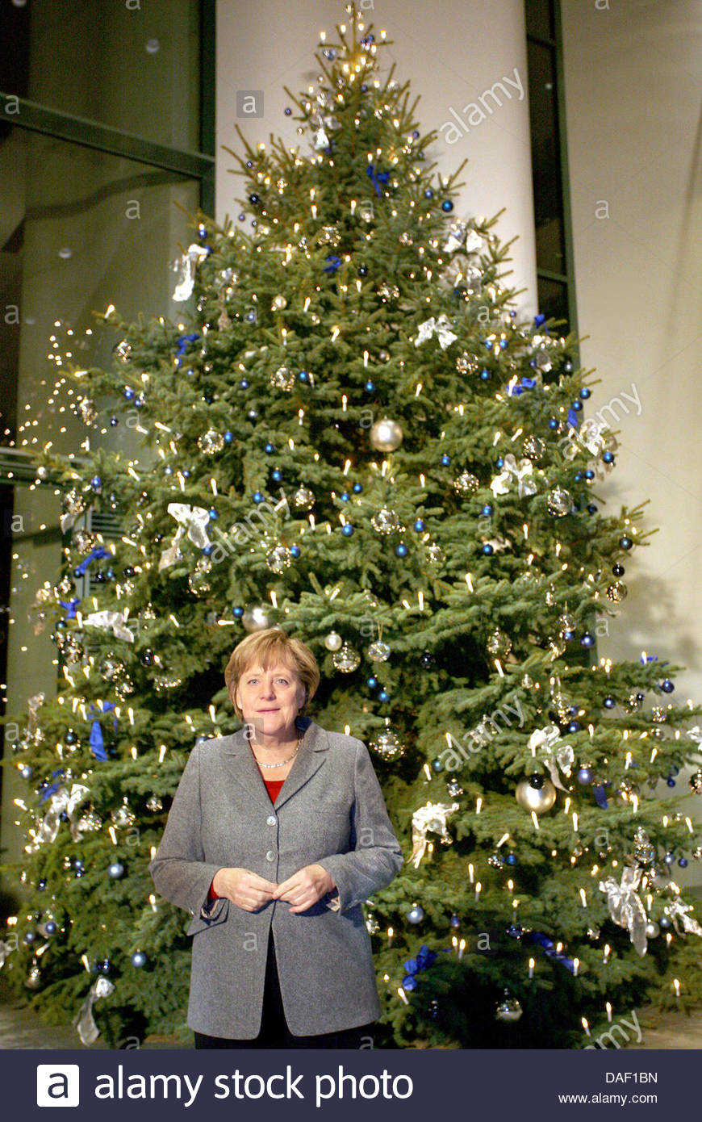
Merkle Tree

Slide 41
Merkle Tree
Fundamental data structure

Slide 42
Merkle Tree
Fundamental data structure
Many variations

Slide 43
Merkle Tree
Fundamental data structure
Many variations
Blockchain itself is a degenerate
Merkle tree

Slide 44
Merkle Tree
BTW, I’m Angela Merkel, not Ralf Merkle, and I did not invent this tree!
Fundamental data structure
Many variations
Blockchain itself is a degenerate
Merkle tree

Slide 45
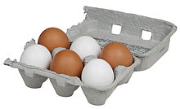
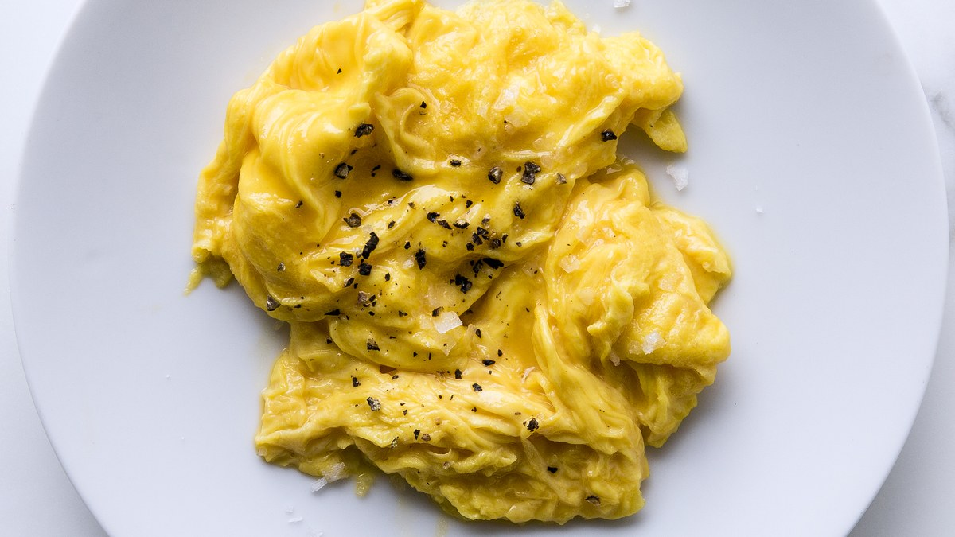
Cryptographic Hash Functions
Easy
Hard

Slide 46
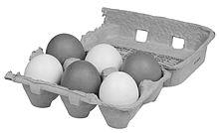
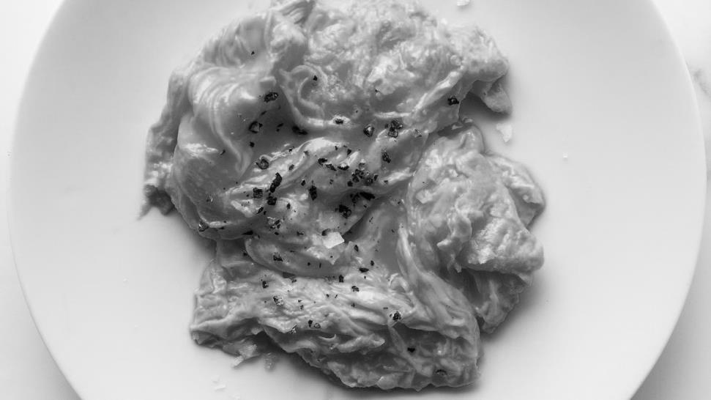
Cryptographic Hash Functions
Hard to reconstruct x from H(x)
Easy
“preimage resistance”
Hard

Slide 47
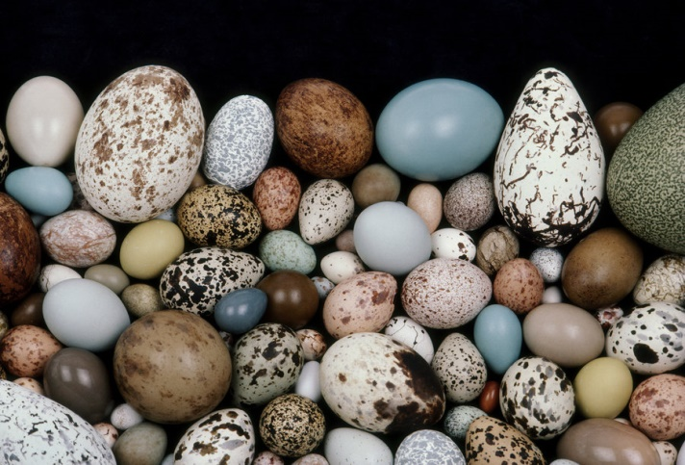
Cryptographic Hash Functions
Given
Hard to find

Slide 48
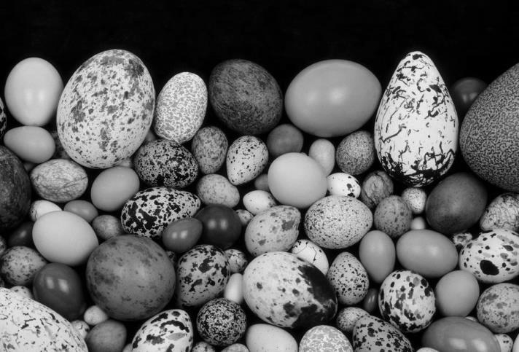
Cryptographic Hash Functions
Given
Hard to find x’ such that H(x’) = H(x)
Hard to find
“2nd preimage resistance”

Slide 49
Cryptographic Hash Functions
Hard to find

Slide 50
Cryptographic Hash Functions
Hard to find
Hard to find any x, x’ such that H(x’) = H(x)
“collision resistance”

Slide 51
Tree
d₁, d₂
d₀, d₁
d₂, d₃
d₀, d₀
d₁, d₁
d₂, d₂
d₃, d₃
d₀
d₁
d₂
d₃

Slide 52
Tree
d₁, d₂
Data at leaves
d₀, d₁
d₂, d₃
d₀, d₀
d₁, d₁
d₂, d₂
d₃, d₃
d₀
d₁
d₂
d₃

Slide 53
Tree
Navigation via internal nodes
d₁, d₂
d₀, d₁
d₂, d₃
d₀, d₀
d₁, d₁
d₂, d₂
d₃, d₃
d₀
d₁
d₂
d₃

Slide 54
Tree
d₁, d₂
d₀, d₁
d₂, d₃
d₀, d₀
d₁, d₁
d₂, d₂
d₃, d₃
d₀
d₁
d₂
d₃
tamper

Slide 55
Tree
shrug …
d₁, d₂
d₀, d₁
d₂, d₃
d₀, d₀
d₁, d₁
d₂, d₂
d₃, d₃
d₀
d₁
d₂
d₃
tamper

Slide 56
Merkle Tree
h₀₃ =H(h_{01,}h₂₃)
h₀₁ =H(h_{0,}h₁)
h₂₃ =H(h_{2,}h₃)
h₀ =H(d₀)
h₁ =H(d₁)
h₂ =H(d₂)
h₃ =H(d₃)
d₀
d₁
d₂
d₃

Slide 57
Merkle Tree
h₀₃ =H(h_{01,}h₂₃)
Data at leaves, as before
h₀₁ =H(h_{0,}h₁)
h₂₃ =H(h_{2,}h₃)
h₀ =H(d₀)
h₁ =H(d₁)
h₂ =H(d₂)
h₃ =H(d₃)
d₀
d₁
d₂
d₃

Slide 58
Merkle Tree
Nodes have hashes of children
h₀₃ =H(h_{01,}h₂₃)
h₀₁ =H(h_{0,}h₁)
h₂₃ =H(h_{2,}h₃)
h₀ =H(d₀)
h₁ =H(d₁)
h₂ =H(d₂)
h₃ =H(d₃)
d₀
d₁
d₂
d₃

Slide 59
Merkle Tree
h₀₃ =H(h_{01,}h₂₃)
h₀₁ =H(h_{0,}h₁)
h₂₃ =H(h_{2,}h₃)
h₀ =H(d₀)
h₁ =H(d₁)
h₂ =H(d₂)
h₃ =H(d₃)
d₀
d₁
d₂
d₃
Nodes have hashes of children

Slide 60
Questions?

Slide 61
Don’t Mess with the Merkle Tree
h₀₃ =H(h_{01,}h₂₃)
h₀₁ =H(h_{0,}h₁)
h₂₃ =H(h_{2,}h₃)
h₀ =H(d₀)
h₁ =H(d₁)
h₂ =H(d₂)
h₃ =H(d₃)
d₀
d₁
d₂
d₃
tamper

Slide 62
Don’t Mess with the Merkle Tree
!!!
h₀₃≠H(h_{01,}h₂₃)
!!!
h₀₁≠H(h_{0,}h₁)
h₂₃ =H(h_{2,}h₃)
!!!
h₀≠H(d₀)
h₁ =H(d₁)
h₂ =H(d₂)
h₃ =H(d₃)
d₀
d₁
d₂
d₃
tamper

Slide 63

Short Proof of Membership
I know root hash h₀₃
h₀₃ =H(h_{01,}h₂₃)
Here is a short proof that d₁ is in the tree
h₀₁ =H(h_{0,}h₁)
h₂₃ =H(h_{2,}h₃)
h₀ =H(d₀)
h₁ =H(d₁)
h₂ =H(d₂)
h₃ =H(d₃)
d₀
d₁
d₂
d₃

Slide 64
Proof d₁ is in the Tree
h₀₃ =H(h_{01,}h₂₃)
h₀₁ =H(h_{0,}h₁)
h₂₃ =H(h_{2,}h₃)
h₀ =H(d₀)
h₁ =H(d₁)
h₂ =H(d₂)
h₃ =H(d₃)
d₀
d₁
d₂
d₃

Slide 65
Proof d₁ is in the Tree
h₀₃ =H(h_{01,}h₂₃)
h₀₁ =H(h_{0,}h₁)
h₂₃ =H(h_{2,}h₃)
h₀ =H(d₀)
h₁ =H(d₁)
h₂ =H(d₂)
h₃ =H(d₃)
d₀
d₁
d₂
d₃

Slide 66
Proof d₁ is in the Tree
h₀₃ =H(h_{01,}h₂₃)
Check!
h₀₁ =H(h_{0,}h₁)
h₂₃ =H(h_{2,}h₃)
h₀ =H(d₀)
h₁ =H(d₁)
h₂ =H(d₂)
h₃ =H(d₃)
d₀
d₁
d₂
d₃

Slide 67
Proof d₁ is in the Tree
h₀₃ =H(h_{01,}h₂₃)
h₀₁ =H(h_{0,}h₁)
h₂₃ =H(h_{2,}h₃)
Check!
h₀ =H(d₀)
h₁ =H(d₁)
h₂ =H(d₂)
h₃ =H(d₃)
d₀
d₁
d₂
d₃

Slide 68
Proof d₁ is in the Tree
h₀₃ =H(h_{01,}h₂₃)
h₀₁ =H(h_{0,}h₁)
h₂₃ =H(h_{2,}h₃)
h₀ =H(d₀)
h₁ =H(d₁)
h₂ =H(d₂)
h₃ =H(d₃)
Check!
d₀
d₁
d₂
d₃

Slide 69
Proof d₁ is in the Tree
h₀₃ =H(h_{01,}h₂₃)
String “d₁,h₀,h₂₃ ” …
convinces someone who knows only root h₀₃ …
h₀₁ =H(h_{0,}h₁)
h₂₃ =H(h_{2,}h₃)
that d₁ is in the tree!
h₀ =H(d₀)
h₁ =H(d₁)
h₂ =H(d₂)
h₃ =H(d₃)
Proof length is O(log n)
d₀
d₁
d₂
d₃

Slide 70
Short Proof of Absence?
I know root hash h₀₃
h₀₃ =H(h_{01,}h₂₃)
Is there a short proof that z is not in the tree?
h₀₁ =H(h_{0,}h₁)
h₂₃ =H(h_{2,}h₃)
h₀ =H(d₀)
h₁ =H(d₁)
h₂ =H(d₂)
h₃ =H(d₃)
d₀
d₁
d₂
d₃

Slide 71
Updating a Merkle Tree
h₀₃ =H(h_{01,}h₂₃)
h₀₁ =H(h_{0,}h₁)
h₂₃ =H(h₂)
h₀ =H(d₀)
h₁ =H(d₁)
h₂ =H(d₂)
d₀
d₁
d₂

Slide 72
Updating a Merkle Tree
h₀₃ =H(h_{01,}h₂₃)
h₀₁ =H(h_{0,}h₁)
h₂₃ =H(h₂)
h₀ =H(d₀)
h₁ =H(d₁)
h₂ =H(d₂)
h₃ =H(d₃)
d₀
d₁
d₂
d₃

Slide 73
Updating a Merkle Tree
h₀₃ =H(h_{01,}h₂₃)
h₀₁ =H(h_{0,}h₁)
h₂₃ =H(h₂)
nope
h₀ =H(d₀)
h₁ =H(d₁)
h₂ =H(d₂)
h₃ =H(d₃)
d₀
d₁
d₂
d₃

Slide 74
Updating a Merkle Tree
h₀₃
h'₀₃
new tree
h₀₁
h₂₃
h₀₁
h'₂₃
h₀
h₁
h₂
h₀
h₁
h₂
h'₃
d₀
d₁
d₂
d₀
d₁
d₂
d₃

Slide 75
Updating a Merkle Tree
h₀₃
h'₀₃
new tree
h₀₁
h₂₃
h'₂₃
h₀
h₁
h₂
h'₃
d₀
d₁
d₂
d₃

Slide 76
Questions?

Slide 77
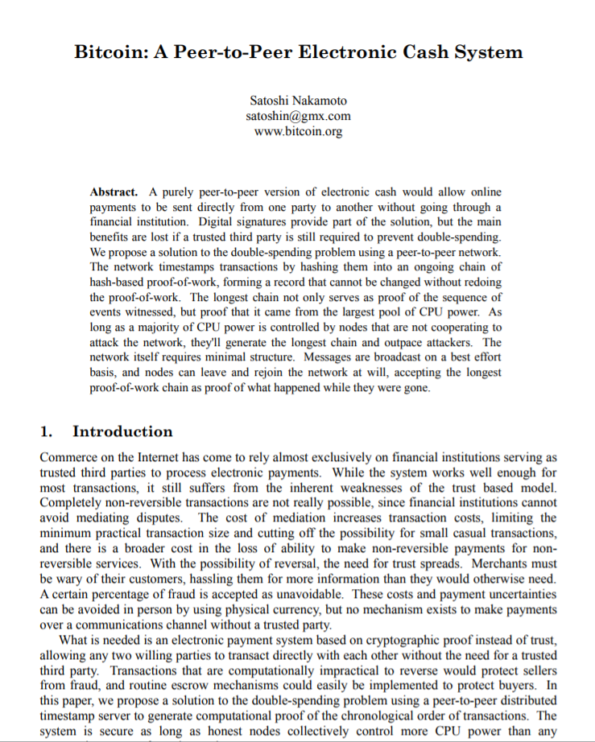
Let’s talk about Bitcoin’s data structures
Notes:
Bitcoin, Ethereum, ICOs, blockchains, etc. are the result of a single paper (and running code) that appeared mysteriously in 2008. I am going to claim it’s all about distributed computing, but it did not come from the distributed computing research community. I feel confident speculating that if this paper had been submitted to PODC in 2008, it would have been rejected for defining consensus weirdly, or not proving any lemmas, or not providing experiments. Yet here we are, looking at a new, vibrant, and active area of CS. What are we to make of it?

Slide 78
This happened
This happened
This happened
pointer
pointer
pointer
time
Notes:
A Blockchain is just a list, where each element contains a list of events to be recorded, and various cryptographic hashes and signatures. The technical details are not important here.

Slide 79
This happened
This happened
This happened
pointer
pointer
pointer
shrug
shrug
tamper
time
Notes:
A Blockchain is just a list, where each element contains a list of events to be recorded, and various cryptographic hashes and signatures. The technical details are not important here.

Slide 80
This happened
This happened
This happened
pointer
pointer
pointer
tamper
time
Notes:
A Blockchain is just a list, where each element contains a list of events to be recorded, and various cryptographic hashes and signatures. The technical details are not important here.

Slide 81
Merkle-ize it!
This happened
This happened
This happened
hash
hash
hash
time
Notes:
A Blockchain is just a list, where each element contains a list of events to be recorded, and various cryptographic hashes and signatures. The technical details are not important here.

Slide 82
Merkle-ize it!
This happened
This happened
This happened
hash
hash
hash
tamper
time
Notes:
A Blockchain is just a list, where each element contains a list of events to be recorded, and various cryptographic hashes and signatures. The technical details are not important here.

Slide 83
Uh,oh …
Uh,oh …
Merkle-ize it!
This happened
This happened
This happened
hash
hash
hash
tamper
time
Notes:
A Blockchain is just a list, where each element contains a list of events to be recorded, and various cryptographic hashes and signatures. The technical details are not important here.

Slide 84
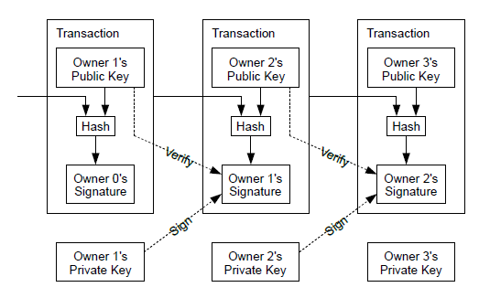
This happened
This happened
This happened
tamper
Uh,oh …
Uh,oh …
hash
predecessor
hash
predecessor
hash
predecessor
time
Notes:
A Blockchain is just a list, where each element contains a list of events to be recorded, and various cryptographic hashes and signatures. The technical details are not important here.

Slide 85
This happened
This happened
This happened
tamper
Uh,oh …
Uh,oh …
hash
predecessor
hash
predecessor
hash
predecessor
time
Notes:
A Blockchain is just a list, where each element contains a list of events to be recorded, and various cryptographic hashes and signatures. The technical details are not important here.

Slide 86
header
hash
transaction
transaction
transaction
transaction
time
Notes:
A Blockchain is just a list, where each element contains a list of events to be recorded, and various cryptographic hashes and signatures. The technical details are not important here.

Slide 87
header
hash
Version, height, PoW nonces, etc.
transaction
transaction
transaction
transaction
time
Notes:
A Blockchain is just a list, where each element contains a list of events to be recorded, and various cryptographic hashes and signatures. The technical details are not important here.

Slide 88
header
hash
transaction
transaction
transaction
transaction
time
Notes:
A Blockchain is just a list, where each element contains a list of events to be recorded, and various cryptographic hashes and signatures. The technical details are not important here.

Slide 89
Each block keeps its transactions in a Merkle tree
header
hash
time
Notes:
A Blockchain is just a list, where each element contains a list of events to be recorded, and various cryptographic hashes and signatures. The technical details are not important here.

Slide 90
Questions?

Slide 91
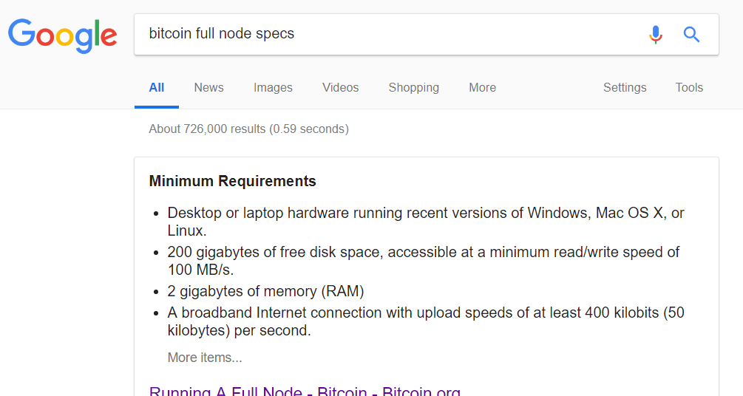
Bitcoin full node
200G disk space
2G memory
50K network
3-4 days initial download

Slide 92
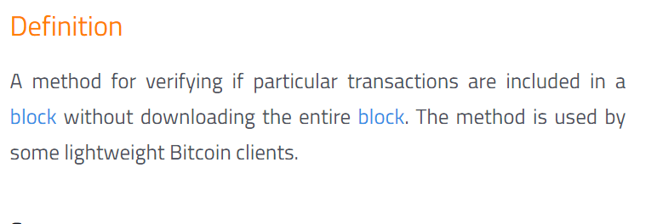
Bitcoin lightweight node
Fits on your phone

Slide 93
Full node
header
hash
time
Notes:
A Blockchain is just a list, where each element contains a list of events to be recorded, and various cryptographic hashes and signatures. The technical details are not important here.

Slide 94
Lightweight node
header
hash
time
Notes:
A Blockchain is just a list, where each element contains a list of events to be recorded, and various cryptographic hashes and signatures. The technical details are not important here.

Slide 95
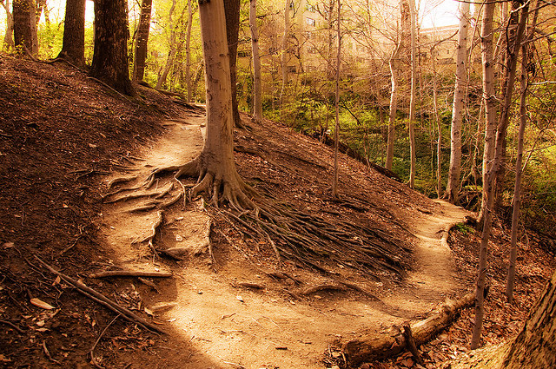
The Road not Taken

Slide 96
Why is the blockchain a chain?
time

Slide 97
Why is the blockchain a chain?
Blocks of interest

Slide 98
Why is the blockchain a chain?
Blocks of interest
Must traverse all

Slide 99
Why is the blockchain a chain?
Blocks of interest
Must traverse all
Must store all headers

Slide 100
Merkleized Skip Lists?
time
Notes:
One efficient way to do it is with a skip-list.
A skip list keeps the elements sorted in nodes that are linked in multiple layers, such that every layer is a sublist of the layer underneath it.
So as you can see, the bottom layer contains all the elements, and in the next layer we skip 2, and so on, so that in the last layer we only have the 0 and 9 nodes. So now if we’re searching for 8, for example,

Slide 101
Merkleized Skip Lists?
Each layer is sub-list of lower levels
Each layer jumps about twice as far
Logarithmic search time
time
Notes:
One efficient way to do it is with a skip-list.
A skip list keeps the elements sorted in nodes that are linked in multiple layers, such that every layer is a sublist of the layer underneath it.
So as you can see, the bottom layer contains all the elements, and in the next layer we skip 2, and so on, so that in the last layer we only have the 0 and 9 nodes. So now if we’re searching for 8, for example,

Slide 102
Merkleized Skip Lists?
time
Notes:
One efficient way to do it is with a skip-list.
A skip list keeps the elements sorted in nodes that are linked in multiple layers, such that every layer is a sublist of the layer underneath it.
So as you can see, the bottom layer contains all the elements, and in the next layer we skip 2, and so on, so that in the last layer we only have the 0 and 9 nodes. So now if we’re searching for 8, for example,

Slide 103
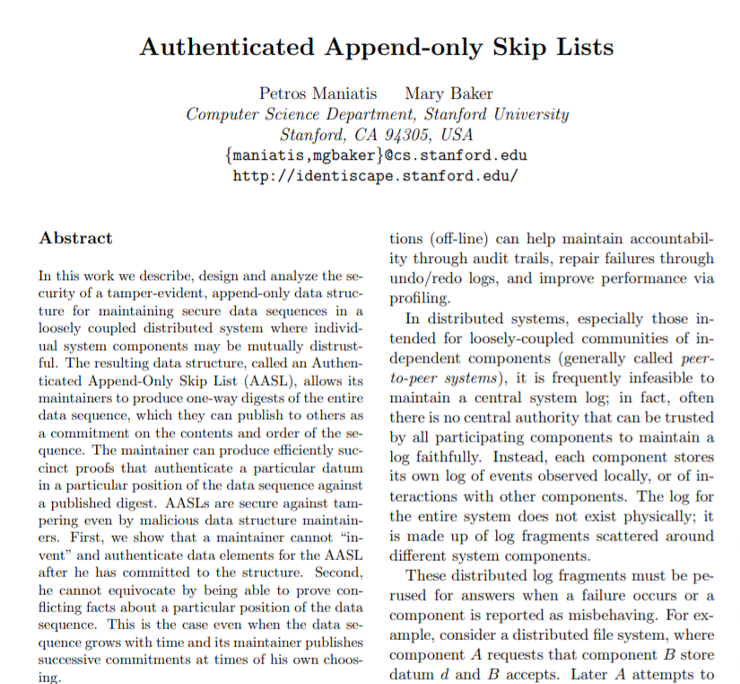
Merkleized skip lists already invented
Pre-blockchain
Research opportunity?

Slide 104
Keep Blocks in Merkle Tree instead of Chain?
h₀₃ =H(h_{01,}h₂₃)
h₀₁ =H(h_{0,}h₁)
h₂₃ =H(h_{2,}h₃)
h₀ =H(d₀)
h₁ =H(d₁)
h₂ =H(d₂)
h₃ =H(d₃)
d₀
d₁
d₂
d₃
time

Slide 105

Certificate Transparency
Certificate authorities issue SSL certificates
So you can be sure you are talking to Amazon, Facebook, etc.
They sometimes mess up

Slide 106
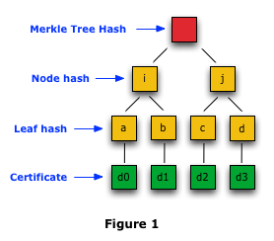
Google Certificate Transparency Project
Publish certificates on public logs
Replicate logs for availability
Each log is a Merkle tree
Not exactly a blockchain, but very close …

Slide 107

Ideas we covered in this lecture
Bitcoin node data storage
Cryptographic hash functions
Merkle Trees
Merkle Tree of Transactions
Lightweight Nodes
Merkle Skip Lists
Google Certificate Transparency = Merkle tree

Slide 108
