Slide 1

CS1951 L
Blockchains & Cryptocurrencies
Spring 2024
Lecture 5
Ethereum Virtual Machine
Maurice Herlihy
Brown University

Slide 2
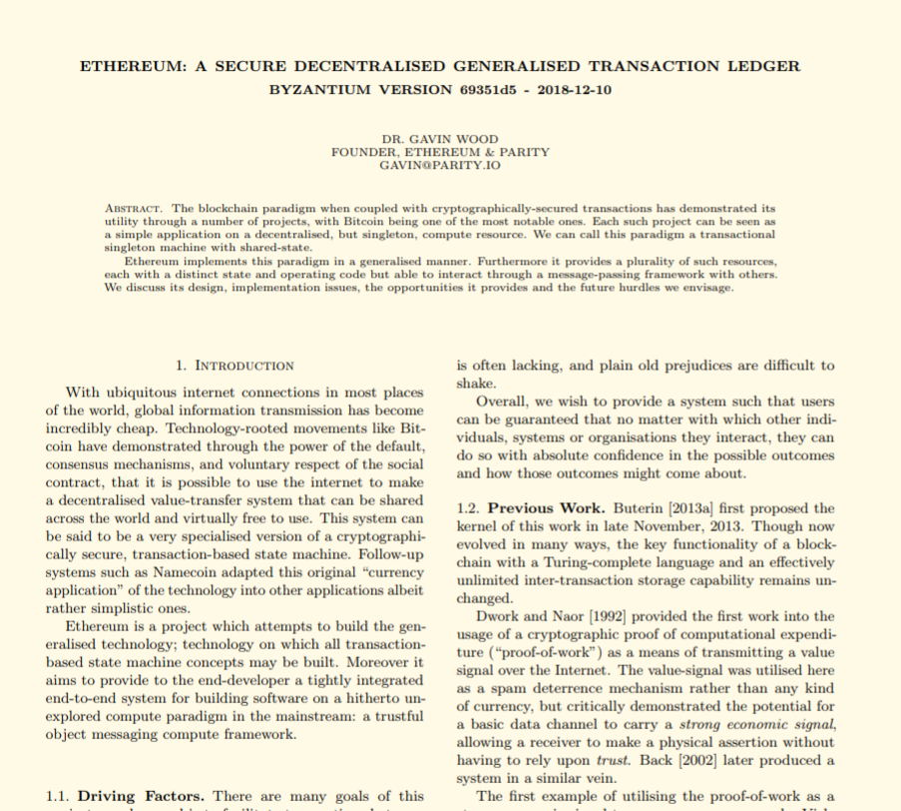
Second-largest Cryptocurrency
Accounts, not UTXO
Programmable via “smart contracts”
“Turing-Complete” Language

Slide 3
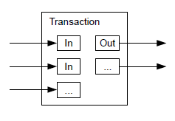
Bitcoin UTXO Model

Slide 4
Bitcoin UTXO Model
A txn can have multiple inputs …

Slide 5
Bitcoin UTXO Model
1 BTC Alice
1 BTC Bob
2 BTC Carol

Slide 6
Bitcoin UTXO Model
… and multiple outputs

Slide 7
Bitcoin UTXO Model
3 BTC pizza order
Carol’s 1 BTC change

Slide 8
UTXO Model
Can also place other conditions on transfer …
“smart contracts”

Slide 9
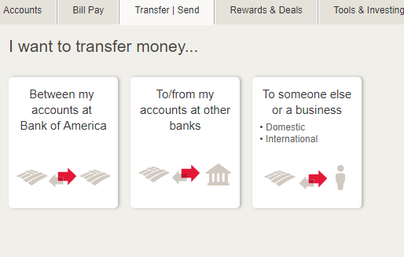
Ethereum Account Model

Slide 10
In the beginning …
state
time

Slide 11
On the first day …
Transaction
(This happened)
state
new state
time

Slide 12
Not long after …
Transaction
(This happened)
Transaction
(This happened)
Transaction
(This happened)
Transaction
(This happened)
Transaction
(This happened)
block
state
new state
time

Slide 13
Chain of Blocks
Txn
Txn
Txn
Txn
Txn
Txn
Txn
Txn
Txn
Txn
Txn
Txn
time

Slide 14
Chain of States
state
state
state
time

Slide 15
Block-State Duality
Txn
Txn
Txn
Txn
Txn
Txn
Txn
Txn
Txn
Txn
Txn
Txn
state
state
state
time

Slide 16

Ethereum State
My God, it’s full of accounts!

Slide 17
Ethereum State
Account Address
Account State
Account Address
Account State
Account Address
Account State
Account Address
Account State

Slide 18

External Account
Owned by person or organization
Controlled by private keys
Holds currency balance
Active agent: transfers currency, calls contract code

Slide 19
External Account
Address
balance

Slide 20

Contract Account
Holds currency balance
Associated with code
Passive Agent:
code called by other accounts
code can transfer money, call other contracts

Slide 21
Contract Account
Address
balance
code
storage

Slide 22
Transaction Creation
Submitted by external party

Slide 23
Contract Creation Transaction

Slide 24
Contract Creation Transaction
Hello World!

Slide 25

Contract Creation Transaction
Hello World!
code
storage

Slide 26
Message Call Transaction
Run your code with these args
Yes sir!

Slide 27

Message Call Transaction
Run your code with these args
Yes sir!

Slide 28
External to External Message
Here’s the money I owe you
thanks!
transfer money

Slide 29
External to Contract & Vice-Versa
function call
function return

Slide 30
Contract to Contract Message
function call
function return

Slide 31

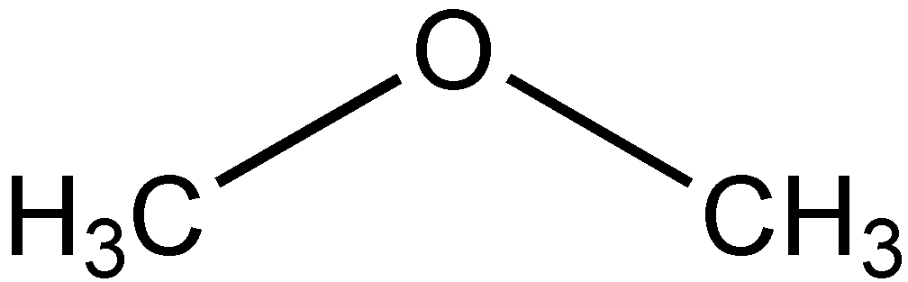
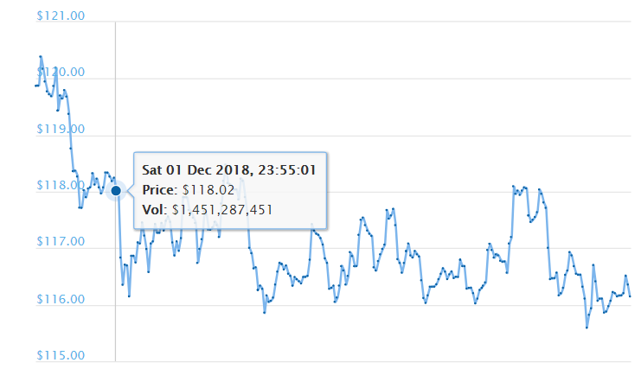
Money, Honey
Native currency called ether
not this
but this

Slide 32

Gas
Caller pays fee for each transaction step
Denial of Service attacks expensive

Slide 33
Gas
Each step has fixed “gas” fee
But gas price in Ether up to caller!
Low price means low priority …
And vice-versa

Slide 34
Gas
If a call runs out of gas …
Effects discarded
Gas not refunded
If a call has leftover gas …
Unused gas refunded

Slide 35
Block Gas Limit
Bitcoin has limit on block size
Ethereum has limit on block gas
Block full when transactions’ gas costs reach limit
We will see how this can be exploited later

Slide 36
Questions?

Slide 37
Transaction Fields
Gas price
Value
Gas limit
Data
Nonce
Et cetera
To

Slide 38
Transaction Fields
Priority Fee
Value
How much caller is willing to
tip the miner for inclusion
Gas limit
Data
Nonce
Et cetera
Miners prioritize transactions with higher tips
To
Extra-low tip may never run

Slide 39
Transaction Fields
Priority Fee
Value
Max gas caller willing to spend
Gas limit
Data
Call canceled if exceeded
Nonce
Et cetera
No refunds for cancelations!
To

Slide 40
Transaction Fields
Priority Fee
Value
Transaction sequence number
(from sender)
Gas limit
Data
Nonce
Et cetera
To

Slide 41
Transaction Fields
Priority Fee
Value
Gas limit
Data
Nonce
Et cetera
destination address
(external or contract)
To

Slide 42
Transaction Fields
Gas price
Value
Gas limit
Data
How much ether to transfer
Nonce
Et cetera
To

Slide 43
Transaction Fields
Priority Fee
Value
Gas limit
Data
Nonce
Et cetera
Payload:
function name, args, etc. …
To

Slide 44
Transaction Fields
Priority Fee
Value
Gas limit
Data
Nonce
Et cetera
To
ECDSA signature args ….

Slide 45
Questions?

Slide 46
Ethereum Virtual Machine
EVM Code
EVM engine

Slide 47
Ethereum Virtual Machine
EVM Code
(immutable)
Program Counter
Stack
storage
Gas Available
Memory
(persistent)
(volatile)

Slide 48
Types of Instructions
Stack operations
No registers
Load, store
Control Flow
Most operations act on stack
Block Info
PUSH1 0x1
PUSH2 0x2
ADD
Cryptography
Logging
Environment

Slide 49
Types of Instructions
Stack operations
Load, store
Local control flow
Control Flow
Block Info
Cryptography
Call other contracts
Logging
Call system libraries
Environment

Slide 50
Types of Instructions
Stack operations
Load, store
Control Flow
Various crypto hashes provided
Block Info
Cryptography
Logging
Environment
Gas costs too expensive to compute directly

Slide 51
Types of Instructions
Stack operations
Load, store
Caller’s address
Control Flow
Ether balance
Block Info
Cryptography
Gas costs
Logging
Lots more …
Environment

Slide 52
Types of Instructions
Stack operations
Load, store
Control Flow
Block Info
Cryptography
Load and store
from non-stack memory
Logging
Environment

Slide 53
Types of Instructions
block number
Stack operations
Load, store
and more …
Control Flow
Block Info
Cryptography
Logging
256 latest block hashes
block timestamp
Environment

Slide 54
Types of Instructions
Stack operations
Load, store
communicate with outside world
Control Flow
Block Info
Cryptography
Logging
Environment
Write events to log
debug

Slide 55
EVM Stack
All operations
act on stack
1024 elements
…
PUSH, POP,
COPY, SWAP …
256 bits

Slide 56
EVM Stack
All operations
act on stack
1024 elements
…
PUSH, POP,
COPY, SWAP …
256 bits

Slide 57
EVM Memory
256-bit load
256-bit or 8-bit store
…
byte-addressable
Grows dynamically
Gas charged for growth
8 bits

Slide 58
Questions?

Slide 59

Observation: Storage is Expensive
Users need incentive to free up unneeded storage
Ethereum gives a gas refund for
Freeing storage (overwrite with 0s)
Destroying contracts
This has had unexpected consequences …

Slide 60
Details:
Costs 5000 to zero out location
15000 gas added to refund counter
At transaction end, …
Refund counter added to unused gas
(up to half of total gas used)
Destroying contracts similar arithmetic

Slide 61
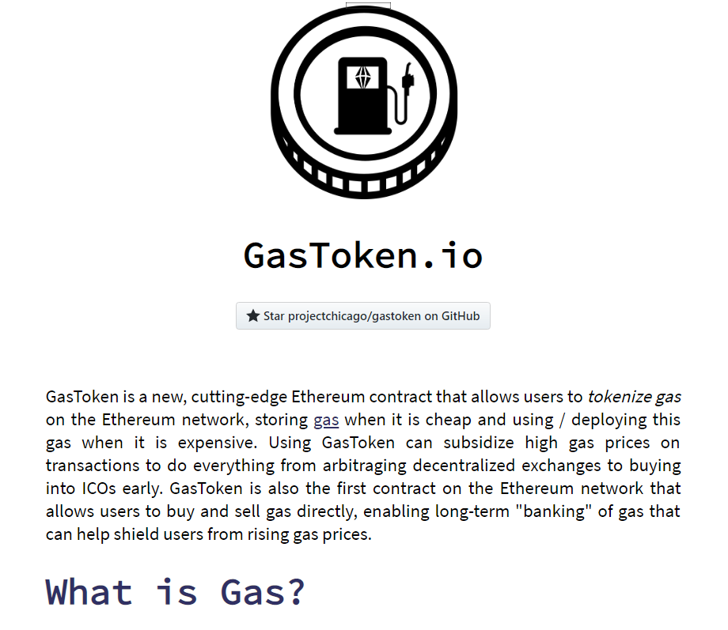
Gas Token
GasToken managed by a contract
Create GasToken when gas is cheap
Token allocates memory
Or creates an empty contract
Tokens can be transferred, sold, traded

Slide 62
Gas Token
When gas prices climb, ….
Buy GasTokens
Send to contract for destruction
Destruction gets gas refund
Up to half of contract’s gas costs

Slide 63
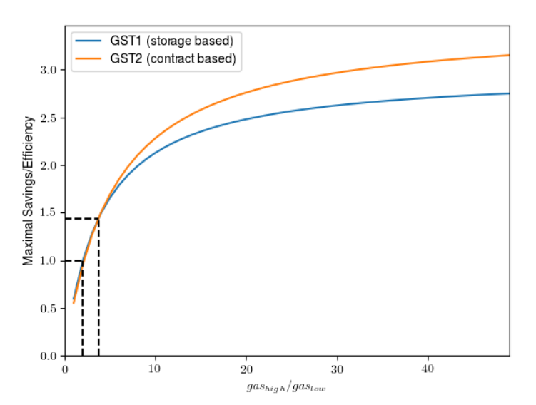

Slide 64
Is that a Good Thing?
Positive Effects
Gas-banking service for users
Hedge against increases
Predictability in face of volatility

Slide 65
2022 “London” Hard Fork
No more refund on self-destruct
Diminished refunds on recycling memory
Gas Tokens no longer worth it

Slide 66

Proposal for Rent
Storage is forever
Cost to system: bytes X time
Cost to user: bytes
Partial fix: refund for deletion

Slide 67
Proposal for Rent
Keep track of:
Last block to access data: last_accessed
Size in bytes: storage_bytes
On store, extra charge of:
O((block.number – last_accessed)
* storage_bytes)

Slide 68
Proposal for Rent
Why would anyone want this?
May benefit applications that use storage for short durations
Disk space for a full node may go down
This proposal still under discussion.

Slide 69

Ideas we covered in this lecture
UTXO versus Account Mode
Block-State duality
Accounts, External and Contract
Ether and Gas
Transaction state
Ethereum Virtual Machine

Slide 70
