Slide 1

CS1951 L
Blockchains & Cryptocurrencies
Spring 2024
Lecture 7
Ethereum Data Structures
Maurice Herlihy
Brown University

Slide 2
Ethereum Storage Model
2²⁵⁶-1
A very, very big array
Initially all 0s
0
32 bytes

Slide 3
Each Variable has a Slot
pragma solidity ^0.5.2;
contract Example {
address owner;
address[2] player;
mapping (address => uint) balances;
…
}
Slot 1
Slots 2 & 3
Slot 4

Slide 4
Simple Variable
declaration
T v;
value
location
v
v’s slot

Slide 5
Fixed-Size Arrays
declaration
T[10] v;
value
location
V[i]
(v’s slot)+i*(sizeof T)

Slide 6
Dynamic Arrays
declaration
T[] v;
value
location
V[i]
hash(v’s slot)+i*(sizeof T)
v.length
v’s slot

Slide 7
Mappings
declaration
mapping(T1 => T2) v;
value
location
V[i]
hash(i.(v’s slot))

Slide 8
OK, We Lied to You
We don’t really have an array with 2²⁵⁶ elements
Instead, we keep data structures in a …
Key-value store: key → value
So we don’t have to store all those zeros

Slide 9
Key-Value Pairs
Key | Value
do | 0
dog | 1
dax | 2
dodo | 3
cat | 4
cats | 5

Slide 10
Radix Trie
Key | Value
do | 0
dog | 1
dax | 2
dodo | 3
cat | 4
cats | 5
a
z
…
b
y
One possible child for each letter
Each path spells a key word
Value at end of path
Search time = key length

Slide 11
Radix Trie
d
c
Key | Value
do | 0
dog | 1
dax | 2
dodo | 3
cat | 4
cats | 5
a
o
a
0
x
g
d
t
2
1
4
o
s
3
5

Slide 12
Radix Trie
Search for “dog”
d
c
Key | Value
do | 0
dog | 1
dax | 2
dodo | 3
cat | 4
cats | 5
a
o
a
0
x
g
d
t
2
1
4
o
s
3
5

Slide 13
Radix Trie
Search for “dog”
d
c
Key | Value
do | 0
dog | 1
dax | 2
dodo | 3
cat | 4
cats | 5
a
o
a
0
x
g
d
t
2
1
4
o
s
3
5

Slide 14
Radix Trie
Search for “dog”
d
c
Key | Value
do | 0
dog | 1
dax | 2
dodo | 3
cat | 4
cats | 5
a
o
a
0
x
g
d
t
2
1
4
o
s
3
5

Slide 15
Radix Trie
Search for “dog”
d
c
Key | Value
do | 0
dog | 1
dax | 2
dodo | 3
cat | 4
cats | 5
a
o
a
0
x
g
d
t
2
1
4
o
s
3
5

Slide 16
Radix Trie
Search for “dog”
d
c
Key | Value
do | 0
dog | 1
dax | 2
dodo | 3
cat | 4
cats | 5
a
o
a
0
x
g
d
t
2
1
4
o
s
Search successful, bound to 1
3
5

Slide 17
Radix Trie
Search for “ca”
d
c
Key | Value
do | 0
dog | 1
dax | 2
dodo | 3
cat | 4
cats | 5
a
o
a
0
x
g
d
t
2
1
4
o
s
3
5

Slide 18
Radix Trie
Search for “ca”
d
c
Key | Value
do | 0
dog | 1
dax | 2
dodo | 3
cat | 4
cats | 5
a
o
a
0
x
g
d
t
2
1
4
o
s
3
5

Slide 19
Radix Trie
Search for “ca”
d
c
Key | Value
do | 0
dog | 1
dax | 2
dodo | 3
cat | 4
cats | 5
a
o
a
0
x
g
d
t
2
1
4
o
s
3
5

Slide 20
Radix Trie
Search for “ca”
d
c
Key | Value
do | 0
dog | 1
dax | 2
dodo | 3
cat | 4
cats | 5
a
o
a
0
x
g
d
t
2
1
4
o
s
Search failed,
Node contains no value
3
5

Slide 21
Radix Trie
Search for “zoo”
d
c
Key | Value
do | 0
dog | 1
dax | 2
dodo | 3
cat | 4
cats | 5
a
o
a
0
x
g
d
t
2
1
4
o
s
3
5

Slide 22
Radix Trie
Search failed,
No path
Search for “zoo”
d
c
Key | Value
do | 0
dog | 1
dax | 2
dodo | 3
cat | 4
cats | 5
a
o
a
0
0
x
g
d
t
g
2
1
4
2
1
4
o
s
3
5
3
5

Slide 23
Radix Trie
d
c
One more optimization
a
o
a
0
x
g
d
t
2
1
4
o
s
3
5

Slide 24
Radix Trie
Combine “degenerate”
Edges"
d
cat
One more optimization
4
a
o
s
0
5
x
g
do
x
g
2
1
3

Slide 25
Questions?

Slide 26
Actual Ethereum Patricia Trie
256-byte key
hash
value
0
1
2
3
4
10
11
12
13
14
15
data

Slide 27
BTW: Patricia Tries
PATRICIA =
"Practical Algorithm To Retrieve Information Coded In Alphanumeric"
“Trie” is pronounced either try or tree

Slide 28
BTW: Recursive Length Prefix
Binary data structure
RLP
Byte string
Like JSON, Msgpack, etc.

Slide 29
BTW: Recursive Length Prefix
[ "cat", "dog" ]
List payload 8
RLP
Raw, seething chars
0xc8, 0x83,'c','a','t',0x83,'d','o','g'
string payload 3

Slide 30
Alternative Data Structures
Patricia Merkle trees not only choice
What do we need from search structure?
What is out there?

Slide 31
Efficient Operations?
1
2
8
7
10
5
O(log n) searches, updates
Even when adversary chooses keys!

Slide 32
Small Proofs of Inclusion?
h₀₃
h₀₁
h₂₃
h₀
h₁
Constant factors matter too
d₁

Slide 33
Small Proofs of Non-Inclusion?
d
c
Proof that radix trie does not contain key “ca”
h₁
a
h₂

Slide 34
History Independence?
1
same content
different shape
1
2
2
8
7
7
10
8
5
5
10
Data structure shape depends on contents only

Slide 35
History Independence?
1
1
Same hashes for
2
Replication
2
8
7
7
10
8
5
5
10
Data structure shape depends on contents only

Slide 36
History Independence?
1
1
Same hashes for
2
Replication
2
8
Concurrency
7
7
10
8
5
5
10
Data structure shape depends on contents only

Slide 37
History Independence?
1
1
Same hashes for
2
Replication
2
8
Concurrency
7
Debugging
7
10
8
5
5
10
Data structure shape depends on contents only

Slide 38
Sharding?
1
2
8
7
10
5

Slide 39
Sharding?
1
2
8
7
10
5

Slide 40
Sharding?
1
2
8
7
10
Parallelism: per-shard threads
5

Slide 41
Sharding?
1
2
8
7
10
Parallelism: per-shard threads
5
Load-balancing

Slide 42
Sharding?
1
2
8
7
10
Parallelism: per-shard threads
5
Load-balancing
Must minimize communication

Slide 43
Fork-Join Parallelism
integer fib(Integer n) {
if (n > 2) {
left = new Future( fib(n-1) );
right = fib(n-2);
return left.get() + right;
} else {
return 1;
}}}

Slide 44
Fork-Join Parallelism
integer fib(Integer n) {
if (n > 2) {
left = new Future( fib(n-1) );
right = fib(n-2);
return left.get() + right;
} else {
return 1;
}}}
If convenient, create a thread to evaluate expression

Slide 45
Fork-Join Parallelism
integer fib(Integer n) {
if (n > 2) {
left = new Future( fib(n-1) );
right = fib(n-2);
return left.get() + right;
} else {
return 1;
}}}
Wait for thread to join, or evaluate sequentially

Slide 46
Fork-Join Parallelism
Efficient “Work-Stealing” schedulers
Parallelism adapts to resources
No locks, only fork + join

Slide 47
Questions?

Slide 48
What Makes a Good Smart Contract Data Structure?
Efficient lookup against adversary
History independence
Short proof of inclusion
Short proof of non-inclusion
Sharding & Parallelism

Slide 49
The Storage Structure Arboretum
Radix or Patricia Trie
Sparse Merkle Tree
Treaps

Slide 50

Radix or Patricia Trie
Efficient lookup against adversary
History independence
Short proof of inclusion
Log (# keys)
Short proof of non-inclusion
Sharding & Parallelism

Slide 51
Radix or Patricia Trie
Efficient lookup against adversary
History independence
Short proof of inclusion
Short proof of non-inclusion
Sharding & Parallelism

Slide 52
Radix or Patricia Trie
Efficient lookup against adversary
History independence
Short proof of inclusion
¯\_(ツ)_/¯
Short proof of non-inclusion
Asymptotically good
Constants suboptimal
Sharding & Parallelism

Slide 53
Radix or Patricia Trie
Efficient lookup against adversary
History independence
Short proof of inclusion
¯\_(ツ)_/¯
Short proof of non-inclusion
¯\_(ツ)_/¯
Sharding
Same as proof
of inclusion
Parallelism

Slide 54
Radix or Patricia Trie
Efficient lookup against adversary
History independence
Short proof of inclusion
¯\_(ツ)_/¯
Short proof of non-inclusion
¯\_(ツ)_/¯
Sharding & Parallelism
Each subtree on own node

Slide 55
Review: Merkle Tree
h₀₃ =H(h_{01,}h₂₃)
h₀₁ =H(h_{0,}h₁)
h₂₃ =H(h_{2,}h₃)
h₀ =H(d₀)
h₁ =H(d₁)
h₂ =H(d₂)
h₃ =H(d₃)
d₀
d₁
d₂
d₃

Slide 56
Review: Proof of d₁ Inclusion
h₀₃ =H(h_{01,}h₂₃)
h₀₁ =H(h_{0,}h₁)
h₂₃ =H(h_{2,}h₃)
h₀ =H(d₀)
h₁ =H(d₁)
h₂ =H(d₂)
h₃ =H(d₃)
d₀
d₁
d₂
d₃

Slide 57
Proof of d₅ Non-Inclusion?
h₀₃ =H(h_{01,}h₂₃)
Can’t prove a value not included
h₀₁ =H(h_{0,}h₁)
h₂₃ =H(h_{2,}h₃)
Except by displaying entire tree
h₀ =H(d₀)
h₁ =H(d₁)
h₂ =H(d₂)
h₃ =H(d₃)
d₀
d₁
d₂
d₃
57

Slide 58
Sorted Merkle Tree
h₀₃ =H(h_{01,}h₂₃)
h₀₁ =H(h_{0,}h₁)
h₂₃ =H(h_{2,}h₃)
h₀ =H(00)
h₁ =H(⊥)
h₂ =H(⊥)
h₃ =H(11)
00
⊥
⊥
11

Slide 59
Sorted Merkle Tree
h₀₃ =H(h_{01,}h₂₃)
h₀₁ =H(h_{0,}h₁)
h₂₃ =H(h_{2,}h₃)
h₀ =H(00)
h₁ =H(⊥)
h₂ =H(⊥)
h₃ =H(11)
00
00, 11 included
⊥
⊥
11

Slide 60
Sorted Merkle Tree
h₀₃ =H(h_{01,}h₂₃)
h₀₁ =H(h_{0,}h₁)
h₂₃ =H(h_{2,}h₃)
01, 10 not included
h₀ =H(00)
h₁ =H(⊥)
h₂ =H(⊥)
h₃ =H(11)
00
⊥
⊥
11

Slide 61
Proof of Inclusion for 00
h₀₃ =H(h_{01,}h₂₃)
h₀₁ =H(h_{0,}h₁)
h₂₃ =H(h_{2,}h₃)
h₀ =H(00)
h₁ =H(⊥)
h₂ =H(⊥)
h₃ =H(11)
00
⊥
⊥
11

Slide 62
Proof of Non-Inclusion for 01
h₀₃ =H(h_{01,}h₂₃)
h₀₁ =H(h_{0,}h₁)
h₂₃ =H(h_{2,}h₃)
h₀ =H(00)
h₁ =H(⊥)
h₂ =H(⊥)
h₃ =H(11)
00
⊥
⊥
11

Slide 63
Sparse Merkle Tree
h₀₃ =H(h_{01,}h₂₃)
h₀₁ =H(h_{0,}h₁)
h₂₃ =H(h_{2,}h₃)
h₀ =H(00)
h₃ =H(11)
H(⊥)
00
11

Slide 64
Sparse Merkle Trees
Most leaves are ⊥
H(⊥), H(H(⊥)), ... can be precomputed
Can truncate all Traps-⊥ subtrees
Navigation vs re-hashing trade-offs

Slide 65
Sparse Merkle Tree
Efficient lookup against adversary
History independence
Short proof of inclusion
Short proof of non-inclusion
Sharding & Parallelism

Slide 66
Sparse Merkle Tree
Efficient lookup against adversary
History independence
Short proof of inclusion
Short proof of non-inclusion
Sharding & Parallelism

Slide 67
Sparse Merkle Tree
Efficient lookup against adversary
History independence
Short proof of inclusion
Short proof of non-inclusion
Sharding & Parallelism
Usual Merkle proof

Slide 68
Sparse Merkle Tree
Efficient lookup against adversary
History independence
Short proof of inclusion
Short proof of non-inclusion
Sharding & Parallelism

Slide 69
Sparse Merkle Tree
Efficient lookup against adversary
History independence
Short proof of inclusion
Short proof of non-inclusion
Sharding & Parallelism

Slide 70
Binary Search Tree
x
keys < x
Challenge: balance
keys > x

Slide 71
Rotations
x
y
a
A
b
c
B
C

Slide 72
Rotation (1)
y
x
c
C
a
A
b
B

Slide 73
Rotation (2)
y
x
c
C
a
A
b
B

Slide 74
Rotations
y
x
right
x
c
a
y
C
A
left
a
b
b
c
A
B
B
C

Slide 75
Heap
1
2
2
4
3
8
28
Each key < children keys

Slide 76
Treap
1,K
2,J
2,L
4,B
3,H
8,M
28,A
Both search tree & heap!

Slide 77
Treap
H(K),K
H(J),J
H(L),L
H(B),B
H(H),H
H(M),M
H(A),A
Use key hash as priority?

Slide 78
Adding an Item
H(K),K
H(J),J
H(L),L
H(B),B
H(H),H
H(M),M
H(N),N
H(A),A
Step1: add as if for search tree

Slide 79
Rotations
y
x
right
x
c
a
y
C
A
left
a
b
b
c
A
B
B
C
Step 2: rotate tree to restore heap

Slide 80
Treap
But linear depth if adversary controls priorities
Efficient lookup against adversary
¯\_(ツ)_/¯
History independence
Short proof of inclusion
Short proof of non-inclusion
Sharding & Parallelism
Log-depth but only with high probability

Slide 81
Treap
Efficient lookup against adversary
¯\_(ツ)_/¯
History independence
Short proof of inclusion
Short proof of non-inclusion
Sharding & Parallelism

Slide 82
Treap
Efficient lookup against adversary
¯\_(ツ)_/¯
History independence
Short proof of inclusion
Short proof of non-inclusion
Sharding & Parallelism

Slide 83
Treap
Efficient lookup against adversary
¯\_(ツ)_/¯
History independence
Short proof of inclusion
Short proof of non-inclusion
Sharding & Parallelism

Slide 84
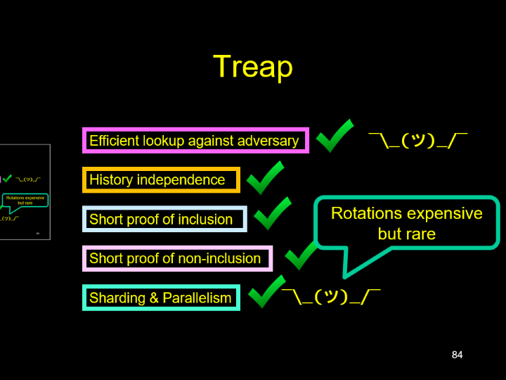
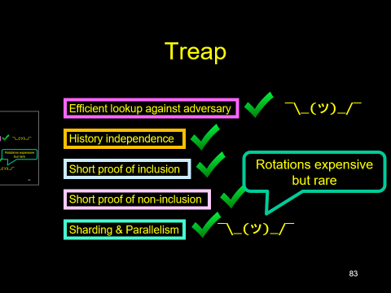
Treap
Efficient lookup against adversary
¯\_(ツ)_/¯
History independence
Rotations expensive but rare
Short proof of inclusion
Short proof of non-inclusion
Sharding & Parallelism
¯\_(ツ)_/¯

Slide 85
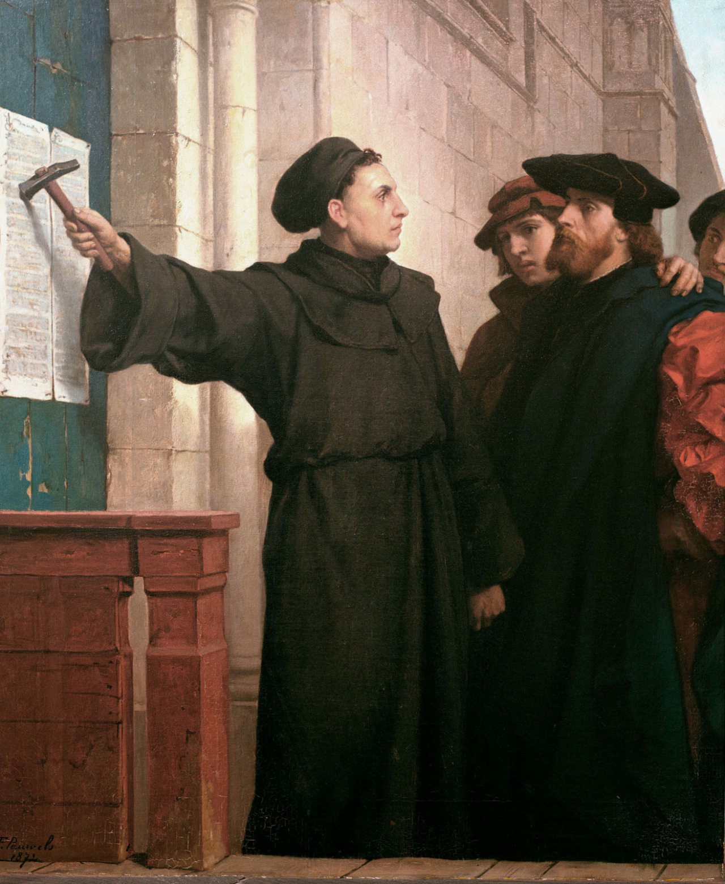
Ideas we covered in this lecture
EVM storage model
What do we want from search trees?
Patricia or radix tries
Sparse Merkle tree
Treaps

Slide 86
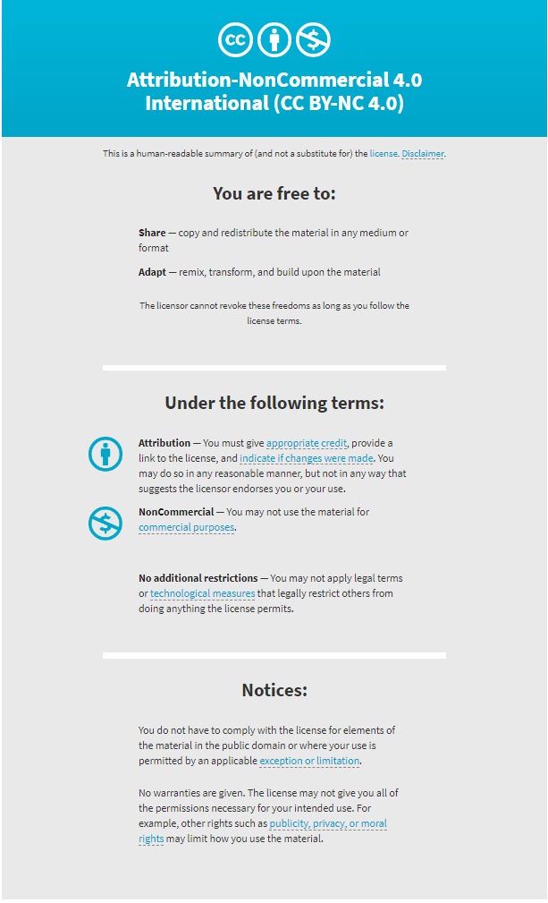

Slide 87
h₀=H(h_{10,}h_{11,}h₁₂)
h₁₀=H(h_{20,}h_{21,}h₂₂)
h₁₁=H(h_{23,}h_{24,}h₂₂)
h₁₂=H(h_{20,}h_{21,}h₂₂)
H₂₀=H(d₀)
H_{21`}=H(d₁)
H₂₂=H(d₂)
H₂₆=H(d₆)
H_{27`}=H(d₇)
H₂₈=H(d₈)
H₂₃=H(d₃)
H_{24`}=H(d₄)
H₂₅=H(d₅)
d₀
d₁
d₂
d₃
d₄
d₅
d₆
d₇
d₃

