Slide 1

CS1951 L
Blockchains & Cryptocurrencies
Spring 2024
Lecture 8
Gas
Maurice Herlihy
Brown University

Slide 2

Gas (Classic)
Caller pays fee for each transaction step
Denial of Service attacks expensive

Slide 3
Gas (Classic)
Each step has fixed “gas” fee
But gas price in Ether up to caller!
Low price means low priority …
And vice-versa

Slide 4
Caller offers
fee cap := gas limit X gas price
paid to successful miner

Slide 5
Gas (Classic)
If a call runs out of gas …
Effects discarded
Gas not refunded
If a call has leftover gas …
Unused gas refunded

Slide 6
Block Gas Limit
Bitcoin has limit on block size
Ethereum had 15M limit on block gas
Block full when transactions’ gas costs reach limit
This limit has changed …

Slide 7
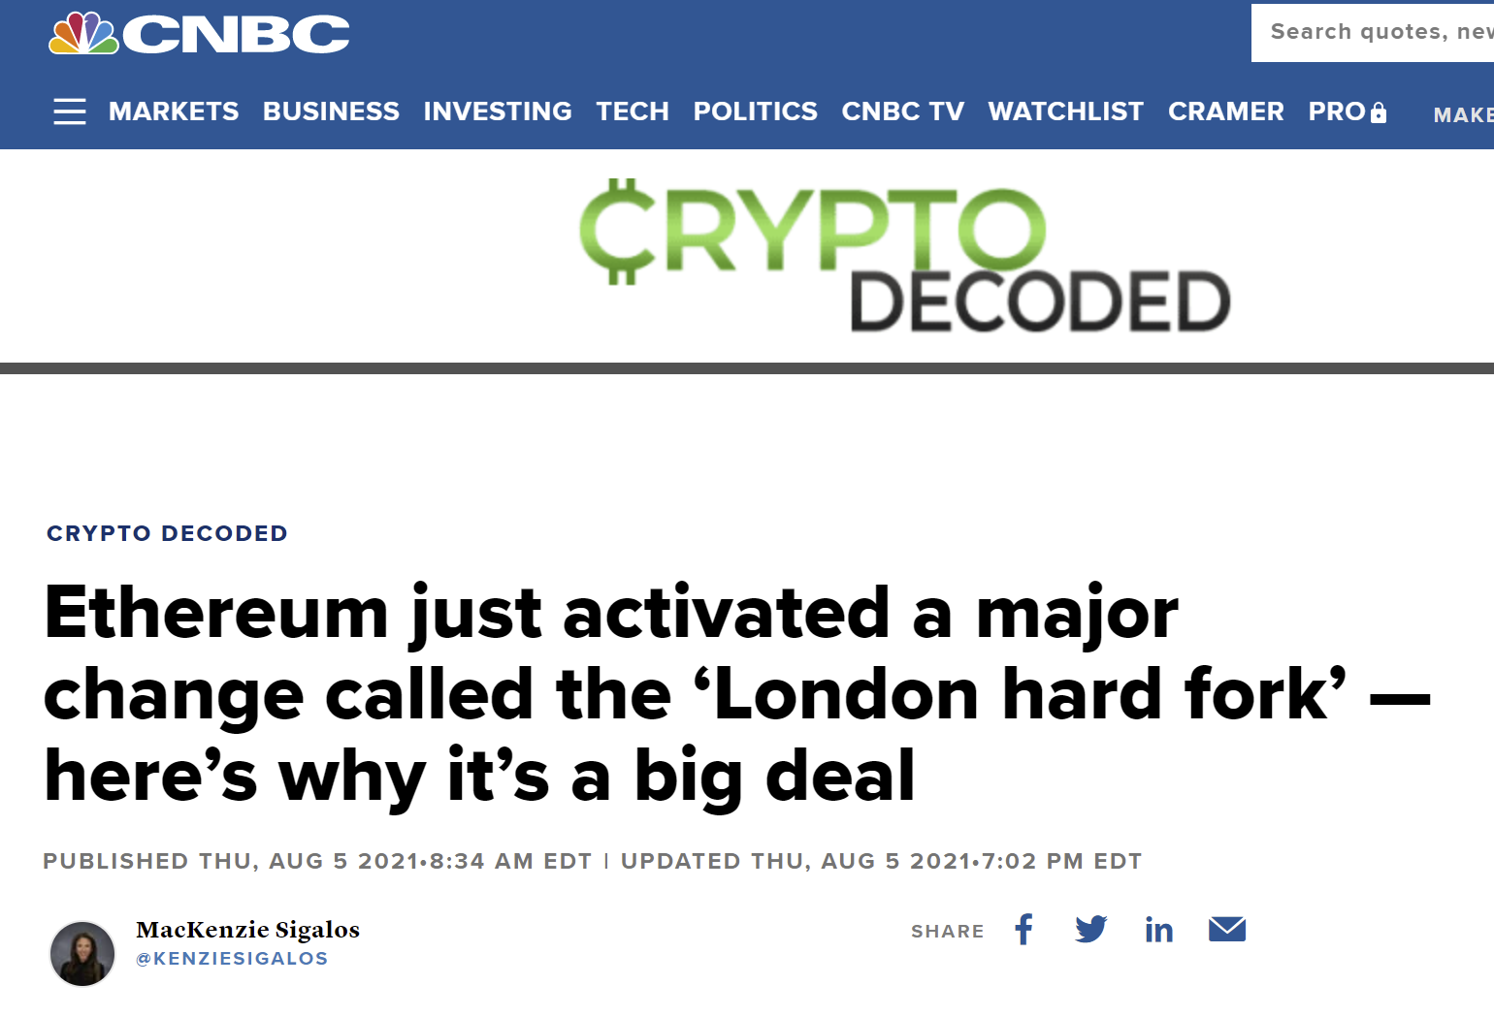
August 2021

Slide 8
This Changes Everything
“London Hard Fork”
Changes gas price model
Why was a change needed?
What was changed?
Consequences?

Slide 9






Reminder
Clients
Miners

Slide 10
Why Fees?
Want transactions!
Want transactions
Want transactions
Want transactions
Want transactions
But Limited Space in Blocks

Slide 11

High-value vs Low-value txns
Super important
Pretty important
Meh ..
Not enough space for everyone

Slide 12
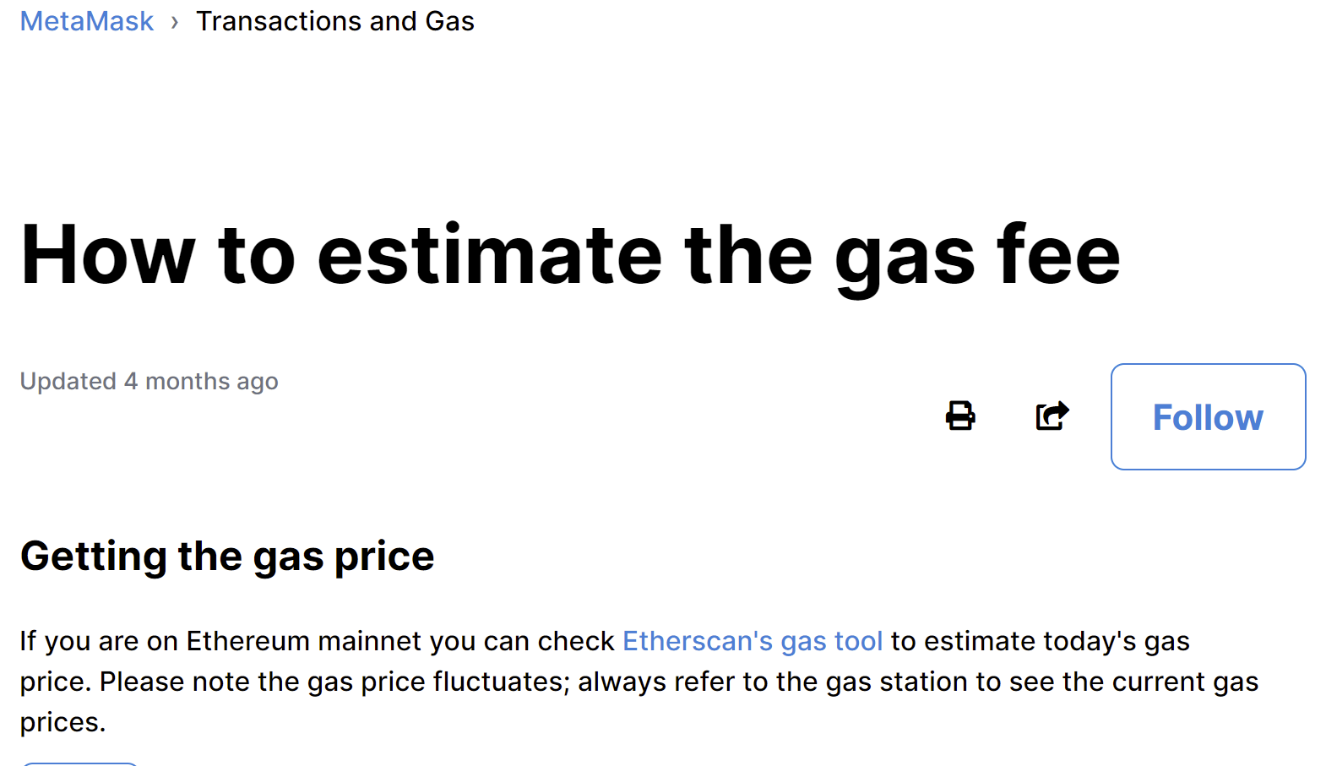
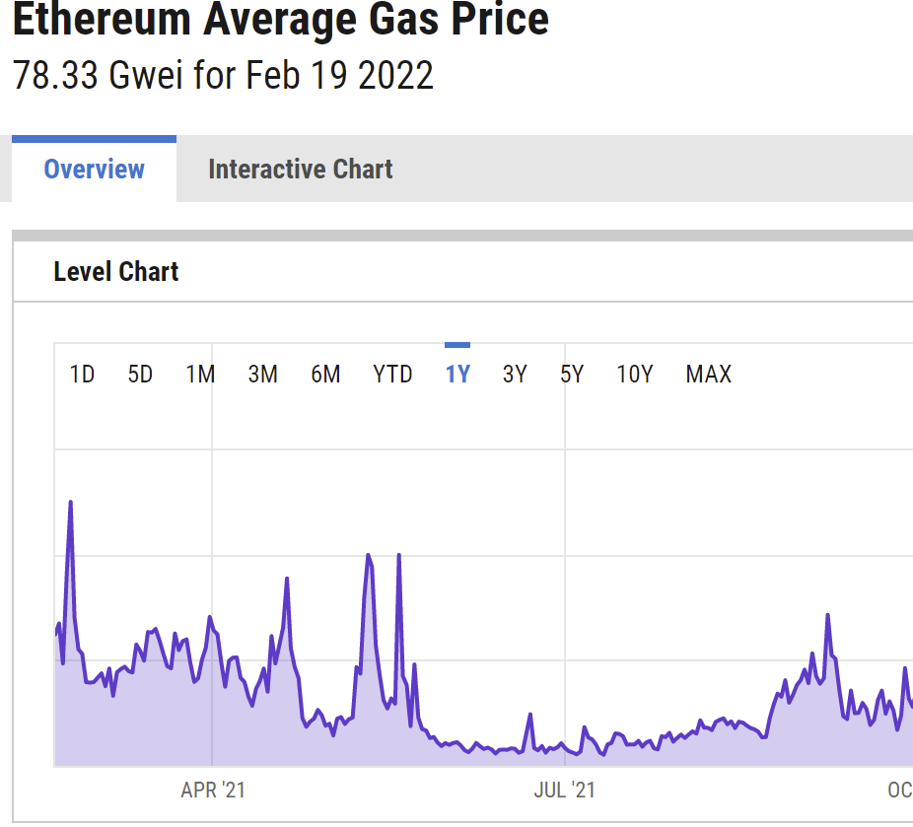
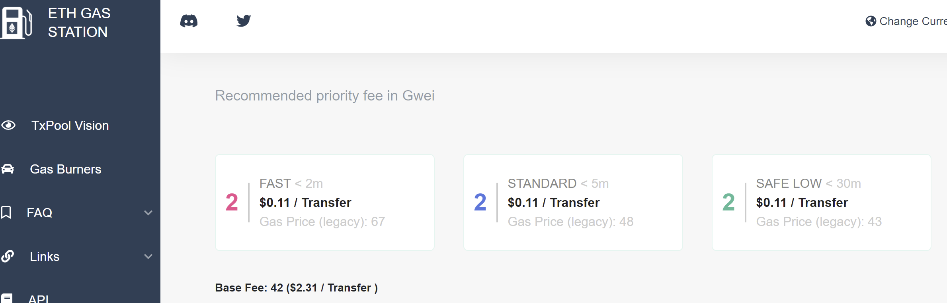
Estimation Services?
Normally fine
Not good when chain is volatile
“Surprise! New NFT just announced”

Slide 13
Blind Auction
$100
$50
$25
Place your bids

Slide 14
Blind Auction
$100
$50
$25
Place your bids

Slide 15
First-Price Auction
$100
$50
$25
In, for $100
In, for $50
Out

Slide 16
Regret
I should have bid less!
In, for $100
In, for $50
Out

Slide 17
Blind Auction
$100
$125
$125
Place your bids

Slide 18
Blind Auction
$100
$125
$125
Place your bids

Slide 19
First-Price Auction
$100
$125
$125
Out
In, for $125
In, for $125

Slide 20
Regret
I should have bid more!
Out
In, for $125
In, for $125

Slide 21
Uniform Price Auction
$100
$50
$25
In, for $50
In, for $50
Out

Slide 22

Regret-Free Auctions?
Bid honestly
Included if price ≤ value
Excluded if price ≥ value
Either way, no regrets

Slide 23
What could possibly go wrong?

Slide 24
What could go wrong?
$100
$100
$25
Space for 3 txns,
Clearing price is $25,
my profit is $75.

Slide 25
What could go wrong?
$100
$100
$25
$100
My self-serving bid means
clearing price is now $100,
my profit is $200.

Slide 26
What else could go wrong?
Double your bid and I will secretly refund you!
Heh-heh
Heh-heh

Slide 27
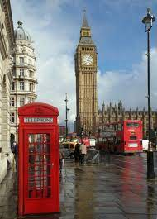

London Hard Fork

Slide 28
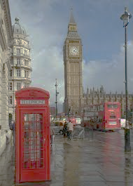

London Hard Fork
Goals
Dampen short-term volatility
Better user experience
Make fees more predictable

Slide 29
London Hard Fork
Non-Goals
Lower fees for users
Lower fees is scalabilty problem …
Supply vs demand not mechanism design

Slide 30
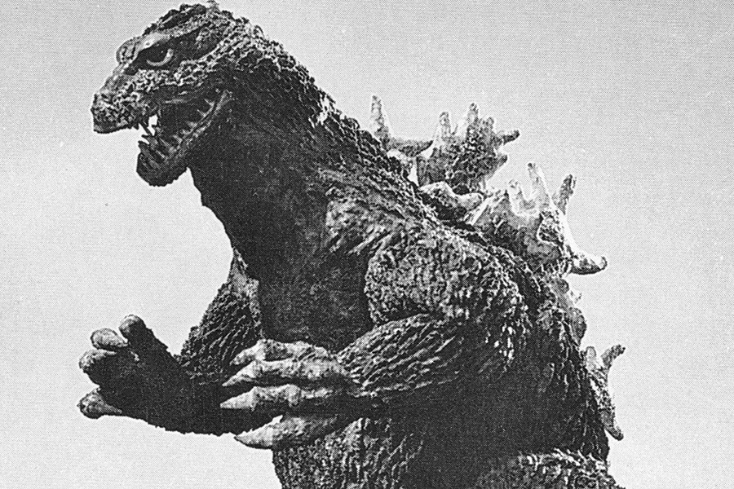
Possible Attacks
Miners create fake transactions
Off-chain black market

Slide 31
Transaction Fees
Base fee
Tip
fixed by chain
burned
fixed by user
paid to miner
(per gas unit)

Slide 32
Flexible Block Size (in Gas)
target
maximum

Slide 33

Base Price Calculation
$
≤12.5%
$
≤ 12.5%

Slide 34
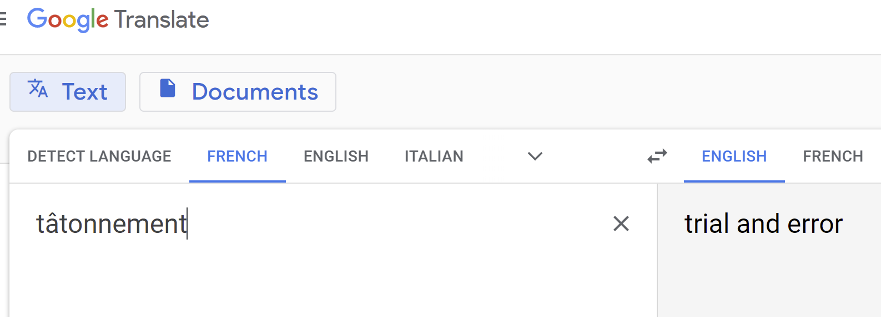
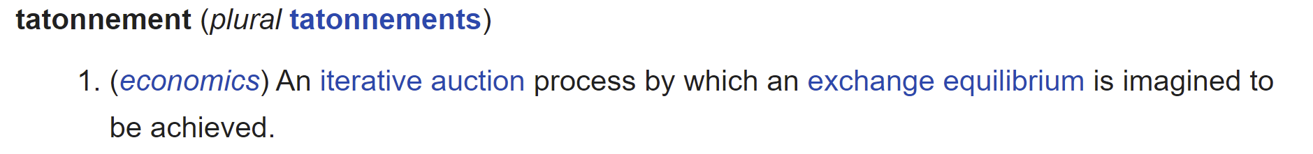
Vocabulary: Tâtonnement

Slide 35
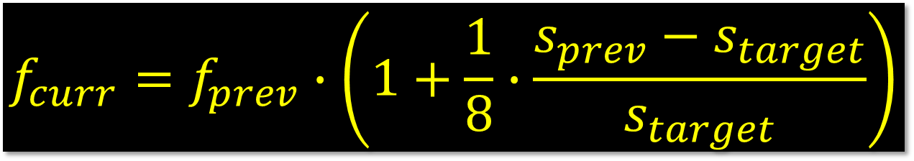
Base Price Calculation
$$f_{curr}=f_{prev}∙\left(1+\frac{1}{8}∙\frac{s_{prev}{− s}_{target}}{s_{target}}\right)$$

Slide 36
Base Price Calculation
Target block size (15M gas)
Base fee for previous block
$$f_{curr}=f_{prev}∙\left(1+\frac{1}{8}∙\frac{s_{prev}{− s}_{target}}{s_{target}}\right)$$
Base fee for current block
Size of previous block (in gas)

Slide 37
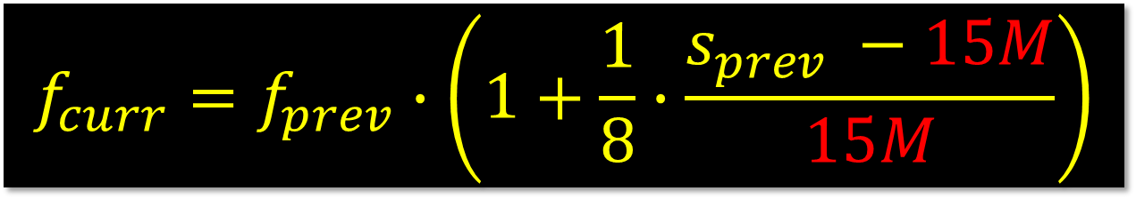
Base Price Calculation
$$f_{curr}=f_{prev}∙\left(1+\frac{1}{8}∙\frac{s_{prev} −15M}{15M}\right)$$

Slide 38

Previous Block Half Full?
$$f_{curr}=f_{prev}∙\left(1+\frac{1}{8}∙\frac{15M−15M}{15M}\right)$$

Slide 39

Previous Block Half Full?
$$f_{curr}=f_{prev}∙\left(1+\frac{1}{8}∙0\right)$$

Slide 40
Previous Block Half Full?
$$f_{curr}=f_{prev}$$
Base fee unchanged

Slide 41

Previous Block Full?
$$f_{curr}=f_{prev}∙\left(1+\frac{1}{8}∙\frac{30M−15M}{15M}\right)$$

Slide 42

Previous Block Full?
$$f_{curr}=f_{prev}∙\left(1+\frac{1}{8}∙1\right)$$

Slide 43

Previous Block Full?
$$f_{curr}=f_{prev}∙\left(1+\frac{1}{8}\right)$$
Base fee up 12.5%

Slide 44

Previous Block Empty?
$$f_{curr}=f_{prev}∙\left(1+\frac{1}{8}∙\frac{0−15M}{15M}\right)$$

Slide 45

Previous Block Empty?
$$f_{curr}=f_{prev}∙\left(1+\frac{1}{8}∙−1\right)$$

Slide 46

Previous Block Empty?
$$f_{curr}=f_{prev}∙\left(1−\frac{1}{8}\right)$$
Base fee down 12.5%

Slide 47

No tips?
Miners just mine empty blocks
Collect block rewards
Txn gas pays for miners’ costs

Slide 48
Automatic tips?
Cannot identify high-value txns
Burning tips?
Would drive tipping off-chain

Slide 49
Pre-London Fees
$1
$1

Slide 50
Pre-London Fees
$10
$1
$10

Slide 51

Pre-London Fees
$10
$1
$10
Our txns subject to very long wait …

Slide 52
Post-London Fees
$1
$1

Slide 53
Post-London Fees
$10
$1
$1 and $10

Slide 54
Post-London Fees
$10
$1
Whew! But next block will be more expensive
$

Slide 55

Post-London Fees
$
$
Higher demand means higher base fees …

Slide 56
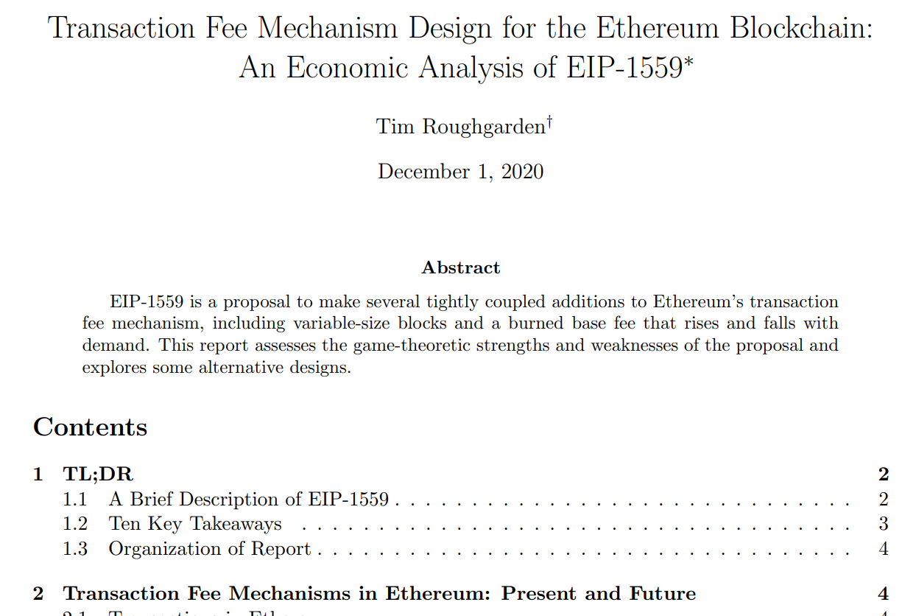
Miners
Incentivized to follow inclusion rule
Disincentivized from including fake txns

Slide 57
Users
fee cap := txn value
tip ≥ marginal cost of gas to miner
(Execpt special circumstances)

Slide 58
Miners & Users
No incentive for off-chain deals

Slide 59
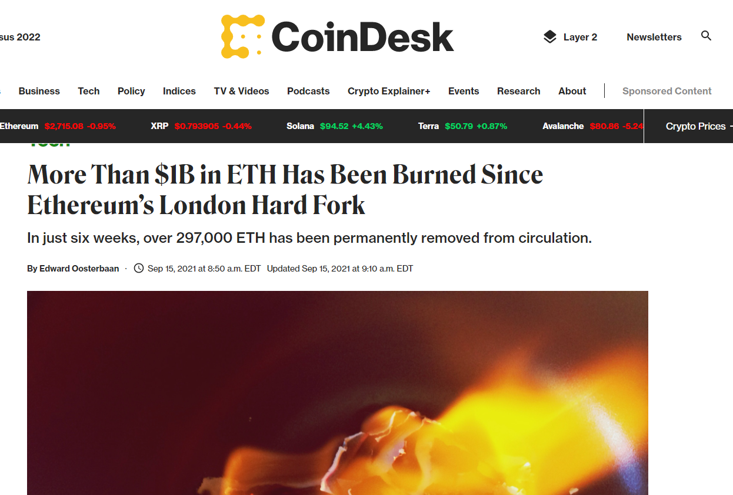
Burning ETH makes remaining ETH more valuable
Before:
Ethereum mildly inflationary
After
Hard to tell, maybe deflationary
“monetary policy” harder now

Slide 60

Ideas we covered in this lecture
Review old-school gas
Regrets in first-price auctions
Problems with uniform-price auctions
London Hard Fork
Base fee calculation
Tips!

Slide 61
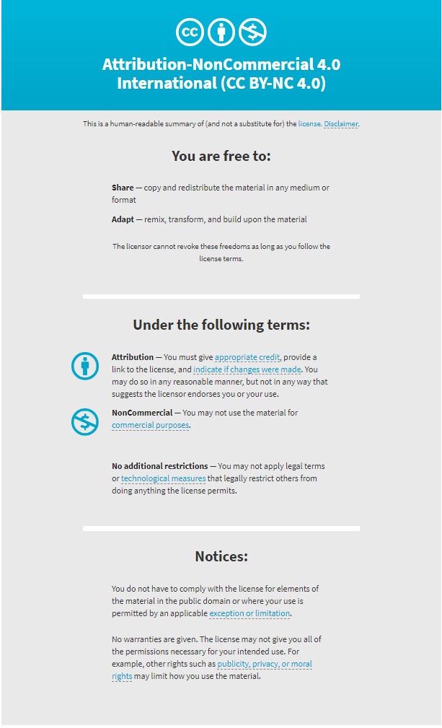

Slide 62
Title
one
two
three
four
five

