Slide 1

CS1951 L
Blockchains & Cryptocurrencies
Spring 2025
Lecture 16
Concurrency in Smart Contracts
Maurice Herlihy
Brown University

Slide 2







Clients ….
Proposer
Validators …

Slide 3
Clients ….
send transactions …
to Proposer

Slide 4
Proposer
assembles transactions …
into blocks.

Slide 5


Validators
do distributed consensus to pick one block …

Slide 6
time
end of
blockchain
consensus
winner
to append to the blockchain.

Slide 7




Validators …
Also clients, full nodes …
end of
blockchain
check hashes, signatures

Slide 8
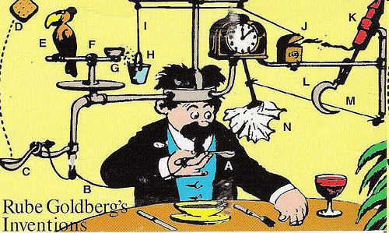
OK, we left out some details …

Slide 9

Smart Contracts
Not smart
Not contracts
Scripts on chain

Slide 10
Proposer assembles contracts …

Slide 11
Proposer assembles contracts …
Apply them one-at-a-time to compute new state
state
state
state
state

Slide 12
Block has contracts & new state
state

Slide 13
state
state
state
time
state
state
state
Blocks include contracts & states

Slide 14
Validators replay all block contracts in order …
state
state
state
state
state

Slide 15
Validators replay all block contracts in order …
state
state
state
state
state
state
… for every block

Slide 16
Contracts re-executed for How Long?

Slide 17

Contracts re-executed for How Long?
forever
Every validator eventually executes every contract

Slide 18
Contracts re-executed for How Long?
sequentially

Slide 19
Proposer
Execute block’s contracts sequentially
Paid by client per step
High latency slows everything

Slide 20
Validators …
Execute every block’s contracts sequentially
Not paid
Every validator, every contract, forever

Slide 21
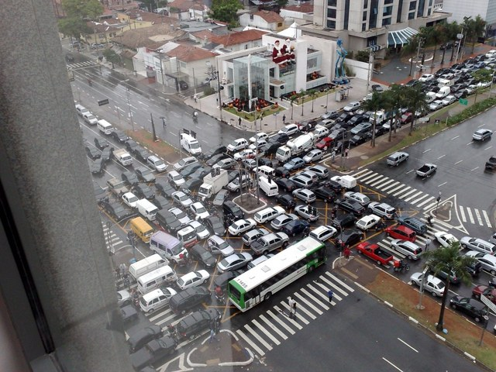
Why is sequential execution so wrong?
Slows throughput
Competitive disadvantage for participants
Cannot exploit modern multicore technology

Slide 22

Naïve Concurrency?
Nope
Inconsistent shared state
For example, double spending

Slide 23
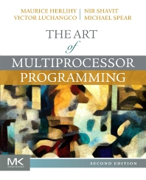
Add explicit concurrency to the language?
Locks!
Threads!
Priorities!

Slide 24

Add explicit concurrency to the language?
Locks!
Threads!
Priorities!
Nope

Slide 25
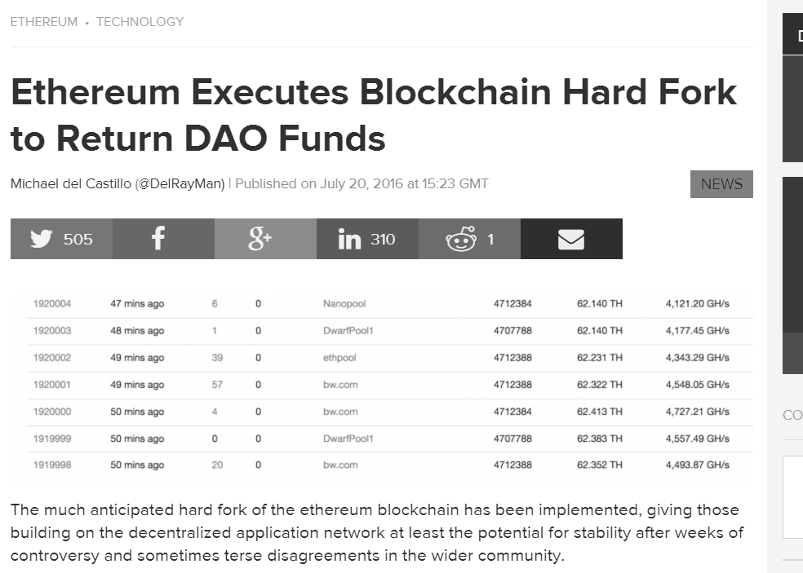
Remember the DAO?
Because concurrency is hard
25
Notes:
25

Slide 26
Concurrent Schedule
Each vertex is a transaction
Each arc is a dependency
No arc from a to b? Run them in parallel!
Safe to execute respecting partial order

Slide 27

Concurrent Schedule via Static Analysis?
These contracts never conflict, so it’s safe to run them concurrently

Slide 28

Concurrency via Static Analysis?
These contracts never conflict, so it’s safe to run them concurrently
Nope
Undecidable in theory & Intractable in practice
Because contracts call other contracts …
Address variables mean dynamic call graph …
Might have to inspect every contract ever

Slide 29

“It's easier to ask forgiveness than it is to get permission”
Grace Murray Hopper
(wrote the first compiler)

Slide 30
Speculation
Execute transactions in parallel …
(without asking permission)
But instrument memory to detect conflicts
Add dependencies when conflicts detected
Roll back & retry (apologize)

Slide 31
Building Concurrent Schedules
Execute transactions, order them
Order transactions, execute them

Slide 32
Instrumenting Memory
balance["Alice"] += sum
Notes:
and records an undo operation in the log. Note that the undo can depend on the operation result.

Slide 33
Instrumenting Memory
balance["Alice"] += sum
hash(“Alice”.slot(balance))
write
read
Notes:
and records an undo operation in the log. Note that the undo can depend on the operation result.

Slide 34
Instrumenting Memory
balance["Alice"] += sum
Abstract lock
Notes:
and records an undo operation in the log. Note that the undo can depend on the operation result.

Slide 35
Instrumenting Memory
balance["Alice"] += sum
Abstract lock
read mode
read
Notes:
and records an undo operation in the log. Note that the undo can depend on the operation result.

Slide 36
Instrumenting Memory
balance["Alice"] += sum
Abstract lock
Write mode
write
read
Notes:
and records an undo operation in the log. Note that the undo can depend on the operation result.

Slide 37
Instrumenting Memory
balance["Alice"] += sum
balance[“Bob"] += sum
write
Allows operations that commute
Notes:
and records an undo operation in the log. Note that the undo can depend on the operation result.

Slide 38
Instrumenting Memory
balance["Alice"] += sum
balance[“Alice"] += sum
write
Prevents operations that do not commute
Notes:
and records an undo operation in the log. Note that the undo can depend on the operation result.

Slide 39
Conflict Detected
Bob has triggered a data conflict
Bob must die
Bob’s effects must be reverted
Bob will be rescheduled and restarted
Notes:
and records an undo operation in the log. Note that the undo can depend on the operation result.

Slide 40
Locks
Every memory location has a lock
Before I read (write) the location ..
I acquire that lock in read (write) mode
Write mode conflicts with other modes
I must revert and retry later
If I fail to acquire a lock because I conflict …

Slide 41
Too Many Locks
2²⁵⁶-1
0

Slide 42
Lock Striping
2²⁵⁶-1
0
Small chance of false conflicts

Slide 43
Undo Log
But if I’m reverted, the system will need a way to undo everything I did
I will record the old value of each memory location I update in an undo log

Slide 44
Sequence of Steps
balance["Alice"] += sum
Acquire lock
balance["Alice"] -= sum
Record undo info in log
Modify memory

Slide 45
On Commit
I completed my updates without conflict!
Discard undo log
Release my locks

Slide 46
On Revert
I encountered a conflict!
Undo everything by executing undo log entries in reverse order …
Discard undo log
Release all locks
Try again later!

Slide 47
What about the Validators?
end of
blockchain

Slide 48
Validators: Trust but Check
Execute non-conflicting transactions in parallel
But still acquire locks
If lock conflict, proposer lied
Reject block, or re-execute sequentially

Slide 49
Tracking Dependencies
Revert and restart!
That lock is mine!
Bob must be scheduled after Alice
Notes:
and records an undo operation in the log. Note that the undo can depend on the operation result.

Slide 50
Use: 0
Locks track number of times acquired
Use: 1
Use: 0

Slide 51
0⊥⊥
Use: 0
⊥0⊥
⊥10
Use: 1
Use: 0
Threads track use counts seen

Slide 52
0⊥⊥
⊥0⊥
parallel
⊥10
sequential
Can reconstruct “happens-before” graph

Slide 53
Construct Concurrent Scheduler for Validators
Vertex = transaction
Arc = dependency
No locks or speculation
Just thread fork/join

Slide 54
Validators Cannot Speculate
Speculation is non-deterministic
Maybe Alice goes first, maybe Bob
If proposer & validator build different schedules
Valid blocks will be rejected

Slide 55
Why should I?
Give us your concurrent schedule!
Give us your concurrent schedule!
Give us your concurrent schedule!

Slide 56
What’s in it for the Proposer?
If too many transactions revert, I waste time
I don’t get paid for redoing reverted steps

Slide 57
What’s in it for the Proposer?
Why should I bother making my conflict analysis available to validators?
Some of them might be rivals!
But if there is a fork, my analysis makes my block more attractive!

Slide 58
What’s in it for the Validators?
If most transactions commit, I finish sooner
I consume less power

Slide 59
Here is a concurrent schedule!
Give us your concurrent schedule!
Give us your concurrent schedule!
This will speed up our validation!

Slide 60
Validators Execute Fork-Join Program
Efficient “work-stealing” schedulers known
Can check validity by simulating lock counts
No locks or speculation

Slide 61
A Simpler Implementation

Slide 62
Two-Bin Strategy
I will put transactions that committed into a bin …
They ran without conflict
committed

Slide 63
Two-Bin Strategy
Reverted transactions go into another bin …
I will run them sequentially after the concurrent phase
committed
reverted

Slide 64
Two-Bin Blocks
My block will mark which transactions can be executed in parallel
committed
reverted

Slide 65
Block

Slide 66
Block with Transactions

Slide 67
Block with Transactions and Concurrency Meta-Data

Slide 68
Soft Fork
Old-school validators execute sequentially with same result
Woke validators execute these transactions concurrently
And these sequentially

Slide 69
Two-Bin Blocks
Did I leave some concurrency on the table?
committed
reverted

Slide 70
Building Concurrent Schedules
Execute transactions, order them
Order transactions, execute them

Slide 71
Issues with Execute-Order
Proposer does all the work
Proposer takes risk if conflicts common
What if proposer is dishonest?
Can we spread load / risk?

Slide 72
Here is a sequential txn order for everyone!
Give us your concurrent schedule!
Give us your concurrent schedule!
We will build our own concurrent schedules!

Slide 73
Thread Pool
Platform-specific

Slide 74
Task Pool
Execution tasks
E₃
E₄
E₅
Validation tasks
V₁
V₂

Slide 75
Multi-Version Buffer
T₁ writes
v₁
T₂ writes
v₂
v₃
T₄ reads
v₄
T₅ writes
v₅
T₅ reads
one per location

Slide 76
Validation
v₁
v₂
v₃
T₄ read
v₄
v₅
For every read in T₄‘s read set …
Did T₄ read the right version?

Slide 77

VM
code
v₁
v₂
VM
reads
v₃
v₄
v₅
read set write set
MV-buffer

Slide 78
Initially
Execution tasks
E₁
E₂
E₃
E₄
E₅
Validation tasks

Slide 79
Pop Task with least index
Execution tasks
T₃
Validation tasks
?

Slide 80
Was it an Execution Task?
E₃
!

Slide 81
Execute code, get RW sets
T₃ code
E₃
Read/write sets
VM

Slide 82
Apply write set to MV-buffer
v₁
write set
v₂
v₃
v₄
v₅

Slide 83
Schedule Validations for T₃ & Higher Txns
Validation tasks
V₃
V₄
T₃ could have invalidated higher txns
V₅

Slide 84
Was it a Validation Task?
V₃
!

Slide 85
Execute Validation Task
Check T₃ read set against MV-buffer
V₃
v₁
v₂
v₃
v₄
v₅

Slide 86
When Validation Succeeds
Check T₃ read set against MV-buffer
v₁
v₂
v₃
If OK, just loop around …
v₄
v₅

Slide 87
When Validation Fails
Check T₃ read set against MV-buffer
v₁
v₂
v₃
Oh no, T₃ read a stale value!
v₄
v₅

Slide 88
When Validation Fails
Execution tasks
E₃
Validation tasks
V₃
V₄
V₅
Schedule T₃ re-execution & re-validation of T₃ and higher txns

Slide 89
Termination
If
No execution tasks
No validation tasks
No thread is busy
Then
Block is ready
Flush MV-buffer to storage

Slide 90
Termination Guaranteed?
T_{i} invalidates T_{j} only if i < j
T₁ cannot be invalidated
Once T₁ commits, T₂ cannot be invalidated
Et cetera

Slide 91

Ideas we covered in this lecture
Why concurrent execution needed
Concurrent Schedules
Speculative execution
Execute-Order strategy
Order-Execute strategy

Slide 92
